Slide 2

Shawn Talbott, PhD
CNS, LDN, FACSM, FAIS, FACN
Chief science officer & Founding executive

Slide 3


Slide 4


Slide 5


Slide 6
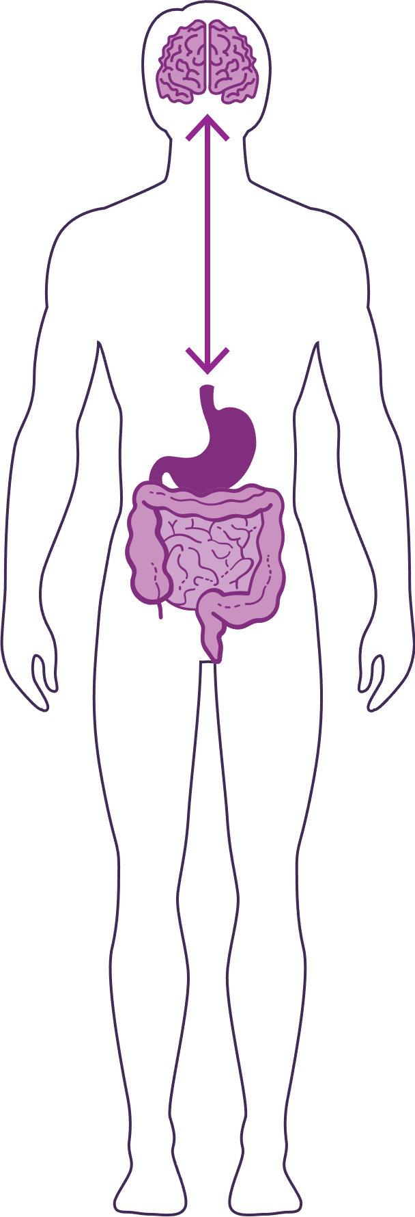
HOW DO OUR “3 BRAINS” COMMUNICATE?
Our “3 brains” communicate through a highly extensive, multi-directional network, known as the gut-brain axis or what we refer to as the GBX.
THE NETWORK CONSISTS OF:
“wires” — nerves
“chemicals” — neurotransmitters/hormones
“cells” — immune system
The GBX connects our
nervous system (brain)
immune system (axis)
and gastrointestinal system (gut)
with a vast array of cellular and biochemical messengers throughout the entire body, which include the microbiome, hormones, cytokines, and neurotransmitters.

Slide 7
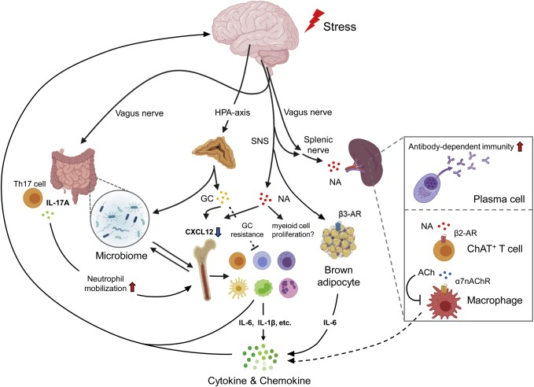

Slide 8
Serotonin / Dopamine / GABA??? Inflammation???

Slide 9
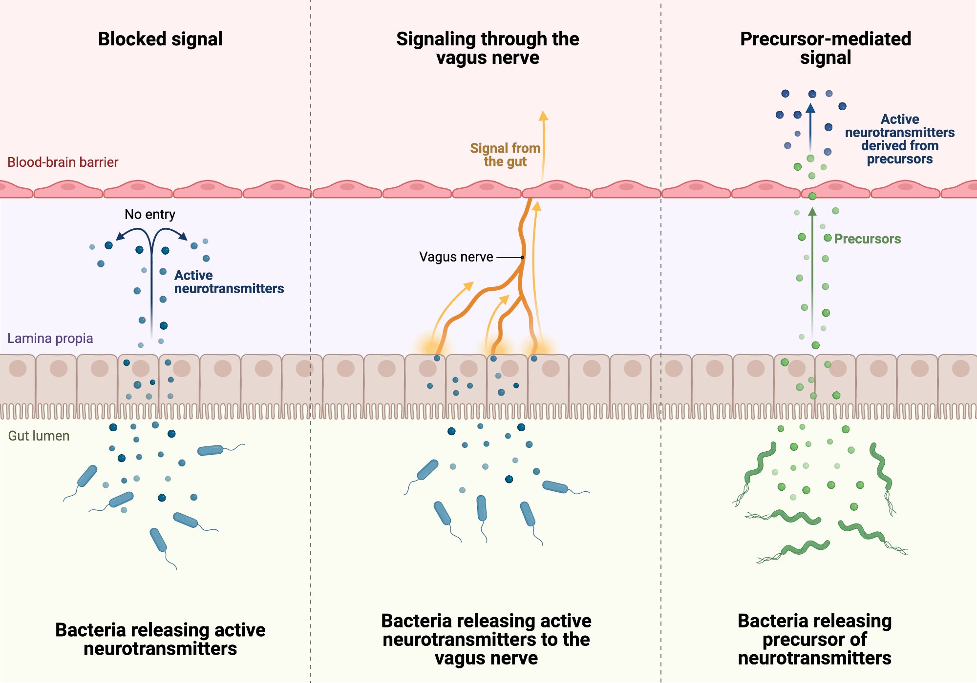

Slide 10
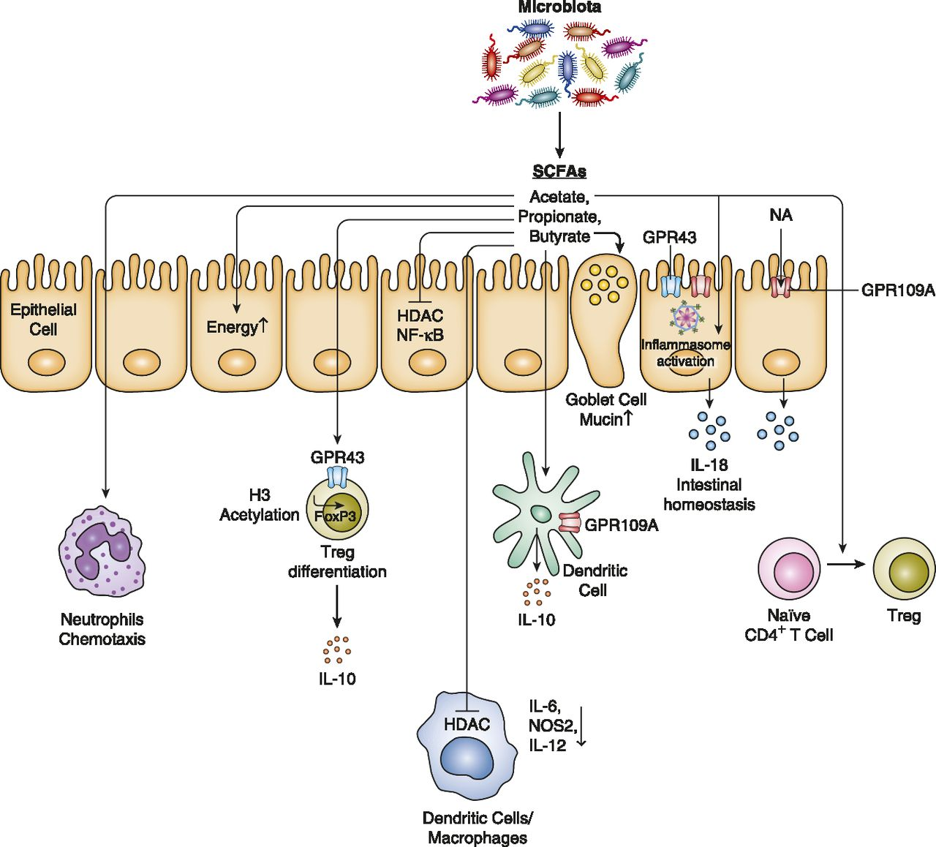
Microbiome educates, trains, orchestrates and coordinates systemic immune responses!

Slide 12
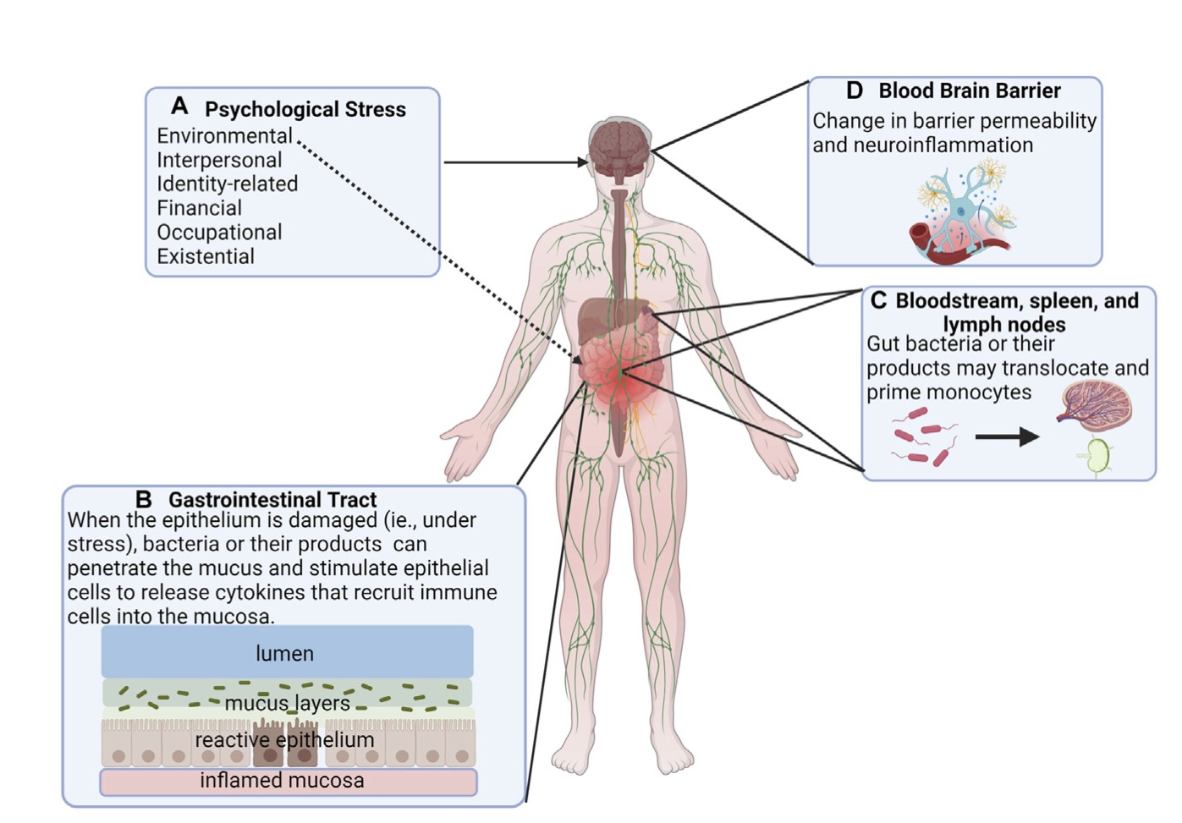

Slide 13
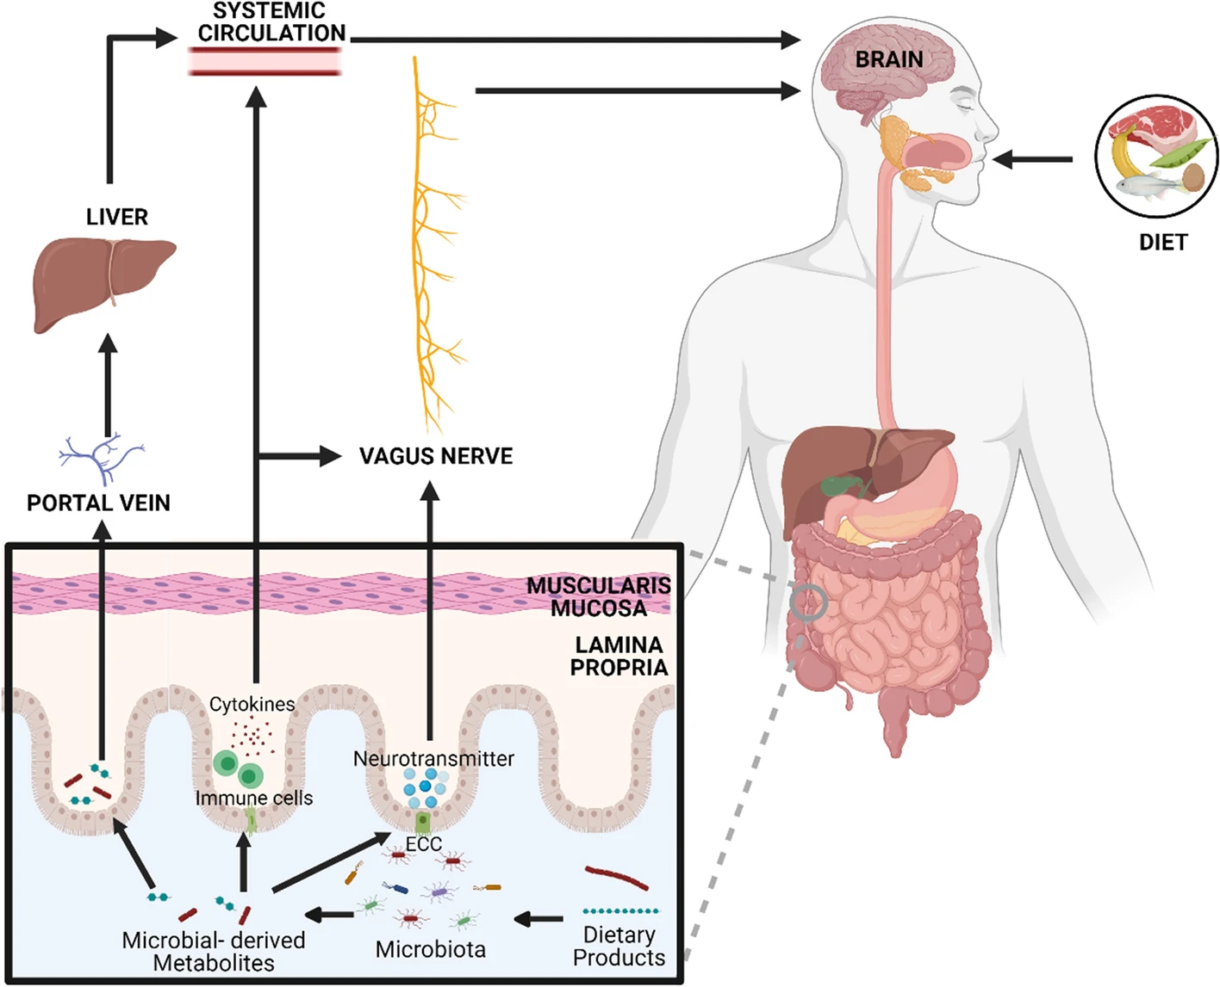

Slide 14
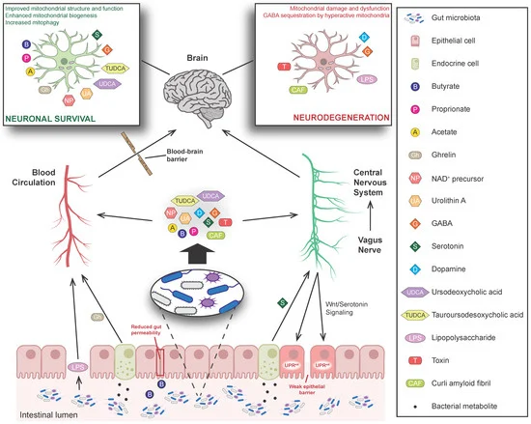

Slide 15
An impaired intestinal barrier function can be detrimental to the host as it may allow the translocation of luminal antigens and toxins into the subepithelial tissue and bloodstream.
…psychosocial stress is one of the factors that can increase intestinal permeability…

Slide 16
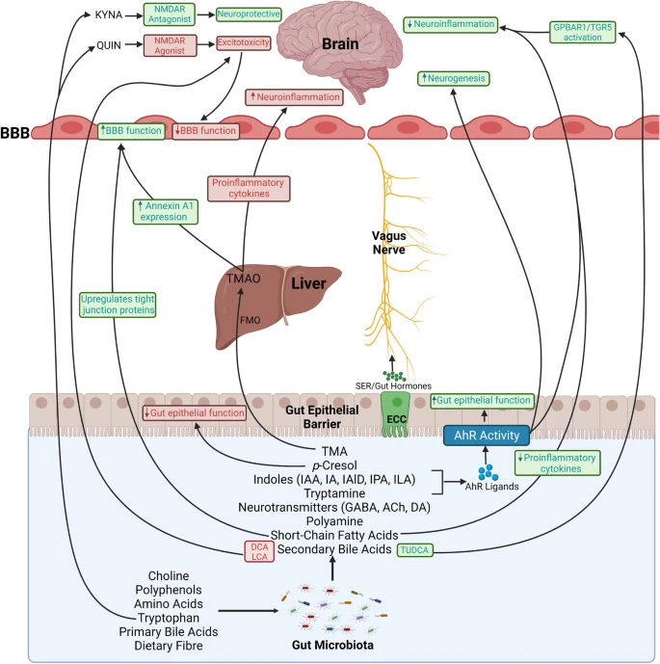

Slide 17
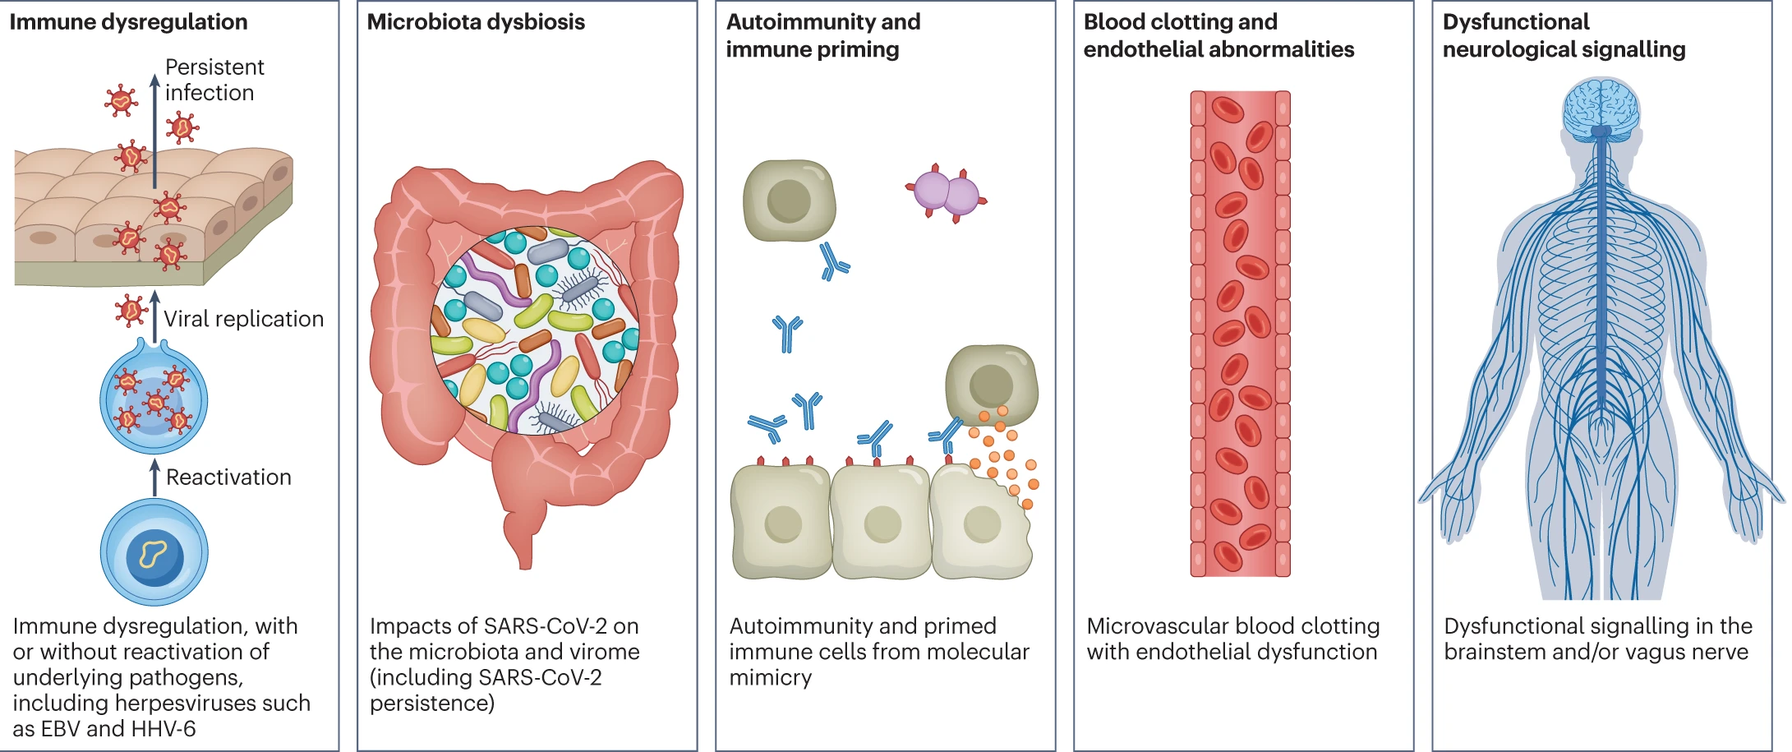

Slide 18



