Slide 1
Mental Wellness Economy

Slide 3
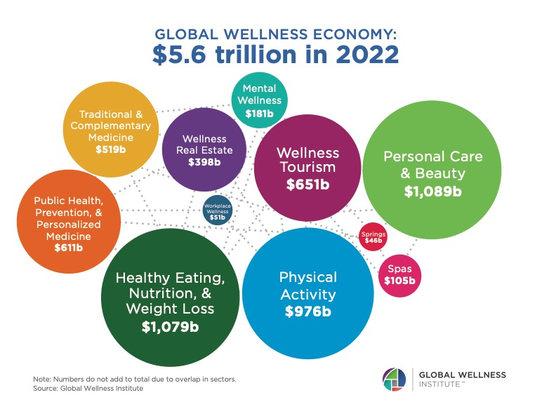

Slide 4
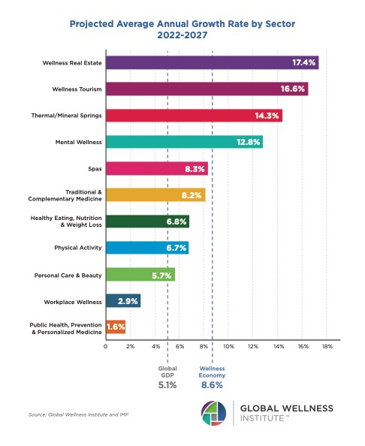

Slide 5
