Slide 1
Amare Products Overview
Shawn Talbott, PhD
CNS, LDN, FACSM, FAIS, FACN
Founding Executive & Chief Science Officer
Amare Global

Slide 2

20+ years developing nutritional products.
Fellow of the American College of Nutrition, the American College of Sports Medicine, and the American Institute of Stress.
Author of two academic textbooks, an award-winning documentary film, and several best-selling books translated into more than a dozen languages.
Featured guest on the “Dr. Oz Show,” “Ask Dr. Nandi,” The TED stage, and the White House.
Served as a nutrition educator for elite-level athletes (US Ski Team, US Track & Field, US Olympic Training Centers)
Diplomate of the International Olympic Committee’s (IOC) Sports Nutrition program.
Dr. Shawn Talbott
Amare’s Chief Science Officer
PhD, CNS, LDN, FACSM, FAIS, FACN

Slide 3
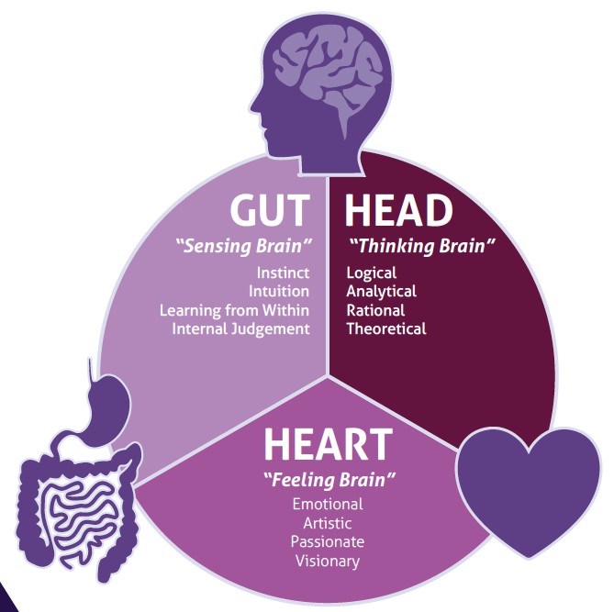
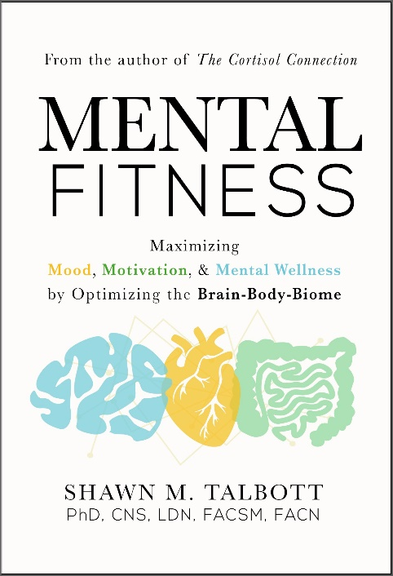
Subscribe for updates at:
–Amare.com (Resources)
–Facebook.com/AmareGlobal
–Facebook.com/DrShawnTalbott
–YouTube.com/DrShawnTalbott
–Instagram.com/doctalbott
–ShawnTalbott.com (blog)
Questions?
https://link.AnyQuestion.com/DocTalbott

Slide 4

Where do SUPPLEMENTS FIT?
Supplements
Exercise
Nutrition
Sleep
Evaluation
?
Motivation and energy to exercise?
Appetite and craving modulation?
Relaxation and recovery?

Slide 5



Products + Programs + People = Mental Wellness

Slide 6

Presentation Description…
1. How the Microbiome-Gut-Brain-Heart-Axis is related to mental well-being
2. How to engineer their microbiome for ultimate mental performance (stress, mood, energy, focus, sleep, resilience, etc).
3. How to choose probiotics, prebiotics, and other nutrients for maximum benefits.
Learning Objectives…
1. Understand how bacteria in our gut determine what happens in our brain and relate to our overall mental well-being?
2. Understand how those signals get out of balance – and how to rebalance them?
3. What are some of the mistakes that people make when they think about "gut health"?
4. Can people do this with food and exercise alone - Where do supplements fit in?

Slide 7
Intellectual Property Platform
Dozens of peer-reviewed scientific presentations & publications
Dozens of Patent Applications pending globally
  MentaHeart
  Kid’s Mood+
Multiple Industry “Best Of” Awards – including “Startup of the Year” (twice)

Slide 8
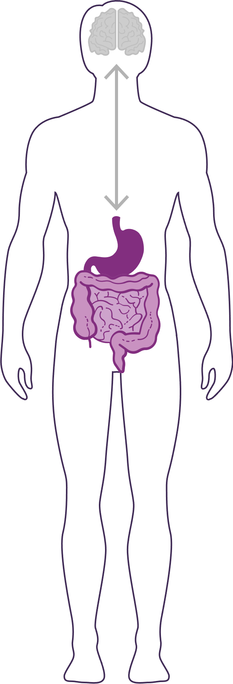


How Important is Your Microbiome?
Communicates with the brain to regulate health, weight, immune function, digestive function, mood, and overall mental wellness and physical health (including longevity).
What we put in our bodies affects the microbiome, which in turn affects our mind and other crucial bodily systems.
The microbiome plays an important role in the way you feel mentally and physically.
IN BALANCE
Feeling great!
-internal, on-demand, dynamic, natural pharmacy
OUT OF BALANCE
This explains why you have those “GUT FEELINGS”
Feeling not great…
-fatigue, sad, tense, hungry, heavy, bloated, confused, stiff/sore…
THE MENTAL WELLNESS COMPANY®

Slide 9
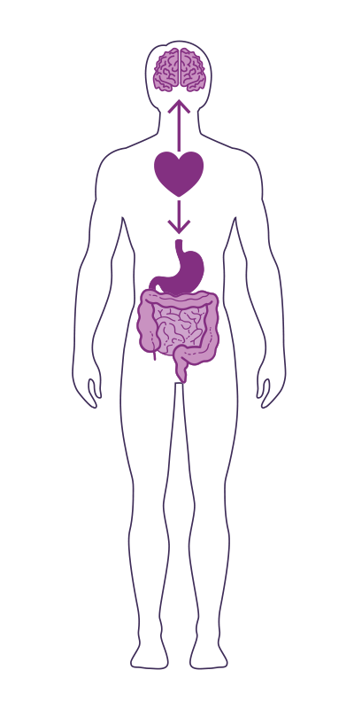
GUT-HEART-BRAIN-AXIS
Studies have now shown that the heart is the body’s third brain, containing approximately 40,000 neurons that can sense, feel, learn, and remember.
Similar to the gut-brain axis, the heart and brain are also closely connected via the heart-brain axis.
The heart sends messages to the brain about what it needs, how the body feels and more.
Nervous system (brain)
Cardiovascular system (heart)
Immune system (axis)
Gastrointestinal system (gut)
Endocannabinoid system (ECS)

Slide 10
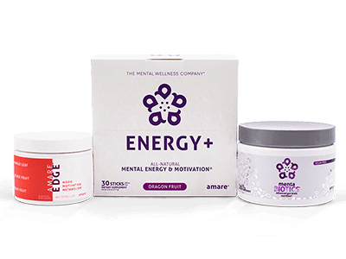
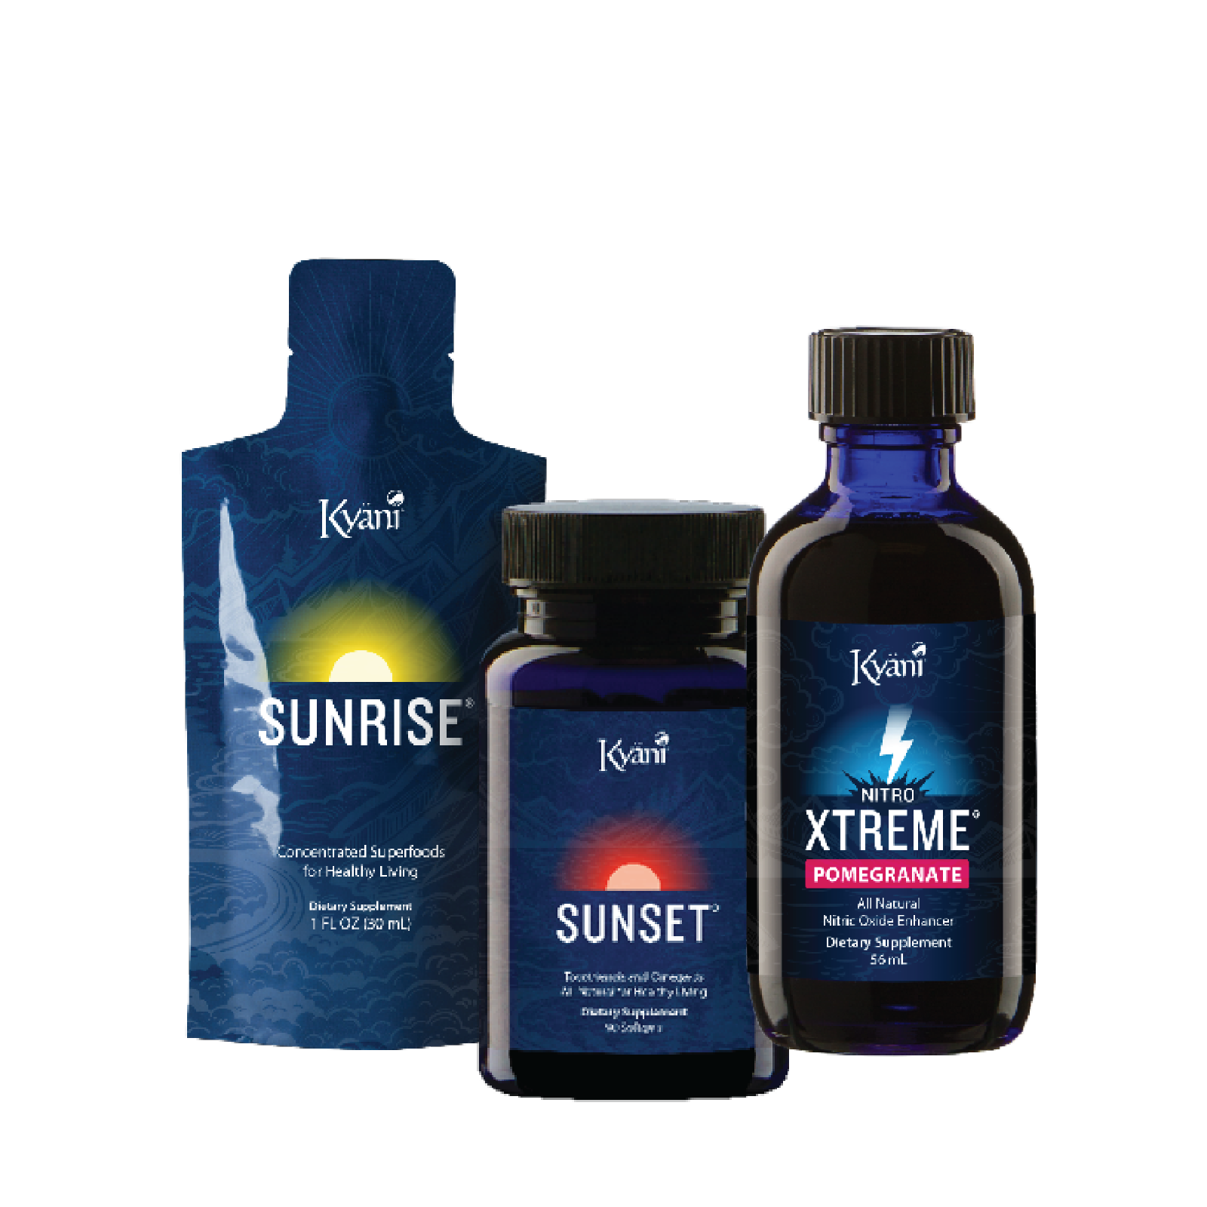
Coordinated Neurotransmitter Balance
Mentabiotics = Serotonin/GABA (Mood)
Edge = Dopamine/Glucose (Motivation)
Energy+ = Norepinephrine/Neuron Activation (Focus)
Coordinated Cellular Protection
Sunrise = Antioxidant Protection
Nitro = Blood Flow
Sunset = Inflammatory Balance
“Level-Up Lifestyle”
Reduce Stress & Boost Resilience = “feel better” (mind)
Protect Cells & Enhance Blood Flow = “function better” (body)
Achieve Mind/Body Balance = “Next-Level” Mental & Physical Performance
THE MENTAL WELLNESS COMPANY®

Slide 11
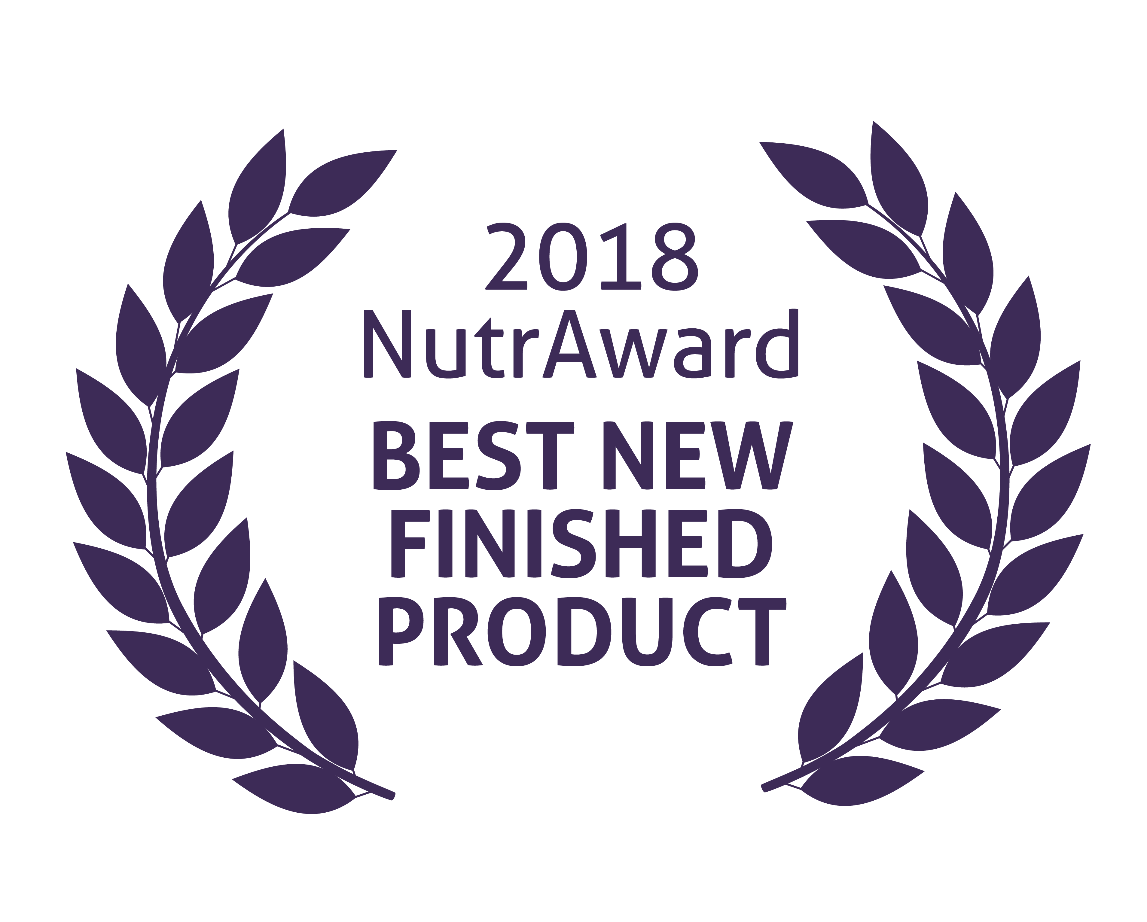
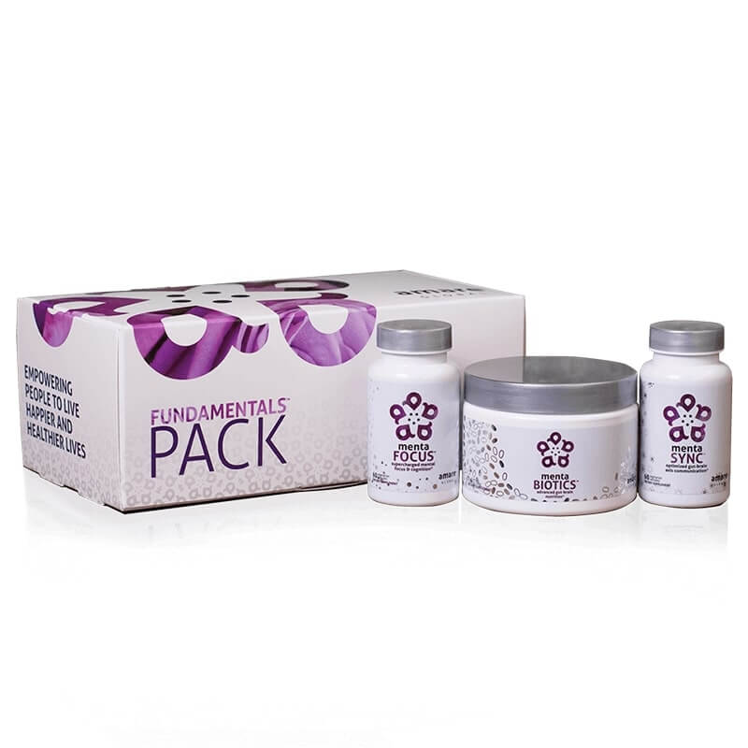

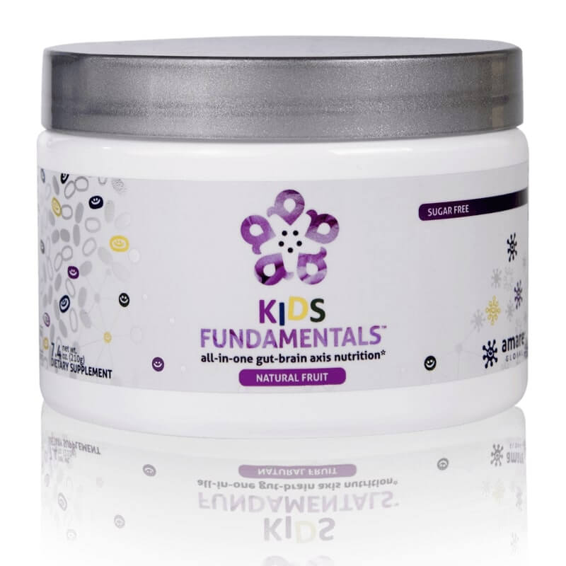
FundaMentals
World’s 1st comprehensive/holistic GBX system
  Addresses each level of GBX balance
  Microbiome modulation
  Gut integrity
  Immune priming
  Inflammatory balance
  Neurotransmitter signaling
Specific probiotic strains for mood/tension/stress
Specific prebiotics fibers for reducing stress and improving resilience
Patent-pending phytonutrients for GBX support (“phytobiotics” – patent-pending)
Scientifically-supported formula
  Dozens of peer-reviewed scientific presentations and publications
  *Effect of Coordinated Probiotic/Prebiotic/Phytobiotic Supplementation on Microbiome Balance and Psychological Mood State in Healthy Stressed Adults
  Functional Foods in Health & Disease Journal FFHD: Online ISSN:2160-3855 Vol 9, No 4 (2019) https://www.ffhdj.com/index.php/ffhd/article/view/599/

Slide 12

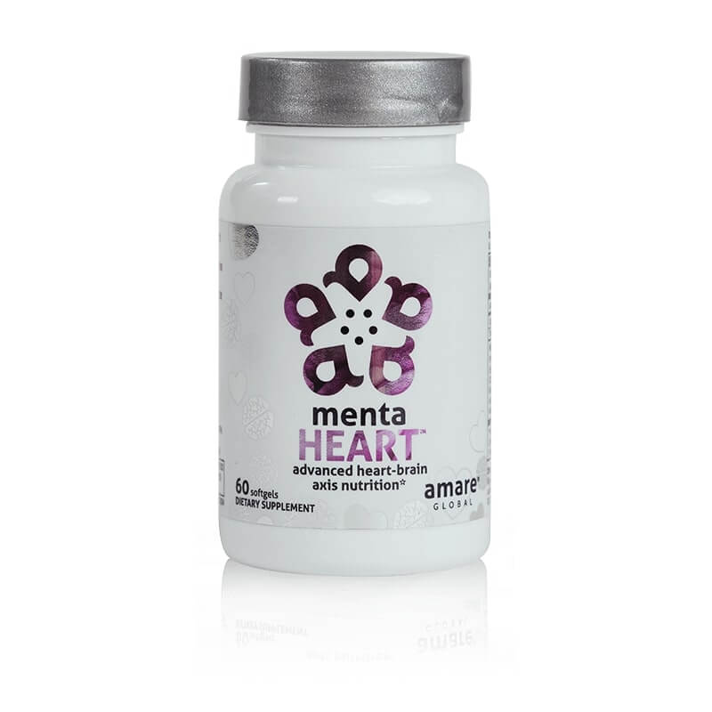
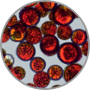



MentaHeart
Supports the Heart-Brain-Axis
“Heart Health” & part of Fundamentals Plus Pack
Physical Performance (Sports)
Cognitive Performance (Brain)
Mental Performance (Mood)
THE MENTAL WELLNESS COMPANY®

Slide 13
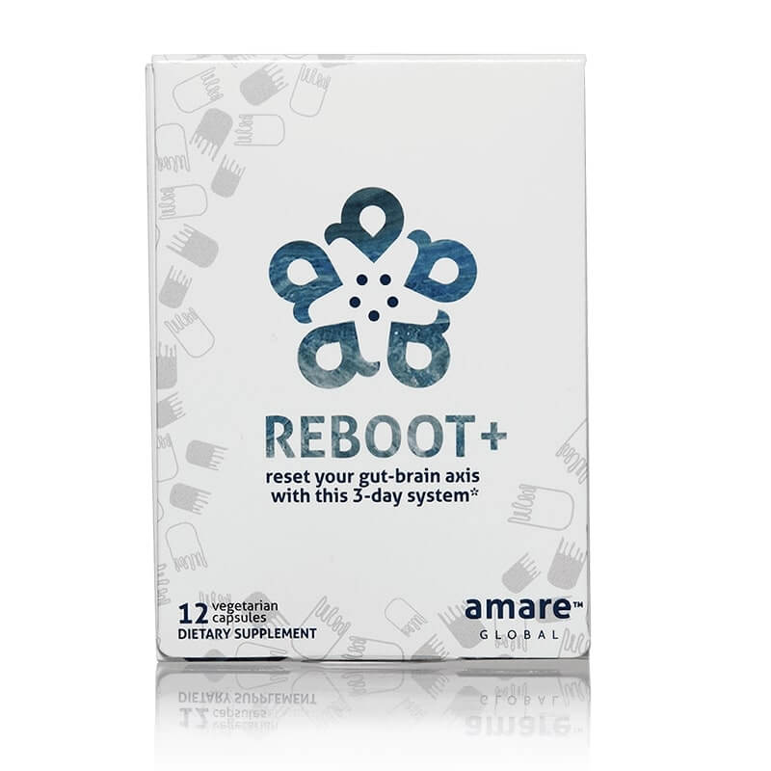
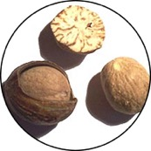
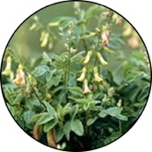
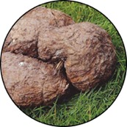
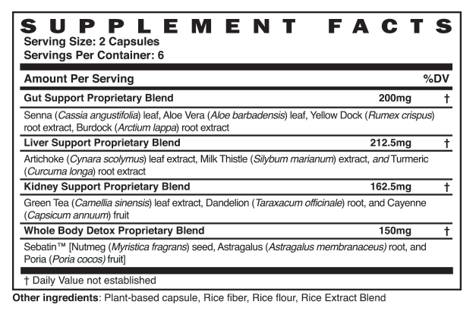
Reboot+
NOT a traditional “cleanse” or “detox”
Reboot+ is the first step to ridding your body of the imbalances in gut bacteria that can be the source of digestive problems, unbalanced inflammation, and nagging mental wellness issues such as fatigue, tension, and depressed mood.
For optimal mental wellness, "rebooting" the ecology of your gut microbiome helps prepare your body and mind for healthy re-population and re-balancing.
THE MENTAL WELLNESS COMPANY®

Slide 14

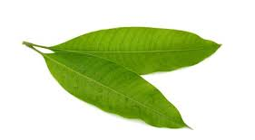
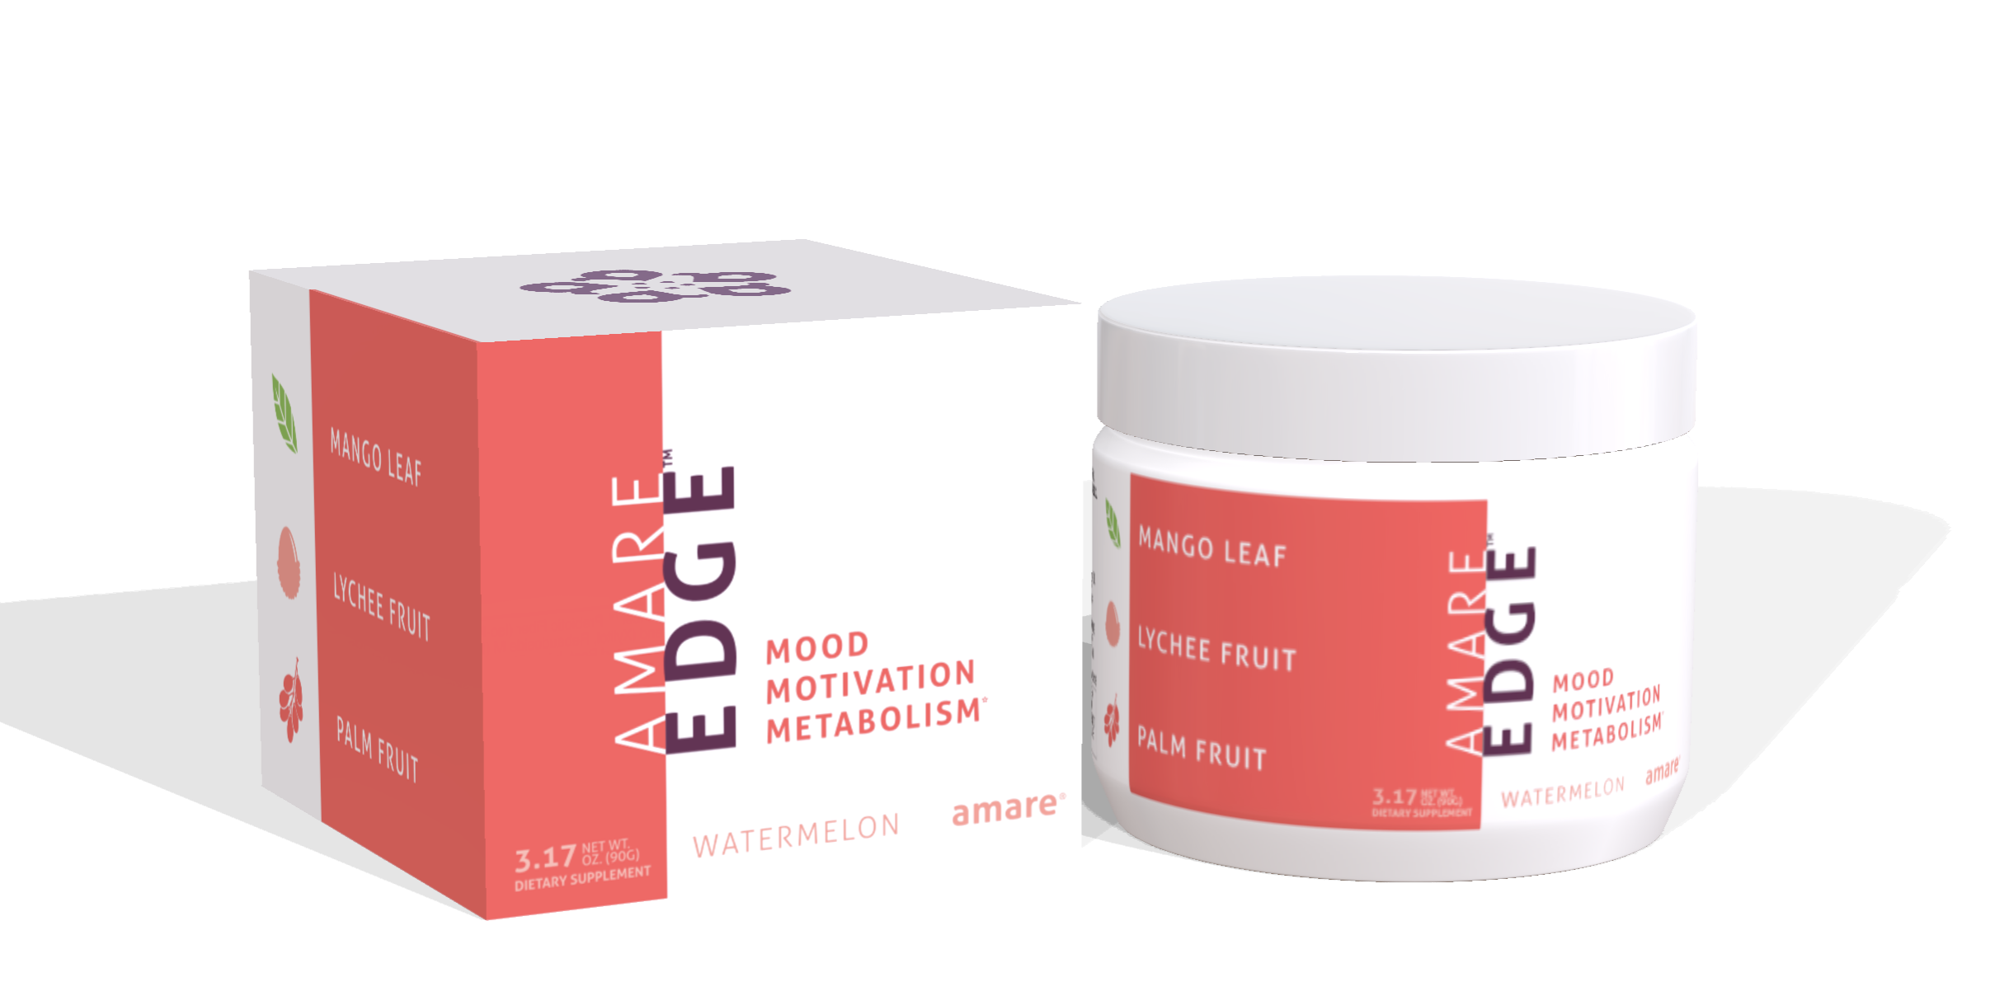
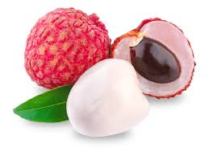
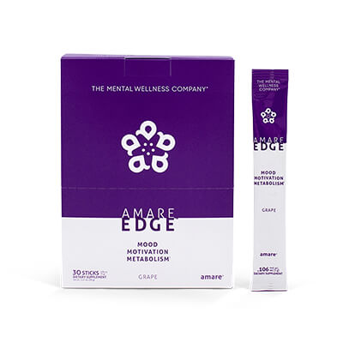
Edge
Motivation
Mango Leaf (Xanthones – inflammation)
Lychee Fruit (Polyphenols – glycation)
Palm Fruit (Flavonoids – oxidation)
Dozens of clinical studies on sports performance, cognitive performance, glucose balance…
THE MENTAL WELLNESS COMPANY®

Slide 15
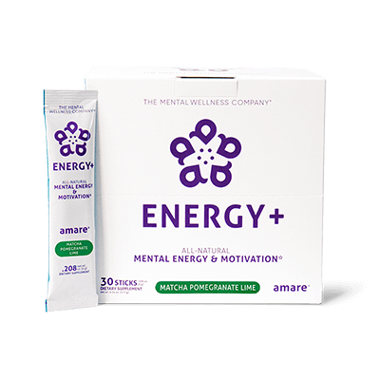
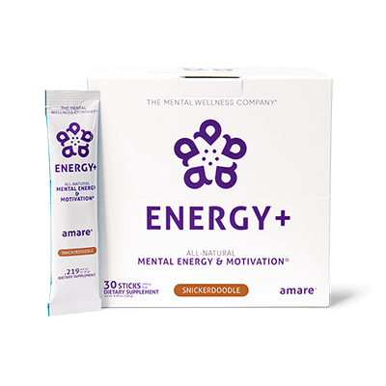

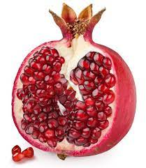
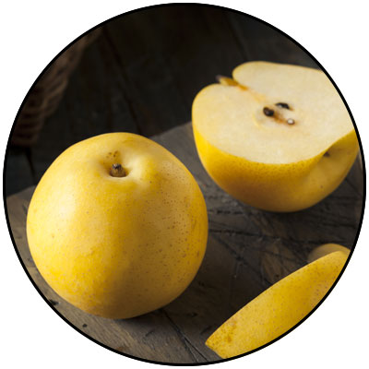
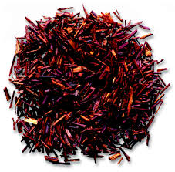
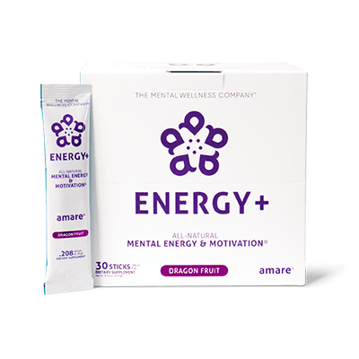

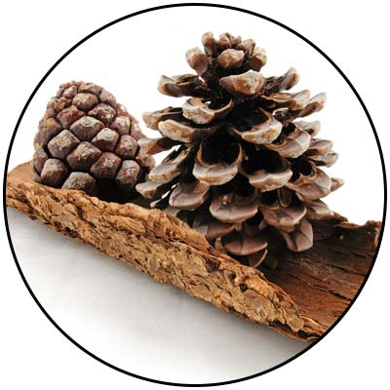
Energy+
3-tiered Energy
Physical Energy (Matcha Green Tea – or – Rooibos)
Mental Energy (Pomegranate extract & GBX Polyphenols)
Mental Awareness (Guayusa – or – Glycine)
THE MENTAL WELLNESS COMPANY®

Slide 16
Coordinated Neurotransmitter Balance
Mentabiotics = Serotonin/GABA (Mood)
Edge = Dopamine/Glucose (Motivation)
Energy+ = Norepinephrine/Neuron Activation (Focus)
Coordinated Cellular Protection
Sunrise = Antioxidant Protection
Nitro = Blood Flow
Sunset = Inflammatory Balance
“Level-Up Lifestyle”
Reduce Stress & Boost Resilience = “feel better” (mind)
Protect Cells & Enhance Blood Flow = “function better” (body)
Achieve Mind/Body Balance = “Next-Level” Mental & Physical Performance

Slide 17
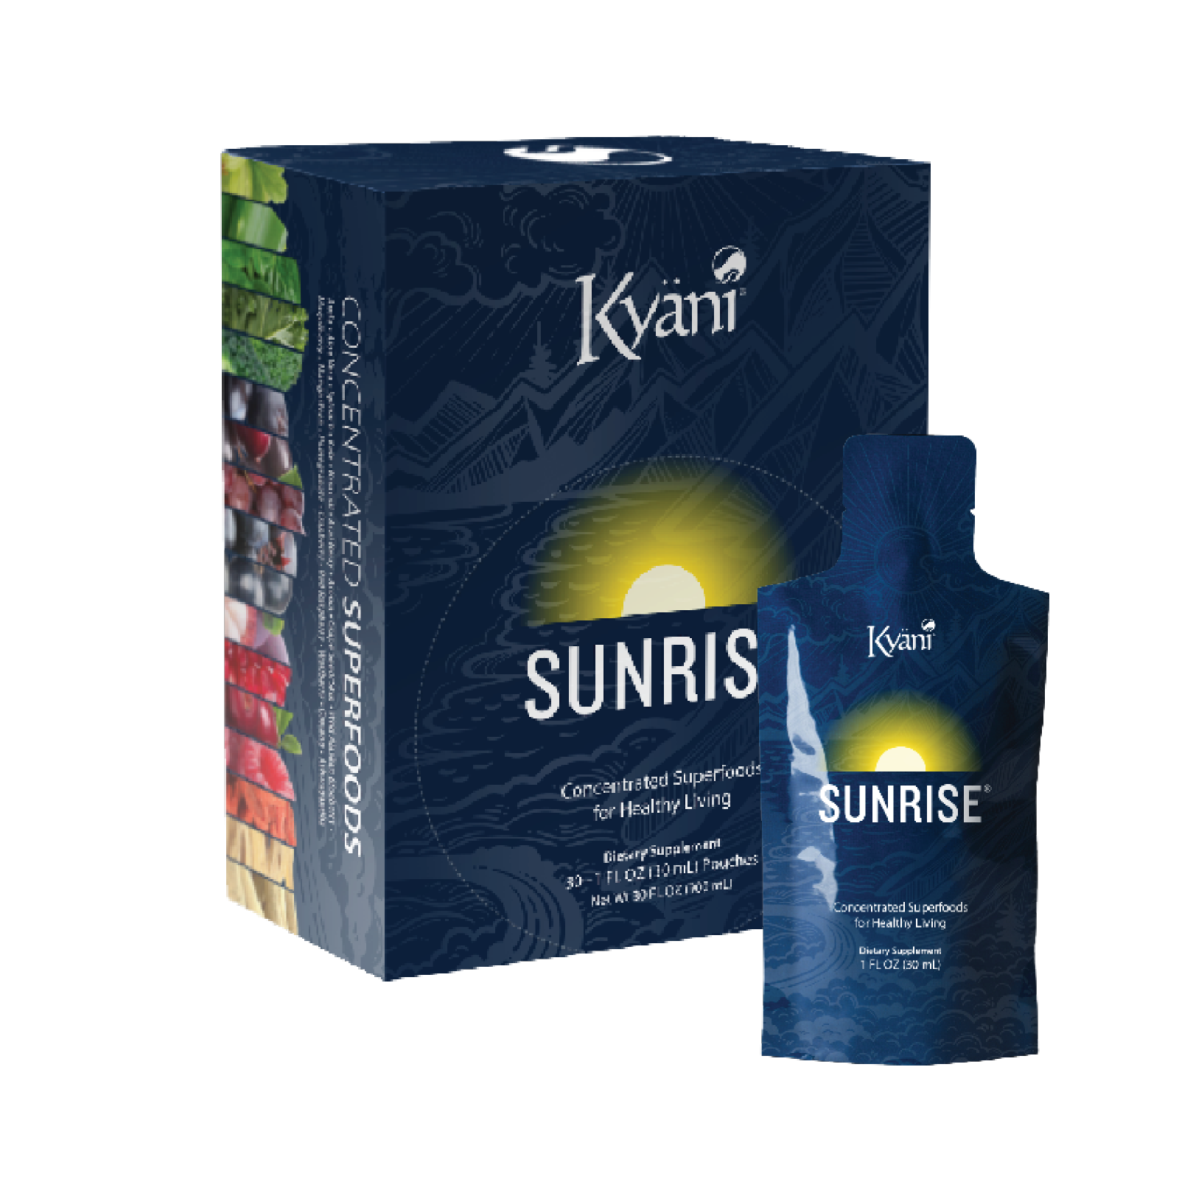
Superfoods / Phytonutrients!
Ingredients (juices/extracts/powders)
Blueberry Juice Blend (Blueberry & Wild Alaskan Blueberry)
Aronia Juice
Pomegranate Juice
Red Raspberry Juice
Wolfberry (Gogi)
Grape Skin & Seed
Mangosteen Puree
Aloe Vera Leaf
Ashwagandha Root
Spinach Leaf
Pomegranate Fruit
Broccoli Powder
Kale Powder
Ginseng
Cranberry
Acai
Amla Berry
Maqui Berry

Slide 18
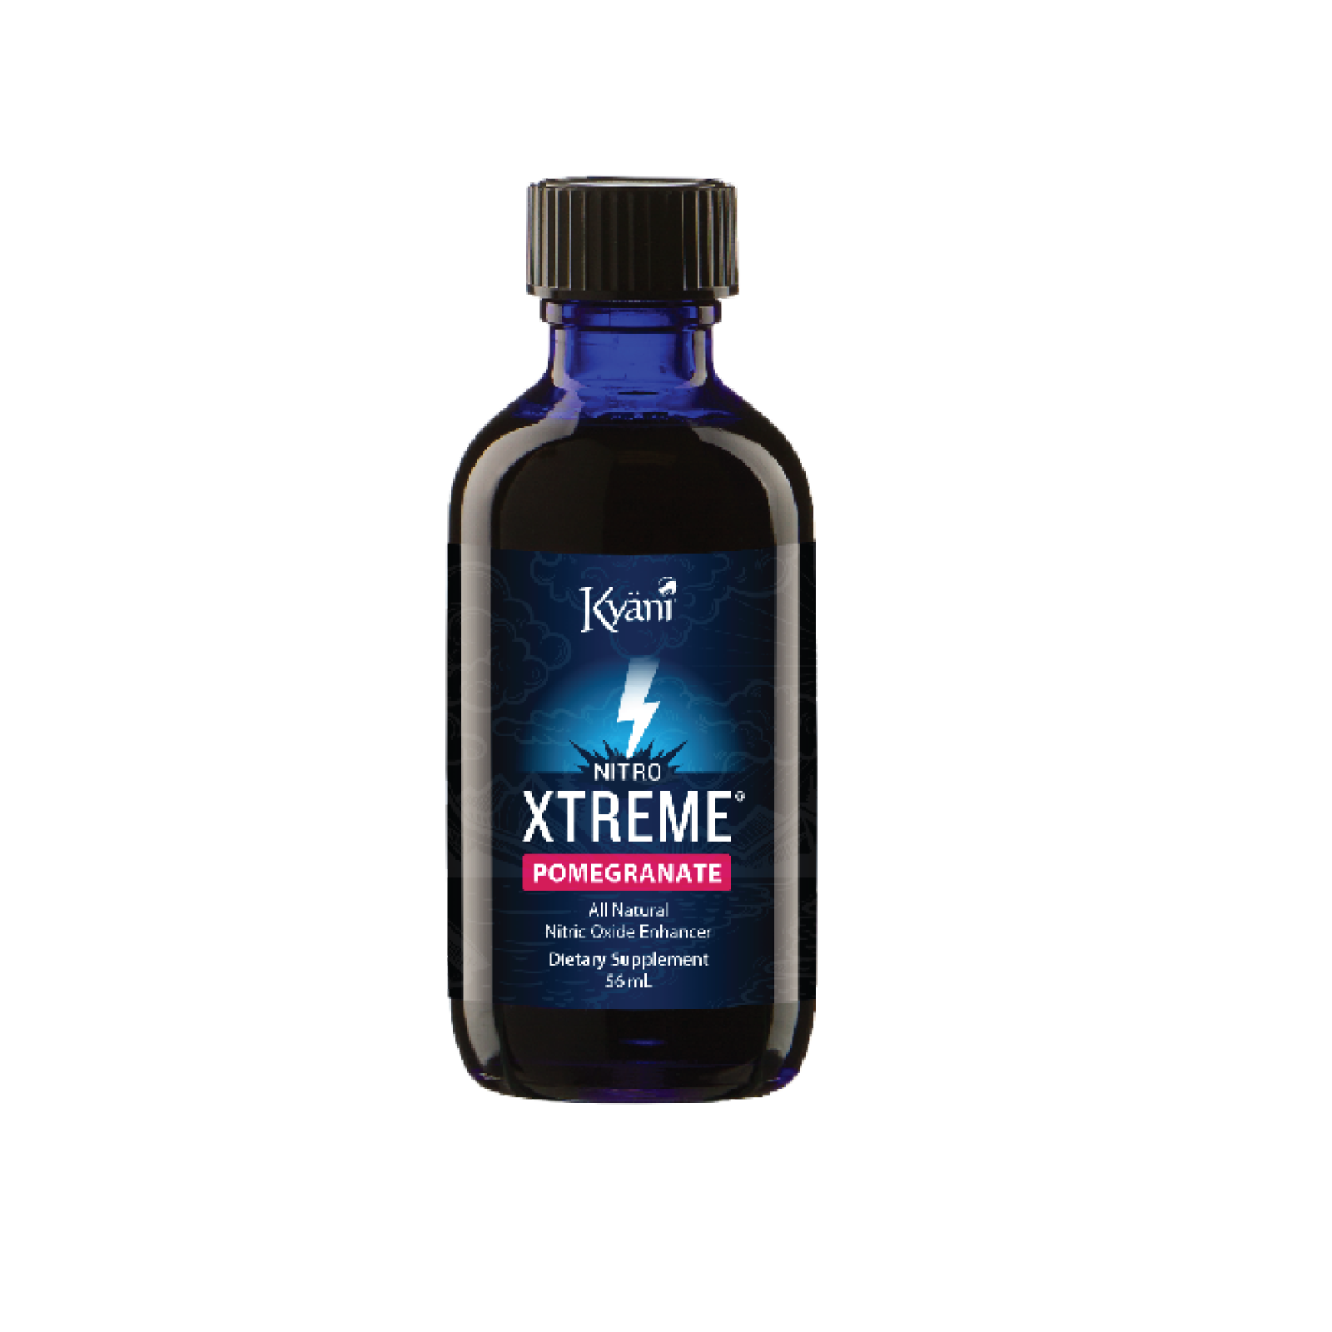
Nitrates!
Noni fruit concentrate = high in nitrates
Nitrates > Nitric Oxide (NO)
NO = Blood Flow!
Nitrates +
Precursors (Citrulline) +
Regenerators (Polyphenols)

Slide 19
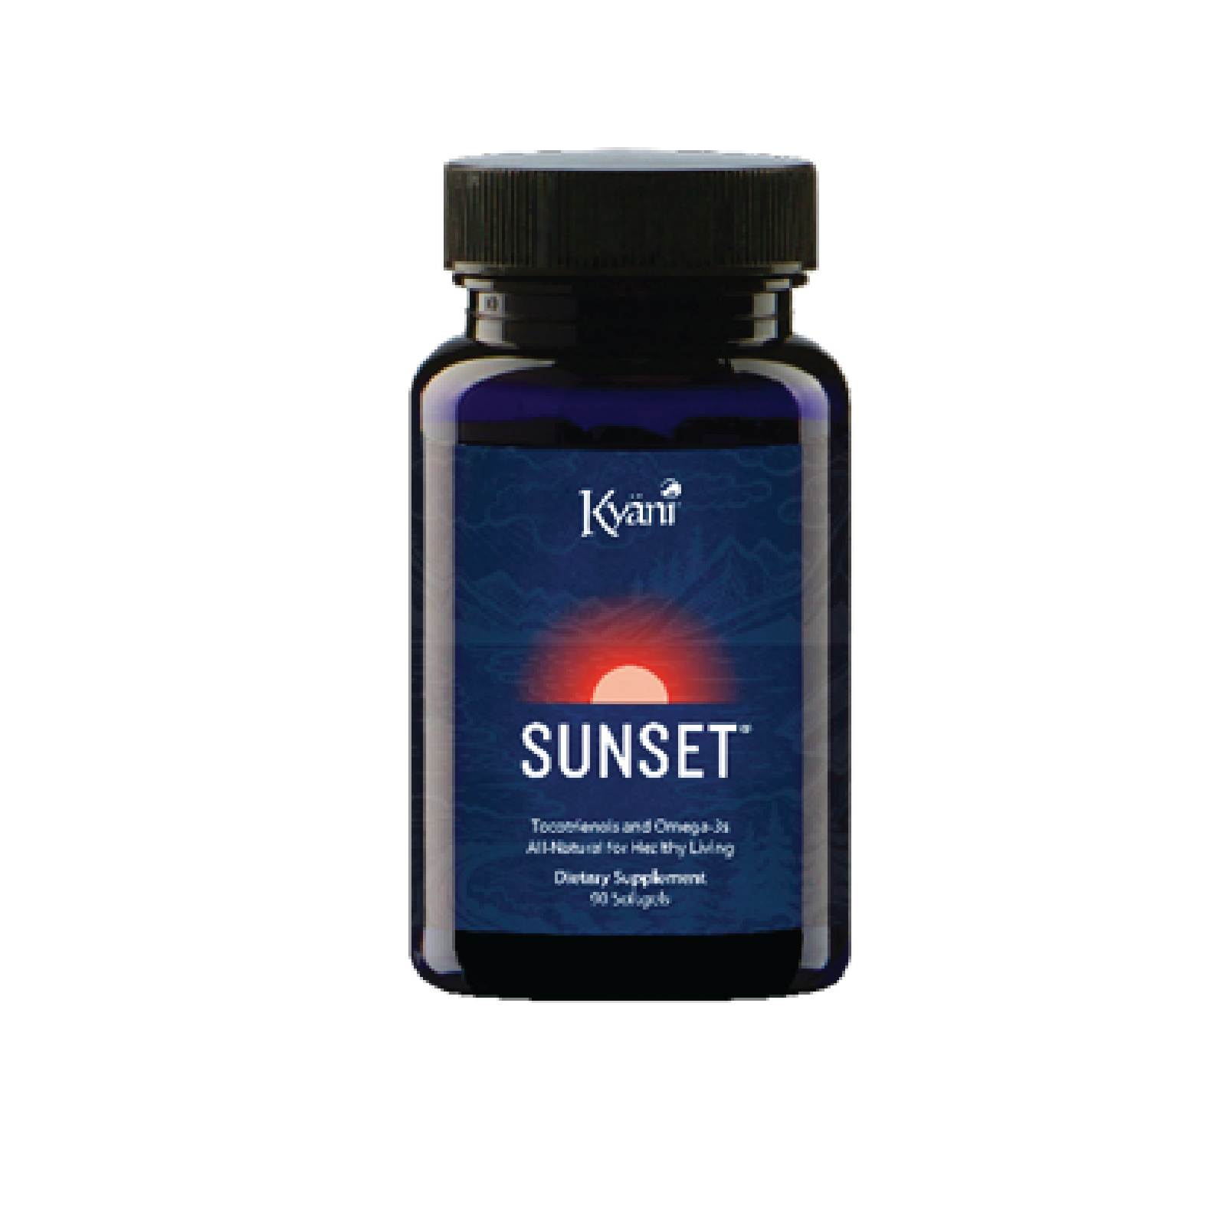
Tocotrienols & Omegas & Vitamin D!
Vitamin D3 (Cholecalciferol) (800IU/20 mcg/100%)
Astaxanthin (2mg)
“Vitamin E” (Annatto Oil) 100mg
  90% Delta Tocotrienols
  10% Gamma Tocotrienols
Kyäni Fish Oil Blend (1g)
  Wild Alaskan Fish & Wild Alaskan Sockeye Salmon
  Total Omega-3 (500mg)
    Eicosapentaenoic Acid (EPA) 300mg
    Docosahexaenoic Acid (DHA) 150mg

Slide 20


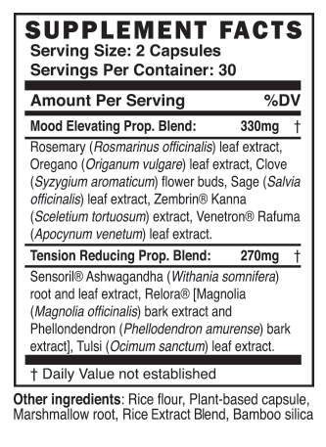
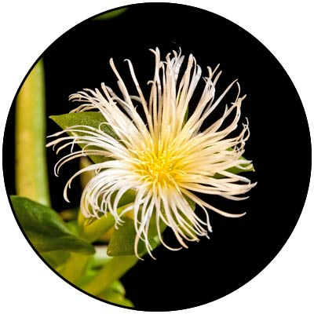
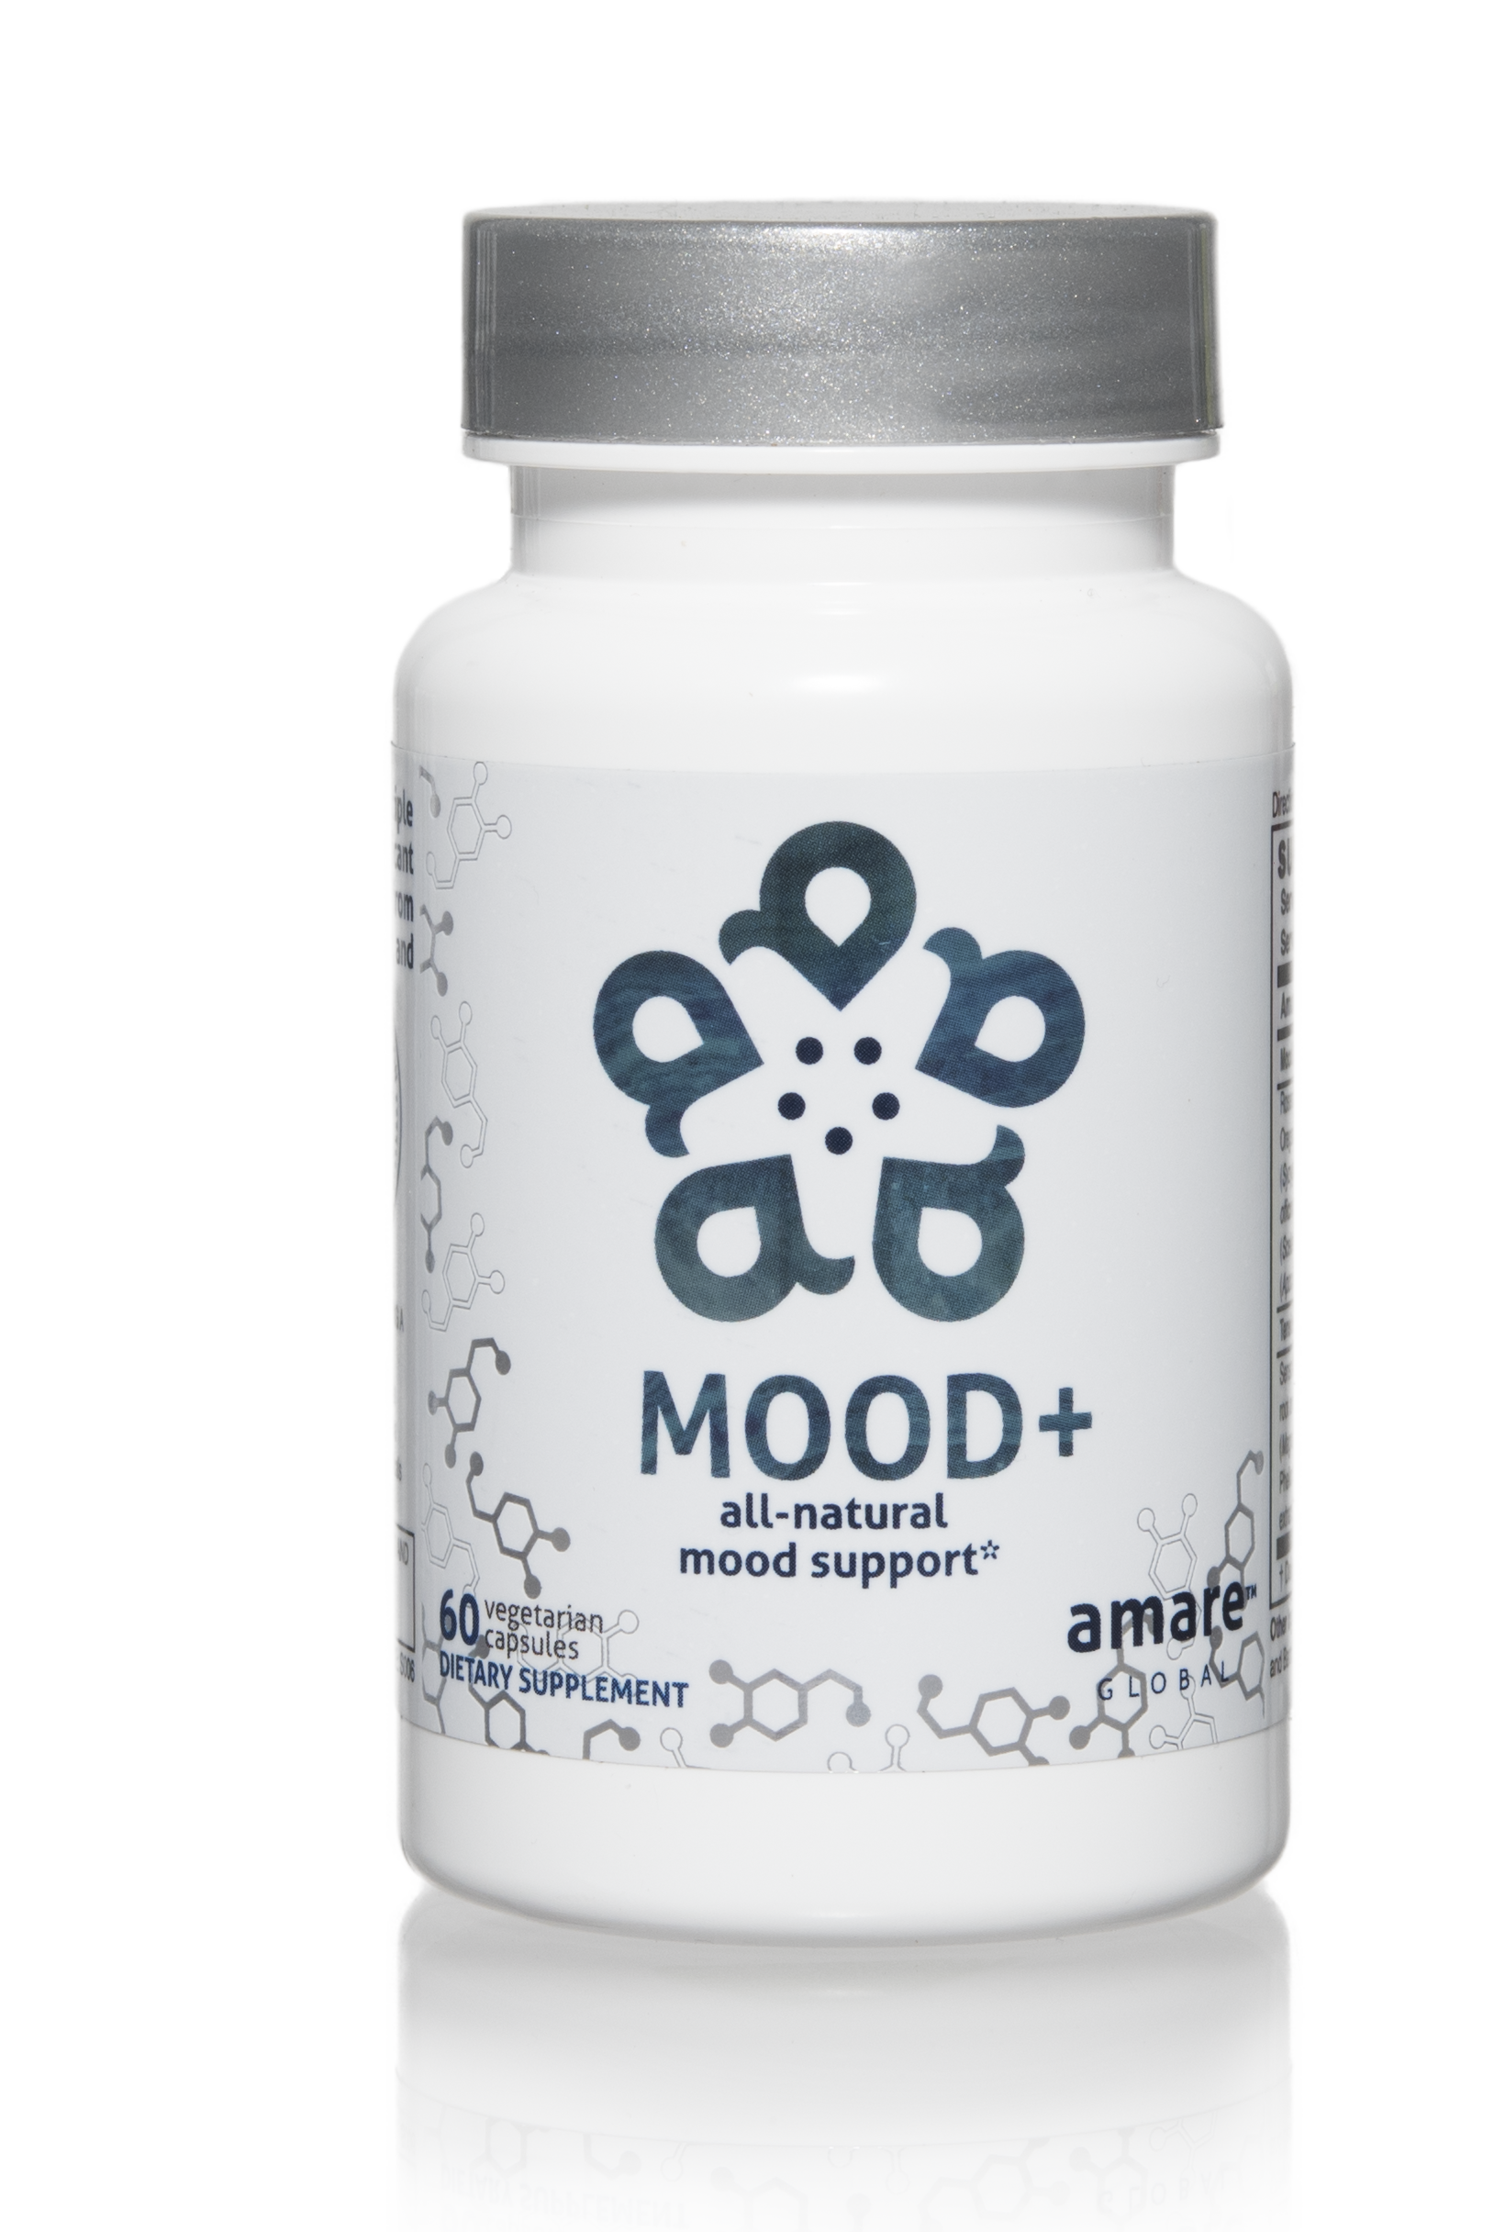
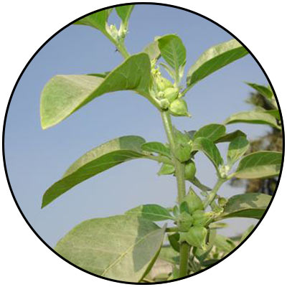
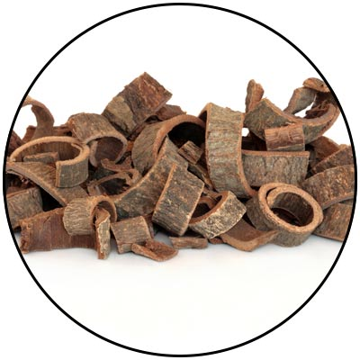
Mood+
Comprehensive Herbal Mood-Support
Phased Benefits (fast acting / long lasting)
Kanna (Zembrin) – Resilience
Rafuma (Venetron) – Mood
Ashwagandha (Sensoril) – Stress
Magnolia Bark (Relora) – Anxious Feelings
THE MENTAL WELLNESS COMPANY®

Slide 21
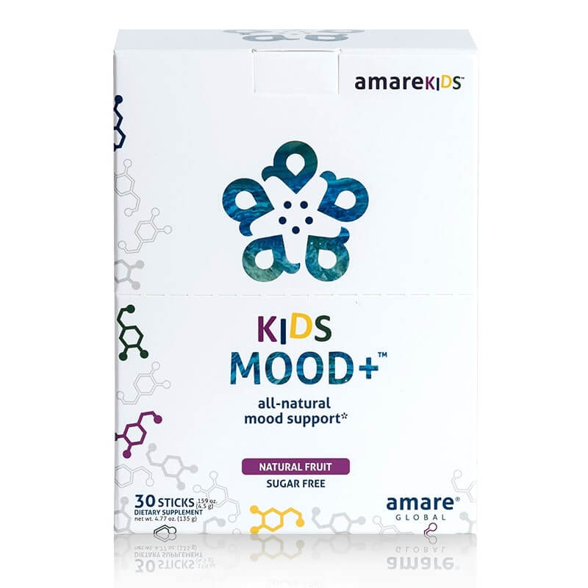
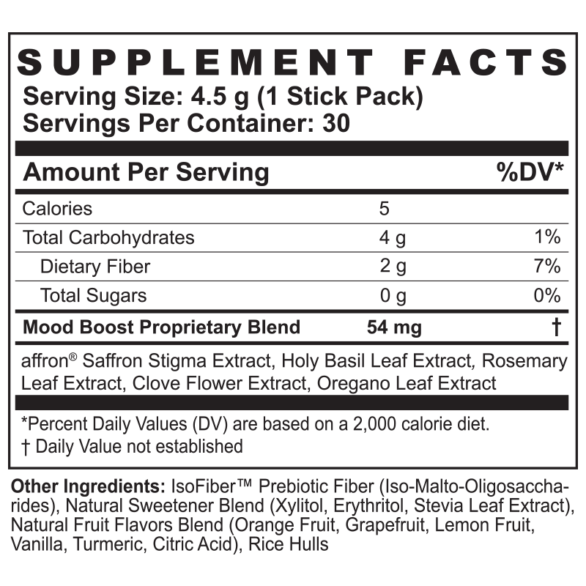

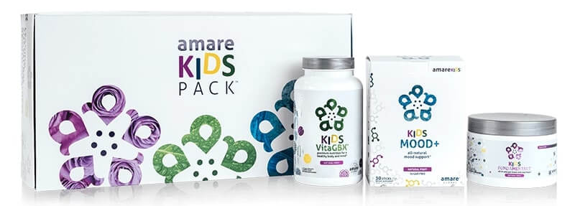
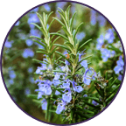

Kids Mood+
Not “just kids” – and not “just mood”
Helps normalize serotonin and dopamine activity — the “feel good” neurotransmitters
Balances stress hormones (cortisol)
Supports Resilience
Improves Focus, Attention, Mood, Listening, Tension, Irritation
Holy Basil
THE MENTAL WELLNESS COMPANY®
Rosemary
Saffron

Slide 22
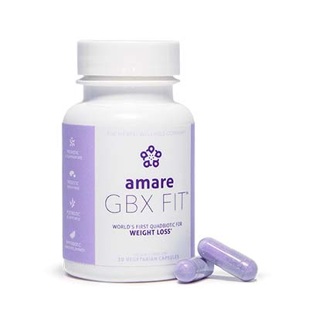

GBX Fit & GBX Burn
Overweight is a “signaling” problem (hormones, neurotransmitters, SCFAs)
Not a math problem! (calories in versus calories out)
It might be your microbiome?
Microbiome regulates…
  Mood
  Metabolism
  Appetite
  Inflammation
  Immune Function
  Gut Integrity (“leaky gut”)
Microbiome is our “internal pharmacy”…
  …producing what we need…
  …in the right amounts…
  …when we need it…
  …IF we activate it properly!
2022
THE MENTAL WELLNESS COMPANY®

Slide 23
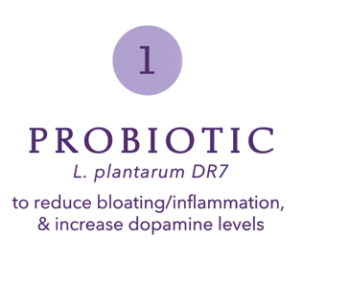
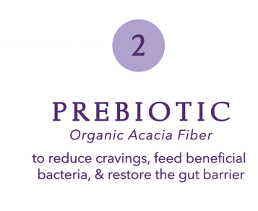
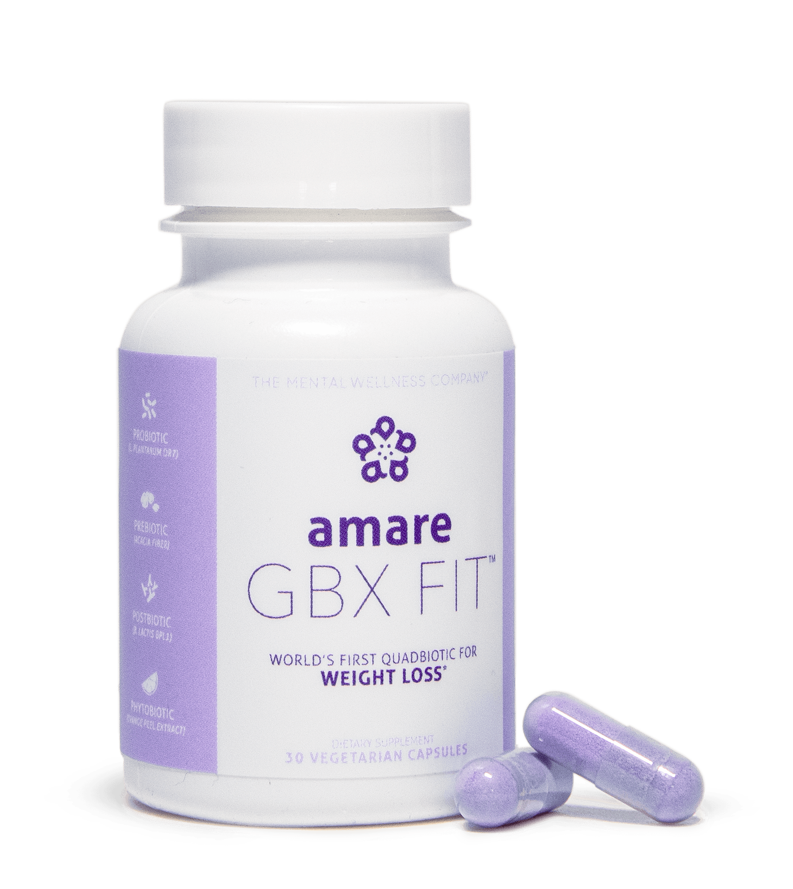
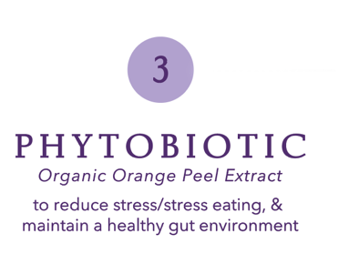
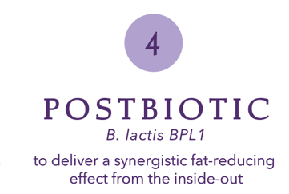
World’s First “QUADbiotic”
GBX Fit
controls appetite and supports fat release
(increases fat loss*)
“Take it Off”

Slide 24
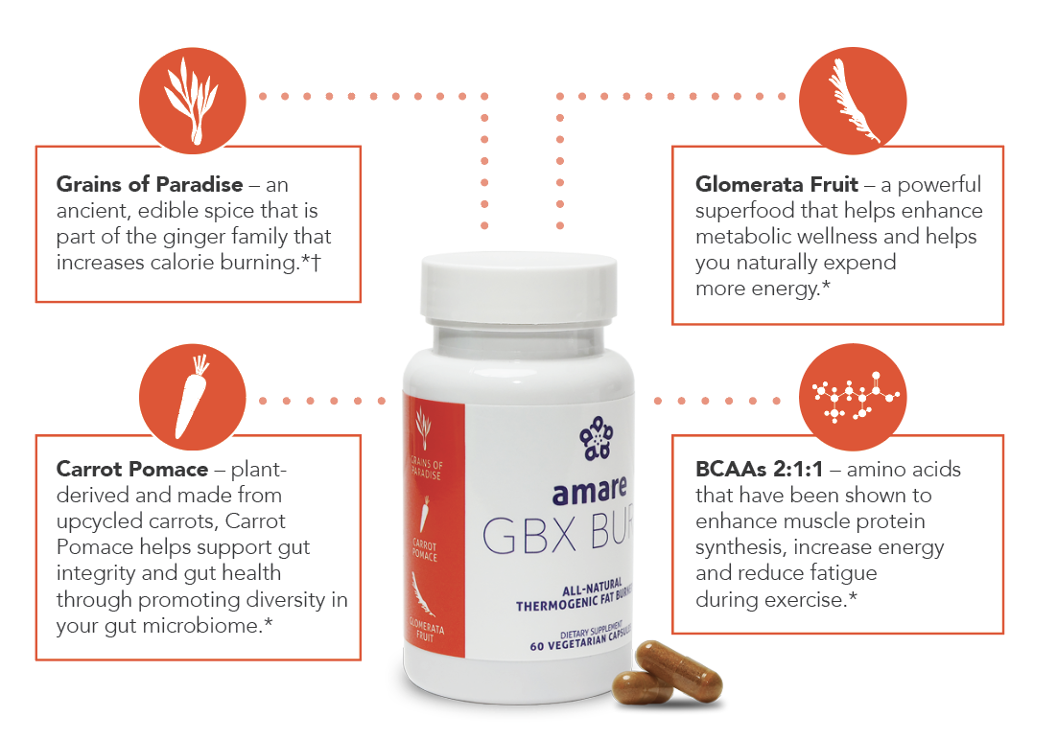
All-Natural Thermogenic
GBX Burn
Thermogenic fat burner*
“Keep it Off”
*These statements have not been evaluated by the Food and Drug Administration. This product is not intended to diagnose, treat, cure or prevent any disease.
†Individual weight loss results may vary. It's possible for individuals to lose 1-2 pounds a week using Amare products and following the Amare Fit Program. However, there is no guarantee of specific weight loss results.

Slide 25
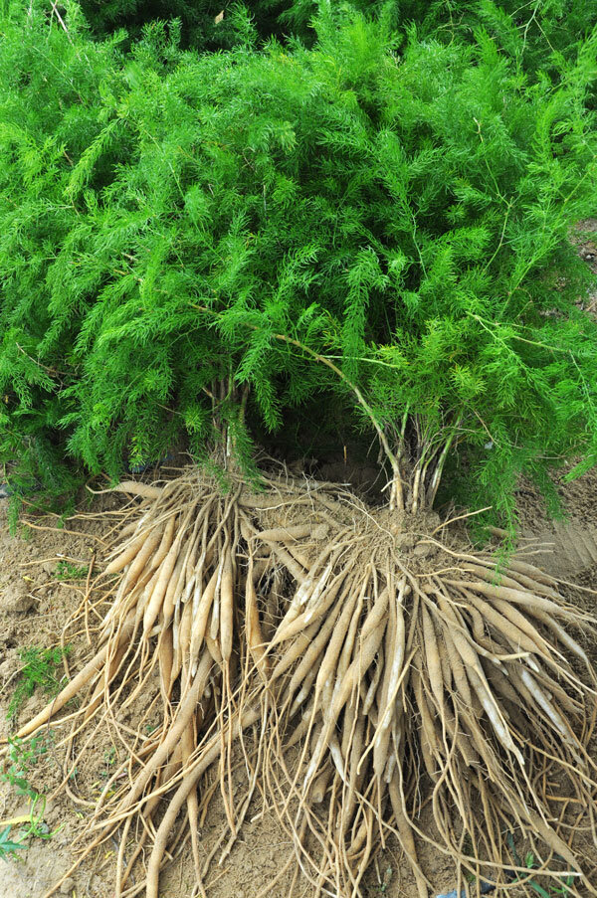
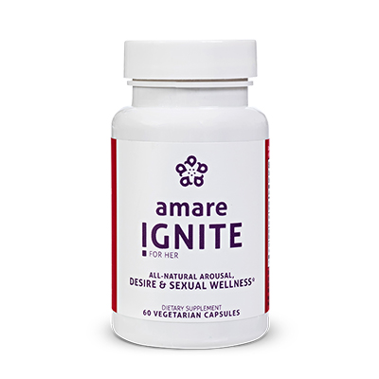
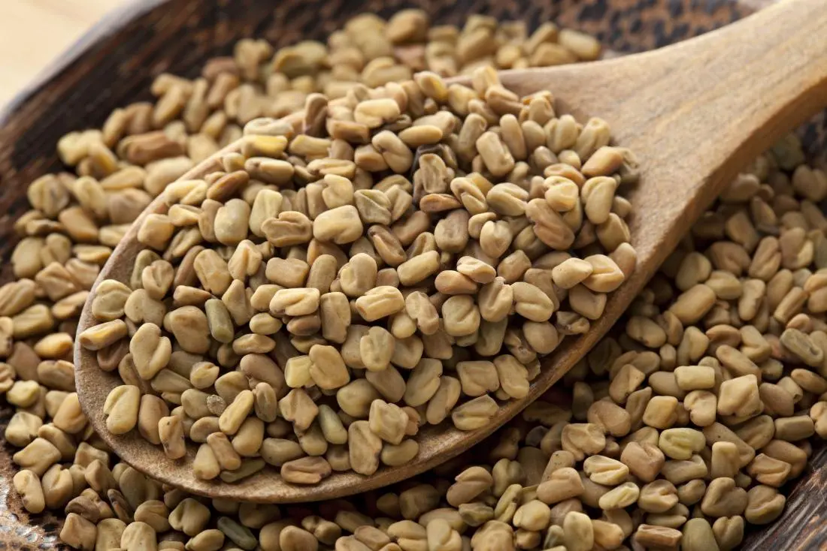
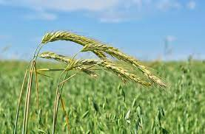


Ignite for Her
Hormone Balance for Women (estrogen, progesterone, testosterone, cortisol)
Combines clinically validated adaptogens, herbs, and phytonutrients that have been used for thousands of years to address performance and reproductive health.
Shatavari – “Queen of Herbs” – “she with 100 husbands” – mood issues related to menopause/PMS
Fenugreek – libido, lubrication, arousal, orgasm, satisfaction
Wild Green Oats – “nervous system tonic” = cramps/bloat, circulation, mood, libido
Lemon Balm – calming/relaxation
Beet Root – blood flow
THE MENTAL WELLNESS COMPANY®

Slide 26




Ignite for Him
Hormone Balance for Men (testosterone, cortisol, progesterone, estrogen)
Rhodiola – stamina/endurance – DNA fingerprint
Beet Root – Blood flow
Cordyceps Mushroom – libido – emperor/concubines
Tongkat Ali – free testosterone – erectile function
THE MENTAL WELLNESS COMPANY®

Slide 27


Sleep+
Non-Melatonin Sleep Enhancer
Corn Grass (non-GMO)
High in 6-MBOA
Make your own Serotonin (mood)
Make your own Melatonin (sleep)
Fall asleep faster (33%)
Wake up fewer times per night (30%)
50% improvement in Sleep Efficiency
40% Improvement in Sleep Quality
THE MENTAL WELLNESS COMPANY®

Slide 28






Relief+
Fast-acting & Long-Lasting Reliever of Physical & Mental Discomfort
Pain-Relief Blend:
Turmeric = fast-acting inflammatory balance
Boswellia = long-lasting inflammatory balance
Sports Recovery Blend:
Scutellaria = joint discomfort
Catechu = flexibility and range-of-motion
THE MENTAL WELLNESS COMPANY®

Slide 29




Digestive
Total GI Support (upper, middle, lower)
Less bloating, gas, heartburn
Prebiotic (FOS)
Digestive Enzymes (carbs, fats, proteins)
Motility Enhancers (artichoke leaf + ginger root)
THE MENTAL WELLNESS COMPANY®

Slide 30


Probiotics
Broad Spectrum General Wellness – with Strain Specificity (Acid-Resistant Capsule)
Bifidobacterium bifidum (Bb-06)
Maintains microflora balance by producing lactic acid and acetic acid to compete with “bad” bacteria (Staph. aureus, E. coli, Camplylobacter jejuni, etc).
Bifidobacterium longum (Bl-05)
Highly resistant to low pH and bile salts and is well-suited to the intestinal environment to help reduce inflammation. Helps reduce gastrointestinal discomfort caused by stress.
Lactobacillus acidophilus (La-14)
Ferments carbohydrates to lactic acid, which competes with “bad” bacteria for adhesion spaces on the intestinal mucosa. Increases mineral bioavailability (incl copper, magnesium, calcium, and manganese).
Lactobacillus casei (LC-11)
Wide range of benefits for improved digestion, reduced cholesterol, modulation of immune function (inflammation/allergies).
Lactobacillus rhamnosus (Lr-32)
Promotes general GI health and function — especially beneficial for occasional diarrhea and constipation after probiotic treatment.
THE MENTAL WELLNESS COMPANY®

Slide 31

Gut Health
Probiotics (“Nitrobiotics” = L. plantarum, L. acidophilus, L. rhamnosus, B. longum infantis)
Digestive Enzymes (Amylase, Lipase, Protease, Lactase, Cellulase, Glucoamylase, Invertase, Bromelain, Diastase, Papain, Peptizyme)
Gut Health Blend (Ginger Root, Trace Minerals, Black Pepper, Fennel Seed, Juniper Berry, Marshmallow Root)
Liver/Kidney Blend (Dandelion Leaves, Milk Thistle, Beet Root, Horsetail, Parsley)

Slide 32




VitaGBX
Premium multivitamin - more than 50 vitamins, minerals, amino acids, and phytonutrients. Bright Mind Blend (mind support) and GBX+ Blend (gut–brain axis support) to empower a well-balanced body and mind.
Bioavailable forms of vitamins/minerals/phytonutrients
Tyrosine > Dopamine
GBX Polyphenols
Carnitine (fat metabolism)
Alpha-Lipoic Acid (glucose metabolism)
Choline (brain support)
Full-spectrum Tocopherols
Full-spectrum Tocotrienols
Full-spectrum Carotenoids
Modulates numerous CDRs (Cellular-Defense Responses)
Nrf2 (antioxidant)
NfKb (inflammation)
SIRT/NAD (cellular aging)
MTOR/AMPK (metabolism)
HSP (autophagy = cellular cleanup)
THE MENTAL WELLNESS COMPANY®

Slide 33



OmMEGA
High-potency / High-purity Omega-3
Lavender-infused / Wild Anchovy (sustainable)
70% omega-3 concentration (more than 2x typical purity)
5:1 ratio of EPA:DHA for targeted mental wellness benefits
Superior cognition, memory, mental acuity, alertness, positive mood, neurogenesis, and resilience compared to generic fish oils
THE MENTAL WELLNESS COMPANY®

Slide 34





GBX Protein
Delicious Plant-based Protein/Prebiotic
17g protein / 0g sugar / 1g fat / 3g fiber
Chickpea protein & Oligosaccharides
Prebiotic fiber for your gut microbiome
THE MENTAL WELLNESS COMPANY®

Slide 35


Protein! (but not “just” protein)
Balanced Macronutrient Blend
20g Protein / 4.5g Fat / 12g Carb (5g Fiber / 5g Sugar)
Protein Blend = Pea, Organic Pumpkin Seed, Organic Sunflower Seed, Fava Bean
Fiber Blend = Chicory Root Inulin, Milled Flaxseed, Cellulose Fiber, Apple Fiber, Bamboo Fiber
Citrulline (1.5g)

Slide 36

Protein! (but not “just” protein)
Targeted Macronutrient Blend (muscles/tendons/ligaments)
20g Protein (10g Whey / 10g Collagen)
4.5g Fat
5g Carb (1g Sugar)
Citrulline (1.5g)

Slide 37


Collagen
5g liquid collagen (skin, joints, gut, “connective”
Berry Lemonade / Peach
Sugar free
Chicory Root Extract, Fern Extract (Phlebodium Leucotomos), Apple Cider Vinegar Powder, CoQ10, Hyaluronic acid

Slide 38














SuperFood
Close the Fruit/Veg Gap
3 servings of fruits & veggies
Phytobiotic-rich plant extracts
Prebiotic Fiber Blend (IsoFiber/IMO, Apple fiber, Chia seed, Flaxseed)
Anti-Stress Benefits (Japanese Asparagus) – for cells & whole-body
Apple Fiber
Chia Seed
Flaxseed
Beet Root
Carrot
Spirulina
Spinach
Strawberry
Kale
Asparagus
Broccoli
Pomegranate
Tart Cherry
THE MENTAL WELLNESS COMPANY®

Slide 39








SeedFiber
Fibers & Phytonutrients from cold-pressed seed hulls for microbiome & immune support
Sunflower Seed – One of the top natural sources of good fats, copper, selenium, folate & vitamin E
Cucumber Seed – Great source of fiber & beta carotene - helps with immunity, skin and eye health
Cranberry Seed – Good source of vitamin E, Omega-3-6-9, and antioxidant protection
Black Cumin Seed – Contains B vitamins & antioxidants for immune system support
Blackberry Seed – Rich in Omega-3 (alpha-linolenic acid) and Omega-6 (linolenic acid) fats, which are good for heart and brain health
Concord Grape Seed – Great natural source of vitamins A & E, crucial for skin, circulation, cholesterol, and antioxidant effects
Cultured Shiitake Mycelium Extract - Rich in alpha-glucans (immune priming) - supports microRNA signaling between the microbiome and the central nervous system (reduces feelings of anxiety)
THE MENTAL WELLNESS COMPANY®

Slide 40


Electrolytes!
Hydration
Coconut Lime / Crisp Apple
10 Calories (2g Carbs – 2g Sugar)
Electrolyte Blend = 9mg Calcium (citrate), 9mg Magnesium (citrate + malate), 300mg Sodium (sea salt), 150mg Potassium (chloride + bicarbonate)
200mg L-Citrulline
60mg NR-8™ Blend (Apple, Grape Seed, Black Currant, Elderberry, Bilberry, Lingonberry, Spinach, Broccoli)

Slide 41





HempGBX+
Full-spectrum Phytocannabinoid Hemp Oil combined with Terpenes for priming endocannabinoid system (ECS) receptors and activating ECS receptors for overall superior benefits
Premium, high-quality full-spectrum hemp oil, derived from the least processed extraction method of hemp cannabinoids in the rawest form
Black cumin seed extract enhances the inflammatory balance effects of the full-spectrum hemp oil by a factor of 7–10x
Black pepper oil is rich in terpenes, which adds to the entourage effect
White frankincense oil helps promote respiratory health, support overall cellular function, and revive and rejuvenates skin health
THE MENTAL WELLNESS COMPANY®

Slide 42




DermaBiotics
Plant-Based (non-animal collagen support)
Microbiome Regenerating Serum
To revitalize skin elasticity and balance … nourish it. This clean, plant-based, all-natural, topical serum delivers targeted prebiotics, probiotics, phytobiotics, and essential sea minerals to support the skin microbiome for healthy, protected, glowing skin.
Collagen-Boosting Spray
For radiant, firm skin, instead of “taking” collagen … make it. This clean, plant-based, all-natural oral spray helps boost collagen production, improve skin moisture, and support skin elasticity.
THE MENTAL WELLNESS COMPANY®

Slide 43


Pep
Supports mental alertness & improved concentration
A delicious infusion of probiotics, prebiotics, and clean energy ingredients
Probiotics
  DE111® Bacillus subtilis
  Organic Live Kombucha
Prebiotics
  PFBc (Palm Fruit Bioactives)
  Sunfiber®
Clean energy
  Organic Green Coffee Bean (contains caffeine)
  Suntheanine®
THE MENTAL WELLNESS COMPANY®

Slide 44

Packs
Where to Start for Best Experience?
Fundamentals – if you need to “support” something
Comprehensive GBX support (microbiome, gut integrity, immune/inflammatory balance, focus/memory)
Happy Juice – if you just want to “feel better”
Move from languishing/burnout to flourishing/vigor
Happy Hormones – if you want to “dial in” your performance
Ignite: Sex hormones (estrogen, progesterone, testosterone)
Mood+: Stress/Mood hormones/neurotransmitters (cortisol, serotonin, dopamine)
GBX Fit: Metabolic hormones (insulin/glucose, thyroid, GLP-1, SCFAs)

Slide 45



Mental Wellness (“Mind”)
Physical Wellness (“Body”)
Mind/Body Balance
“Next-Level” Mental & Physical Performance
THE MENTAL WELLNESS COMPANY®

