Slide 1
Amare Health Pro Training
Shawn Talbott, PhD
CNS, LDN, FACSM, FAIS, FACN
Founding Executive & Chief Science Officer
Amare Global

Slide 2

20+ years developing nutritional products.
Fellow of the American College of Nutrition, the American College of Sports Medicine, and the American Institute of Stress.
Author of two academic textbooks, an award-winning documentary film, and several best-selling books translated into more than a dozen languages.
Featured guest on the “Dr. Oz Show,” “Ask Dr. Nandi,” The TED stage, and the White House.
Served as a nutrition educator for elite-level athletes (US Ski Team, US Track & Field, US Olympic Training Centers)
Diplomate of the International Olympic Committee’s (IOC) Sports Nutrition program.
Dr. Shawn Talbott
Amare’s Chief Science Officer
PhD, CNS, LDN, FACSM, FAIS, FACN

Slide 3
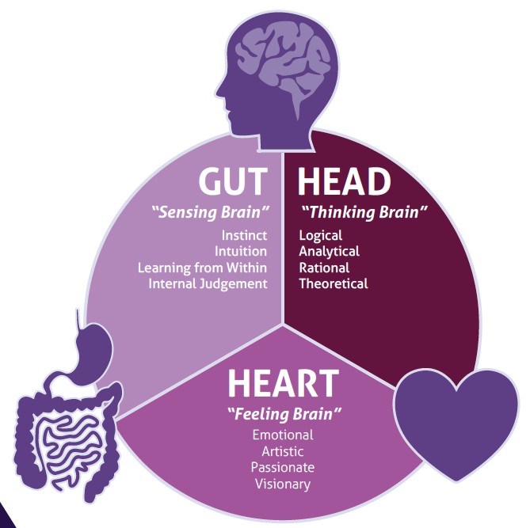
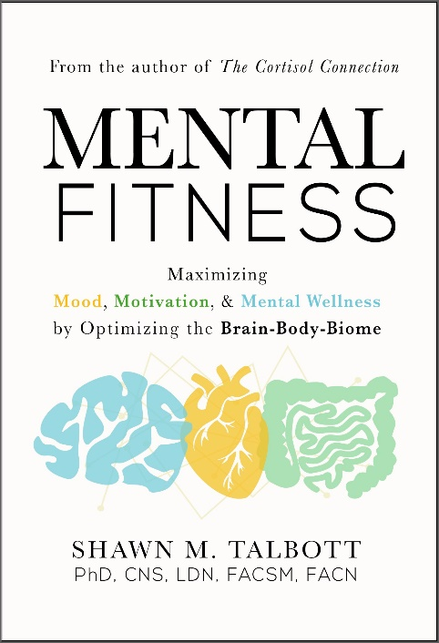
Subscribe for updates at:
–Amare.com (Resources)
–Facebook.com/AmareGlobal
–Facebook.com/DrShawnTalbott
–YouTube.com/DrShawnTalbott
–Instagram.com/doctalbott
–ShawnTalbott.com (blog)
Questions?
https://link.AnyQuestion.com/DocTalbott

Slide 4

Where do SUPPLEMENTS FIT?
Supplements
Exercise
Nutrition
Sleep
Evaluation
?
Motivation and energy to exercise?
Appetite and craving modulation?
Relaxation and recovery?

Slide 5



Products + Programs + People = Mental Wellness

Slide 6

Presentation Description…
1. How the Microbiome-Gut-Brain-Heart-Axis is related to mental well-being
2. How to engineer their microbiome for ultimate mental performance (stress, mood, energy, focus, sleep, resilience, etc).
3. How to choose probiotics, prebiotics, and other nutrients for maximum benefits.
Learning Objectives…
1. Understand how bacteria in our gut determine what happens in our brain and relate to our overall mental well-being?
2. Understand how those signals get out of balance – and how to rebalance them?
3. What are some of the mistakes that people make when they think about "gut health"?
4. Can people do this with food and exercise alone - Where do supplements fit in?

Slide 7
Intellectual Property Platform
Dozens of peer-reviewed scientific presentations & publications
Dozens of Patent Applications pending globally
  MentaHeart
  Kid’s Mood+
Multiple Industry “Best Of” Awards – including “Startup of the Year” (twice)

Slide 8
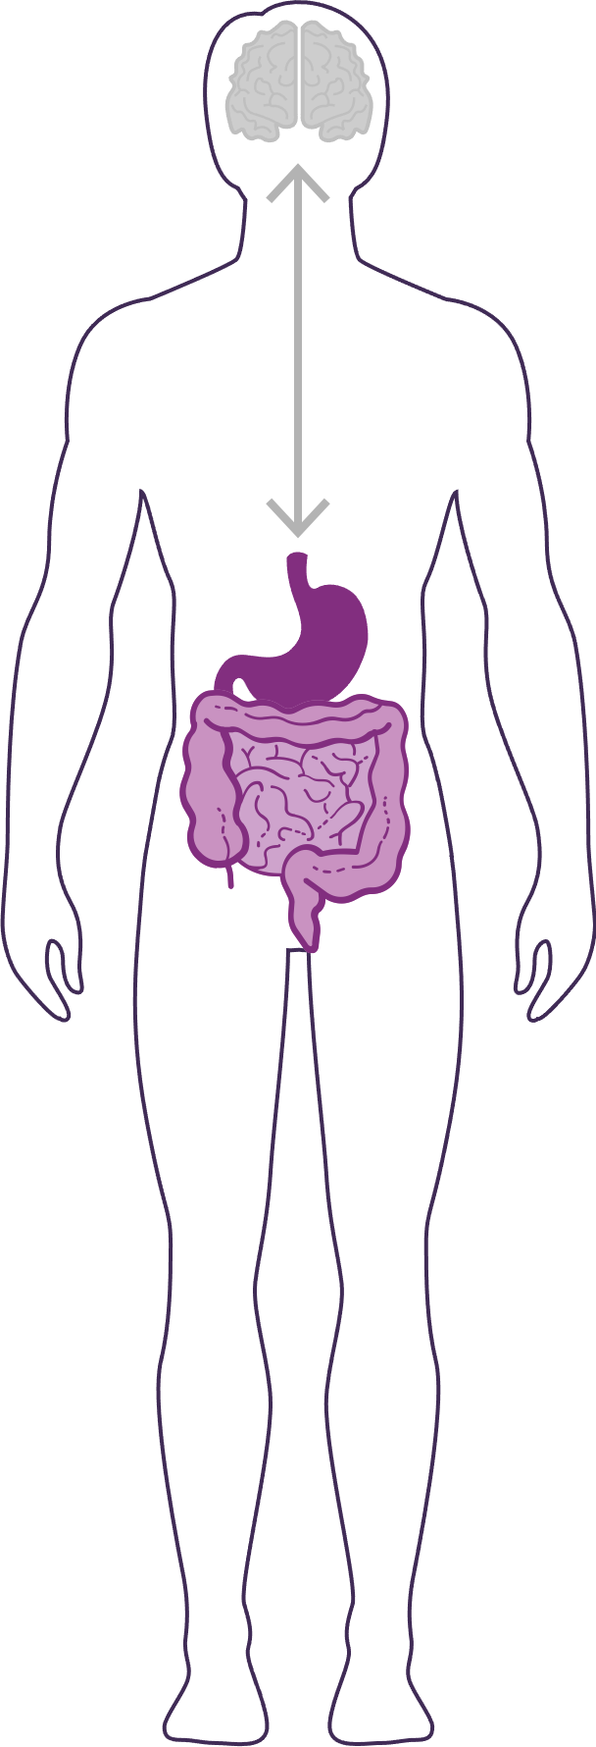
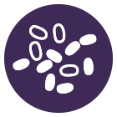

How Important is Your Microbiome?
Communicates with the brain to regulate health, weight, immune function, digestive function, mood, and overall mental wellness and physical health (including longevity).
What we put in our bodies affects the microbiome, which in turn affects our mind and other crucial bodily systems.
The microbiome plays an important role in the way you feel mentally and physically.
IN BALANCE
Feeling great!
-internal, on-demand, dynamic, natural pharmacy
OUT OF BALANCE
This explains why you have those “GUT FEELINGS”
Feeling not great…
-fatigue, sad, tense, hungry, heavy, bloated, confused, stiff/sore…
THE MENTAL WELLNESS COMPANY®

Slide 9
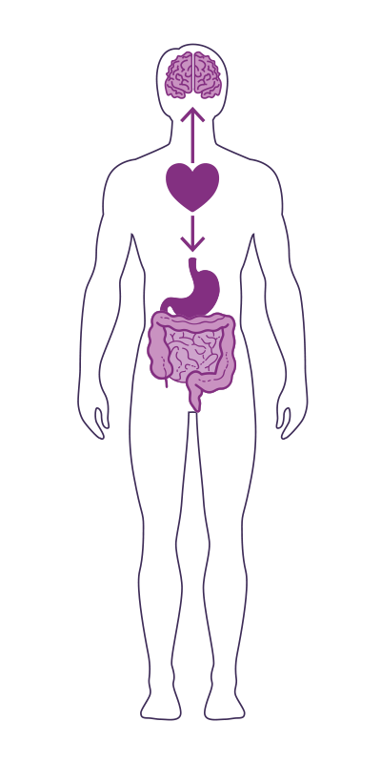
GUT-HEART-BRAIN-AXIS
Studies have now shown that the heart is the body’s third brain, containing approximately 40,000 neurons that can sense, feel, learn, and remember.
Similar to the gut-brain axis, the heart and brain are also closely connected via the heart-brain axis.
The heart sends messages to the brain about what it needs, how the body feels and more.
Nervous system (brain)
Cardiovascular system (heart)
Immune system (axis)
Gastrointestinal system (gut)
Endocannabinoid system (ECS)

Slide 10
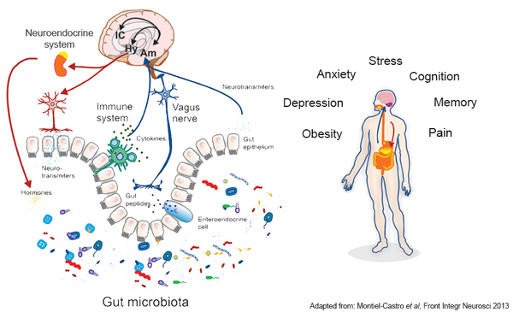
Mental
Wellness?

Slide 11


Slide 12



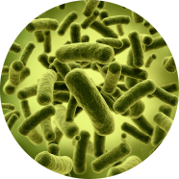
Obese
Overeating
Lean
Obese
Overeating
Obesogenic microbiota
Germ-free
Obesogenic microbiota

Slide 13



Timid
“Introvert”
Outgoing
“Extrovert”
Timid
“Introvert”
Normal gut microbes
Germ-free
Transplanted

Slide 14
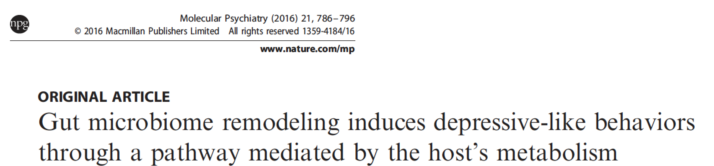
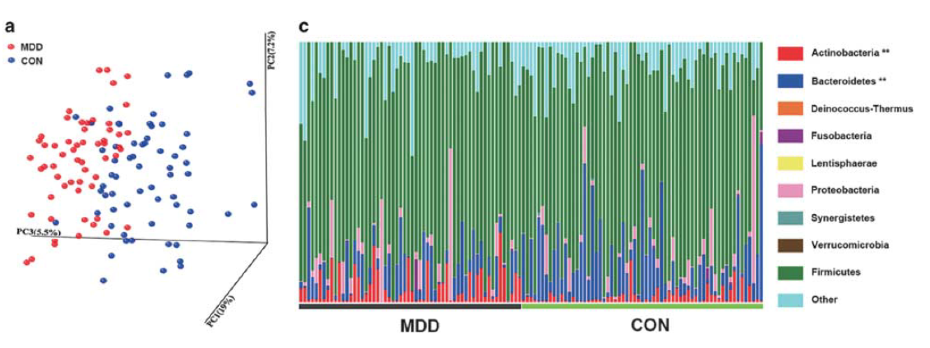

Depression
Zheng P et al, 2016

Slide 15
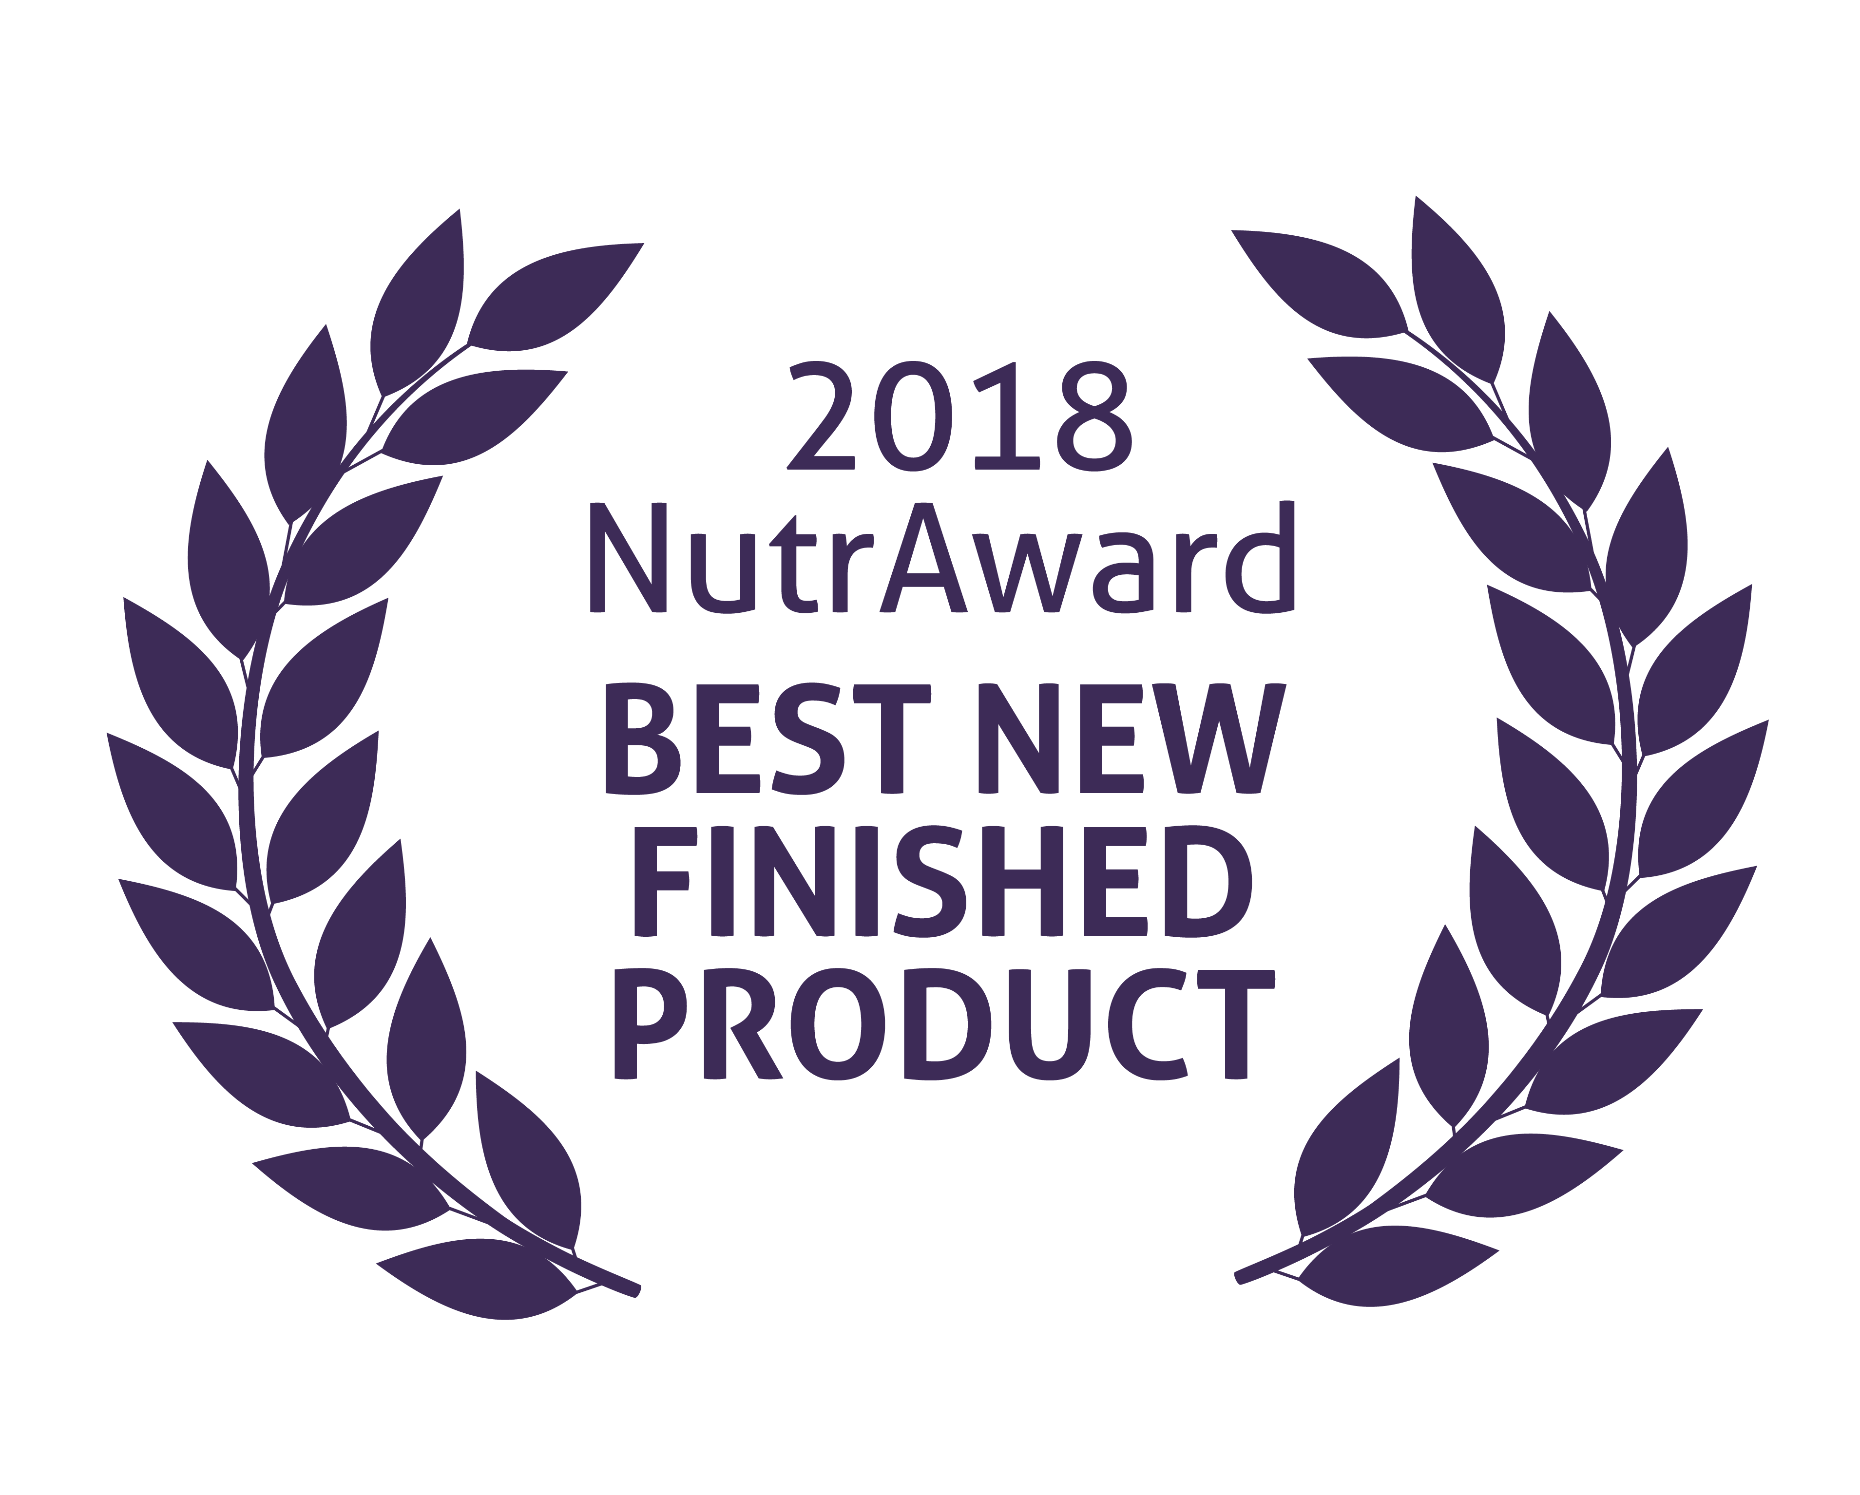
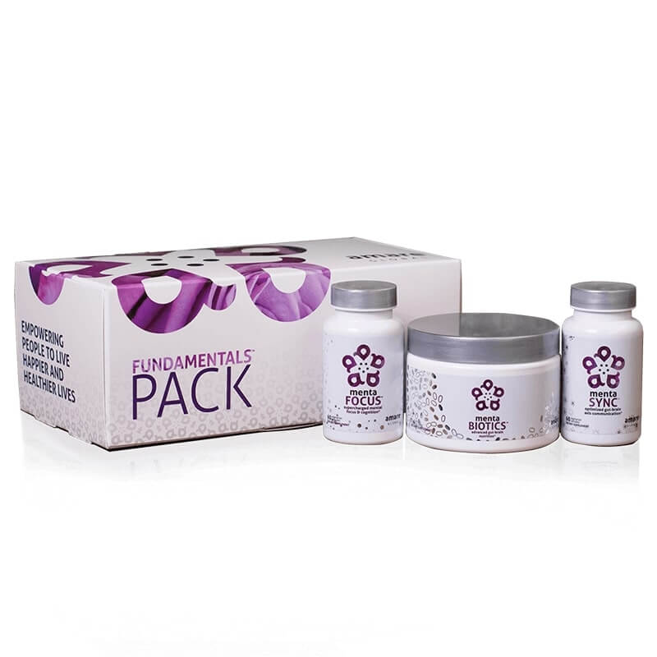
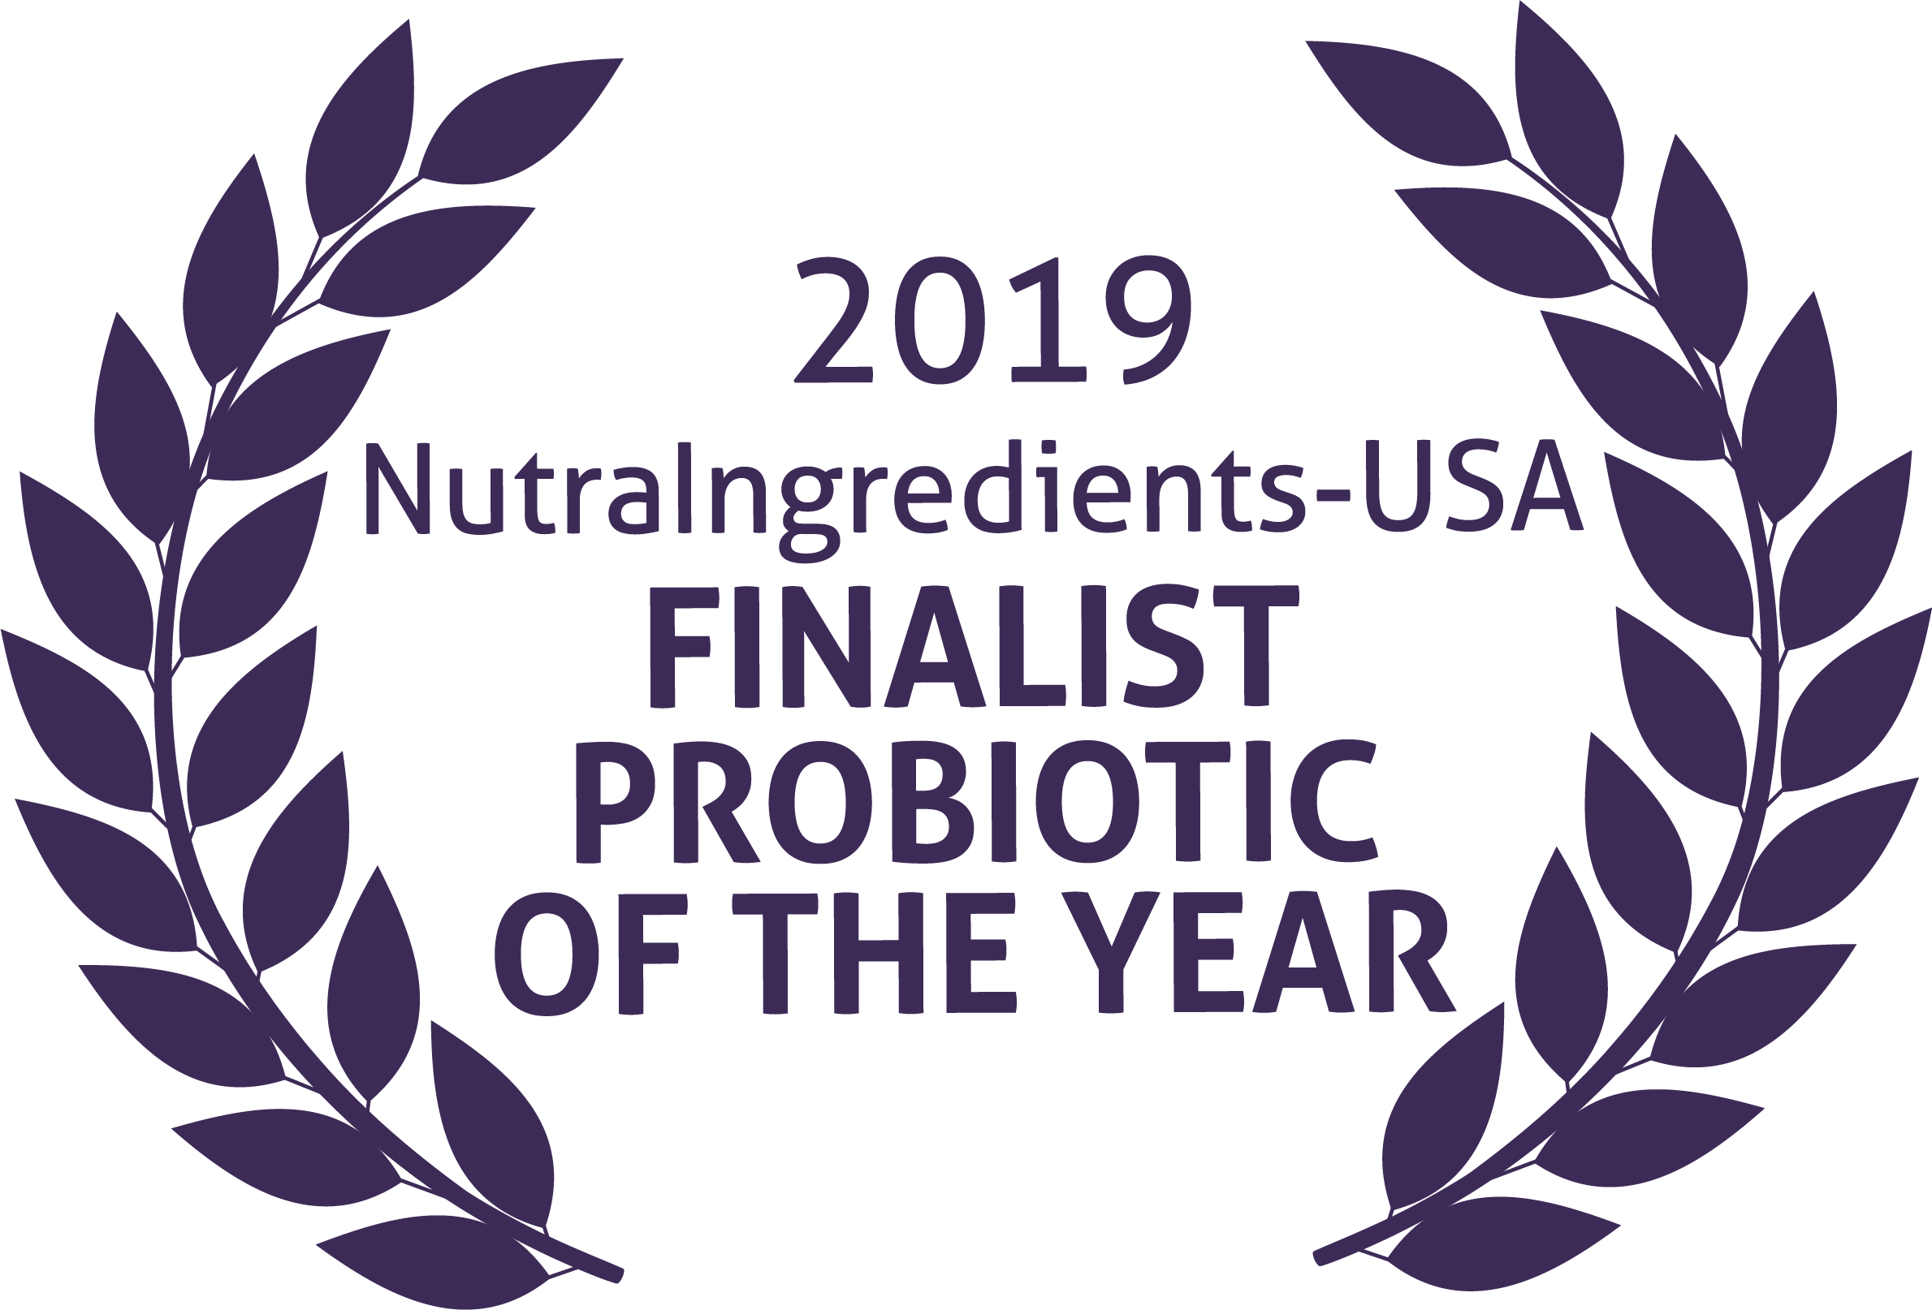
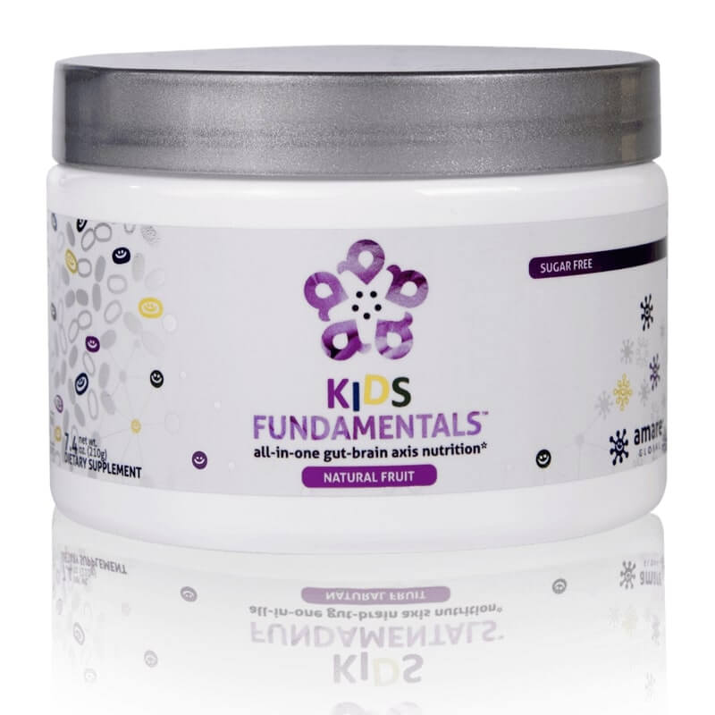
FundaMentals
World’s 1st comprehensive/holistic GBX system
  Addresses each level of GBX balance
  Microbiome modulation
  Gut integrity
  Immune priming
  Inflammatory balance
  Neurotransmitter signaling
Specific probiotic strains for mood/tension/stress
Specific prebiotics fibers for reducing stress and improving resilience
Patent-pending phytonutrients for GBX support (“phytobiotics” – patent-pending)
Scientifically-supported formula
  Dozens of peer-reviewed scientific presentations and publications
  *Effect of Coordinated Probiotic/Prebiotic/Phytobiotic Supplementation on Microbiome Balance and Psychological Mood State in Healthy Stressed Adults
  Functional Foods in Health & Disease Journal FFHD: Online ISSN:2160-3855 Vol 9, No 4 (2019) https://www.ffhdj.com/index.php/ffhd/article/view/599/

Slide 16
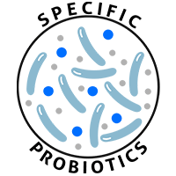
MW3 Probiotic Strains:
LACTOBACILLUS RHAMNOSUS R0011
Reduces stress by lowering cortisol exposure
and improves GABA neurotransmission*
BIFIDOBACTERIUM LONGUM R0175
Enhances calmness by decreasing anxiety indices and improves cognitive function*
LACTOBACILLUS HELVETICUS R0052
Improves mood by decreasing neuro-inflammation and increasing serotonin*
Our blend contains unique and specific probiotic strains targeted to enhance overall mental wellness.*

Slide 17

MW3 Prebiotic Fibers:
IsoFiber™
(Iso-Malto-Oligosaccharides)
Contains a combination of naturally occurring prebiotic plant fibers that are clinically shown to improve the growth of specific probiotic strains featured in Kids FundaMentals™ and now MentaBiotics™ Sugar Free!
Bimuno®
(Galacto-Oligo-Saccharides)
Resets and increases friendly gut bacteria, maintains immune health, controls inflammation in the body and supports microbiome balance. Is highly effective and a natural way of increasing preferred bacteria in the gut.
Plays an important role in feeding Bifidobacteria probiotic strains.*
SunFiber®
(Galactomannan Fiber)
Helps improve the growth and vitality of beneficial bacteria, including Bifidobacteria and Lactobacillus.*
Our MW3 Prebiotic Proprietary Blend provides optimal gut support by feeding the specific mental wellness probiotic strains found in our MW3 Probiotic Proprietary Blend.*

Slide 18
Which prebiotics match up
With our mental wellness probiotics?
MW3TM Prebiotic
Proprietary Blend
IsoFiberTM
Iso-Malto-Oligosaccharides
BiMuno®
Galacto-Oligo-Saccharides
SunFiber®
Galactomannan Fiber
MW3TM Probiotic
Proprietary Blend
Lactobacillus
R0052
Bifidobacterium Longum
R0175
Lactobacillus rhamnosus
R0011

Slide 19
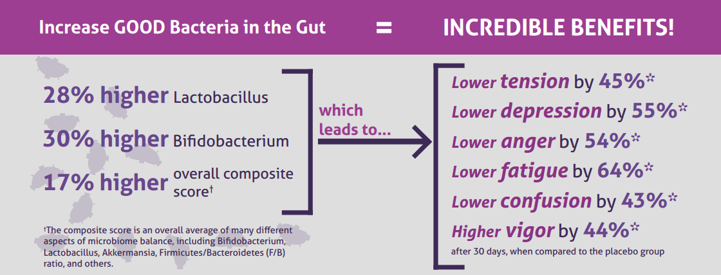
Effect of Coordinated Probiotic/Prebiotic/Phytobiotic Supplementation
on Microbiome Balance and Psychological Mood State in Healthy Stressed Adults
Functional Foods in Health & Disease Journal (www.FFHDJ.com)

Slide 20
INGREDIENT | PURPOSE/EFFECT | SUPPLIER
Lactobacillus helveticus R0052 | Serotonin/Depression | Lallemand Health Solutions, Montreal Canada
Bifidobacterium longum R0175 | GABA/Anxiety | Lallemand Health Solutions, Montreal Canada
Lactobacillus rhamnosus R0011 | Cortisol/Stress | Lallemand Health Solutions, Montreal Canada
Bimuno GOS | Microbiome/Resilience | Clasado BioSciences, UK
Sunfiber Guar Gum Galactomannan | Microbiome/Resilience | Taiyo, Minneapolis, MN USA
Suntheanine L-theanine | Stress/Tension | Taiyo, Minneapolis, MN USA
Applephenon Asian Apple Polyphenols | Gut-Brain-Axis Balance | BGG, Beijing, China
Enovita French Grape Seed Polyphenols | Gut-Brain-Axis Balance | Indena, Milan, Italy
Enzogenol New Zealand Pine Bark Polyphenols | Gut-Brain-Axis Balance | Enzo, Auckland, New Zealand
Pomma+ Pomegranate Extract | Brain Activation | Stauber, Fullerton, CA USA
ProDigest Artichoke Leaf Extract plus Ginger Root Extract | Gut Motility | Indena, Milan, Italy
Wellmune Baker’s Yeast Beta 1,3/1,6 Glucan | Immune Priming | Kerry Group, Tralee, Ireland
MycoFusions high-polyphenol purple mushrooms (Maitake, Shiitake, Agaricus, Chaga) | Immune Priming | NutraGenesis, Brattleboro, VT USA
FucoMax Fucoidan | Gut integrity | BGG, Beijing China
Calcium/Magnesium Butyrate (short-chain fatty acid) | Gut integrity | Phoenix Formulations, Tempe AZ
Zinc Carnosine Complex | Gut integrity | Phoenix Formulations, Tempe AZ
Artesa Chickpea Protein | Gut Integrity | PLT Health, Morristown, NJ
ETAS Japanese Asparagus Extract | Stress / Heat Shock Proteins | AminoUp, Sapporo Japan
AHCC Shiitake Mycelia Extract | Anxiety / microRNA Signaling | AminoUp, Sapporo Japan
Table 1.
Key Bioactive
Ingredients
in Supplement
(Project b3, Amare Global)

Slide 21
International Society for
Nutritional Psychiatry
Research (ISNPR)
November 2019
London, England
Peer-reviewed Publication
Functional Foods in Health
and Disease 2020; 10(1): 37-54.
Modulation of Gut-Brain Axis Improves Microbiome, Metabolism, and Mood
January 2020
Functional Foods
for Longevity Conference
August 2020
San Diego, CA

Slide 22
Talbott S.M., Talbott J.A, Stephens B.J., and Oddou M.P.
Modulation of Gut-Brain Axis Improves Microbiome, Metabolism, and Mood.
Functional Foods in Health and Disease 2020; 10(1): 37-54.
DOI: https:/doi.org/10.31989/ffhd.v10i1.685

Slide 23
Following supplementation, there was a significant increase in populations of “good” bacteria
(+8% Bifidobacterium, +33% Lactobacillus, +62% S. Thermophilus, +90% Akkermansia) as well as bacterial ratios associated with a healthier “obesity-resistant” metabolism (+6% composite score, -11% Firmicutes,
+6% Bacteroidetes, -14% F/B ratio).
Metabolites associated with stress and glycemic control improved post-supplementation (-11% cortisol;
+89% butyrate kinase, -6% glucose), as did body fat (-2%) and blood lipids (-8% total cholesterol, -5% LDL, +3% HDL, -23% triglycerides, -7% TC/HDL).
Psychological indices were significantly improved post-supplementation for both positive (+17% Global Mood; +23% Vigor) and negative mood states (-38% Depression; -41% Tension; -42% Fatigue; -31% Confusion; -39% Anger).
Results

Slide 24
FIGURE
01
Body Weight & Muscle Mass
Body Fat %

Slide 25
FIGURE
2A
Microbiome Composite Score
Microbiome Species
+6%
+90%
+33%
+8%
+62%

Slide 26
2B
FIGURE
Metabolic Ratio
F/B Ratio

Slide 27
FIGURE
3A
Butyrate Kinase
Cortisol
-11%
+89%

Slide 28
FIGURE
3B
Blood Chemistry
Cardiac Risk
-8%
-23%
-5%
-6%
+3%

Slide 29
FIGURE
04
+23%
-41%
-38%
-42%
-39%
-31%

Slide 30
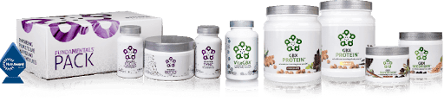
These results demonstrate
the close relationship between
microbiome balance, systemic metabolism, and psychological parameters –
and the utility of targeted supplementation to optimize gut-brain-axis balance for both improved metabolism and enhanced mental wellness.
Conclusions

Slide 33

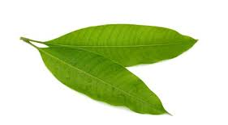
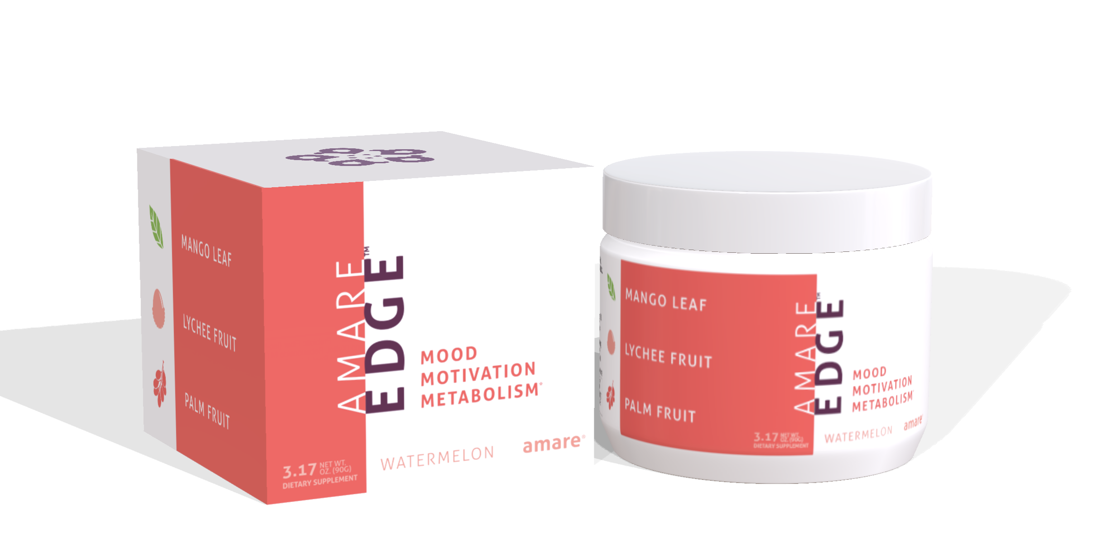
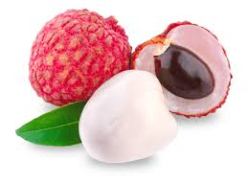
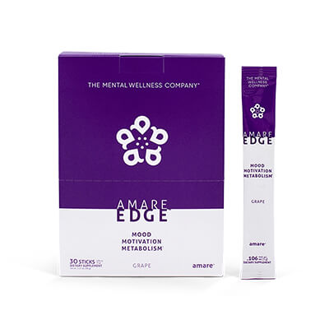
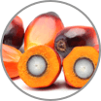
Edge
Motivation
Mango Leaf (Xanthones – inflammation)
Lychee Fruit (Polyphenols – glycation)
Palm Fruit (Flavonoids – oxidation)
Dozens of clinical studies on sports performance, cognitive performance, glucose balance…
THE MENTAL WELLNESS COMPANY®

Slide 34

2022 Finalist for “Best New Product” (over 1,100 entries)

Slide 38

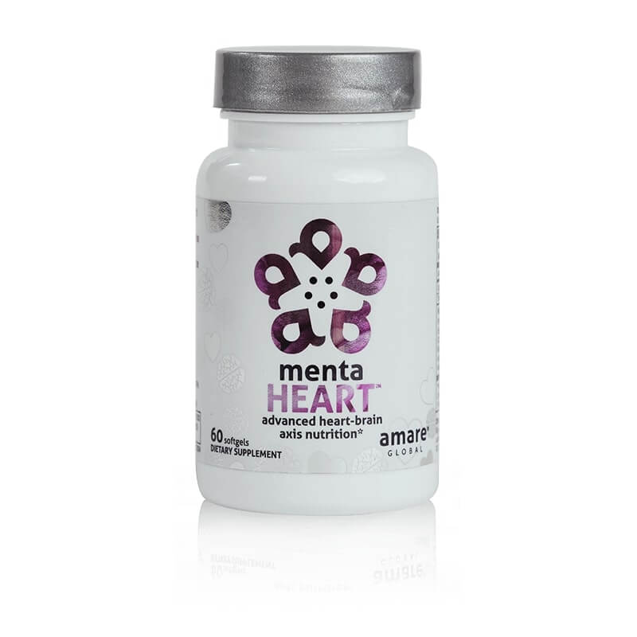
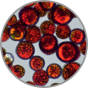


MentaHeart
Supports the Heart-Brain-Axis
“Heart Health” & part of Fundamentals Plus Pack
Physical Performance (Sports)
Cognitive Performance (Brain)
Mental Performance (Mood)
THE MENTAL WELLNESS COMPANY®

Slide 39
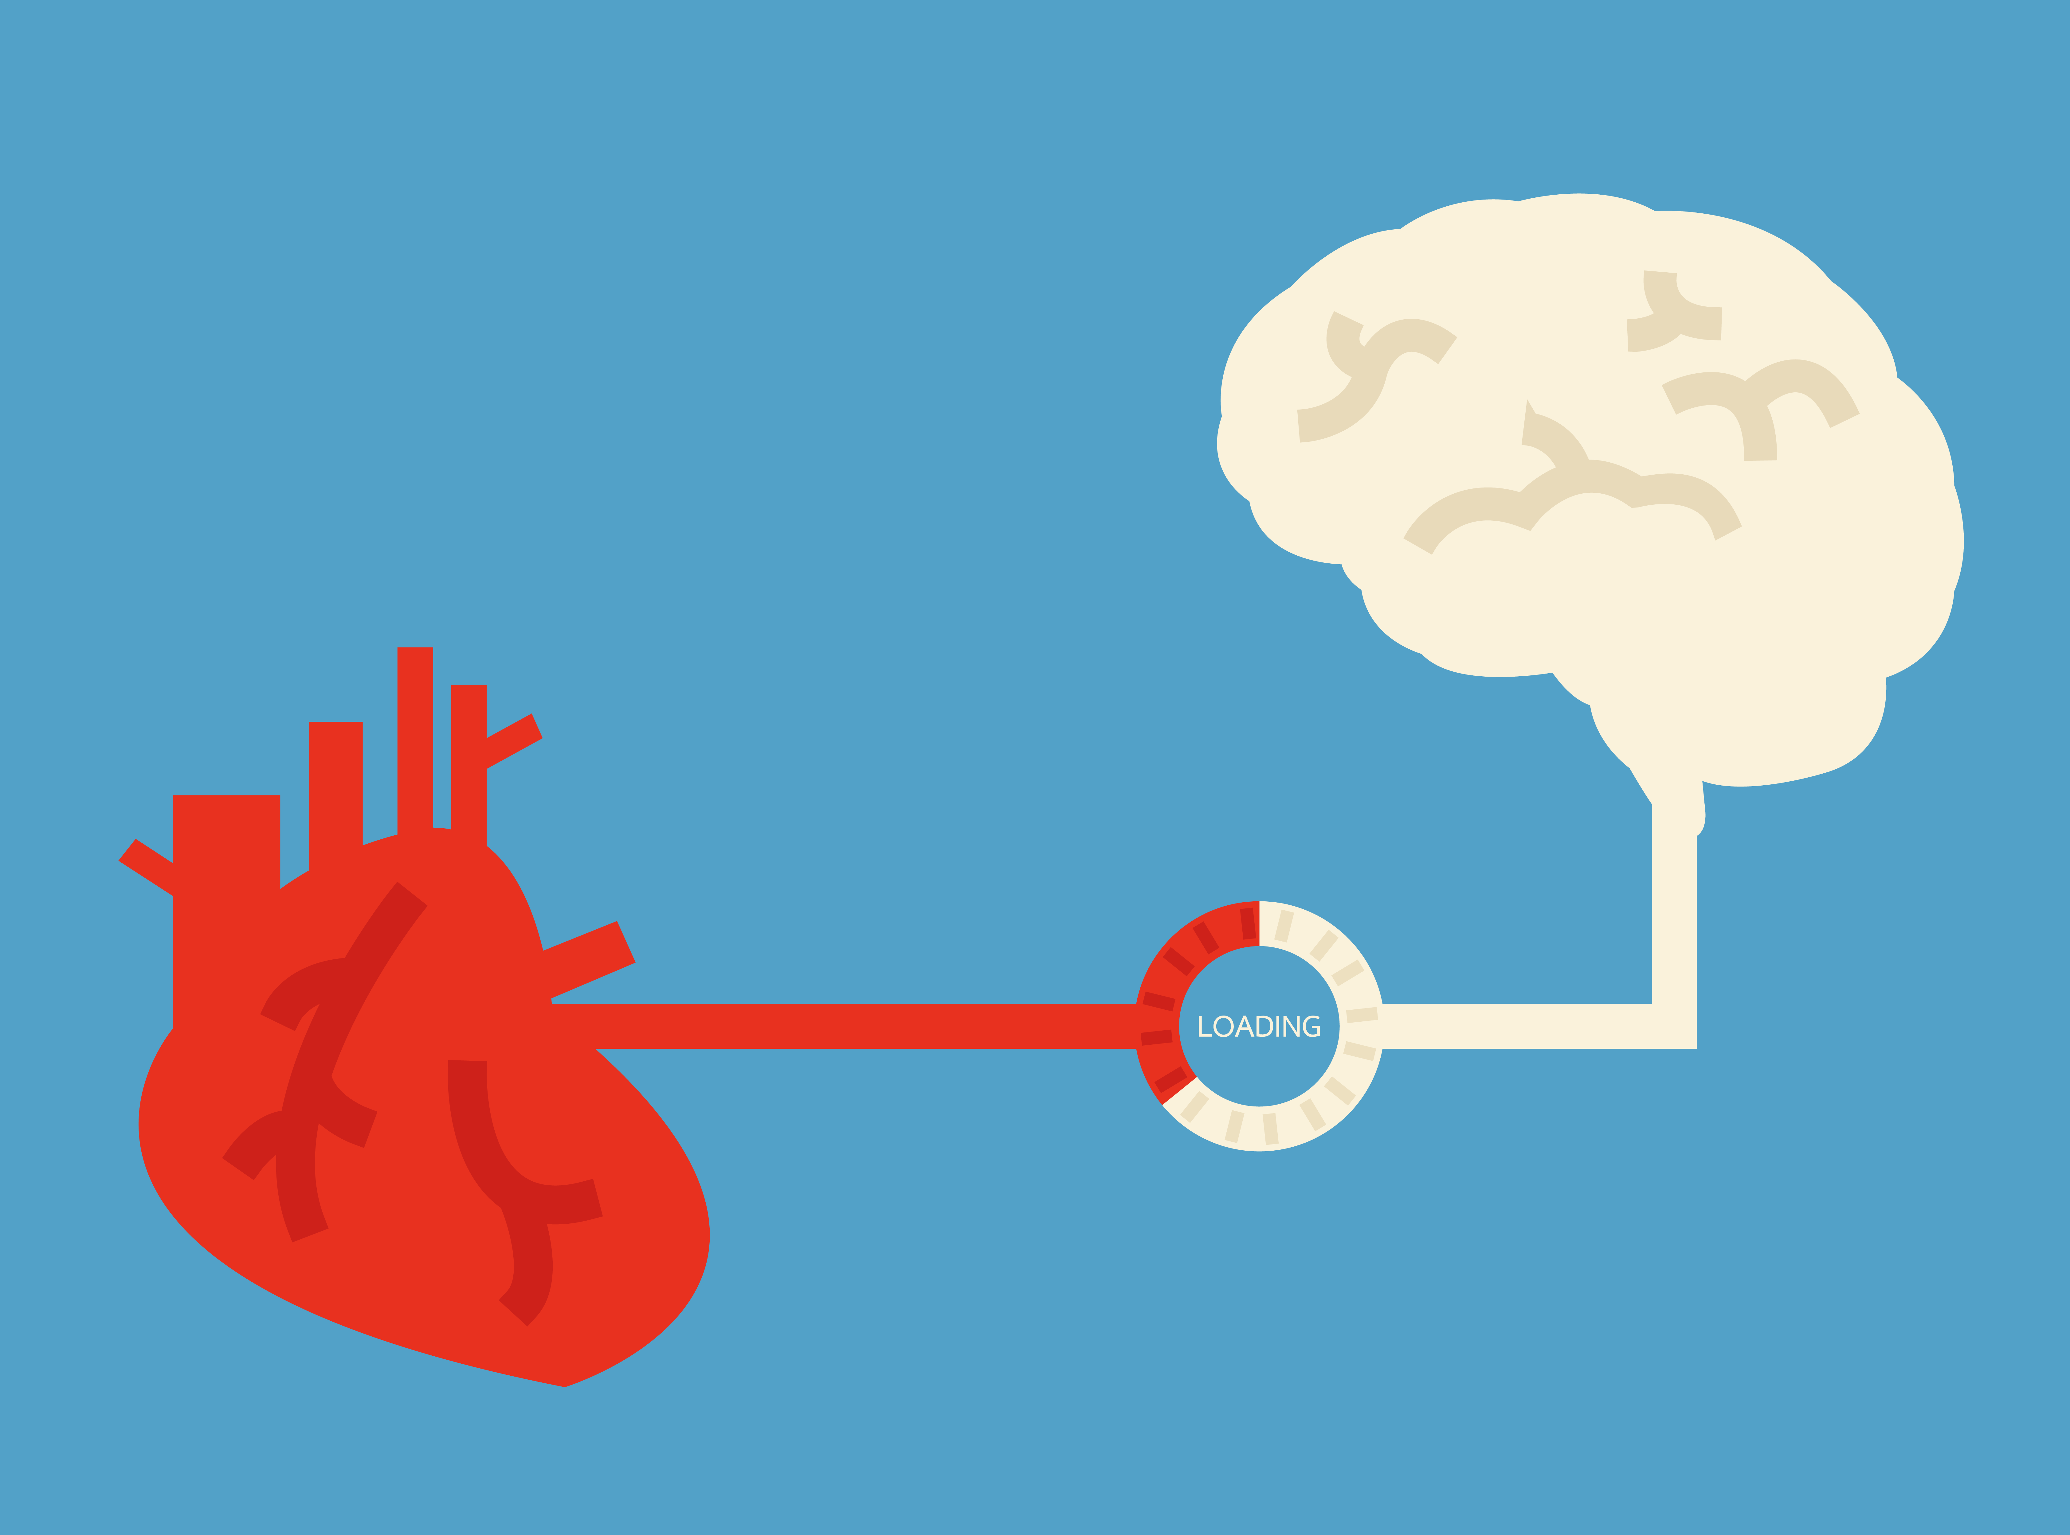
DEPRESSED
PATIENTS =
higher risk
for heart attack
HEART ATTACK PATIENTS =
higher risk
for depression

Slide 40
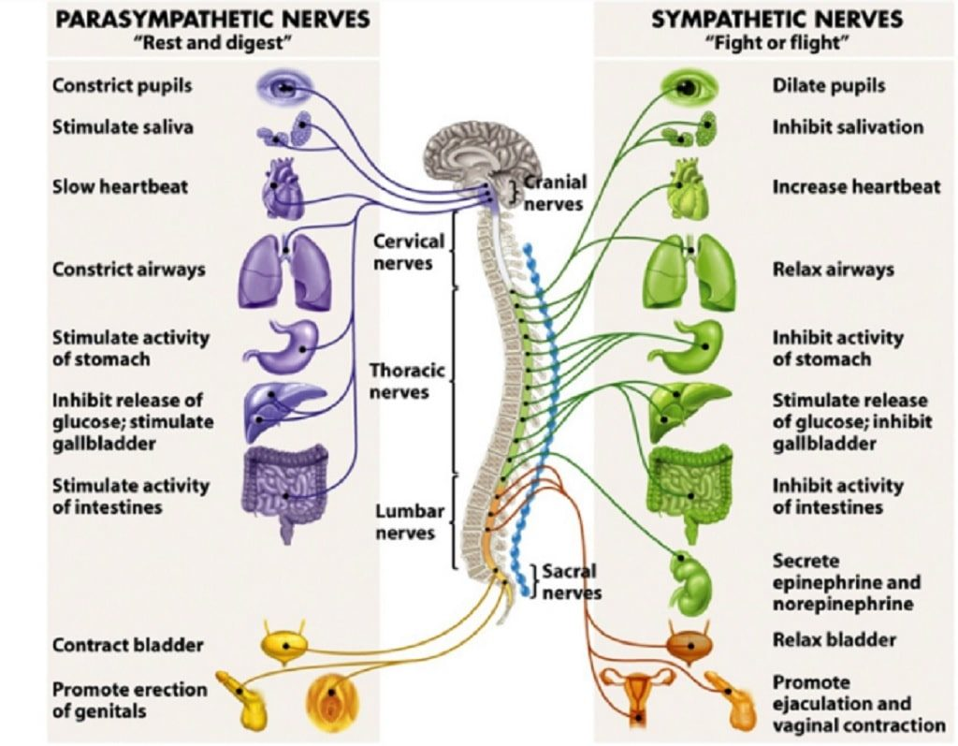

Slide 41
May 26-30. San Francisco, California USA

Slide 42

Optimization
of Heart-Brain-Axis Signaling Improves Mental and Physical Performance
Courtney Talbott¹,
Lindsey Faucette DO²,
and Shawn Talbott PhD³
¹California Polytechnic University, Dept of Food Science and Nutrition
²California Health Sciences University College of Osteopathic Medicine
³Amare Global

Slide 43

RESULTS:
Following 30-days of supplementation,
HRV was improved 11% (SDNN; 47.5msec Pre versus 58.2msec Post) and 19% (RMSSD 3.7 Pre versus 4.4 Post), indicating superior ANS tone and enhanced stress resilience.
Psychological Mood State (POMS) parameters showed dramatic improvements following supplementation,
with reductions in negative mood states:
Tension (-49%)
Depression (-76%)
Anger (-39%)
Fatigue (-51%)
and Confusion (-62%)
with corresponding increases in positive mood states; Global Mood (+23%) and Vigor (+22%).

Slide 44
MentaHeart Clinical Pilot Study
HRV / SDNN (msec)
HRV / RMSSD
+11%
+19%
SDNN = standard deviation of N-N intervals
RMSSD – root mean square of successive differences

Slide 45
MentaHeart Clinical Pilot Study
Global Mood State
POMS Sub-Scales
+23%
+22%
-49%
-39%
-51%
-76%
-62%
SDNN = standard deviation of N-N intervals
RMSSD – root mean square of successive differences

Slide 46

CONCLUSIONS:
Supplementation resulted in a meaningful
11-19% increase in HRV
(suggesting a “physical” heart benefit)
and also improved mood state parameters
(suggesting a “mental” brain benefit).
While previous studies have shown individual ingredients
to improve general heart/brain health, these data are the first to show that targeted multi-nutrient supplementation supports the multi-faceted psychophysiological
“Heart-Brain-Axis” with simultaneous and coordinated
IMPROVEMENTS IN BOTH PHYSICAL
AND MENTAL PERFORMANCE.

Slide 47

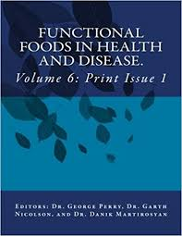
Heart-Brain Axis
Functional Foods in Health & Disease Journal
Vol 9, No 8 (Aug 2019)
“Physical” heart benefits and “Mental” brain benefits are related via the psychophysiological “heart-brain-axis” with simultaneous improvements in both physical and mental wellness.
Our studies have shown targeted supplementation to improve parameters associated with heart health
(antioxidant, fat oxidation, endurance)
and brain health (neuro-inflammation, cognition, antidepressant/anxiolytic) —
with further previously-undescribed
benefits for psychological mood state
(depression, fatigue, vigor).

Slide 48

Heart-Brain Axis
“Physical” heart benefits and “Mental” brain benefits are related
via the psychophysiological “heart-brain-axis” with simultaneous improvements in both physical and mental wellness.
Our studies have shown targeted supplementation to improve parameters associated with heart health (antioxidant, fat oxidation, endurance) and brain health (neuro-inflammation, cognition, antidepressant/anxiolytic) — with further previously-undescribed benefits for psychological mood state (depression, fatigue, vigor).

Slide 49


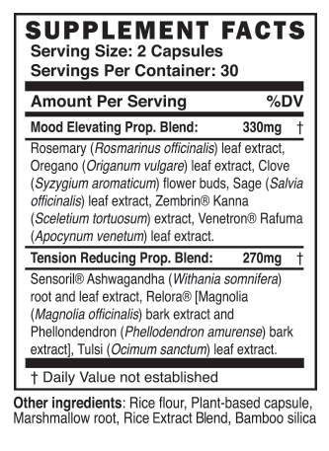
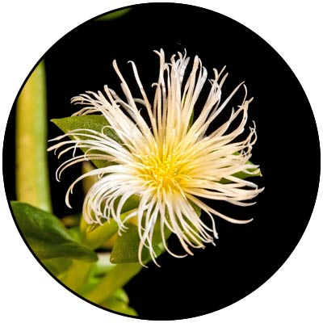
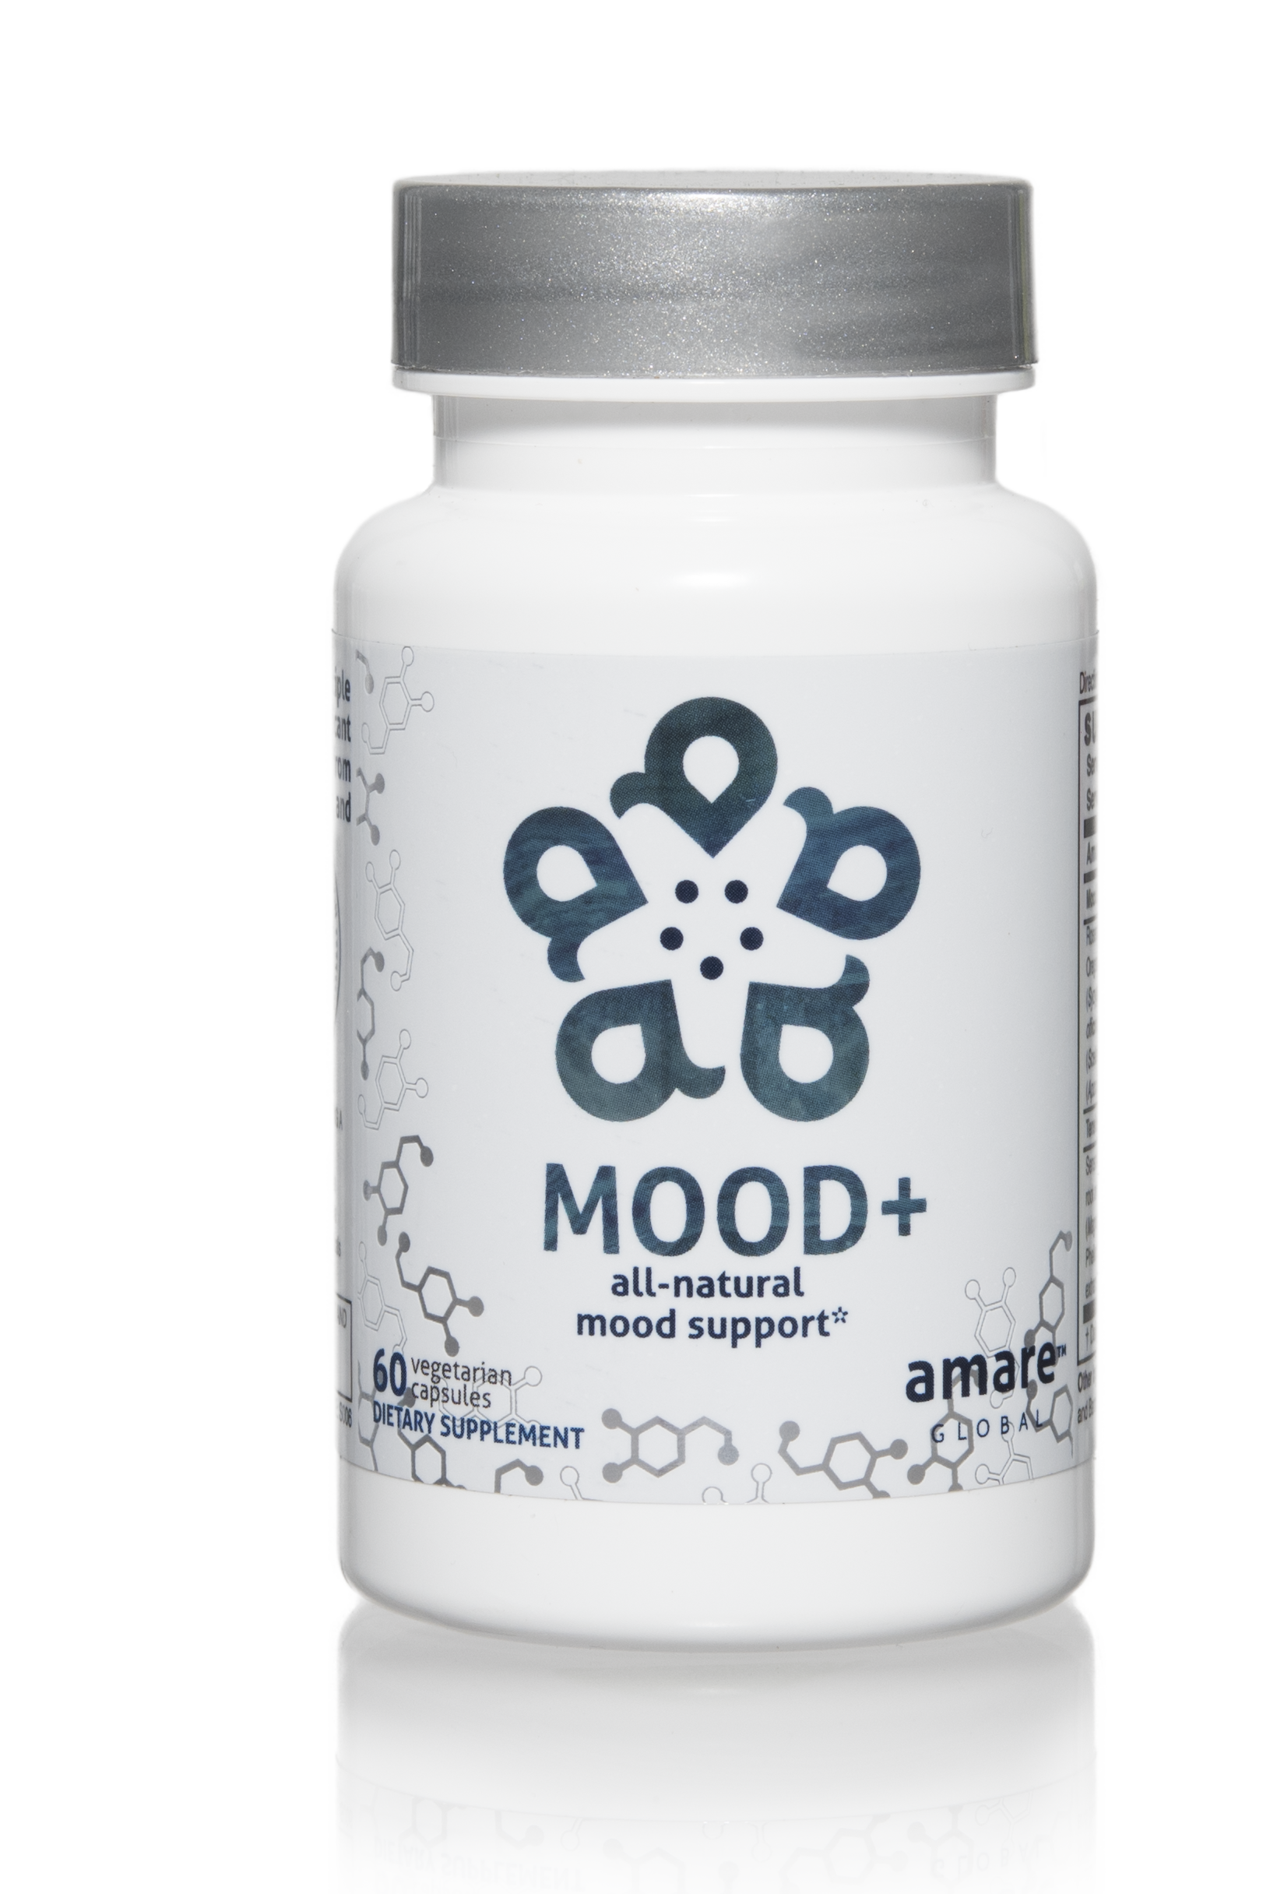
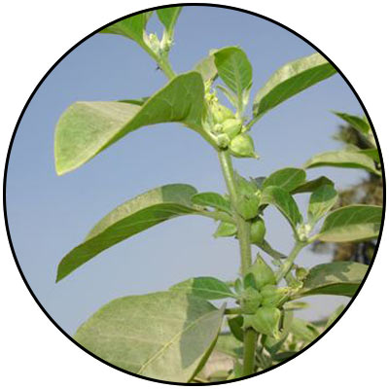
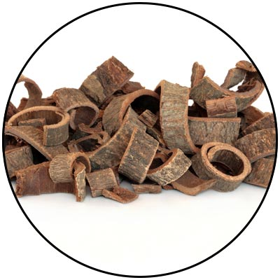
Mood+
Comprehensive Herbal Mood-Support
Phased Benefits (fast acting / long lasting)
Kanna (Zembrin) – Resilience
Rafuma (Venetron) – Mood
Ashwagandha (Sensoril) – Stress
Magnolia Bark (Relora) – Tension
THE MENTAL WELLNESS COMPANY®

Slide 50
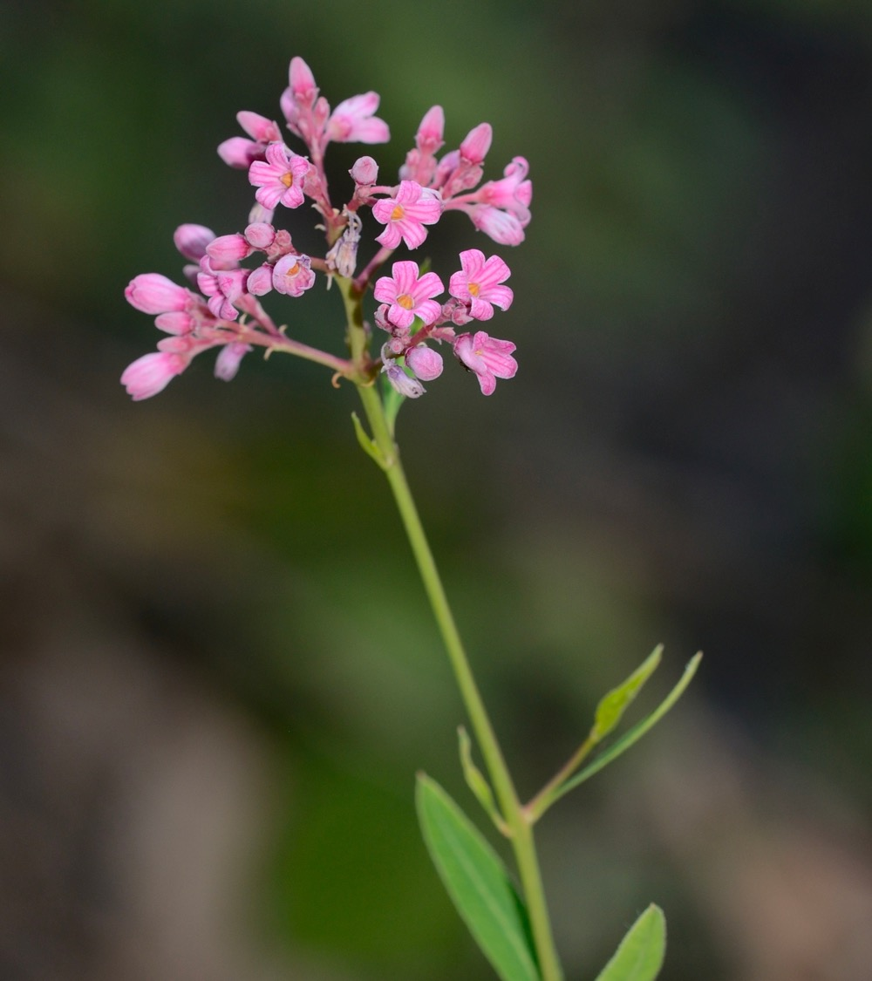
Venetron®
(Rafuma)
Mood
*These statements have not been evaluated by the Food and Drug Administration.
This product is not intended to diagnose, treat, cure, or prevent any disease.

Slide 51
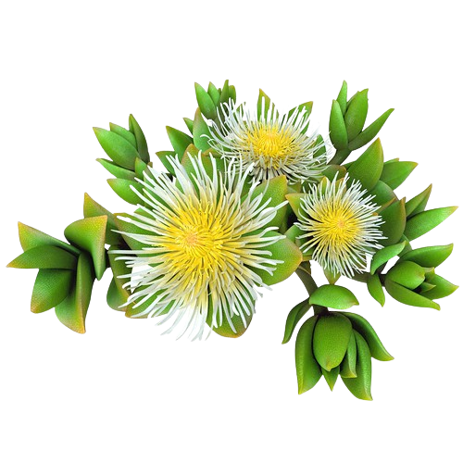
®
Zembrin
Resilience
(Kanna - Sceletium tortuosum)
®
*These statements have not been evaluated by the Food and Drug Administration.
This product is not intended to diagnose, treat, cure, or prevent any disease.

Slide 52

Zembrin
®
FMRI STUDY RESULTS SHOW REDUCED STRESS RESPONSE
can help in the management of stress in everyday life
A single dose of Zembrin® attenuates reactivity within the part of the brain (amygdala) that responds to threat/stress
*These statements have not been evaluated by the Food and Drug Administration.
This product is not intended to diagnose, treat, cure, or prevent any disease.
Notes:
Terburg et al. Acute Effects of Sceletium tortuosum (Zembrin), a Dual
5-HT Reuptake and PDE4 Inhibitor, in the Human Amygdala and its Connection to the Hypothalamus. Neuropsychopharmacology (2013), 1–9.

Slide 53
Cognitive Flexibility =
“Resilience”
60.2*
Ability to shift attention between two or more tasks and the ability to adapt to rapidly changing directions and intelligently utilize the information.
Necessary for decision-making,
impulse control and strategy formation.
CNS VitalSign® has been used for testing neurocognitive function by over 5,000 clinicians in 52 countries.
49.7
Mean percentiles
35.4
®
Baseline
Zembrin
Placebo
3 weeks
*These statements have not been evaluated by the Food and Drug Administration.
This product is not intended to diagnose, treat, cure, or prevent any disease.
*p < 0.022 vs placebo
Notes:
Chiu et al. Proof-of-Concept Randomized Controlled Study of Cognition Effects of the Proprietary Extract Sceletium tortuosum (Zembrin) Targeting Phosphodiesterase-4 in Cognitively Healthy Subjects: Implications for Alzheimer’s Dementia. Evidence-Based Complementary and Alternative Medicine Volume 2014, Article ID 682014

Slide 54
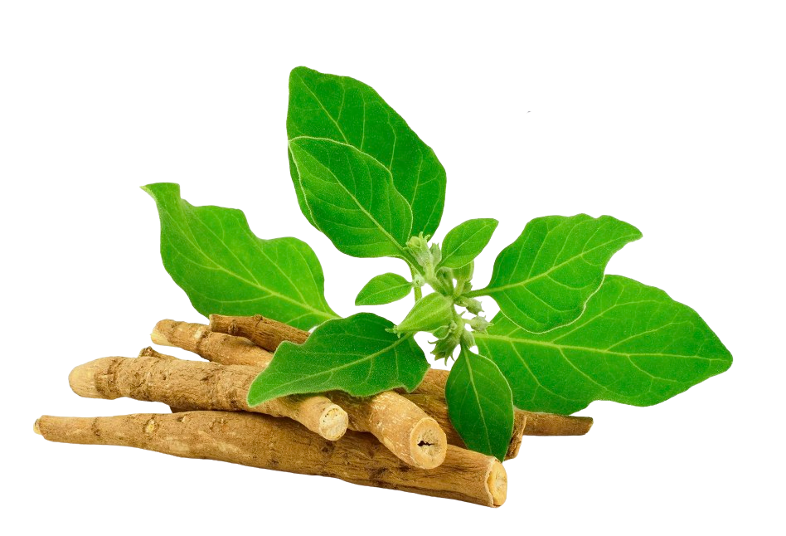
Sensoril®
(Ashwagandha)
Stress
Notes:
Auddy et al. A Standardized Withania Somnifera Extract Significantly Reduces Stress-Related Parameters in Chronically Stressed Humans: A Double-Blind, Randomized, Placebo-Controlled Study. Journal of the American Nutraceutical Association Vol.11,No.1, 2008 pp50-56.

Slide 55
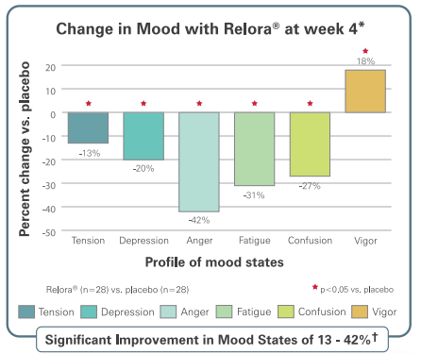
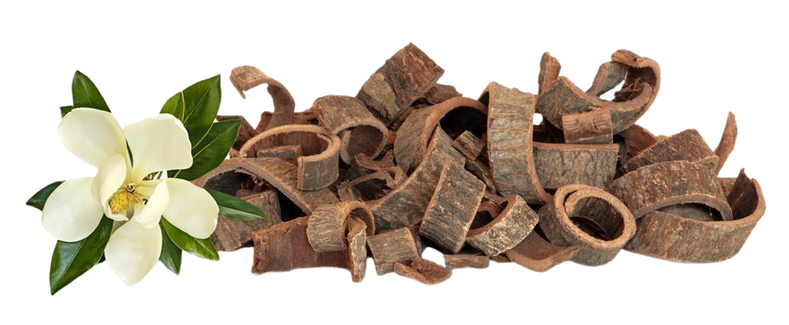
Relora®
(Magnolia & Phellodendron)
Tension
*These statements have not been evaluated by the Food and Drug Administration.
This product is not intended to diagnose, treat, cure, or prevent any disease.
Notes:
Talbott et al. Effect of Magnolia officinalis and Phellodendron amurense (Relora®) on cortisol and psychological mood state in moderately stressed subjects. Journal of the International Society of Sports Nutrition 2013, 10:37
Garrison et al. Effect of a proprietary Magnolia and Phellodendron extract on weight management: a pilot, double-blind, placebo-controlled clinical trial. Altern Ther Health Med. 2006;12(1):50-54.
Kalman et al. Effect of a proprietary Magnolia and Phellodendron extract on stress levels in healthy women: a pilot, double-blind, placebo-controlled clinical trial. Nutrition Journal 2008, 7:11

Slide 56
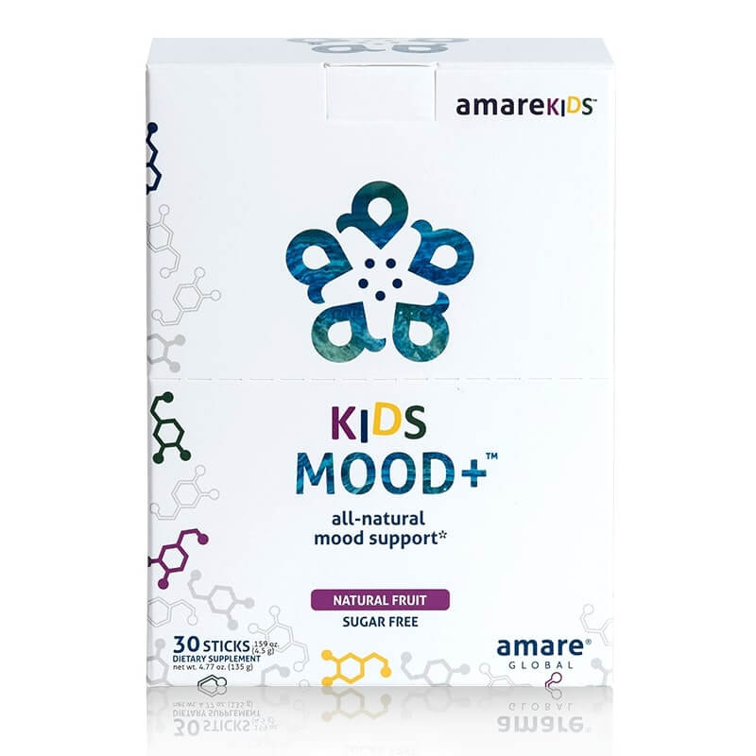
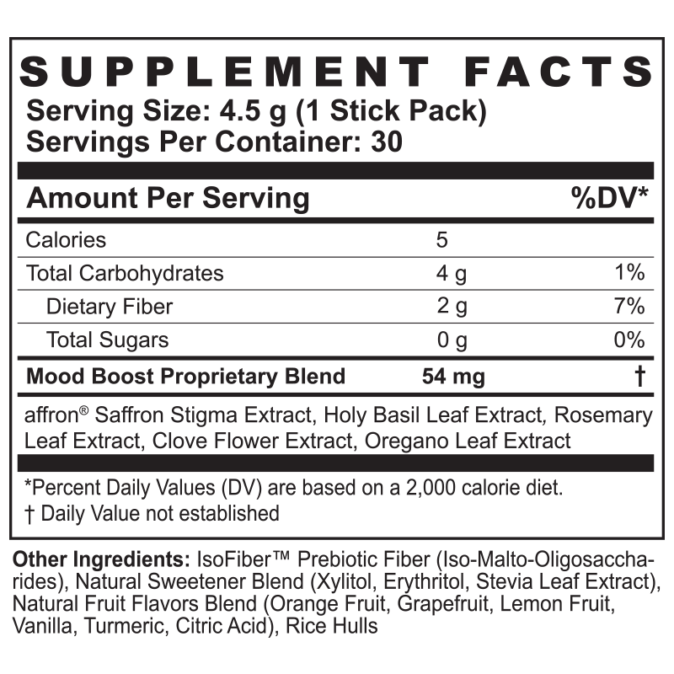
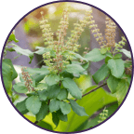
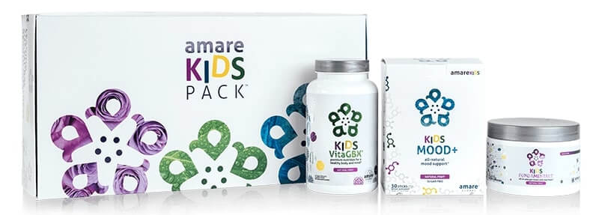
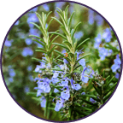

Kids Mood+
Not “just kids” – and not “just mood”
Helps normalize serotonin and dopamine activity — the “feel good” neurotransmitters
Balances stress hormones (cortisol)
Supports Resilience
Improves Focus, Attention, Mood, Listening, Tension, Irritation
Holy Basil
THE MENTAL WELLNESS COMPANY®
Rosemary
Saffron

Slide 57


Slide 58

10/10
KIDS SAW IMPROVEMENTS
IN FOCUS, MOOD
AND MENTAL PERFORMANCE
Proprietary Blend (54 mg):
Affron®
standardized Saffron
(Crocus sativus L.) Stigma extract
Tulsi Holy Basil
(Ocimum sanctum) Leaf extract
Rosemary
(Rosmarinus officinalis) Leaf extract
Oregano
(Origanum vulgare)
Leaf extract Clove
(Syzygium aromaticum)
Flower extract
Delivery Base:
IsoFiberTM
Prebiotic Fiber
(iso-malto-oligosaccharides)
Natural Sweetener Blend
(Xylitol, Erythritol, Stevia Leaf extract)
Natural Fruit Flavors Blend
(orange fruit, grapefruit, lemon fruit,
vanilla, turmeric, citric acid)
Plant Cellulose
(to improve dissolution)
Rice Hull Concentrate
(to reduce clumping)
Notes:
Please add image of Kids Mood+ on right section

Slide 59
Experimental Biology
Applied Physiology Society
April 2020

Slide 60
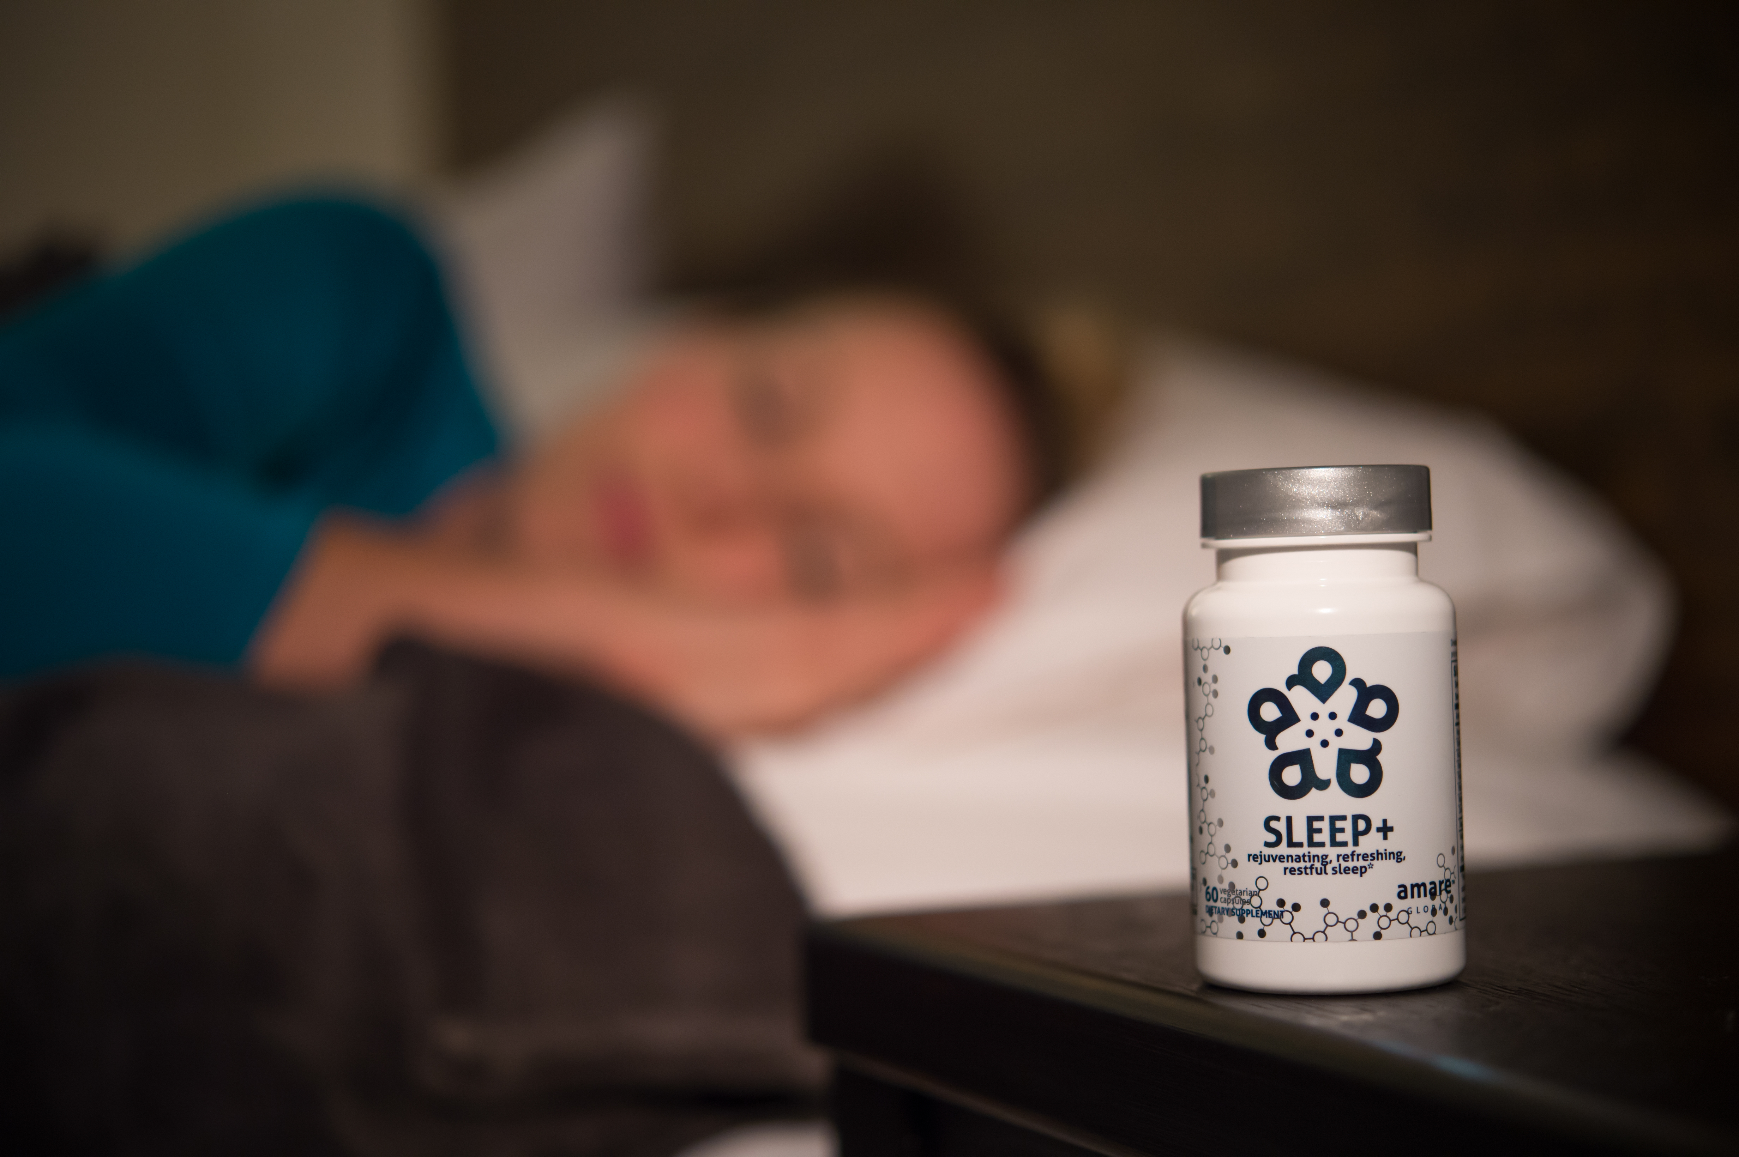
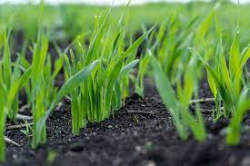
Sleep+
Non-Melatonin Sleep Enhancer
Corn Grass (non-GMO)
High in 6-MBOA
Make your own Serotonin (mood)
Make your own Melatonin (sleep)
Fall asleep faster (33%)
Wake up fewer times per night (30%)
50% improvement in Sleep Efficiency
40% Improvement in Sleep Quality
THE MENTAL WELLNESS COMPANY®

Slide 61
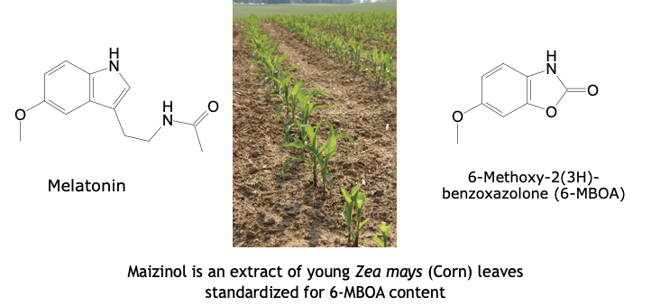

Slide 62
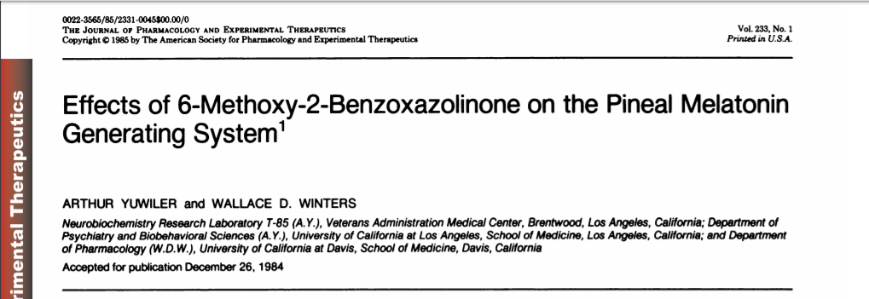

Slide 63
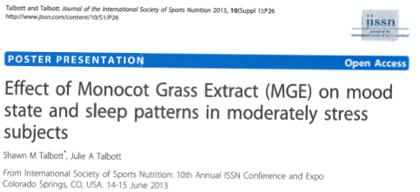

Slide 64
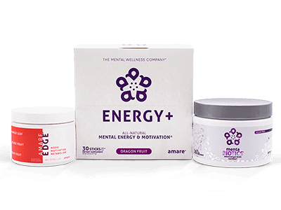
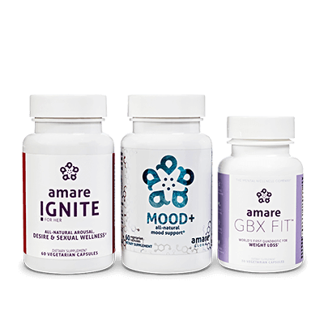
Packs
Where to Start for Best Experience?
Fundamentals – if you need to “support” something
Comprehensive GBX support (microbiome, gut integrity, immune/inflammatory balance, focus/memory)
Happy Juice – if you just want to “feel better”
Move from languishing/burnout to flourishing/vigor
Happy Hormones – if you want to “dial in” your performance
Ignite: Sex hormones (estrogen, progesterone, testosterone)
Mood+: Stress/Mood hormones/neurotransmitters (cortisol, serotonin, dopamine)
GBX Fit: Metabolic hormones (insulin/glucose, thyroid, GLP-1, SCFAs)

Slide 65
Thank You!

