Slide 1
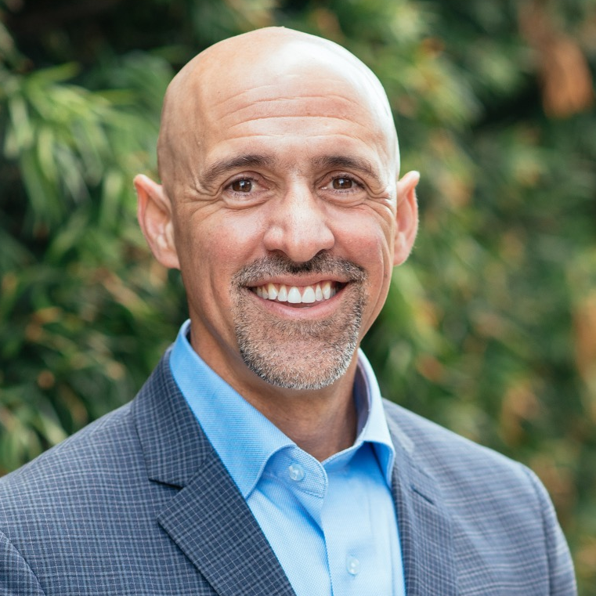
Science Social Hour "Want to lose weight? Get your microbiome in shape!"
More Info?
ShawnTalbott.com (blog)
YouTube = https://www.youtube.com/drshawntalbott
Instagram = DocTalbott
Questions?
https://link.anyquestion.com/DocTalbott
Dr. Shawn Talbott
Chief Science Officer
PHD, CNS, LDN, FACSM, FAIS, FACN

Slide 2
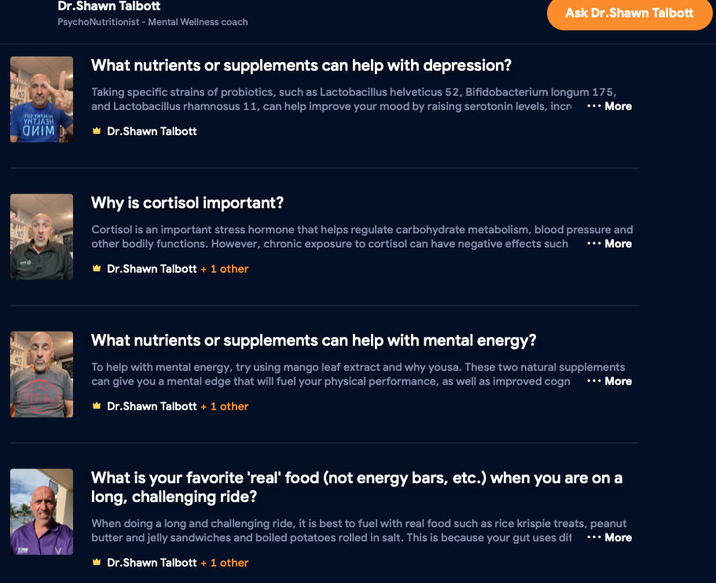

Slide 3

Where do SUPPLEMENTS FIT?
Supplements
Exercise
Nutrition
Sleep
Evaluation
?
Motivation and energy to exercise?
Appetite and craving modulation?
Relaxation and recovery?

Slide 4


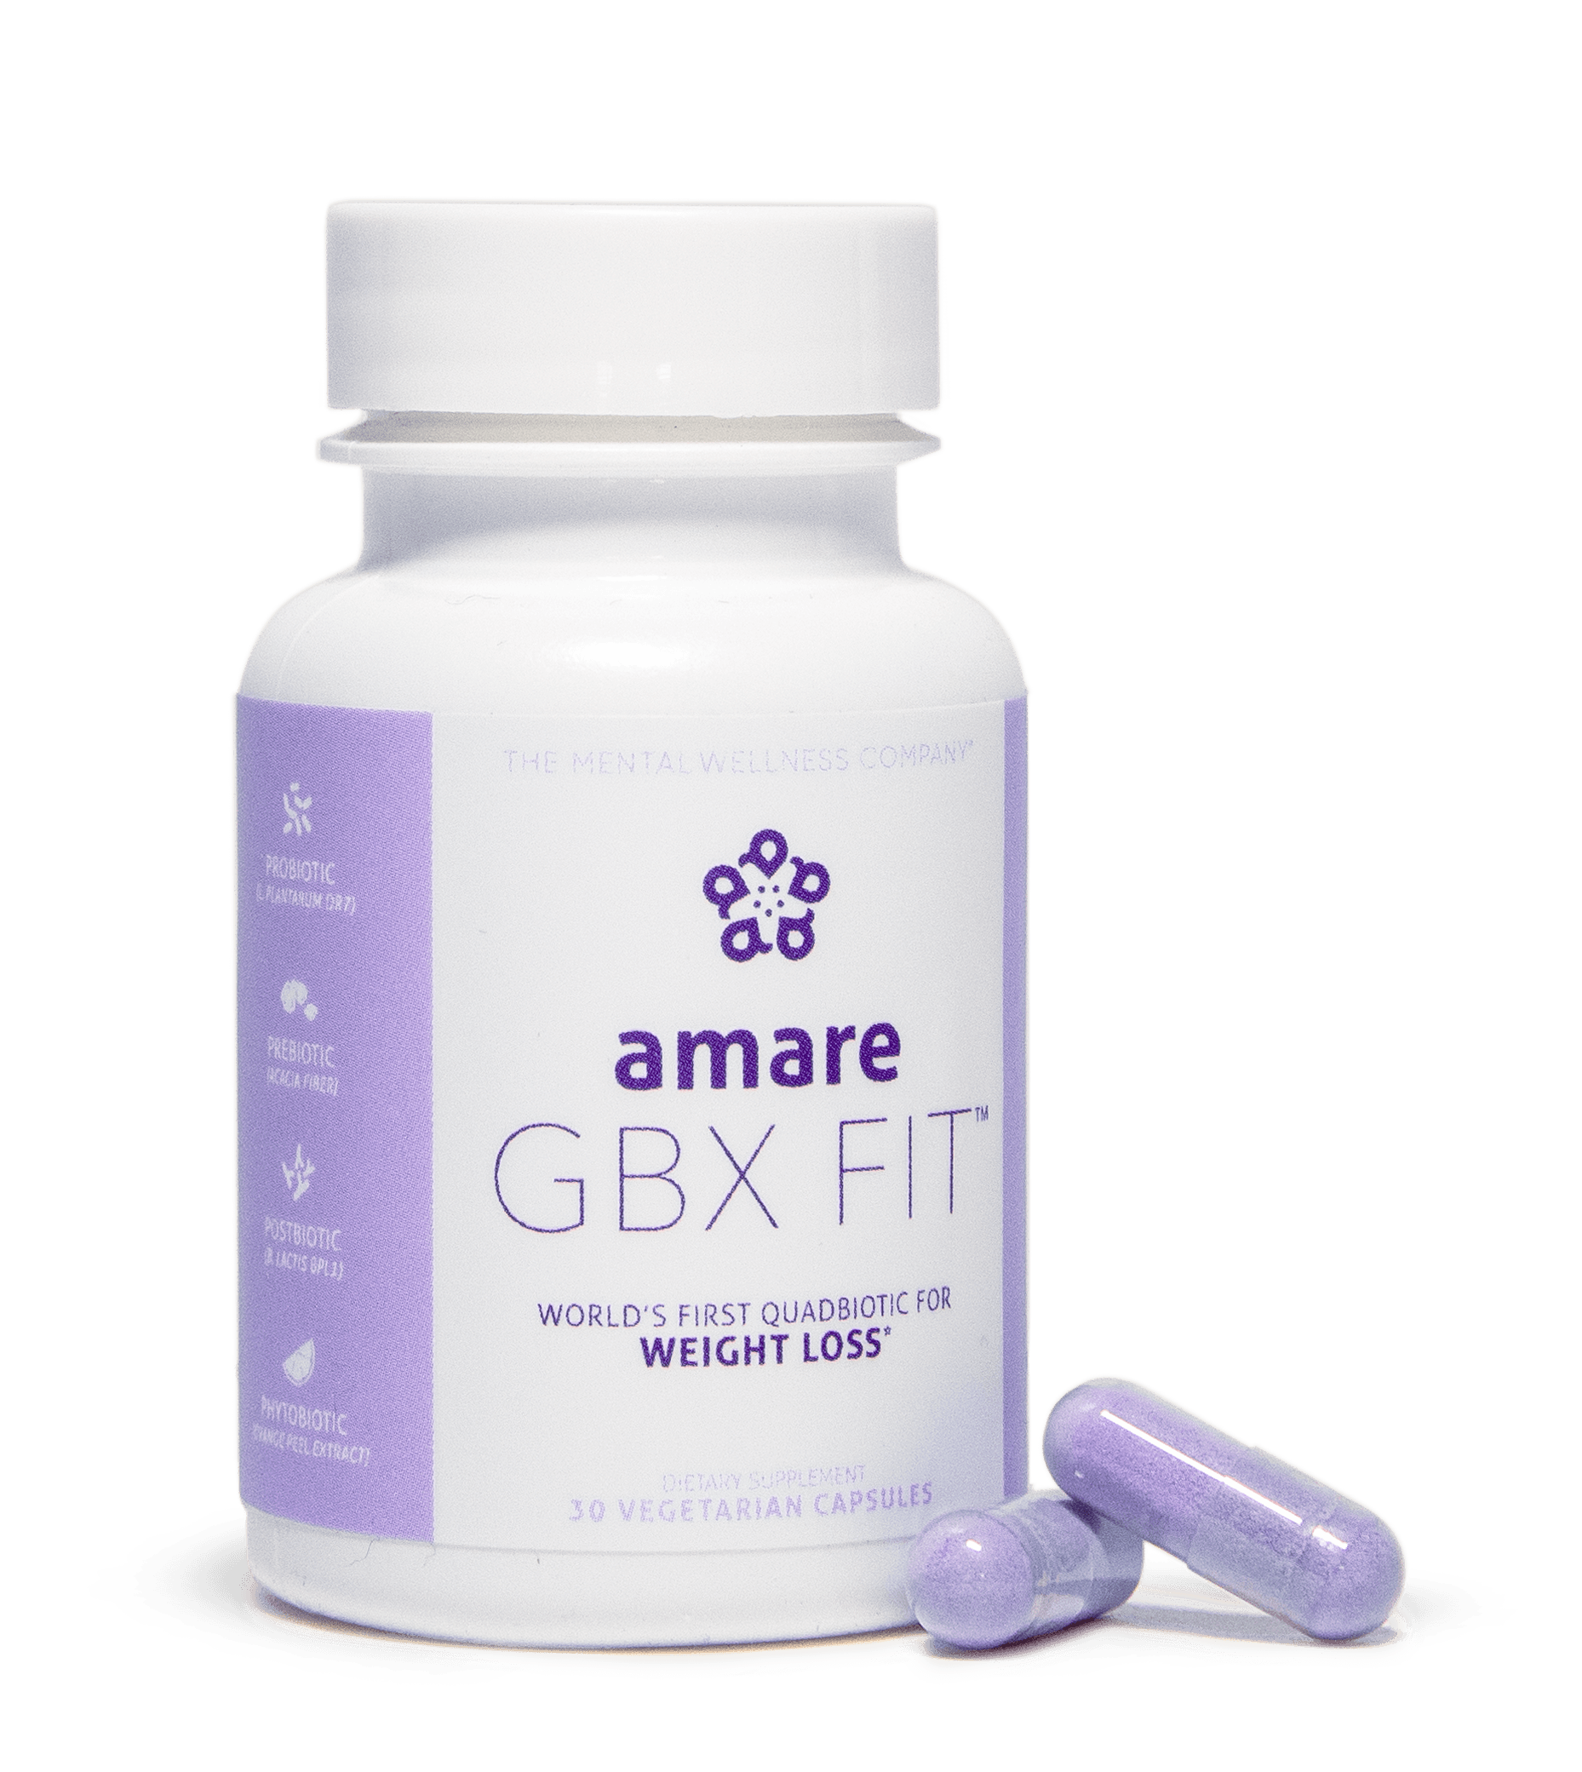

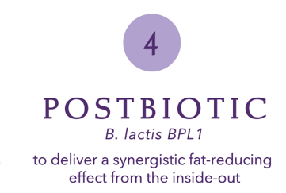
World’s First “QUADbiotic”
GBX Fit
controls appetite and supports fat release
(increases fat loss*)
“Take it Off”

Slide 5
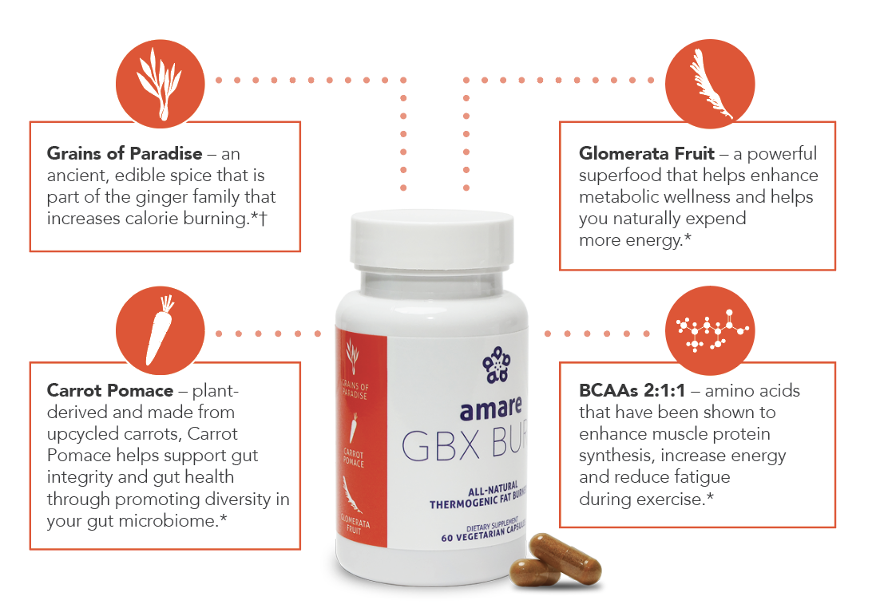
All-Natural Thermogenic
GBX Burn
Thermogenic fat burner*
“Keep it Off”
*These statements have not been evaluated by the Food and Drug Administration. This product is not intended to diagnose, treat, cure or prevent any disease.
†Individual weight loss results may vary. It's possible for individuals to lose 1-2 pounds a week using Amare products and following the Amare Fit Program. However, there is no guarantee of specific weight loss results.

Slide 6
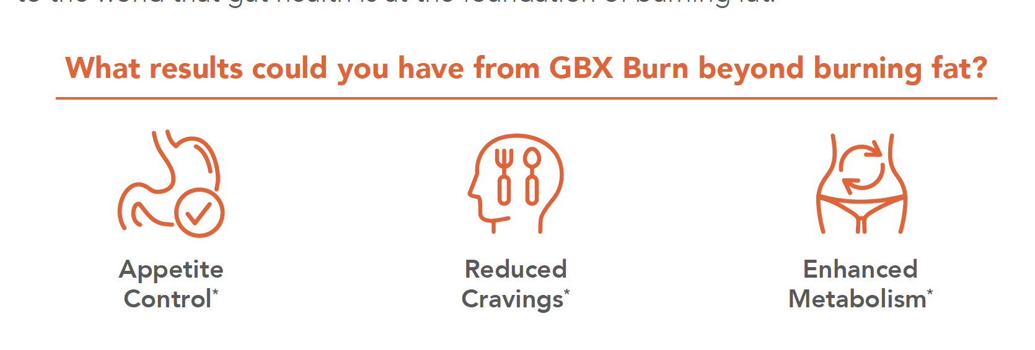
Amare GBX Burn™
Appetite control
(non-stimulant)
Gut Integrity
Muscle Maintenance
Fat “Burn”
(before storage)
*These statements have not been evaluated by the Food and Drug Administration. This product is not intended to diagnose, treat, cure or prevent any disease.
†Individual weight loss results may vary. It's possible for individuals to lose 1-2 pounds a week using Amare products and following the Amare Fit Program. However, there is no guarantee of specific weight loss results.

Slide 7
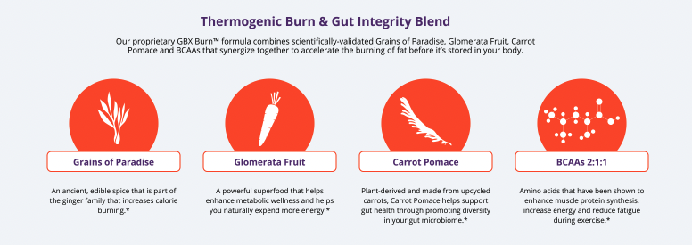
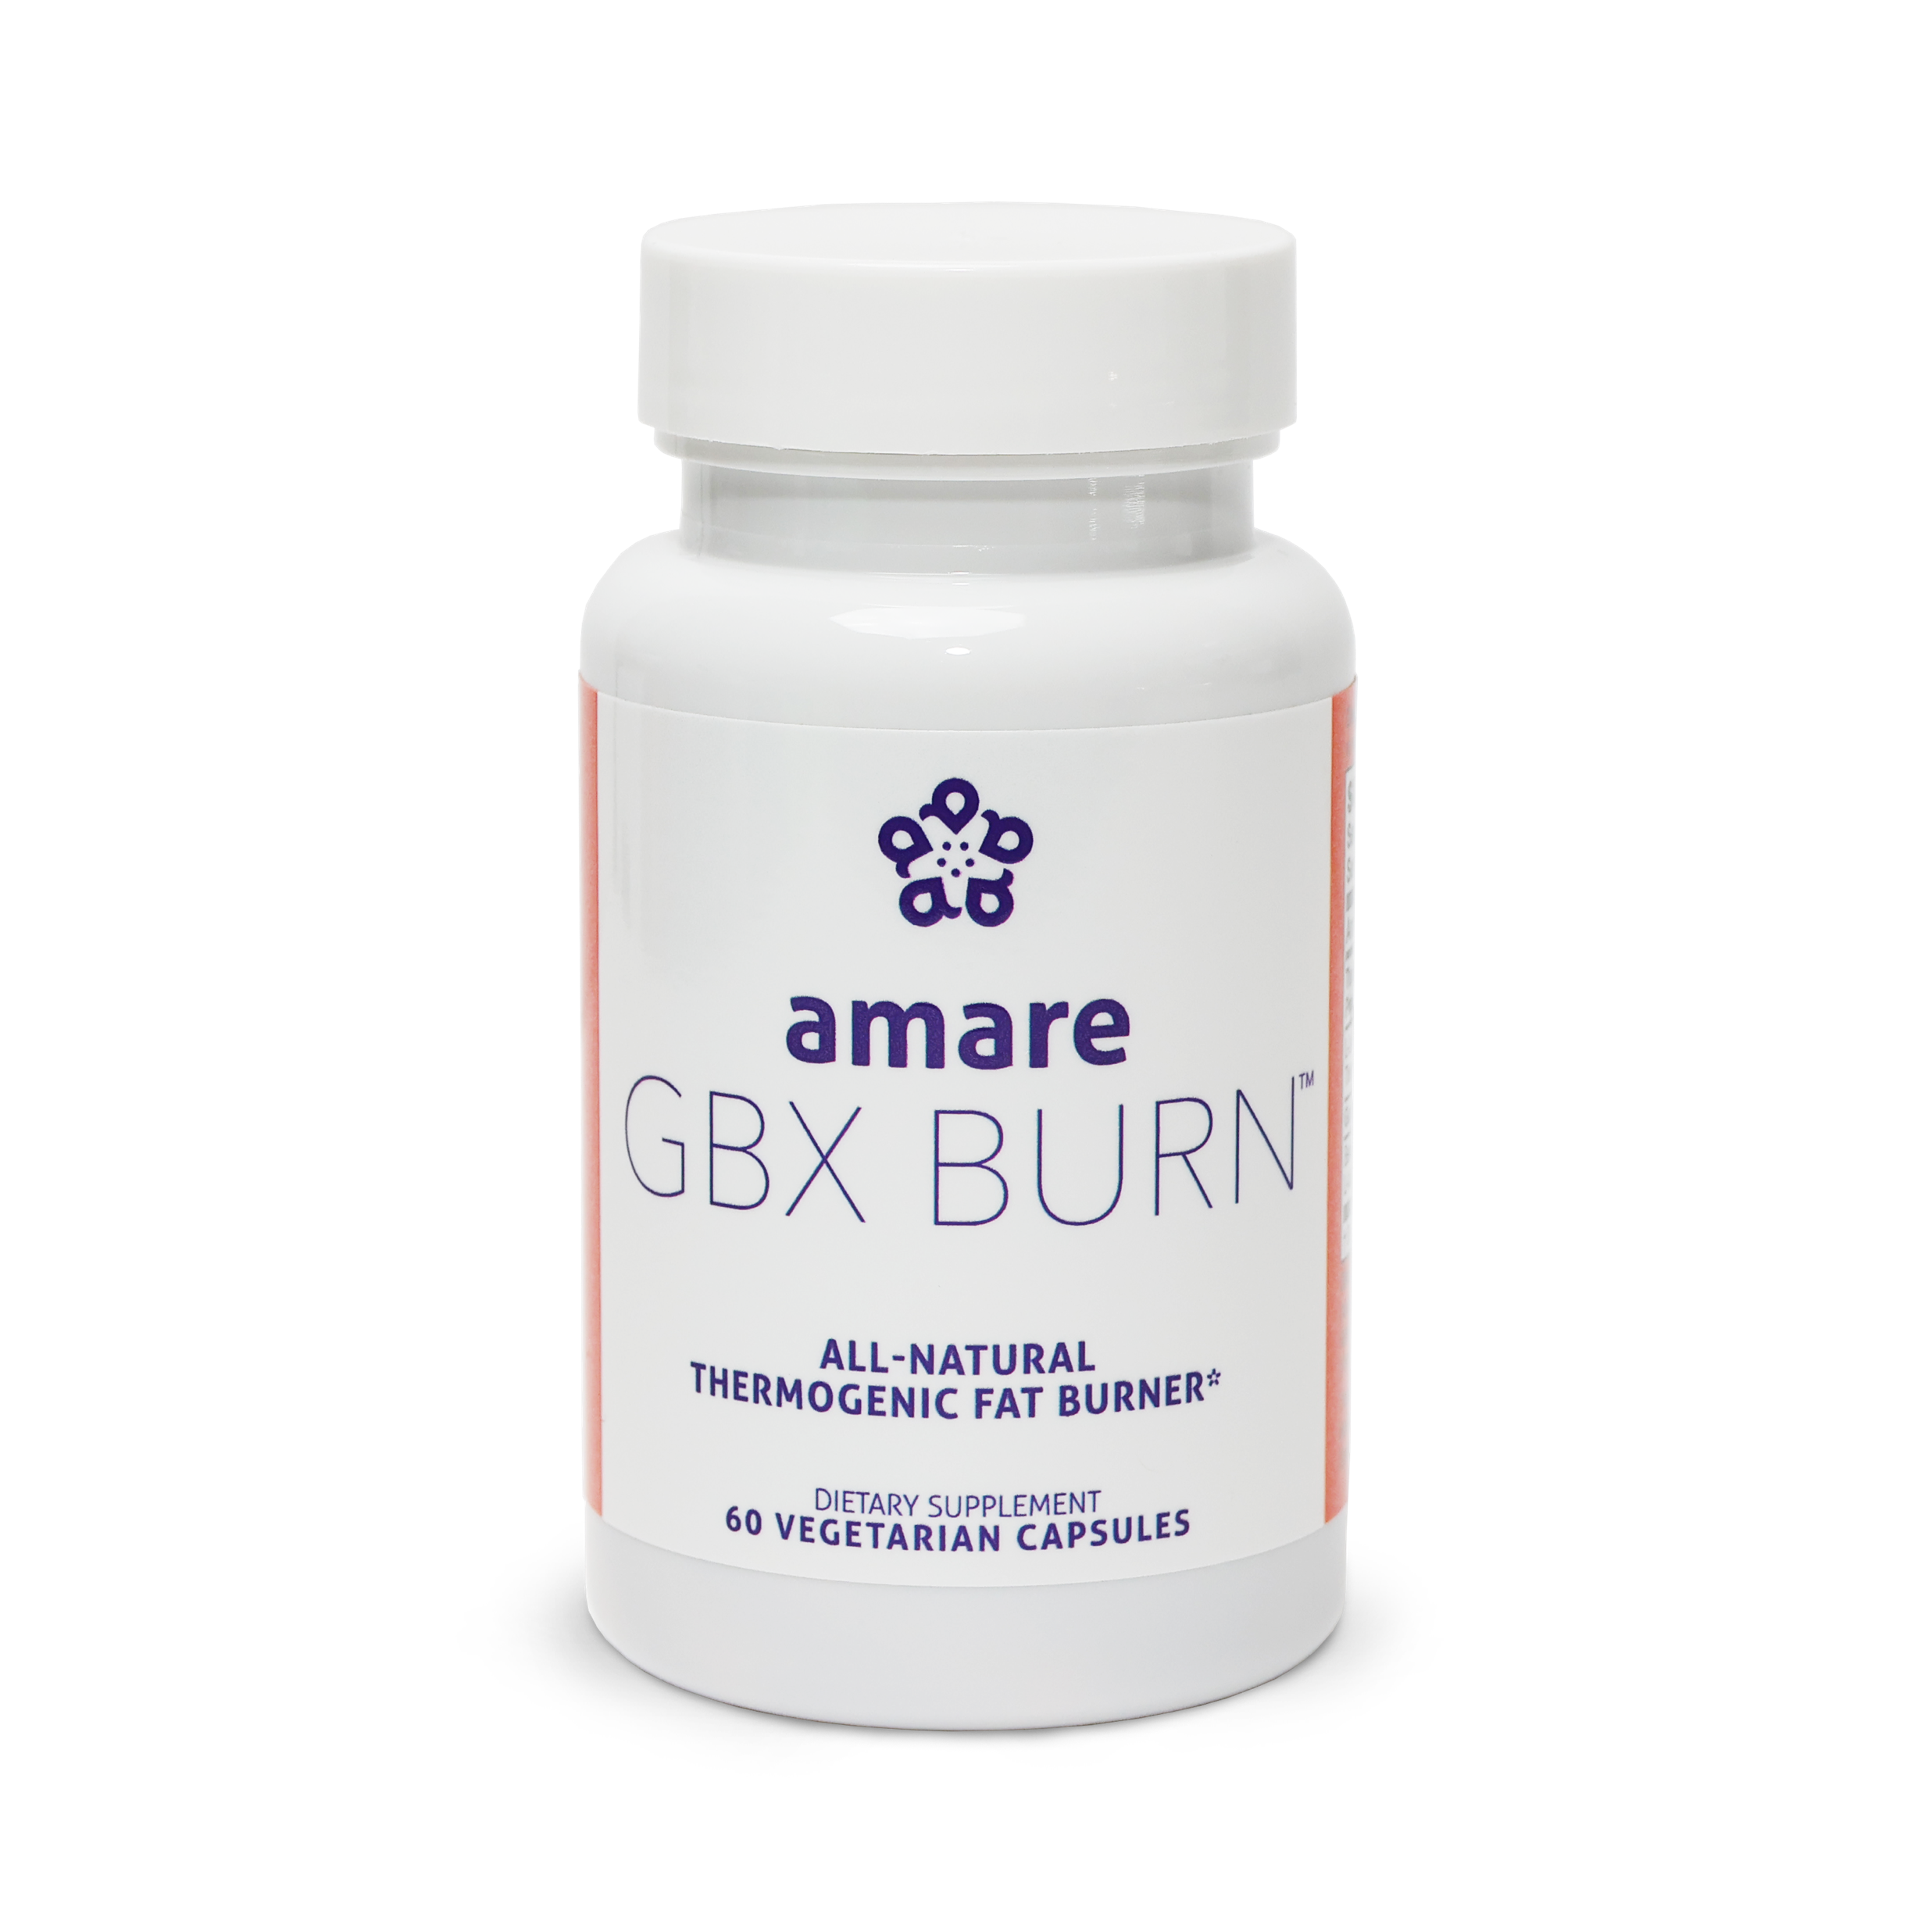
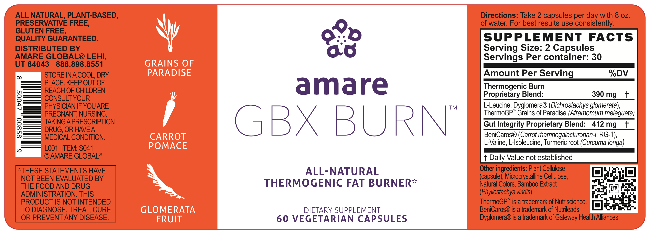
*These statements have not been evaluated by the Food and Drug Administration. This product is not intended to diagnose, treat, cure or prevent any disease.
†Individual weight loss results may vary. It's possible for individuals to lose 1-2 pounds a week using Amare products and following the Amare Fit Program. However, there is no guarantee of specific weight loss results.

Slide 8
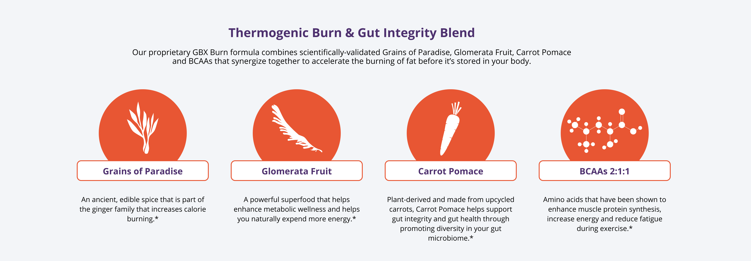
*These statements have not been evaluated by the Food and Drug Administration. This product is not intended to diagnose, treat, cure or prevent any disease.
†Individual weight loss results may vary. It's possible for individuals to lose 1-2 pounds a week using Amare products and following the Amare Fit Program. However, there is no guarantee of specific weight loss results.

Slide 9
All-Natural Thermogenic
Improve
“Diet-Induced
Thermogenesis” (Burn)
GBX Burn
controls appetite and supports fat burning
(reduces fat gain*)
“Keep it Off”
Maintain Gut Integrity
and Muscle Integrity
*These statements have not been evaluated by the Food and Drug Administration. This product is not intended to diagnose, treat, cure or prevent any disease.
†Individual weight loss results may vary. It's possible for individuals to lose 1-2 pounds a week using Amare products and following the Amare Fit Program. However, there is no guarantee of specific weight loss results.

Slide 10
AMPK = AMP-activated protein kinase:
“master regulator” of cellular energy homeostasis
Activates BAT (brown adipose tissue)
Converts WAT (white) to Beige?
Improves glucose balance (fat burns in the flame of carbohydrate)
Induces autophagy (cellular cleanup)
Activates mitochondria (non-stimulant energy)
Enhances lipolysis & beta-oxidation (“fat-burning”)
Enhances total energy expenditure (“calorie-burning”)

Slide 11


Slide 12
How to activate BAT?
Cold Immersion/Exposure
Fasting
Targeted Nutrients
  Capsaicin (hot peppers)
  Cinnamon
  Creatine
  Glomerata
  Grains of Paradise

Slide 13
All-Natural Thermogenic
Improve
“Diet-Induced
Thermogenesis” (Burn)
GBX Burn
controls appetite and supports fat burning
(reduces fat gain*)
“Keep it Off”
Maintain Gut Integrity
and Muscle Integrity
*These statements have not been evaluated by the Food and Drug Administration. This product is not intended to diagnose, treat, cure or prevent any disease.
†Individual weight loss results may vary. It's possible for individuals to lose 1-2 pounds a week using Amare products and following the Amare Fit Program. However, there is no guarantee of specific weight loss results.

Slide 14
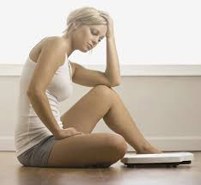
Leaky Gut Syndrome

Slide 15
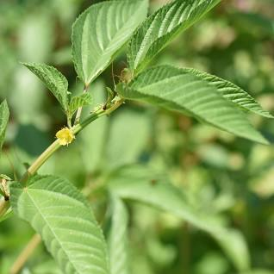

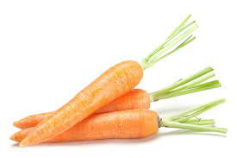

Slide 16
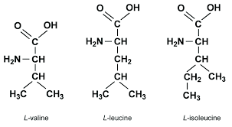

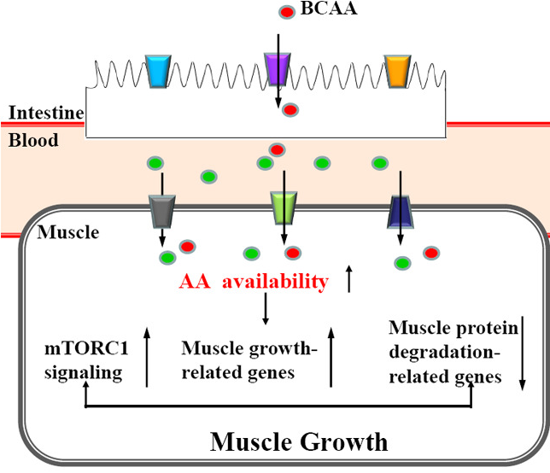
mTOR = mammalian target of rapamycin
“master regulator” of muscle protein synthesis
Activated by exercise
Activated by BCAAs
Inhibited by AMPK
Burn the Fat…
Keep the Muscle…

Slide 17
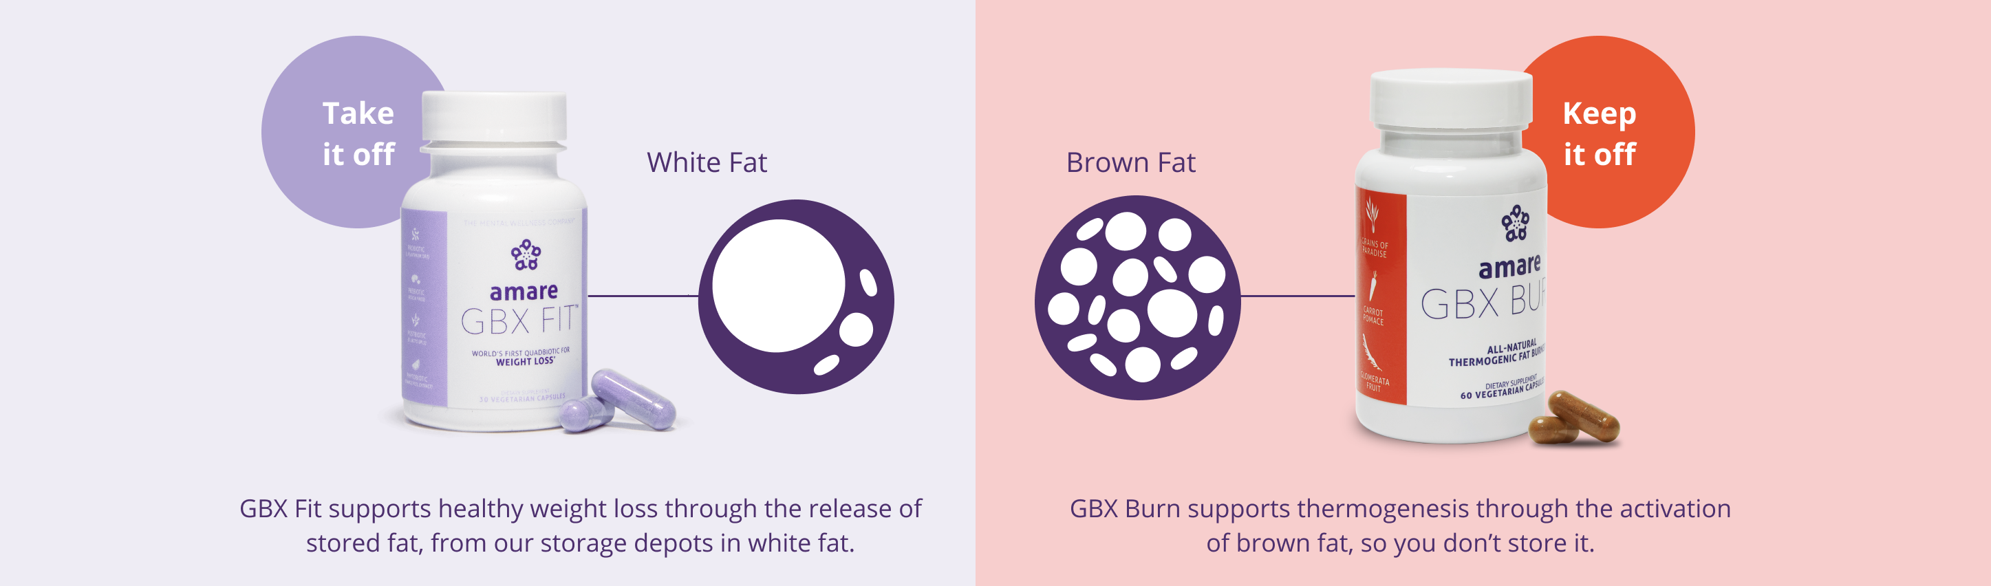
Amare GBX FitTM
Controls appetite and supports
fat release (increases fat loss)
Amare GBX BurnTM
Controls appetite and supports
fat burning (reduces fat gain)
*These statements have not been evaluated by the Food and Drug Administration. This product is not intended to diagnose, treat, cure or prevent any disease.
†Individual weight loss results may vary. It's possible for individuals to lose 1-2 pounds a week using Amare products and following the Amare Fit Program. However, there is no guarantee of specific weight loss results.

Slide 18

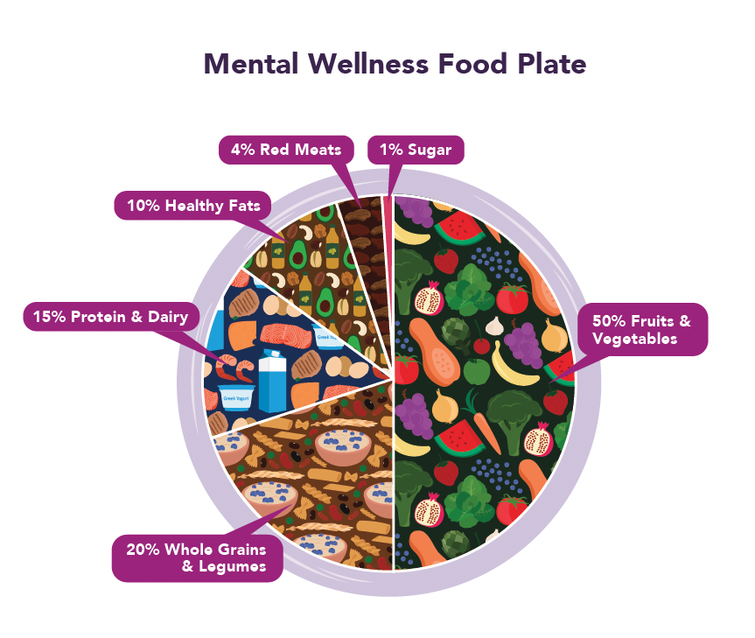
*These statements have not been evaluated by the Food and Drug Administration. This product is not intended to diagnose, treat, cure or prevent any disease.
†Individual weight loss results may vary. It's possible for individuals to lose 1-2 pounds a week using Amare products and following the Amare Fit Program. However, there is no guarantee of specific weight loss results.

Slide 19
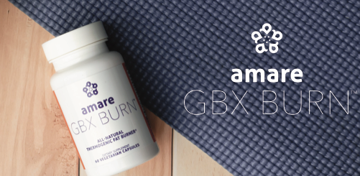

Slide 20

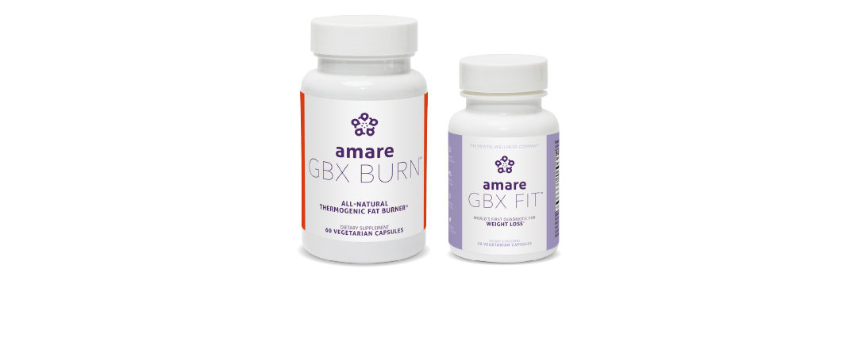
Happy Fit Pack
Retail Price: $293.95
Subscribe & Save Price: $263.95
Move toward a healthier, stronger you with Amare Happy Fit Pack.
Paired with daily movement and a healthy lifestyle, this pack is specifically curated to support weight management and a healthy gut microbiome in a variety of ways.
In addition to your choice of Digestive or Restore, this pack includes our most popular "Happy Juice Pack" and the incredible stimulant free duo of GBX Fit and GBX Burn to help you lose weight and keep it off.*
GBX Fit + GBX Burn Pack
Retail Price: $144.95
Subscribe & Save Price: $129.95
This incredible stimulant free duo will help you lose weight and keep it off.
When combined with daily movement and a healthy lifestyle, GBX Fit—the world's first QUADbiotic for weight loss and GBX Burn – an all-natural stimulant free thermogenic, help support weight management and break the weight gain cycle.*

Slide 21


Get FREE GBX Fit & Burn February 3–28 Purchase the Happy Fit Pack and get 1 free GBX Fit and 1 free GBX Burn! Use promo code: FREEBURN
Get Free GBX Burn! February 3–28 Optimize your weightloss journey with GBX Fit and GBX Burn!*† Purchase the GBX Fit + GBX Burn Pack and get an additional GBX Burn FREE! Use promo code: FREEBURN

Slide 22
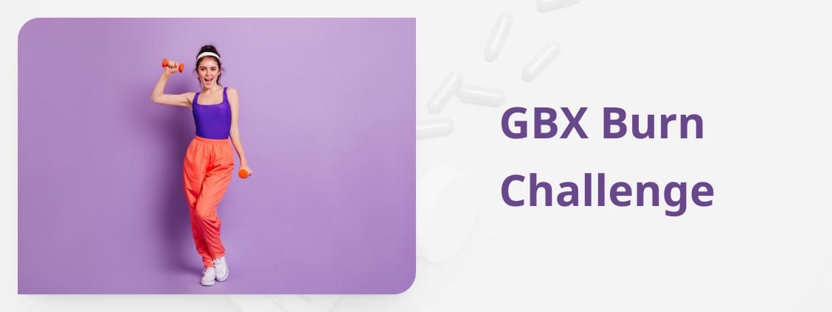
25 Winners: Trips, Fitness Equipment, Cash Prizes, & More!
Ready to regain your joy for movement? Heat up your fitness goals with the GBX Burn challenge! Take charge of your fitness goals for your chance to win these amazing prizes!
CHALLENGE PERIOD
Registration Opens February 15th → Closes At Midnight February 22nd → Challenge Period February 27 – May 29

Slide 23


