Slide 1

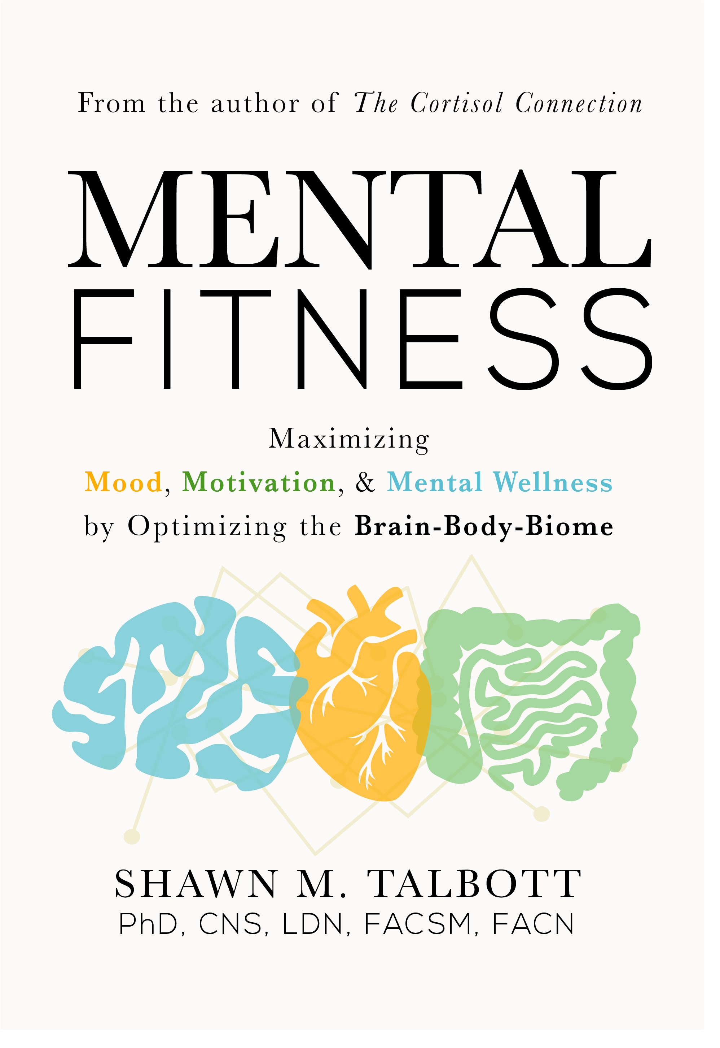
January 11, 2023
Social Science Hour
Mental Fitness Diet

Slide 2



Slide 3
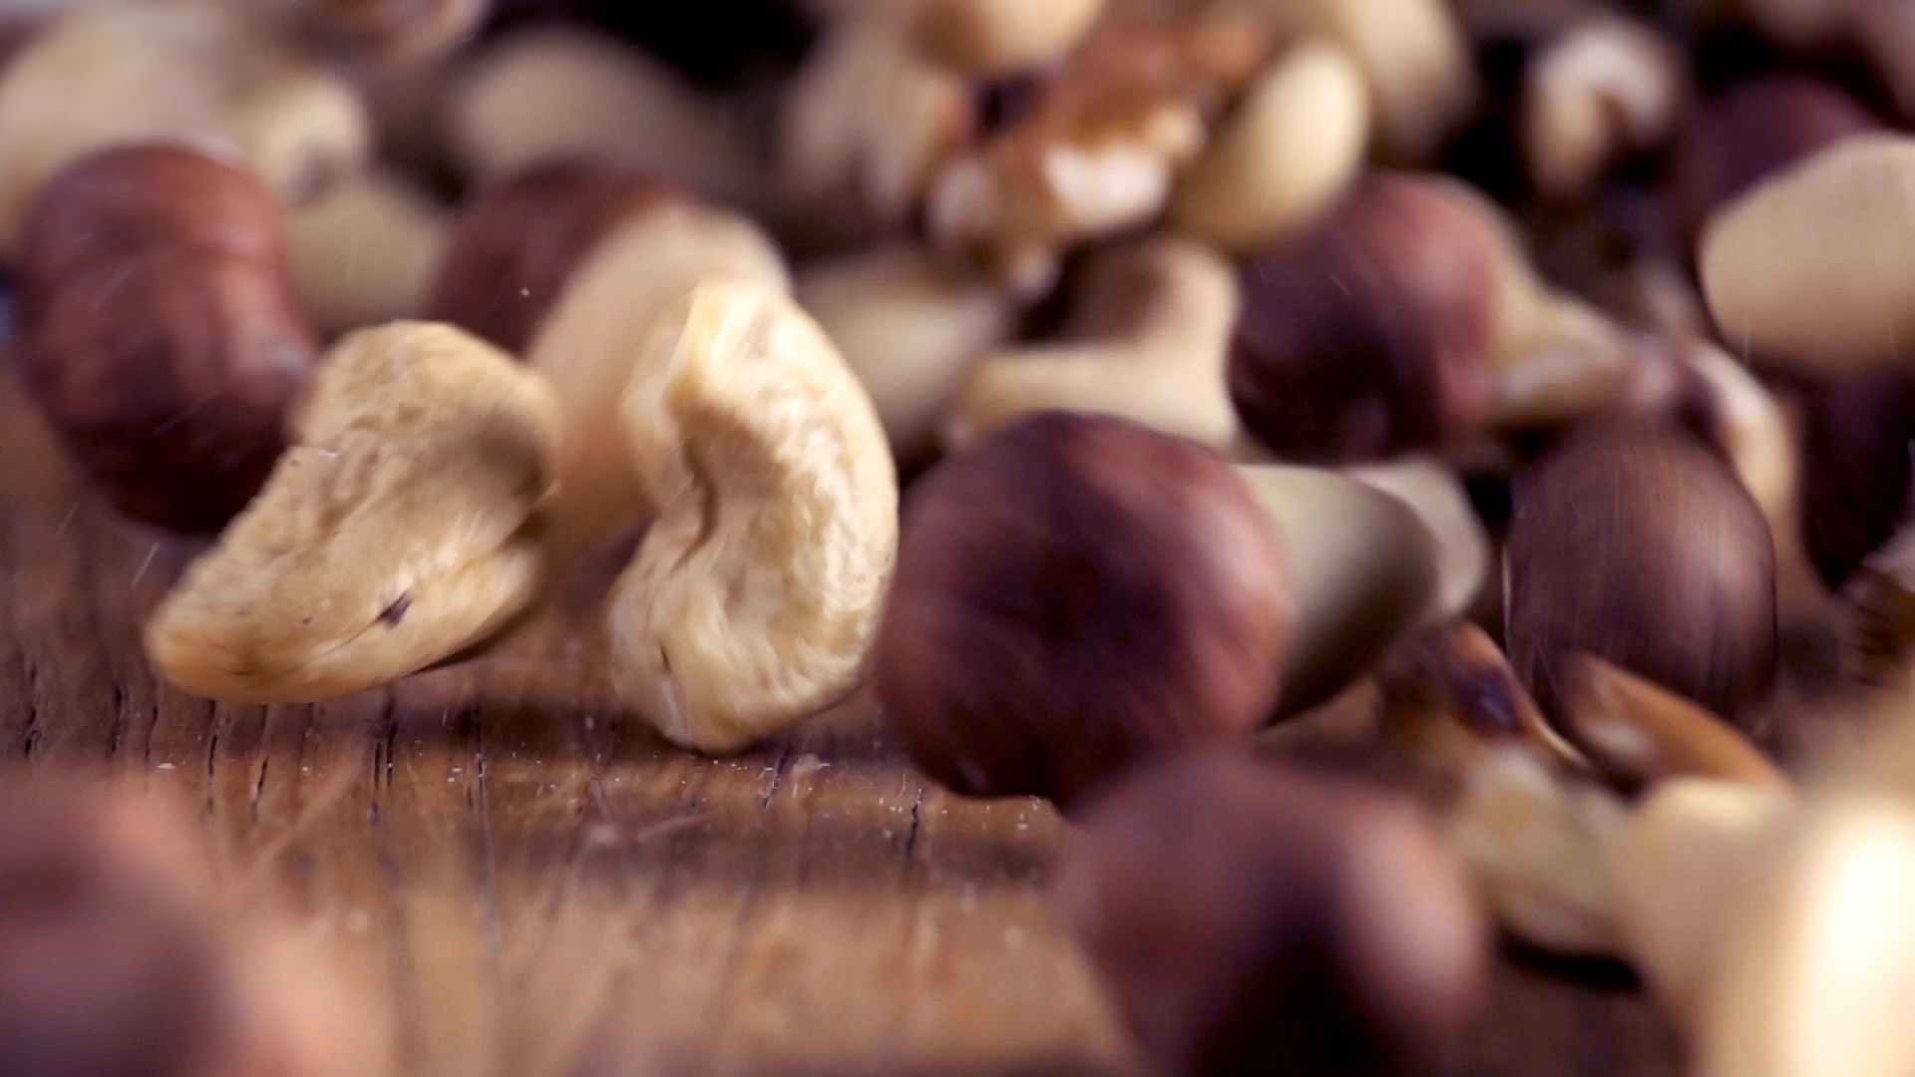
Functional Nutrition

Slide 4
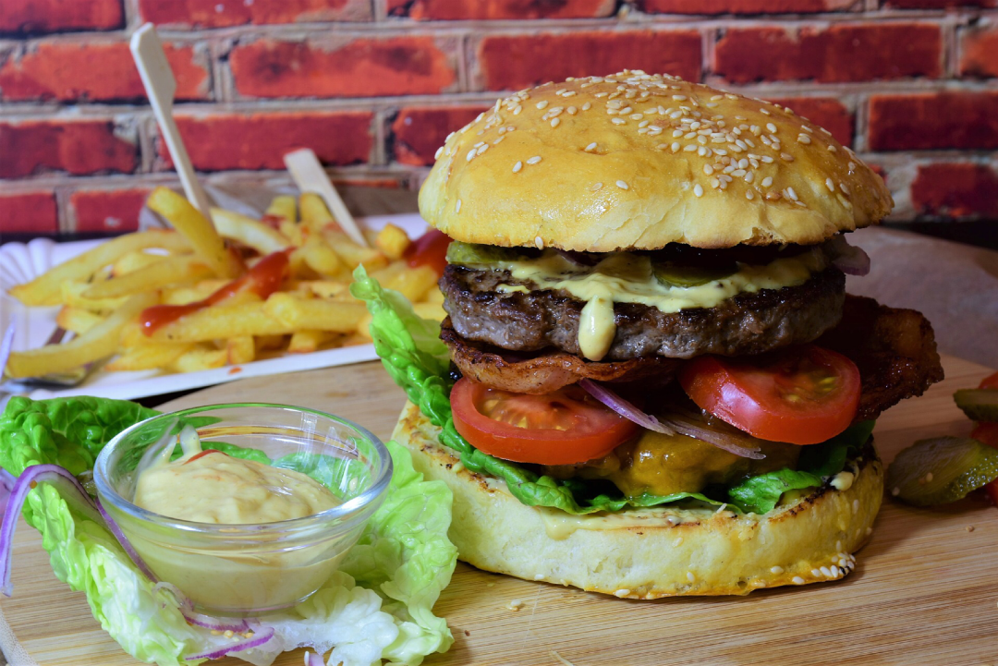
YMISAD? (Why Am I Sad?)
The Standard American Diet (SAD)
Salt
Sugar
Emulsifiers
Unhealthy Fat
Artificial sweeteners/colors
Processed / Ultra-Processed food

Slide 5
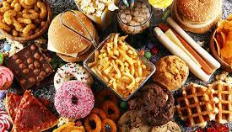
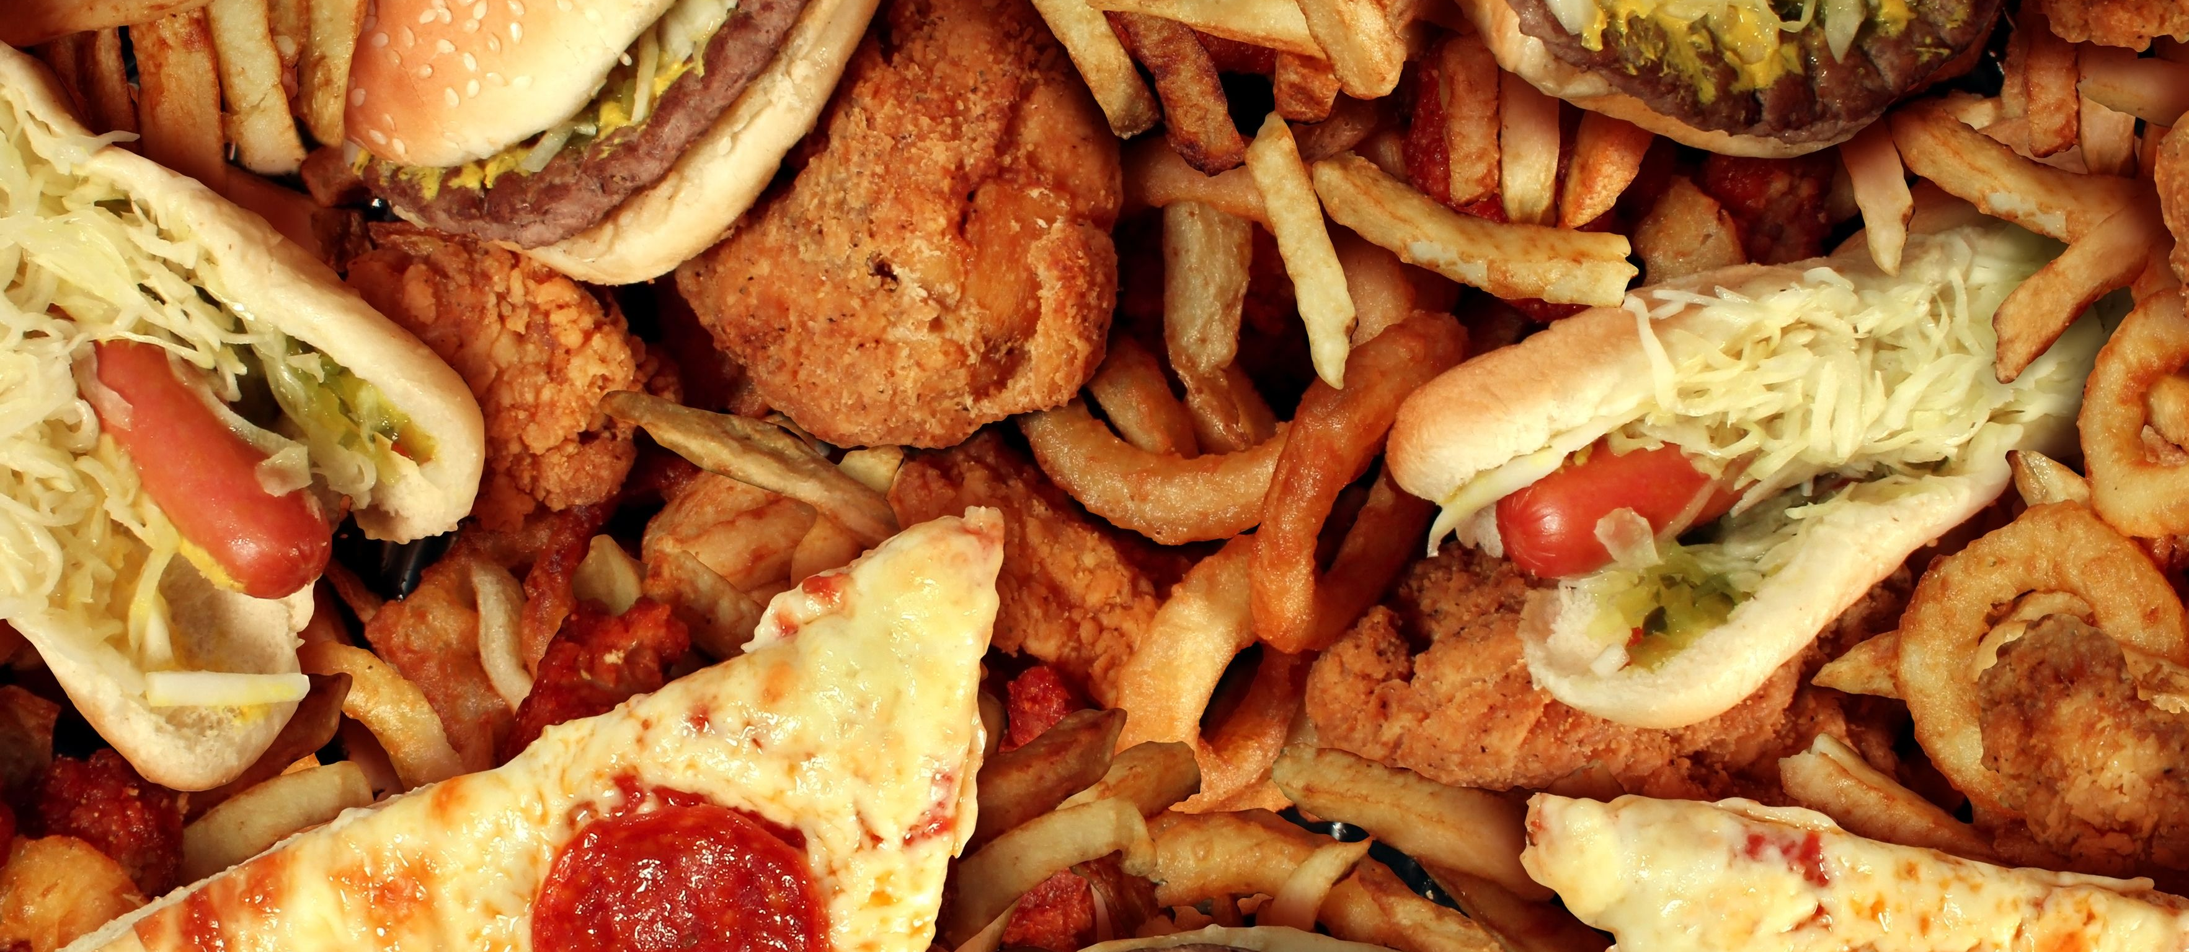
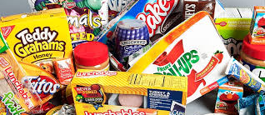
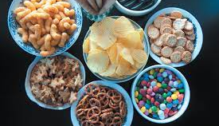

Slide 6
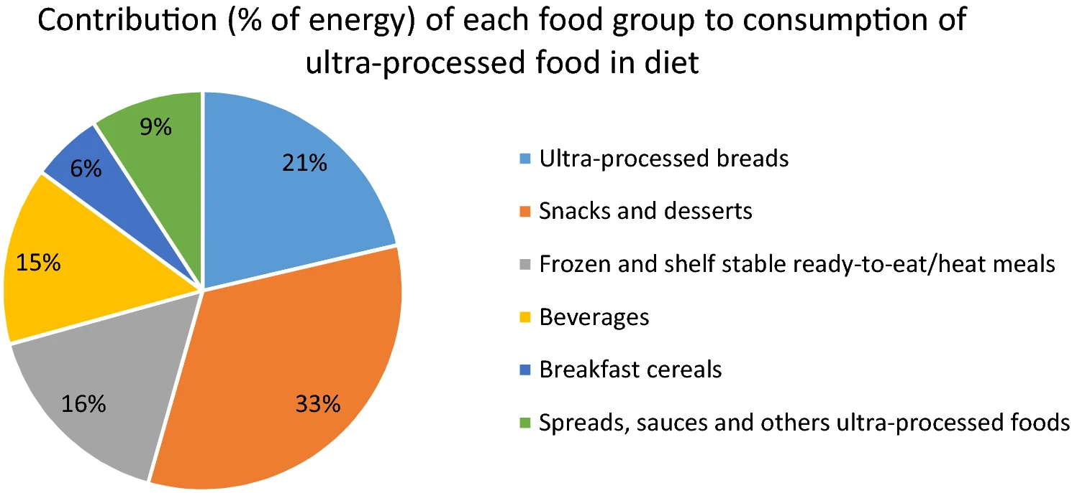
22,659 subjects – median follow up = 5 years
Conclusion = more processed foods = more obesity

Slide 7
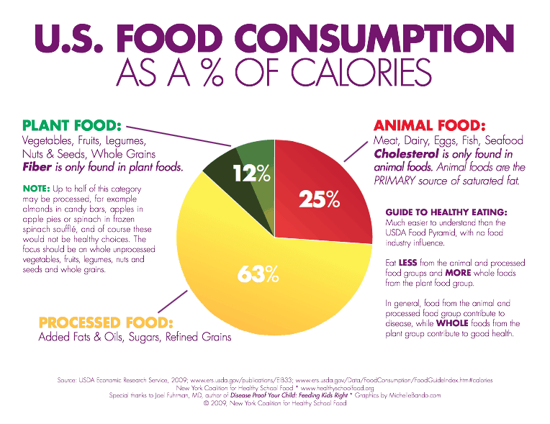

Slide 8
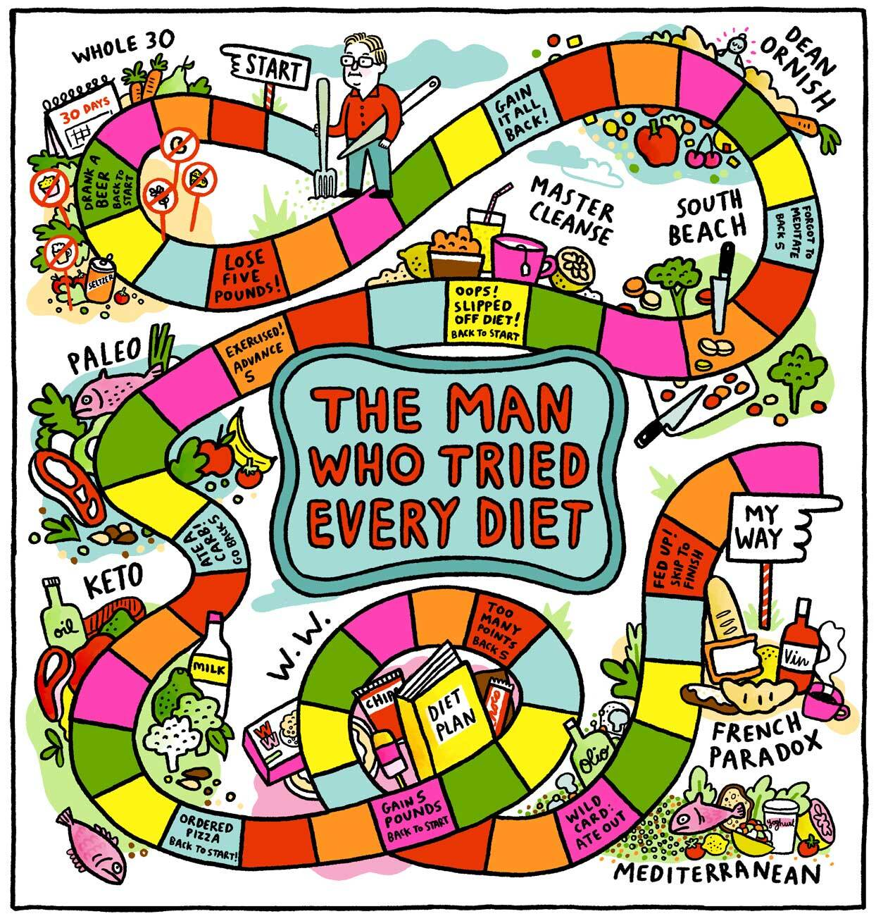
Fasting?
Macro Balance?
Vegan?
Carnivore?
Low-Fat?
Low-Carb?
High-Protein?
Paleo?
Keto?
Blah…
Blah…
Blah…

Slide 9
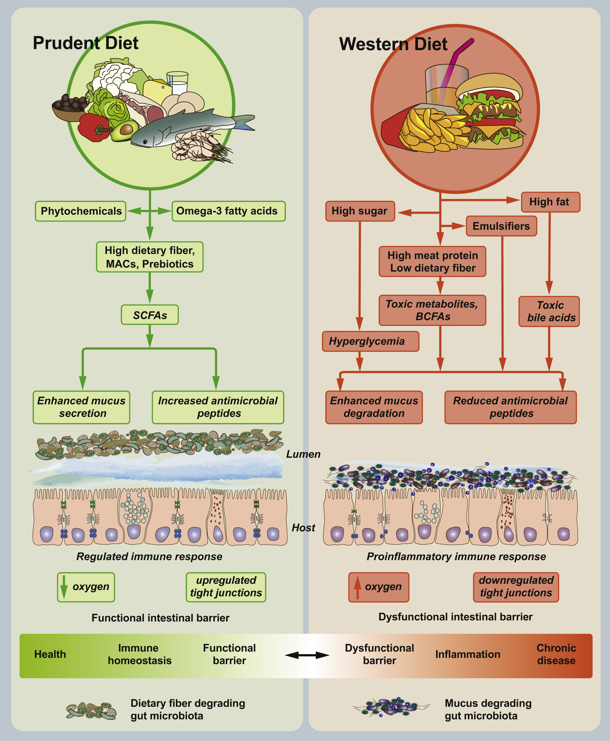

Slide 10
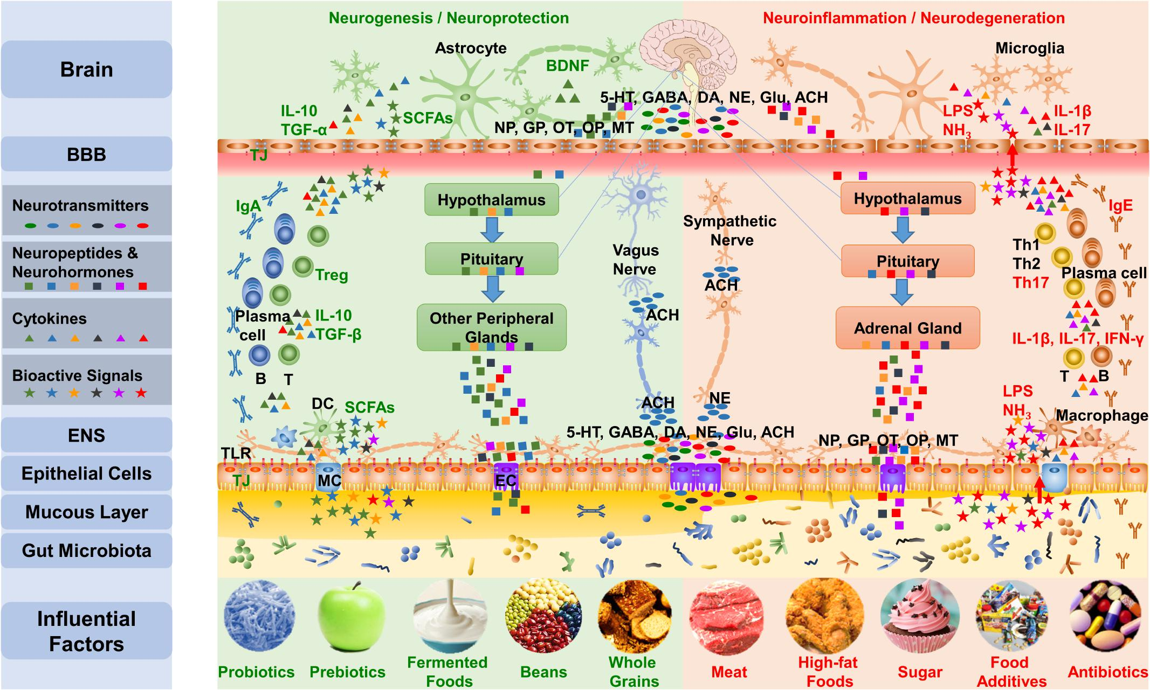

Slide 11
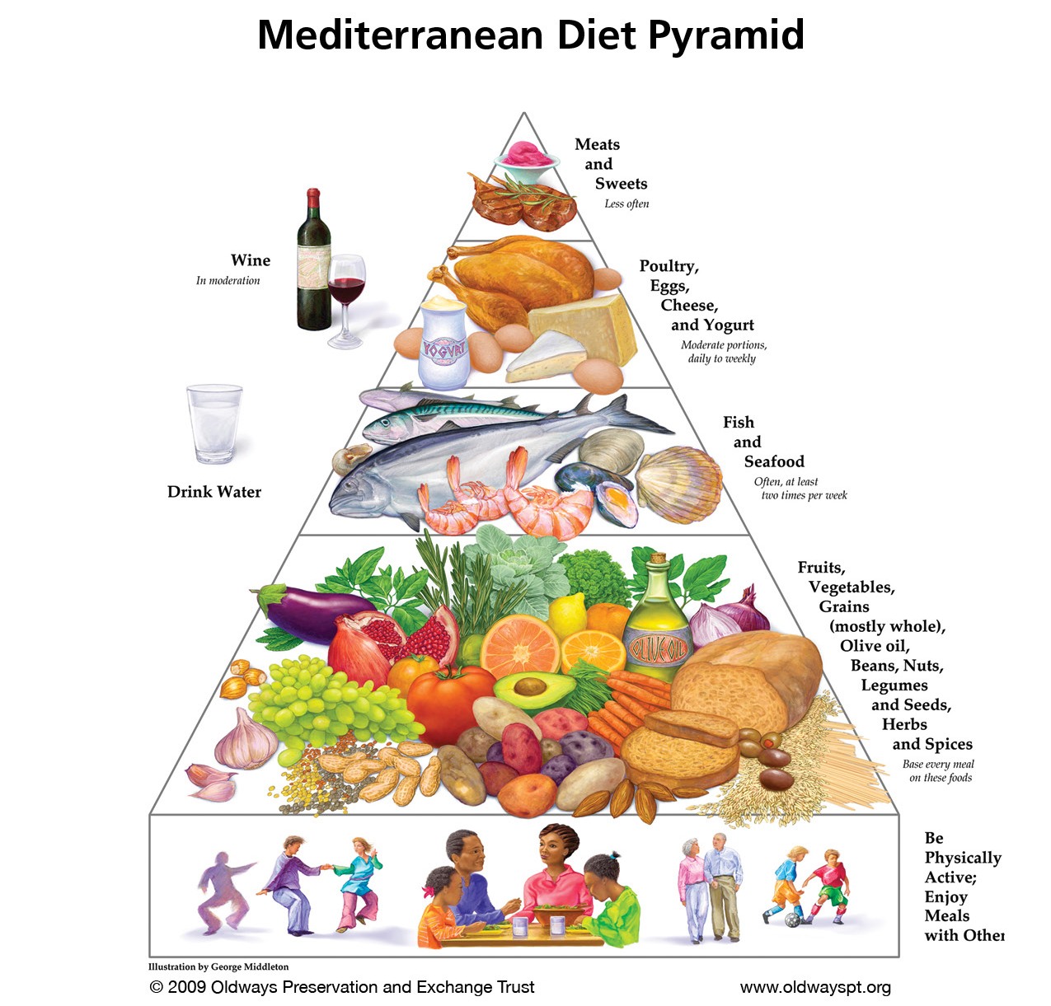

Slide 12

8 Years in a row…
Heart Disease
Stroke
Alzheimer’s/Dementia
Weight Loss
Diabetes
Rheumatoid Arthritis
Cancer
Depression

Slide 13
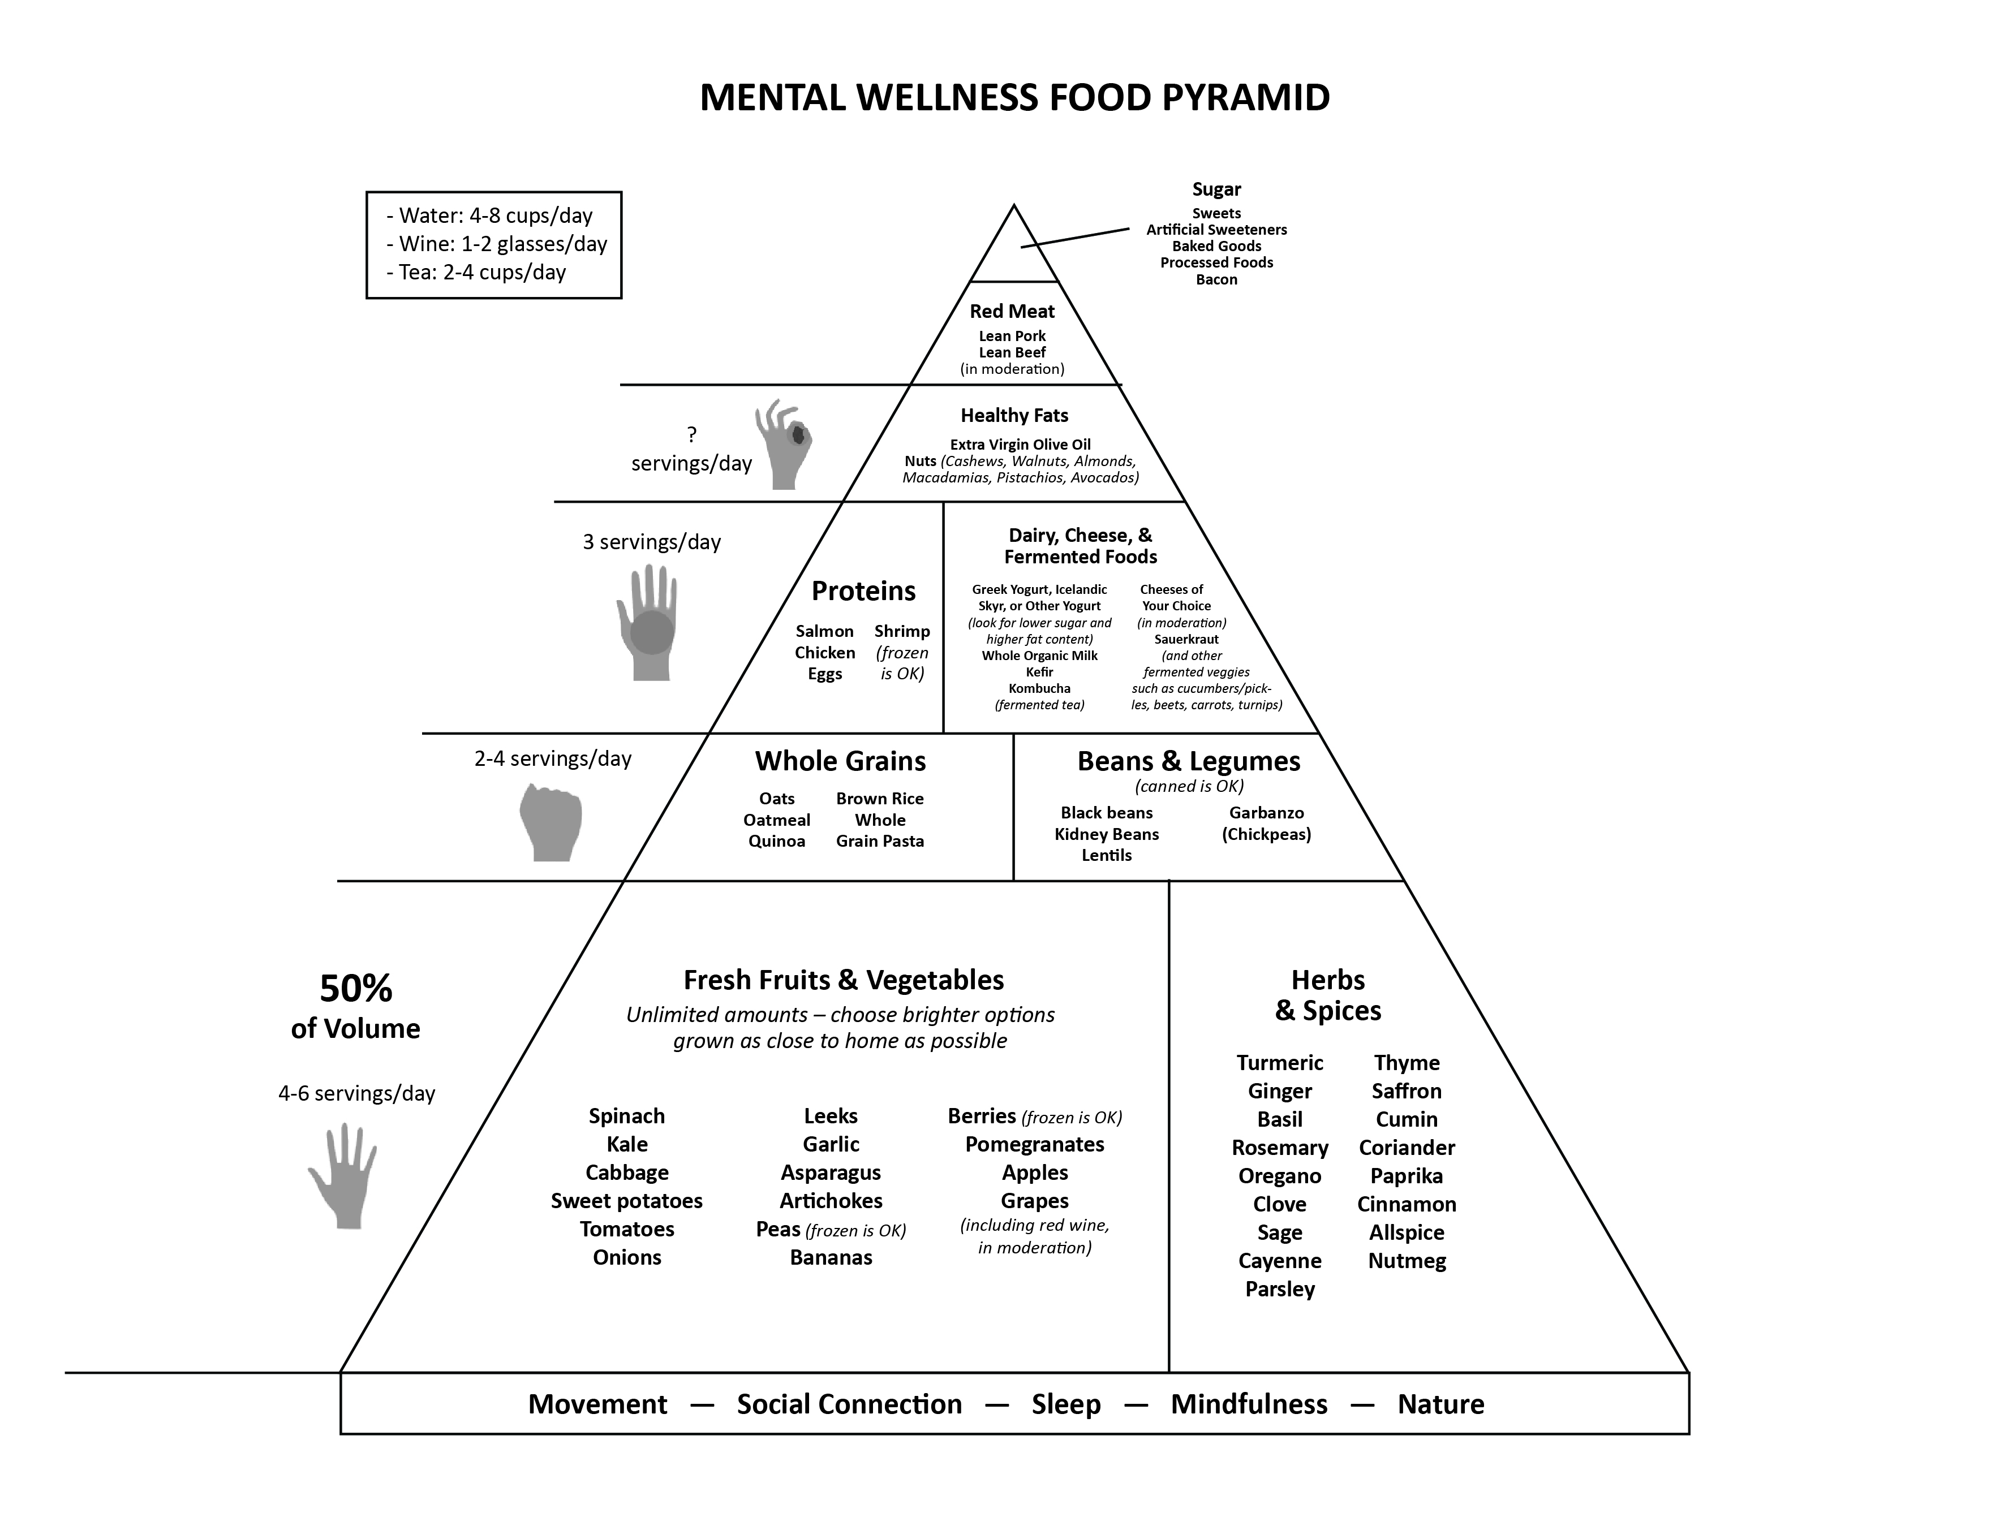

Slide 14
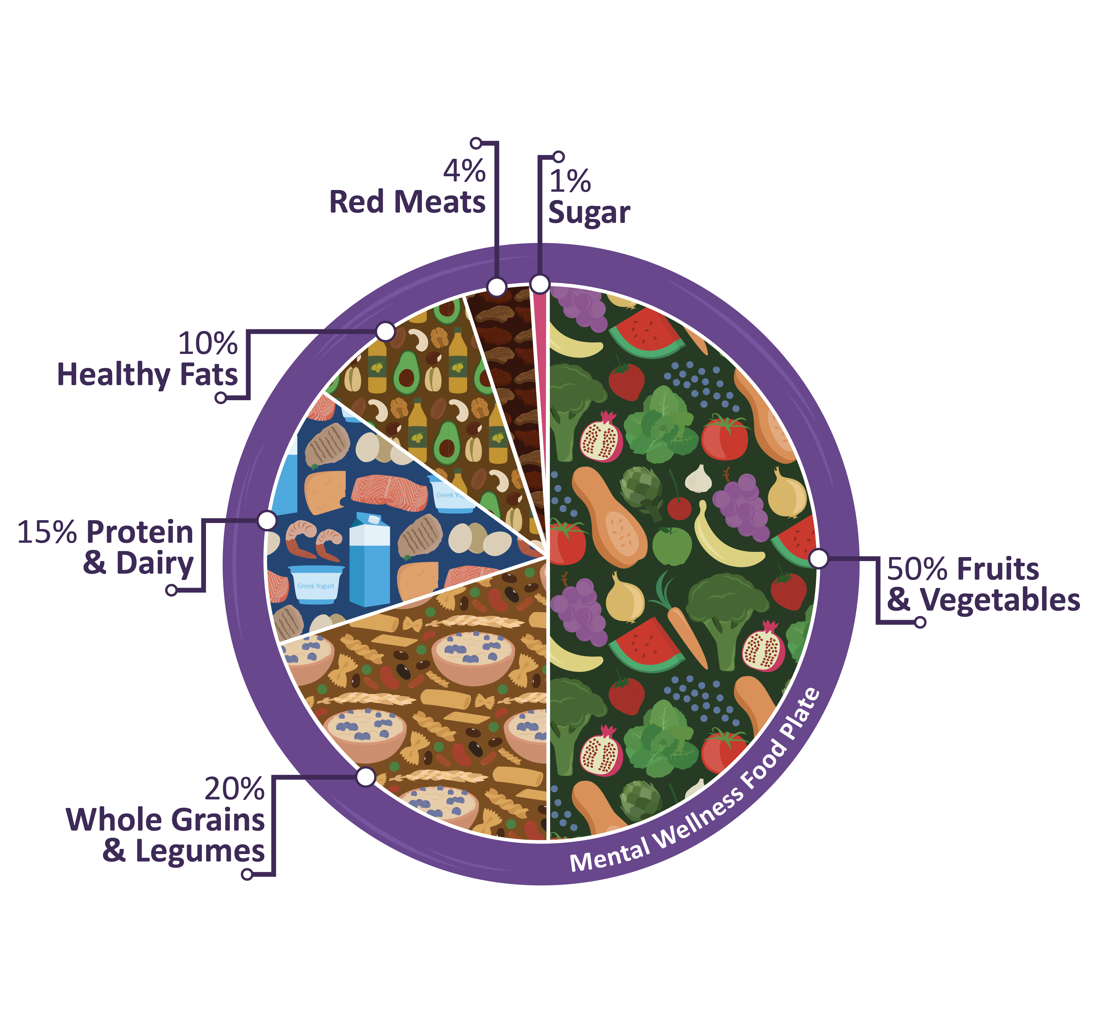

Slide 15
Your Fiber Deficiency…
You almost certainly need more fiber in your diet.
In fact, fiber might be the MOST important nutrient for you to focus on?
The national recommendations are around 30 grams per day – but most Americans only get around 15 grams or less (mostly because we’re not eating enough fruits and vegetables).
This lack of fiber has serious implications for not just your gut, but also the health and performance of your brain, heart, immune system, and virtually every aspect of your health.

Slide 16
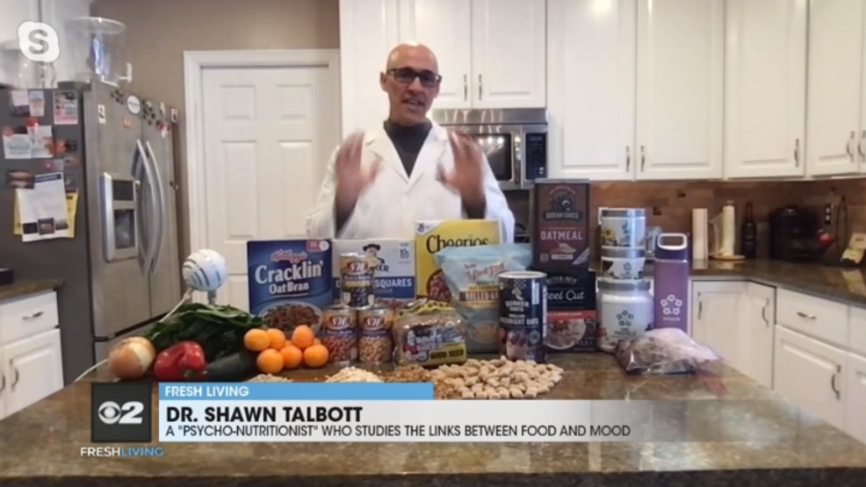

Slide 17
My most important nutrition tip – of all my nutrition tips – is to focus on getting more fiber in your diet!!!
National Recommendation = 30 grams
BUT – Most people get less than 15 grams
Traditional diets = 100 grams!
WHY get more fiber in your diet – good for your heart, gut, and brain = what I call our 3 brains!
-feed the bacteria in your gut (microbiome) – so you feel better and function better
Higher fiber intakes are associated with less depression, lower body fat, superior heart health, and reduced risk for dementia.
BUT – go slow – so you don’t experience gas, bloating, cramps.
-add an extra serving of fiber every day to allow your gut and gut bacteria to adjust
Be sure to drink plenty of fluids
—about 16 ounces of water, four times a day – to fully “hydrate” the fiber and help it pass through your digestive system.
How to get more fiber:
Eat at least 5 servings of fruits (2) and vegetables (3) every day.
a “serving” is a piece of fruit; half-cup of raw vegetables; or cup of leafy greens
Eat at least 3 servings per week of pulses (the seeds of plants in the legume family), such as beans, lentils, and peas.
Add nuts and seeds to yogurt, oatmeal, salads, and stir-fries.
Look for whole-grain versions of rice and pasta (brown instead of white).
Looks on Nutrition Fact labels for at least 5 grams of fiber/serving.

Slide 18
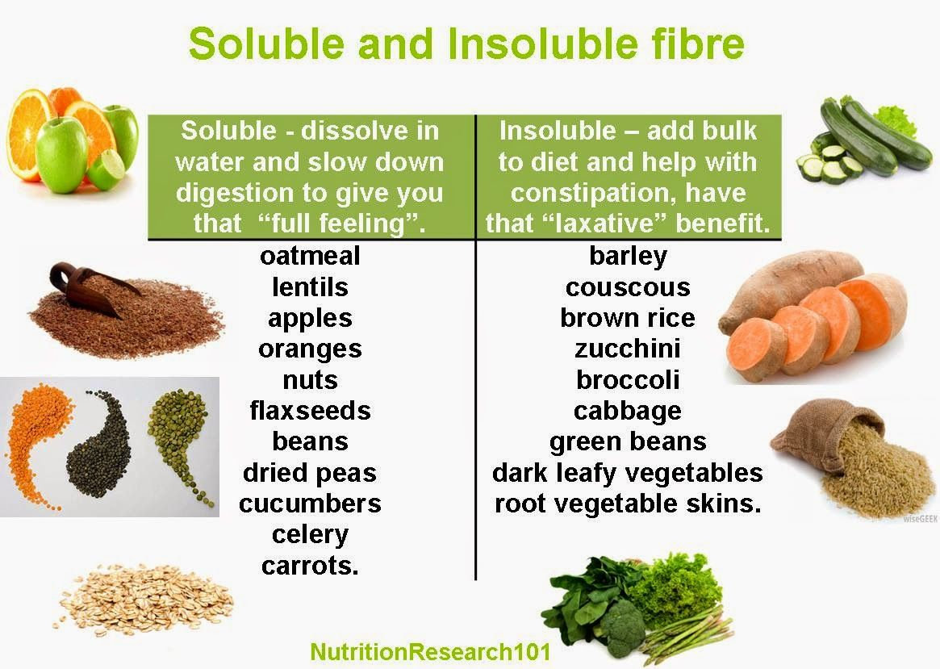

Slide 19
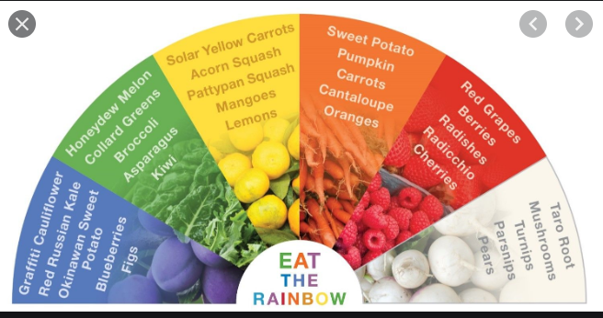

Slide 20
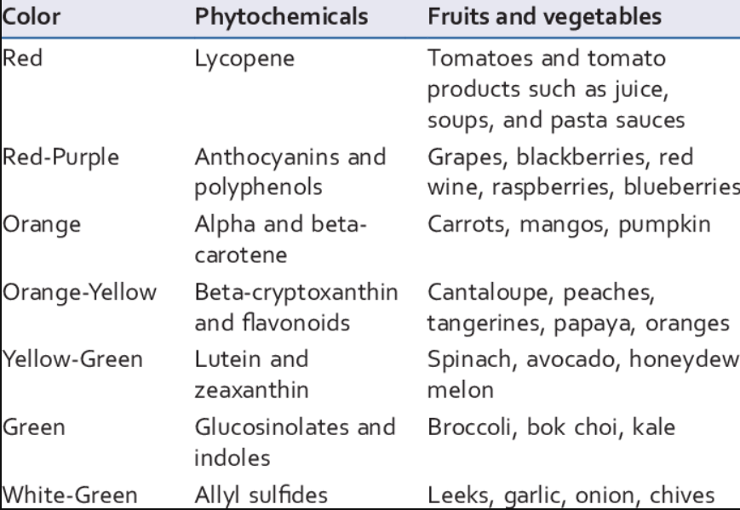

Slide 21
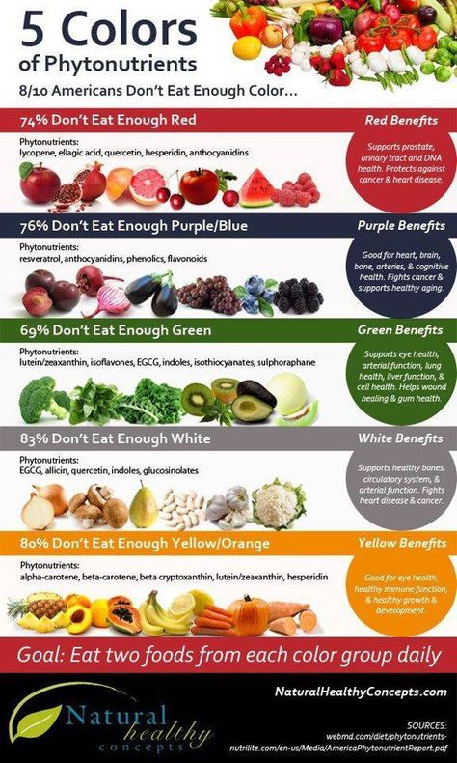

Slide 23
Natural Induction of CDRs = Cellular Defense Responses
Hundreds of natural bioactive plant compounds are known to trigger CDR pathways.
In many cases, the main reason that a particular fruit, vegetable, spice, or herb is “good for us” is because of its ability to trigger CDR and set in motion the production of the cell’s own protective proteins.
Anti-oxidant benefits of Flavonoids (GBX blend of Apple phenols, Grape Seed resveratrol/catechins, NZ Pine Bark OPCs – oligomeric-proantho-cyanidins)
Anti-inflammatory benefits of effect of healthy spices such as turmeric (curcumin) and ginger (gingerols)
Mental-focus benefits of herbs such as ashwagandha (withaferin) and pomegranate (punicalagins)

Slide 24
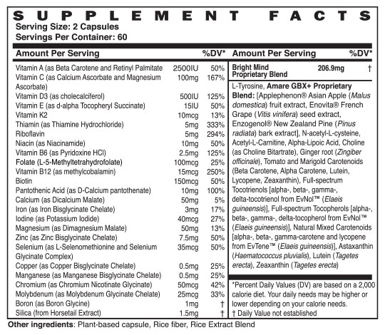

Slide 25
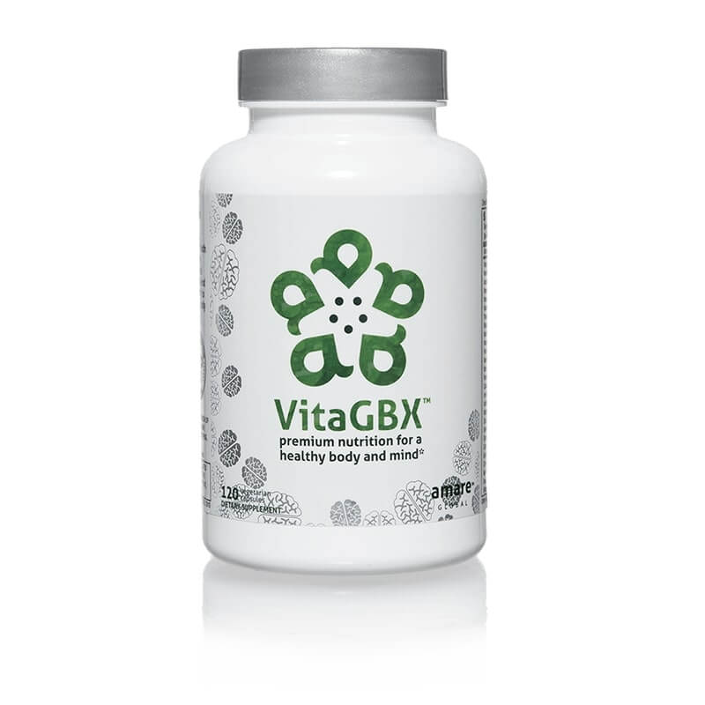
Bioavailable forms of vitamins/minerals/phytonutrients
Nourishes body and mind
Modulates numerous CDRs (Cellular-Defense Responses)
Nrf2 (antioxidant)
NfKb (inflammation)
SIRT/NAD (cellular aging)
MTOR/AMPK (metabolism)
HSP (autophagy = cellular cleanup)

Slide 26
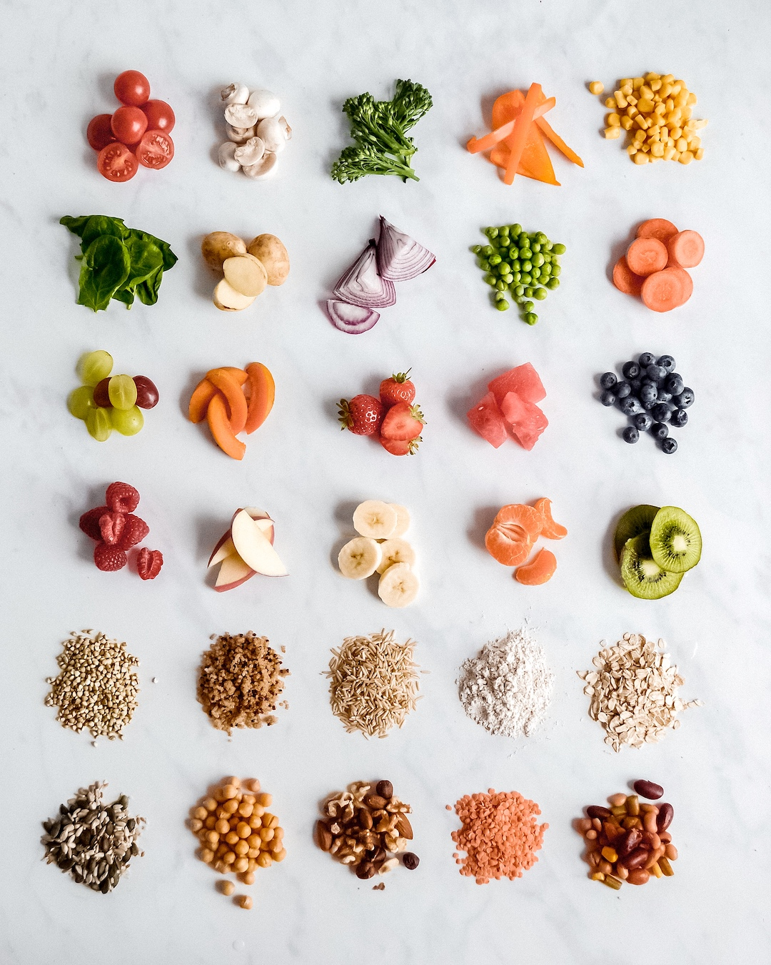
30 Plant Challenge

Slide 27
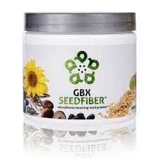
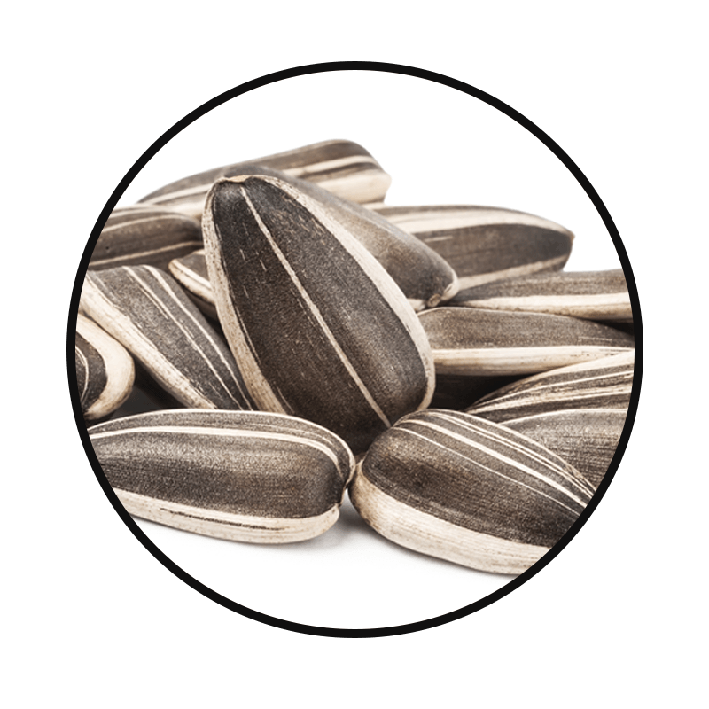
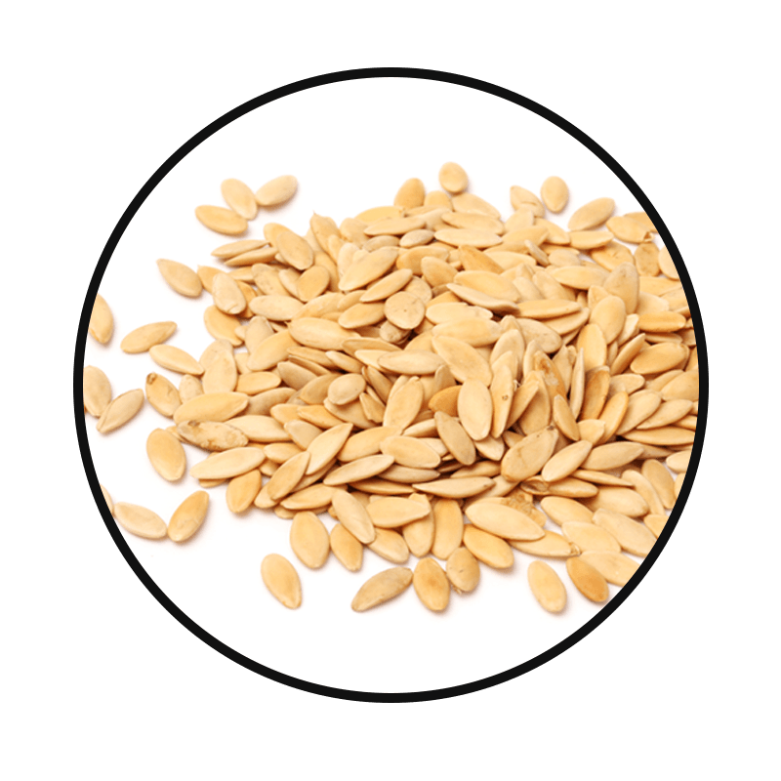
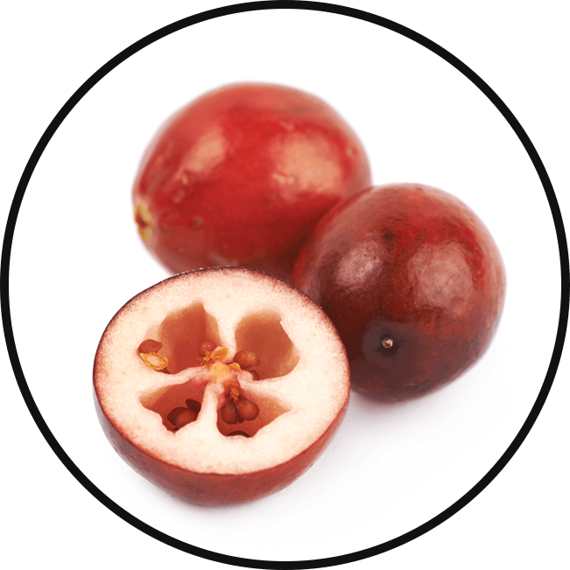
Cold-Pressed Natural Seeds
Sunflower Seed
One of the top natural sources of good fats, copper, selenium, folate and vitamin E*
Cucumber Seed
Great source of fiber and beta carotene, which helps with immunity, and skin and eye health*
Cranberry Seed
Great source of vitamin E, Omega-3, -6 and -9, and also acts as an antioxidant to protect the body from stressors*
*These statements have not been evaluated by the Food and Drug Administration. This product is not intended to diagnose, treat, cure, or prevent any disease.

Slide 28
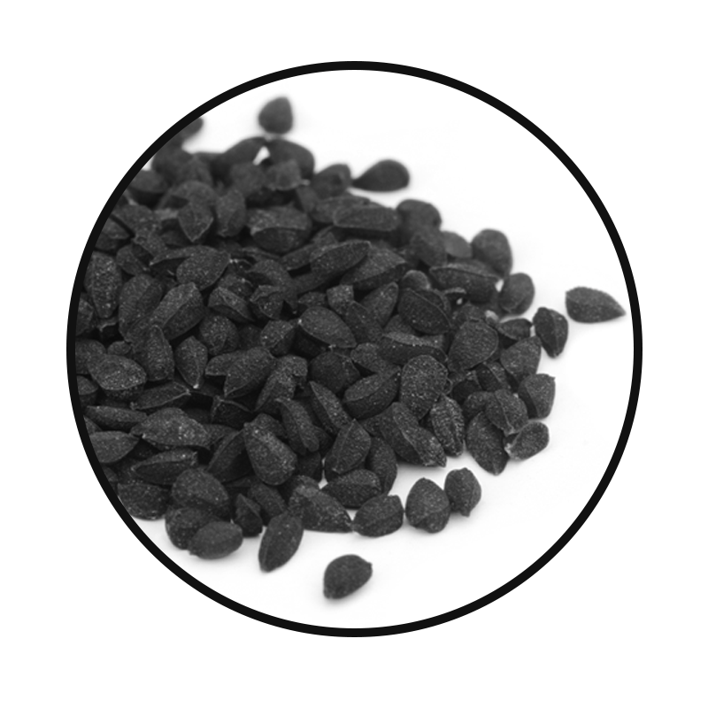
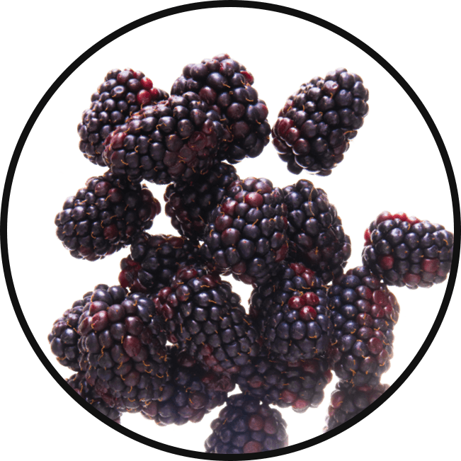
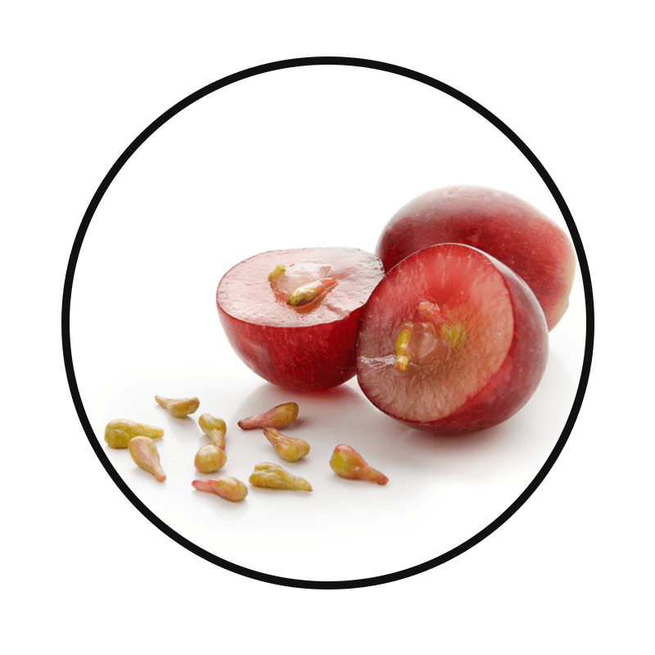
Cold-Pressed Natural Seeds
Black Cumin Seed
Contains B vitamins and antioxidants, and helps boost the immune system*
Blackberry Seed
Rich in Omega-3 (alpha-linolenic acid) and Omega-6 (linolenic acid) fats, which are good for heart and brain health*
Concord Grape Seed
Great natural source of vitamin A and E, which is crucial for skin, circulation, cholesterol, and has antioxidant effects*
*These statements have not been evaluated by the Food and Drug Administration. This product is not intended to diagnose, treat, cure, or prevent any disease.

Slide 29
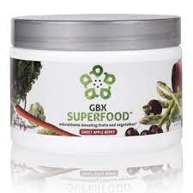


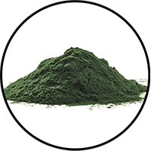



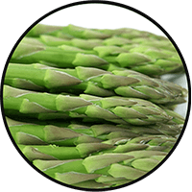
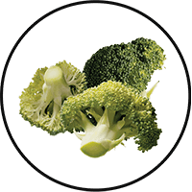


Anti-Stress Phytobiotic Proprietary Blend
Fruits and Vegetables
Provides three servings of natural fruits and veggies for comprehensive nutrition in a convenient, single serving*
Beet Root
Carrot
Spirulina
Spinach
Strawberry
Kale
Asparagus
Broccoli
Pomegranate
Tart Cherry
*These statements have not been evaluated by the Food and Drug Administration. This product is not intended to diagnose, treat, cure, or prevent any disease.

Slide 30



Gut-Integrity Prebiotic Proprietary Blend
Apple Fiber
Helps with bulking in the intestinal tract, and heart health
Chia Seed
Good source of omega-3 fatty acids, fiber, antioxidants, proteins and calcium*
Good for heart and brain health*
Flax Seed
Good natural source of omega-3 fatty acids, lignans and fiber*
Helps with heart and brain health*
*These statements have not been evaluated by the Food and Drug Administration. This product is not intended to diagnose, treat, cure, or prevent any disease.

Slide 31

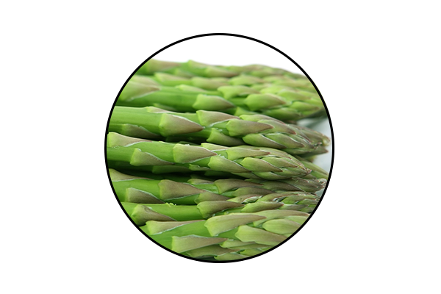
Anti-Stress Phytobiotic Proprietary Blend
ETAS™: Enzyme-Treated Japanese Asparagus
Supports mood and cognitive function*
Protects neuronal cells*
Induces the production of natural anti-stress molecules called Heat Shock Proteins*
*These statements have not been evaluated by the Food and Drug Administration. This product is not intended to diagnose, treat, cure, or prevent any disease.
Notes:
ETAS™: Enzyme-Treated Japanese Asparagus
Uniquely sourced from Japan
Has been used for > 5,000 years
Derived from the lower stalk portion of asparagus stalks, where the most phytonutrients are found.
Rich in hydroxymethylfurfural derivatives, which is a necessary compound that induces HSP70 microRNA expression.
ETAS™: Mechanism of Action
What is HSP70? Heat Shock Proteins
ETAS works by increasing the production of HSP70: an intracellular protein produced naturally by the body when it encounters a stressor, such as extreme heat.
Clinical Studies have shown ETAS induces a significant production of HSP70 microRNA expression activities that helps with biological activities such as cellular protection, cellular repair, reduced cell death, blood flow, cellular stress, anti inflammatory activity, sleep, mood, energy, and antioxidant activity.
ETAS™: Mechanism of Action
Why is HSP70 production important?
As we age, the Heat Shock Protein production to stressors decrease with age.
ETAS helps preserve and maintain the appropriate HSP70 expression to promote brain health, stress response and cognitive performance as we age!
HSP70 has a number of beneficial, physiological effects in the body, including reduced cell death, anti-inflammatory activity and antioxidant activity.
There is no reason why you shouldn’t feel 25, when you’re 50!

Slide 32
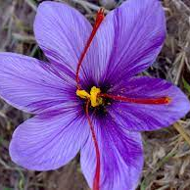
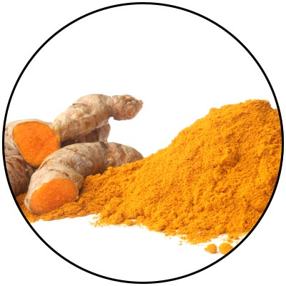
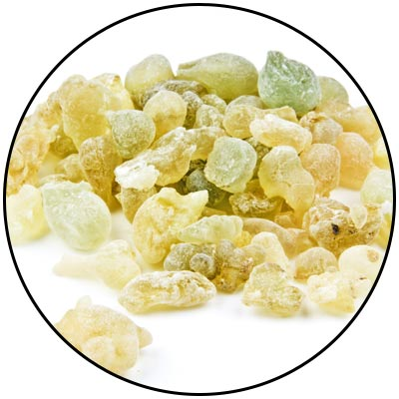
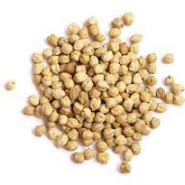

Slide 33
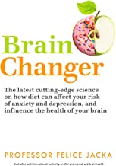
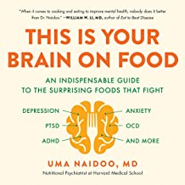

Slide 35
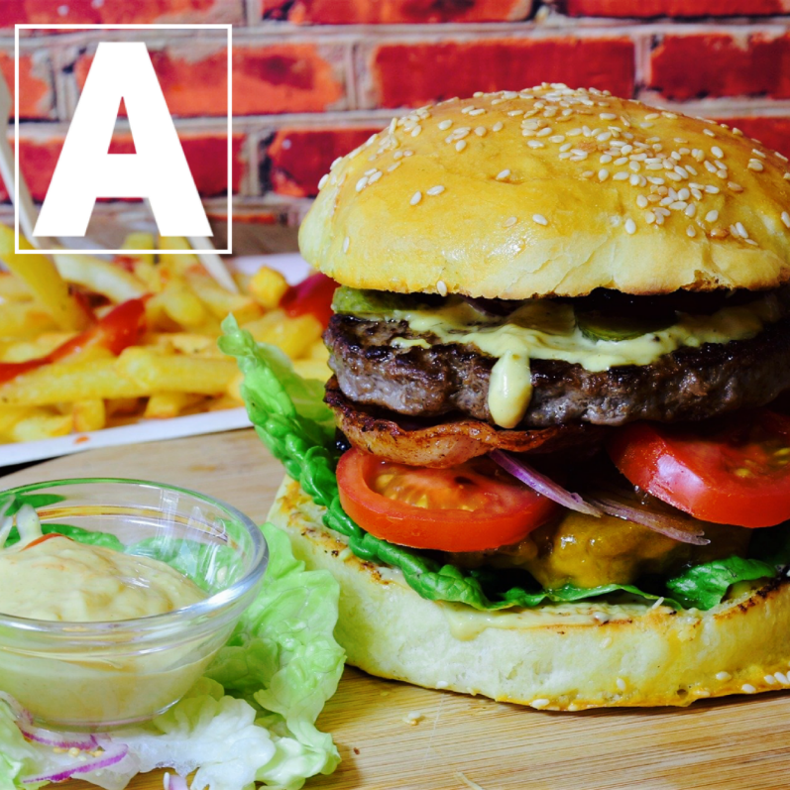
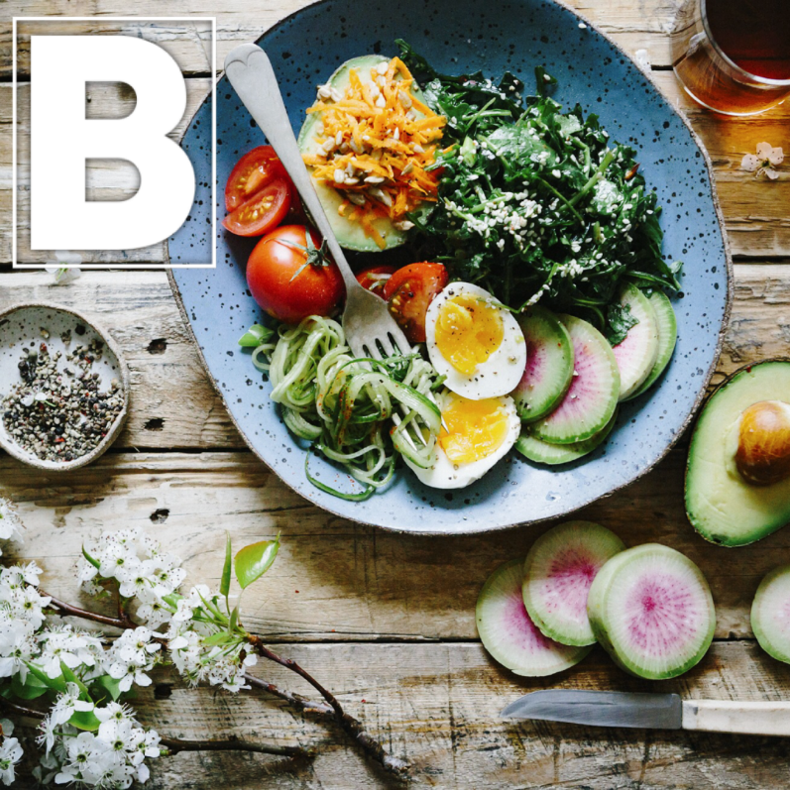
We get to choose how we feel!

