Slide 1
Your Skin Has a Biome?!?!
October 18, 2022
Shawn M. Talbott, PhD
CNS, LDN, FACSM, FAIS, FACN
Co-Founder & Chief Science Officer
Amare Global

Slide 2
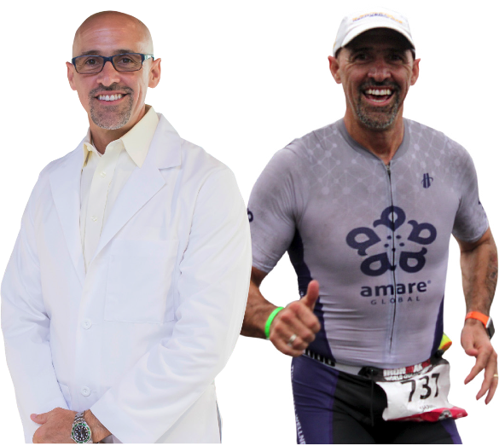
20+ years developing nutritional products.
Fellow of the American College of Nutrition, the American College of Sports Medicine, and the American Institute of Stress.
Author of two academic textbooks, an award-winning documentary film, and several best-selling books translated into more than a dozen languages
Featured guest on the “Dr. Oz Show,” “Ask Dr. Nandi,” The TED stage, and the White House.
Served as a nutrition educator for elite-level athletes.
Diplomate of the International Olympic Committee’s (IOC) Sports Nutrition program.
Dr. Shawn Talbott
Amare’s Chief Science Officer
PhD, CNS, LDN, FACSM, FAIS, FACN

Slide 3

Subscribe for updates at:
–Facebook.com/AmareGlobal
–Facebook.com/DrShawnTalbott
–YouTube.com/DrShawnTalbott
–ShawnTalbott.com (blog)
- Amare.com (Resources)

Slide 4
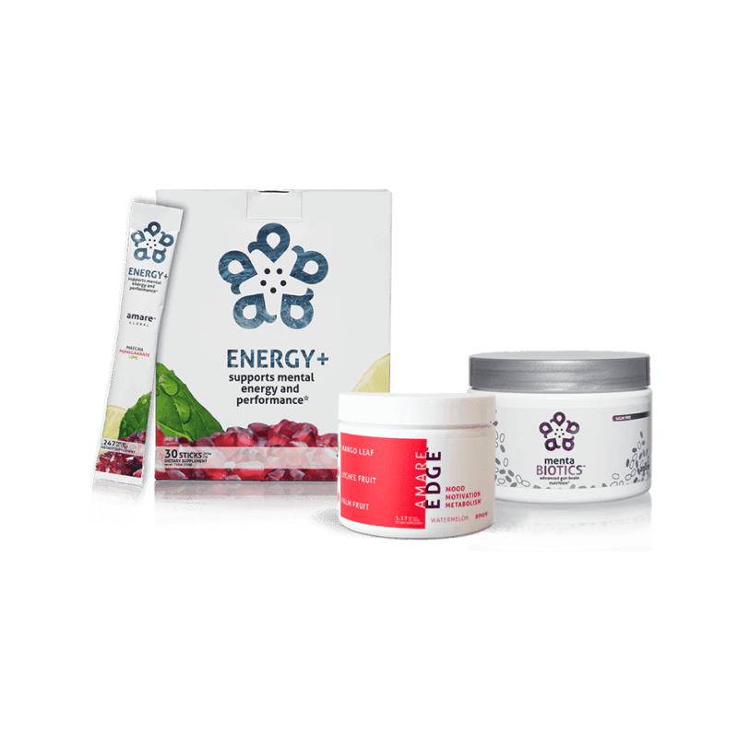

Slide 5
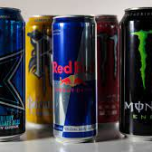
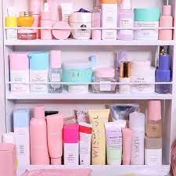
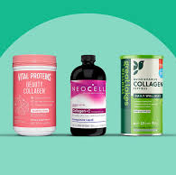
3 New Products
MASSIVE Markets…
Energy Drinks
Skin Microbiome
Collagen
$19.6 Billion (2020)
$28.2 Billion (2027)
$17.5 Billion (2021) TOTAL
$700 Million (2021) Microbiome
$2 Billion (2029) Microbiome
$8.7 Billion (2021)
$16.7 Billion (2028)

Slide 6
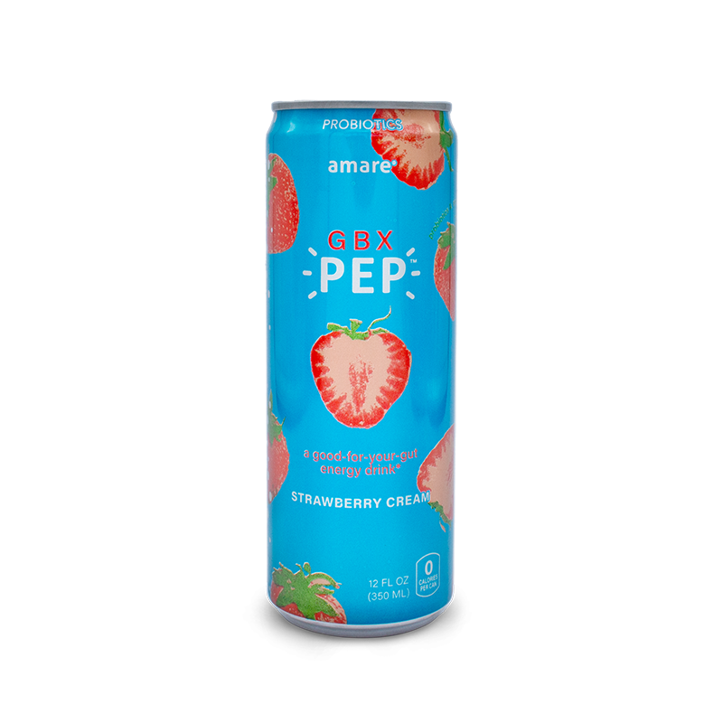
GBX PEP
GBX PEP is the first Ready-to-Drink Gut-Brain-Axis product with light carbonation that nourishes the gut bacteria with prebiotics, phytonutrients, probiotics, and amino acids that are clinically shown to modulate neurochemicals through the science of the microbiome.
Naturally flavored with strawberry and vanilla.
Fermented in a base of organic tea with a hint of caffeine (50mg).
These statements have not been evaluated by the food and drug administration. This product is not intended to diagnose, treat, cure or prevent any disease.

Slide 7
GBX PEP
GBX Pep is a lot of things, but at the end of the day it is a good-for-you tasty soda that supports digestive health and mental flow across the entire GBX!
These statements have not been evaluated by the food and drug administration. This product is not intended to diagnose, treat, cure or prevent any disease.

Slide 8
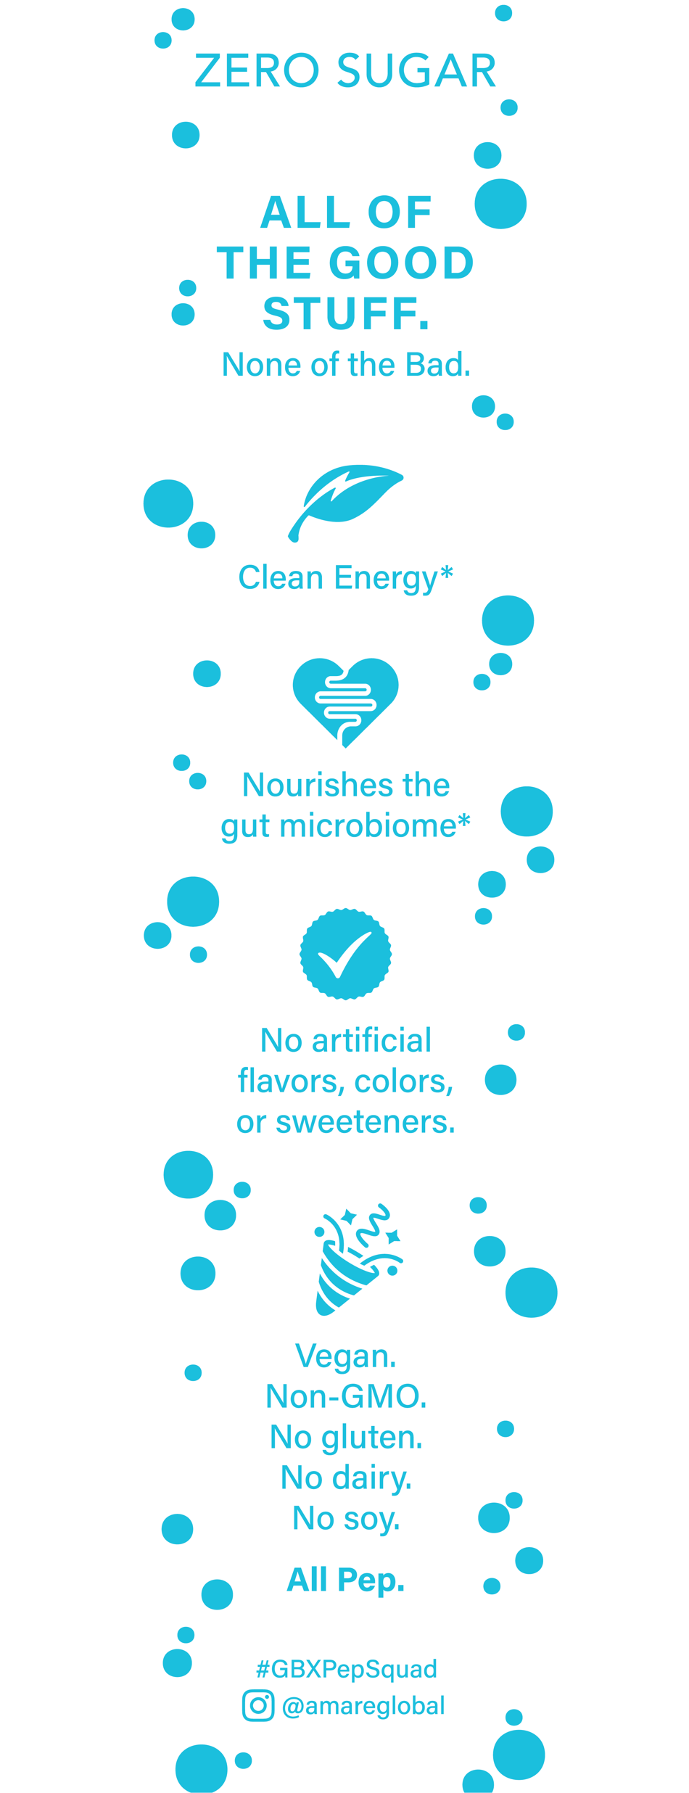
These statements have not been evaluated by the food and drug administration. This product is not intended to diagnose, treat, cure or prevent any disease.

Slide 9
Global Mood State
Vigor
“Overall Well-Being”
“Overall Resilience”
Positive Mood States

Slide 10
Tension
Fatigue
Negative Mood States
Confusion
Depression

Slide 11
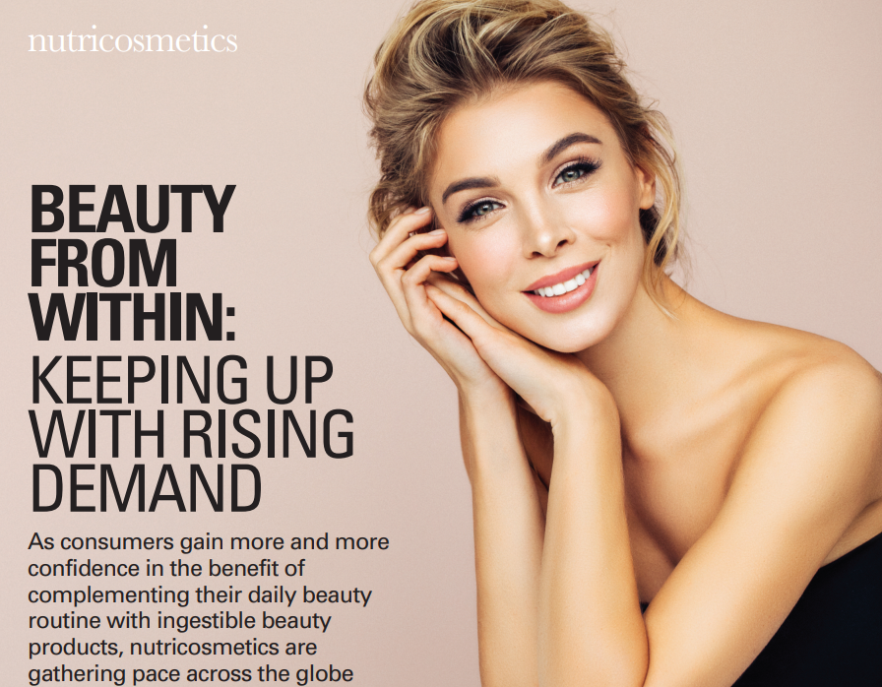
Look Better – Feel Better
How the Mental Wellness Company “does beauty”
Confidence = Mental Wellness
Beauty – size of market
Collagen – size of market
Skin Microbiome (outside)
Gut Microbiome (inside)

Slide 12
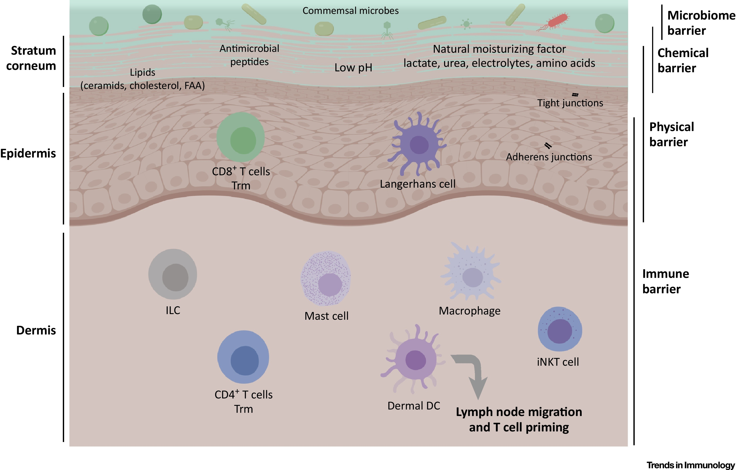

Slide 13
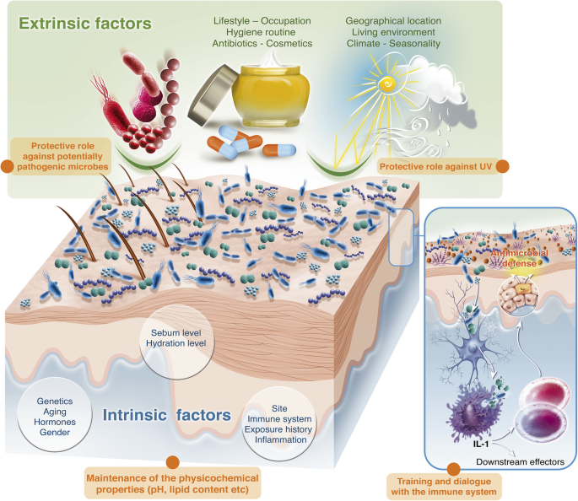

Slide 14
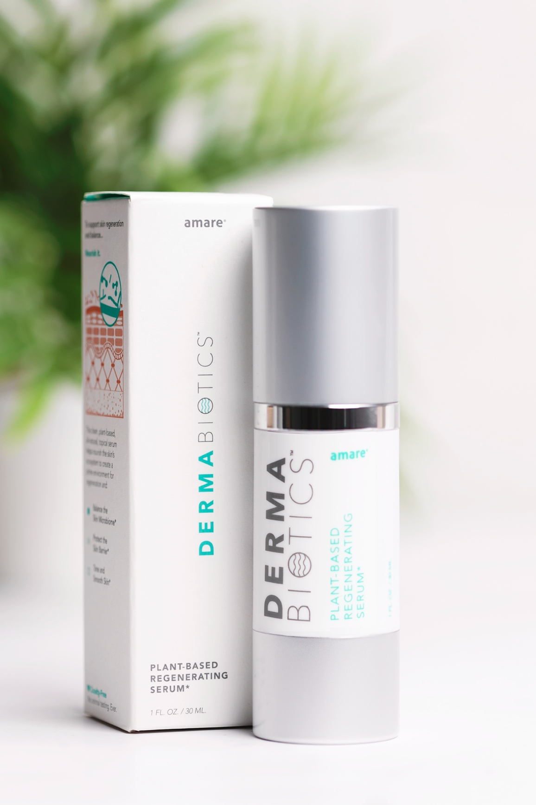

Slide 15
These statements have not been evaluated by the food and drug administration. This product is not intended to diagnose, treat, cure or prevent any disease.

Slide 16
These statements have not been evaluated by the food and drug administration. This product is not intended to diagnose, treat, cure or prevent any disease.

Slide 17
Bioactive Delivery Matrix
(Coco-Caprylate/Caprate, Phenoxyethanol, Lauroyl Lysine, Glycerin, Lecithin, Ethylhexylglycerin, Citric Acid)
Microbiome Nourishing Blend
Postbiotic (Lactococcus Ferment Lysate)
Prebiotic Fiber Blend (Xanthan Gum, Sclerotium, Pullulan)
Phytobiotic Blend (Seaweed (Laminaria Digitata) Extract, Algae (Chlorella Vulgaris) Extract, Plant Saccharide Isomerate)
Collagen Support Blend
(Linoleic/Linolenic Acid Blend, Hydrolyzed Soy Fiber, Hyaluronic Acid, Silica, Tocotrienols, Superoxide Dismutase)

Slide 18
Microbiome Nourishing Blend
Postbiotic (Lactococcus Ferment Lysate)
Prebiotic Fiber Blend (Xanthan Gum, Sclerotium, Pullulan)
Phytobiotic Blend (Seaweed (Laminaria Digitata) Extract, Algae (Chlorella Vulgaris) Extract, Plant Saccharide Isomerate)
Lactococcus Ferment Lysate (Germany) – Balances pH and strengthens skin integrity
Laminaria Digitata (France) – Atlantic kelp/seaweed rich in alginates, mannitol and amino acids that help moisturize, re-mineralize, and nourish the skin
Chlorella Vulgaris (Taiwan) – Algae known to help with skin firmness/tone by acting as a buffer between the skin’s different layers
Saccharide Isomerate (France) – Seaweed-derived moisture reservoir that binds to the skin for hydration and balance
These statements have not been evaluated by the food and drug administration. This product is not intended to diagnose, treat, cure or prevent any disease.

Slide 19
Collagen Support Blend
(Linoleic/Linolenic Acid Blend, Hydrolyzed Soy Fiber, Hyaluronic Acid, Silica, Tocotrienols, Superoxide Dismutase)
Linoleic/Linolenic Acid – Fortifies the skin’s shield and helps with moisture and plumpness
Hydrolyzed Soy Fiber – Helps retain moisture and revitalize skin elasticity, while soothing skin and maintaining microflora balance
Hyaluronic Acid – Maintains skin hydration/moisture content, promoting softness/smoothness, while decreasing the appearance of wrinkles, dry skin, and aging (non-animal/vegan, Kosher/Halal)
Silica – promotes collagen strength
Tocotrienols – Vitamin E blend - antioxidant protects skin cells from external damage and increases skin sebum/oil for moisturization
Superoxide Dismutase – Powerful natural antioxidant enzyme that reduces cellular stress to help nourish and soothe skin
Glycerin – Vegetable-derived humectant supports skin moisture/hydration
Sea Water – Skin-soothing mineral blend high in magnesium, potassium, and calcium and functions as an exfoliant and supports pore integrity
These statements have not been evaluated by the food and drug administration. This product is not intended to diagnose, treat, cure or prevent any disease.

Slide 20
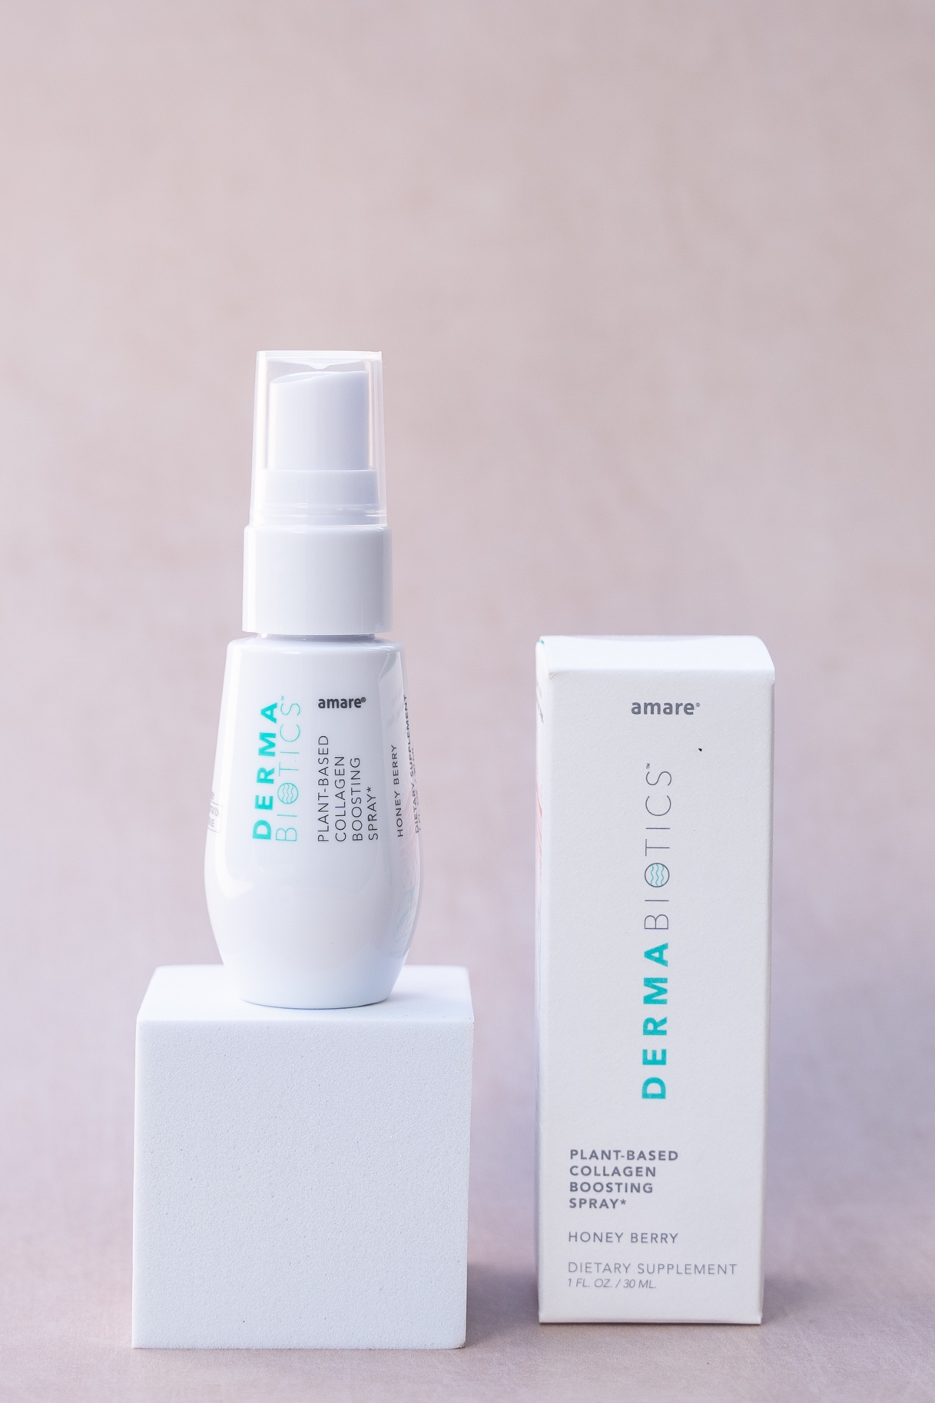

Slide 21
These statements have not been evaluated by the food and drug administration. This product is not intended to diagnose, treat, cure or prevent any disease.

Slide 22
These statements have not been evaluated by the food and drug administration. This product is not intended to diagnose, treat, cure or prevent any disease.

Slide 23
Moldavian Dragonhead
(Dracocephalum moldavica) extract (aerial parts – sustainably sourced from farms in Moldova, Switzerland, Germany, and Austria)
High content of flavonoid glucuronides
In-vivo studies show a collagen-boosting effect preserving a youthful collagen expression and mass during aging
Uniquely activates collagen synthesis/support pathways (AMPK/FOXO) for wrinkles, skin, hydration, elasticity, moisturization, tissue repair, etc
In humans = significantly increased skin moisturization (14%) and elasticity (7%)
Flavored with organic Honey, organic Grapefruit extract and natural Strawberry flavor
Dracobelle was a Nutra Ingredients Asia 2022 Finalist “Beauty from Within”
These statements have not been evaluated by the food and drug administration. This product is not intended to diagnose, treat, cure or prevent any disease.

Slide 24
Lactobacillus Sakei 65
Heat Treated Probiotic (Postbiotic) – lactic acid bacteria from fermented Korean Kimchi
Immune-modulating and inflammation-reducing strain with clinically tested efficacy on AD (Atopic Dermatitis)
Nourishes the gut skin axis to optimize overall skin health and is studied to help with dermatitis, eczema, hydration, etc.
These statements have not been evaluated by the food and drug administration. This product is not intended to diagnose, treat, cure or prevent any disease.

Slide 25
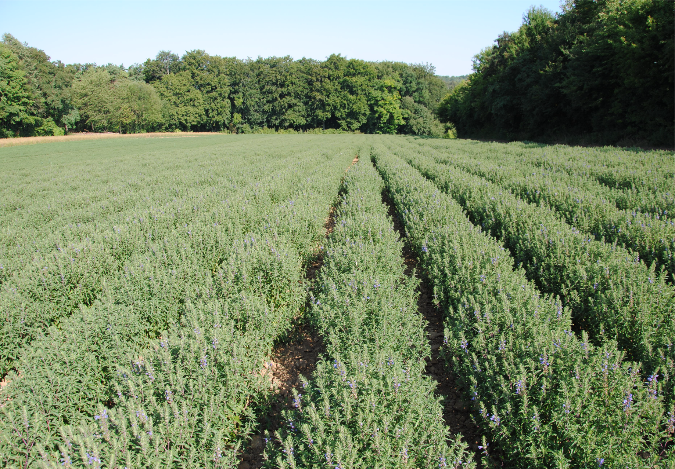
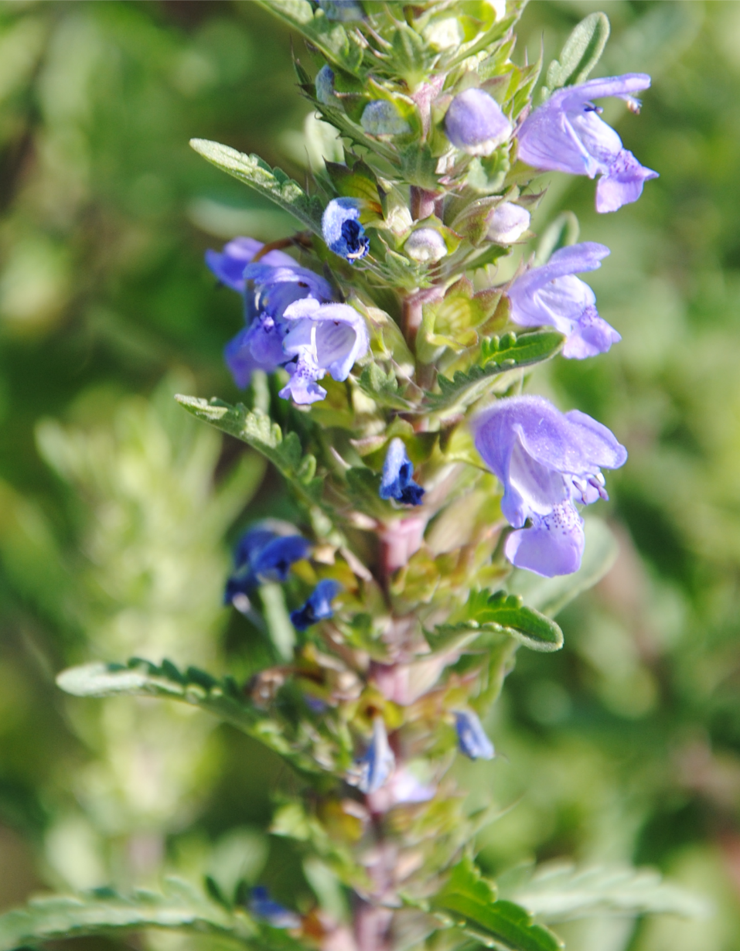

Slide 26
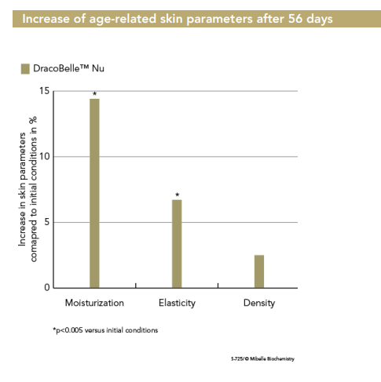
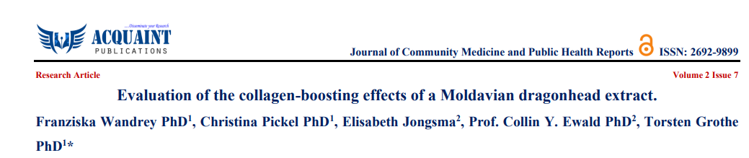
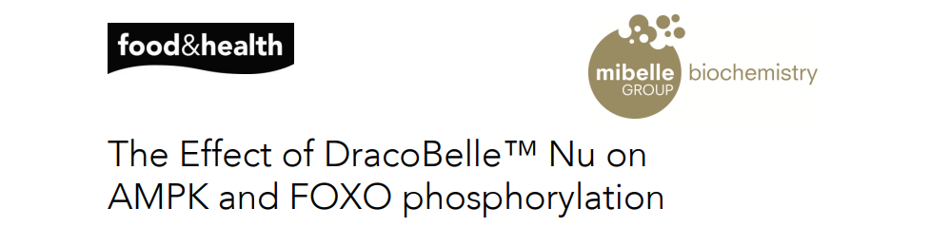
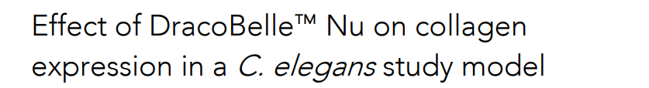
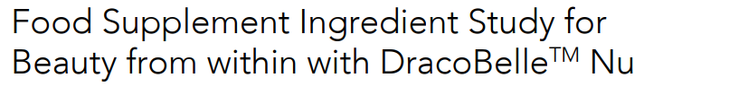

Slide 27
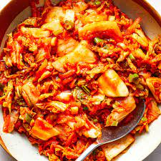
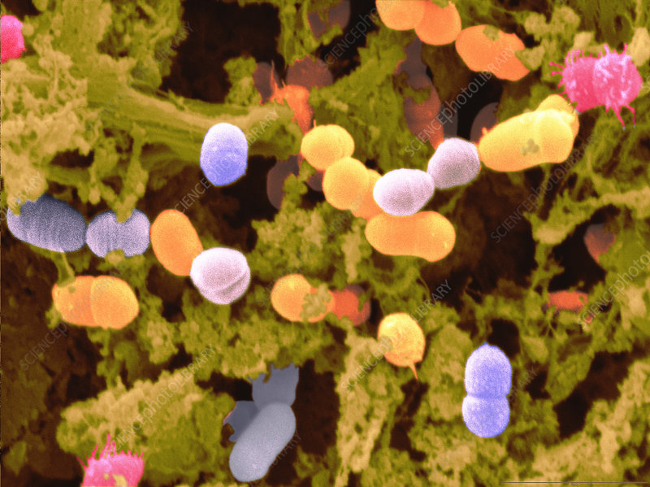
Fermented Veggies!
Specific “good” bacteria perform the fermentation

Slide 28
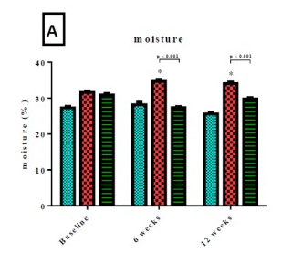
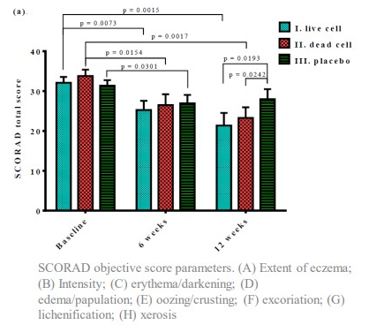
Skin Moisture & Dermatitis
Lactobacillus Sakei 65
These statements have not been evaluated by the food and drug administration. This product is not intended to diagnose, treat, cure or prevent any disease.
Notes:
COMPLIANCE: Add below disclaimer
These statements have not been evaluated by the food and drug administration. This product is not intended to diagnose, treat, cure or prevent any disease.

Slide 29
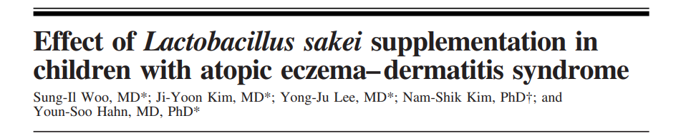
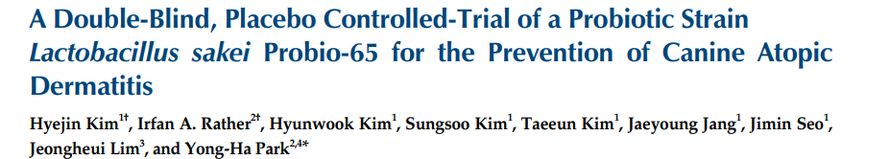
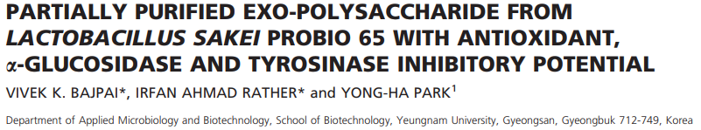
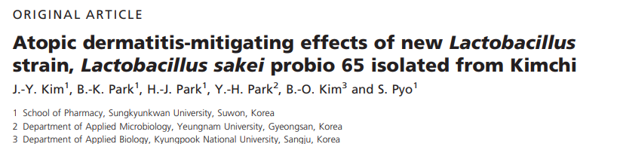
Notes:
COMPLIANCE: Add below disclaimer
These statements have not been evaluated by the food and drug administration. This product is not intended to diagnose, treat, cure or prevent any disease.

Slide 30
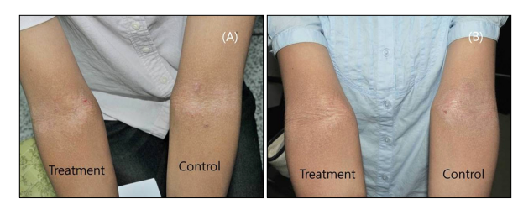
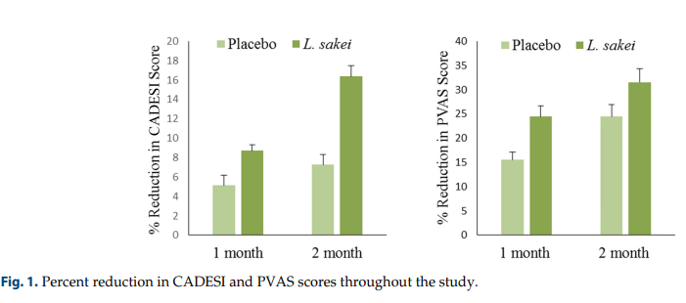
These statements have not been evaluated by the food and drug administration. This product is not intended to diagnose, treat, cure or prevent any disease.

Slide 31
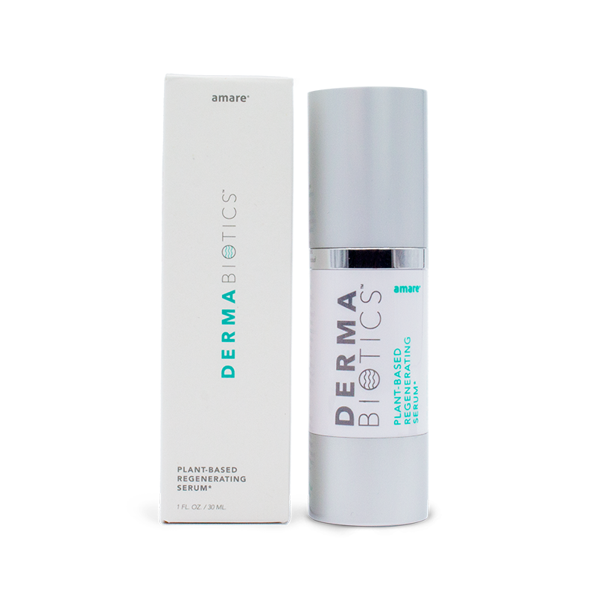
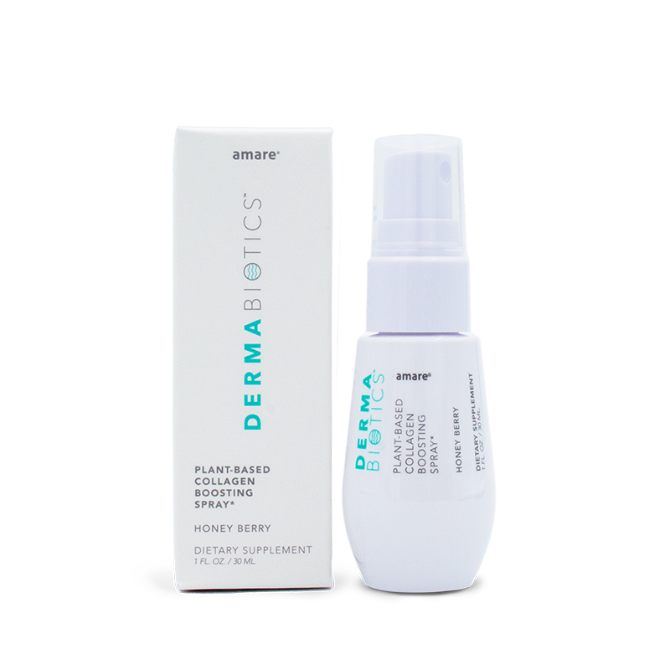

Slide 32
