Slide 1
Mental Wellness Meets Metabolism
Shawn Talbott, PhD
CNS, LDN, FACSM, FACN, FAIS
Chief Science Officer & Founding Executive

Slide 2
What if it’s not your fault that you’re having trouble losing weight…
…It might be your microbiome?
Overweight is a “hormone signaling” problem
Not a math problem!
  calories in versus calories out
Microbiome regulates…
  Mood
  Metabolism
  Appetite
  Inflammation
  Immune Function
  Gut Integrity (“leaky gut”)
Microbiome is our “internal pharmacy” — producing what we need — in the right amounts — when we need it…IF we activate it properly!

Slide 3
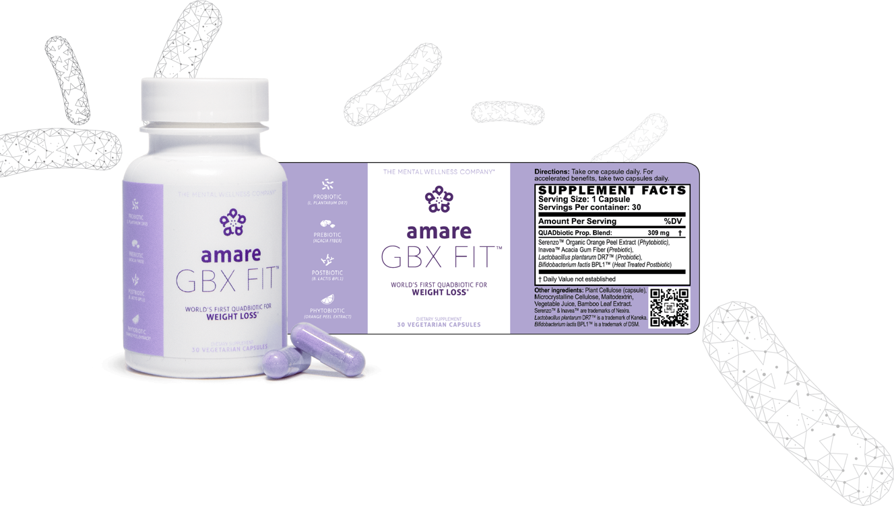
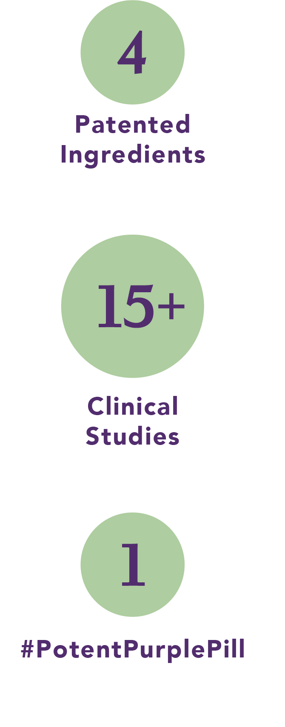
Like nothing else on the market.

Slide 4
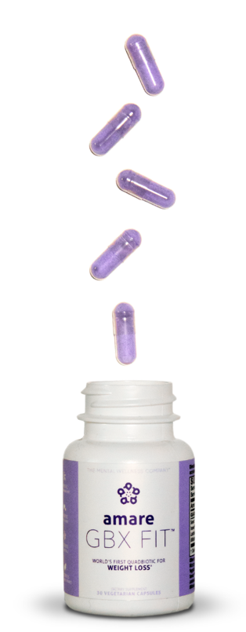
What It Is
the world’s first QUADbiotic formula in a convenient & cool purple pill that targets the gut microbiome for healthy weight loss
How It Works
Probiotic: Inflammation (de-bloat)*
Prebiotic: Appetite (less cravings)*
Phytobiotic: Stress (better sleep)*
Postbiotic: Belly Fat (lose inches)*
Why You’ll Love It
Weight loss support*
Improves gut health*
Reduces bloating and inflammation*
Regulates appetite and cravings*
How To Use It
Simply, take one pill per day. For accelerated benefits, take one pill in the morning and one in the evening. That’s it!

Slide 5
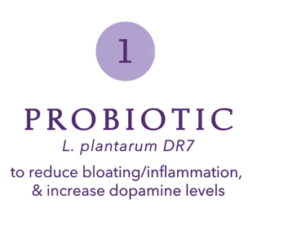
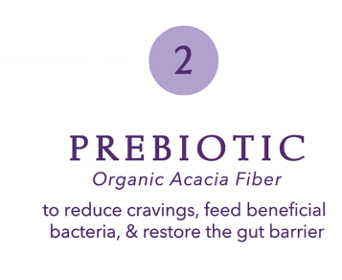

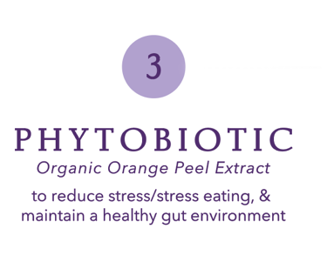
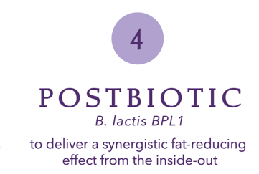
World’s First “QUADbiotic”

Slide 6
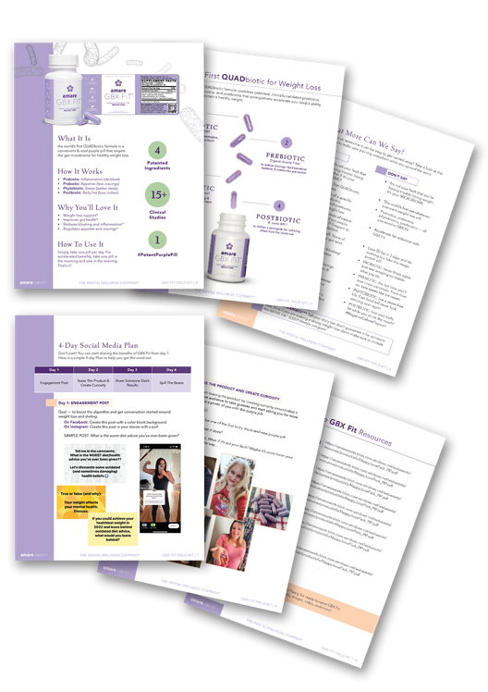

The Media Kit
Product Overview and Differentiators
4 Day Social Media Plan
Reachout scripts
PDFs, images, and video
Get all this info and MORE!
Download it now…

Slide 11
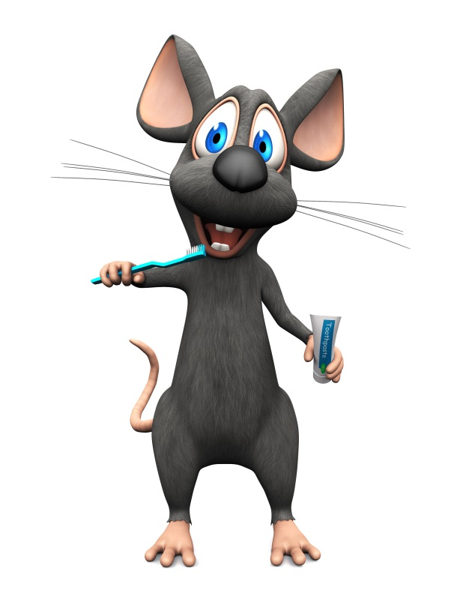
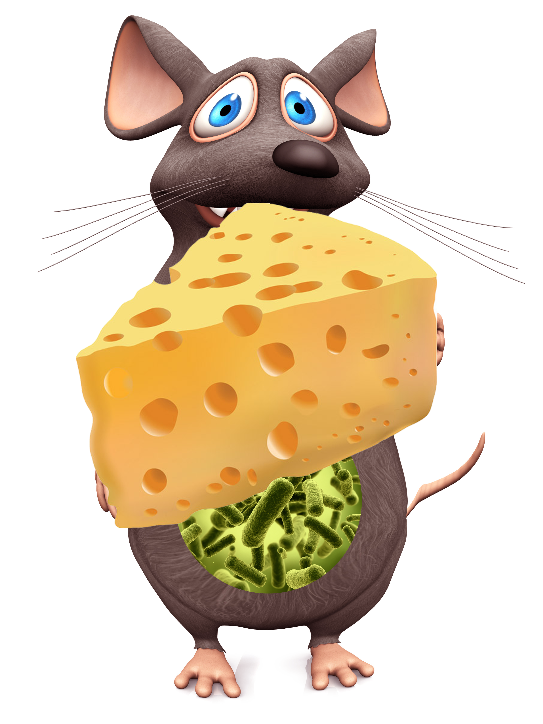
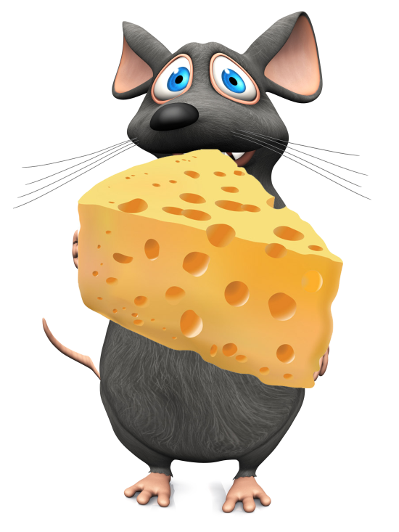
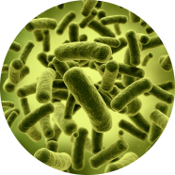
Obese
Overeating
Obese
Overeating
Lean
Obesogenic microbiota
Obesogenic microbiota
Germ-free

Slide 12
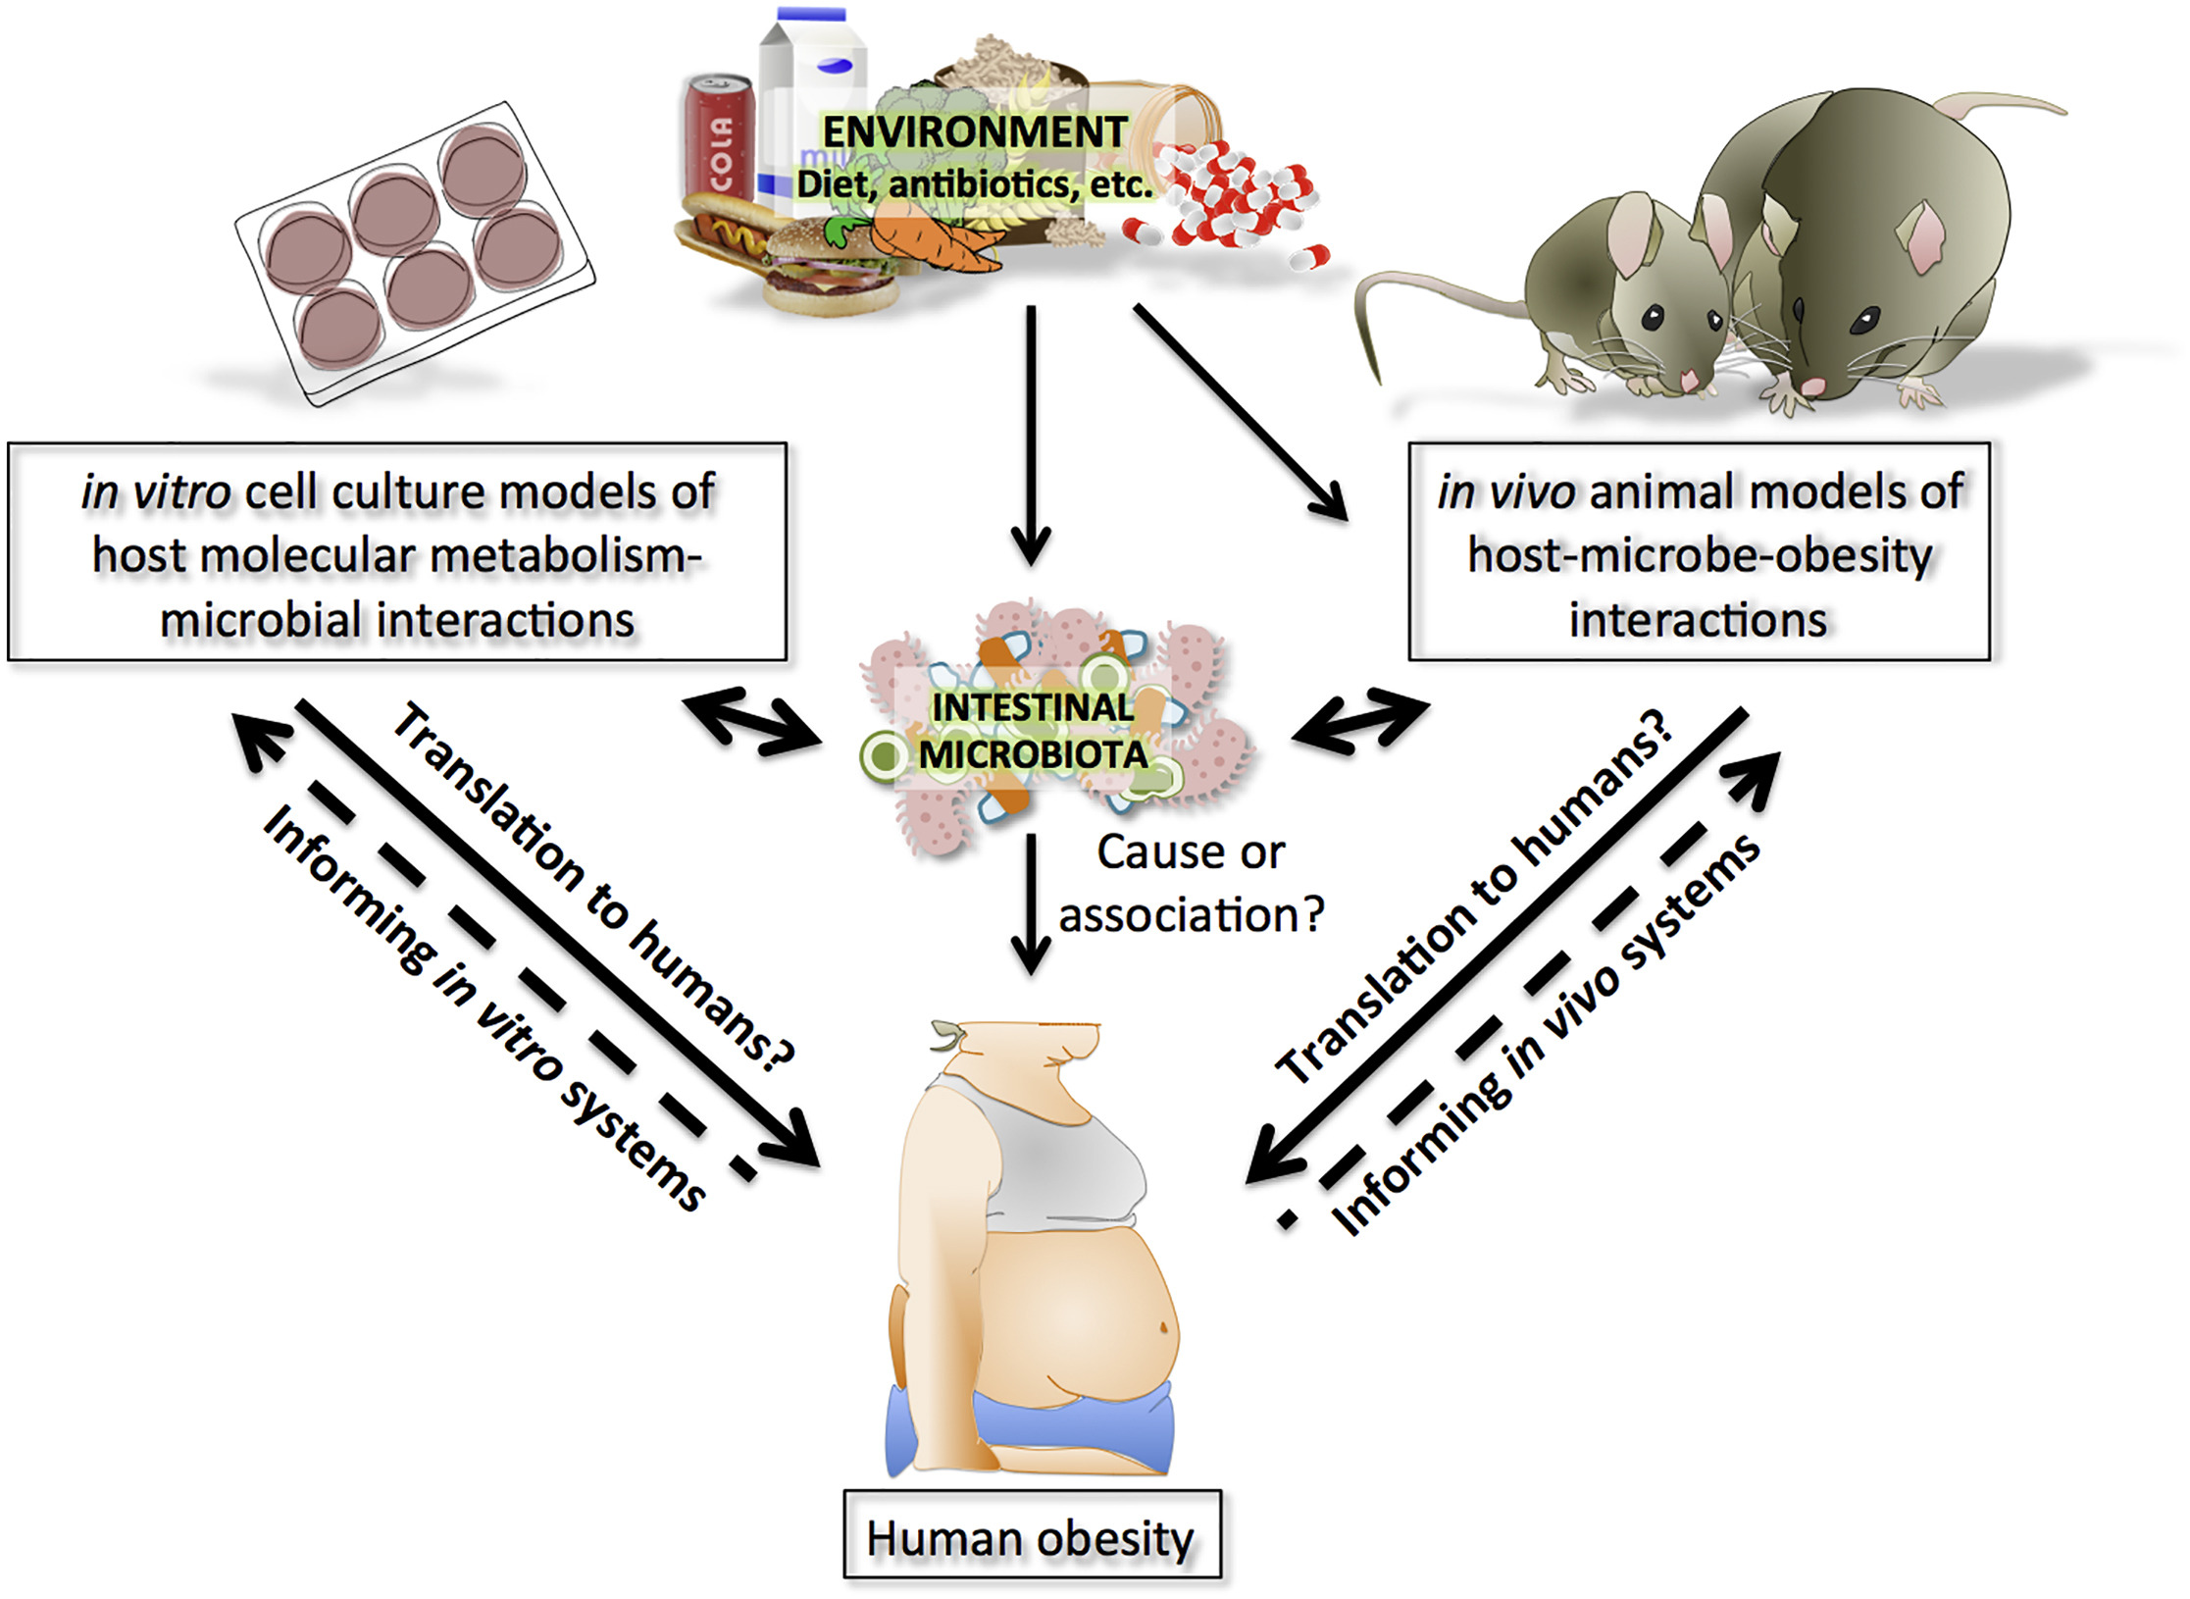

Slide 14
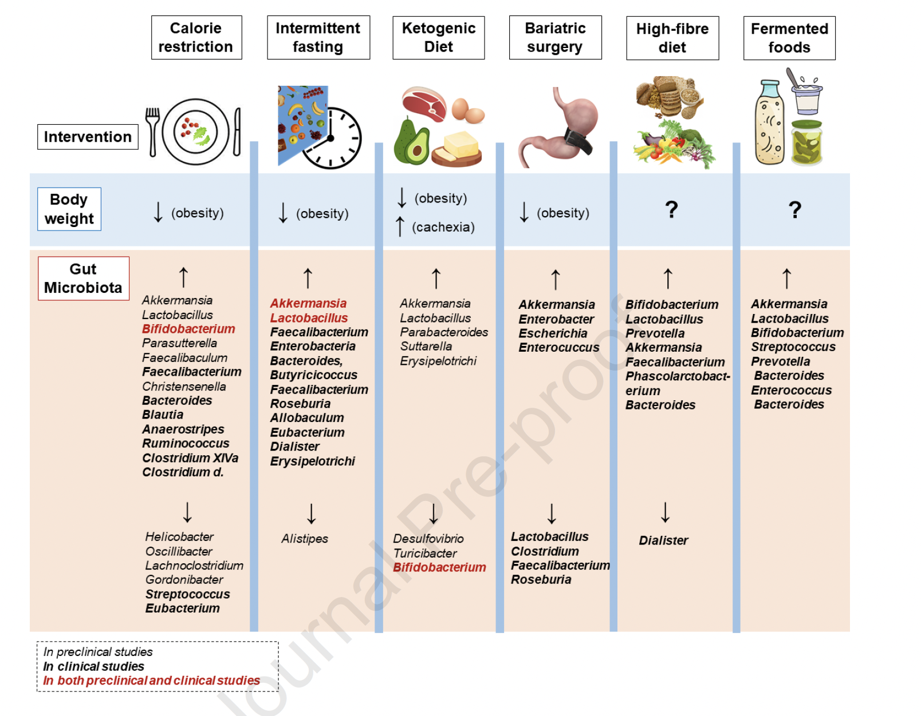

Slide 15
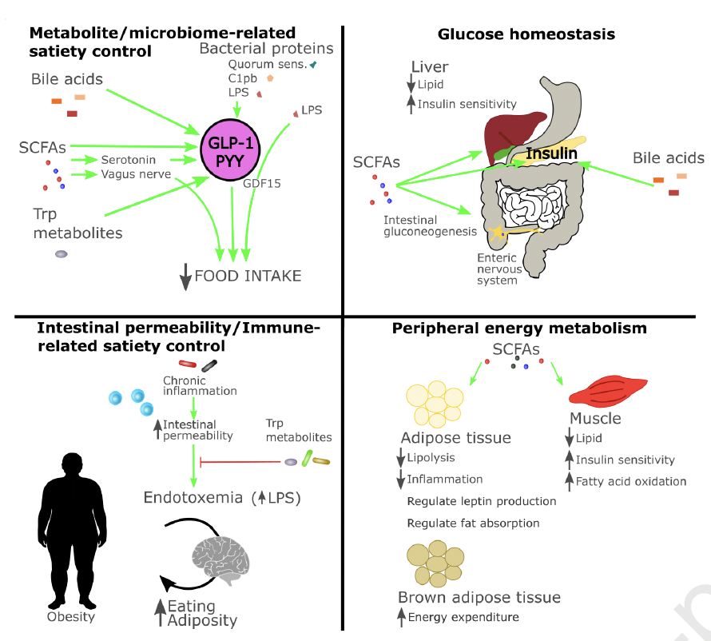

Slide 16
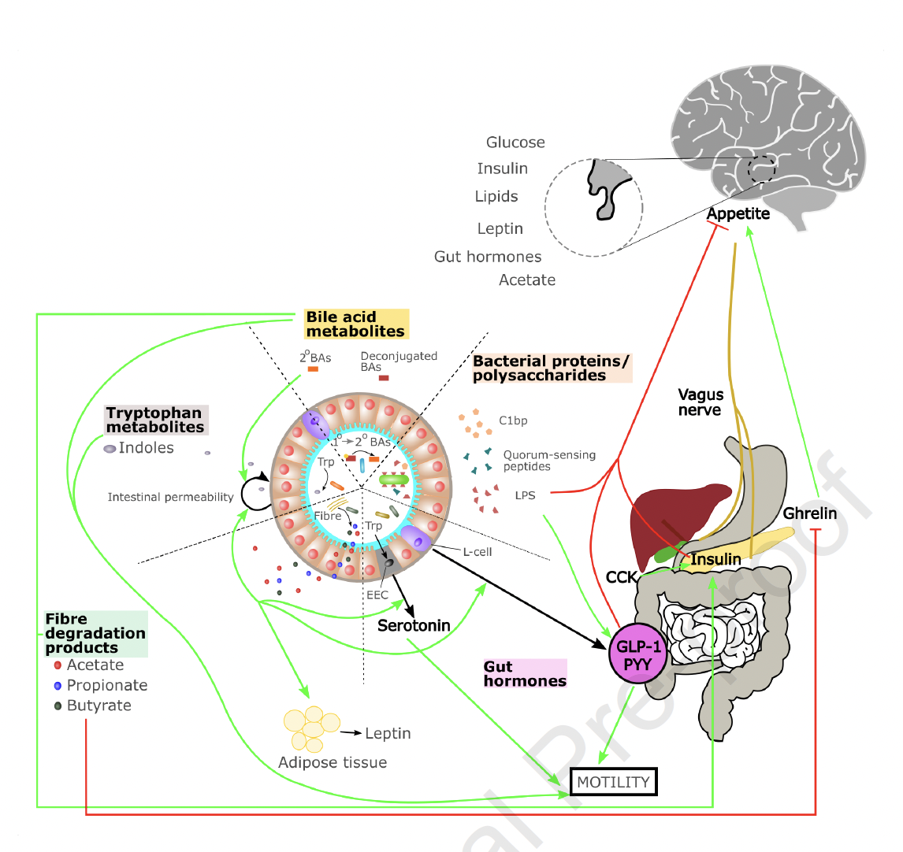

Slide 17
Highlights
The gut microbiota is involved in the control of nutrient availability, appetite and body weight;
Obesity and cachexia are associated with an altered gut microbiota;
Specific dietary and surgical approaches positively impact on body weight and gut microbiota
Manipulation of the gut microbiota alone is insufficient to alter body weight in humans.

Slide 19
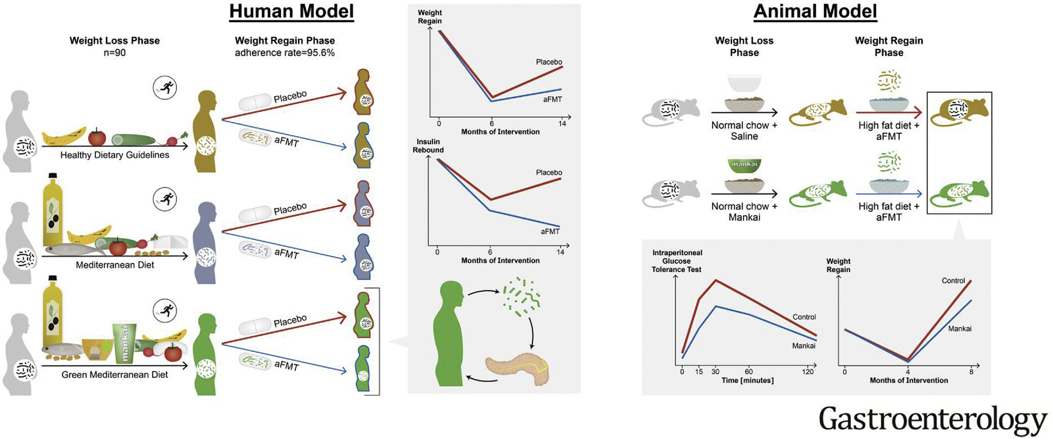

Slide 20


Bifidobacterium lactis BPL1
*Lose a dress size?
A study of HT-BPL1 found that people lost up to 2cm off their waist circumference without changing their dieting or exercise habits in 90 days*
(~approx. dropping a dress or jean size).

Slide 21
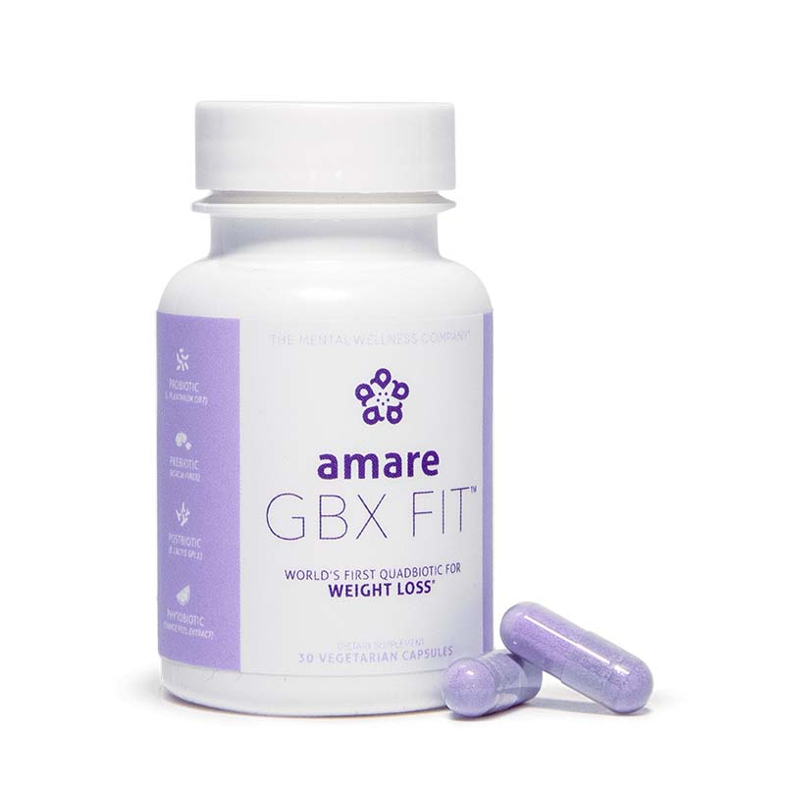

Slide 22
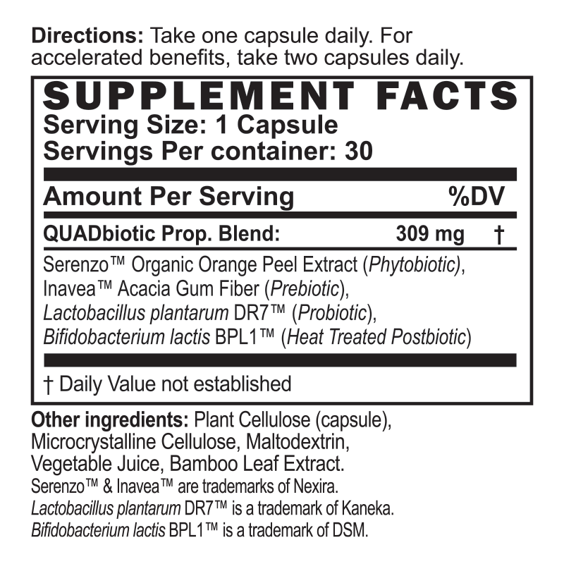




World’s First “Gut-Brain Axis” System for Weight Loss
PROBIOTIC
(L.plantarum DR7)
Feel Better
+
Look Better
PREBIOTIC
(Organic Acacia Fiber)
PHYTOBIOTIC
(Organic Orange Peel Extract)
POSTBIOTIC
(B. lactis BPL1)

Slide 23
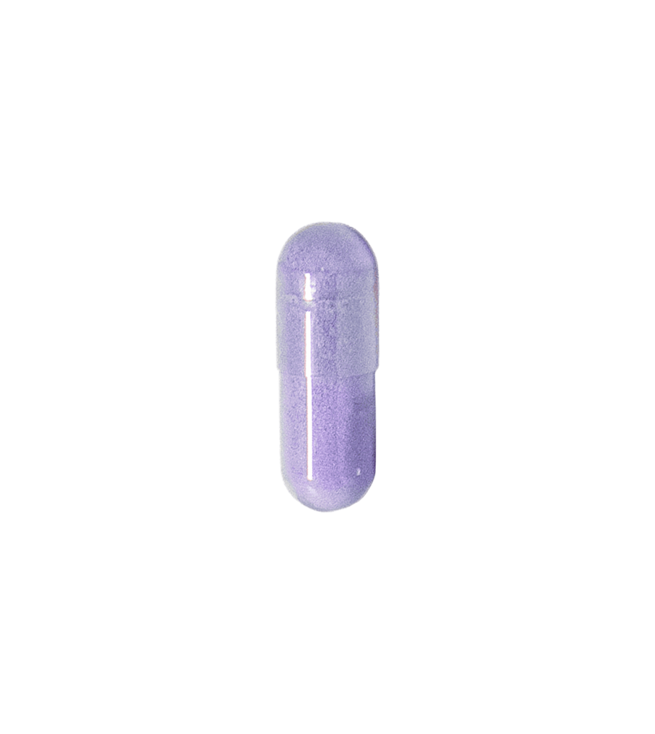
Amare GBX Fit Ingredients (“QUADbiotic”)
Probiotic – Inflammation (de-bloat)
Prebiotic – Appetite (less cravings)
Phytobiotic – Stress (better sleep)
Postbiotic – Belly Fat (lose inches)
Quick Start = 2 caps/day
Maintenance = 1 cap/day

Slide 24
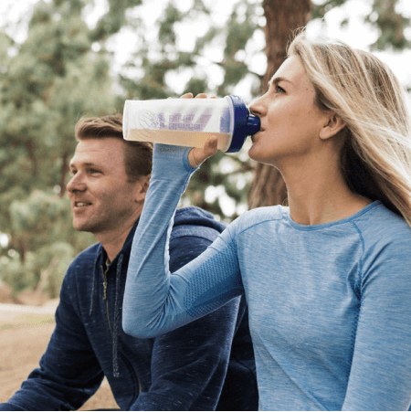

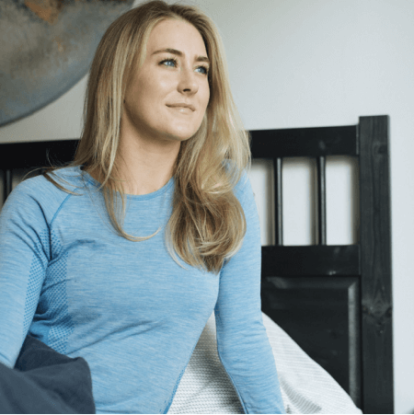
Program is EASY
MOVE
your muscles and lungs to mobilize fat stores and switch on feel-good endorphins and endocannabinoids
EAT
the right nutrients at the right time to switch on your microbiome and activate your mood and metabolism
SLEEP
your secret fat-destroying weapon is high-quality sleep – get it and watch the pounds and inches melt away

Slide 25
Real Life Results
Ironman Fitness
September – Xterra Off-Road Triathlon (Laguna Beach) – 2nd
October – Kona World Championships – Cancelled!
Nov 30 – started GBX Fit
  Already exercising, eating right, sleeping well…

Slide 26
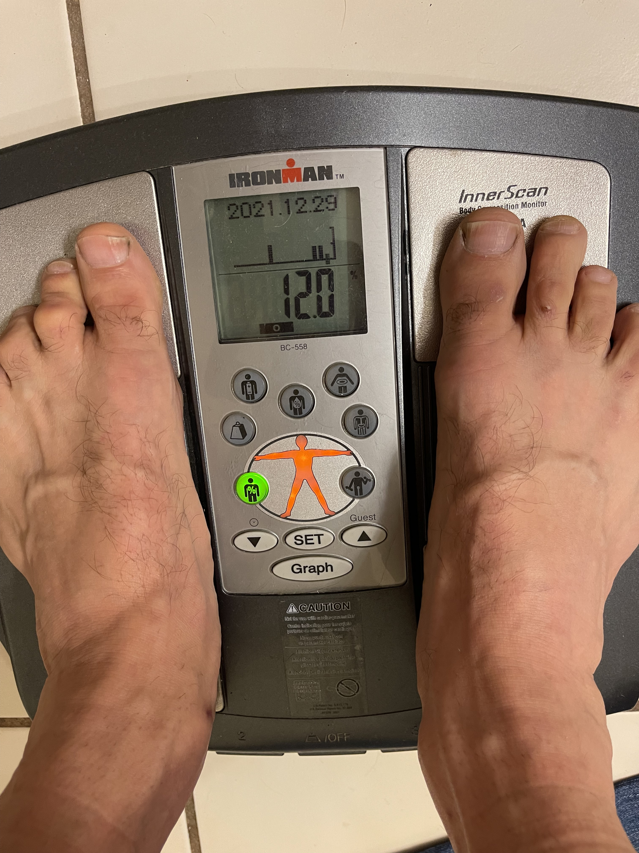
Real Life Results
No major changes in diet/exercise/sleep
Optimized GBX signaling
Signals = Success
November 30 – “Before”
December 29 – “After” (30 Days)
-5.5lbs (-21%)
-4.5lbs
-3%
-12%

Slide 27

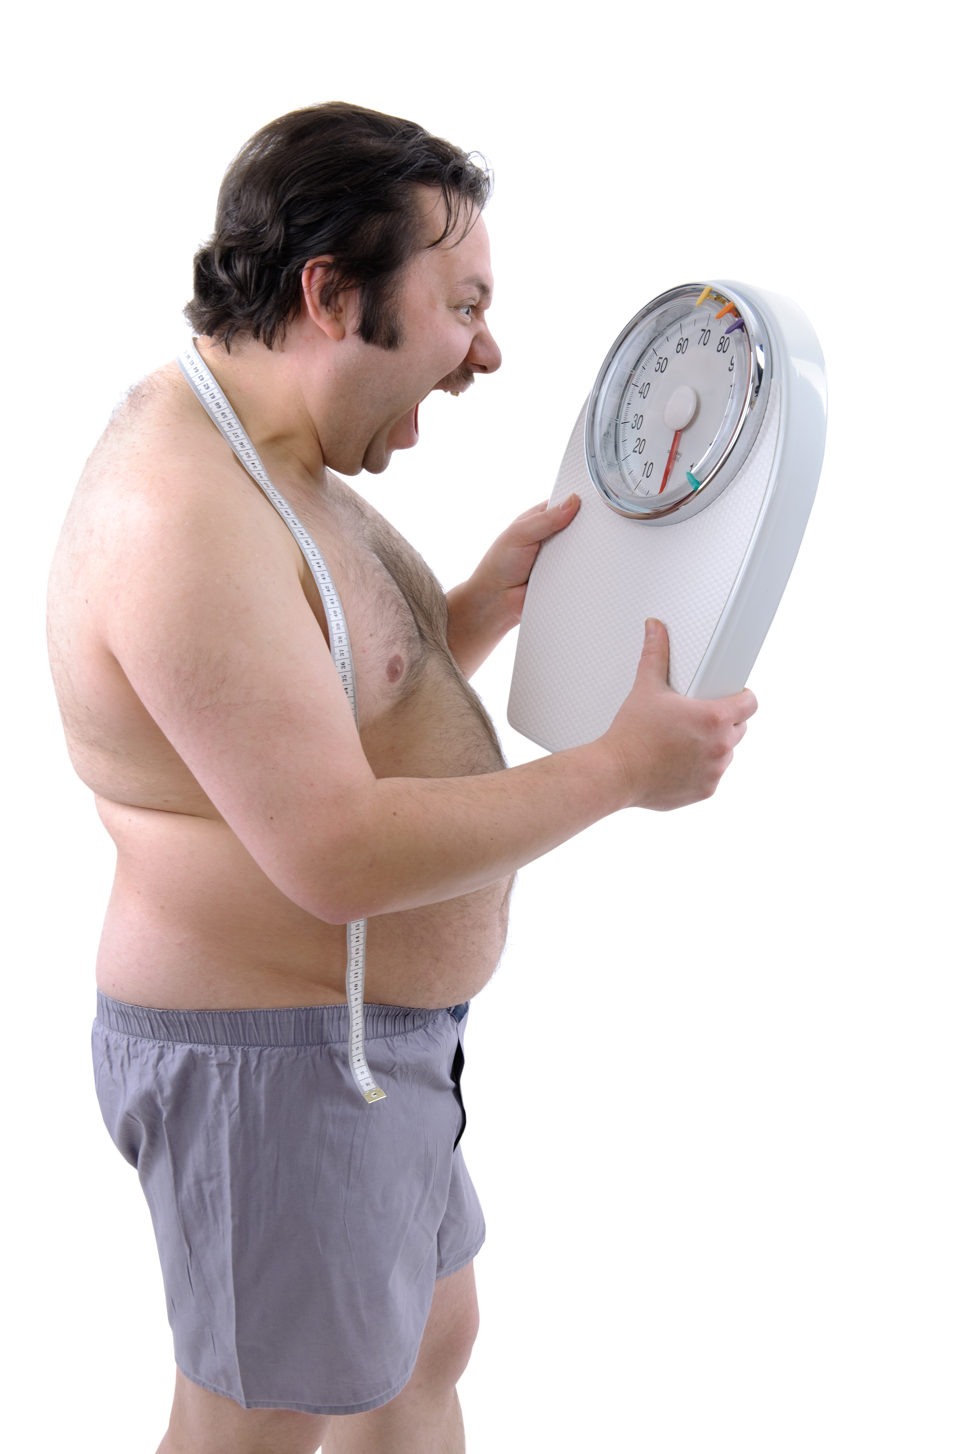
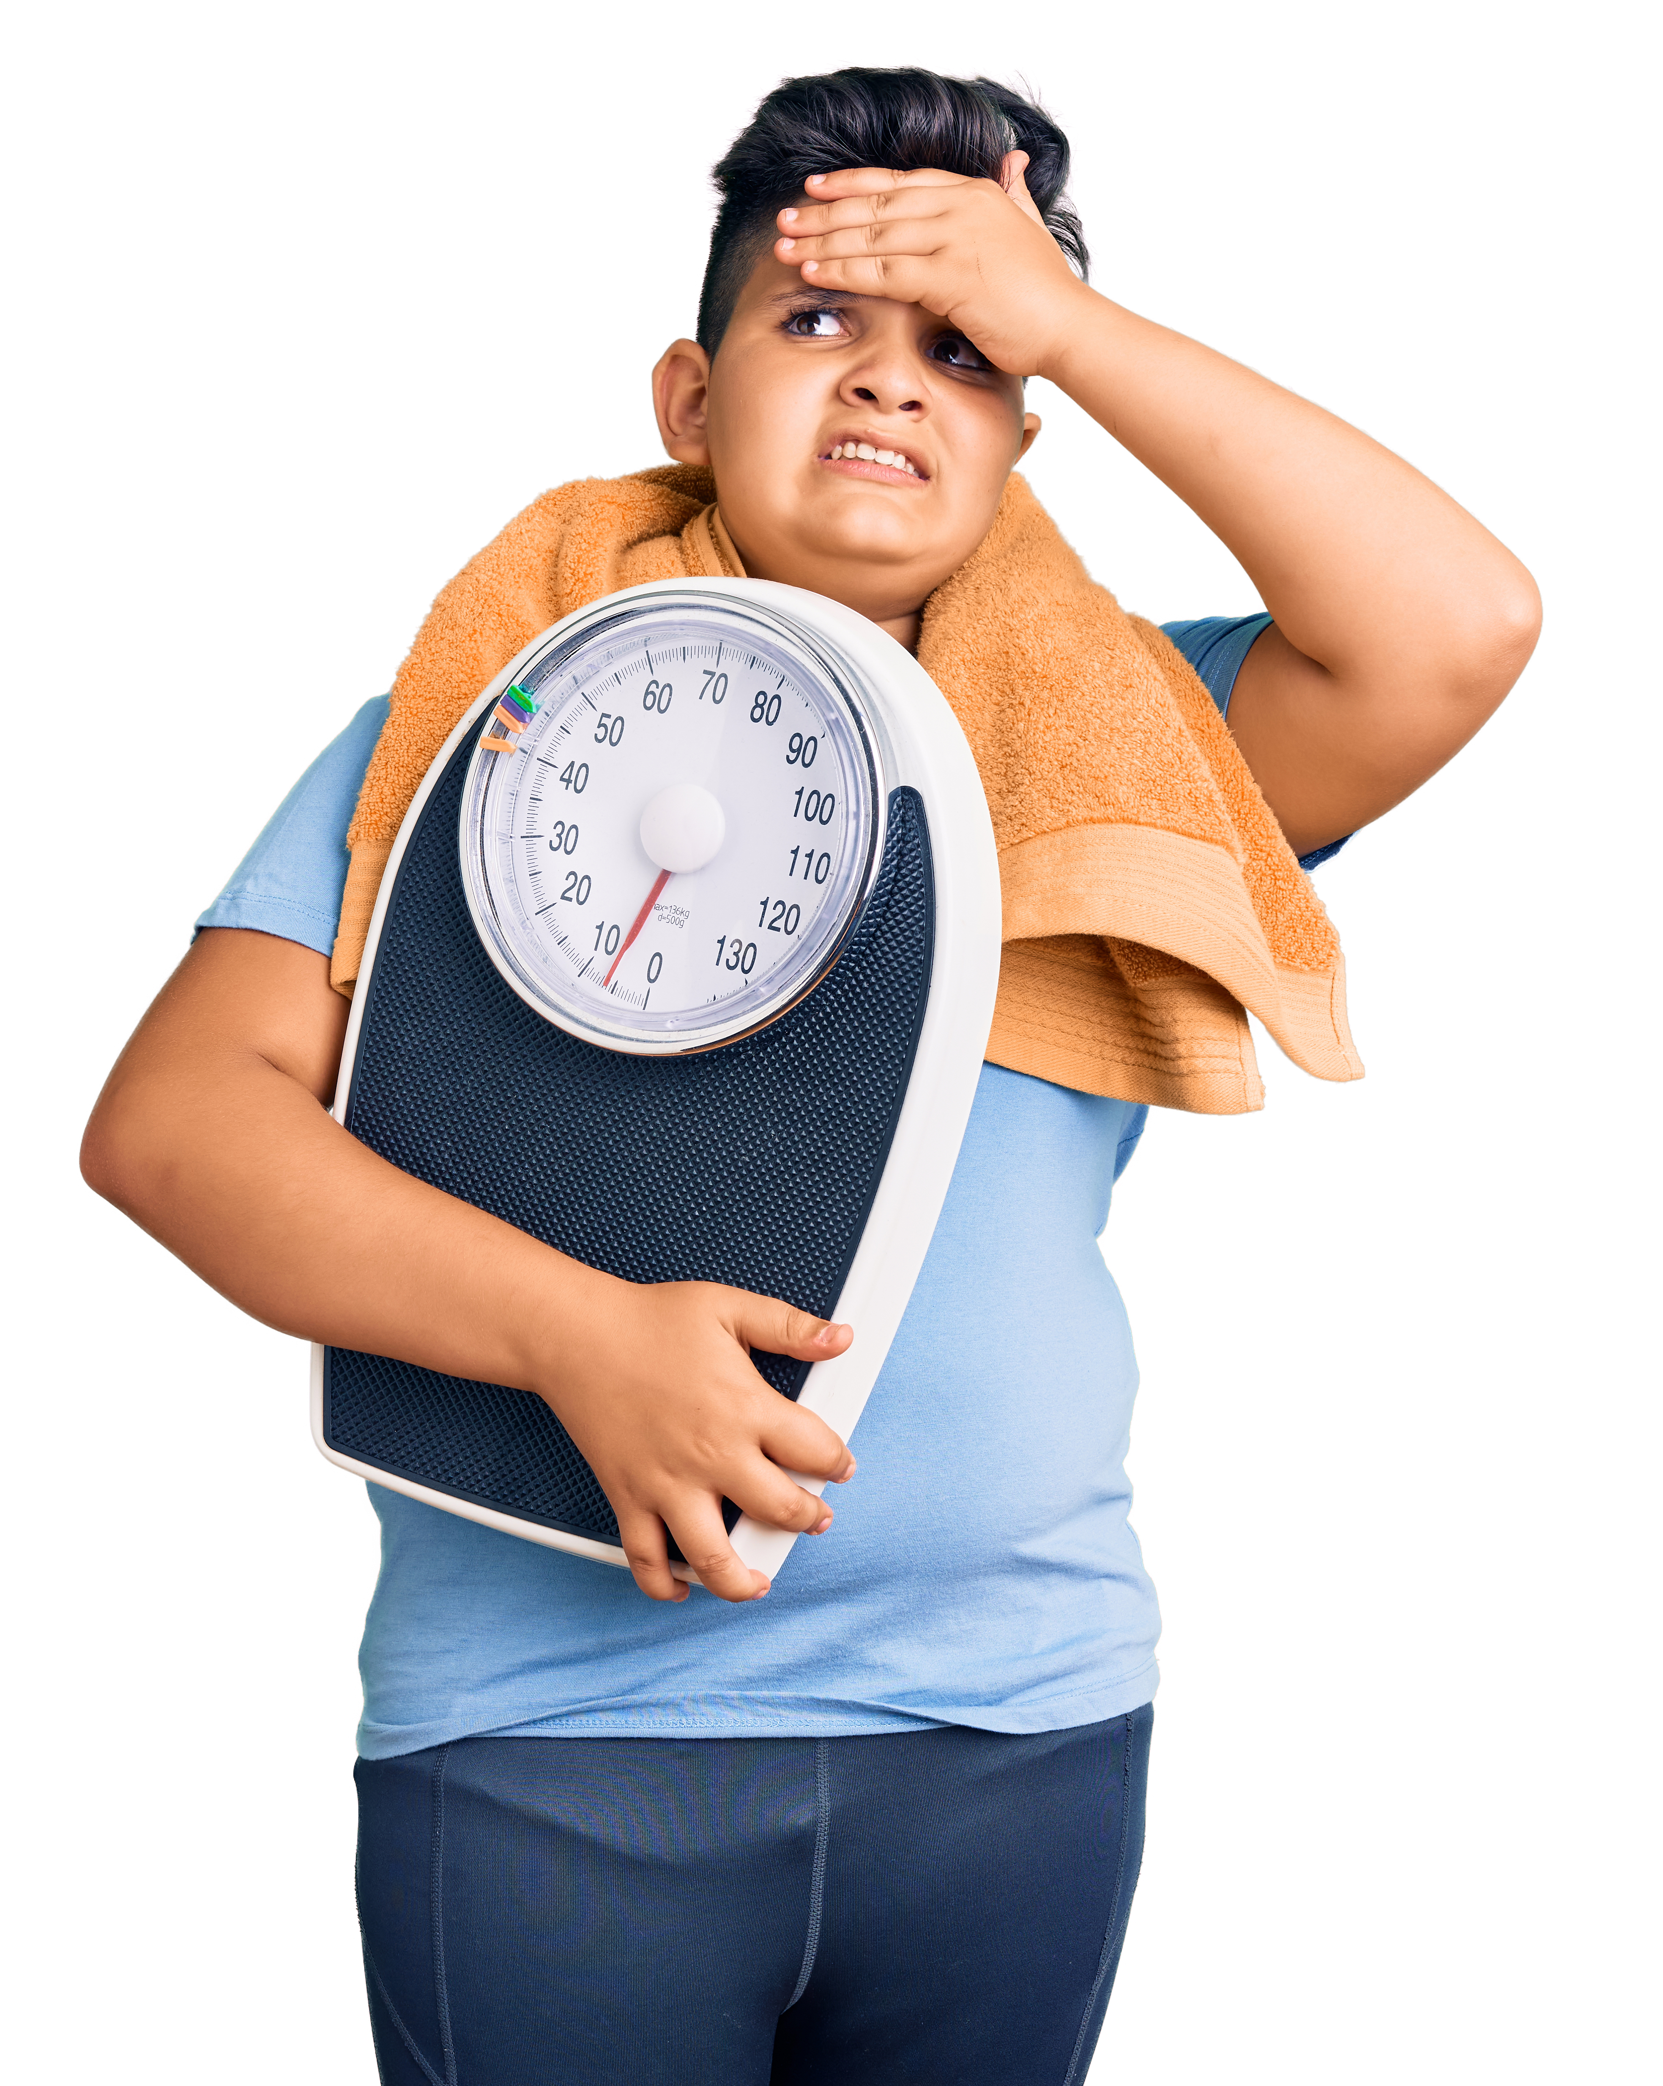
GBX Static → GBX Clarity
Frustration → Happy
Fatigue → Energy
Stress → Resilience
Cravings → Willpower
Storage → Release

Slide 28

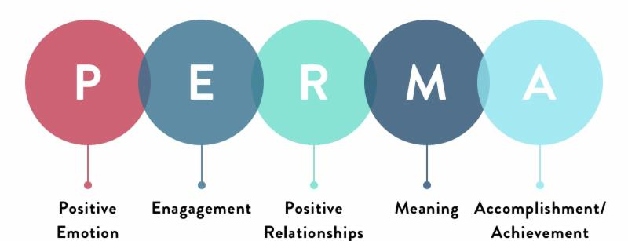
Human Flourishing

Slide 29
THANK YOU!

