Slide 1
Project b3
Summary
Shawn Talbott, PhD

Slide 2
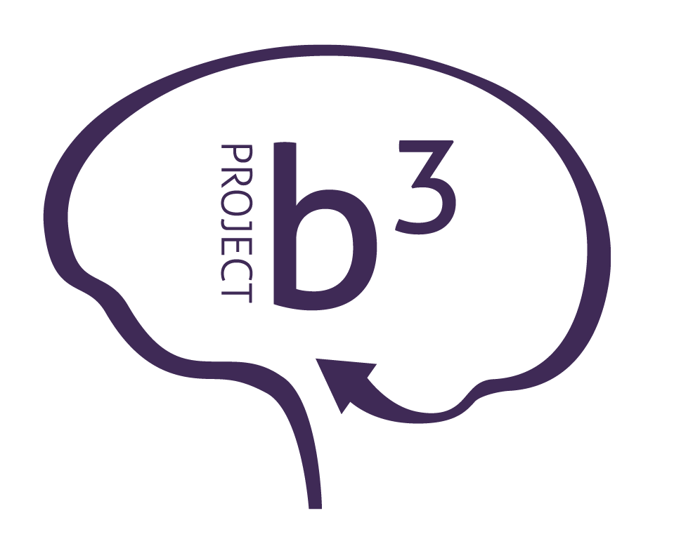

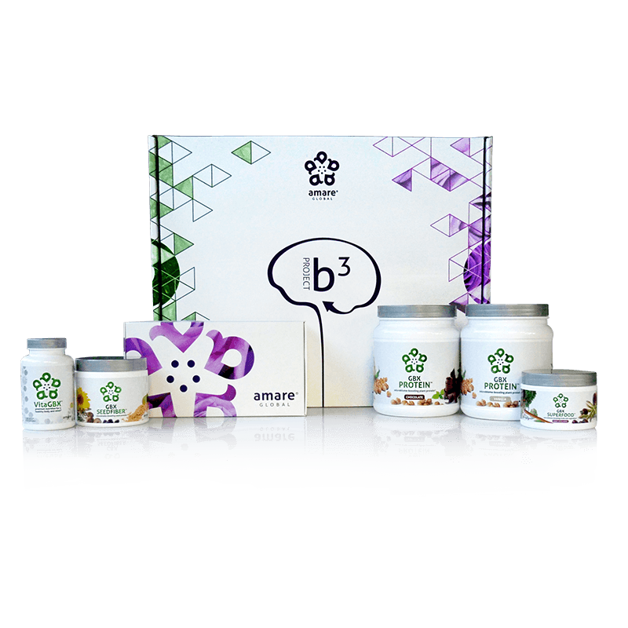
BODY.
BRAIN.
BIOME.
BODY. BRAIN. BIOME.
A fit body begins with mental wellness, and the key to a healthy brain is the gut microbiome. Body. Brain. Biome. Project b3. The holistic solution to a healthier well-being.
Item Code:
Retail Price:
Wholesale Price:
Subscribe & Save:
P012-P017
$486.00
$305.95 / 210 PV
$274.95 / 190 PV
*These statements have not been evaluated by the Food and Drug Administration. This product is not intended to diagnose, treat, cure, or prevent any disease.

Slide 3
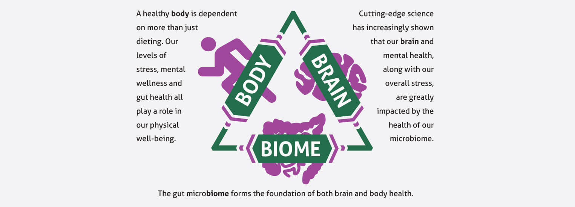
Project b³: BODY. BRAIN. BIOME.
Amare FundaMentals Pack (1), VitaGBX (1), GBX Protein (2), GBX SeedFiber (1), GBX SuperFood (1)

Slide 4
Topic Schedule (Wednesday 7-8pm MT)
May 1 – Session 1 (Week 0) – Overview
May 8 – Session 2 (Week 1) – Body/Brain/Biome
May 15 – Session 3 (Week 2) – Supplementation
May 22 – Session 4 (Week 3) – Exercise
May 29 – Session 5 (Week 4) – Nutrition
June 5 – Session 6 (Week 5) – Stress/Sleep
June 12 – Session 7 (Week 6) – Evaluation
June 19 – Session 8 (Week 7) – Open Discussion
June 26 – Session 9 (Week 8) – Review & Summary

Slide 5

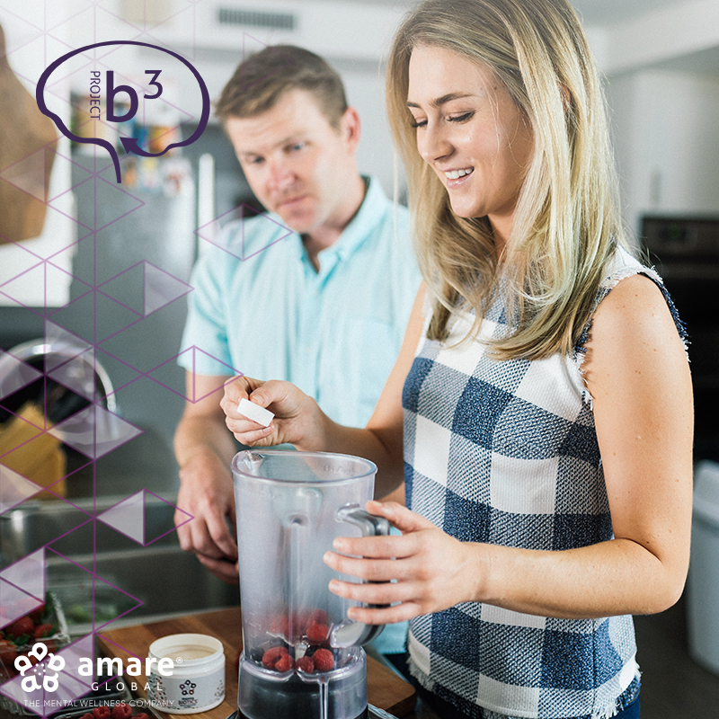


S.E.N.S.E. Program
Follow this step-by-step approach called S.E.N.S.E., which includes effective techniques and tips to create a healthier, happier you.
S – Supplementation
E – Exercise
N – Nutrition
S – Stress Management
E – Evaluation

Slide 6
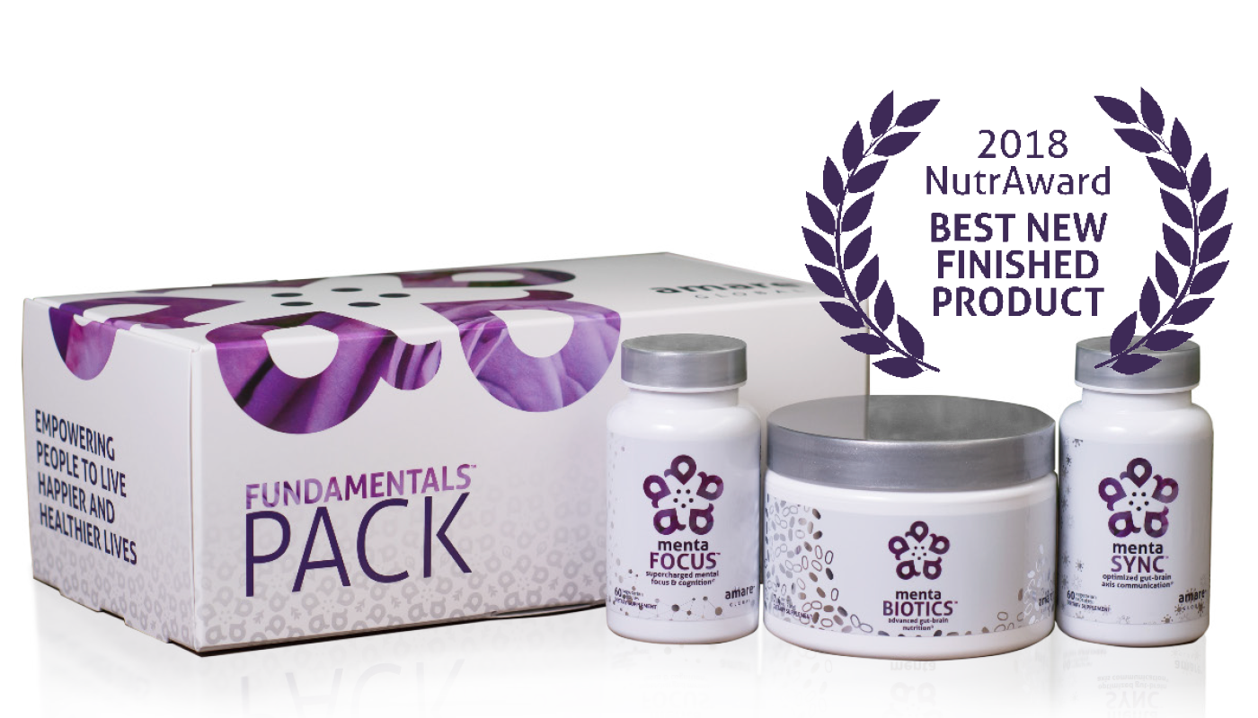





What’s in the Project b³ Pack?
Amare FundaMentals Pack (1), VitaGBX (1), GBX Protein (2),
GBX SeedFiber (1), GBX SuperFood (1)

Slide 7
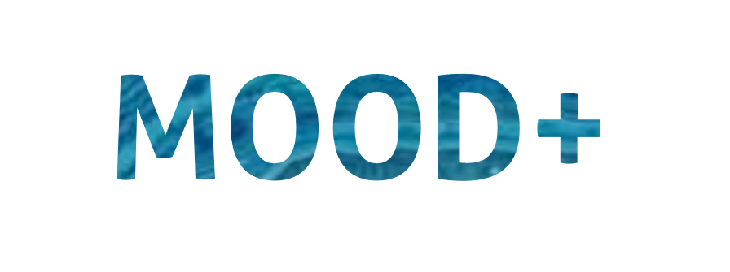

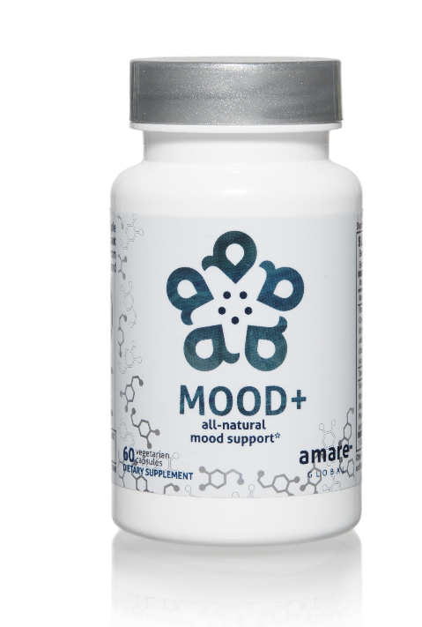
MOOD ELEVATING
PROMOTES RELAXATION
TENSION REDUCING
all-natural
mood support*
The key ingredients in Mood+ have multiple scientific studies that show significant benefits for mood support such as relief from anxious feelings, sadness, restlessness, and overall
stress relief.*
Item Code:
Retail Price:
Wholesale Price:
Subscribe & Save:
S006
$80.00
$59.95 / 52 PV
$53.95 / 46 PV
*These statements have not been evaluated by the Food and Drug Administration. This product is not intended to diagnose, treat, cure, or prevent any disease.

Slide 8
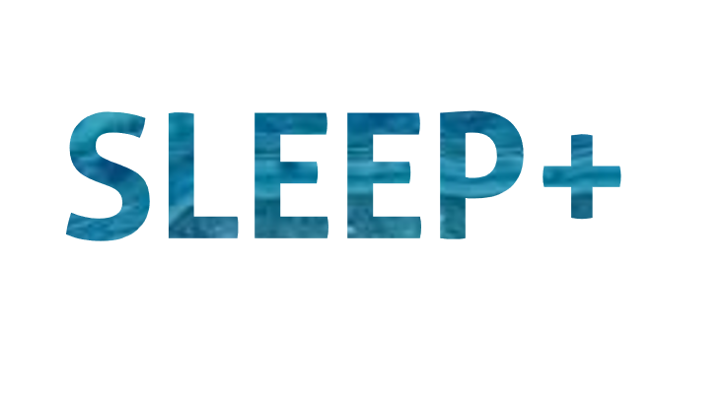
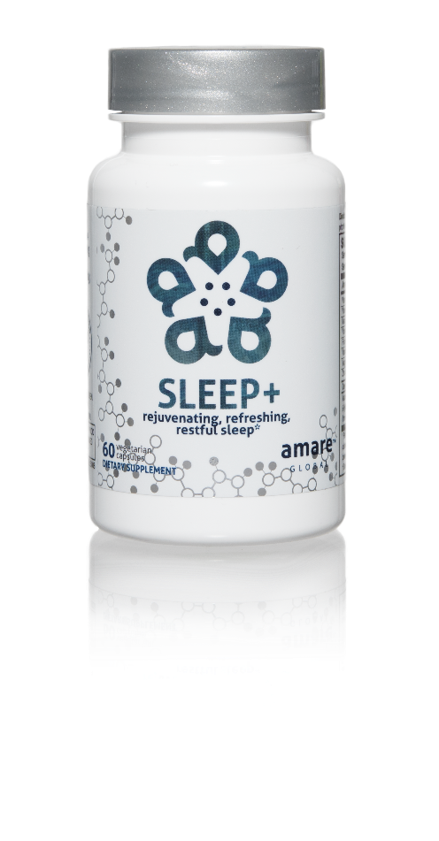

FALL ASLEEP FASTER
STAY ASLEEP LONGER
IMPROVES SLEEP QUALITY
rejuvenating, refreshing,
restful sleep*
The key ingredients in Sleep+ have multiple scientific studies that show significant benefits including helping you to fall asleep faster, stay asleep longer, and experience higher quality plus more rejuvenating sleep.*
Item Code:
Retail Price:
Wholesale Price:
Subscribe & Save:
S008
$80.00
$59.95 / 52 PV
$53.95 / 46 PV
*These statements have not been evaluated by the Food and Drug Administration. This product is not intended to diagnose, treat, cure, or prevent any disease.

Slide 9
What to DO? (simple)
Daily
  Fundamentals (Mentabiotics, MentaFocus, MentaSync)
  VitaGBX (breakfast & dinner)
  GBX Shake/Smoothie (Protein, SuperFood, SeedFiber) – breakfast/lunch?
  Eat REAL Food! (Helping Hand)
  Project B3 FB Group (check-in)
Weekly
  HIIT – 3x
  Weights – 2x
  Project B3 Seminar (education/reinforcement)

Slide 10
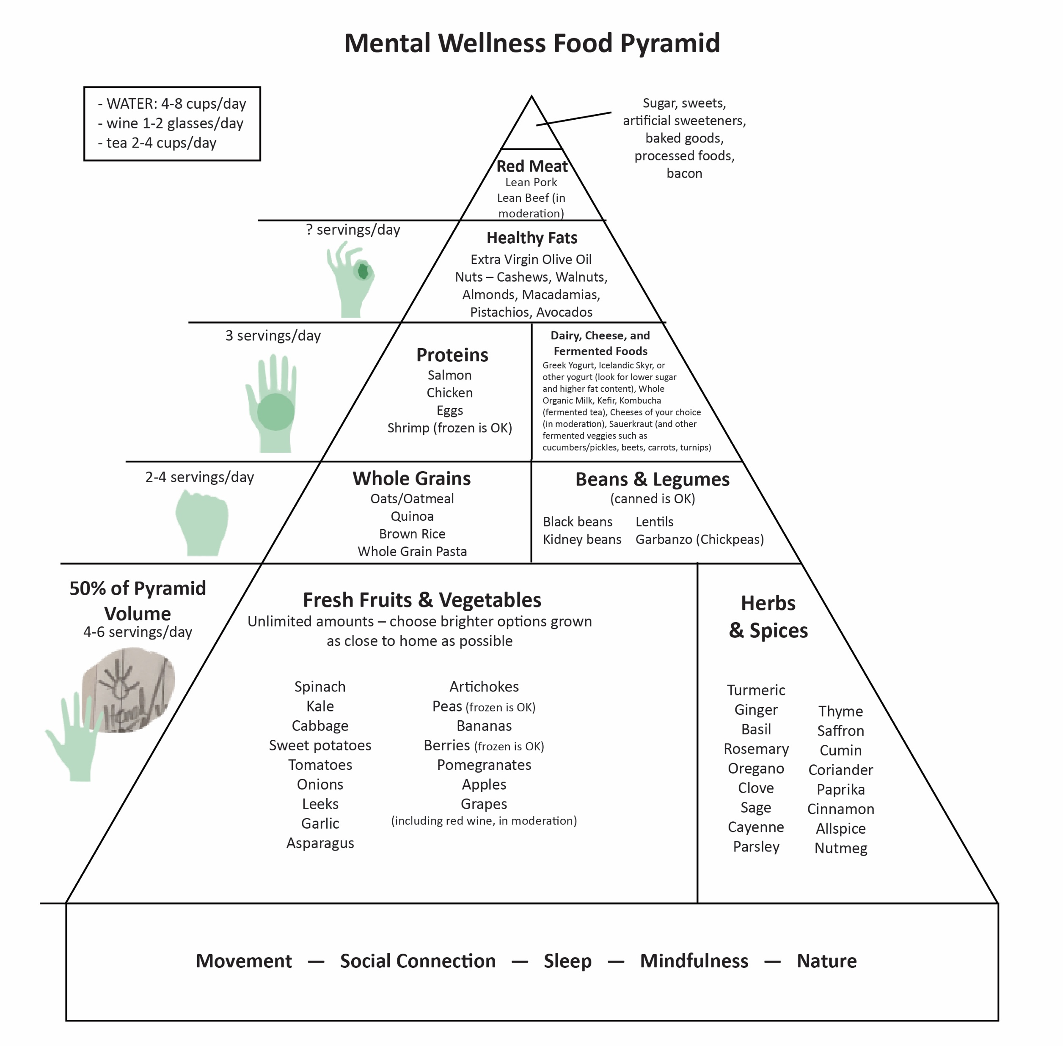

Slide 11


Slide 13
Interval Training
Alternates between high intensity and low intensity exercise
Warm-up (6min)
1 minute high / 1 minute low intensity
2 minutes high / 2 minutes low intensity
3 minutes high / 3 minutes low intensity
2 minutes high / 2 minutes low intensity
1 minute high / 1 minute low intensity
Cool-down (6min)
18min Interval Training + 12 min warm/cooldown = 30min total
3x per week

Slide 14

Strength Training
Builds lean muscle mass, which increases BMR
Tones and defines the muscles
Improves posture
Helps maintain bone mineral density
Reduces stress + improves mood
20min / 2x per week

Slide 15
“Evaluation” = Weekly Check-Ins
Move
Eat (mindfully)
Breathe / Meditate
  5-5-5 triangle x 4 = 60 seconds
  Do this a few times, focusing on your breath
  Refocus a wandering mind as needed back to breath
Prioritize
  You can’t do it all (really, you can’t)
  What are the MOST important things to get done TODAY? (big rocks)
Connect
  Phone a Friend - Talk is better than text or email
Gratitude
  What went well today, yesterday, this week?
  Gratitude Journal (phone notebook, sticky notes near bed…)

Slide 16
What Benefits Should I Expect?
Improve Gut Health
Balance Microbiome
Optimize Gut-Brain-Axis Function
Reduce Stress
Improve Vigor
Boost Energy
Maximize Sleep Quality
Sharpen Mental Clarity
Enhance Skin Tone
Reduced Cravings
Improve Body Composition = Fat/Lean

Slide 17
Eight-Week Survey Results
95% of people experienced an increase in their level of understanding about proper supplementation, exercise, nutrition, and sleep.
87% of individuals stated that Project b3 has helped improve mood, reduce stress, and/or increase motivation.
85% of people said the program was easy to incorporate into their daily routine
85% of people noticed an improvement in their physical health, fitness, and overall wellness.
4 out of 5 people said that Project b3 helped them control food cravings and reduce stress eating and that they feel better and better as time passed with Project b3 (better at week 4 than week 2; better at week 8 than week 4)
9 out of 10 people report after 8 weeks on Project b3 that they plan to continue with the products and program.

Slide 18
THE THREE THINGS YOU SHOULD KNOW ABOUT
MENTAL WELLNESS
How you feel is not just in your head — it’s also in your gut.
Our “second brain” includes the microbiome and plays a major role in mental wellness.
You can now DO something NATURALLY to improve your mental wellness.
WHERE ARE YOU ON THE MENTAL WELLNESS CONTINUUM? (Circle your current number)
1
2
3
4
5
6
7
8
9
10
DISEASE STATUS
“TYPICAL”
OPTIMIZED
Depression
Anxiety
Diabetes
Obesity
Heart Disease
Autoimmune
Arthritis
Fibromyalgia
CFS
Dementia
ADD / ADHD
Alzheimer’s
Fatigue
Tension
Sad
Brain Fog
Headaches
Acne
Eczema
Congestion
URTI’s
Joint Pain
Muscle Pain
Bloated
Chubby
Energetic
Calmness
Happy
Sharp
Creative
Clear Skin
Rarely Sick
Flexible
Lean
Strong
Resilient
RED
ORANGE
YELLOW
GREEN
BLUE
INDIGO
VIOLET

Slide 19
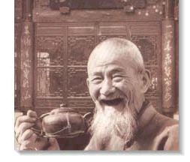
GOOD
HEALTH!

