Slide 1
Project b3 Overview
Shawn Talbott, PhD

Slide 2


Slide 3
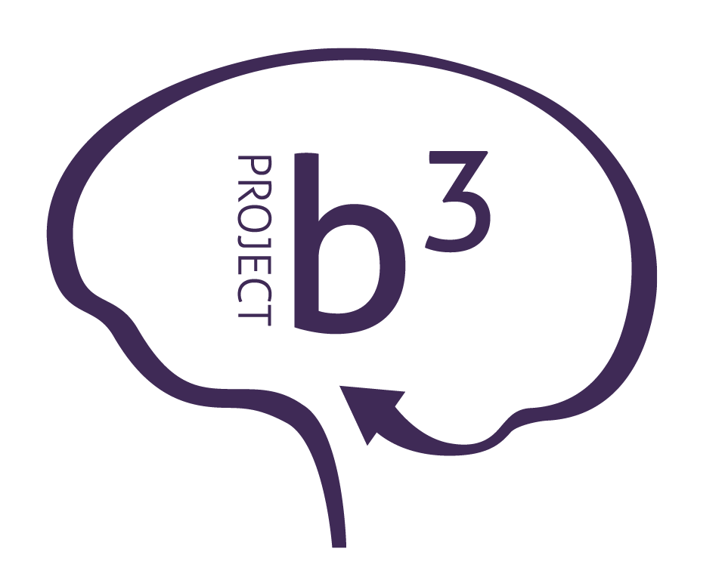

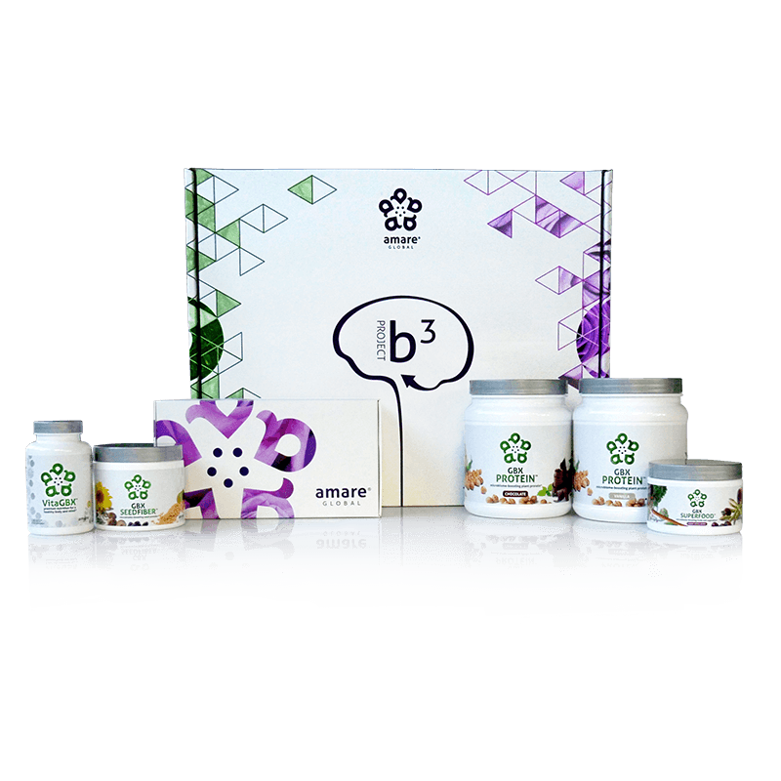
BODY.
BRAIN.
BIOME.
BODY. BRAIN. BIOME.
A fit body begins with mental wellness, and the key to a healthy brain is the gut microbiome. Body. Brain. Biome. Project b3. The holistic solution to a healthier well-being.
Item Code: Retail Price: Wholesale Price: Subscribe & Save:
P012-P017 $486.00 $305.95 / 210 PV $274.95 / 190 PV
*These statements have not been evaluated by the Food and Drug Administration. This product is not intended to diagnose, treat, cure, or prevent any disease.

Slide 4
THE THREE THINGS YOU SHOULD KNOW ABOUT MENTAL WELLNESS
How you feel is not just in your head — it’s also in your gut.
Our “second brain” includes the microbiome and plays a major role in mental wellness.
You can now DO something NATURALLY to improve your mental wellness.
WHERE ARE YOU ON THE MENTAL WELLNESS CONTINUUM? (Circle your current number)
1
2
3
4
5
6
7
8
9
10
DISEASE STATUS
“TYPICAL”
OPTIMIZED
Depression
Anxiety
Diabetes
Obesity
Heart Disease
Autoimmune
Arthritis
Fibromyalgia
CFS
Dementia
ADD / ADHD
Alzheimer’s
Fatigue
Tension
Sad
Brain Fog
Headaches
Acne
Eczema
Congestion
URTI’s
Joint Pain
Muscle Pain
Bloated
Chubby
Energetic
Calmness
Happy
Sharp
Creative
Clear Skin
Rarely Sick
Flexible
Lean
Strong
Resilient
RED
ORANGE
YELLOW
GREEN
BLUE
INDIGO
VIOLET

Slide 5
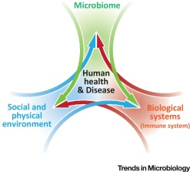
Biome
Body
Brain

Slide 6
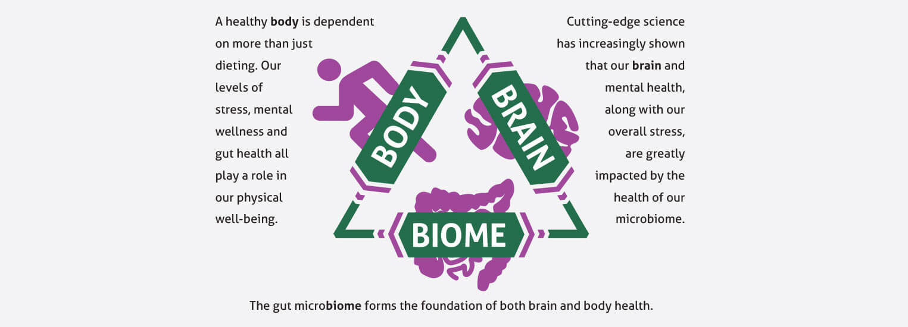
Project b³: BODY. BRAIN. BIOME.
Amare FundaMentals Pack (1), VitaGBX (1), GBX Protein (2), GBX SeedFiber (1), GBX SuperFood (1)

Slide 7
Topic Schedule (Wednesday 7-8pm MT)
May 1 – Session 1 (Week 0) – Overview
May 8 – Session 2 (Week 1) – Body/Brain/Biome
May 15 – Session 3 (Week 2) – Supplementation
May 22 – Session 4 (Week 3) – Exercise
May 29 – Session 5 (Week 4) – Nutrition
June 5 – Session 6 (Week 5) – Stress/Sleep
June 12 – Session 7 (Week 6) – Evaluation
June 19 – Session 8 (Week 7) – Open Discussion
June 26 – Session 9 (Week 8) – Review & Summary

Slide 8




S.E.N.S.E. Program
Follow this step-by-step approach called S.E.N.S.E., which includes effective techniques and tips to create a healthier, happier you.
S – Supplementation
E – Exercise
N – Nutrition
S – Stress Management
E – Evaluation

Slide 9
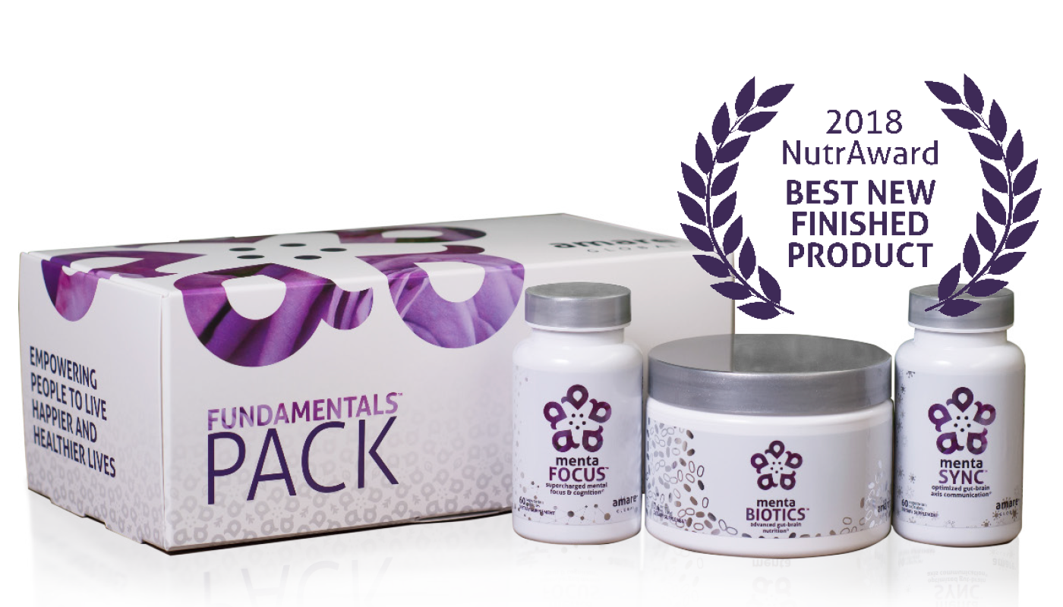
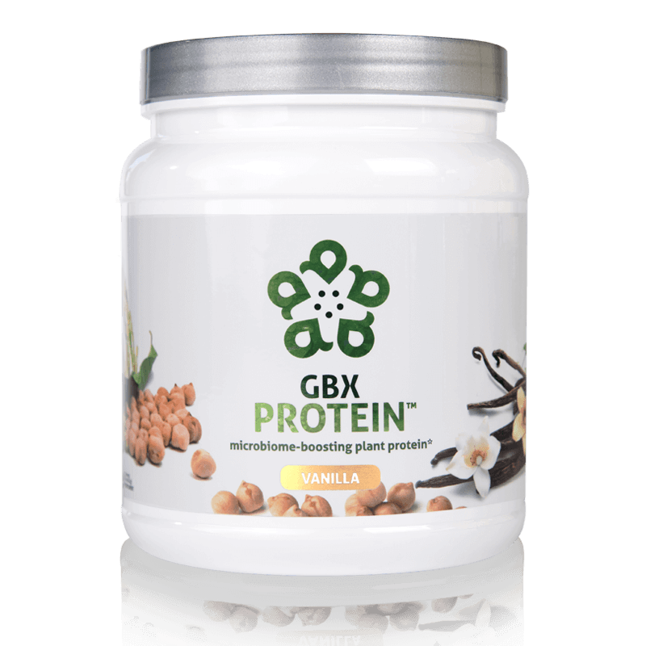
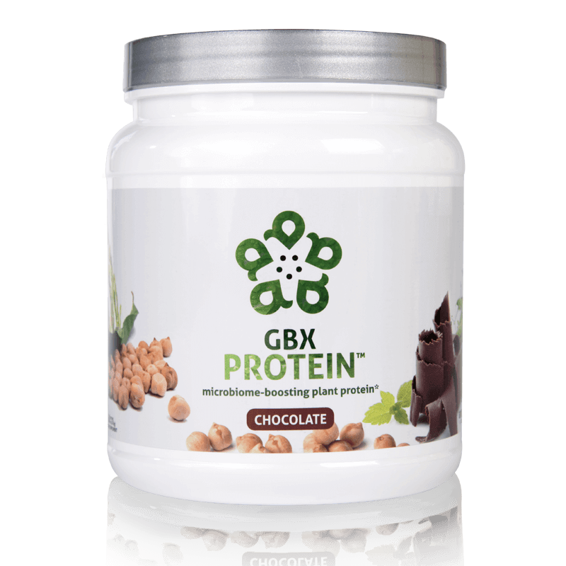
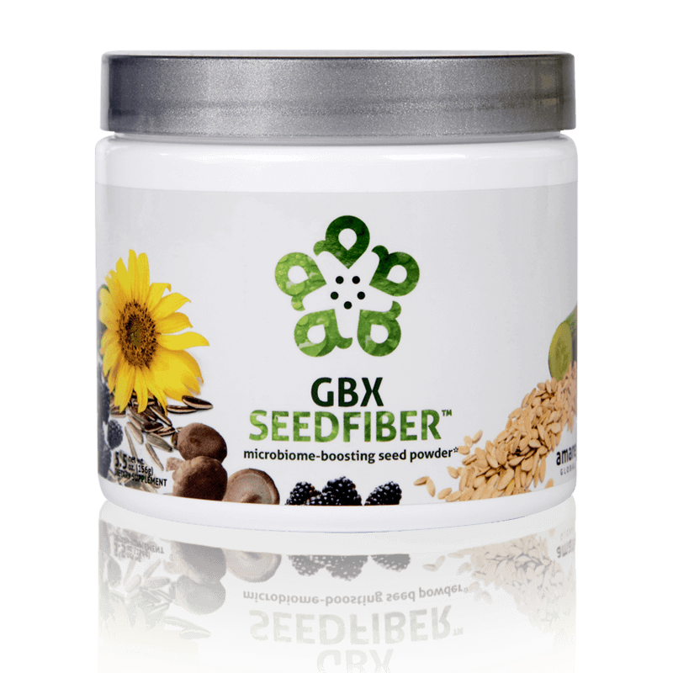

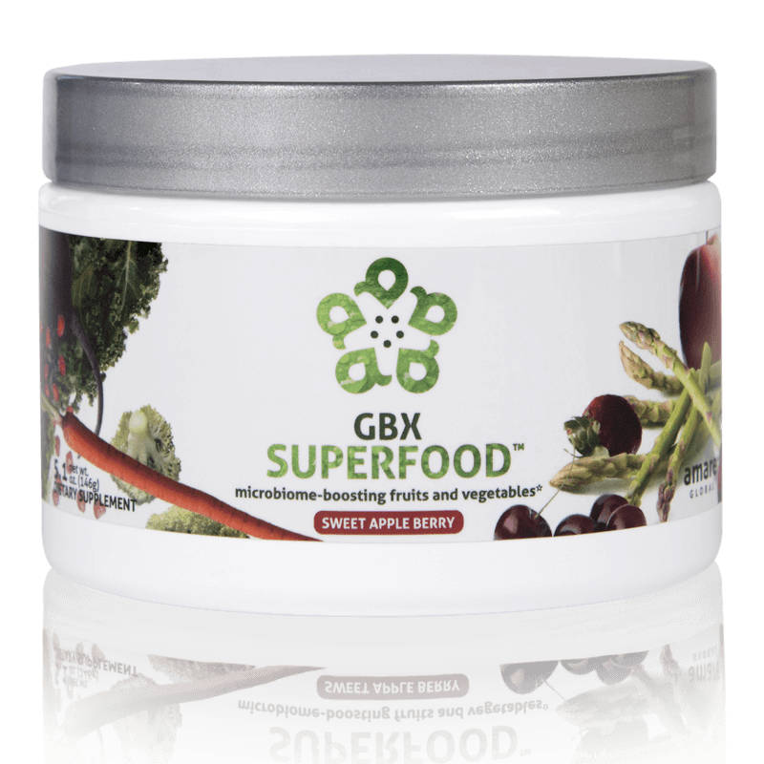
What’s in the Project b³ Pack?
Amare FundaMentals Pack (1), VitaGBX (1), GBX Protein (2),
GBX SeedFiber (1), GBX SuperFood (1)

Slide 10
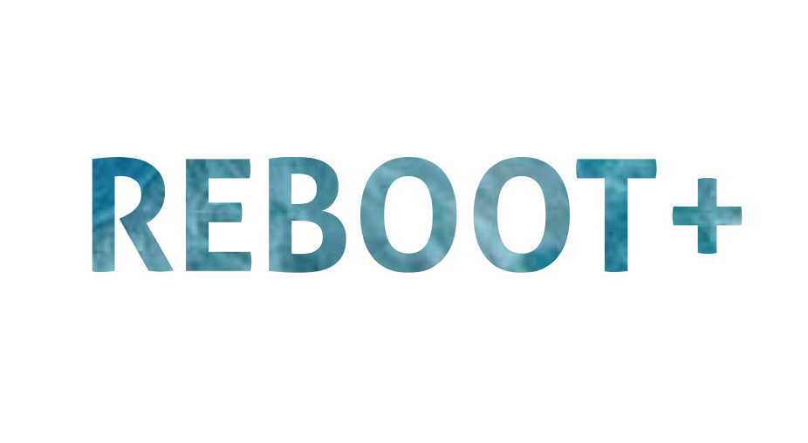

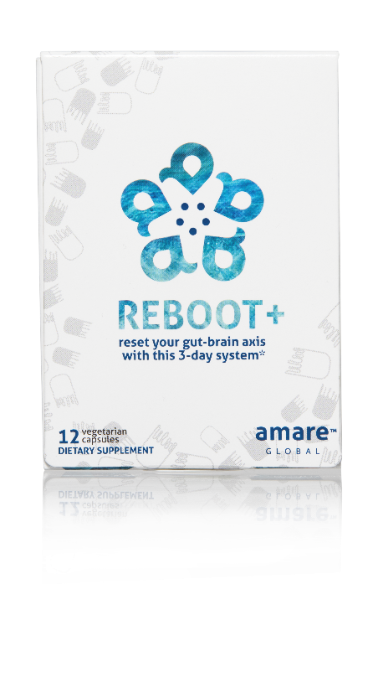
REMOVES WASTE & TOXINS
3-DAY PROGRAM
NATURAL CLEANSING
reset your gut-brain axis with this 3-day system*
A synergistic blend of natural cleansing herbs and phytonutrients to assist the body’s own detoxification process – specifically formulated to reboot your gut-brain axis in 3-days.*
Item Code: Retail Price: Wholesale Price: Subscribe & Save:
S004 $34.00 $24.95 / 21 PV $21.95 / 19 PV
*These statements have not been evaluated by the Food and Drug Administration. This product is not intended to diagnose, treat, cure, or prevent any disease.

Slide 11
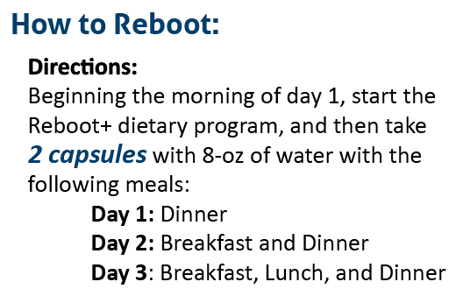
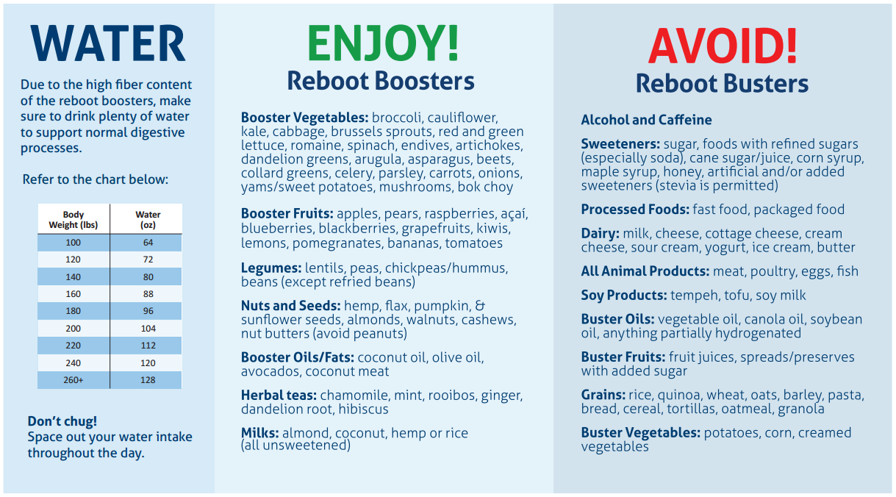
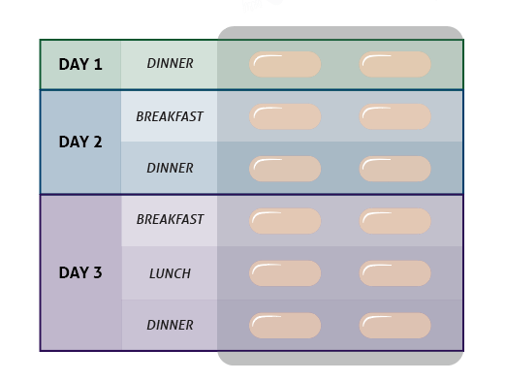
REBOOT+ DIETARY SUGGESTIONS

Slide 12
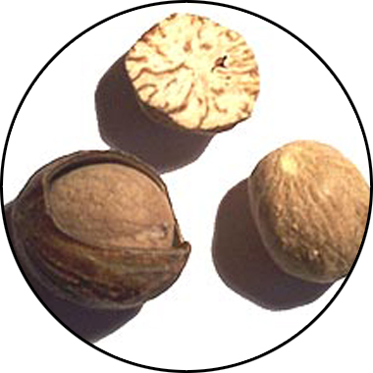
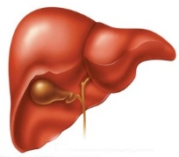
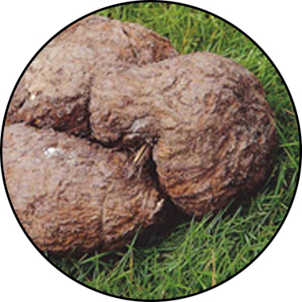
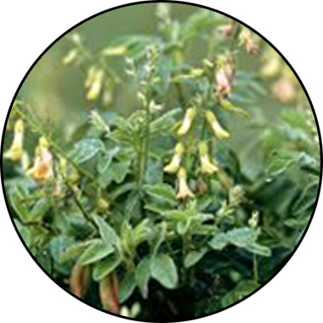
REBOOT+ KEY INGREDIENTS
Sebatin
Synergistic Effects of Sebatin™
™
Anti-inflammatory
Antioxidant
Hepatoprotective
Poria
lanostane triterpene acids
Panchyman (1,3-β-D-glucan)
Inhibition of iNOS & TNF-α production
Myristica
Phenylpropanoids
Induction of glutathion
S-transferase
Astragalus
Saponins & Polysacharin
Increase tissue SOD and GSH
Free radical scavenging
*These statements have not been evaluated by the Food and Drug Administration. This product is not intended to diagnose, treat, cure, or prevent any disease.

Slide 13

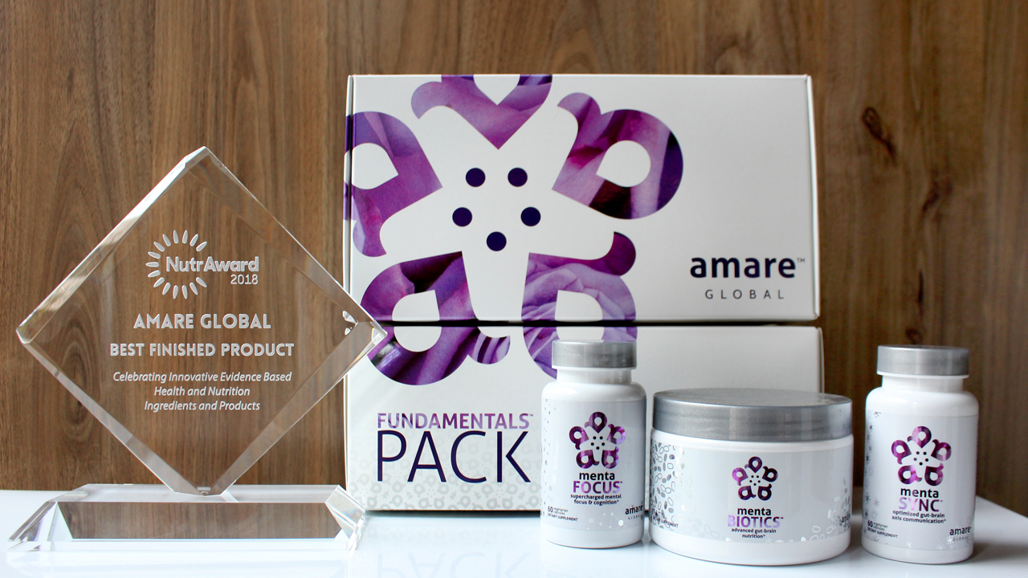
World’s First Award-Winning Gut-Brain Axis Nutrition System!
The NutrAward recognizes companies that are investing in rigorous and measurable scientific studies to prove the efficacy of their proprietary ingredients or technologies.
Submissions are judged on their merit in the following areas:
Viable product
Emerging category
Creative product concept
Distinct health application
Unique packaging
Matchless marketing

Slide 14
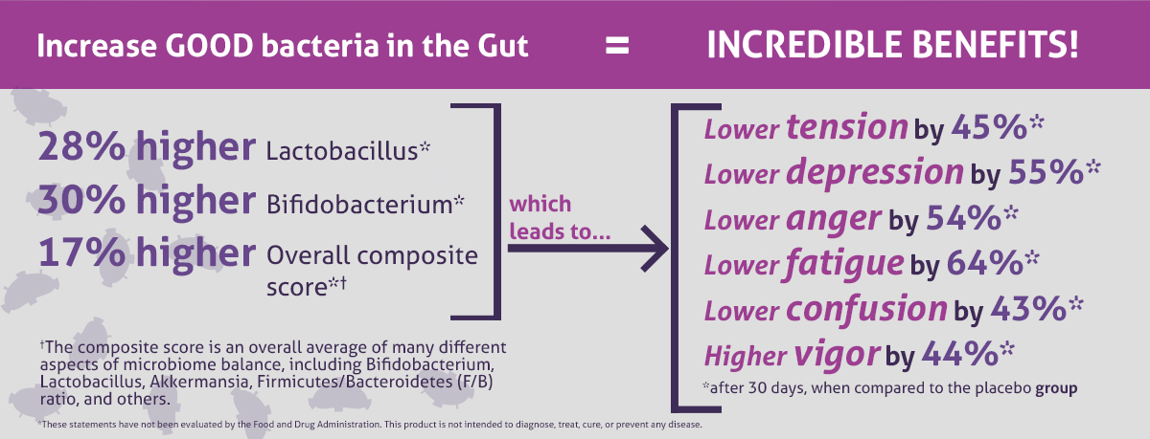
CLINICAL STUDY
The Amare FundaMentals Pack™ has been clinically proven to:

Slide 15

MW3™ Probiotic Proprietary Blend
Our blend contains unique and specific probiotic strains targeted to enhance overall mental wellness.*
MW3 Probiotic Strains:
Lactobacillus rhamnosus R0011 — Reduces stress by lowering cortisol exposure and improves GABA neurotransmission*
Bifidobacterium longum R0175 — Enhances calmness by decreasing anxiety indices and improves cognitive function*
Lactobacillus helveticus R0052 — Improves mood by decreasing neuro-inflammation and increasing serotonin*
*These statements have not been evaluated by the Food and Drug Administration. This product is not intended to diagnose, treat, cure, or prevent any disease.

Slide 16

MW3™ Prebiotic Proprietary Blend
Our MW3 Prebiotic Proprietary Blend provides optimal gut support by feeding the specific mental wellness probiotic strains found in our MW3 Probiotic Proprietary Blend.*
MW3 Prebiotic Fibers:
IsoFiber™ (Iso-Malto-Oligosaccharides) — Contains a combination of naturally occurring prebiotic plant fibers that are clinically shown to improve the growth of specific probiotic strains featured in Kids FundaMentals™ and now MentaBiotics™ Sugar Free!
Bimuno® (Galacto-Oligo-Saccharides) — Resets and increases friendly gut bacteria, maintains immune health, controls inflammation in the body and supports microbiome balance. Is highly effective and a natural way of increasing preferred bacteria in the gut. Plays an important role in feeding Bifidobacteria probiotic strains.*
SunFiber® (Galactomannan Fiber) — Helps improve the growth and vitality of beneficial bacteria, including Bifidobacteria and Lactobacillus.*
*These statements have not been evaluated by the Food and Drug Administration. This product is not intended to diagnose, treat, cure, or prevent any disease.

Slide 17
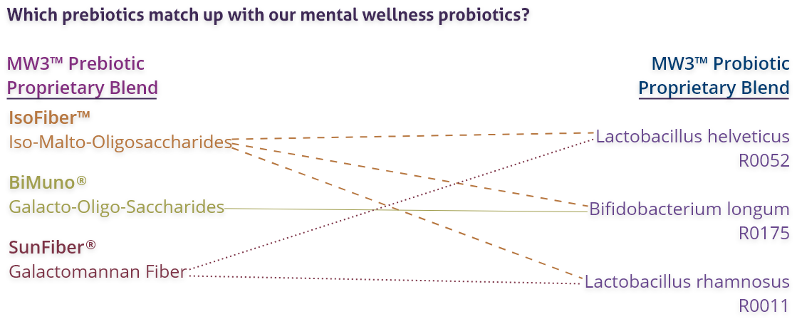
MW3™ Prebiotic/Probiotic Proprietary Blend
*These statements have not been evaluated by the Food and Drug Administration. This product is not intended to diagnose, treat, cure, or prevent any disease.

Slide 18
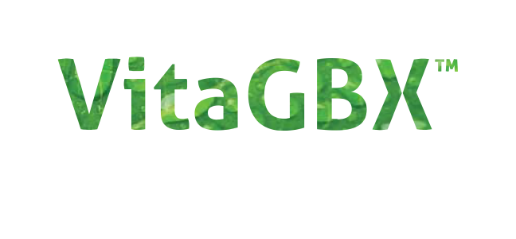



premium nutrition for a healthy body and mind*
Contains a Bright Mind Blend which helps improve concentration, attention, and alertness*
Combines 50+ vitamins, minerals, amino acids, and phytonutrients to deliver micronutrient nutrition for a well-balanced body and mind*
Contains our Amare GBX+ Proprietary Blend that enhances optimal functionality of the gut-brain axis*
*These statements have not been evaluated by the Food and Drug Administration. This product is not intended to diagnose, treat, cure, or prevent any disease.

Slide 19








Microbiome-Boosting Nutrition*
GBX FOODS
™
Vegan /
All Natural*
Non-GMO and Gluten Free*
Sugar Free*
Soy and Dairy Free*
No Preservatives, Artificial Colors, Flavors and Sweeteners*
*These statements have not been evaluated by the Food and Drug Administration. This product is not intended to diagnose, treat, cure, or prevent any disease.

Slide 20


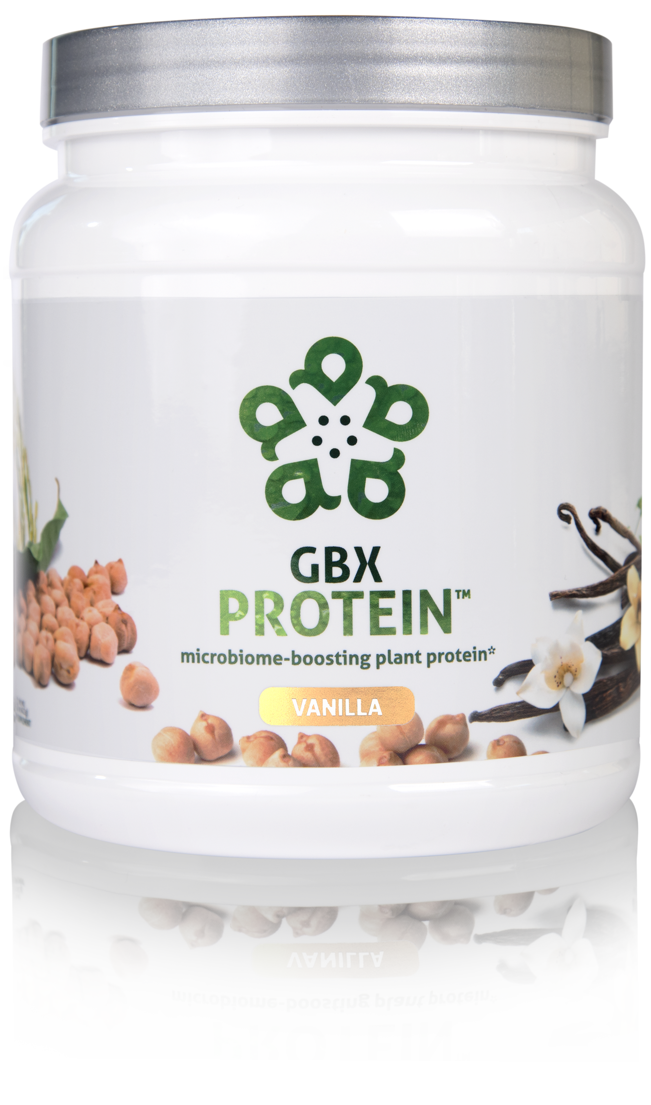
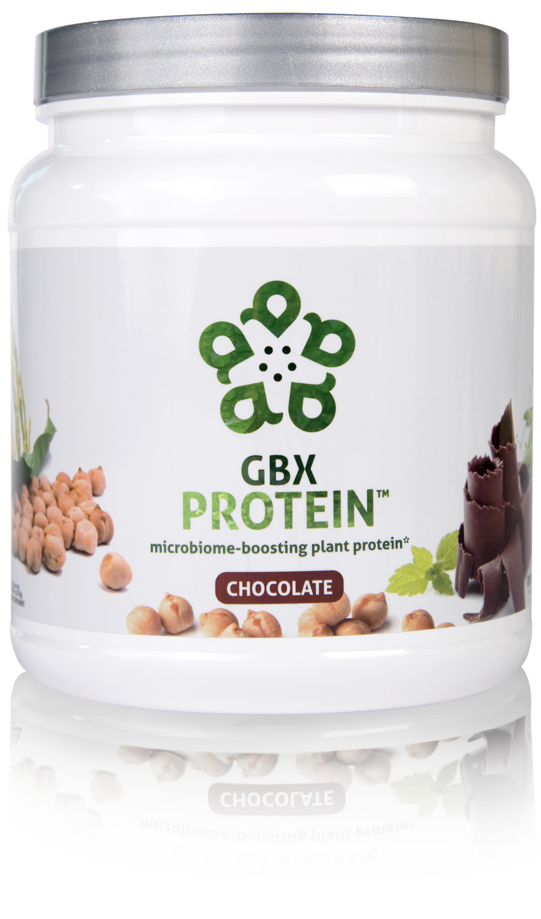
HELPS CONTROL APPETITE AND SUPPORTS MUSCLE MASS*
17 GRAMS OF ULTRA-PURE, PLANT-BASED PROTEIN*
NOURISHES GOOD GUT BACTERIA*
microbiome-boosting plant protein*
GBX Protein™ delivers 17 grams of pure plant protein. This unique chickpea, brown rice, and pea protein blend nourishes good bacteria in the gut and improves microbiome balance, while controlling appetite and supporting muscle mass. Fully-loaded with only functional ingredients, this potent formula supports the gut microbiome, helping fuel a healthy lifestyle.*
Item Code (Vanilla):
Item Code (Chocolate): Retail Price: Wholesale Price: Subscribe & Save:
S015
S016 $54.00 $39.95 / 26 PV $35.95 / 22 PV
*These statements have not been evaluated by the Food and Drug Administration. This product is not intended to diagnose, treat, cure, or prevent any disease.

Slide 21

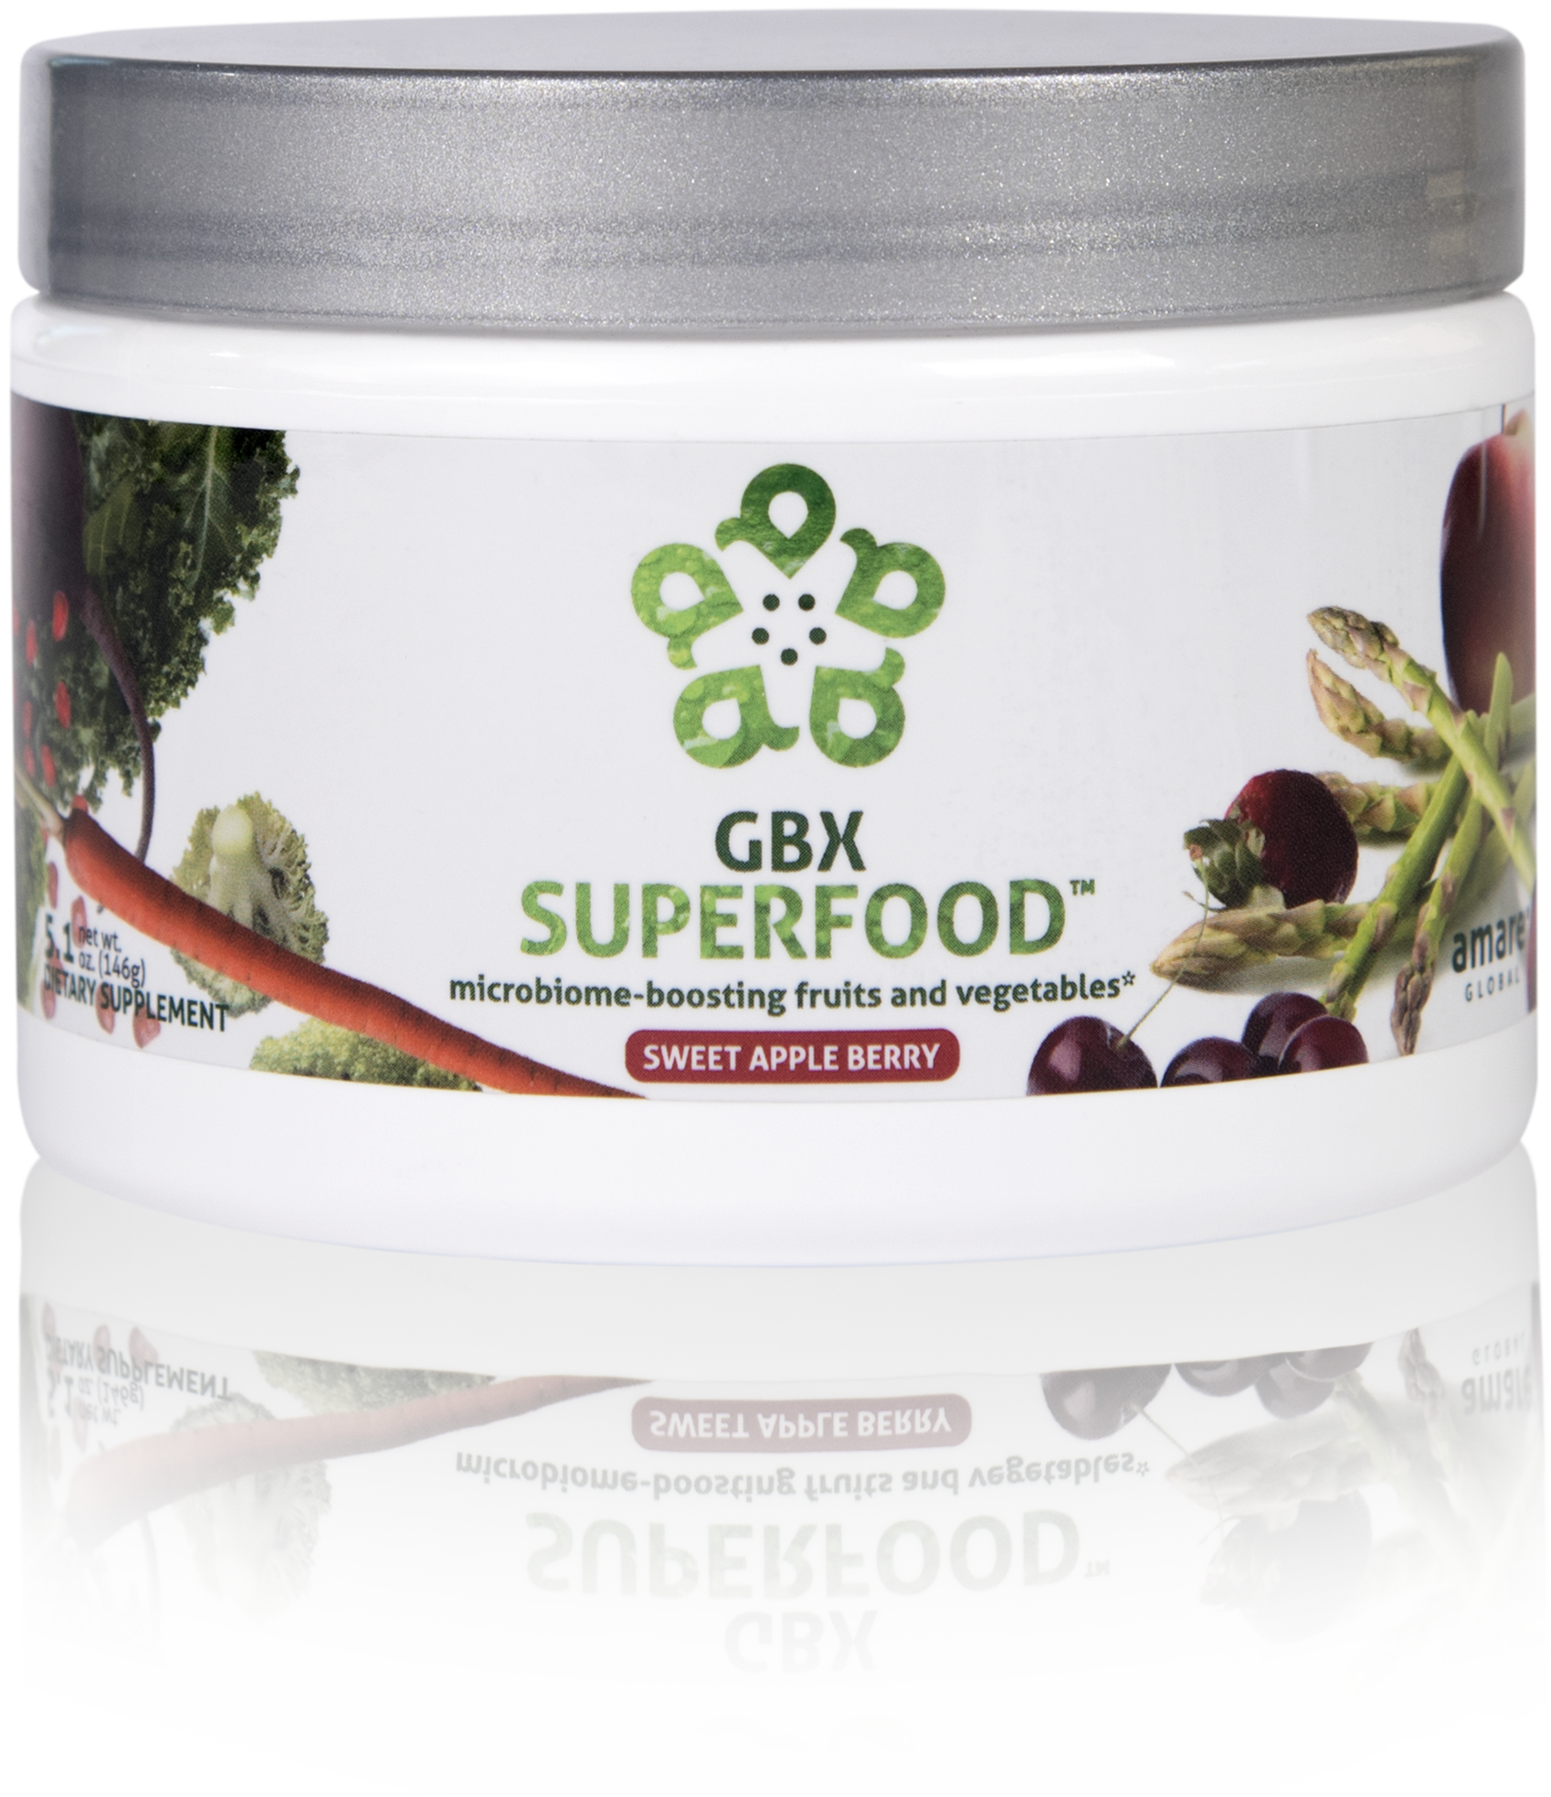
NUTRIENTS EQUIVALENT TO 3 SERVINGS OF FRUITS AND VEGETABLES*
NOURISHES GOOD GUT BACTERIA*
PROVIDES CELLULAR ANTI-STRESS BENEFITS*
microbiome-boosting fruits and vegetables*
GBX SuperFood™ provides the phytonutrient equivalent of three servings of fruits and vegetables per scoop. This phytobiotic-rich blend delivers cellular level anti-stress benefits and helps protect cells from a variety of different stressors, helping the brain and gut run at peak efficiency.*
Item Code: Retail Price: Wholesale Price: Subscribe & Save:
S018 $40.00 $29.95 / 21 PV $26.95 / 18 PV
*These statements have not been evaluated by the Food and Drug Administration. This product is not intended to diagnose, treat, cure, or prevent any disease.

Slide 22



microbiome-boosting fruits and vegetables*
Increases Heat Shock Protein expression*
Enhances internal cellular cleanup (autophagy)*
Stress resilience benefits that you can FEEL at the cellular level*
*These statements have not been evaluated by the Food and Drug Administration. This product is not intended to diagnose, treat, cure, or prevent any disease.

Slide 23

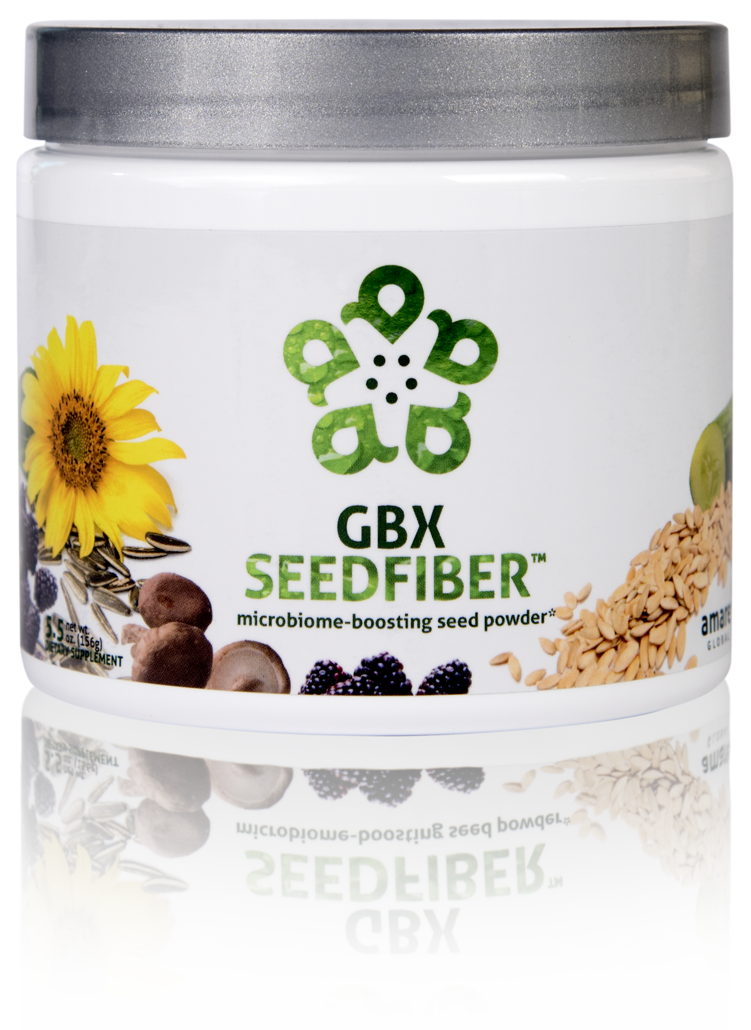
NEXT-GENERATION APPROACH TO OPTIMIZING GUT-BRAIN AXIS*
CONTAINS NATURAL MICROBIOME-BOOSTING FIBERS*
HELPS MANAGE FEELINGS OF STRESS, TENSION AND ANXIETY*
microbiome-boosting seed powder*
GBX SeedFiber™ is the next-generation approach to optimizing the gut-brain axis. This phytobiotic-rich formula contains seeds as sources of natural microbiome-boosting fibers, helping you feel fuller, longer. Featuring a cultured mushroom mycelia extract to support microRNA signaling between the microbiome and central nervous system, this unique blend helps manage feelings of stress, tension and anxiety.*
Item Code: Retail Price: Wholesale Price: Subscribe & Save:
S019 $50.00 $36.95 / 26 PV $32.95 / 21 PV
*These statements have not been evaluated by the Food and Drug Administration. This product is not intended to diagnose, treat, cure, or prevent any disease.

Slide 24



microbiome-boosting seed powder*
Optimizes gut-brain axis communication
Naturally supports microRNA signaling
Helps manage feelings of tension and anxiety*
*These statements have not been evaluated by the Food and Drug Administration. This product is not intended to diagnose, treat, cure, or prevent any disease.

Slide 25
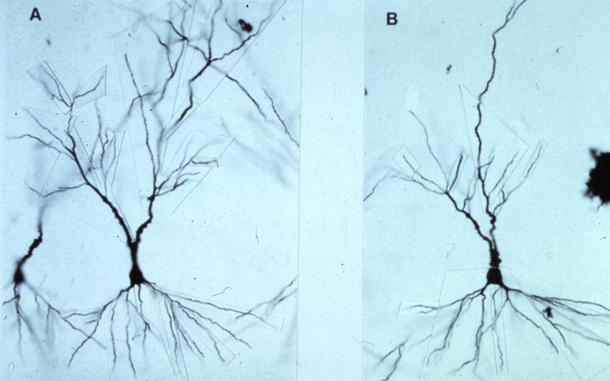
Neuronal Atrophy (dead brain cells)
Normal Stress / Normal Cortisol
Healthy, Large, Many Projections, Optimal Function
High Stress / High Cortisol
Small, Thin, Disrupted
Structural Damage, Poor Function

Slide 26
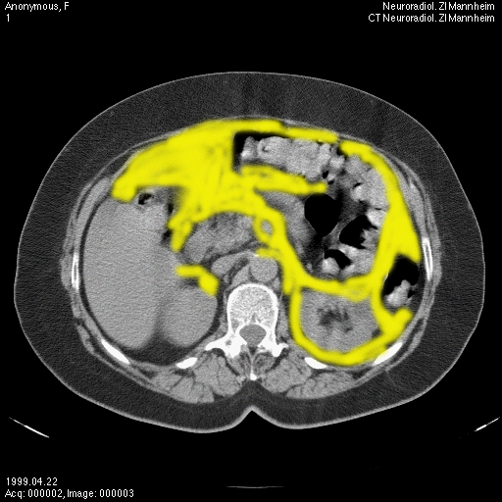
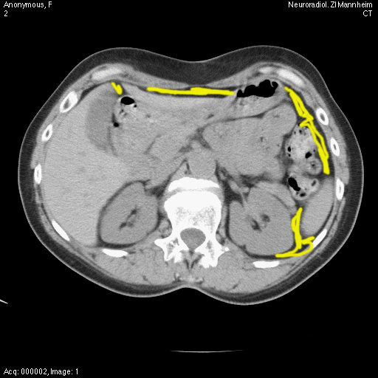
Abdominal Fat Accumulation
High Stress / High Cortisol
Normal Stress / Normal Cortisol

Slide 27
Eight-Week Survey Results
95% of people experienced an increase in their level of understanding about proper supplementation, exercise, nutrition, and sleep.
87% of individuals stated that Project b3 has helped improve mood, reduce stress, and/or increase motivation.
85% of people said the program was easy to incorporate into their daily routine
85% of people noticed an improvement in their physical health, fitness, and overall wellness.
4 out of 5 people said that Project b3 helped them control food cravings and reduce stress eating and that they feel better and better as time passed with Project b3 (better at week 4 than week 2; better at week 8 than week 4)
9 out of 10 people report after 8 weeks on Project b3 that they plan to continue with the products and program.

Slide 28
THE THREE THINGS YOU SHOULD KNOW ABOUT MENTAL WELLNESS
How you feel is not just in your head — it’s also in your gut.
Our “second brain” includes the microbiome and plays a major role in mental wellness.
You can now DO something NATURALLY to improve your mental wellness.
WHERE ARE YOU ON THE MENTAL WELLNESS CONTINUUM? (Circle your current number)
1
2
3
4
5
6
7
8
9
10
DISEASE STATUS
“TYPICAL”
OPTIMIZED
Depression
Anxiety
Diabetes
Obesity
Heart Disease
Autoimmune
Arthritis
Fibromyalgia
CFS
Dementia
ADD / ADHD
Alzheimer’s
Fatigue
Tension
Sad
Brain Fog
Headaches
Acne
Eczema
Congestion
URTI’s
Joint Pain
Muscle Pain
Bloated
Chubby
Energetic
Calmness
Happy
Sharp
Creative
Clear Skin
Rarely Sick
Flexible
Lean
Strong
Resilient
RED
ORANGE
YELLOW
GREEN
BLUE
INDIGO
VIOLET

Slide 29
What Benefits Should I Expect?
Improve Gut Health
Balance Microbiome
Optimize Gut-Brain-Axis Function
Reduce Stress
Improve Vigor
Boost Energy
Maximize Sleep Quality
Sharpen Mental Clarity
Enhance Skin Tone
Reduced Cravings
Improve Body Composition = Fat/Lean

Slide 30
Topic Schedule (Wednesday 7-8pm MT)
May 1 – Session 1 (Week 0) – Overview
May 8 – Session 2 (Week 1) – Body/Brain/Biome
May 15 – Session 3 (Week 2) – Supplementation
May 22 – Session 4 (Week 3) – Exercise
May 29 – Session 5 (Week 4) – Nutrition
June 5 – Session 6 (Week 5) – Stress/Sleep
June 12 – Session 7 (Week 6) – Evaluation
June 19 – Session 8 (Week 7) – Open Discussion
June 26 – Session 9 (Week 8) – Review & Summary

Slide 31
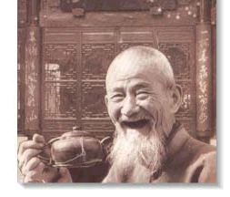
GOOD
HEALTH!

