Slide 1
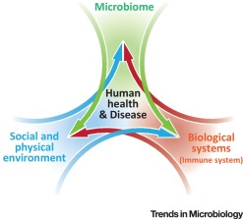
Project b3 May/June 2019
Exercise
Shawn Talbott, PhD
Biome
Body
Brain

Slide 2
Topic Schedule (Wednesday 7-8pm MT)
May 1 – Session 1 (Week 0) – Overview
May 8 – Session 2 (Week 1) – Body/Brain/Biome
May 15 – Session 3 (Week 2) – Supplementation
May 22 – Session 4 (Week 3) – Exercise
May 29 – Session 5 (Week 4) – Nutrition
June 5 – Session 6 (Week 5) – Stress/Sleep
June 12 – Session 7 (Week 6) – Evaluation
June 19 – Session 8 (Week 7) – Open Discussion
June 26 – Session 9 (Week 8) – Review & Summary

Slide 3
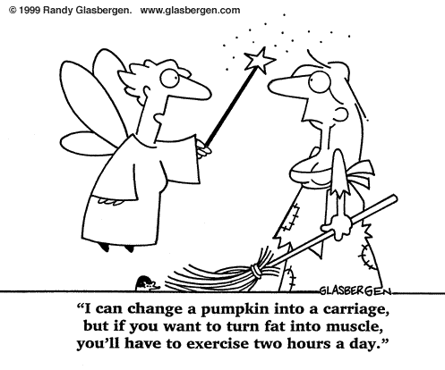

Slide 4
National Weight Control Registry
Database of 3,000+ “successful losers”
  30lb. weight loss maintained for 1+ years (avg. = 66lbs)
  60-80 min/day of physical activity
  1500-1800 calories/day
Get a buddy!
  Participating with friends = 33% more weight loss and 2-3x better maintenance (versus solo)
  E-mail correspondence = doubles your weight loss (JAMA)

Slide 5
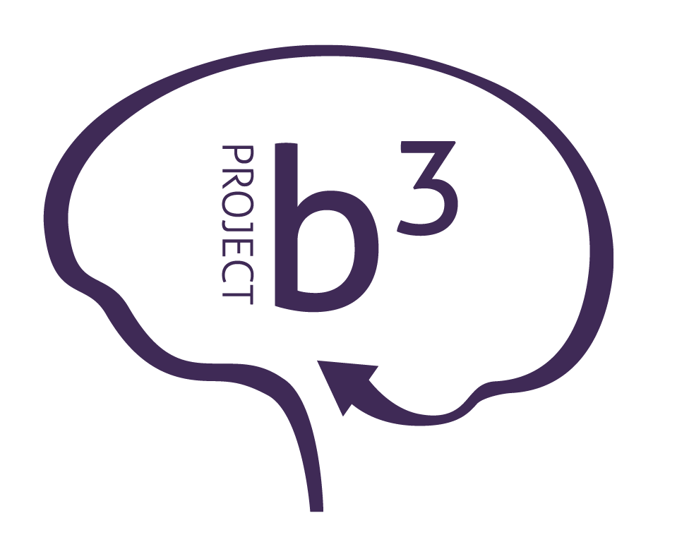
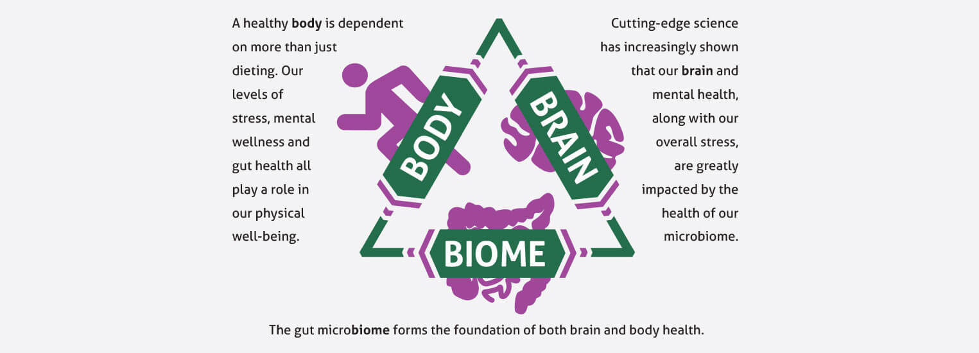
Project b³: BODY. BRAIN. BIOME.
Amare FundaMentals Pack (1), VitaGBX (1), GBX Protein (2), GBX SeedFiber (1), GBX SuperFood (1)

Slide 6
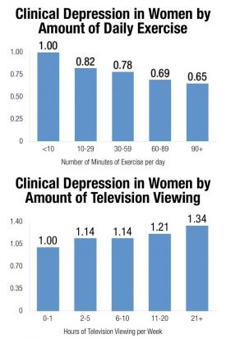

Slide 7
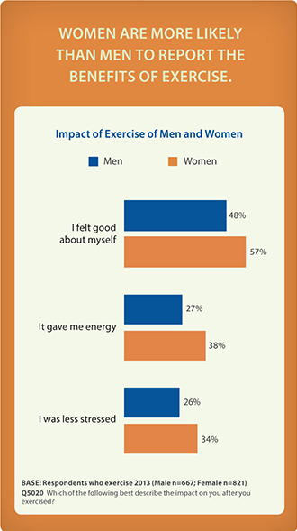
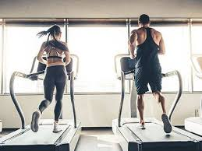
Exercise “works” for men and women

Slide 8
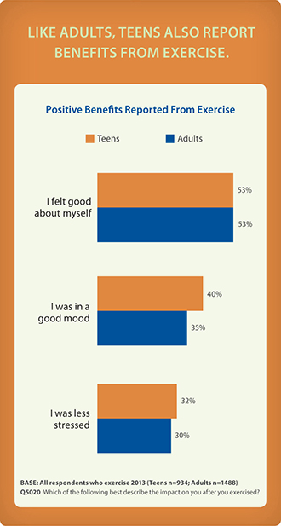
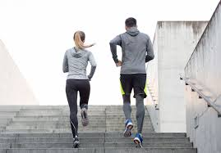
Exercise “works” for older and younger people

Slide 9
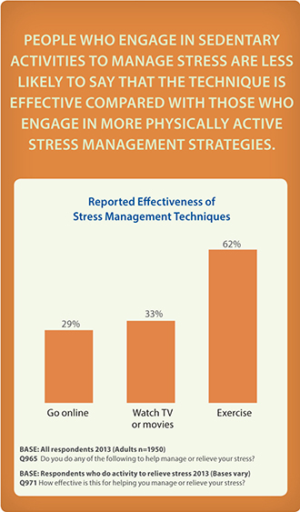
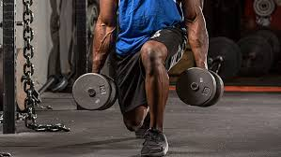
Exercise “works better” than other common forms of avoiding stress

Slide 10


Slide 11
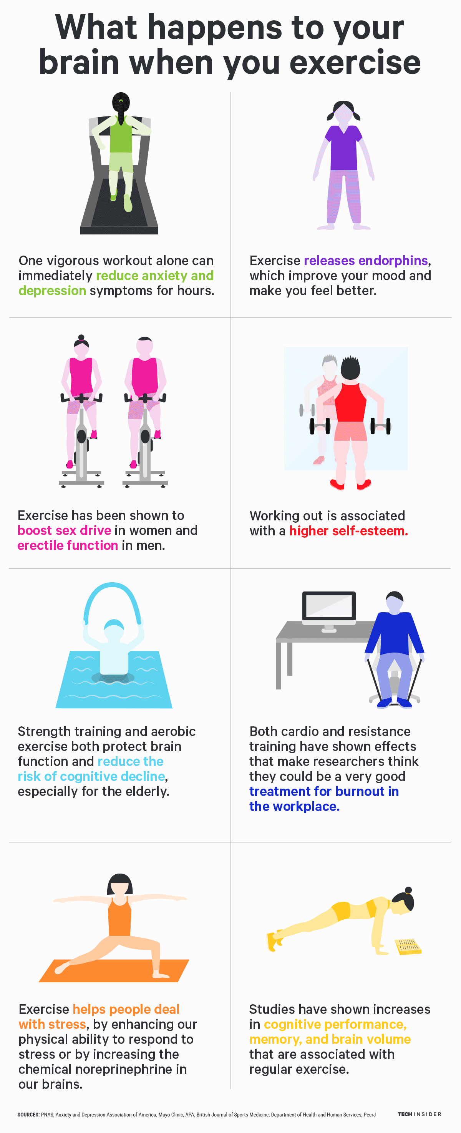

Slide 12
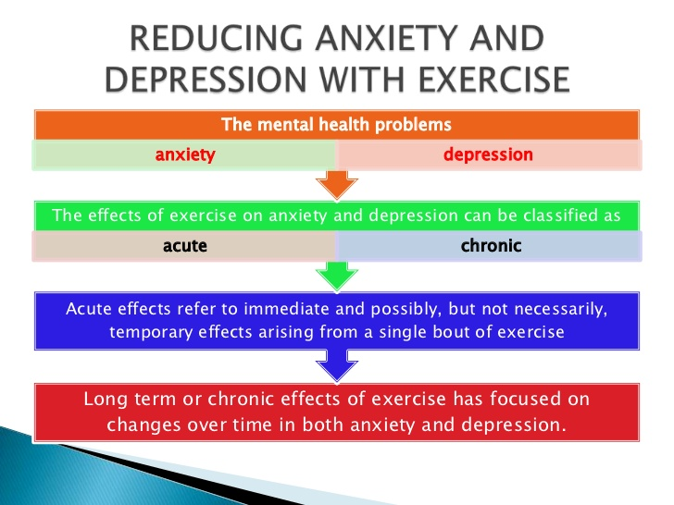

Slide 13
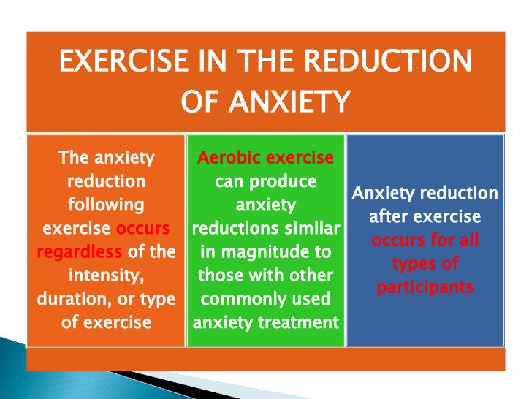

Slide 14
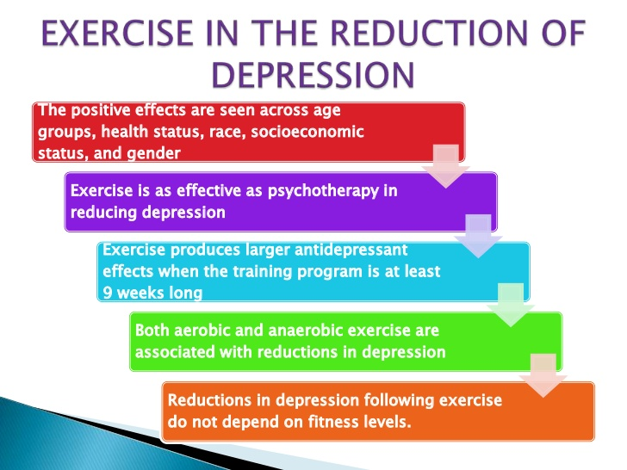

Slide 15
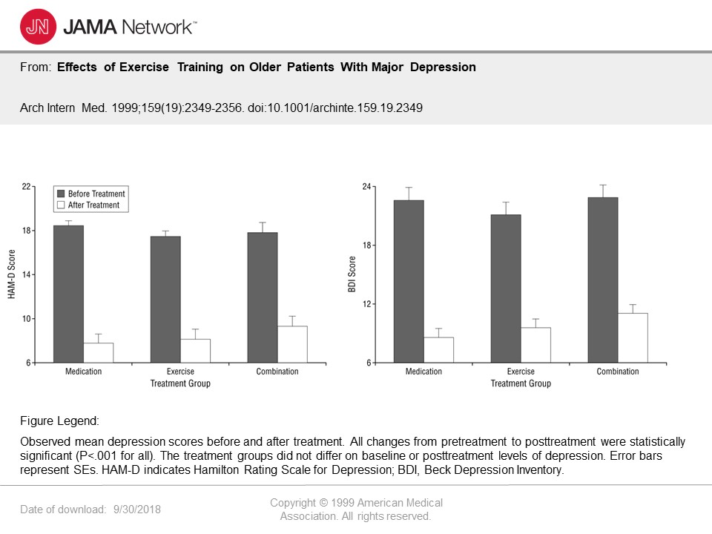

Slide 16
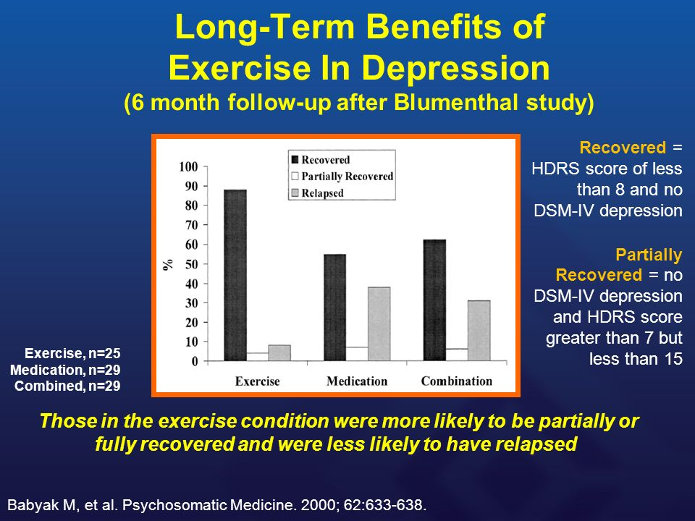

Slide 17
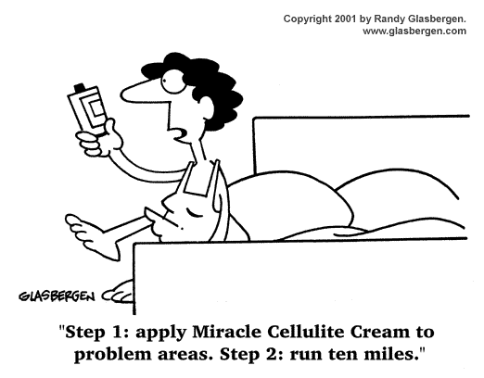

Slide 18


How effective is exercise for weight control?
Exercise needed to promote negative energy balance
  A LOT! (more than most of us do).
  Taco Bell Burrito = 5 mile run
  12 Hershey kisses = 30 min Lap swimming
  6 Oreos = 30 min brisk walking
  Researchers at the U Virginia have determined 250,00 crunches needed to burn 1 pound of fat. (100 crunches per day……………….…for 7 years!)
  Duke University study = 30m/d brisk walking needed to PREVENT weight gain
    no exercise = 2.5lbs gain in 8 months
    jog 17 mile /week = 10lbs fat loss (in 8 months)
    Average is 1lb fat gain/yr from age 25-55y
  Moral = exercise alone stinks for weight loss
You MUST cut calories from the diet

Slide 19
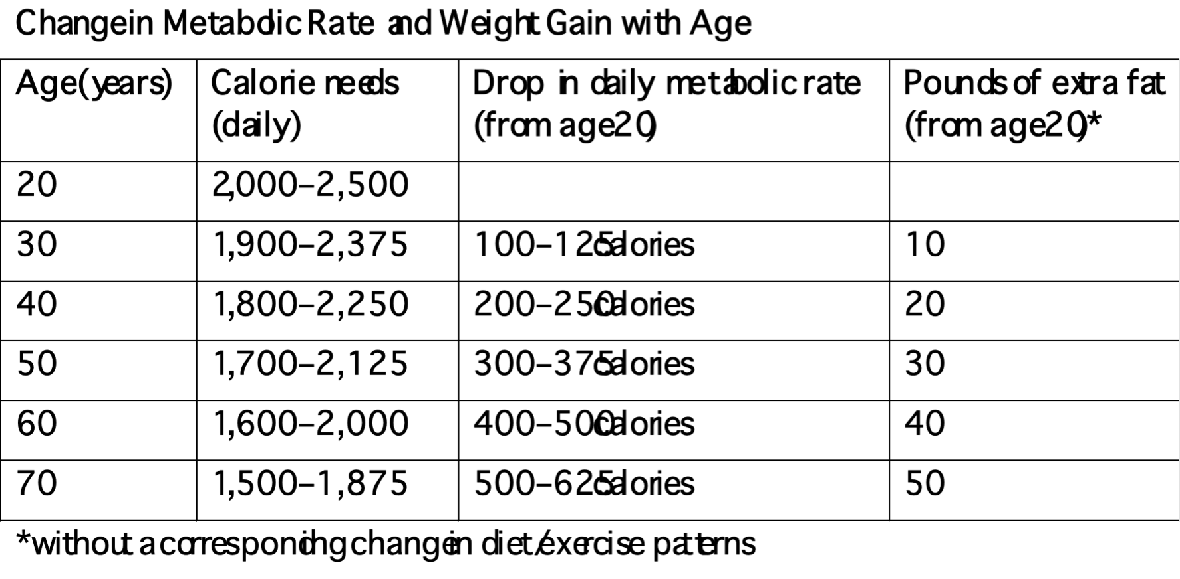
Metabolic Rate tends to Drop with Age

Slide 20
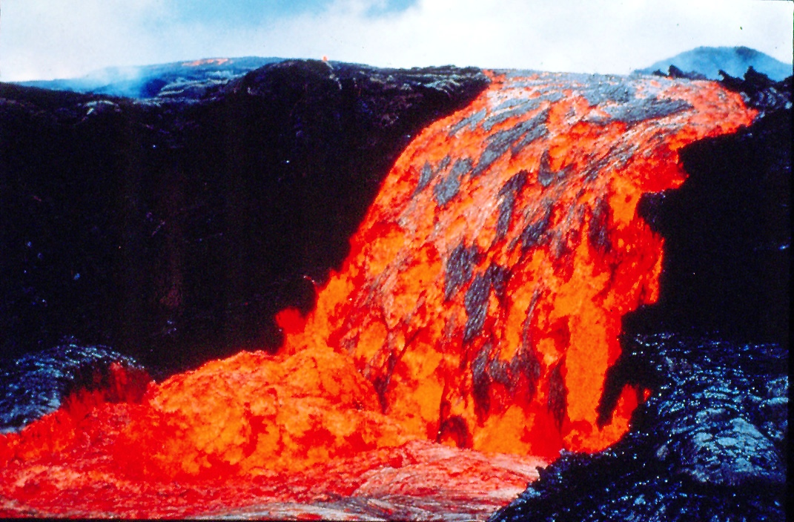

Slide 21
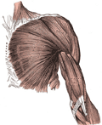
Basal Metabolic Rate (BMR)
BMR is the rate at which our body burns fuel (calories)
When we diet, our body adjusts by slowing BMR

Slide 22


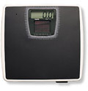
Why Target BMR?
Lean muscle mass requires more energy to sustain itself. You can burn more calories throughout the day and reach your weight management goals!
5 lbs lean muscle = 200 extra calories

Slide 23

Strength Training
Builds lean muscle mass, which increases BMR
Tones and defines the muscles
Improves posture
Helps maintain bone mineral density
Recommendation: 20 minutes, 2x per week

Slide 24

Aerobic Exercise
Ability to perform work in the presence of oxygen
Any movement that involves the large muscles groups
Raises the heart rate for an extended period of time
Recommendation: 30 minutes, 3x per week

Slide 25

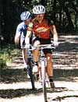


Aerobic Exercise
Running
Cycling
Power Walking
Hiking
Swimming
Aerobics

Slide 26
Interval Training
One approach to increasing caloric expenditure:
Alternates between high intensity and low intensity exercise
Warm-up (~6min)
1 minute high / 1 minute low intensity
2 minutes high / 2 minutes low intensity
3 minutes high / 3 minutes low intensity
2 minutes high / 2 minutes low intensity
1 minute high / 1 minute low intensity
Cool-down (~6min)
18 minutes of Interval Training + 12min warm/cool = 30min

Slide 27
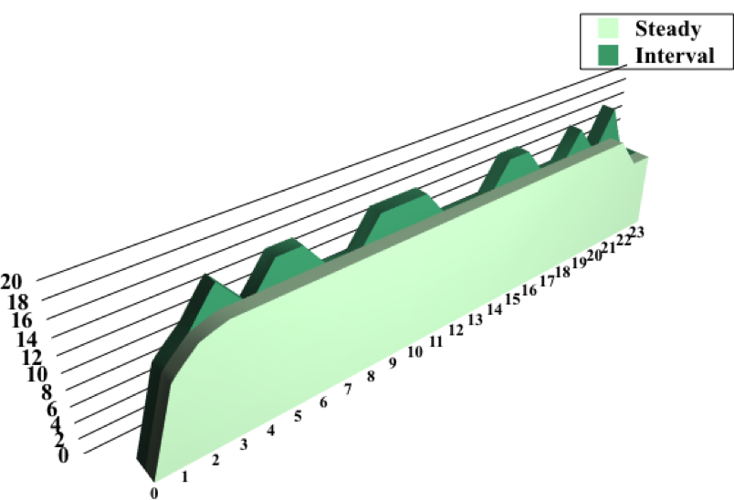
Interval Training vs. Steady State Exercise
More Total Work Accomplished
Higher Average Heart Rate
More Calories Expended
Higher Residual Caloric Expenditure (after)
Cool-down
401 calories
189 calories
Warm-up
20 minutes of exercise

Slide 28
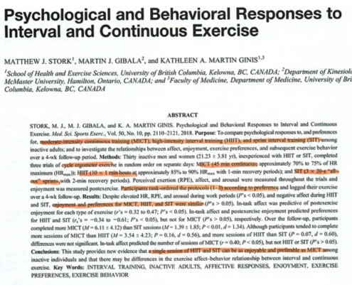

Slide 29
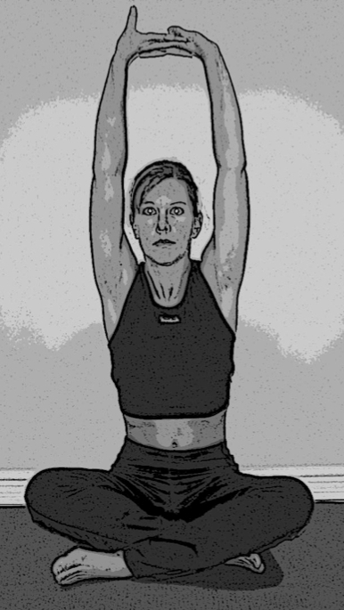
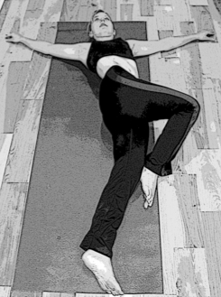
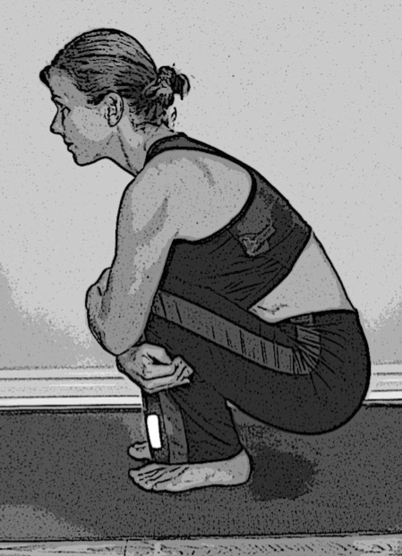
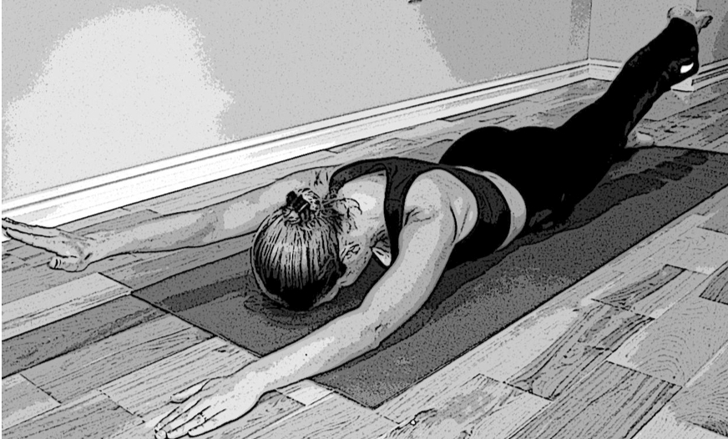
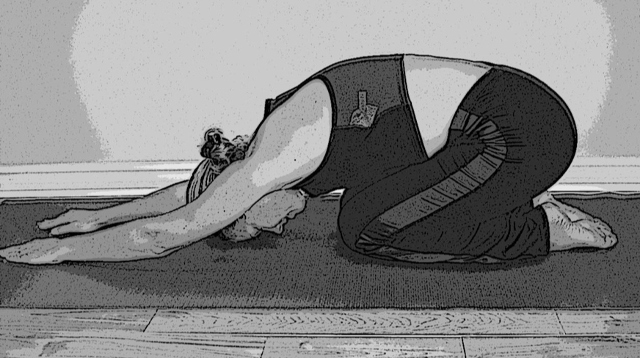
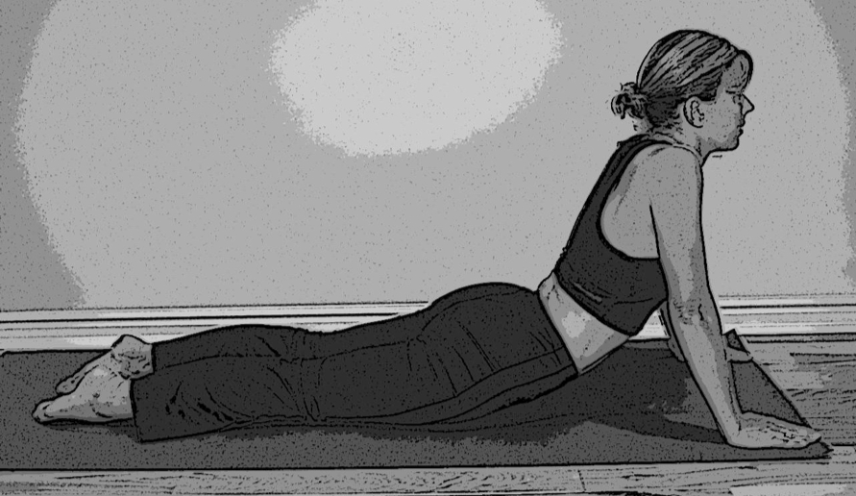
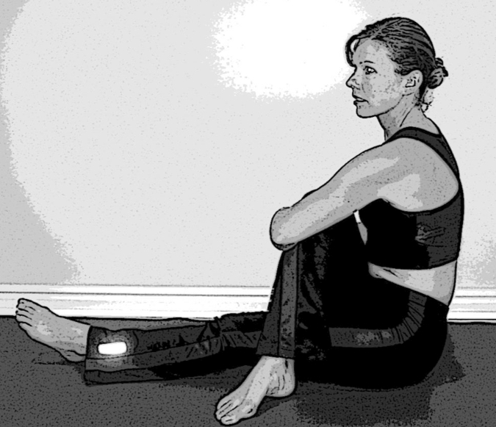
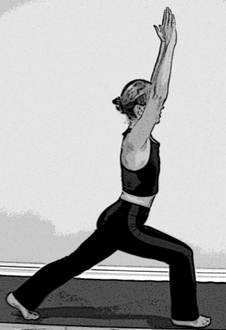
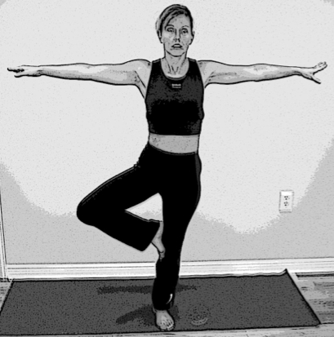
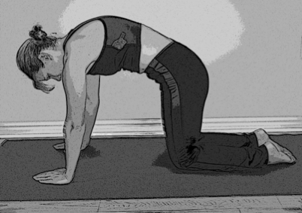
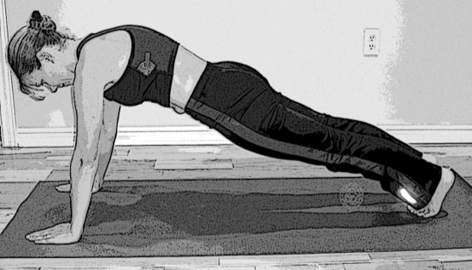
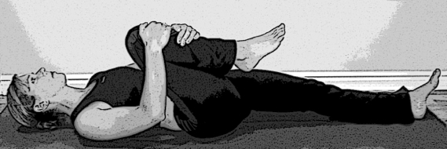
FlexSkills

Slide 30
Topic Schedule (Wednesday 7-8pm MT)
May 1 – Session 1 (Week 0) – Overview
May 8 – Session 2 (Week 1) – Body/Brain/Biome
May 15 – Session 3 (Week 2) – Supplementation
May 22 – Session 4 (Week 3) – Exercise
May 29 – Session 5 (Week 4) – Nutrition
June 5 – Session 6 (Week 5) – Stress/Sleep
June 12 – Session 7 (Week 6) – Evaluation
June 19 – Session 8 (Week 7) – Open Discussion
June 26 – Session 9 (Week 8) – Review & Summary

Slide 31
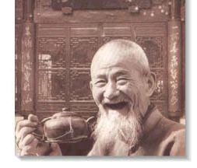
GOOD
HEALTH!

