Slide 1
Project B3 Study Evaluation
Shawn Talbott, PhD

Slide 2
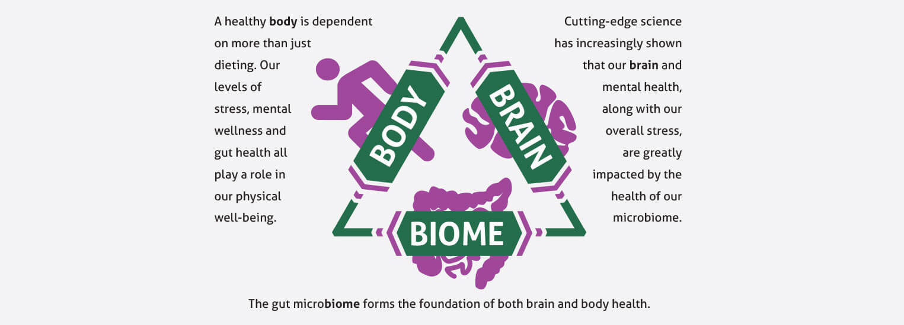

Slide 3
Topic Schedule (Wednesday 7-8pm MT)
May 1 – Session 1 (Week 0) – Overview
May 8 – Session 2 (Week 1) – Body/Brain/Biome
May 15 – Session 3 (Week 2) – Supplementation
May 22 – Session 4 (Week 3) – Exercise
May 29 – Session 5 (Week 4) – Nutrition
June 5 – Session 6 (Week 5) – Stress/Sleep
June 12 – Session 7 (Week 6) – Evaluation
June 19 – Session 8 (Week 7) – Open Discussion
June 26 – Session 9 (Week 8) – Review & Summary

Slide 4





S.E.N.S.E. Program
Follow this step-by-step approach called S.E.N.S.E., which includes effective techniques and tips to create a healthier, happier you.
S – Supplementation
E – Exercise
N – Nutrition
S – Stress Management
E – Evaluation

Slide 5
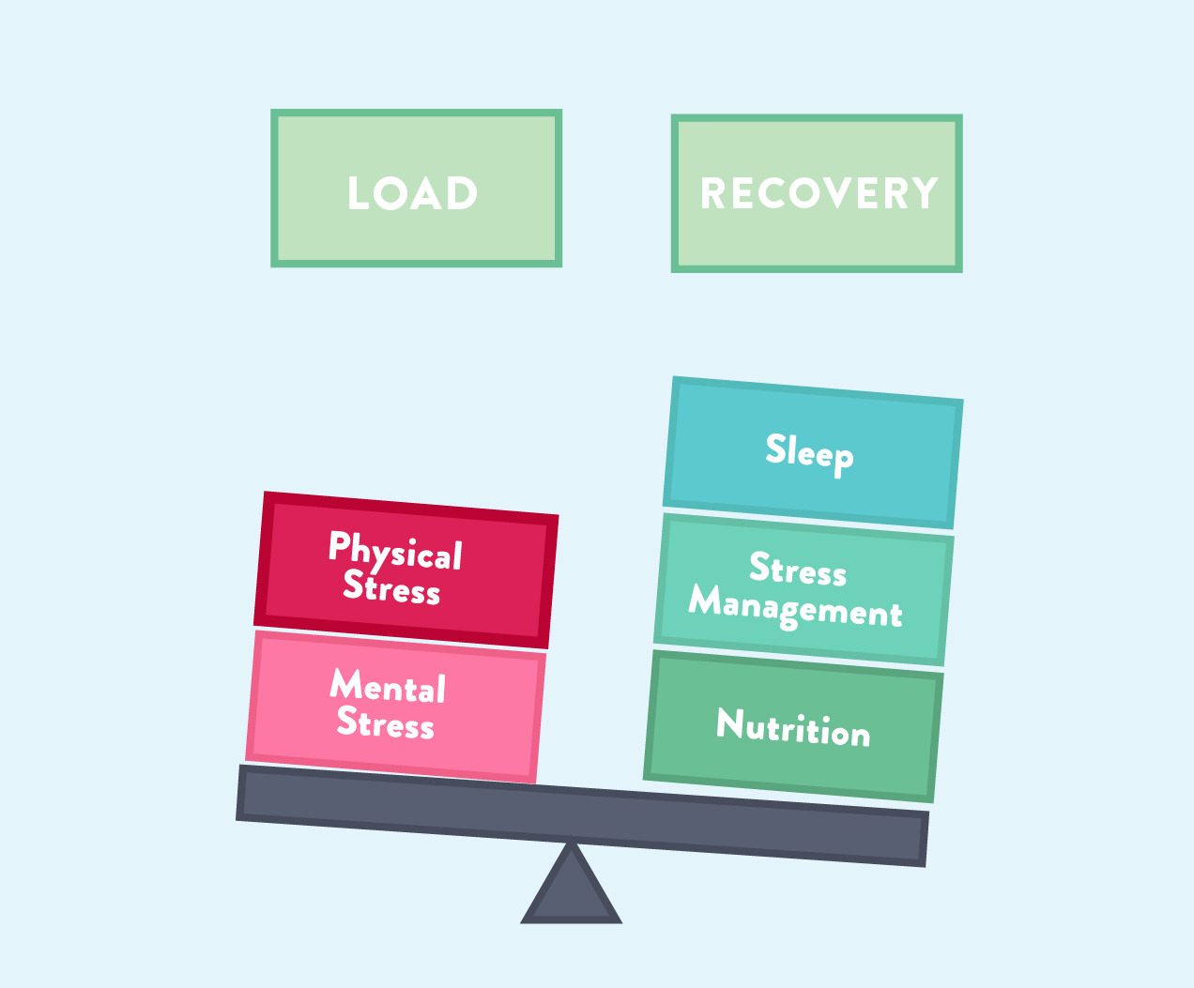

Slide 6
“Evaluation” = Weekly Check-Ins
Move
Eat (mindfully)
Breathe / Meditate
5-5-5 triangle x 4 = 60 seconds
Do this a few times, focusing on your breath
Refocus a wandering mind as needed back to breath
Prioritize
You can’t do it all (really, you can’t)
What are the MOST important things to get done TODAY? (big rocks)
Connect
Phone a Friend - Talk is better than text or email
Gratitude
What went well today, yesterday, this week?
Gratitude Journal (phone notebook, sticky notes near bed…)

Slide 7
Putting it all together…
Move!
HIIT and/or FlexSkills
Burns calories / thermogenic / BMR maintenance
Improves insulin/blood sugar control
Improves cortisol control / stress response / thyroid function
Improves serotonin/norepinephrine/mood better than SSRI/anxiolytic drugs
Eat! (Mindfully)
National Weight Control Registry (1500-1800 calories/day)
Always combine pro/carbs/fat/fiber (Helping Hand)
Choose less processed (whole) foods whenever possible
Mediterranean style meals
Targeted Supplementation
Nourishes microbiome & optimizes gut-brain-axis
Provides the foundation in terms of the main areas of metabolism…
Cortisol (stress) / Testosterone (muscle mass & libido) / Insulin (blood sugar) / Norepinephrine (mental focus)
Serotonin (mood) / Thyroid (metabolism) / Dopamine (motivation)

Slide 8
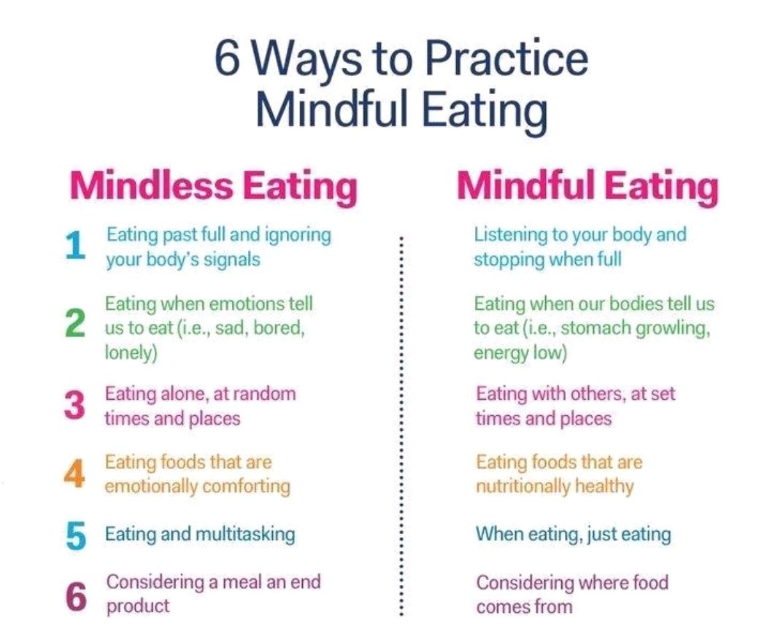

Slide 9
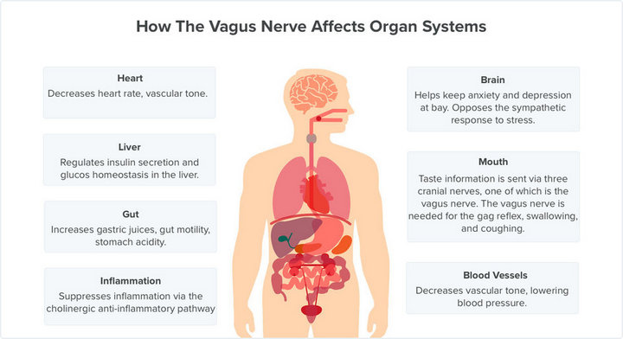

Slide 10
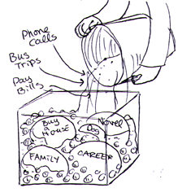
Stephen Covey
First Things First
https://www.youtube.com/watch?v=zV3gMTOEWt8

Slide 13
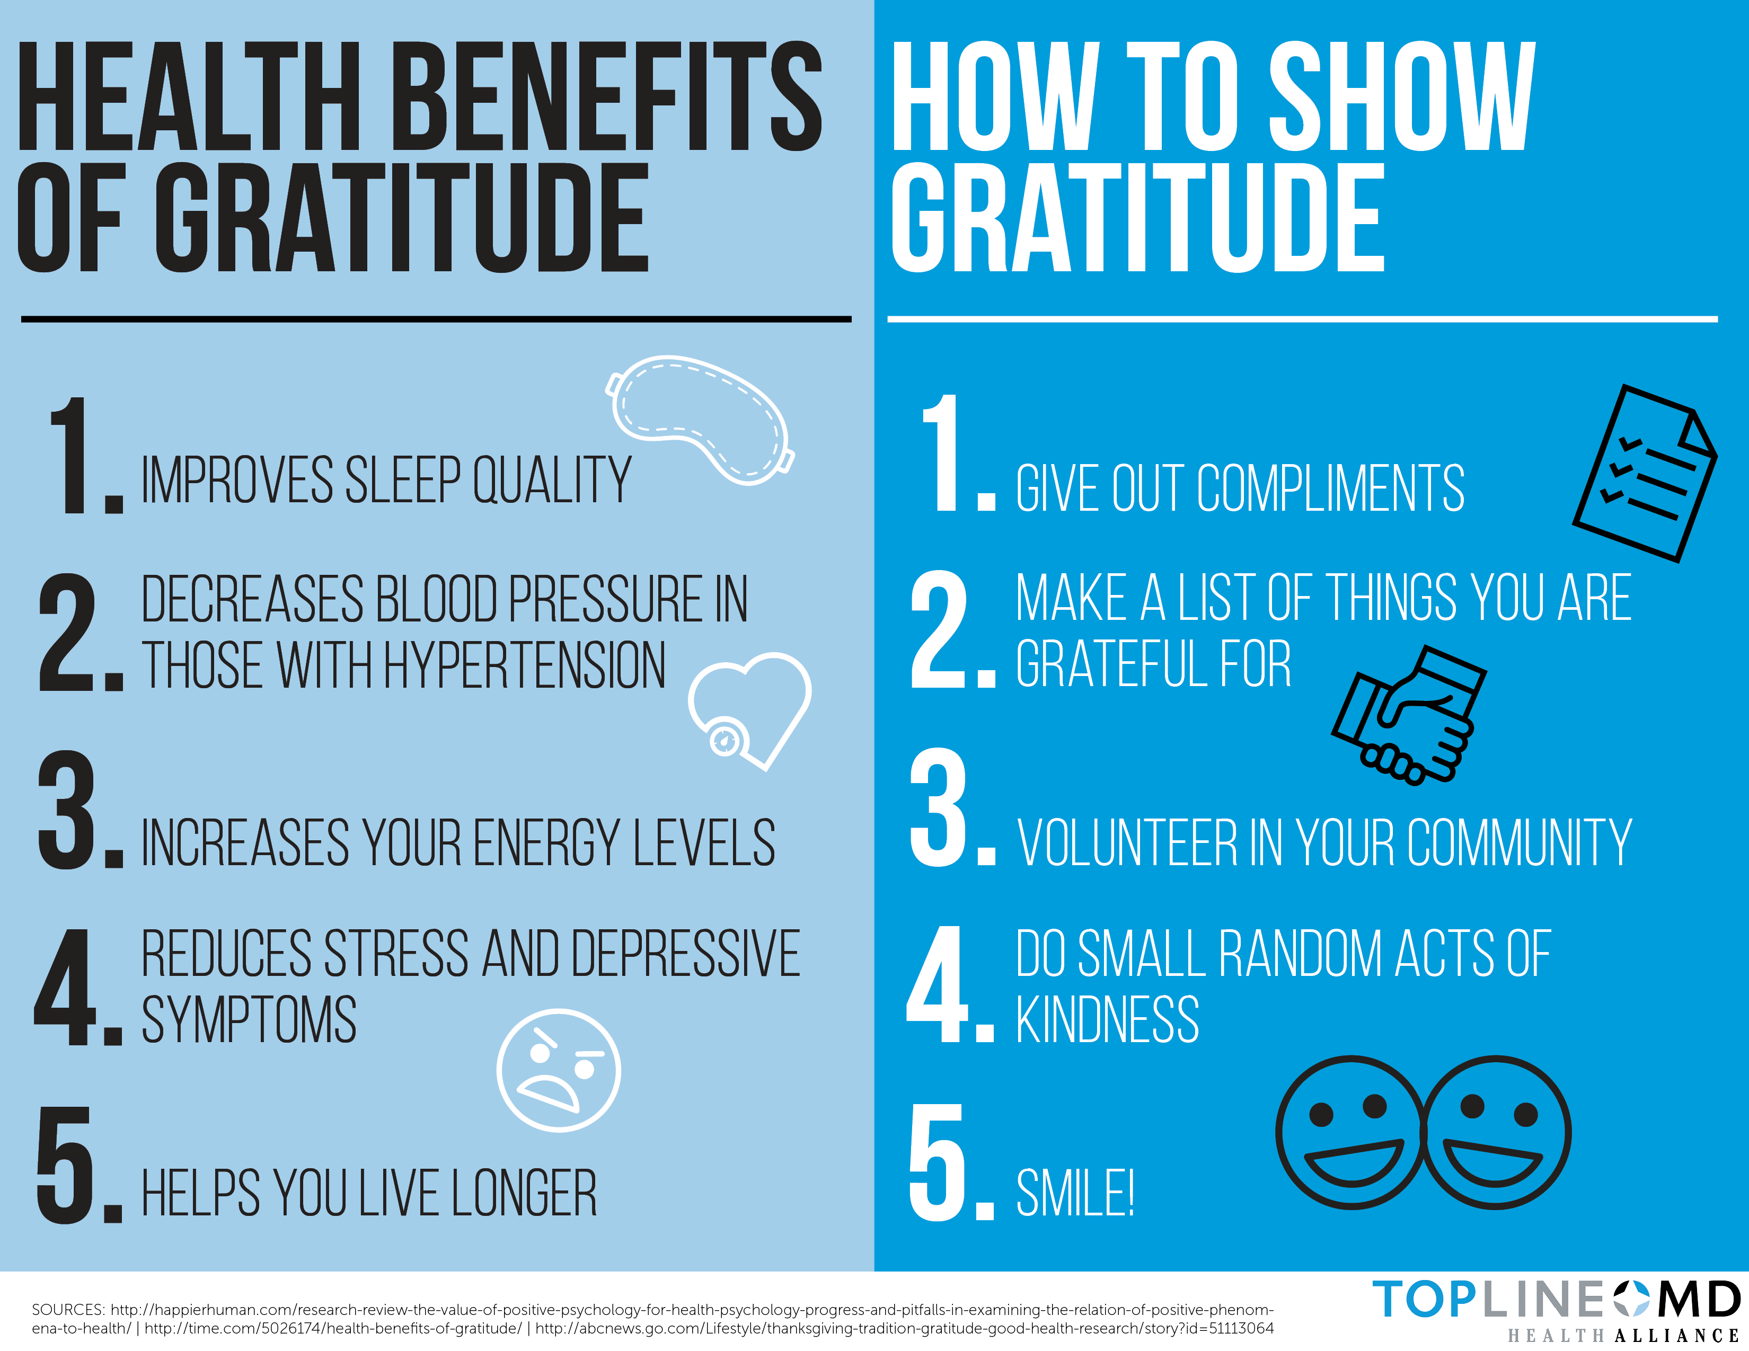

Slide 15
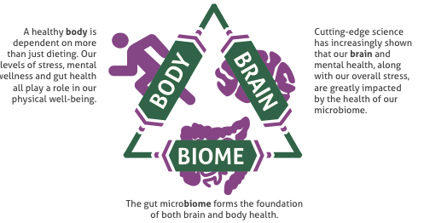

Slide 16
Topic Schedule (Wednesday 7-8pm MT)
May 1 – Session 1 (Week 0) – Overview
May 8 – Session 2 (Week 1) – Body/Brain/Biome
May 15 – Session 3 (Week 2) – Supplementation
May 22 – Session 4 (Week 3) – Exercise
May 29 – Session 5 (Week 4) – Nutrition
June 5 – Session 6 (Week 5) – Stress/Sleep
June 12 – Session 7 (Week 6) – Evaluation
June 19 – Session 8 (Week 7) – Open Discussion
June 26 – Session 9 (Week 8) – Review & Summary

Slide 17
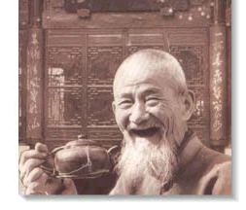
Thank You!

