Slide 1


MENTAL WELLNESS

Slide 2

GRIM REALITY
Americans spend over $100 billion annually on “feel better” products, from painkillers and anti-depressants to alternative and complementary therapies
100 million Americans suffer from chronic pain – this is one of the top reasons for the $100 billion expenditure
350 million people globally are affected by depression each year – another major reason for the $100 billion expenditure
90% of adolescents have a depressive disorder before the age of 18

Slide 3
GRIM REALITY
800,000 people die of suicide each year – that’s over 2000 suicides per day
24 million people, some as young as 12 years old, received treatment for illicit drug or alcohol abuse in 2016
1 in 5 new mothers in the U.S. report postpartum depression each year
The World Health Organization calls stress “the health epidemic of the 21st century”
85% of the nation’s 20 million college students reported feeling overwhelmed by stress - and more than 35% reported feeling “depressed” to the point of dysfunction

Slide 4
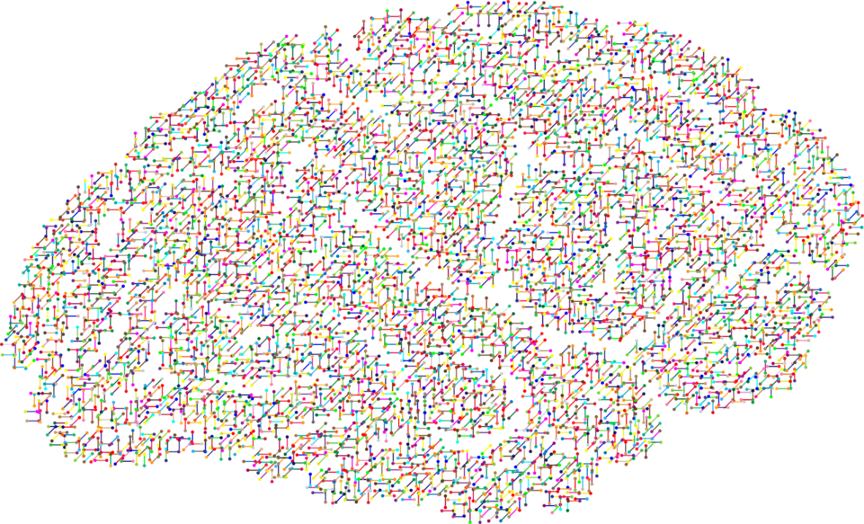
The NEW Science of
Mental Wellness
Science has forever focused on the BRAIN as the primary source to addressing mental wellness problems & answers.
We’ve been relying highly on antidepressants and other forms of serotonin reuptake inhibitors (SSRIs) to resolve these issues.
BUT IS THIS THE RIGHT SOLUTON?

Slide 5

RECENT SCIENTIFIC
DISCOVERIES
Science now tells us that we actually have a SECOND BRAIN!
There has been a massive scientific shift towards the MICROBIOME, also known as our gut and second brain, as being the source to addressing mental wellness issues.

Slide 6
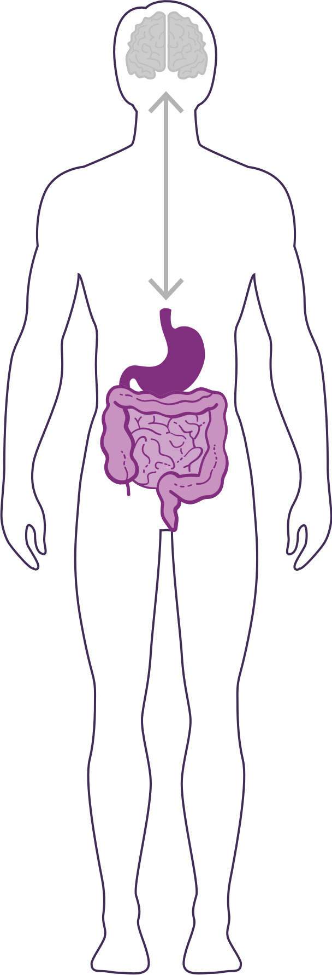
DID YOU KNOW?
90% of the cells in your body are non-human
  Human genes = ~23,000
  Bacterial genes= ~20 million
  (~1,000x MORE than human genes)
The microbiome is an ecological community of trillions of bacteria living symbiotically in/on our body
  “2nd Brain” = 3-4 lbs (approximately the same size as our 1st brain)
YOUR GUT IS CONSIDERED YOUR SECOND BRAIN

Slide 7
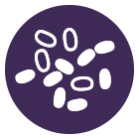
HOW IMPORTANT IS YOUR
MICROBIOME?
Communicates with the brain to regulate health, weight, immune function, digestive function, mood, and overall mental health.
What we put in our bodies affects the microbiome, which in turn affects our mind and other crucial bodily systems
The microbiome plays an important role in the way you feel mentally & physically.
IN BALANCE
Feeling Great
OUT OF BALANCE
This explains why you have those “GUT FEELINGS”
Feeling fatigue, sad, tense, hungry, heavy, bloated, confused, stiff/sore

Slide 8
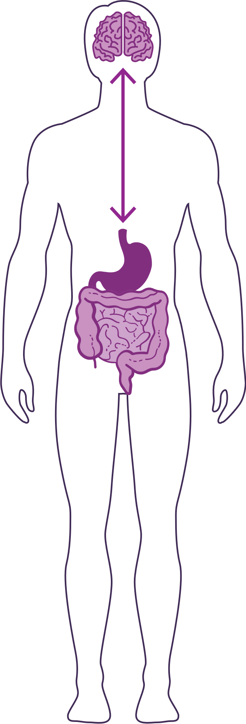
HOW DO YOUR “TWO BRAINS”
COMMUNICATE?
Our “two brains” communicate through a highly extensive, multi-directional network, known as the gut-brain axis or what we refer to as the GBX.
THE NETWORK CONSISTS OF:
“wires” – nerves
“chemicals” – neurotransmitters/hormones
“cells” – immune system
The GBX connects our
nervous system (brain)
immune system (axis)
and gastrointestinal system (gut)
with a vast array of cellular and biochemical messengers throughout the entire body, which include the microbiome, hormones, cytokines, and neurotransmitters.

Slide 9
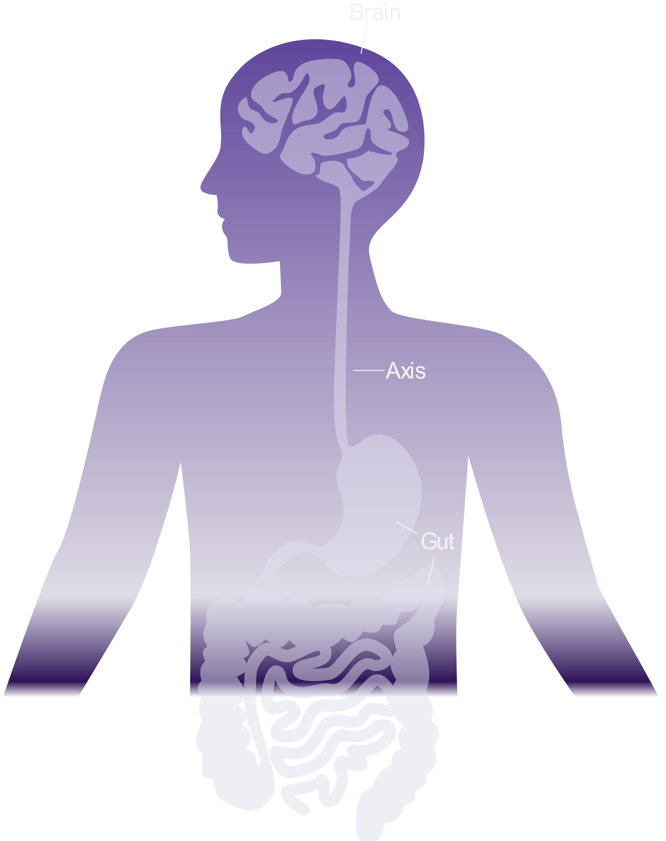




HEALTHY GUT HEALTHY MIND
TWO Brains?
Did you know that we have two brains? One in our head and one in our gut - the 2nd brain. They are connected by a communication axis.
The emerging science
of the Gut-Brain Axis
(GBX) indicates that
many mental wellness
issues originate
as imbalances in
the GBX.
100% Human
Did you know that we have
~100 trillion microorganisms across more than 10,000 different species (Microbiota) in our GI tract? Compare that to our ~10 trillion human body cells and we are only 10% human! Those same microbiota have ~9 million genes (Microbiome) compared to our
~23,000 human genes.
Therefore based on
gene count,
we are
less than 1% human!
Just like weeds compete with flowers in a garden, “bad” bacteria compete with “good” bacteria within our gut. In a healthy and balanced microbiome, “bad” bacteria struggle to flourish.
THE MENTAL WELLNESS COMPANY

Slide 10
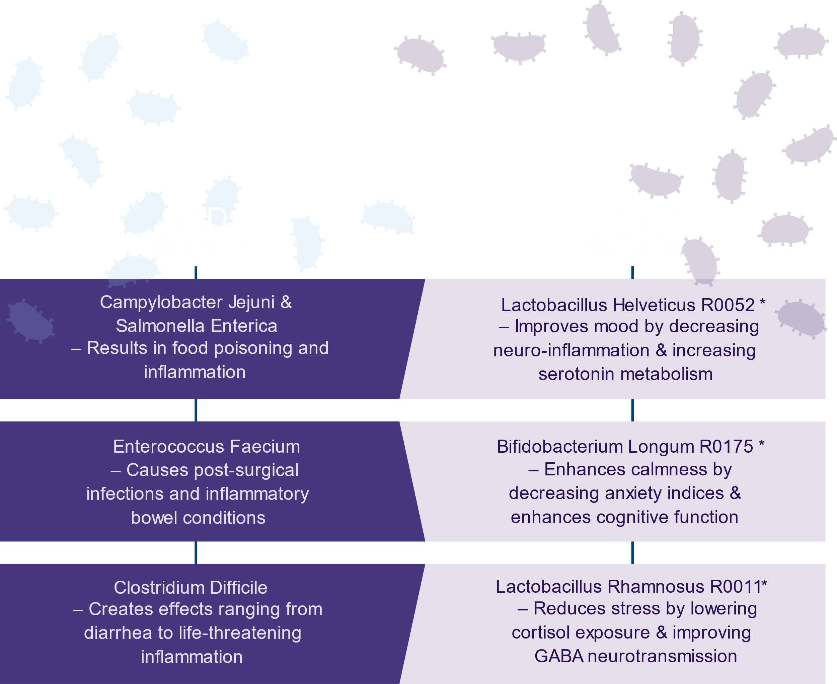




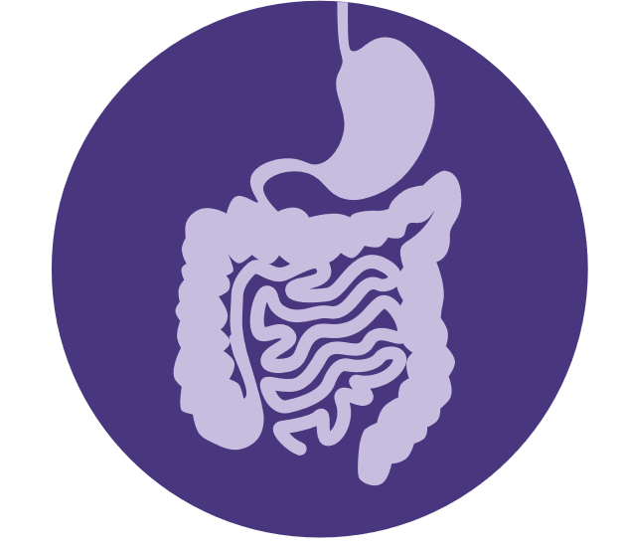
Healthy Inflammatory Balance
Robust Immune Protection
Optimal Digestive Process
THE MENTAL WELLNESS COMPANY

Slide 11






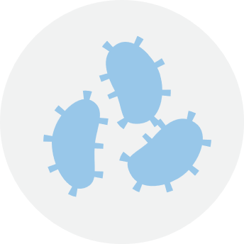
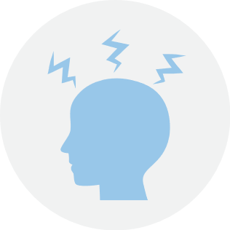
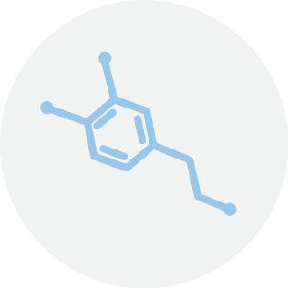
IT GOES BOTH WAYS…
“Butterflies in our stomach” form when we’re in love or anxious
When we eat, receptors in the gut cause the release of enzymes to aid digestion
Gut cells, including microbiome bacteria, send signals to the brain via nerves and hormones to indicate hunger or satiety (fullness)
Fear or sadness makes us “sick to our stomach”
Acute stress can suppress our appetite (short-term), while chronic stress can increase appetite and cravings for comfort foods (stress-eating)
The gut produces as much as 60%-90% of neurotransmitters involved in mental wellness, including dopamine and serotonin
THE MENTAL WELLNESS COMPANY

Slide 12




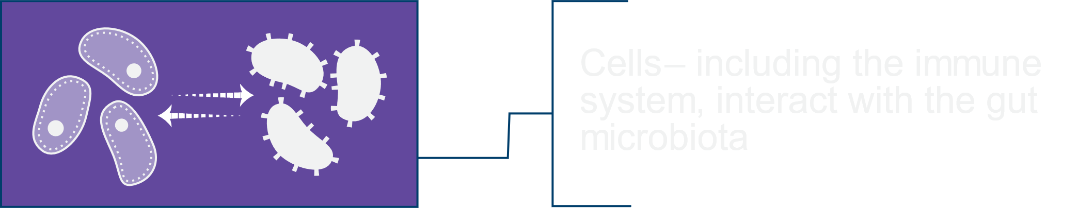
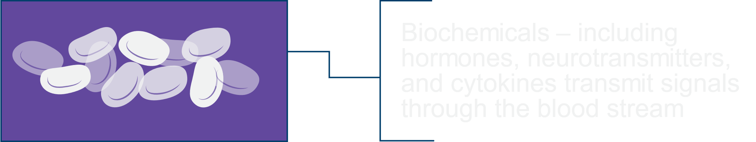
The “Axis” between the Gut and the
Brain coordinates communications
THE MENTAL WELLNESS COMPANY

Slide 13

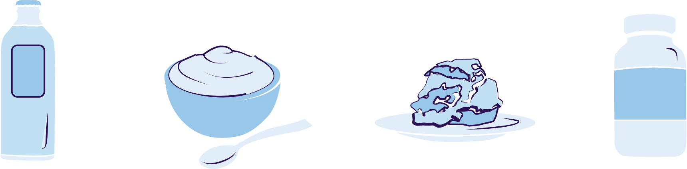
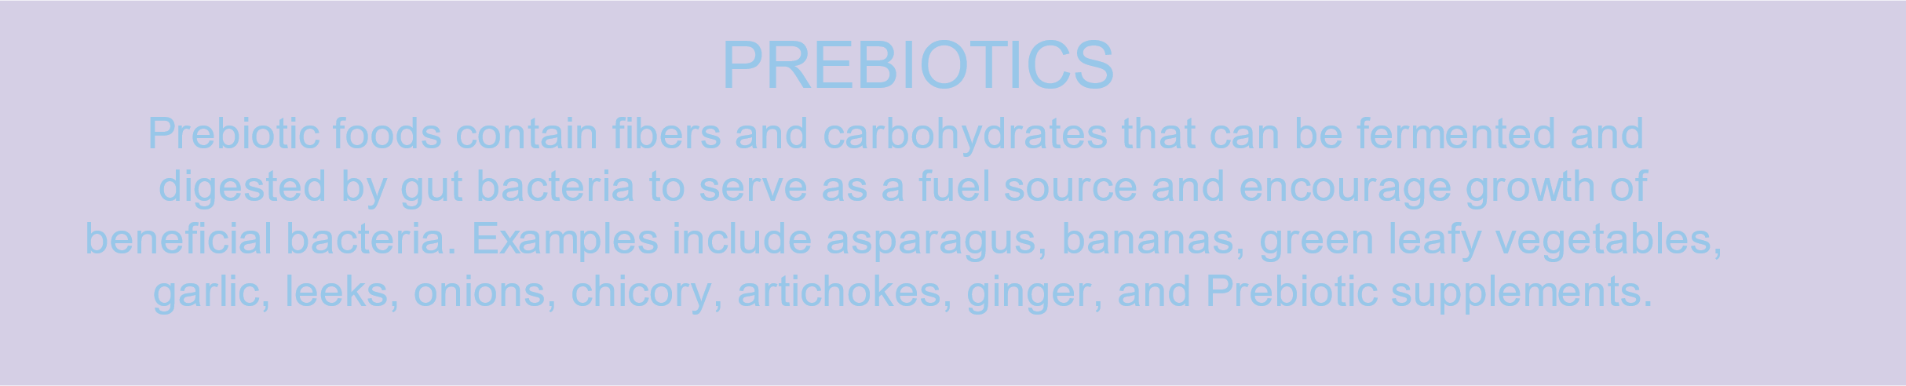
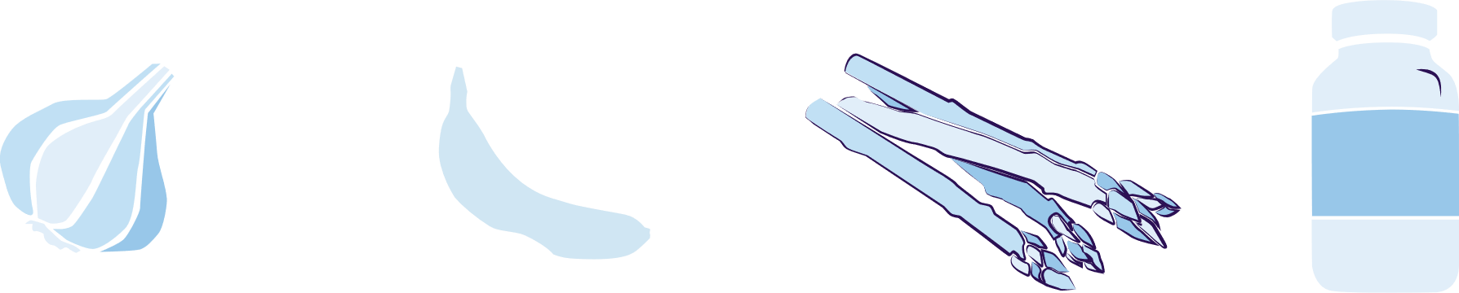

Balance
the GUT
with NUTRITION
PROBIOTICS
Probiotic foods contain live “good bacteria” which support mental wellness and aid digestion. Examples include fermented foods such as yogurt, kefir, kimchi, kombucha, sauerkraut, miso, tempeh, and probiotic supplements.
PREBIOTICS
Prebiotic foods contain fibers and carbohydrates that can be fermented and digested by gut bacteria to serve as a fuel source and encourage growth of beneficial bacteria. Examples include asparagus, bananas, green leafy vegetables, garlic, leeks, onions, chicory, ginger, and prebiotic supplements.
PHYTOBIOTICS
Phytobiotic foods are rich in flavonoids which protect good bacteria and establish a hospitable environment for the growth of good and displacement of bad bacteria.
Examples include apples, grapes, dark chocolate, and berries.
THE MENTAL WELLNESS COMPANY

Slide 14










Mindfulness
Practice such as
meditation, yoga, gratitude, and mindful breathing reduce stress and anxiety
Sleep
Inadequate or poor quality sleep increases stress hormone exposure (cortisol) and interferes with mood and mental function
Physical Activity
Regular exercise is shown to reduce stress, anxiety, and depression as effectively as antidepressant drugs
THE MENTAL WELLNESS COMPANY

Slide 15
THE THREE THINGS YOU SHOULD KNOW ABOUT
MENTAL WELLNESS
How you feel is not just in your head – it’s also in your gut.
Our “second brain” includes the Microbiome and plays a major role in mental wellness.
You can now DO something NATURALLY to improve your mental wellness.
WHERE ARE YOU ON THE MENTAL WELLNESS CONTINUUM? (Circle your current number)
1
2
3
4
5
6
7
8
9
10
DISEASE STATUS
“NORMAL”
OPTIMIZED
Depression
Anxiety
Diabetes
Obesity
Heart Disease
Autoimmune
Arthritis
Fibromyalgia
CFS
Dementia
ADD / ADHD
Alzheimer’s
Fatigue
Tension
Sad
Brain Fog
Headaches
Acne
Eczema
Congestion
URTI’s
Joint Pain
Muscle Pain
Bloated
Chubby
Energetic
Calmness
Happy
Sharp
Creative
Clear Skin
Rarely Sick
Flexible
Lean
Strong
Resilient
RED
ORANGE
YELLOW
GREEN
BLUE
INDIGO
VIOLET

Slide 16
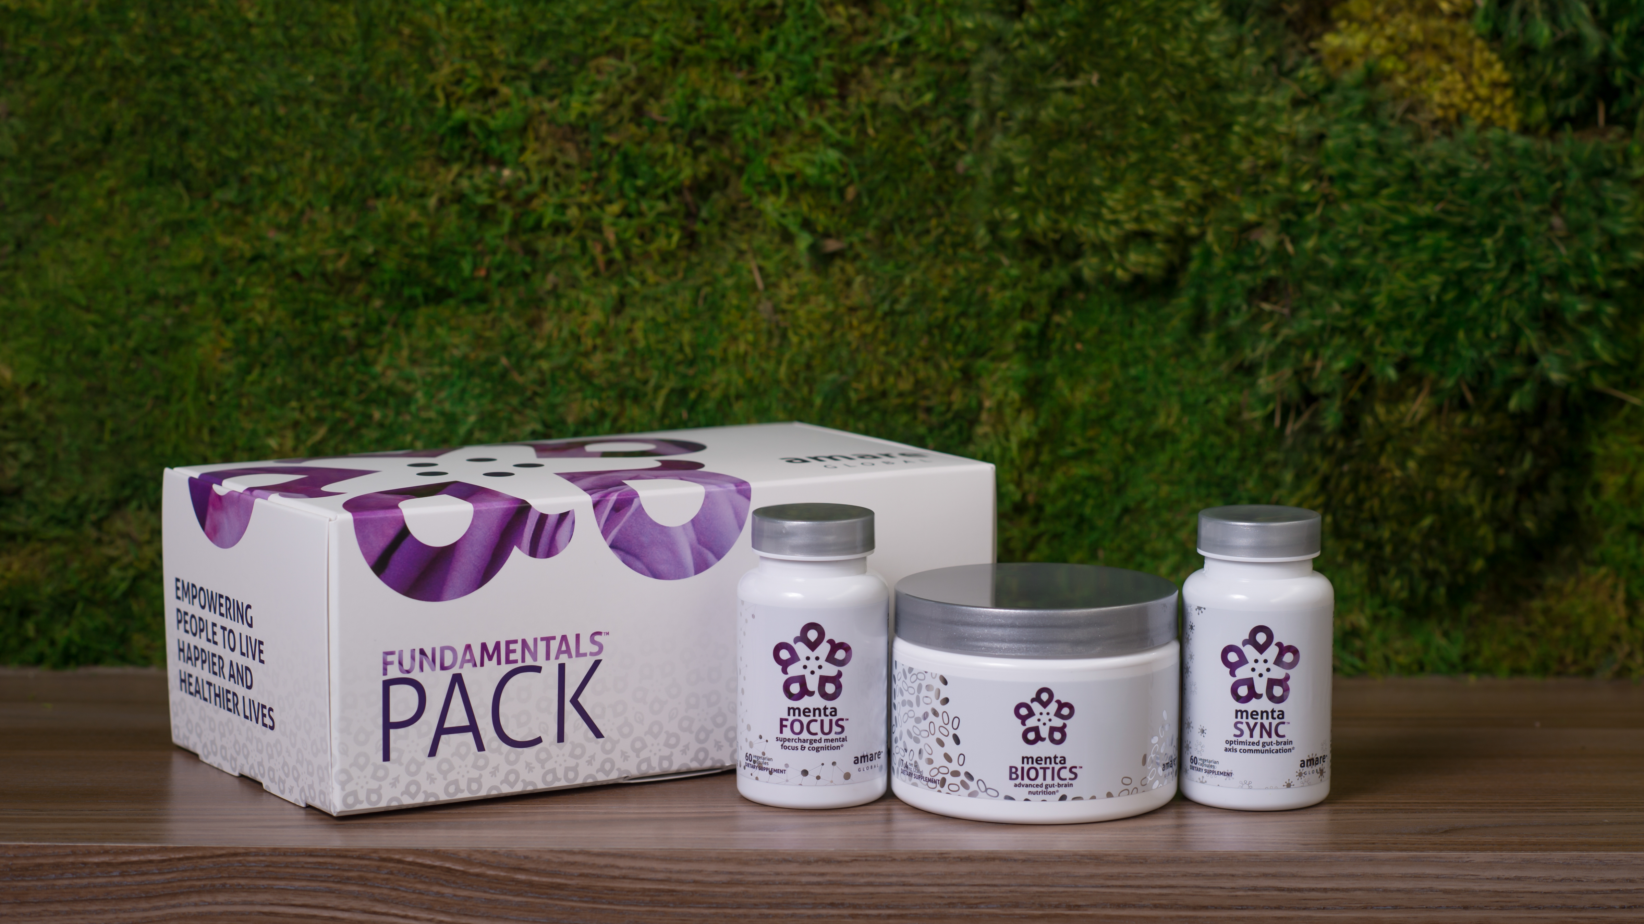
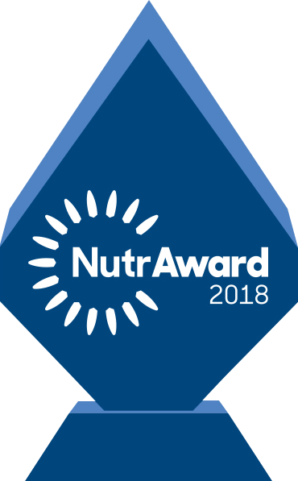
The World’s First Award-Winning Gut-Brain Axis
Nutrition System
AMARE FUNDAMENTALS PACK
™
2018 NutrAward Winner for
“BEST NEW FINISHED PRODUCT”
*These statements have not been evaluated by the Food and Drug Administration. This product is not intended to diagnose, treat, cure, or prevent any disease.

Slide 17
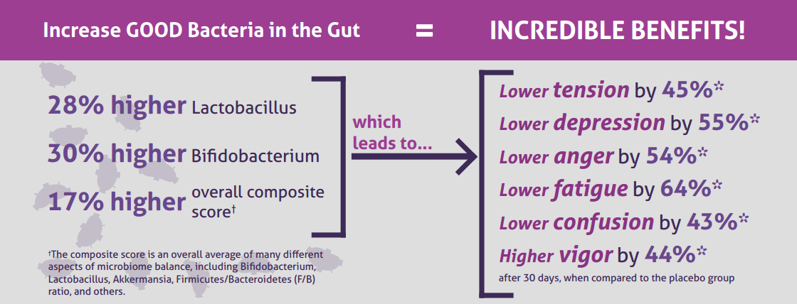
CLINICAL STUDY
The Amare FundaMentals Pack has been clinically proven to:

Slide 18



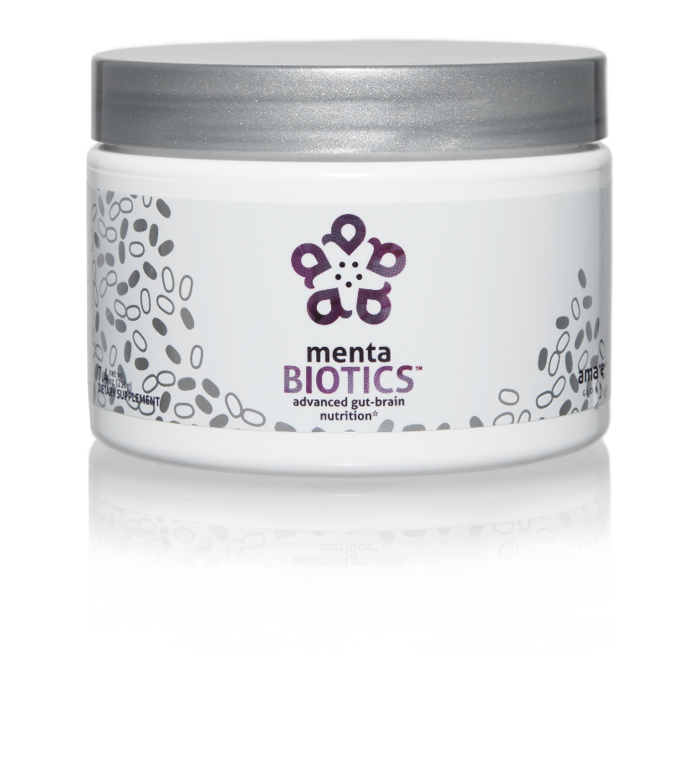
AMARE’S FLAGSHIP PRODUCT
SUPPORTS FEEL-GOOD NEUROTRANS-MITTERS
INCREASES GOOD BACTERIA
The most comprehensive combination of unique strains of probiotics, prebiotics, and phytobiotics that have been scientifically shown to improve mental wellness.*
Item Code:
Retail Price:
Wholesale Price:
Subscribe & Save:
S001
$100.00
$74.95 / 65 PV
$66.95 / 58 PV
*These statements have not been evaluated by the Food and Drug Administration. This product is not intended to diagnose, treat, cure, or prevent any disease.

Slide 19
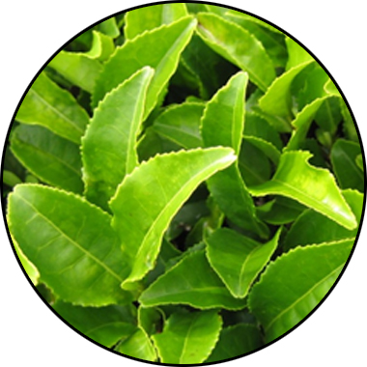
MENTABIOTICS
KEY INGREDIENTS
™
Suntheanine
Increases Alpha Waves
“Relaxed alertness”
*These statements have not been evaluated by the Food and Drug Administration. This product is not intended to diagnose, treat, cure, or prevent any disease.

Slide 20
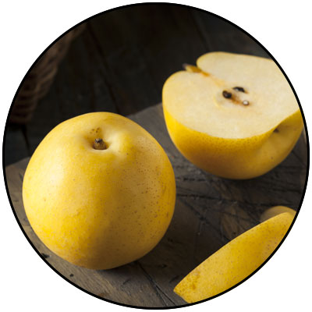

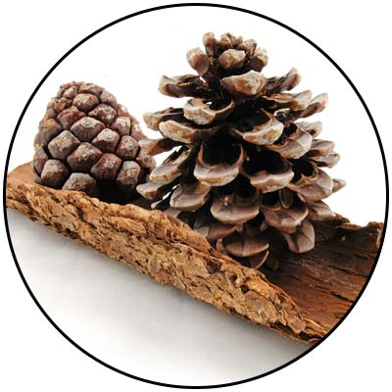
GBX+ proprietary blend…
Patent Pending and Exclusive to Amare
Applephenon: Asian Apple Fruit extract
Supports gut health, immune function, & inflammatory balance*
Enovita: French Grape Seed extract
Enhances blood flow, cardiovascular tone, & cellular defenses*
Enzogenol: New Zealand Pine Bark extract
Improves neurotransmitter balance, mental focus, & psychological vigor*
*These statements have not been evaluated by the Food and Drug Administration. This product is not intended to diagnose, treat, cure, or prevent any disease.

Slide 21
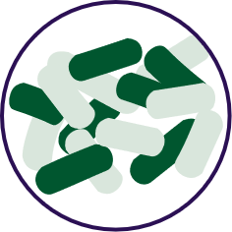


FOR YOUR GUT…
THE PROBIOTIC STRAIN MATTERS
Lactobacillus rhamnosus R0011:
Reduces stress by lowering cortisol exposure and improves GABA neurotransmission*
Stress
Bifidobacterium longum R0175:
Enhances calmness by decreasing anxiety indices and improves cognitive function*
Anxiety/
Cognition
Lactobacillus helveticus R0052:
Improves mood by decreasing neuro-inflammation and increasing serotonin*
Mood
*These statements have not been evaluated by the Food and Drug Administration. This product is not intended to diagnose, treat, cure, or prevent any disease.

Slide 22


Prebiotic proprietary blend…
Supports the growth of preferred bacteria
These prebiotics support the growth and vitality of a range of beneficial gut bacteria, particularly Lactobacillus and Bifidobacterium species (featured in MentaBiotics).
Bimuno® GOS (Galacto-Oligo-Saccharides)
Resets and increases friendly gut bacteria, maintains immune health, controls inflammation in the body, supports your microbiome balance, highly effective and natural way of increasing preferred bacteria in your gut.*
SunFiber® , Galactomannan Fiber – aka PHGG (partially hydrolyzed guar gum)
Helps improve the growth and vitality of beneficial bacteria, including Bifidobacteria and Lactobacillus.*
*These statements have not been evaluated by the Food and Drug Administration. This product is not intended to diagnose, treat, cure, or prevent any disease.

Slide 23

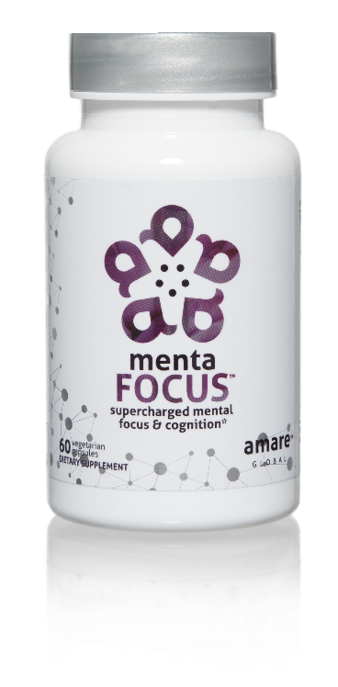
AMPLIFIES ATTENTION & ALERTNESS
ENHANCES BRAIN ACTIVATION
PROMOTES CLARITY COGNITION CREATIVITY
Supercharge your brain with key phytonutrients clinically shown to support focus, mental sharpness, clarity, creativity, and cognitive functioning.*
Item Code:
Retail Price:
Wholesale Price:
Subscribe & Save:
S002
$60.00
$44.95 / 39 PV
$39.95 / 35 PV
*These statements have not been evaluated by the Food and Drug Administration. This product is not intended to diagnose, treat, cure, or prevent any disease.

Slide 24
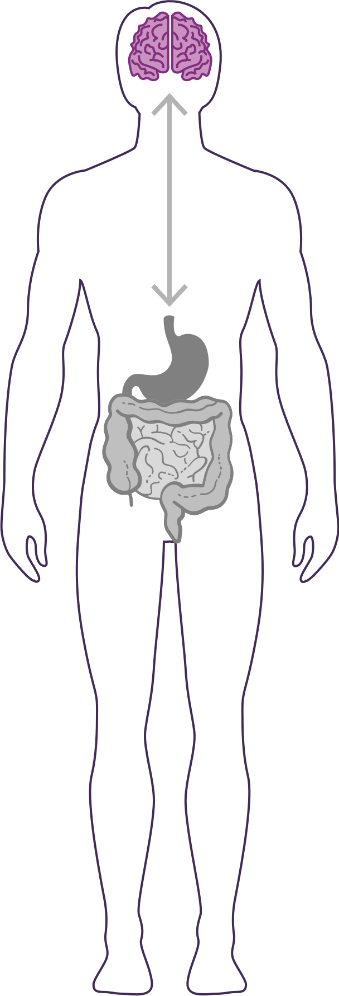



GUT – BRAIN - AXIS
The brain is an extremely complex & powerful system. Fuel it with the right nutrients for enhanced mental focus & cognitive function.
Restores “youthful” brain function*‡
Increases short-term and long-term memory by increasing visual and verbal recall by 28%*‡
Improves both working memory and recognition memory and reduces functional brain age by 12 years*‡
*These statements have not been evaluated by the Food and Drug Administration. This product is not intended to diagnose, treat, cure, or prevent any disease.
‡BASED ON KEY INGREDIENTS CLINICAL STUDIES

Slide 25
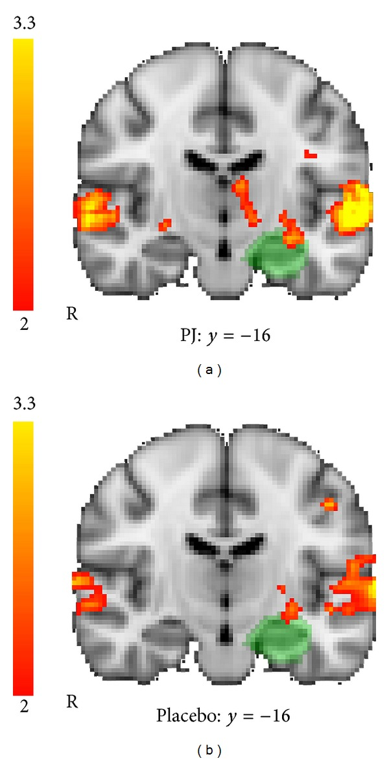
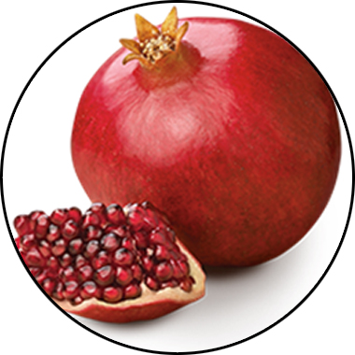
MENTAFOCUS
KEY INGREDIENTS
™
POMx
Enhances Brain Activation
*These statements have not been evaluated by the Food and Drug Administration. This product is not intended to diagnose, treat, cure, or prevent any disease.

Slide 26
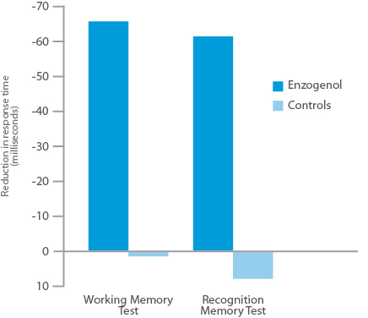
MENTAFOCUS
KEY INGREDIENTS
™
Enzogenol
Improves Memory
*These statements have not been evaluated by the Food and Drug Administration. This product is not intended to diagnose, treat, cure, or prevent any disease.

Slide 27
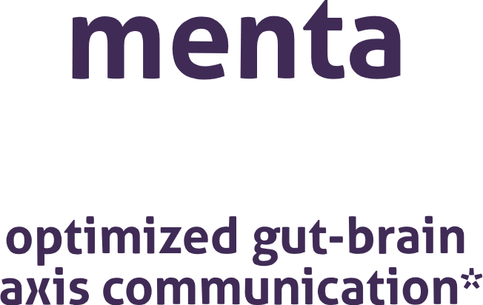

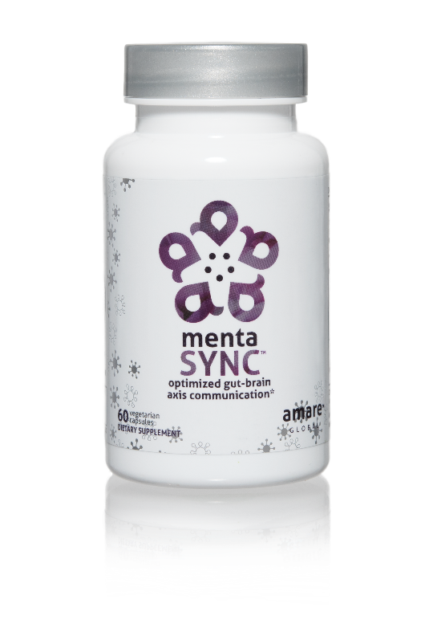
IMPROVES
GUT-BRAIN COMMUNICATION
BALANCES SIGNALING BETWEEN CELLS
ENHANCES
BIO-CHEMICAL COMMUNICATION
Optimize the communication sync of chemical messengers between your brain and your gut with the clinically studied key ingredients in MentaSync.*
Item Code:
Retail Price:
Wholesale Price:
Subscribe & Save:
S003
$74.00
$54.95 / 47 PV
$48.95 / 42 PV
*These statements have not been evaluated by the Food and Drug Administration. This product is not intended to diagnose, treat, cure, or prevent any disease.

Slide 28
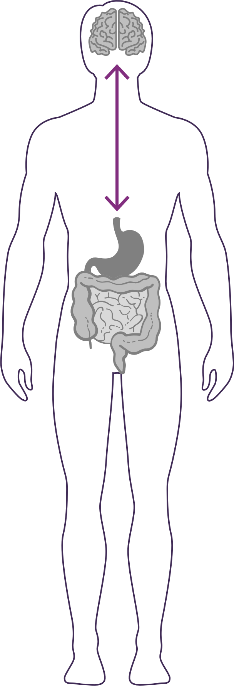


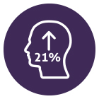
GUT – BRAIN - AXIS
The gut & brain are connected by a link known as the “axis”, which is an important component of the gut-brain axis system. It is the primary connection between our two brains and is greatly responsible for our overall well-being.
Balances normal signaling between cells of the gut, brain, and immune system.*‡
Enhances GBX (gut-brain axis) signaling and gut barrier function via alpha-glucans, beta-glucans, SCFAs (butyrate) and zinc-carnosine*‡
Increases psychological vigor by 21%*‡
*These statements have not been evaluated by the Food and Drug Administration. This product is not intended to diagnose, treat, cure, or prevent any disease.
‡BASED ON KEY INGREDIENTS CLINICAL STUDIES

Slide 29
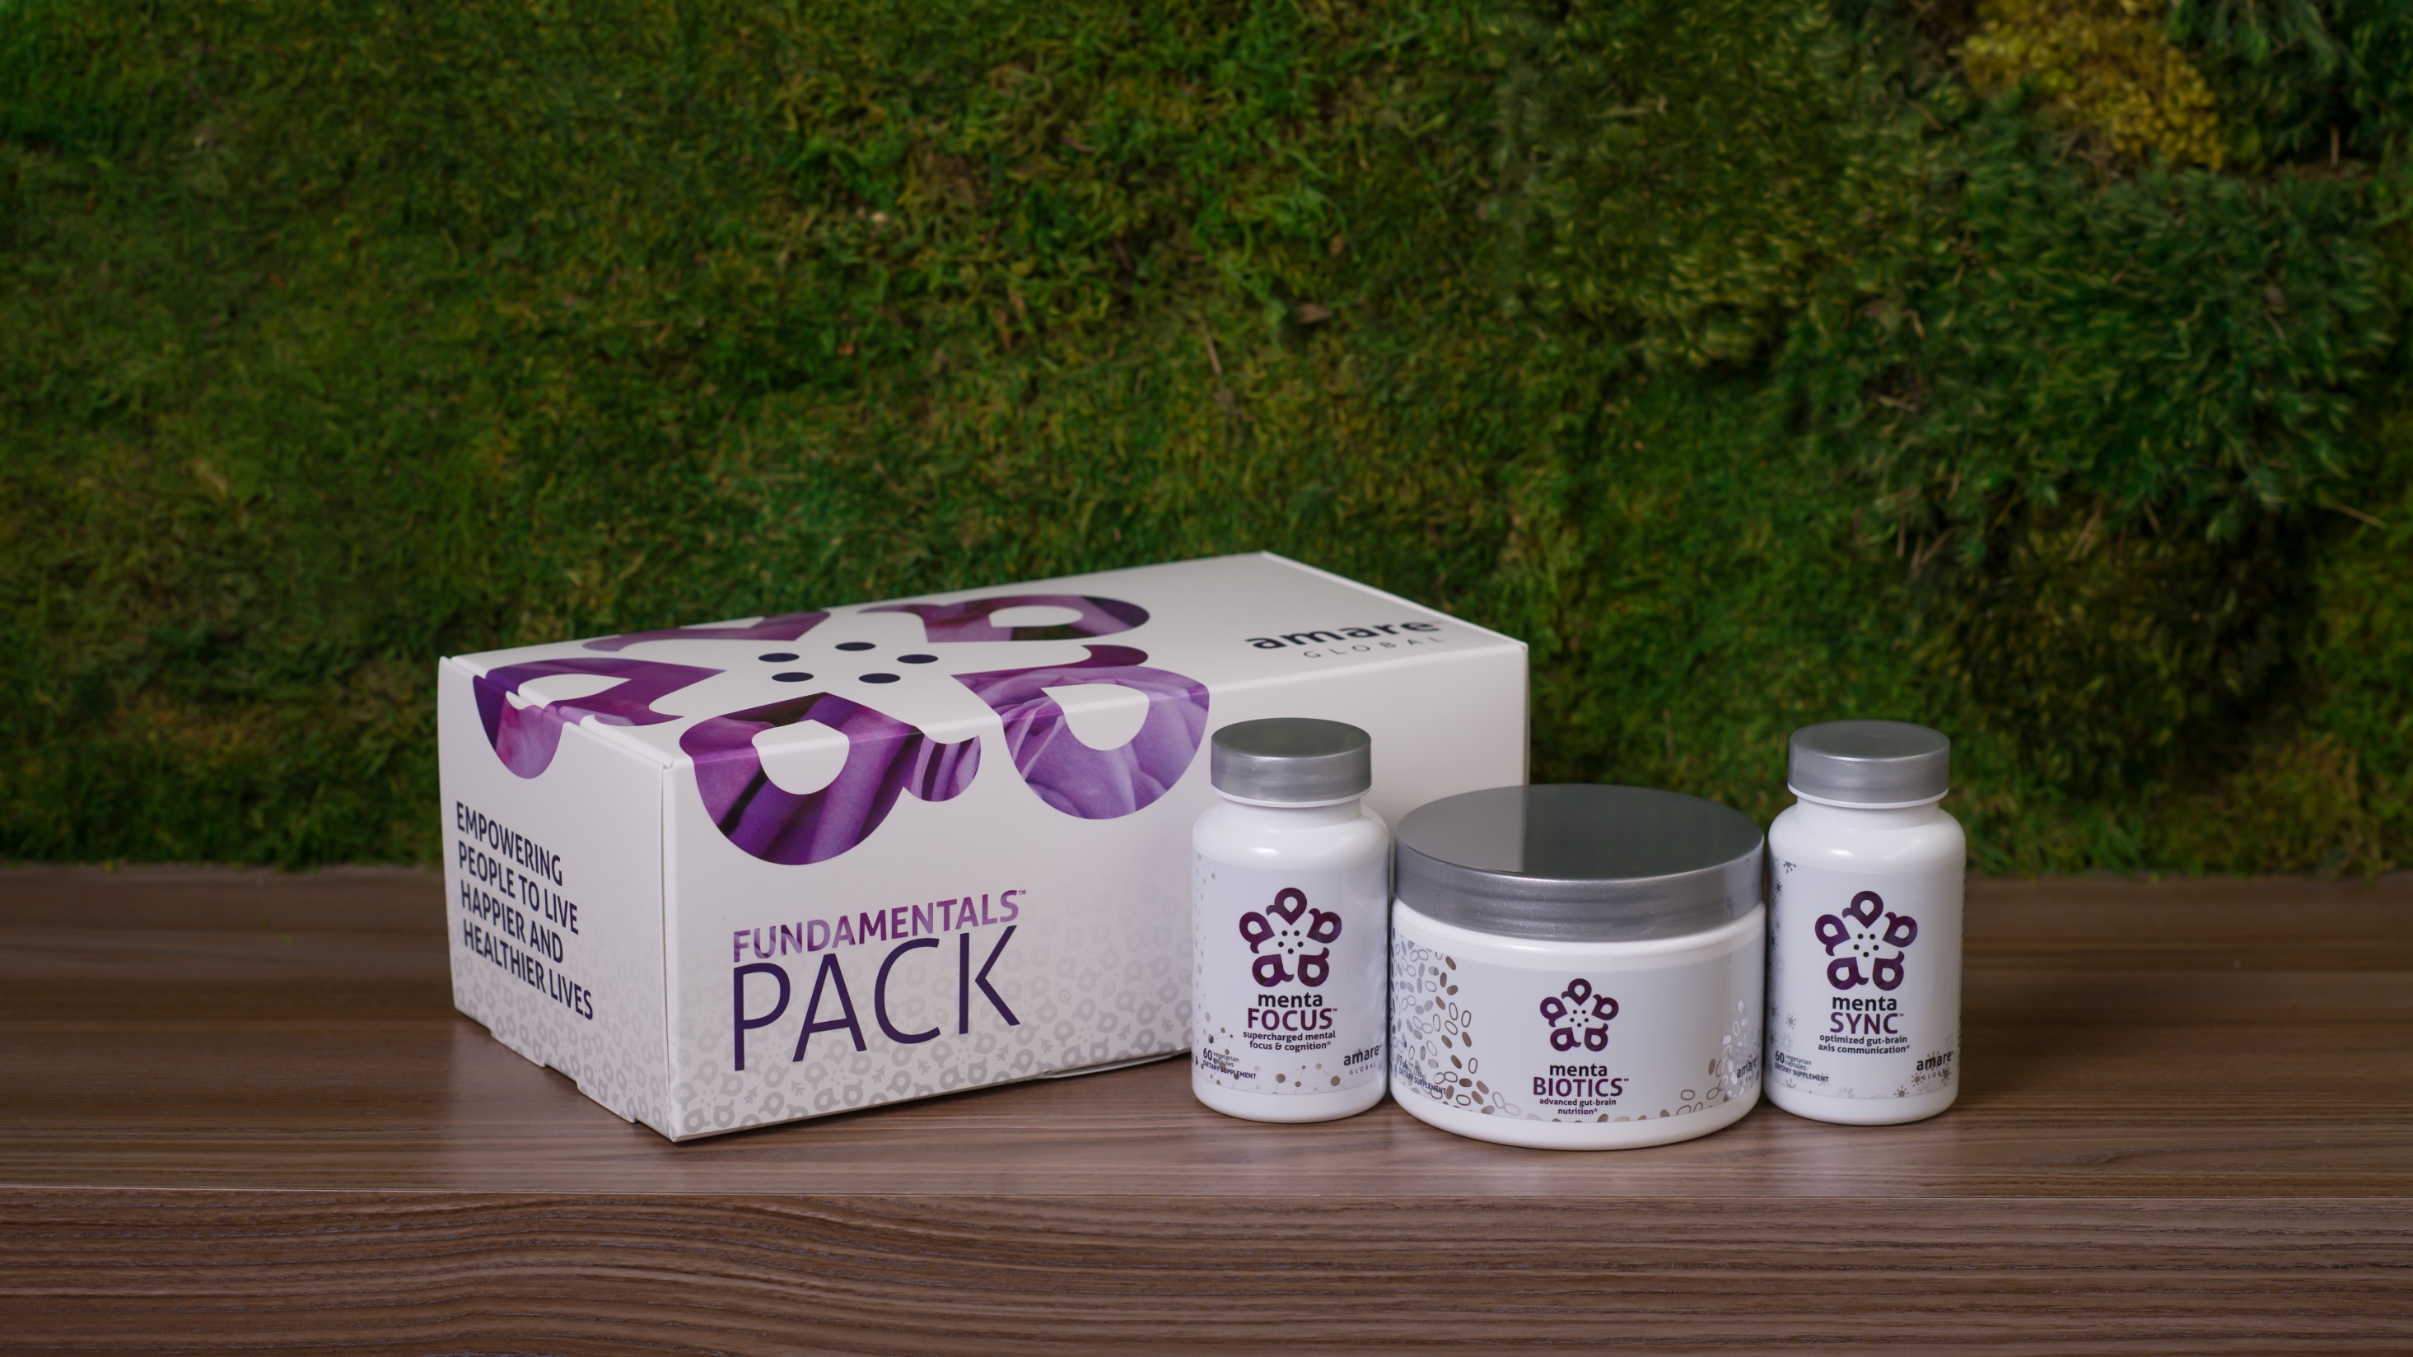
World’s First Award-Winning Gut-Brain Axis Nutrition System
AMARE FUNDAMENTALS PACK
™
2018 NutrAward Winner for
“BEST NEW FINISHED PRODUCT”
Item Code:
Retail Price:
Wholesale Price:
Subscribe & Save:
P001
$234.00
$149.95 / 120 PV
$134.95 / 108 PV
*These statements have not been evaluated by the Food and Drug Administration. This product is not intended to diagnose, treat, cure, or prevent any disease.

Slide 30

Daily Essential Nutrients for Healthy Kids and Teens*
AMARE KIDS
™
*These statements have not been evaluated by the Food and Drug Administration. This product is not intended to diagnose, treat, cure, or prevent any disease.

Slide 31


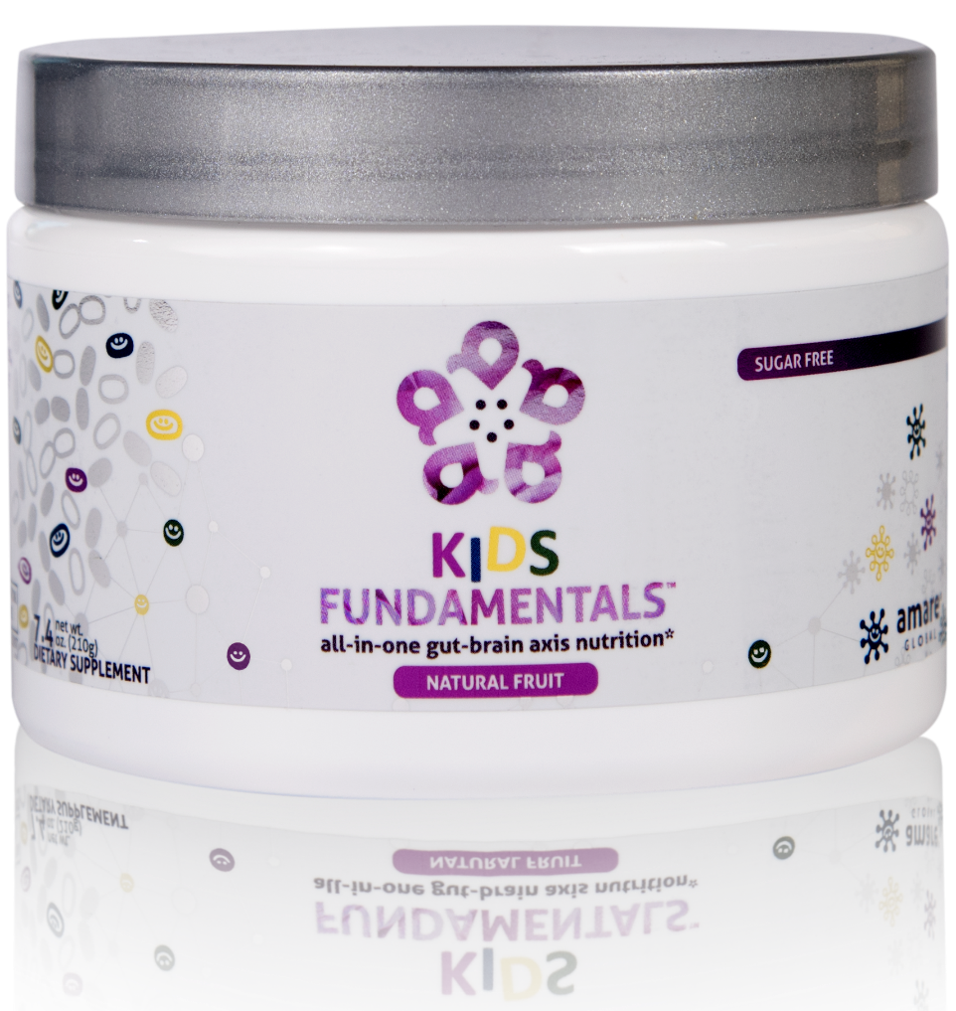
INGREDIENTS SHOWN TO IMPROVE MENTAL WELLNESS*
SUPPORTS ENTIRE GUT-BRAIN AXIS*
EASY-TO-DIGEST FORMULA
all-in-one gut-brain axis nutrition for kids & teens*
Kids FundaMentals™ is an all-in-one product that supports the entire gut-brain axis (GBX) of growing kids and teens. Featuring nutrients scientifically shown to improve mental wellness, this easy-to-digest formula is perfect for kids and teens of all ages.*
Item Code:
Retail Price:
Wholesale Price:
Subscribe & Save:
S017
$90.00
$66.95 / 56 PV
$59.95 / 50 PV
*These statements have not been evaluated by the Food and Drug Administration. This product is not intended to diagnose, treat, cure, or prevent any disease.
Notes:
Add callouts

Slide 32

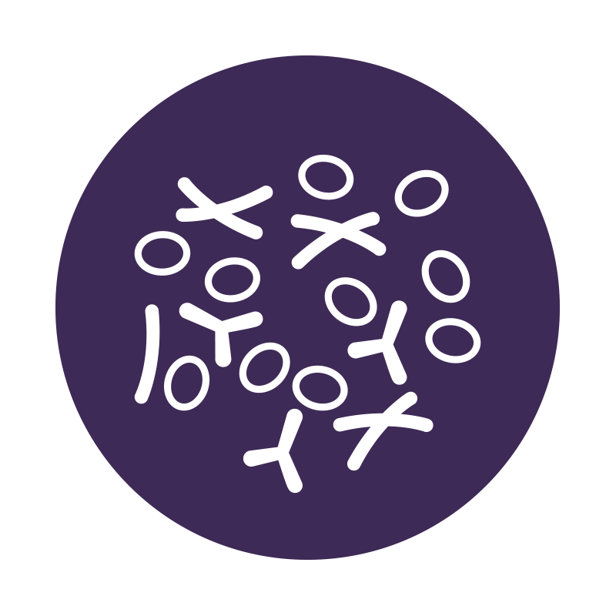

all-in-one gut-brain axis nutrition for kids & teens*
Have equivalent benefits to the Amare FundaMentals PackTM in a one scoop serving for kids and teens of all ages*
Supports the growth and vitality of a range of beneficial gut bacteria*
Increases short-term and long-term memory by increasing visual and verbal recall by 28%*
*These statements have not been evaluated by the Food and Drug Administration. This product is not intended to diagnose, treat, cure, or prevent any disease.
‡BASED ON KEY INGREDIENTS CLINICAL STUDIES
Notes:
Bullet colors are different colors

Slide 33


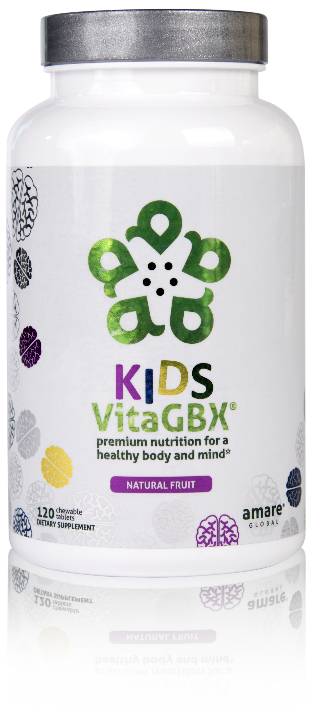
CONTAINS BENEFICIAL VITAMINS AND MINERALS
CONTAINS MORE THAN 50 NUTRIENTS*
PERFECT FOR KIDS AND TEENS OF ALL AGES*
premium nutrition for a healthy body and mind*
Kids VitaGBX® is a comprehensive multivitamin for kids and teens that combines more than 50 vitamins, minerals, amino acids, and phytonutrients. Packed with pure nutrients kids need as they grow and develop, our easy-to-digest chewable tablets feature both our Bright Mind Proprietary Blend (for mind support) and Amare GBX+ Proprietary Blend (for gut-brain axis support) to empower a well-balanced body and mind. Features a delicious, fruity flavor — perfect for kids and teens of all ages.*
Item Code:
Retail Price:
Wholesale Price:
Subscribe & Save:
S020
$48.00
$35.95 / 25 PV
$31.95 / 22 PV
*These statements have not been evaluated by the Food and Drug Administration. This product is not intended to diagnose, treat, cure, or prevent any disease.

Slide 34
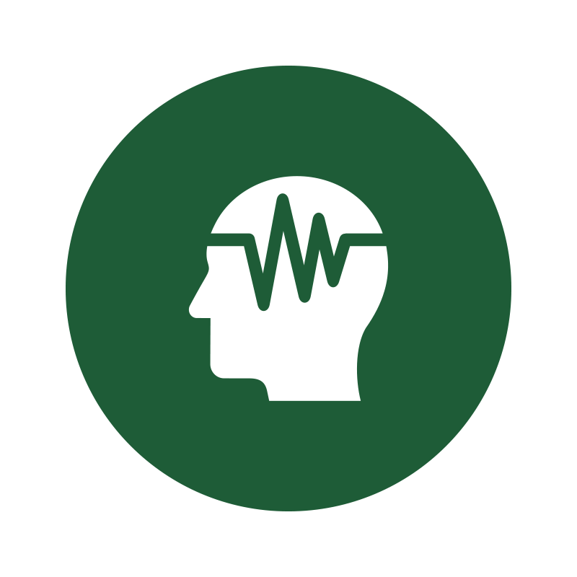


premium nutrition for a healthy body and mind*
Deliver more than 50 vitamins, minerals, amino acids and phytonutrients for a well-balanced body and mind specifically for kids and teens.*
Improve concentration, attention and alertness in the developing brain.*
Enhance optimal functionality of the gut-brain axis specifically for kids and teens.*
*These statements have not been evaluated by the Food and Drug Administration. This product is not intended to diagnose, treat, cure, or prevent any disease.

Slide 35
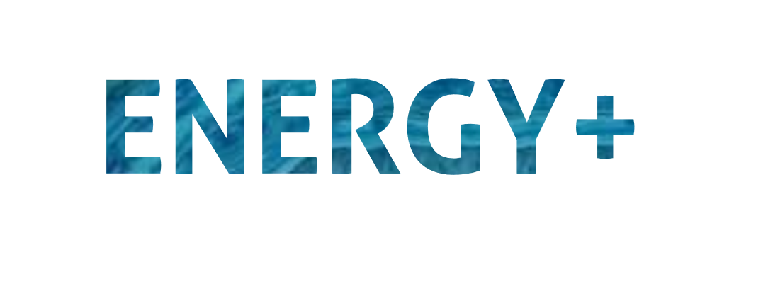

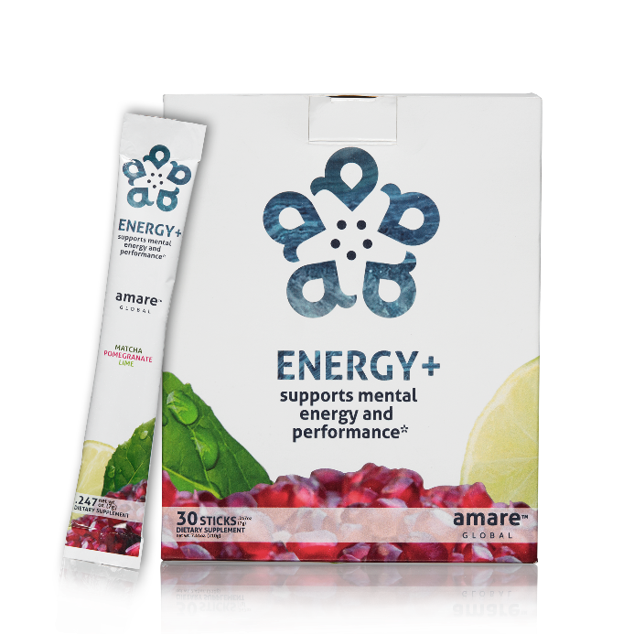
LONG-LASTING STAMINA
ALL-NATURAL
NO SYNTHETICS
MENTAL
ENERGY
supports mental energy and
performance*
A next-generation mental energy product that delivers rapid improvements in brain and physical performance, without the jitters or crash you might get from many high-stimulant or high-sugar energy drinks.*
Item Code:
Retail Price:
Wholesale Price:
Subscribe & Save:
S005
$60.00
$44.95 / 36 PV
$39.95 / 32 PV
*These statements have not been evaluated by the Food and Drug Administration. This product is not intended to diagnose, treat, cure, or prevent any disease.

Slide 36



supports mental energy and
performance*
Rapid improvements in mental energy, acuity, and alertness*
Increases energy levels and endurance*
Provides energy without the jitters or crash from other high-stimulant or high-sugar energy drinks*
*These statements have not been evaluated by the Food and Drug Administration. This product is not intended to diagnose, treat, cure, or prevent any disease.

Slide 37
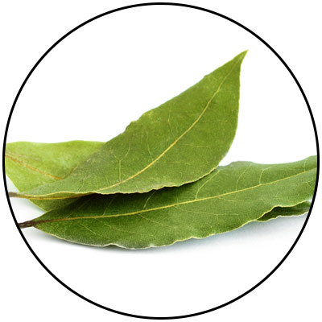
ENERGY+
KEY INGREDIENTS
Guayusa
Amazonian Awareness Enhancer
*These statements have not been evaluated by the Food and Drug Administration. This product is not intended to diagnose, treat, cure, or prevent any disease.
Notes:
Amazonian Hunters call guayusa the “Night Watchman” because it sharpens their awareness and gives them energy when heading into the jungle at night to hunt. Guayusa's effect is usually experienced as a bright and focused energy thanks to healthy synergistic compounds that help balance the naturally occurring caffeine.

Slide 38
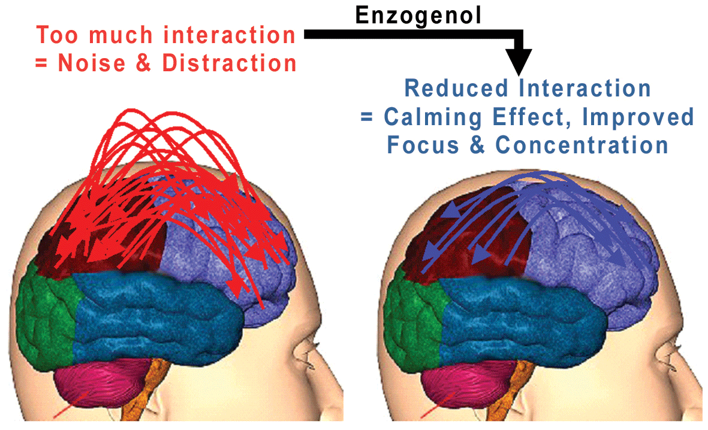
ENERGY+
KEY INGREDIENTS
Enzogenol
Calms “monkey mind”
*These statements have not been evaluated by the Food and Drug Administration. This product is not intended to diagnose, treat, cure, or prevent any disease.

Slide 39
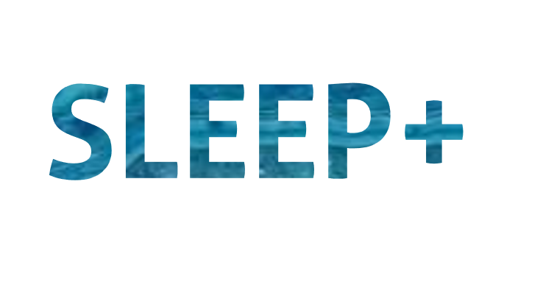
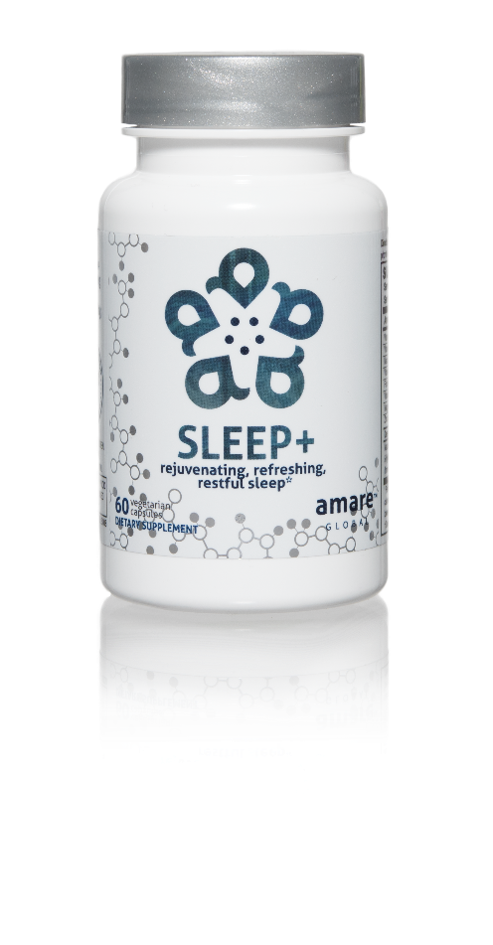

FALL ASLEEP FASTER
STAY ASLEEP LONGER
IMPROVES SLEEP QUALITY
rejuvenating, refreshing,
restful sleep*
The key ingredients in Sleep+ have multiple scientific studies that show significant benefits including helping you to fall asleep faster, stay asleep longer, and experience higher quality plus more rejuvenating sleep.*
Item Code:
Retail Price:
Wholesale Price:
Subscribe & Save:
S008
$80.00
$59.95 / 52 PV
$53.95 / 46 PV
*These statements have not been evaluated by the Food and Drug Administration. This product is not intended to diagnose, treat, cure, or prevent any disease.

Slide 40
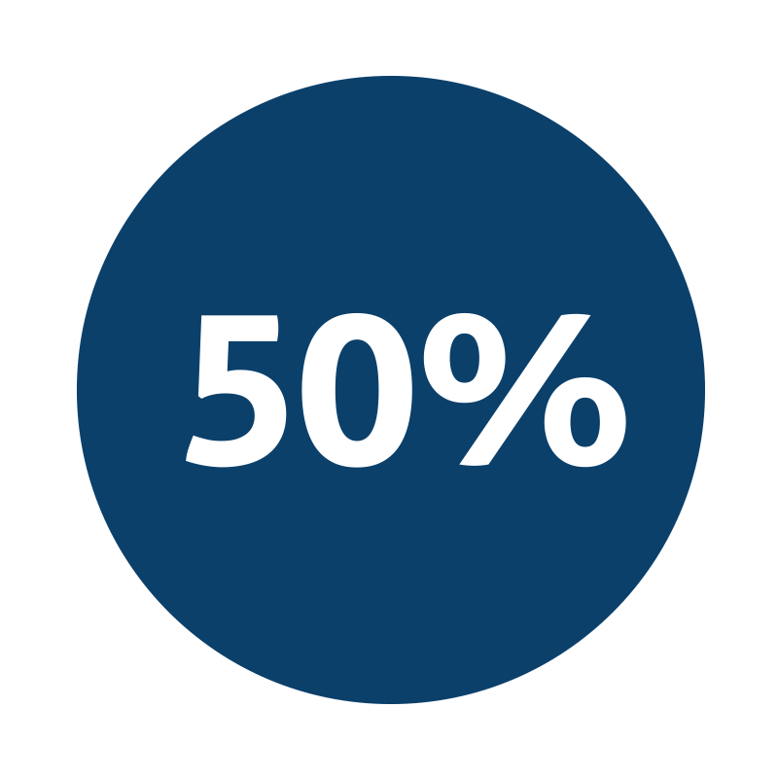
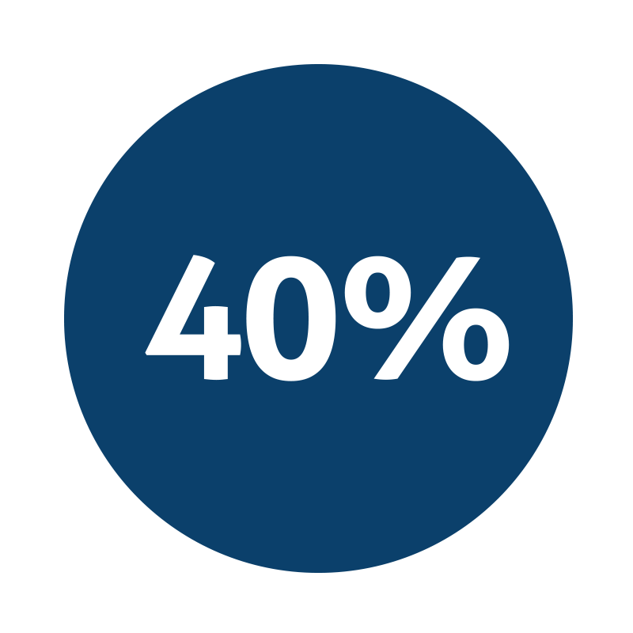

rejuvenating, refreshing,
restful sleep*
Improvement in sleep efficiency*
Improvement in sleep quality*
Fall asleep faster by 33% and wake up fewer times each night by 30%*
*These statements have not been evaluated by the Food and Drug Administration. This product is not intended to diagnose, treat, cure, or prevent any disease.
Notes:
Talbott and Talbott: Effect of Monocot Grass Extract (MGE) on mood state and sleep patterns in moderately stress subjects. Journal of the International Society of Sports Nutrition 2013 10(Suppl 1):P26.

Slide 41
THE THREE THINGS YOU SHOULD KNOW ABOUT
MENTAL WELLNESS
How you feel is not just in your head – it’s also in your gut.
Our “second brain” includes the Microbiome and plays a major role in mental wellness.
You can now DO something NATURALLY to improve your mental wellness.
WHERE ARE YOU ON THE MENTAL WELLNESS CONTINUUM? (Circle your current number)
1
2
3
4
5
6
7
8
9
10
DISEASE STATUS
“NORMAL”
OPTIMIZED
Depression
Anxiety
Diabetes
Obesity
Heart Disease
Autoimmune
Arthritis
Fibromyalgia
CFS
Dementia
ADD / ADHD
Alzheimer’s
Fatigue
Tension
Sad
Brain Fog
Headaches
Acne
Eczema
Congestion
URTI’s
Joint Pain
Muscle Pain
Bloated
Chubby
Energetic
Calmness
Happy
Sharp
Creative
Clear Skin
Rarely Sick
Flexible
Lean
Strong
Resilient
RED
ORANGE
YELLOW
GREEN
BLUE
INDIGO
VIOLET

