Slide 1


Slide 2
Dr. Shawn Talbott
Amare’s Chief Science Officer
PhD, CNS, LDN, FACSM, FAIS, FACN
20+ years of experience developing nutritional products
Fellow of the American College of Nutrition, the American College of Sports Medicine, and the American Institute of Stress
Author of two academic textbooks, an award-winning documentary film, and several best-selling books that have been translated into multiple languages.
Featured guest on The Dr. Oz Show, Ask Dr. Nandi, The TED stage and the White House
Served as a nutrition educator for elite-level athletes
Diplomate of the International Olympic Committee’s (IOC) Sports Nutrition program
ShawnTalbott.com / Amare.com

Slide 3
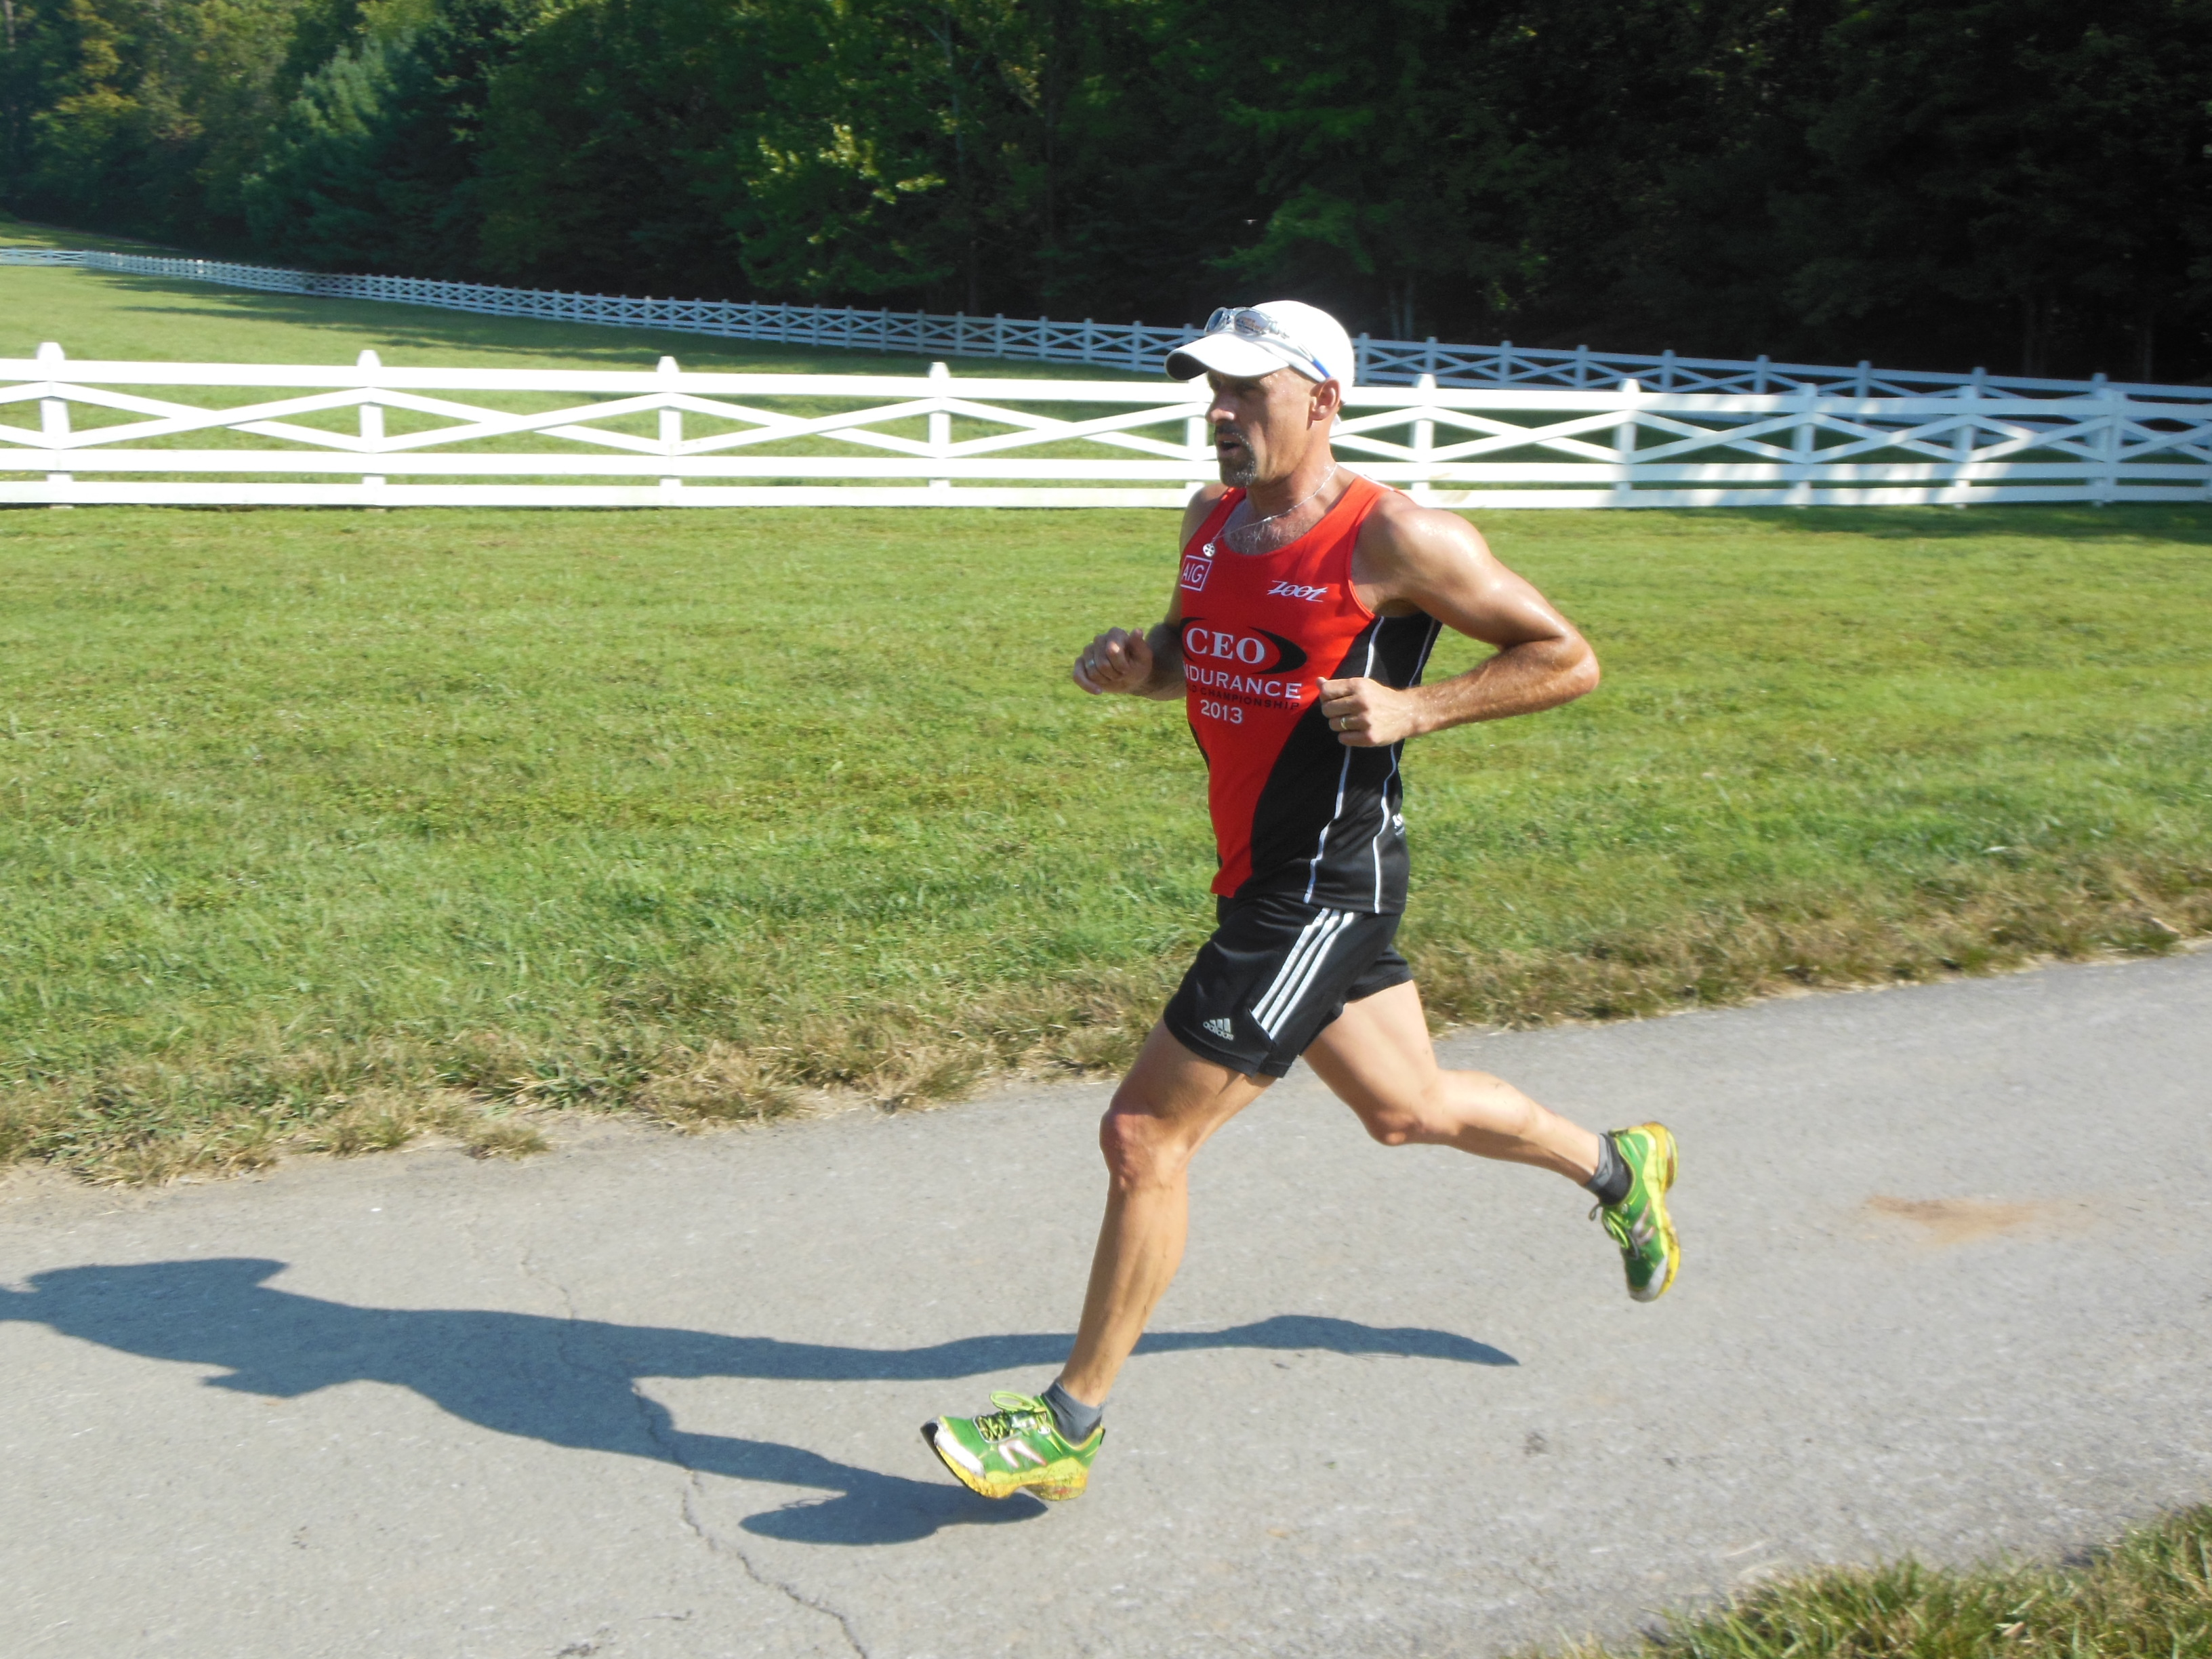
12 Fitness Tips from the “World’s Fittest CEO”
Shawn M. Talbott, PhD, LDN, CNS, FACSM, FACN, FAIS

Slide 4
THE THREE THINGS YOU SHOULD KNOW ABOUT MENTAL WELLNESS
How you feel is not just in your head – it’s also in your gut.
Our “second brain” includes the Microbiome and plays a major role in mental wellness.
You can now DO something NATURALLY to improve your mental wellness.
WHERE ARE YOU ON THE MENTAL WELLNESS CONTINUUM? (Circle your current number)
1
2
3
4
5
6
7
8
9
10
DISEASE STATUS
“TYPICAL”
OPTIMIZED
Depression
Anxiety
Diabetes
Obesity
Heart Disease
Autoimmune
Arthritis
Fibromyalgia
CFS
Dementia
ADD / ADHD
Alzheimer’s
Fatigue
Tension
Sad
Brain Fog
Headaches
Acne
Eczema
Congestion
URTI’s
Joint Pain
Muscle Pain
Bloated
Chubby
Energetic
Calmness
Happy
Sharp
Creative
Clear Skin
Rarely Sick
Flexible
Lean
Strong
Resilient
RED
ORANGE
YELLOW
GREEN
BLUE
INDIGO
VIOLET

Slide 5
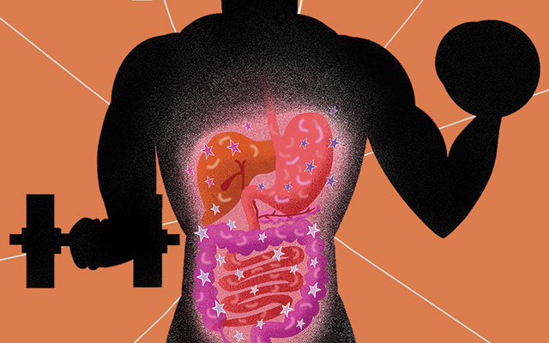
Gutting it Out?
Nutrient Digestion/Absorption (leaky gut)
GI Comfort/Distress
Immune Function (URTIs/Allergies)
Inflammation/Recovery
Metabolism (cortisol, glucose, thyroid, belly fat)
Focus – Engagement – Flow – Zone
Choke/Clutch

Slide 6
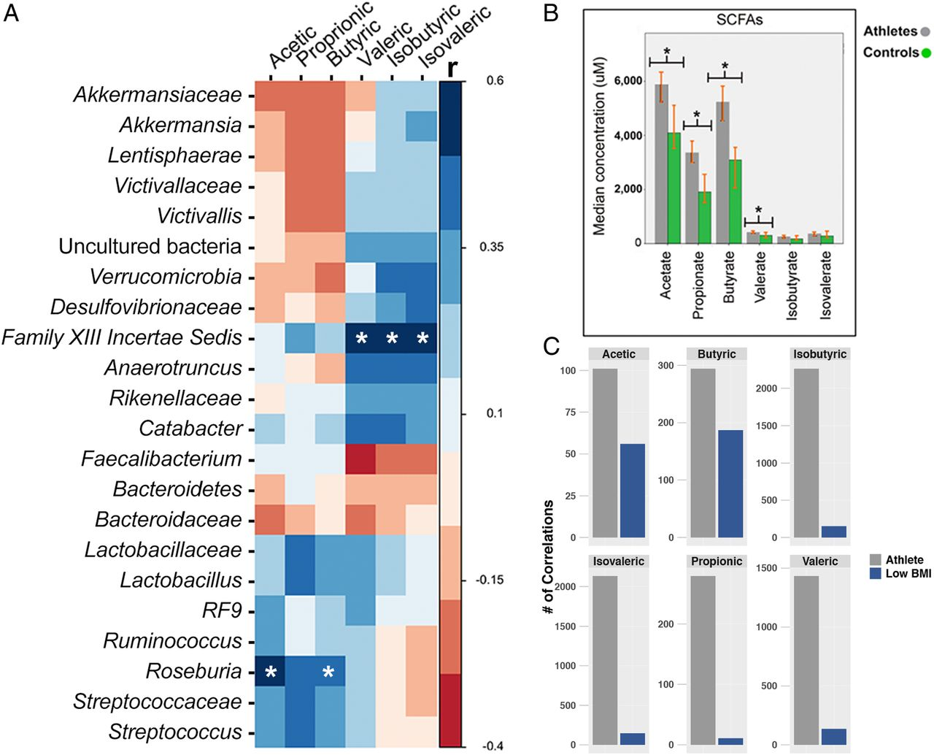

Slide 7



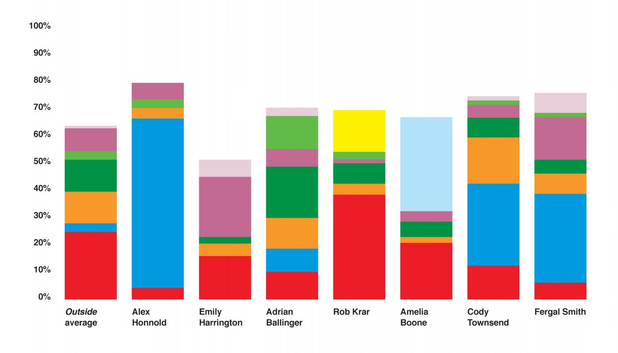
Bacteroides (red) = immune system
Prevotella (blue) = high in endurance athletes and vegetarians
Lachnospiraceae (orange) = produce butyric acid
Faecalibacterium (green) = breaks down fiber into butyrates
Roseburia (light green) = turns fiber into butyric acid.
Acinetobacter (light blue) = don’t know much about the role of this soil-based bacteria, but some are antibiotic-resistant
Ruminococcaceae (purple) = convert resistant starches into short-chain fatty acids
Bacillus (yellow) = immune system
Clostridium (pink) = famous for C. botu­linum and C. difficile, most are harmless, keep the whole bacteria population stable
Other (gray) = thousands of additional strains of bacteria

Slide 8

GRIM REALITY
Americans spend over $100 billion annually on “feel better” products, from painkillers and anti-depressants to alternative and complementary therapies
100 million Americans suffer from chronic pain – this is one of the top reasons for the $100 billion expenditure
350 million people globally are affected by depression each year – another major reason for the $100 billion expenditure
90% of adolescents have a depressive disorder before the age of 18
Notes:
Americans spend over $100 billion annually on “feel better” products, from painkillers and anti-depressants to alternative and complementary therapies
Nearly 100 million Americans suffer from occasional aches and pains – and is one of the most common reasons that people look to complementary and alternative medicine (CAM) for non-pharmaceutical options
Globally, more than 350 million people are affected by feelings of depression each year
Nearly 90% of adolescents struggle with feelings of depression and anxiety before the age of 18
Globally, more than 800,000 people die by suicide every year – around one person every 40 seconds. In the United States, more than 40,000 Americans commit suicide each year – that’s more than 100 suicides per day
Every year, more than 24 million people, some as young as 12 years old, receive treatment for illicit drug or alcohol abuse
Approximately 1 in 5 new mothers in the U.S. have postpartum depression each year
The World Health Organization calls stress “the health epidemic of the 21st century” with more than 350 million people affected around the world
More than 80% of the nation’s 20 million college students feel “exhausted and overwhelmed by stress” - and more than one-third feel “depressed” to the point of dysfunction

Slide 9
GRIM REALITY
800,000 people die of suicide each year – that’s over 2000 suicides per day
24 million people, some as young as 12 years old, received treatment for illicit drug or alcohol abuse in 2016
1 in 5 new mothers in the U.S. report postpartum depression each year
The World Health Organization calls stress “the health epidemic of the 21st century”
85% of the nation’s 20 million college students reported feeling overwhelmed by stress - and more than 35% reported feeling “depressed” to the point of dysfunction
Notes:
Shawn’s verbiage:
Americans spend over $100 billion annually on “feel better” products, from painkillers and anti-depressants to alternative and complementary therapies
Nearly 100 million Americans suffer from occasional aches and pains – and is one of the most common reasons that people look to complementary and alternative medicine (CAM) for non-pharmaceutical options
Globally, more than 350 million people are affected by feelings of depression each year
Nearly 90% of adolescents struggle with feelings of depression and anxiety before the age of 18
Globally, more than 800,000 people die by suicide every year – around one person every 40 seconds. In the United States, more than 40,000 Americans commit suicide each year – that’s more than 100 suicides per day
Every year, more than 24 million people, some as young as 12 years old, receive treatment for illicit drug or alcohol abuse
Approximately 1 in 5 new mothers in the U.S. have postpartum depression each year
The World Health Organization calls stress “the health epidemic of the 21st century” with more than 350 million people affected around the world
More than 80% of the nation’s 20 million college students feel “exhausted and overwhelmed by stress” - and more than one-third feel “depressed” to the point of dysfunction
SOURCES:
Grim Reality Statistics
Americans spend over $100 billion annually on “feel better” products, from painkillers and anti-depressants to alternative and complementary therapies
Centers for Disease Control and Prevention (CDC) https://www.cdc.gov/nchs/data/hus/hus13.pdf;
Journal of the American Medical Association (JAMA) Trends in Prescription Drug Use Among Adults in the United States From 1999-2012 http://jamanetwork.com/journals/jama/fullarticle/2467552; National Survey on Drug Use and Health https://nsduhweb.rti.org/respweb/homepage.cfm; National Center for Complementary and Integrative Medicine (NCCIM) https://nccih.nih.gov/news/press/cost-spending-06222016
Nearly 100 million Americans suffer from occasional aches and pains – and is one of the most common reasons that people look to complementary and alternative medicine (CAM) for non-pharmaceutical options
National Institutes of Health (NIH), National Center for Complementary and Integrative Medicine (NCCIM), National Health Interview Survey (NHIS) https://nccih.nih.gov/news/press/08112015; Washington Post https://www.washingtonpost.com/news/to-your-health/wp/2015/08/11/nih-more-than-1-in-10-american-adults-experience-chronic-pain/?utm_term=.4dd603a1f016
Globally, more than 350 million people are affected by feelings of depression each year
National Institute for Mental Health (NIMH) https://www.nimh.nih.gov/health/publications/depression/index.shtml; Healthline http://www.healthline.com/health/depression/facts-statistics-infographic; National Alliance on Mental Illness (NAMI) https://www.nami.org
Nearly 90% of adolescents struggle with feelings of depression and anxiety before the age of 18
Depression in Children and Teens, WebMD http://www.webmd.com/depression/tc/depression-in-childhood-and-adolescence-topic-overview#1; National Institute of Mental Health (NIMH) https://www.nimh.nih.gov/health/statistics/prevalence/any-disorder-among-children.shtml
Globally, more than 800,000 people die by suicide every year – around one person every 40 seconds. In the United States, more than 40,000 Americans commit suicide each year – that’s more than 100 suicides per day.
Centers for Disease Control & Prevention, National Center for Health Statistics, Increase in Suicide in the United States, 1999–2014, NCHS Data Brief No. 241, April 2016; New York Times https://www.nytimes.com/2016/04/22/health/us-suicide-rate-surges-to-a-30-year-high.html?_r=0; World Health Organization (WHO) http://www.who.int/mediacentre/news/releases/2014/suicide-prevention-report/en/
Every year, more than 24 million people, some as young as 12 years old, receive treatment for illicit drug or alcohol abuse
National Institutes of Health (NIH); National Institute on Drug Abuse (NIDA) https://www.drugabuse.gov/related-topics/trends-statistics; Substance Abuse and Mental Health Services Administration’s (SAMHSA’s) National Survey on Drug Use and Health https://www.drugabuse.gov/publications/drugfacts/treatment-statistics
Approximately 1 in 5 new mothers in the U.S. have postpartum depression each year
Centers for Disease Control and Prevention https://www.cdc.gov/reproductivehealth/depression/index.htm; Postpartum Progress http://postpartumprogress.org/the-facts-about-postpartum-depression/; American Psychological Association (APA) http://www.apa.org/pi/women/resources/reports/postpartum-depression.aspx
The World Health Organization calls stress “the health epidemic of the 21st century” with more than 350 million people affected around the world
World Health Organization (WHO) http://www.who.int/mediacentre/factsheets/fs369/en/; http://www.who.int/mediacentre/factsheets/fs396/en/; Business News Daily http://www.businessnewsdaily.com/2267-workplace-stress-health-epidemic-perventable-employee-assistance-programs.html; Stress: Concepts, Cognition, Emotion, and Behavior http://scitechconnect.elsevier.com/stress-health-epidemic-21st-century/; WHO World Mental Health http://www.who.int/mental_health/world-mental-health-day/2016/en/
More than 80% of the nation’s 20 million college students feel “exhausted and overwhelmed by stress” - and more than one-third feel “depressed” to the point of dysfunction
American College Health Association http://www.acha.org/ACHA/Resources/Topics/MentalHealth.aspx; American Psychological Association (APA) http://www.apa.org/monitor/2014/09/cover-pressure.aspx;

Slide 10
STRESS
ACUTE STRESS
brief
normal circadian rhythm
adaptive
CHRONIC STRESS
prolonged & repeated
disrupted circadian rhythm
maladaptive

Slide 12
Yerkes-Dodson Curve of Human Performance

Slide 14
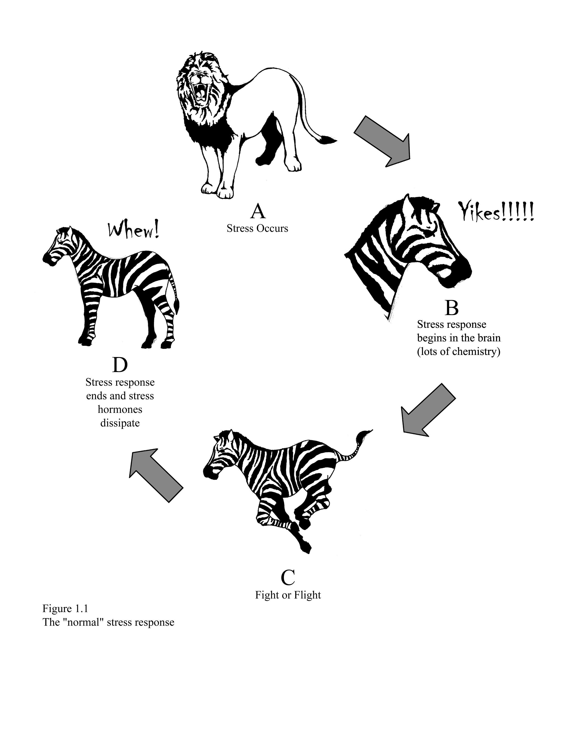
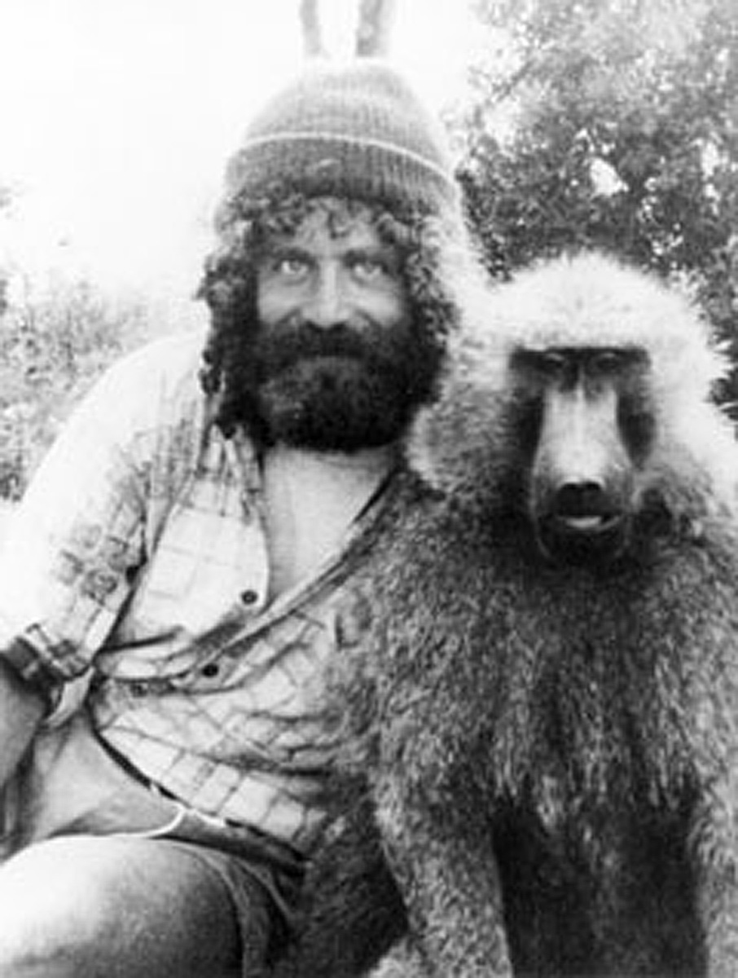
Why Zebras Don’t Get Ulcers…
Robert Sapolsky, PhD
Stanford University
Stress Physiology

Slide 15
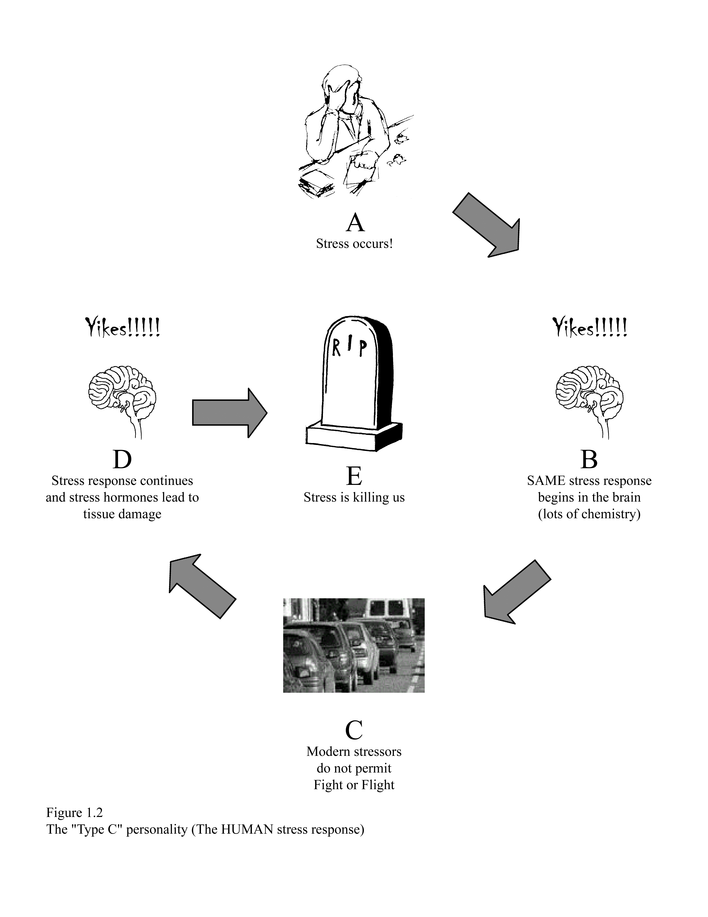
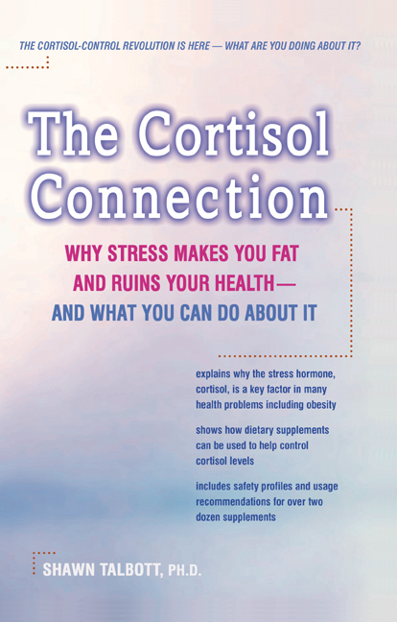
Humans are not Zebras…
…and are not meant to harbor chronic stress

Slide 16
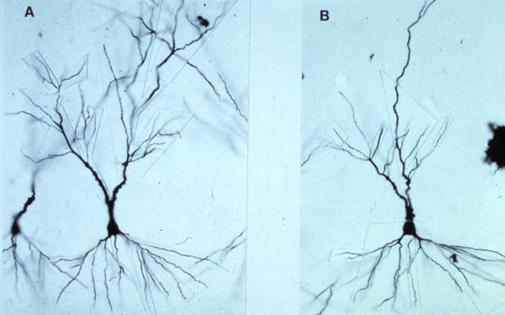
Neuronal Atrophy (dead brain cells)
Normal Stress / Normal Cortisol
Healthy, Large, Many Projections, Optimal Function
High Stress / High Cortisol
Small, Thin, Disrupted
Structural Damage, Poor Function

Slide 17
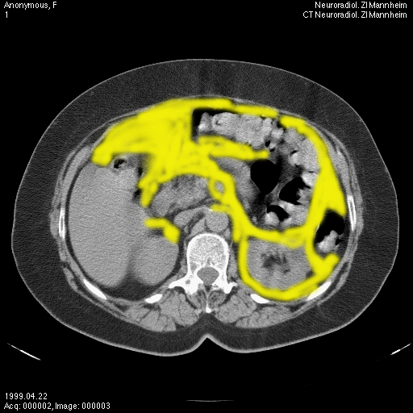
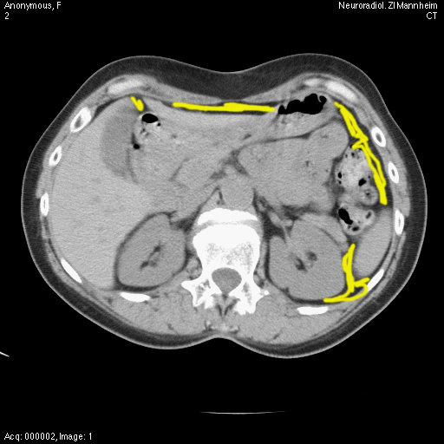
Abdominal Fat Accumulation
High Stress / High Cortisol
Normal Stress / Normal Cortisol

Slide 18
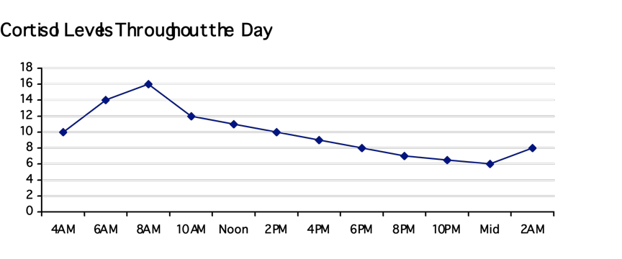
“Normal” Diurnal Cortisol Rhythm

Slide 19
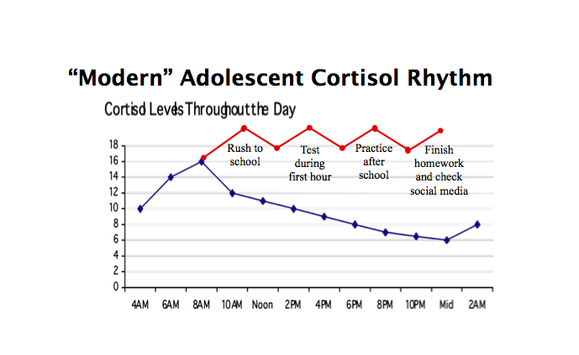

Slide 20
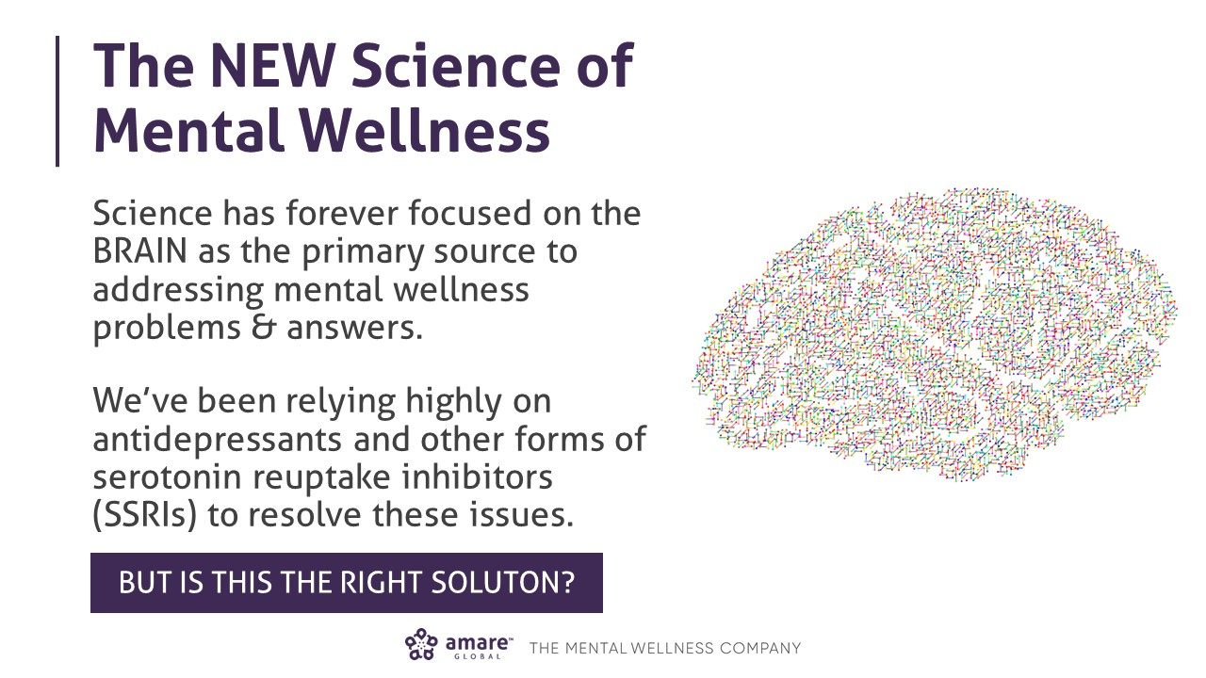

Slide 21
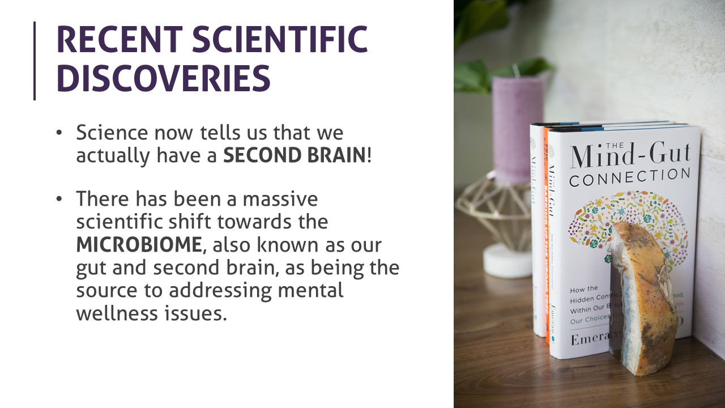

Slide 22
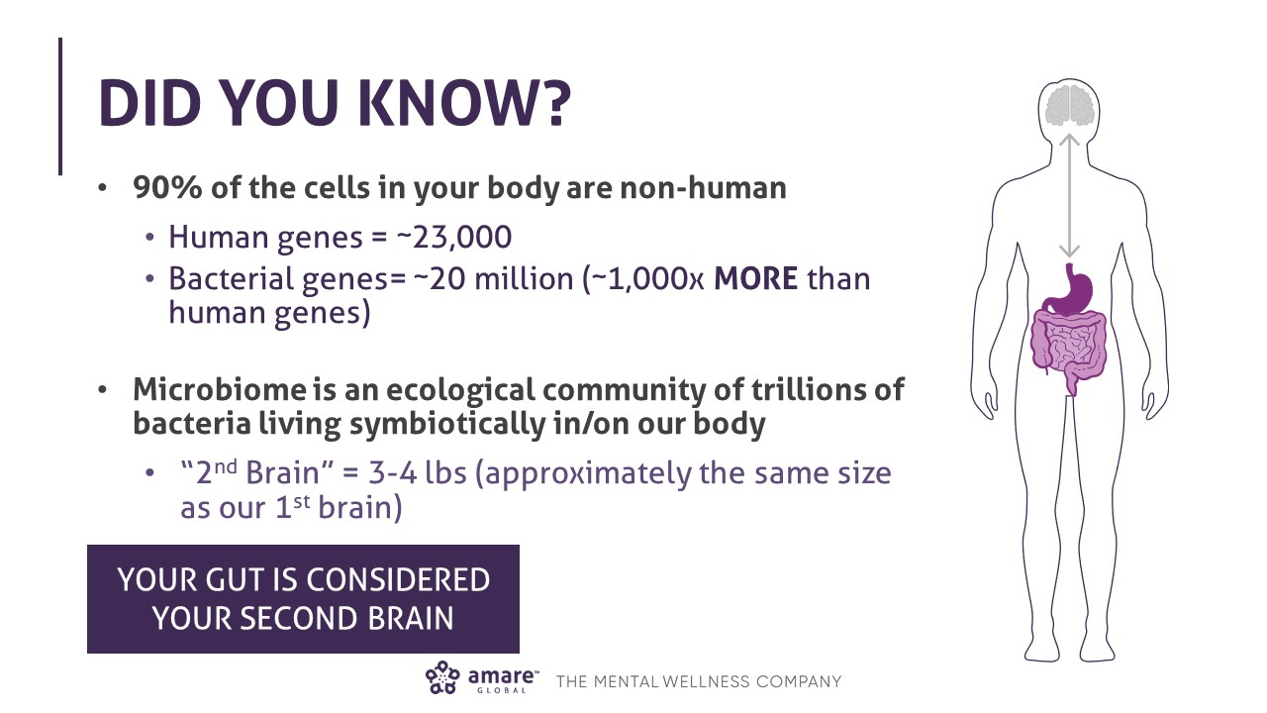

Slide 23
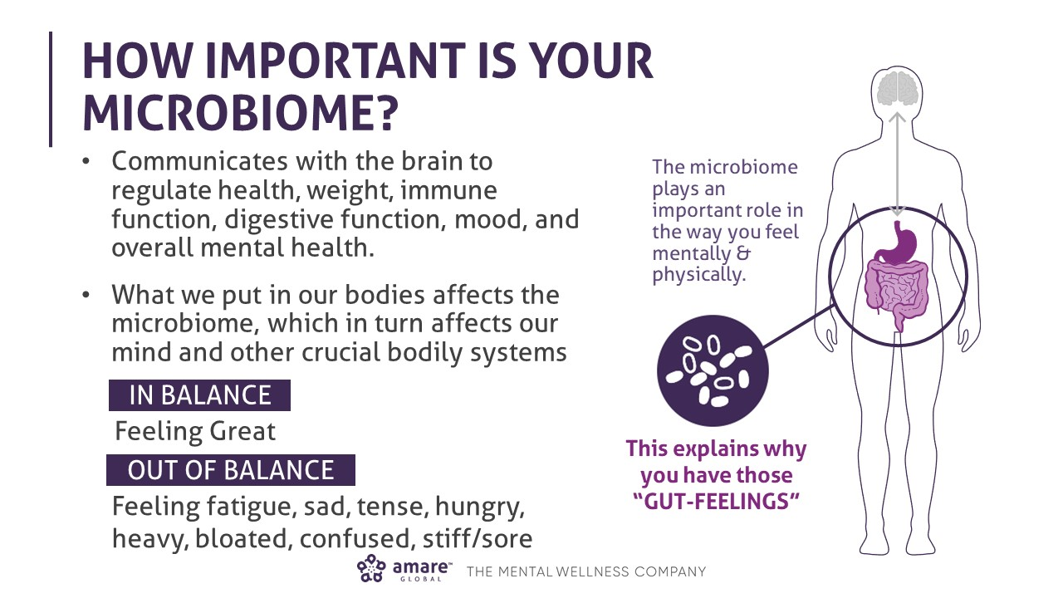

Slide 24
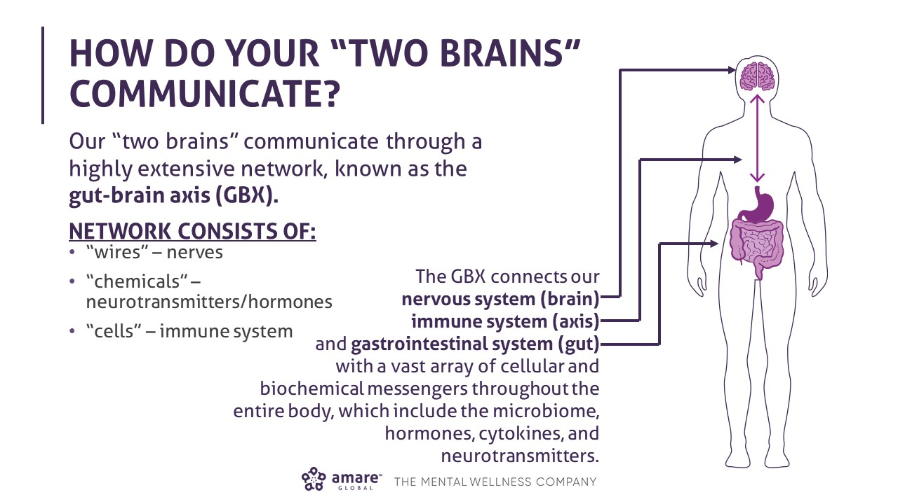

Slide 25
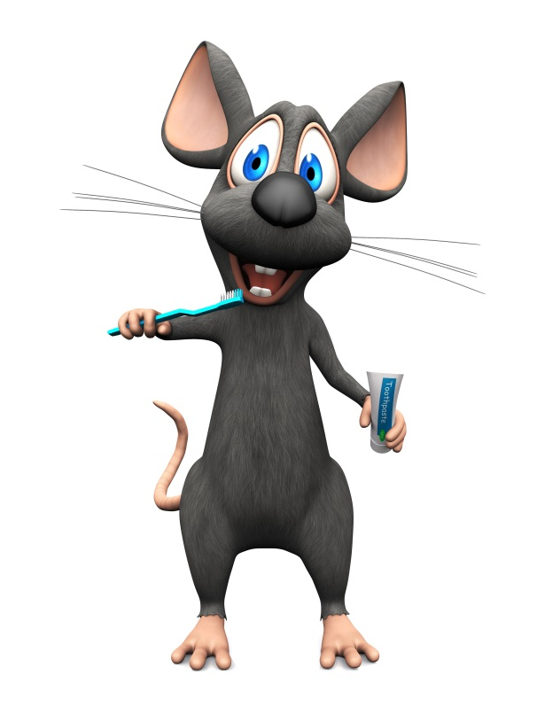
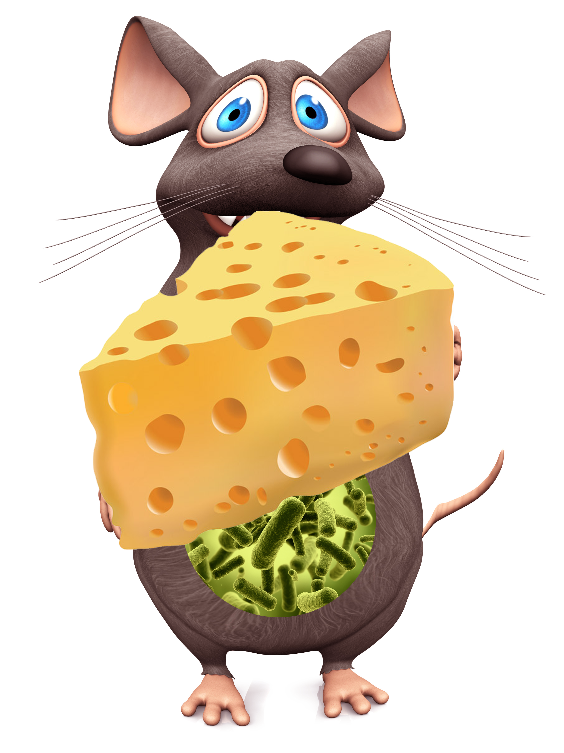
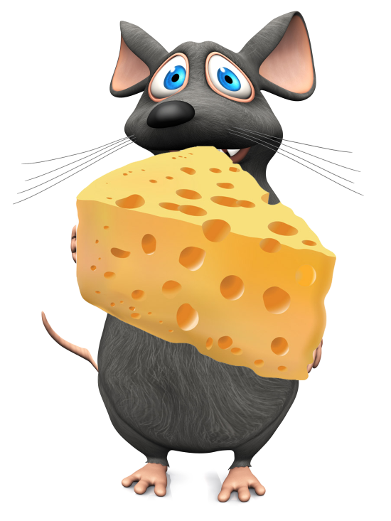
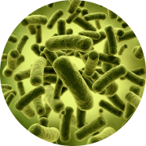
Obese
Overeating
Lean
Obese
Overeating
Obesogenic microbiota
Germ-free
Obesogenic microbiota

Slide 26

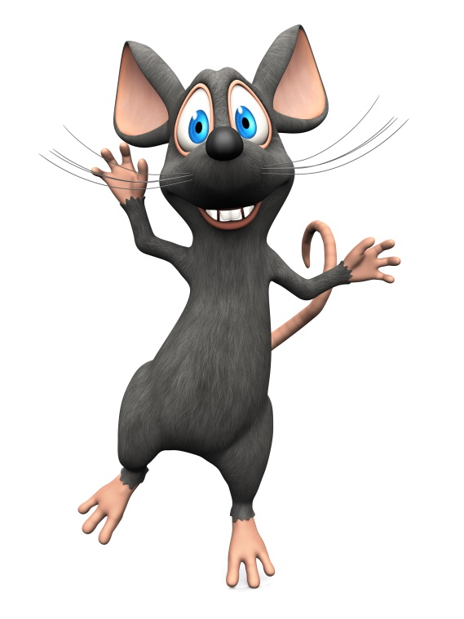
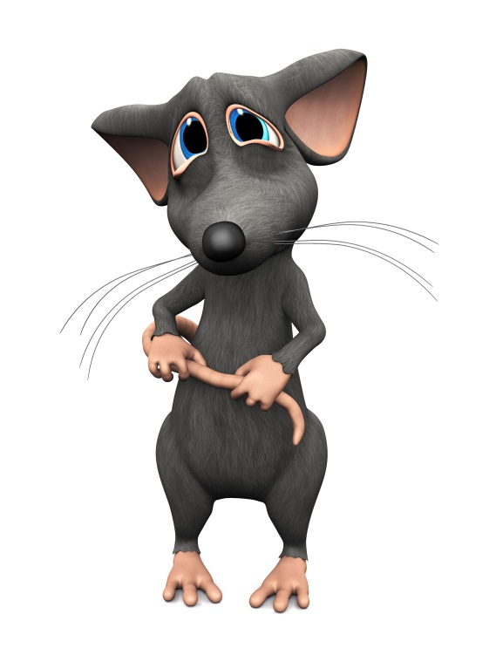
Timid
“Introvert”
Outgoing
“Extrovert”
Timid
“Introvert”
Normal gut microbes
Germ-free
Transplanted

Slide 27
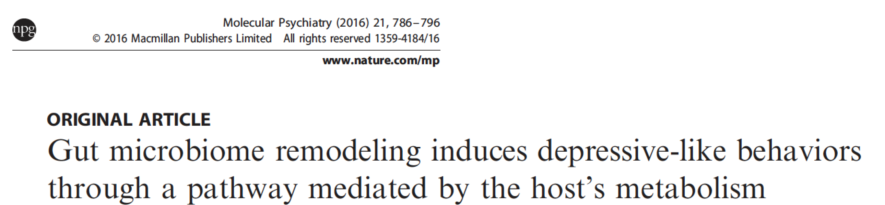
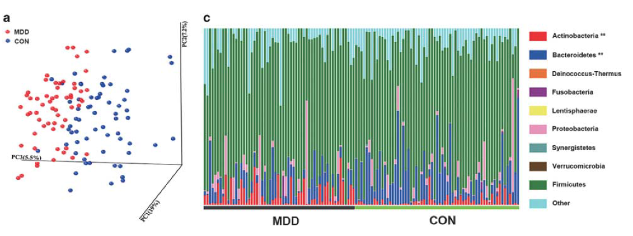
Depression
Zheng P et al, 2016

Slide 30
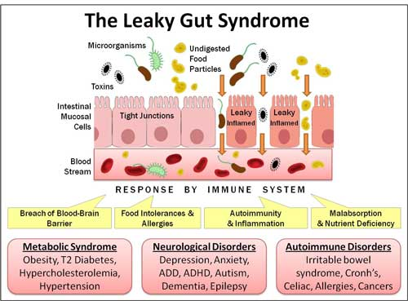

Slide 31
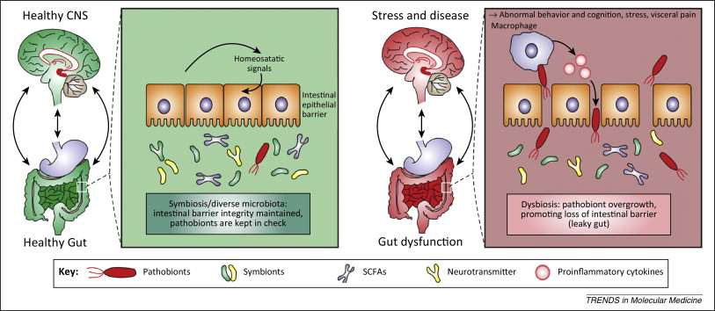

Slide 32
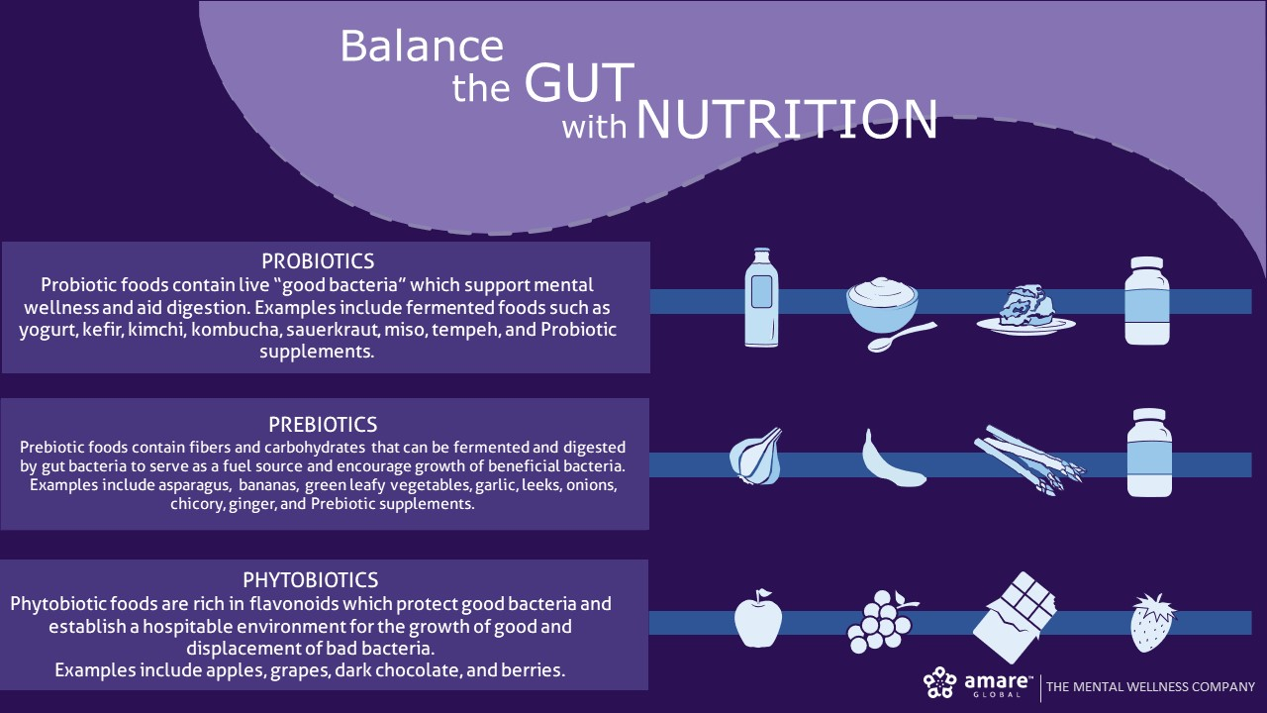

Slide 33
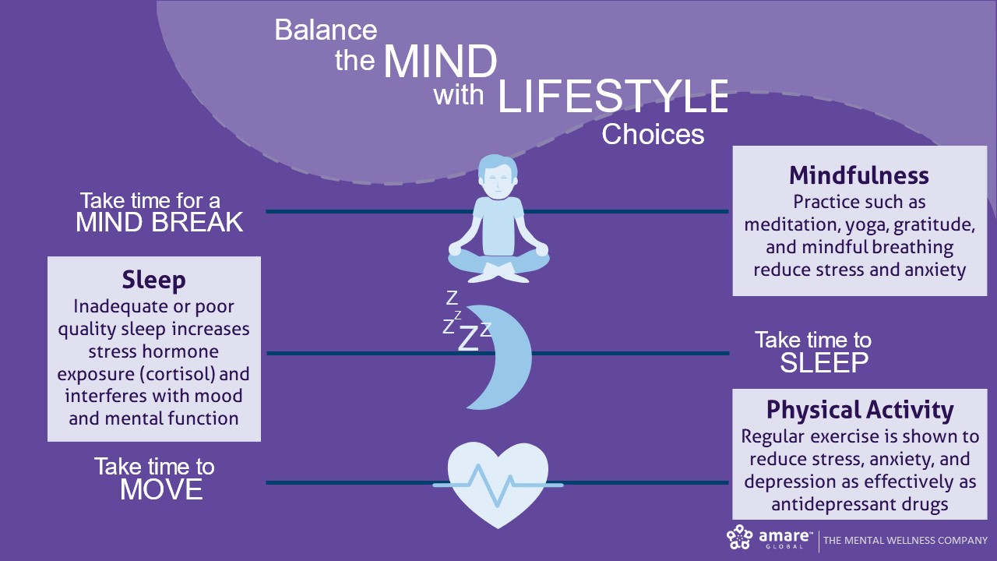

Slide 34
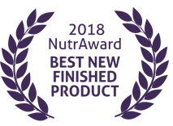
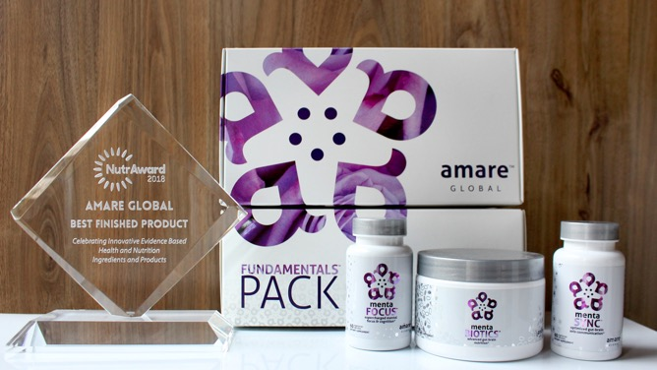
World’s First Award-Winning Gut-Brain Axis Nutrition System!
The NutrAward recognizes companies that are investing in rigorous and measurable scientific studies to prove the efficacy of their proprietary ingredients or technologies.
Submissions are judged on their merit in the following areas:
Viable product
Emerging category
Creative product concept
Distinct health application
Unique packaging
Matchless marketing

Slide 35
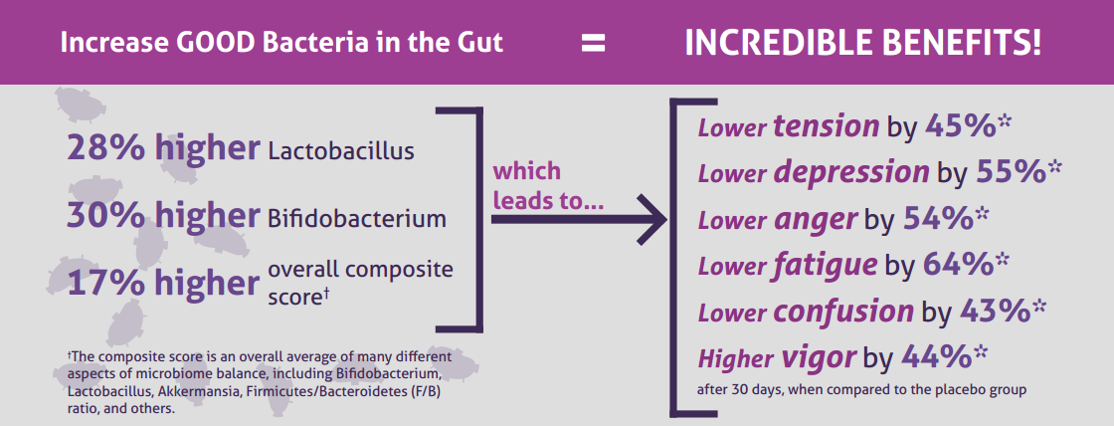

Effect of Coordinated Probiotic/Prebiotic/Phytobiotic Supplementation
on Microbiome Balance and Psychological Mood State in Healthy Stressed Adults
Accepted = Functional Foods in Health & Disease Journal (www.FFHDJ.com)

Slide 36
Portions of Data Presented at:
American College of Nutrition
November 2017 — Alexandria VA (“Outstanding Research” Award)
Experimental Biology
April 2018 — San Diego, CA
American College of Sports Medicine
May 2018 — Minneapolis, MN
Mental Health America — Fit for the Future Conference
June 2018 — Washington DC
Microbiome Movement — Gut Brain Axis
November 2018 — Boston, MA
American Mental Wellness Awareness Association
November 2018 — Hershey, PA
Medical, Nutrition, Biochemistry, Molecular Biology, Physiology, Psychology, Counselors, Policy…

Slide 37

MENTABIOTICS SUGAR FREE MW3TM Probiotic Proprietary Blend
®
Our blend contains unique and specific probiotic strains targeted to enhance overall mental wellness.*
MW3 Probiotic Strains:
Lactobacillus rhamnosus R0011 — Reduces stress by lowering cortisol exposure and improves GABA neurotransmission*
Bifidobacterium longum R0175 — Enhances calmness by decreasing anxiety indices and improves cognitive function*
Lactobacillus helveticus R0052 — Improves mood by decreasing neuro-inflammation and increasing serotonin*
*These statements have not been evaluated by the Food and Drug Administration. This product is not intended to diagnose, treat, cure, or prevent any disease.

Slide 38

MENTABIOTICS SUGAR FREE MW3TM Prebiotic Proprietary Blend
®
Our MW3 Prebiotic Proprietary Blend provides optimal gut support by feeding the specific mental wellness probiotic strains found in our MW3 Probiotic Proprietary Blend.*
MW3 Prebiotic Fibers:
IsoFiber™ (Iso-Malto-Oligosaccharides) — Contains a combination of naturally occurring prebiotic plant fibers that are clinically shown to improve the growth of specific probiotic strains featured in Kids FundaMentals™ and now MentaBiotics® Sugar Free!
Bimuno® (Galacto-Oligo-Saccharides) — Resets and increases friendly gut bacteria, maintains immune health, controls inflammation in the body and supports microbiome balance. Is highly effective and a natural way of increasing preferred bacteria in the gut. Plays an important role in feeding Bifidobacteria probiotic strains.*
SunFiber® (Galactomannan Fiber) — Helps improve the growth and vitality of beneficial bacteria, including Bifidobacteria and Lactobacillus.*
*These statements have not been evaluated by the Food and Drug Administration. This product is not intended to diagnose, treat, cure, or prevent any disease.

Slide 39
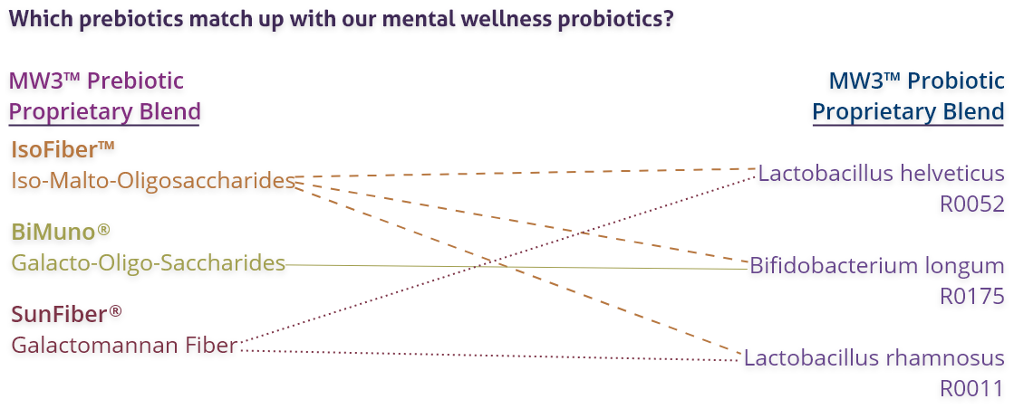
MENTABIOTICS SUGAR FREE MW3TM Prebiotic/Probiotic Proprietary Blend
®
*These statements have not been evaluated by the Food and Drug Administration. This product is not intended to diagnose, treat, cure, or prevent any disease.

Slide 40
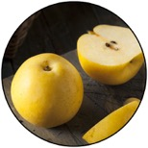

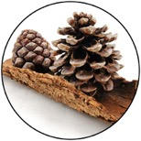
GBX+ Proprietary Blend… Patent Pending and Exclusive to Amare
Applephenon®: Asian Apple Fruit Extract Supports gut health, immune function and inflammatory balance*
Enovita®: French Grape Seed Extract Enhances blood flow, cardiovascular tone and cellular defenses*
Enzogenol®: New Zealand Pine Bark Extract Improves neurotransmitter balance, mental focus and psychological vigor*
*These statements have not been evaluated by the Food and Drug Administration. This product is not intended to diagnose, treat, cure, or prevent any disease.

Slide 41
Why is FundaMentals Different?
World’s 1st comprehensive/holistic GBX system
Addresses each level of GBX balance
Microbiome modulation
Gut integrity
Immune priming
Inflammatory balance
Neurotransmitter signaling
Specific probiotic strains for depression/anxiety/stress
Specific prebiotics fibers for stress/resilience
Patent-pending phytonutrients for GBX support
Scientifically-supported formula
6 peer-reviewed presentations

Slide 42
THE THREE THINGS YOU SHOULD KNOW ABOUT MENTAL WELLNESS
How you feel is not just in your head – it’s also in your gut.
Our “second brain” includes the Microbiome and plays a major role in mental wellness.
You can now DO something NATURALLY to improve your mental wellness.
WHERE ARE YOU ON THE MENTAL WELLNESS CONTINUUM? (Circle your current number)
1
2
3
4
5
6
7
8
9
10
DISEASE STATUS
“TYPICAL”
OPTIMIZED
Depression
Anxiety
Diabetes
Obesity
Heart Disease
Autoimmune
Arthritis
Fibromyalgia
CFS
Dementia
ADD / ADHD
Alzheimer’s
Fatigue
Tension
Sad
Brain Fog
Headaches
Acne
Eczema
Congestion
URTI’s
Joint Pain
Muscle Pain
Bloated
Chubby
Energetic
Calmness
Happy
Sharp
Creative
Clear Skin
Rarely Sick
Flexible
Lean
Strong
Resilient
RED
ORANGE
YELLOW
GREEN
BLUE
INDIGO
VIOLET

