Slide 1
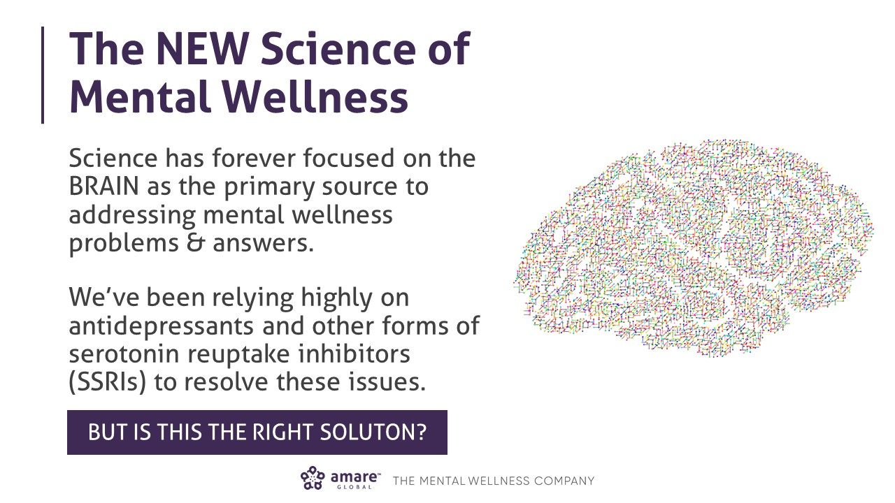

Slide 2
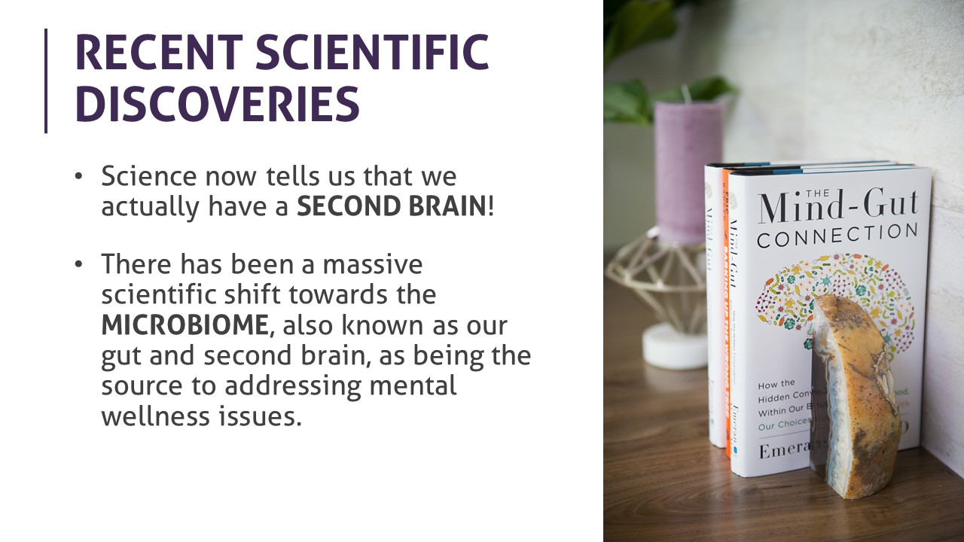

Slide 3
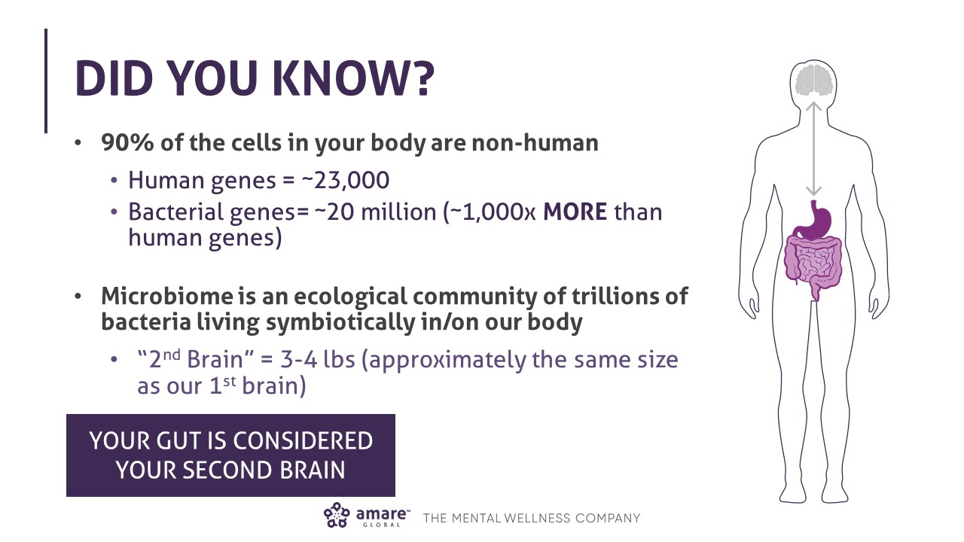

Slide 4
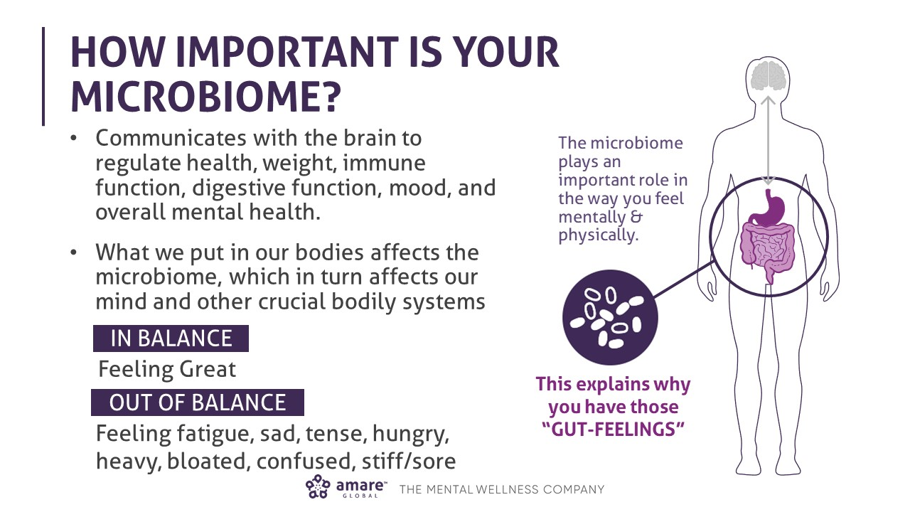

Slide 5
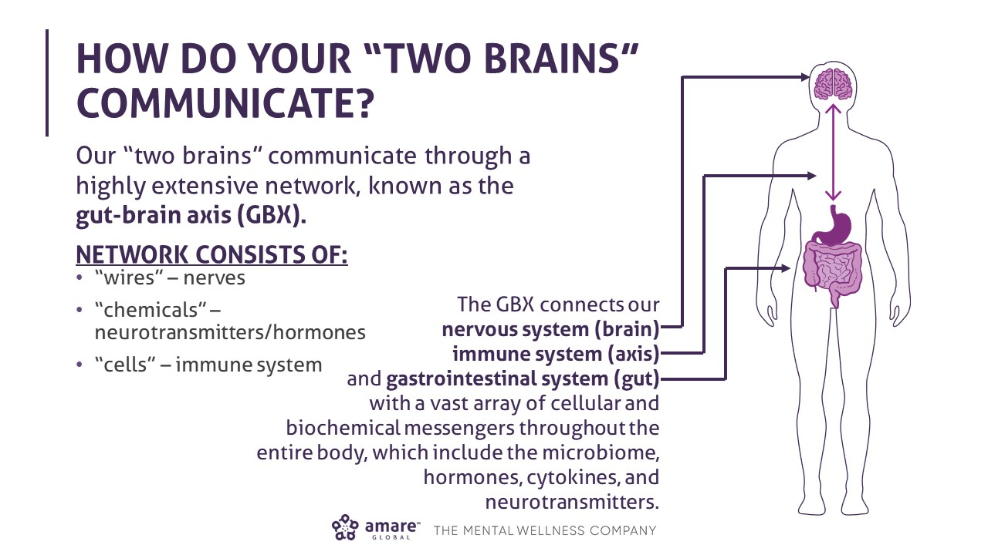

Slide 6
Attention-deficit/hyperactivity disorder (ADHD) is a brain disorder marked by an ongoing pattern of inattention and/or hyperactivity-impulsivity that interferes with functioning or development. (1:10 kids)
Autism, or autism spectrum disorder, refers to a range of conditions characterized by challenges with social skills, repetitive behaviors, speech and nonverbal communication, as well as by unique strengths and differences. We now know that there is not one autism but many types, caused by different combinations of genetic and environmental influences. (1:68 kids)
PANDAS (Pediatric Autoimmune Neuropsychiatric Disorders Associated with Streptococcal Infections) occurs when strep triggers a misdirected immune response results in inflammation on a child’s brain. In turn, the child quickly begins to exhibit life changing symptoms such as OCD, anxiety, tics, personality changes, decline in math and handwriting abilities, sensory sensitivities, restrictive eating, and more. (1:200 kids)

Slide 8
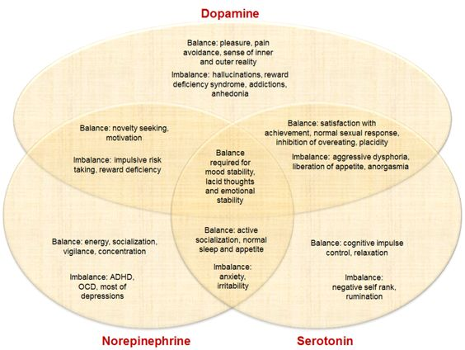

Slide 9
Dependence
Suicide

Slide 10
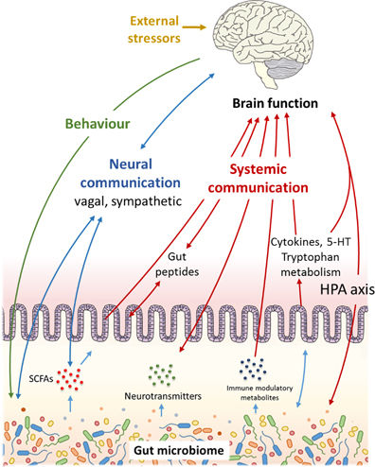
Food?
Gluten?
Milk?
Casein?
Texture?
Sugar?
Sunburn?

Slide 12
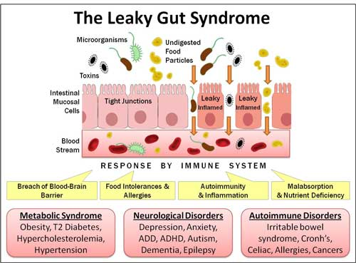

Slide 13
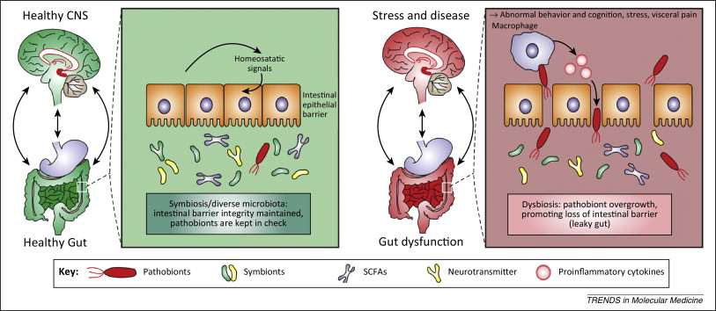

Slide 14
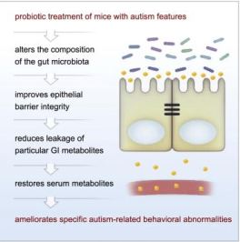

Slide 15
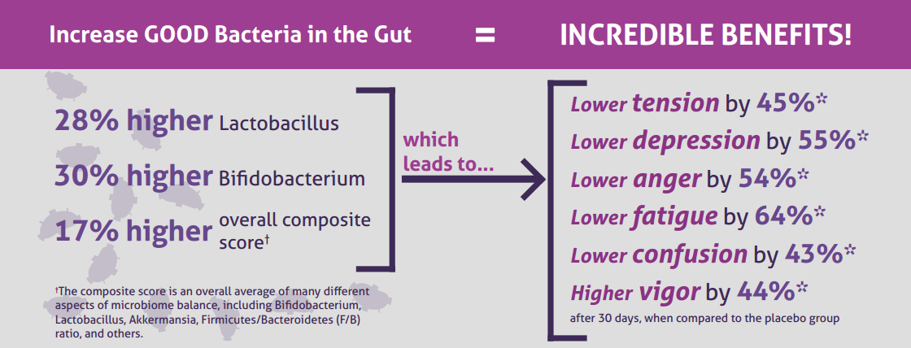
Clinical Study
The Amare FundaMentals Pack® has been clinically proven to:

Slide 16
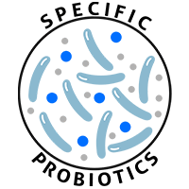
MENTABIOTICS SUGAR FREE MW3TM Probiotic Proprietary Blend
®
Our blend contains unique and specific probiotic strains targeted to enhance overall mental wellness.*
MW3 Probiotic Strains:
Lactobacillus rhamnosus R0011 — Reduces stress by lowering cortisol exposure and improves GABA neurotransmission*
Bifidobacterium longum R0175 — Enhances calmness by decreasing anxiety indices and improves cognitive function*
Lactobacillus helveticus R0052 — Improves mood by decreasing neuro-inflammation and increasing serotonin*
*These statements have not been evaluated by the Food and Drug Administration. This product is not intended to diagnose, treat, cure, or prevent any disease.

Slide 17

MENTABIOTICS SUGAR FREE MW3TM Prebiotic Proprietary Blend
®
Our MW3 Prebiotic Proprietary Blend provides optimal gut support by feeding the specific mental wellness probiotic strains found in our MW3 Probiotic Proprietary Blend.*
MW3 Prebiotic Fibers:
IsoFiber™ (Iso-Malto-Oligosaccharides) — Contains a combination of naturally occurring prebiotic plant fibers that are clinically shown to improve the growth of specific probiotic strains featured in Kids FundaMentals™ and now MentaBiotics® Sugar Free!
Bimuno® (Galacto-Oligo-Saccharides) — Resets and increases friendly gut bacteria, maintains immune health, controls inflammation in the body and supports microbiome balance. Is highly effective and a natural way of increasing preferred bacteria in the gut. Plays an important role in feeding Bifidobacteria probiotic strains.*
SunFiber® (Galactomannan Fiber) — Helps improve the growth and vitality of beneficial bacteria, including Bifidobacteria and Lactobacillus.*
*These statements have not been evaluated by the Food and Drug Administration. This product is not intended to diagnose, treat, cure, or prevent any disease.

Slide 18
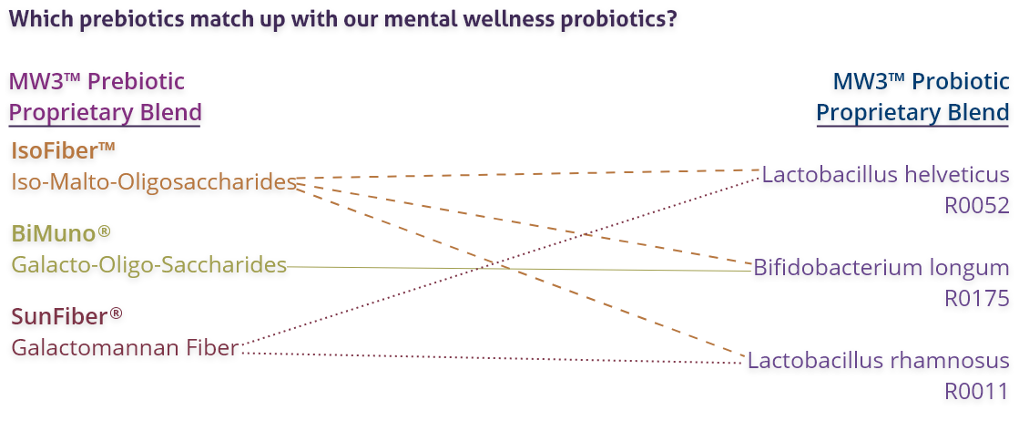
MENTABIOTICS SUGAR FREE MW3TM Prebiotic/Probiotic Proprietary Blend
®
*These statements have not been evaluated by the Food and Drug Administration. This product is not intended to diagnose, treat, cure, or prevent any disease.

Slide 19
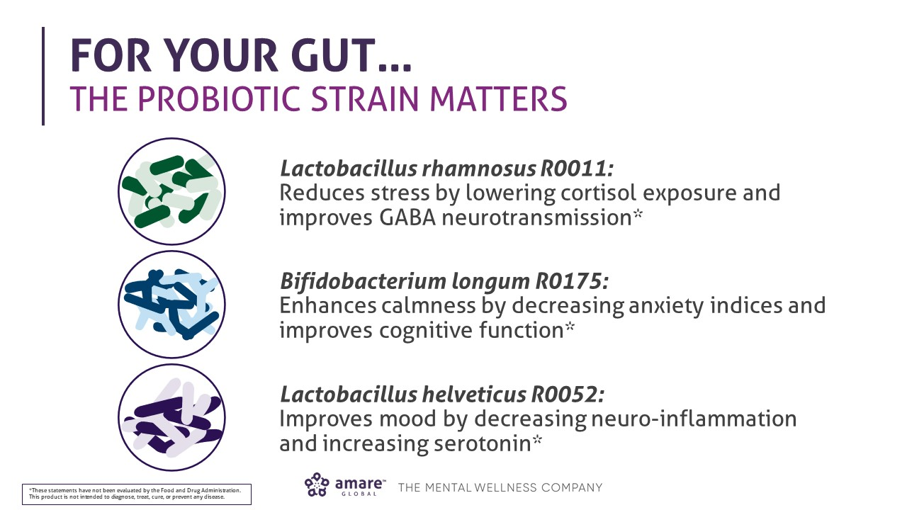

Slide 21
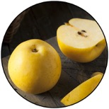

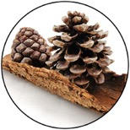
GBX+ Proprietary Blend… Patent Pending and Exclusive to Amare
Applephenon®: Asian Apple Fruit Extract Supports gut health, immune function and inflammatory balance*
Enovita®: French Grape Seed Extract Enhances blood flow, cardiovascular tone and cellular defenses*
Enzogenol®: New Zealand Pine Bark Extract Improves neurotransmitter balance, mental focus and psychological vigor*
*These statements have not been evaluated by the Food and Drug Administration. This product is not intended to diagnose, treat, cure, or prevent any disease.

Slide 22
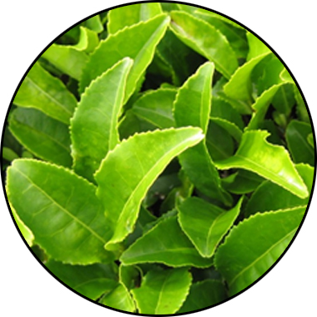
MENTABIOTICS KEY INGREDIENTS
™
Suntheanine
Increases Alpha Waves
“Relaxed alertness”
*These statements have not been evaluated by the Food and Drug Administration. This product is not intended to diagnose, treat, cure, or prevent any disease.
Notes:
Shawn: Slide: Key Ingredients: MentaBiotics pg.25 -- The way we formulated the products is to give you a graded response. Some benefits will come on early, some will come on medium, and some will come on later. So early stage benefits we can deliver through amino acids, such as Suntheanine. Suntheanine is naturally found in green tea leaves. This ingredient cant take your brain from a state of beta-waves that are associated with being tense and anxious or irritable, and shift you within a matter of 60—75 minutes into a state characterized by more alpha-waves. These alpha-waves are associated with a state of relaxed alertness, being in the zone, being more relaxed but not drowsy. Some of the other benefits that you are going to experience, those feelings of good mood, those feelings of less anxiety, that will be days to early weeks. Then the actual re-setting of the microbiome, depending on how out of balance you are, that might be more towards the end of the weeks. That way, we are able to give people early benefits they can feel quickly, and they don’t have to say , "I'm going to take this product for six months before I actually feel anything."
Sources
Nobre et al. L-theanine, a natural constituent in tea, and its effect on mental state Asia Pac J Clin Nutr 2008;17 (S1):167-168

Slide 23
Portions of Data Presented at:
American College of Nutrition
November 2017 — Alexandria VA (“Outstanding Research” Award)
Experimental Biology
April 2018 — San Diego, CA
American College of Sports Medicine
May 2018 — Minneapolis, MN
Mental Health America — Fit for the Future Conference
June 2018 — Washington DC
Microbiome Movement — Gut Brain Axis
November 2018 — Boston, MA
American Mental Wellness Awareness Association
November 2018 — Hershey, PA
Medical, Nutrition, Biochemistry, Molecular Biology, Physiology, Psychology, Counselors, Policy…

Slide 24
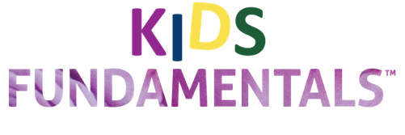

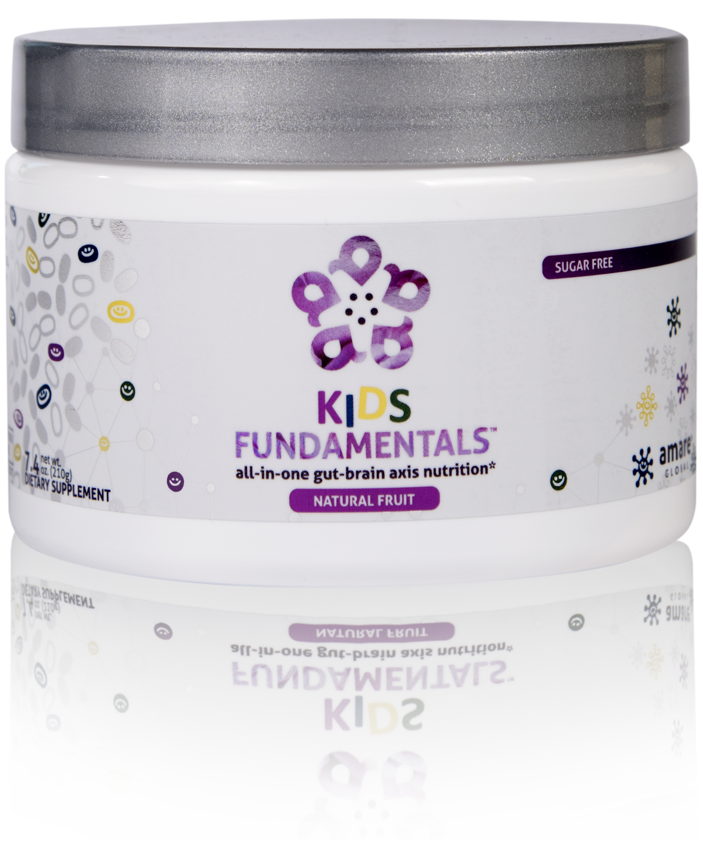
INGREDIENTS SHOWN TO IMPROVE MENTAL WELLNESS*
SUPPORTS ENTIRE GUT-BRAIN AXIS*
EASY-TO-DIGEST FORMULA
all-in-one gut-brain axis nutrition for kids & teens*
Kids FundaMentals™ is an all-in-one product that supports the entire gut-brain axis (GBX) of growing kids and teens. Featuring nutrients scientifically shown to improve mental wellness, this easy-to-digest formula is perfect for kids and teens of all ages.*
*These statements have not been evaluated by the Food and Drug Administration. This product is not intended to diagnose, treat, cure, or prevent any disease.

Slide 25
Why is FundaMentals Different?
World’s 1st comprehensive/holistic GBX system
Addresses each level of GBX balance
Microbiome modulation
Gut integrity
Immune priming
Inflammatory balance
Neurotransmitter signaling
Specific probiotic strains for depression/anxiety/stress
Specific prebiotics fibers for stress/resilience
Patent-pending phytonutrients for GBX support
Scientifically-supported formula
6 peer-reviewed presentations

Slide 26
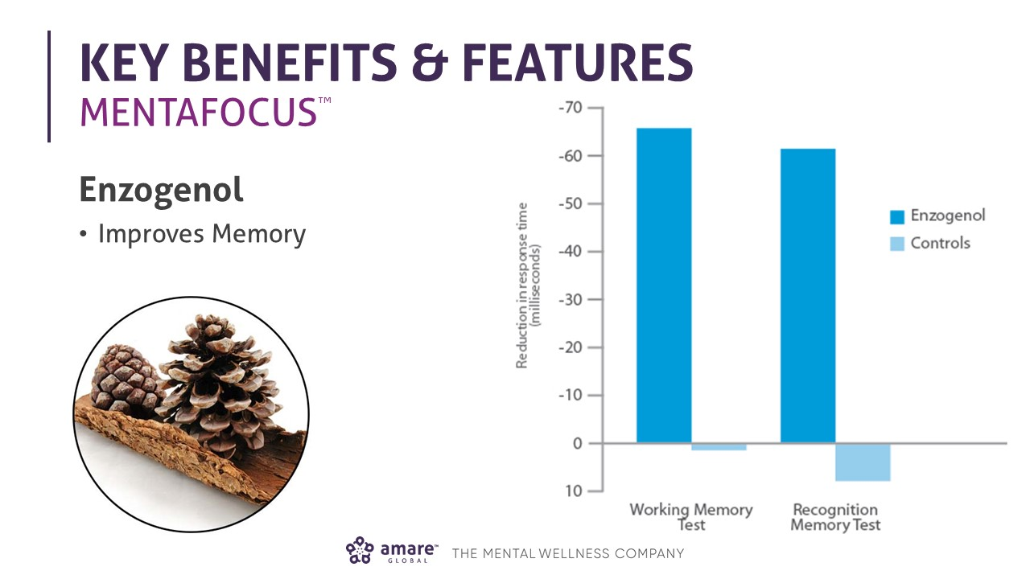

Slide 27
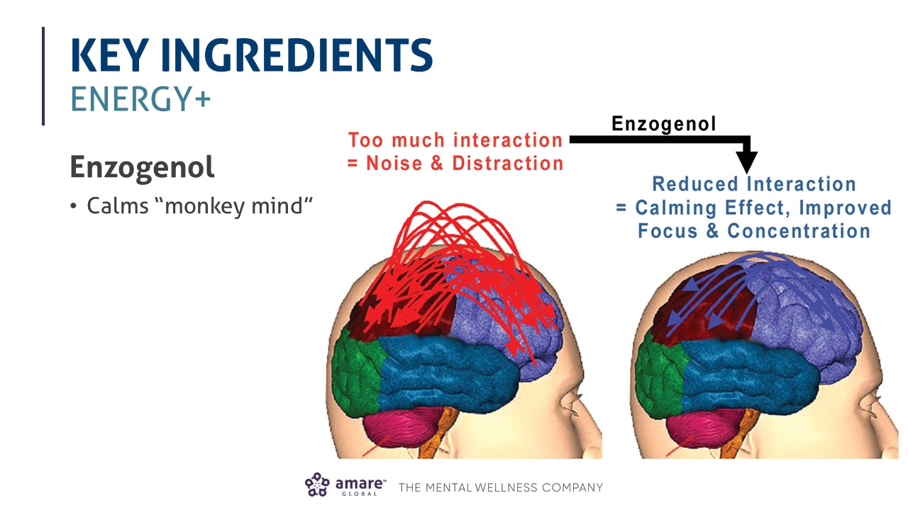

Slide 28
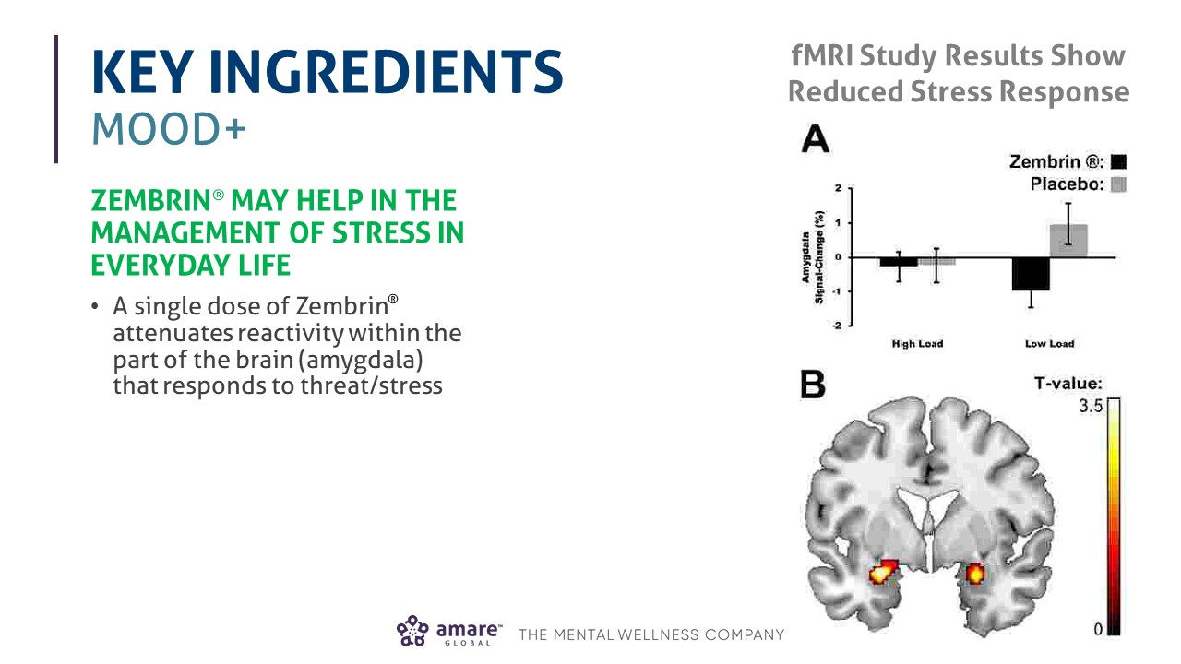

Slide 29
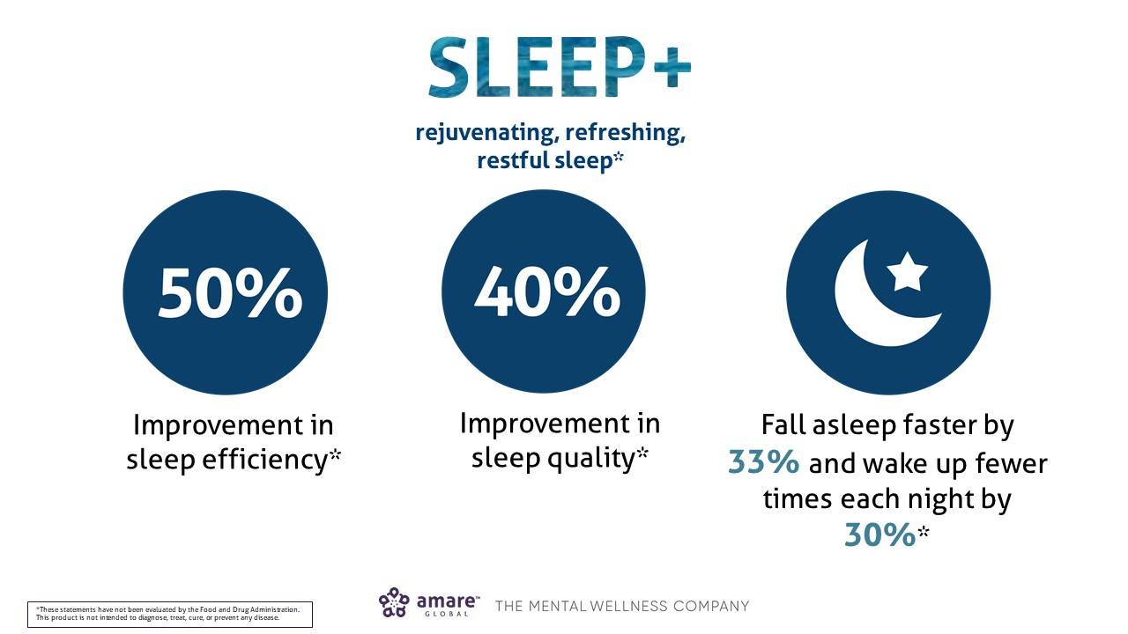

Slide 30
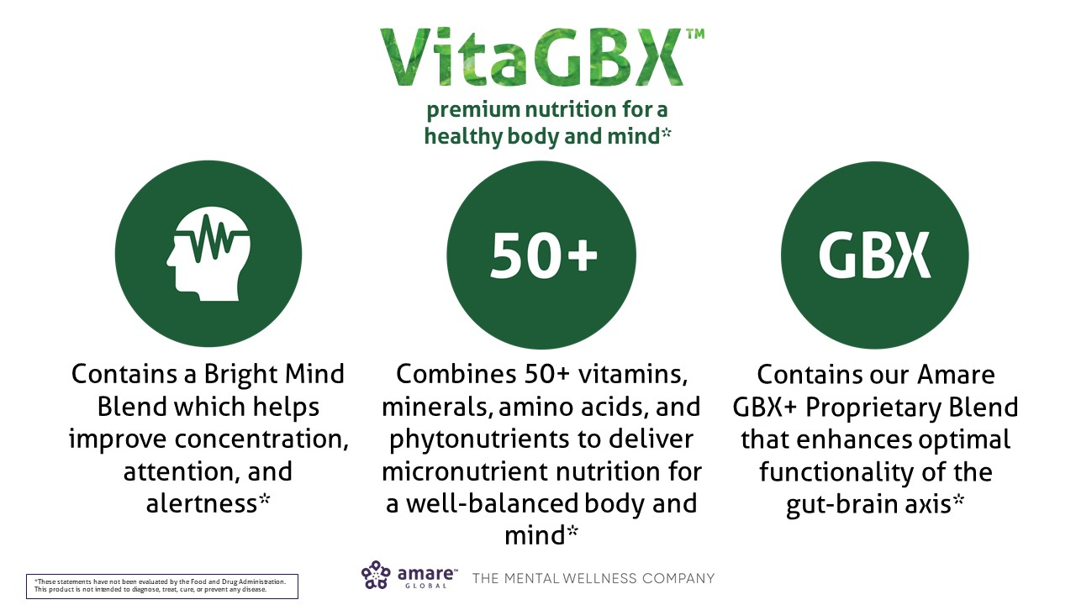

Slide 31
