Slide 1
Project b3 Nutrition for Mental Wellness
Shawn Talbott, PhD

Slide 2
Topic Schedule (Wednesday 6-7pm)
Feb 13 (week 0) = Overview / Supplementation
Feb 20 (week 1) = Body/Brain/Biome
Feb 27 (week 2) = Exercise
March 6 (week 3) = Nutrition (Anaheim)
March 13 (week 4) = Stress/Sleep (Milwaukee)
March 20 (week 5) = Evaluation (St. George)
March 27 (week 6) = Review
March 28 (Th) – 29 (Fri) = Final Measurements

Slide 3
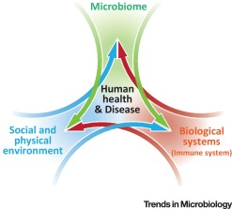
Biome
Brain
Body

Slide 4
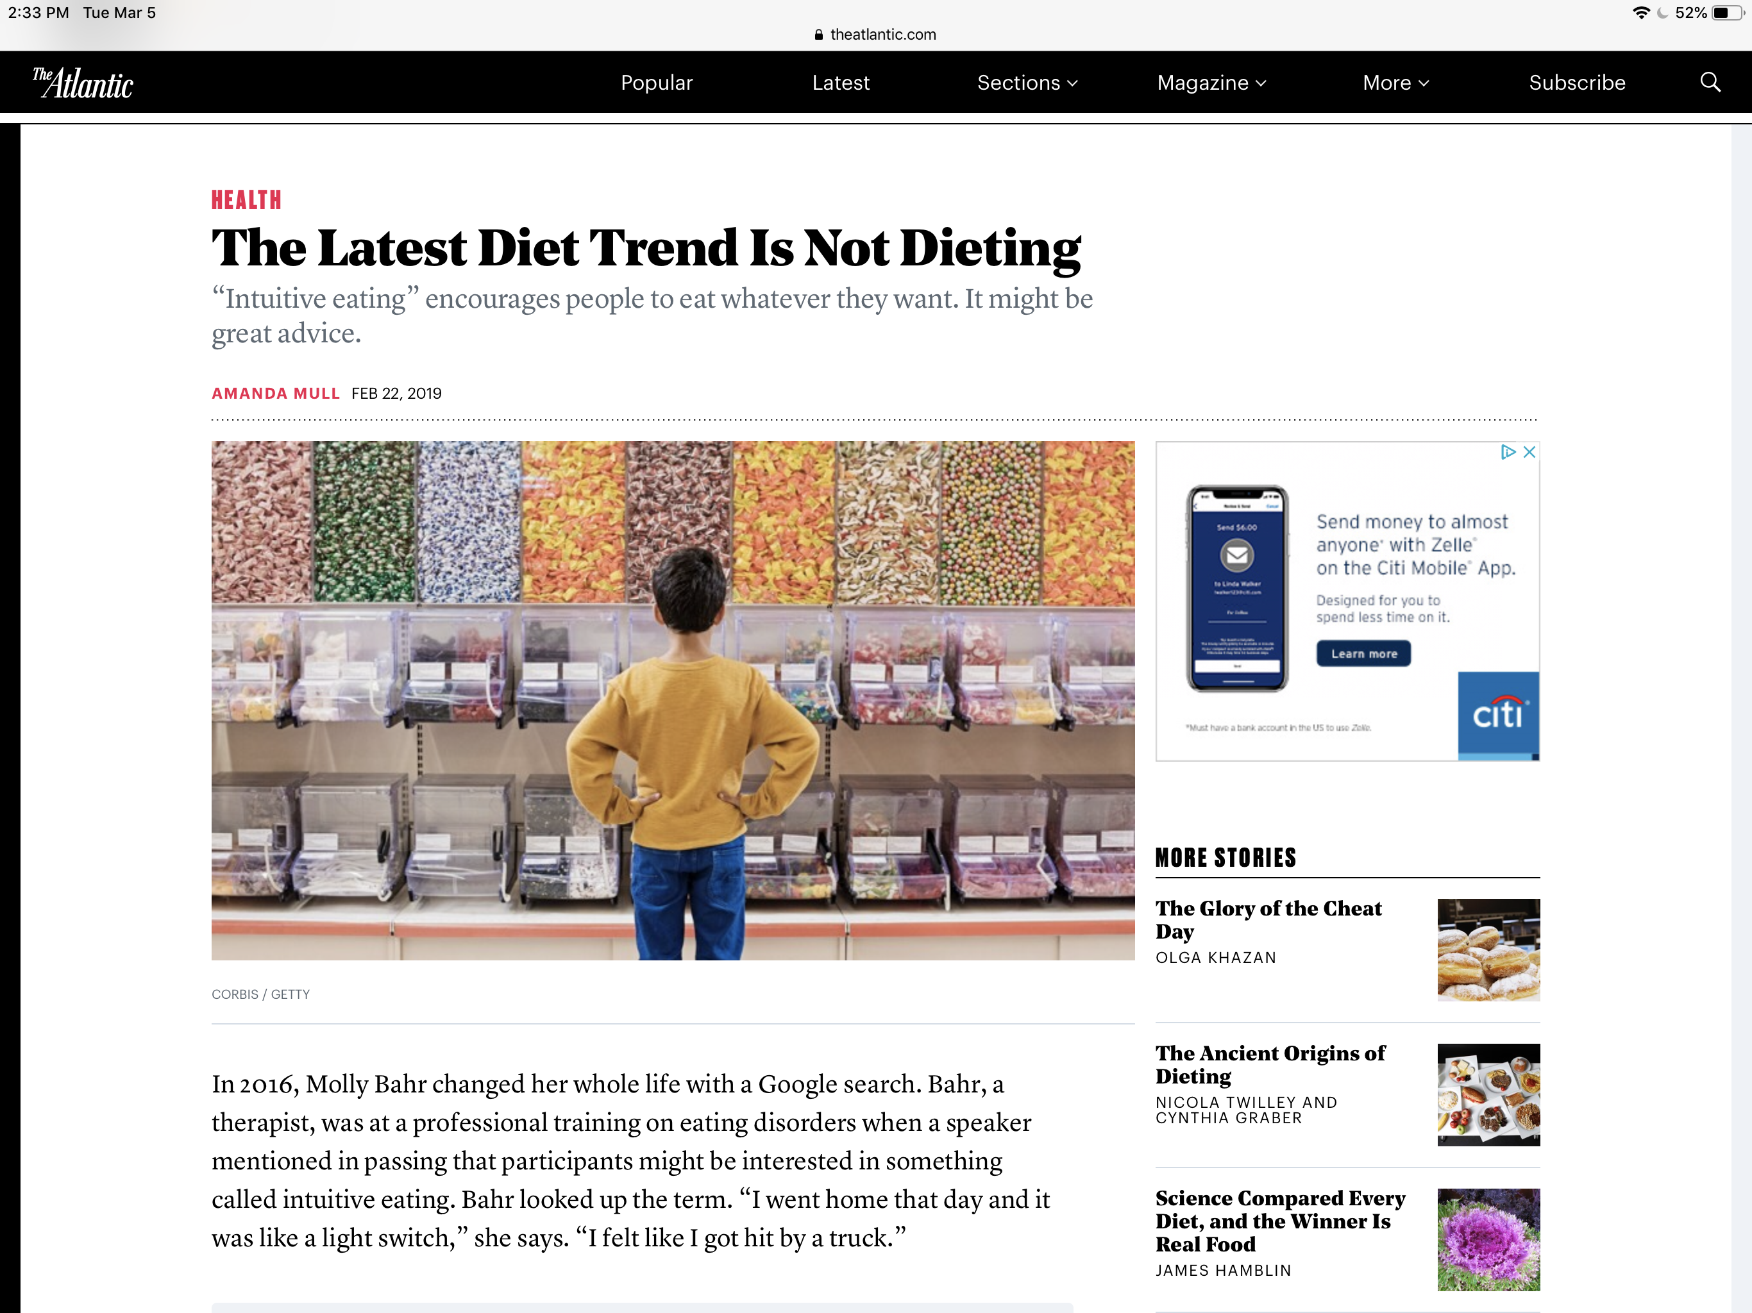

Slide 6
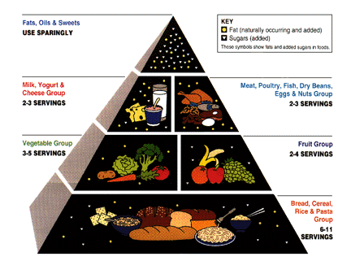

Slide 7
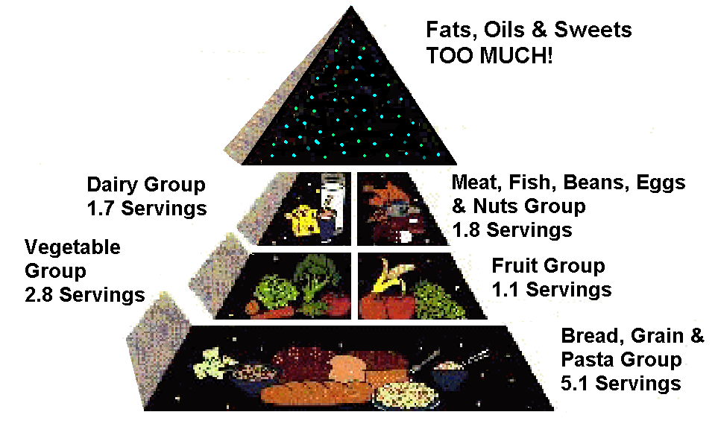

Slide 8
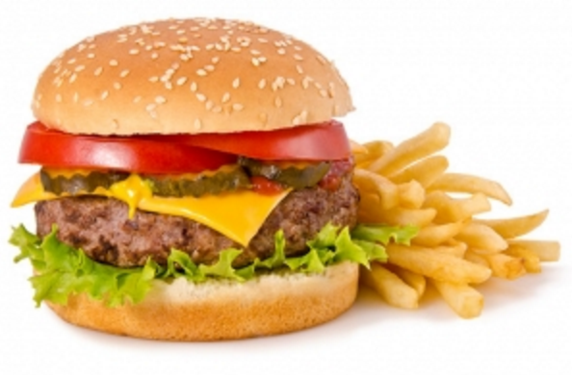
The Standard American Diet (SAD)
Salt
Sugar
Animal Fat
Processed food
Non caloric sweeteners
Emulsifiers

Slide 9
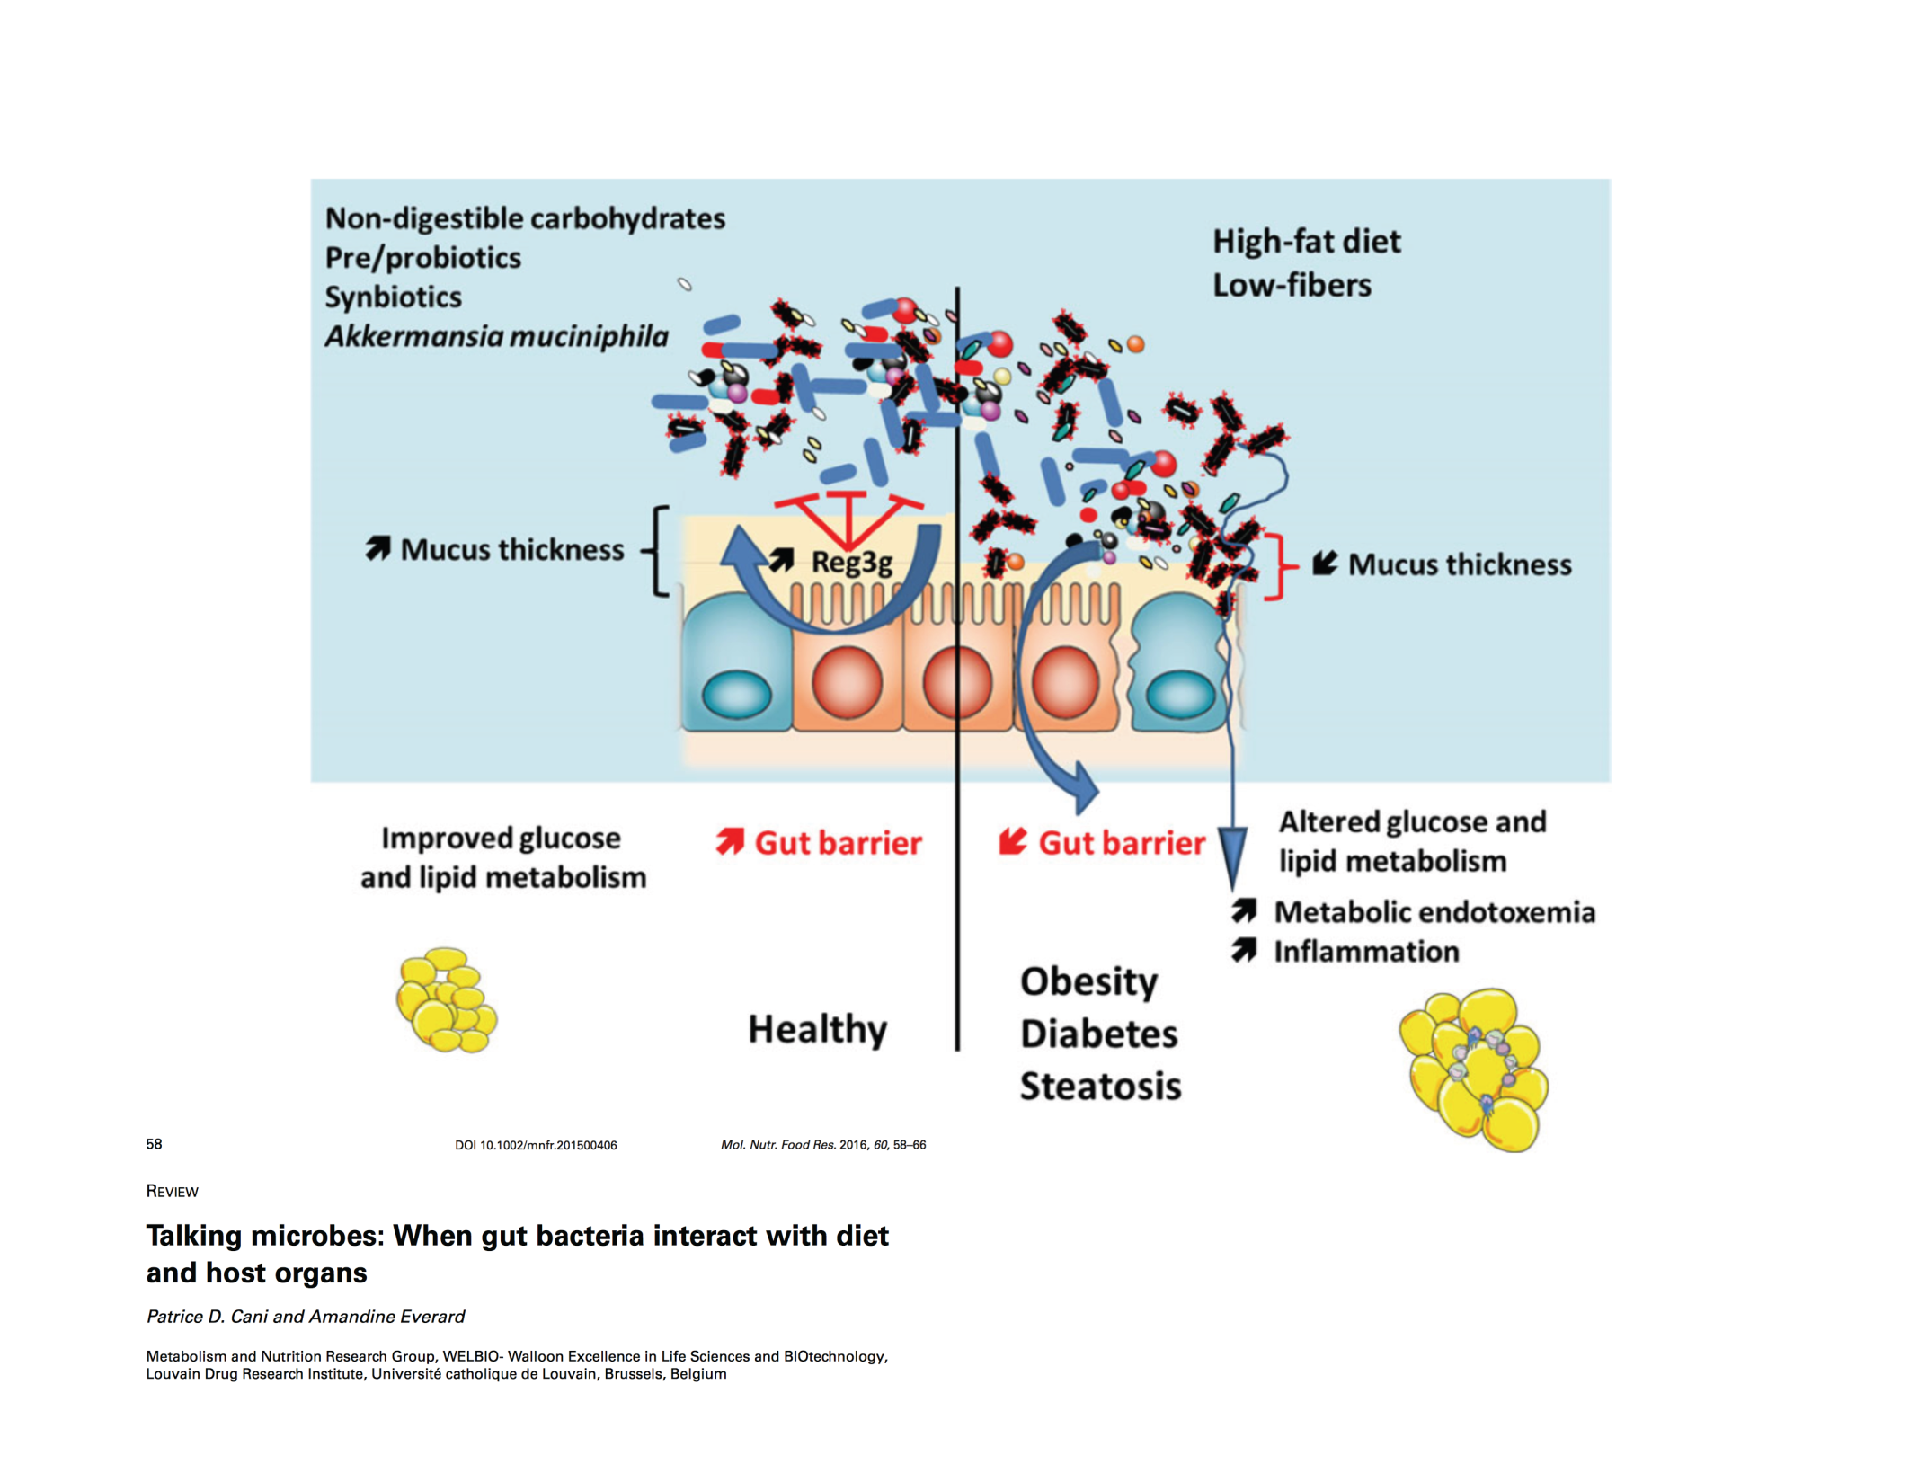
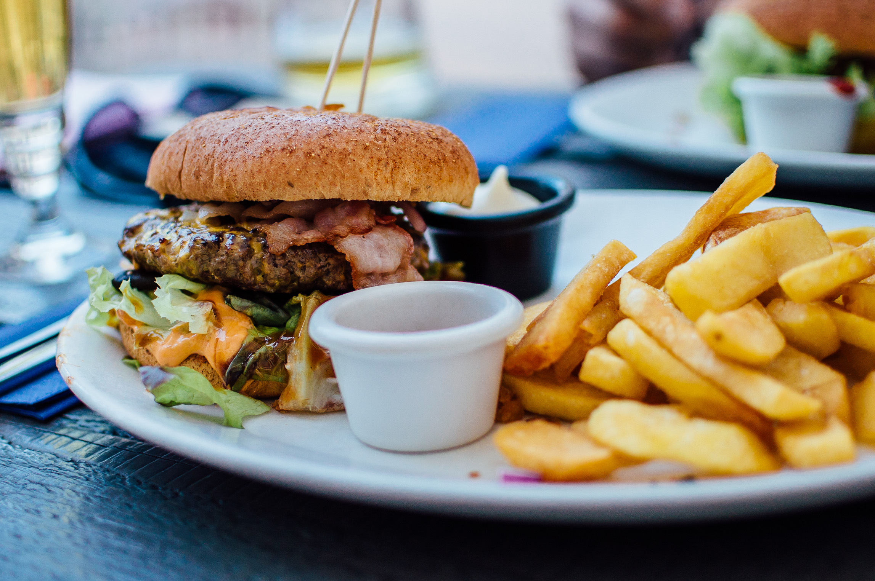
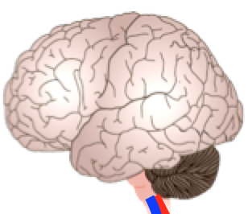
Diet induced Microbiome Perturbations Can Result in Local and Systemic Immune Activation
Depression?
Anxiety?
Food sensitivities?

Slide 10
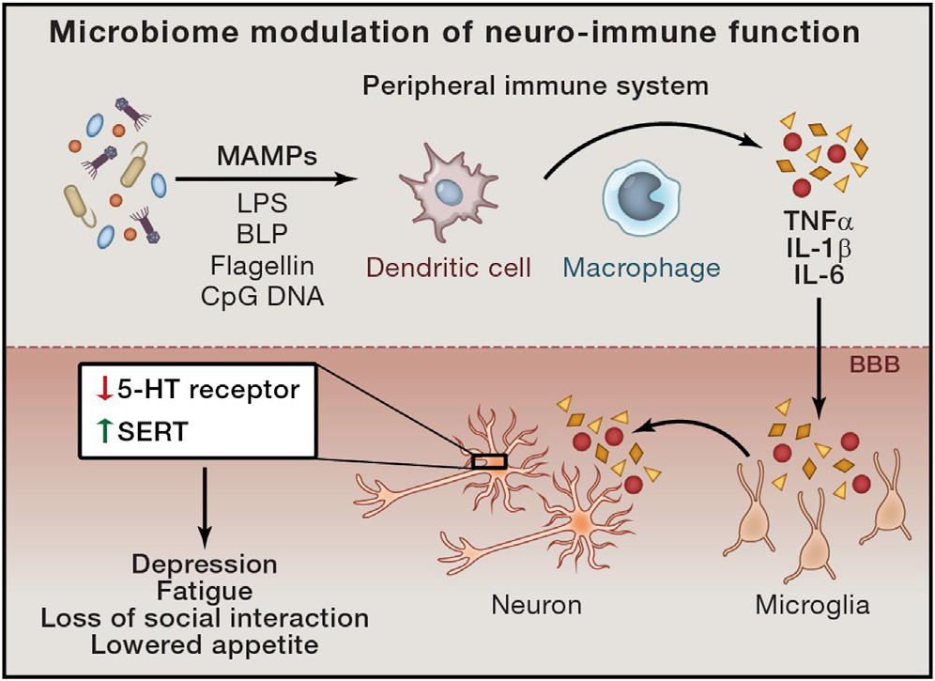
The Inflammed Brain: Microbiota-related Signaling to the Central Immune System
Depression
Obesity
Neurodegenerative diseases
Chronic pain
Chronic inflammation
Modified from Sampson & Mazmanian, 2015

Slide 11
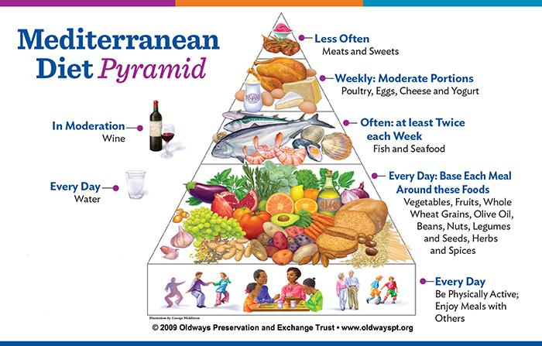

Slide 12
Well Documented Health Benefits of the Mediterranean Diet
Cardiovascular disease
Cancer
Metabolic syndrome
Brain structure and function
Cognitive impairment (Alzheimer’s)
Depression
Estruch et al, NEJM 2013

Slide 13
Why is a Mediterranean Type Diet Good for Your Health?
Good for your gut microbes:
High ratio of plant to animal based foods
High ratio of plant based (unsaturated fats) to animal based fats
Anti inflammatory effects on the gut, brain and body
High concentration of antioxidants and polyphenols produced by plants for their own protection (olive oil, red wine, roots, leaves) which require the gut microbiota to digest
Social interactions

Slide 14
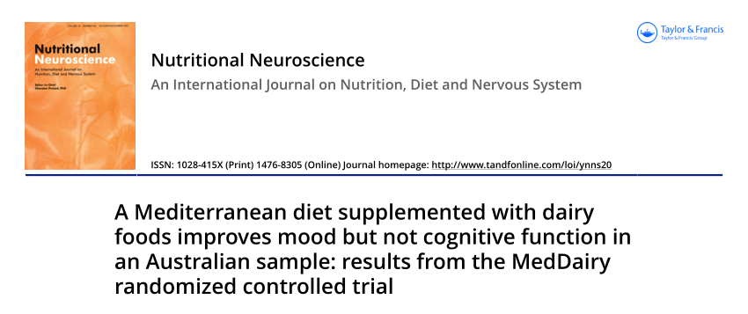
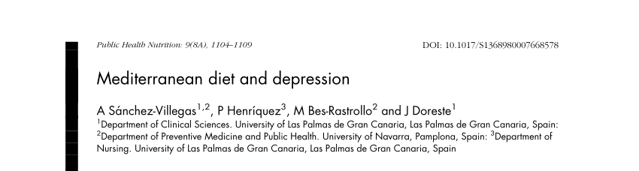
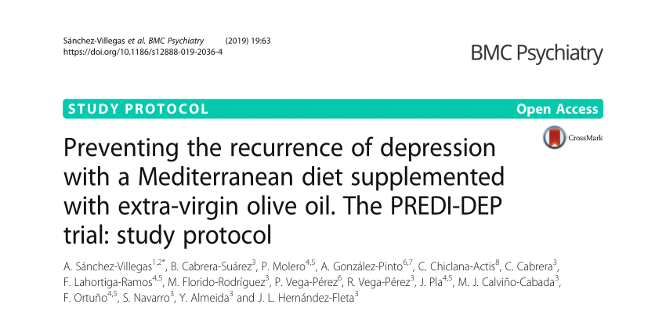
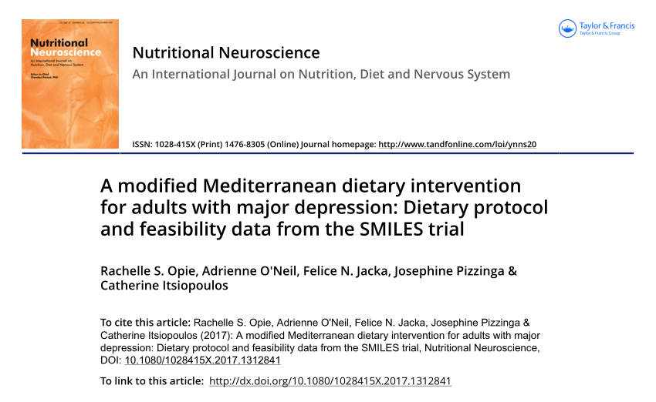
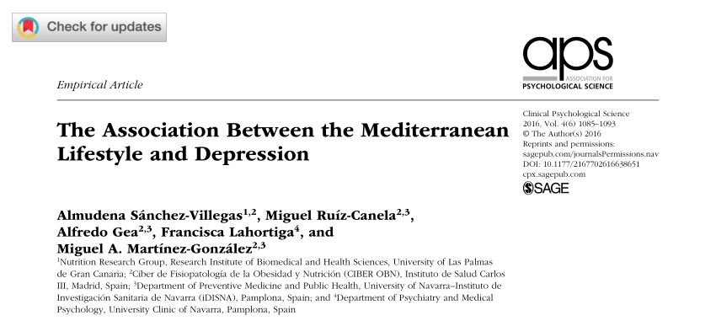
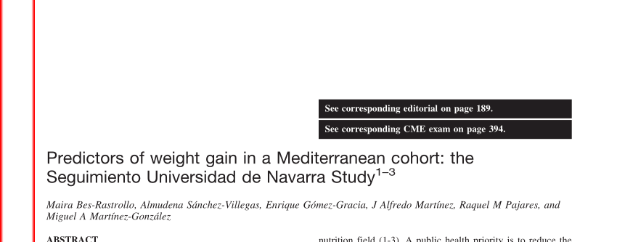
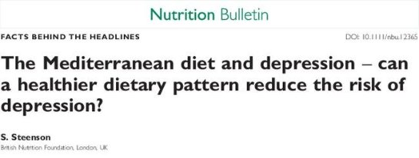
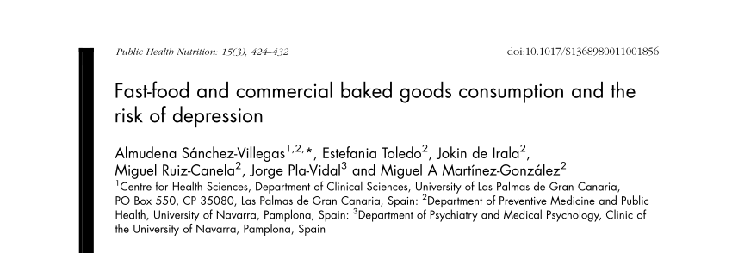

Slide 15
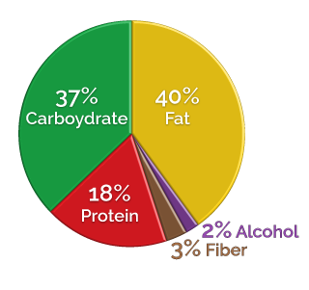
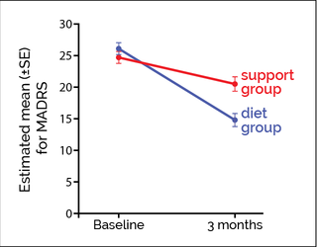
Supporting the Modification of lifestyle In Lowered Emotional States (SMILES)
12-week study - depression symptoms were graded on MADRS scale (Montgomery–Åsberg Depression Rating Scale)
-scale of 0 to 60, with 60 being the most severely depressed.
After 12 weeks, ModiMed diet group saw their MADRS scores improve on average by about 11 points.
-Thirty-two percent had MADRS scores so low that they no longer met criteria for depression—remission!
People in the unhealthy diet group improved by only about 4 points on the MADRS test.

Slide 16
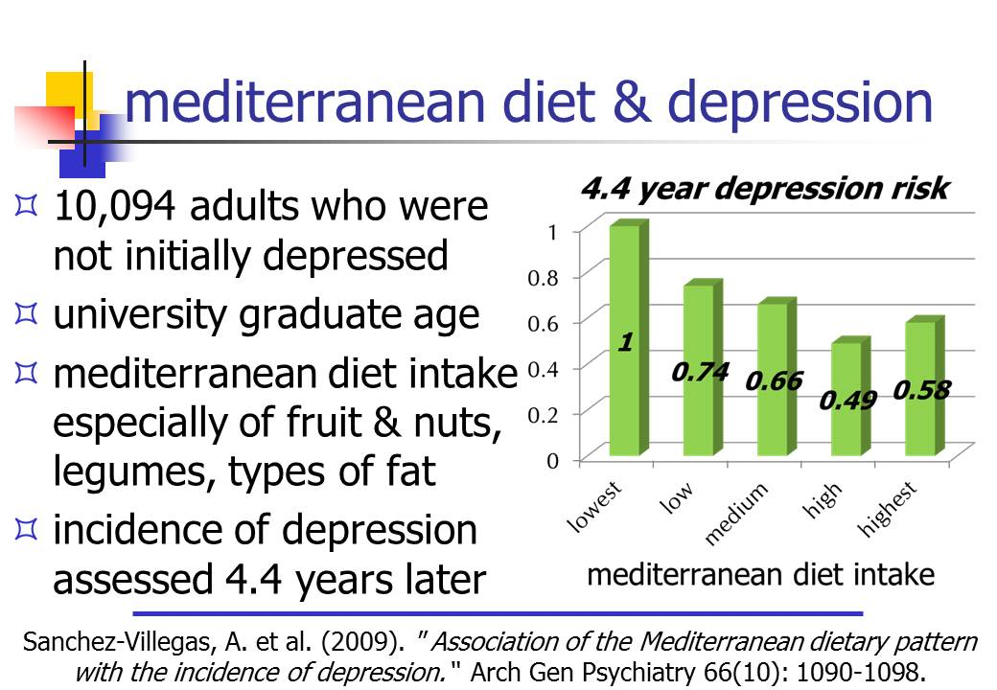

Slide 17

Snacking Approach
5-6 well-proportioned meals/snacks
B/snack/L/snack/D/snack
Portion of protein + carbs + fat
Unlimited fruits & vegetables
Protein for lean muscle maintenance
Carbohydrate for energy and metabolism
Fat for flavor & satiety
Fiber for digestion & satiety
BOTH WORK!
Fasting Approach (IF = intermittent fasting)
Avoid sugars and refined grains
Let your body burn fat between meals (B/L/D). Don’t snack.
Limit the hours of the day when you eat (eat early, but not late)
7am-3pm or 10am-6pm or only during “daylight” hours…
Avoid snacking or eating at nighttime

Slide 18

Carbohydrates
Carbohydrates are the body’s main source of energy
Carbohydrates are broken down in the body to glucose
“Fat Burns in the Flame of Carbohydrate”

Slide 19
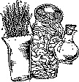
Soluble/Insoluble Fiber
Recommended intake is 25-35 grams per day
Absorbs water in the intestines, providing a feeling of fullness
Slows down the absorption of carbohydrates (blood sugar control)
Good for digestion and intestinal health (gut integrity)
Supports microbiome balance (prebiotics)

Slide 20
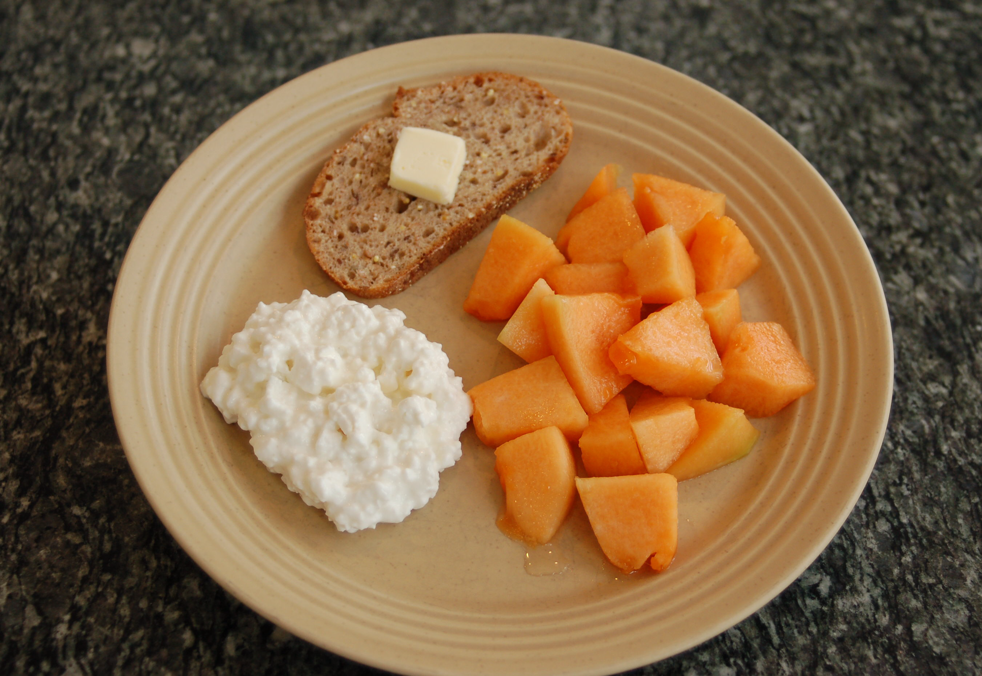
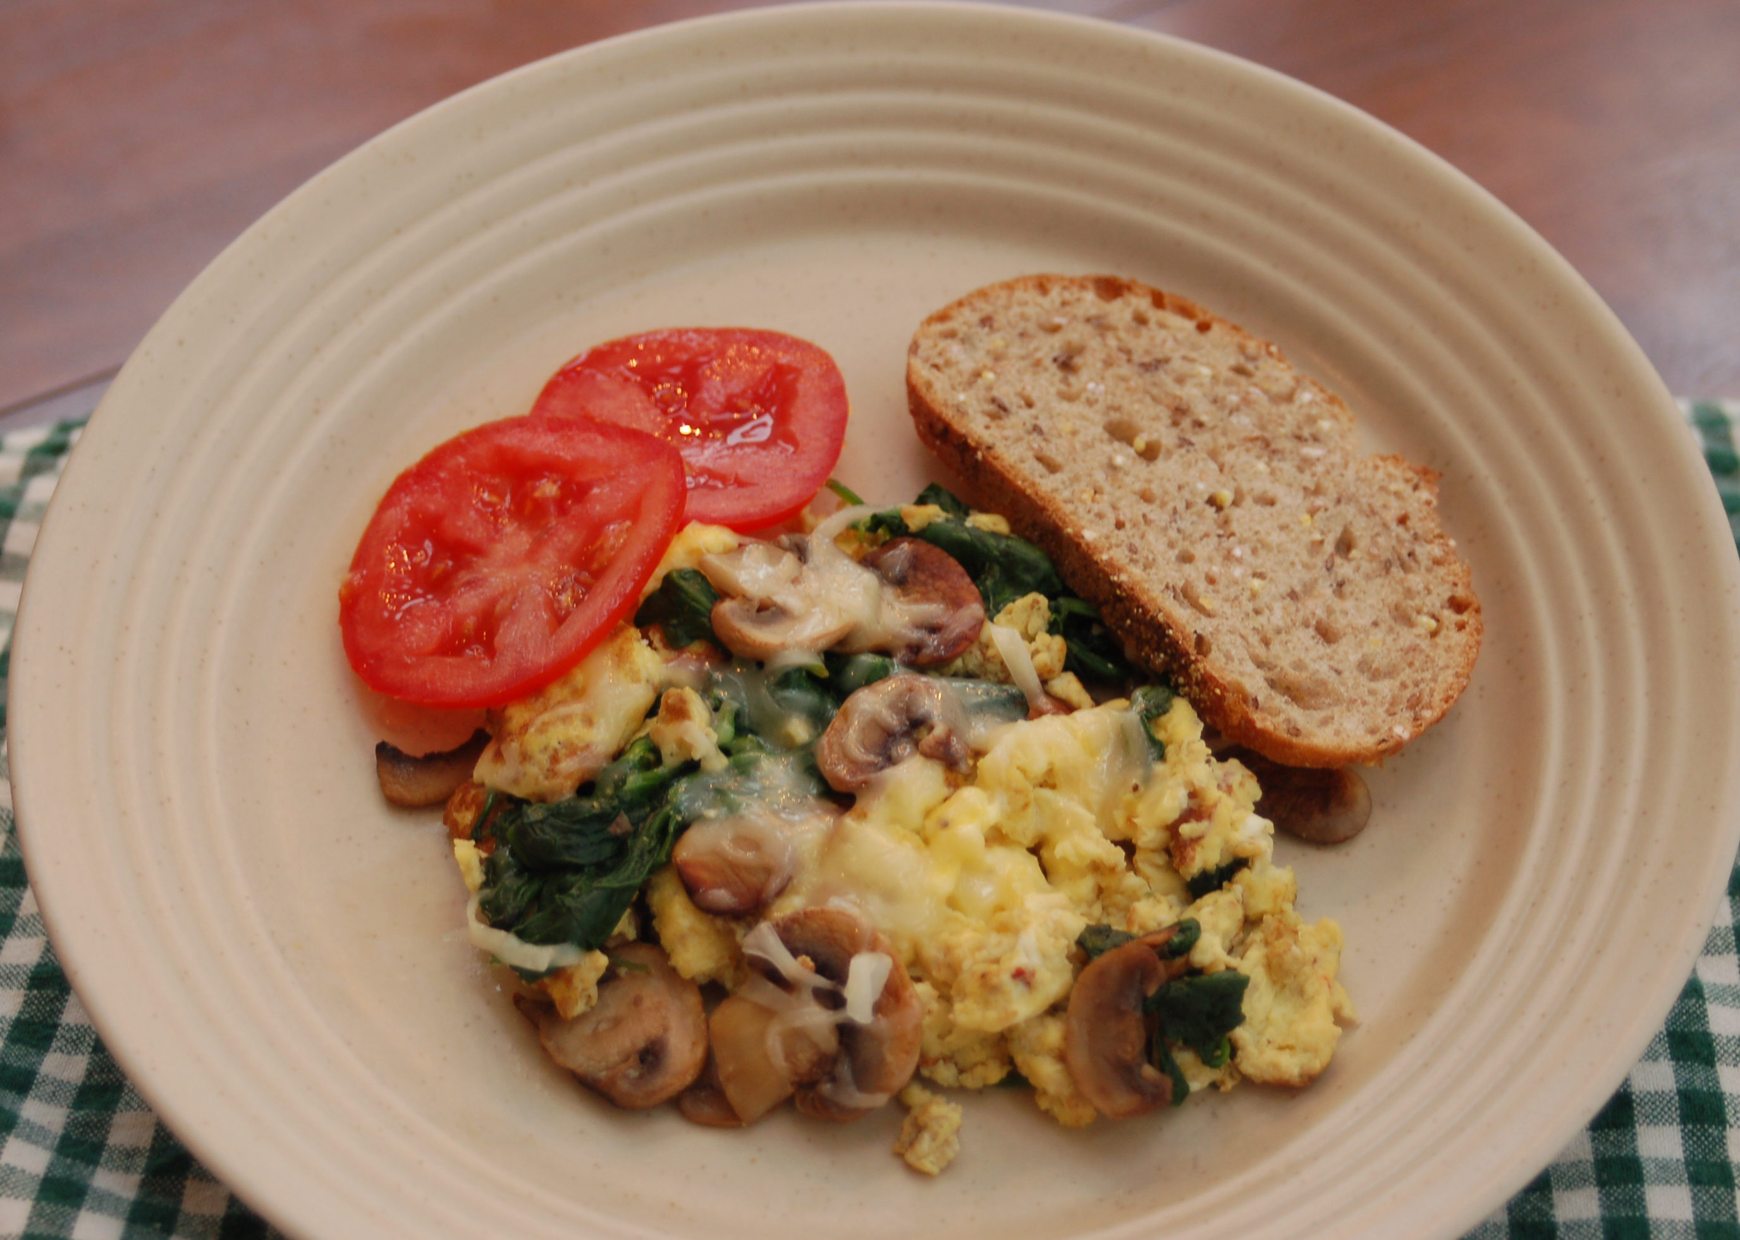
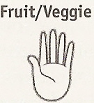
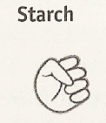
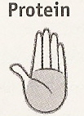

Breakfast
Tomato, Spinach, Mushrooms
Whole-wheat Bread
Egg
Swiss Cheese

Slide 21
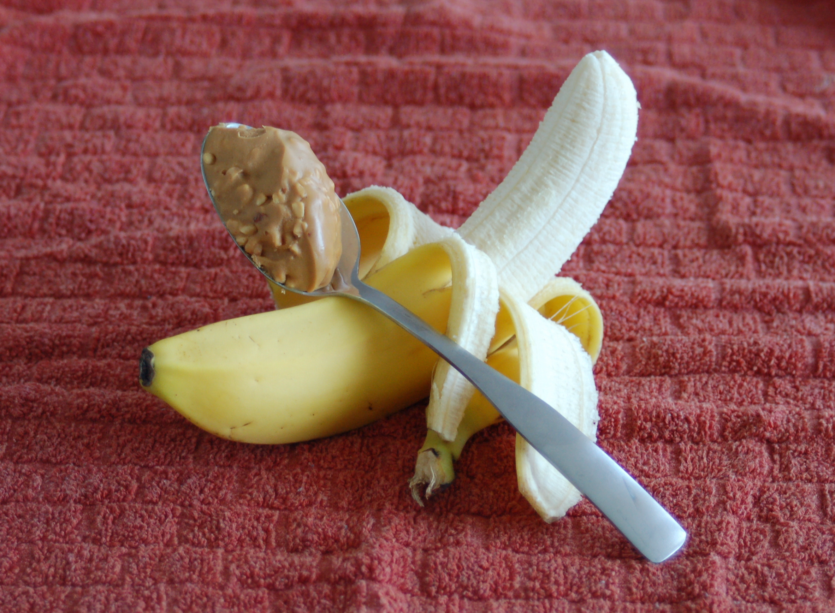
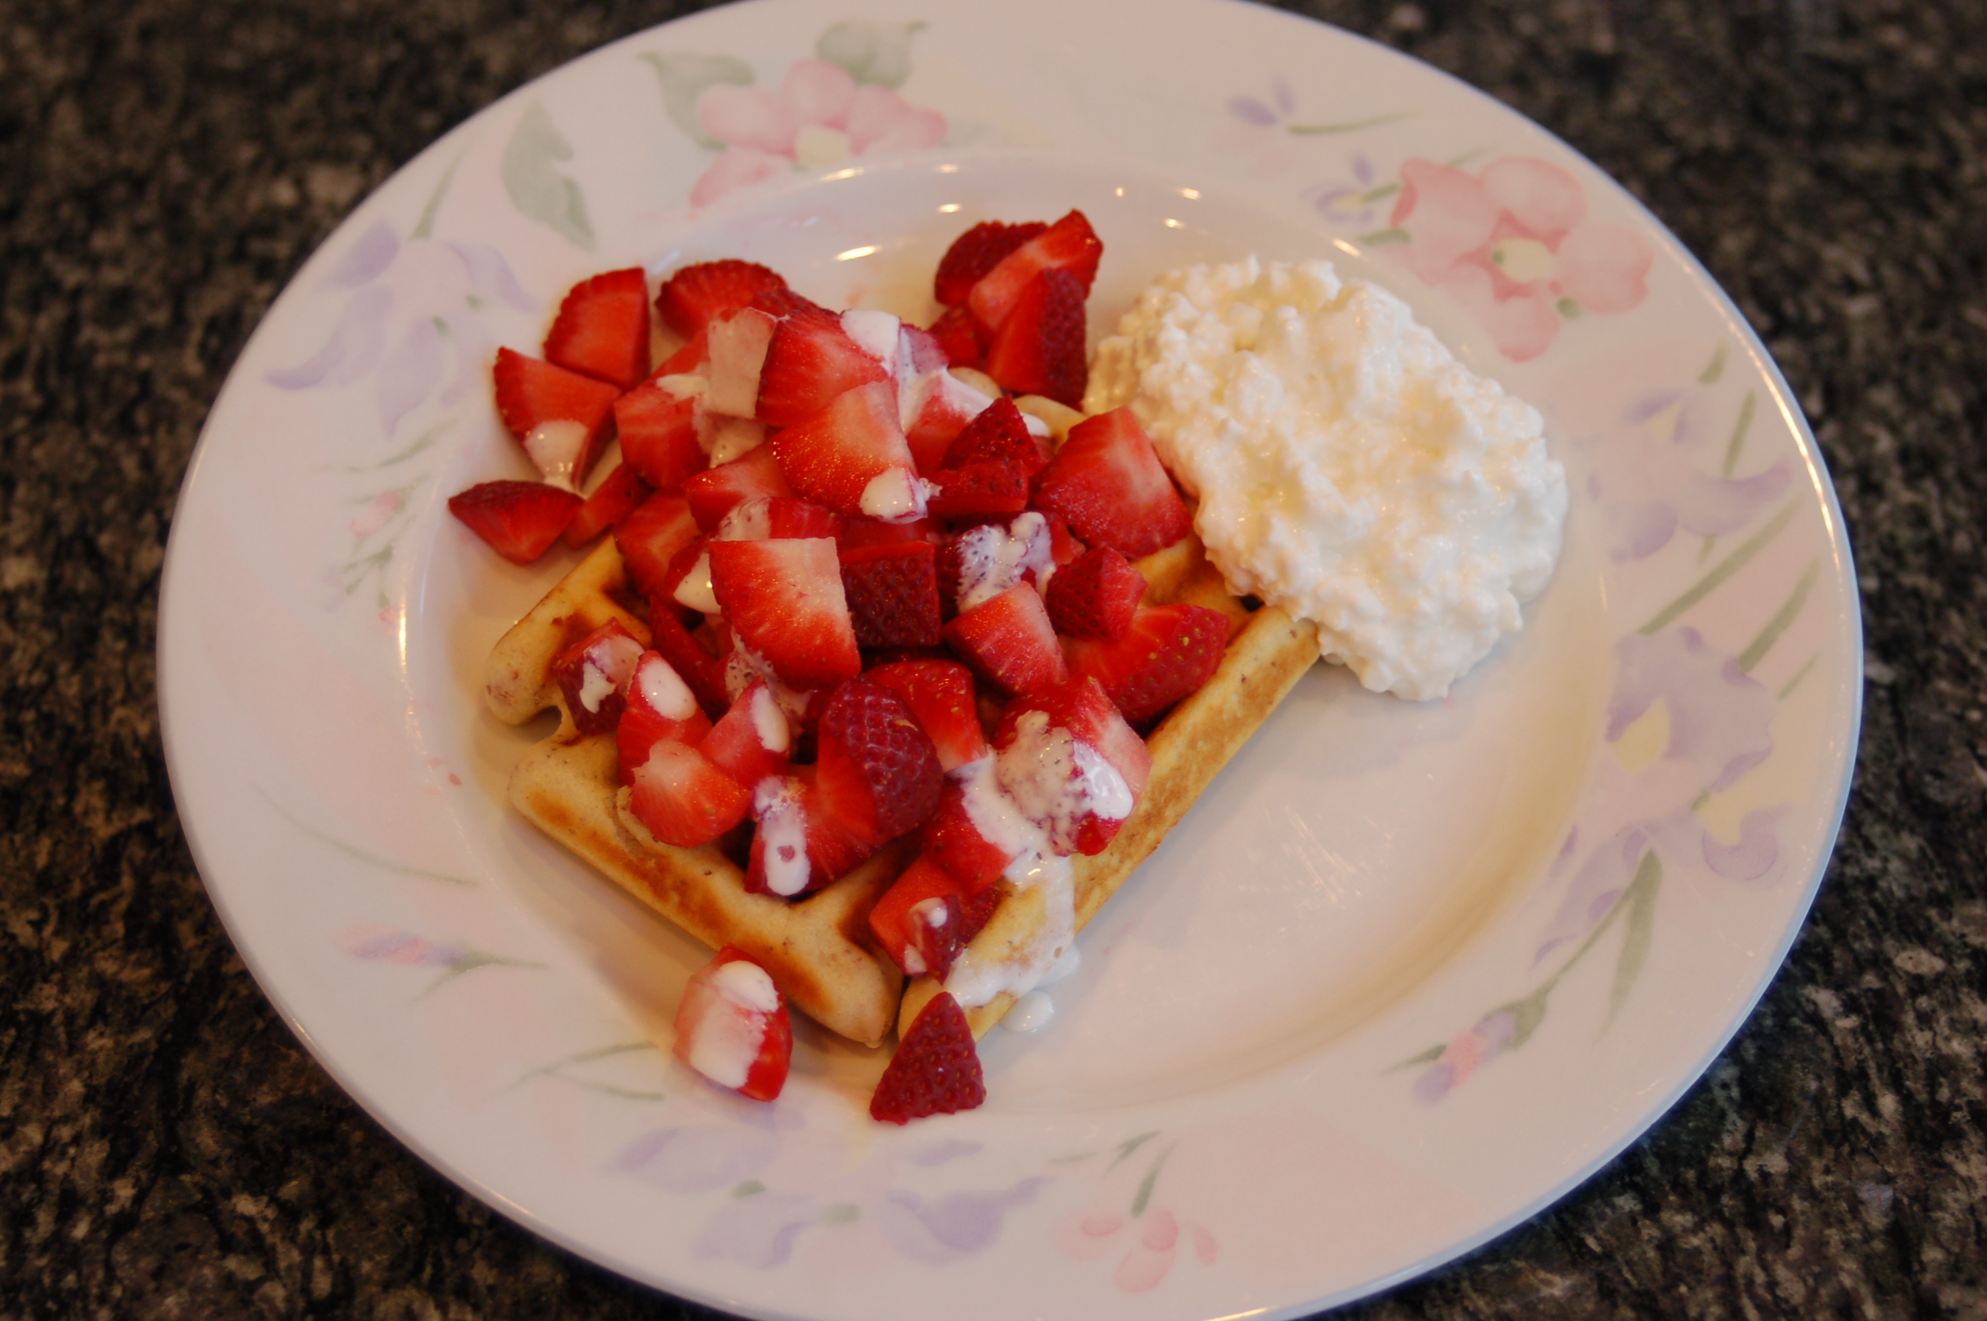
Breakfast
Strawberries
Whole Wheat Waffle
Cottage Cheese
Cream

Slide 22

Breakfast
Cantaloupe
Whole Wheat Toast
Cottage Cheese
Butter

Slide 23
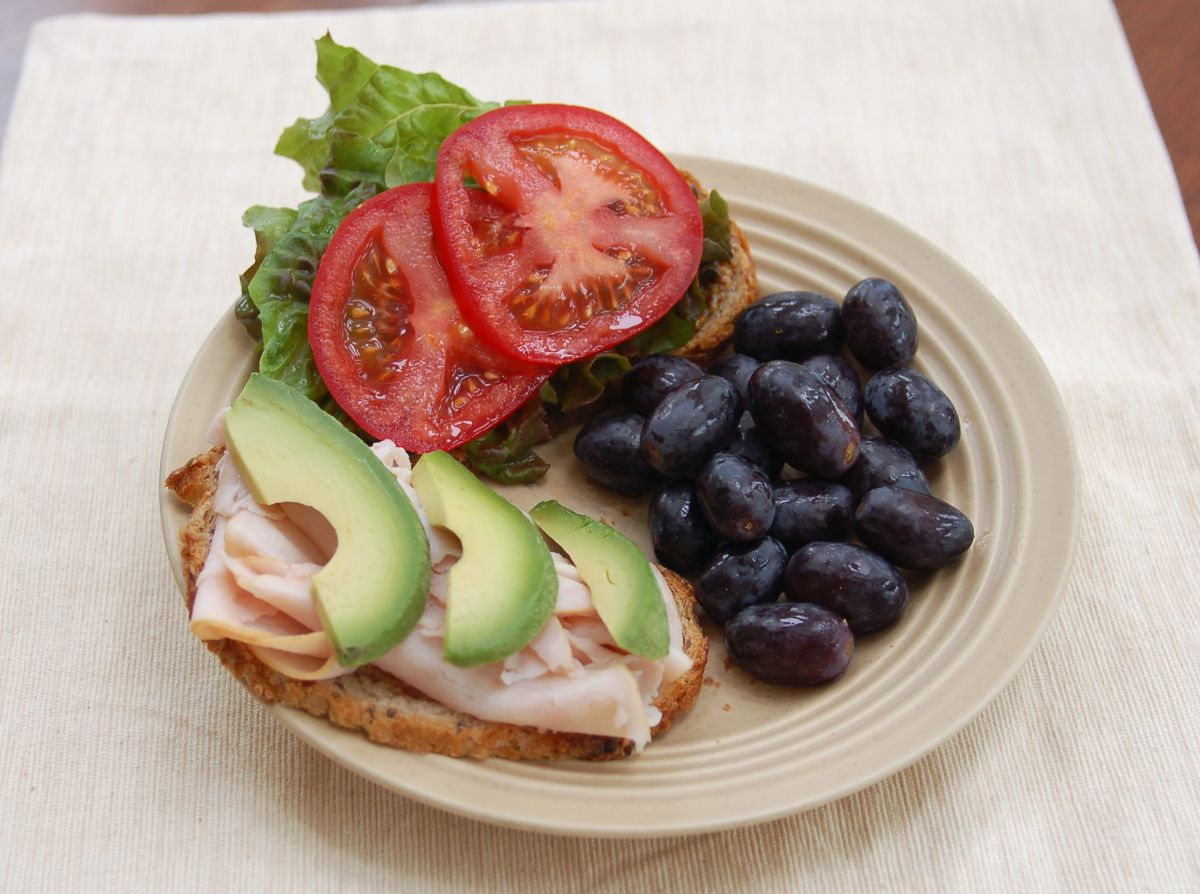
Lunch
Grapes, Lettuce, Tomato
Whole Wheat Bread
Turkey
Avocado

Slide 24
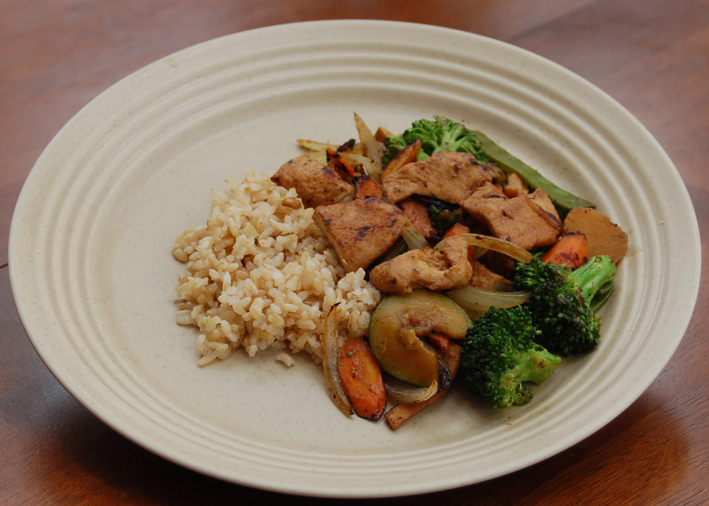
Lunch
Carrots, Onions, Zucchini, Broccoli
Brown Rice
Chicken
Olive oil for Cooking

Slide 25
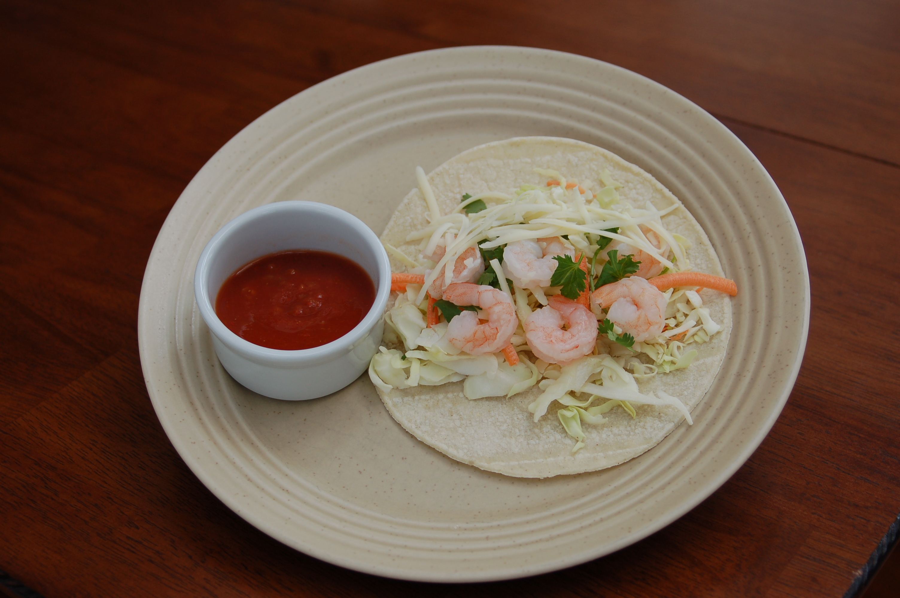
Lunch
Cabbage mix, Salsa
Corn Tortilla
Shrimp
Cheese

Slide 26
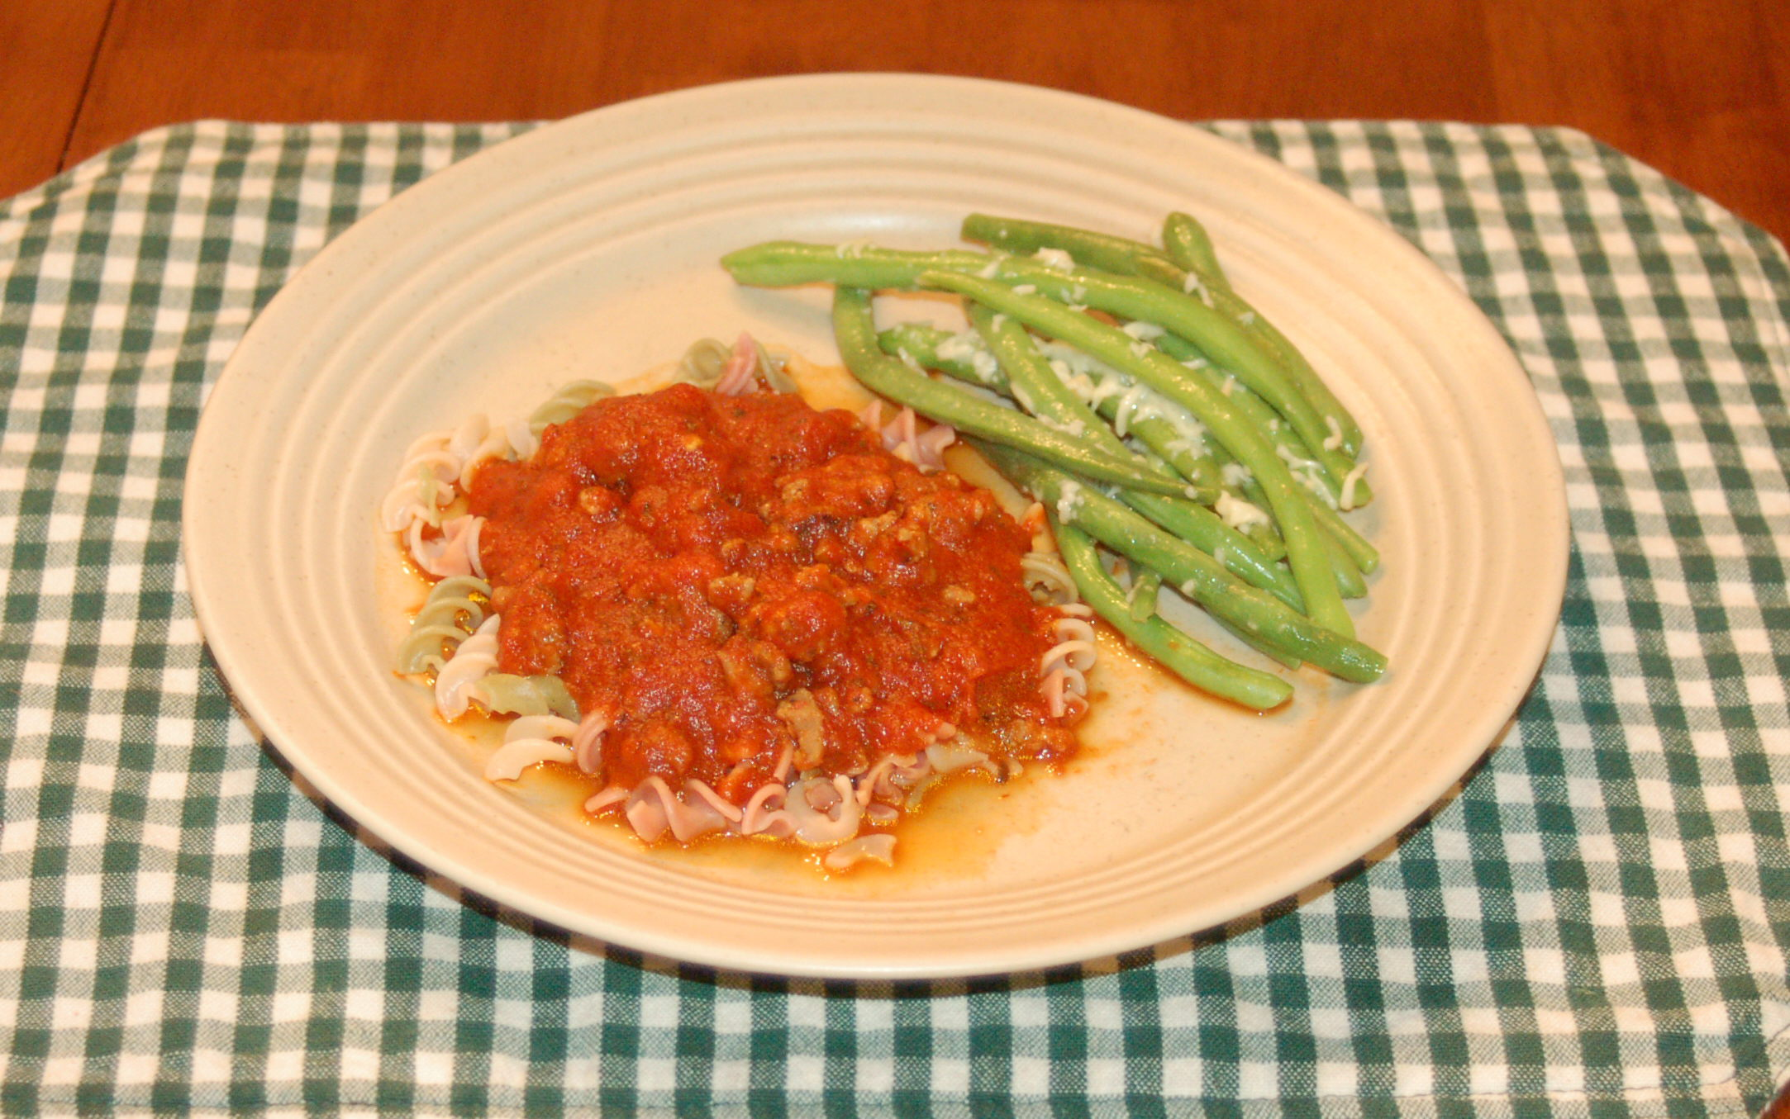
Lunch
Green Beans, Marinara
Whole Wheat Pasta
Lean Turkey Sausage
Parmesan Cheese

Slide 27
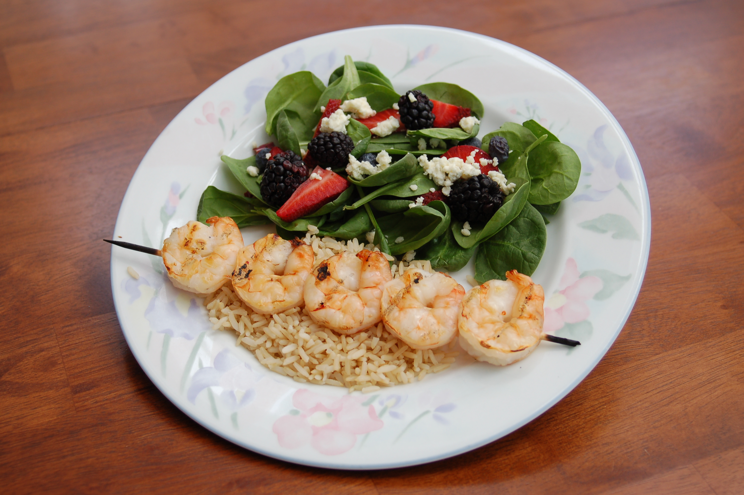
Dinner
Spinach, Berries
Brown Rice
Shrimp
Blue Cheese

Slide 28
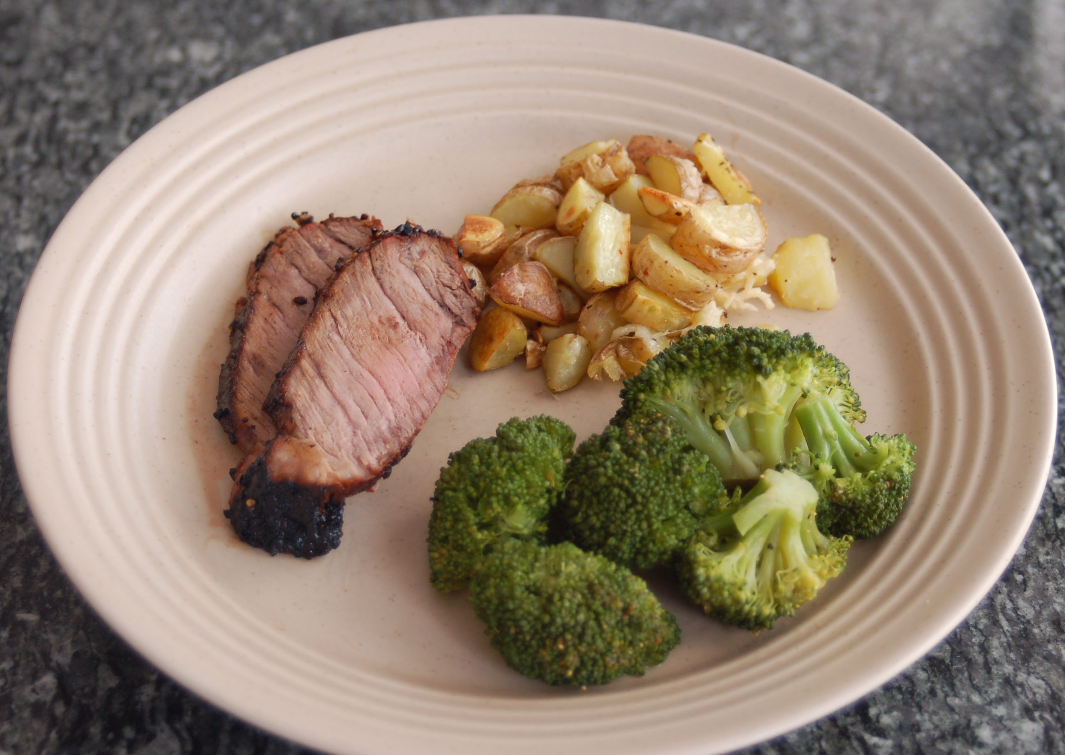
Dinner
Broccoli
Garlic Roasted Potatoes
Lean Beef
Olive Oil for Roasting Potatoes

Slide 29
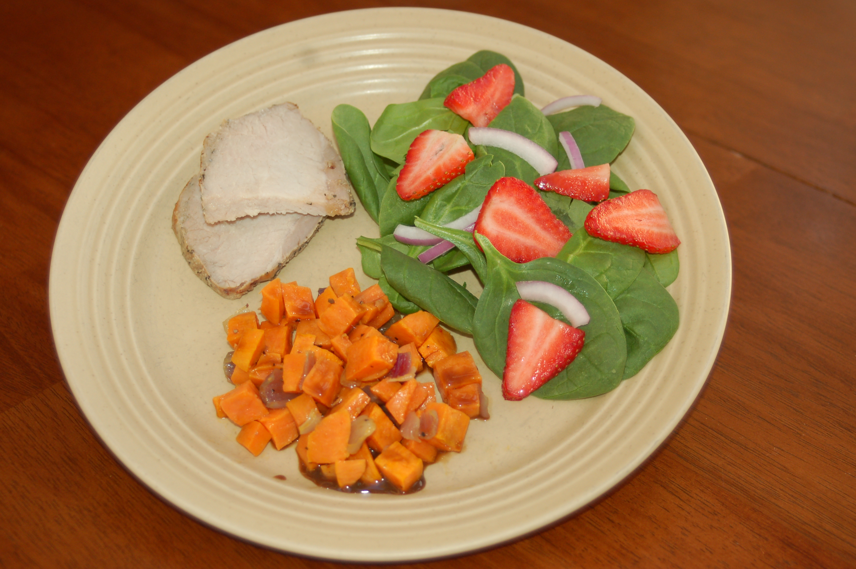
Dinner
Spinach, Strawberry, Onion
Roasted Sweet Potatoes
Lean Pork Tenderloin
Olive Oil for Roasting Potatoes

Slide 30
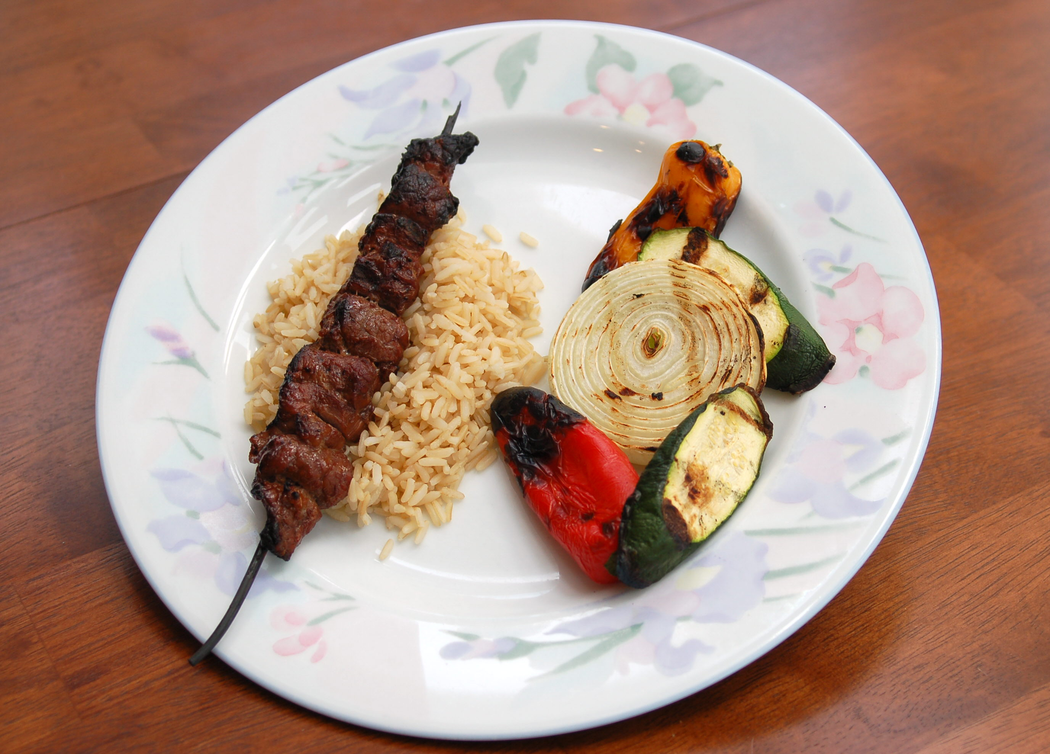
Dinner
Onion, Zucchini, SweetPepper
Brown Rice
Lean Beef
Olive Oil on Vegetables

Slide 31
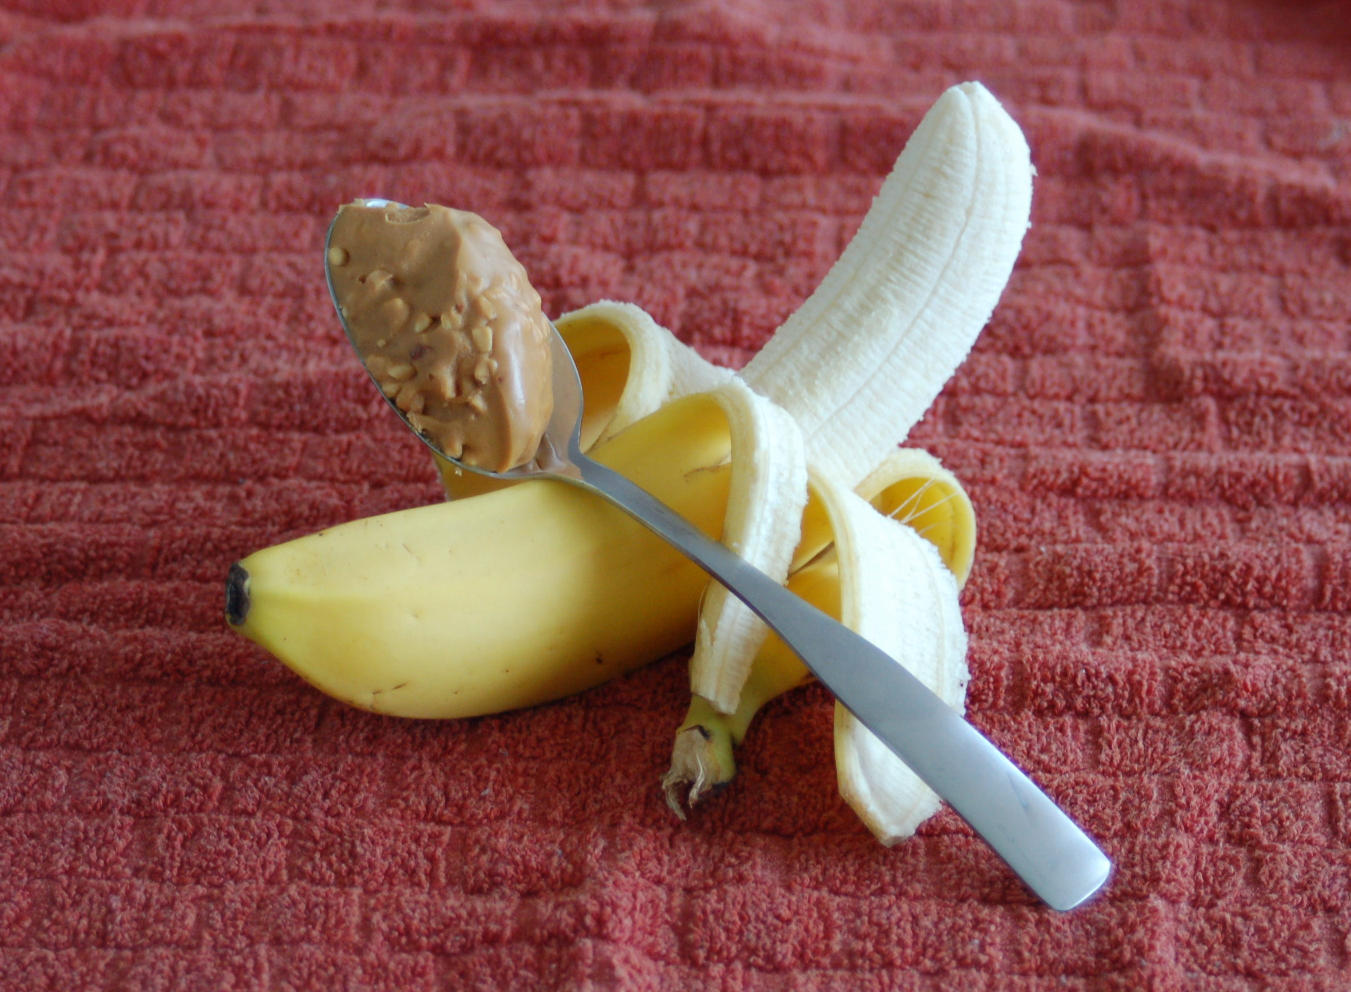
Snack
Banana
N/A
N/A
Peanut Butter

Slide 32
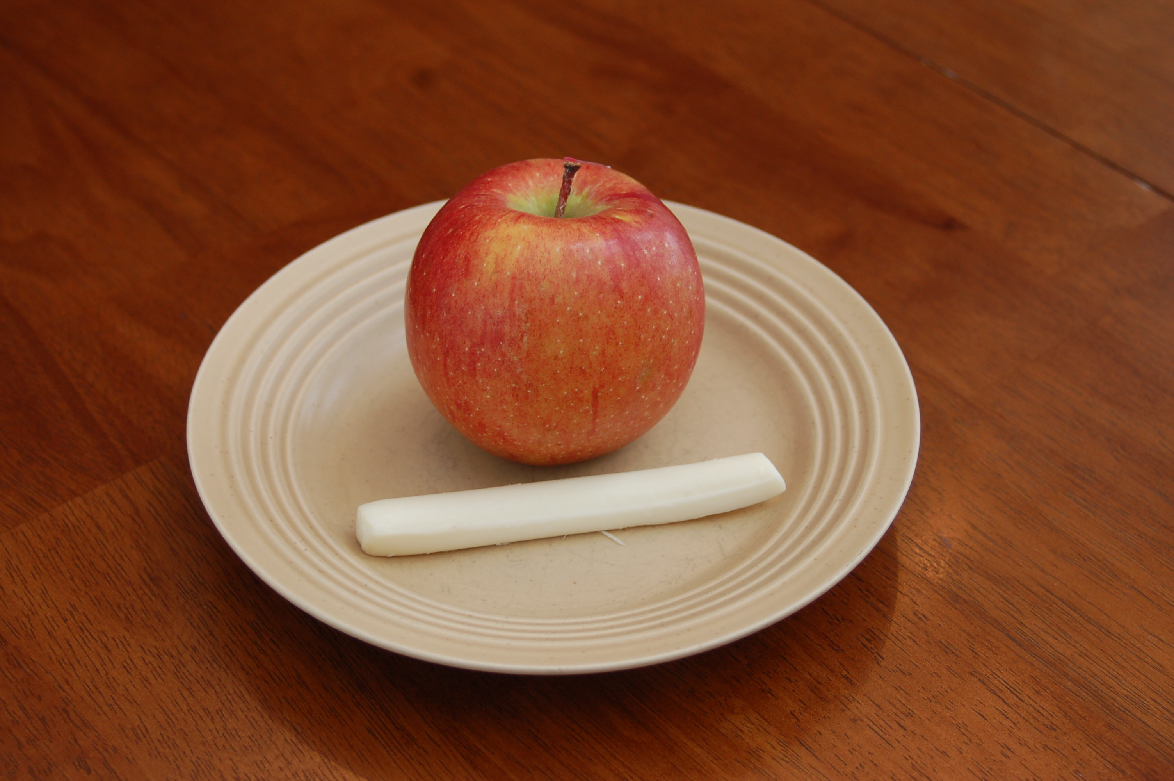
Snack
Apple
N/A
N/A
String Cheese

Slide 33
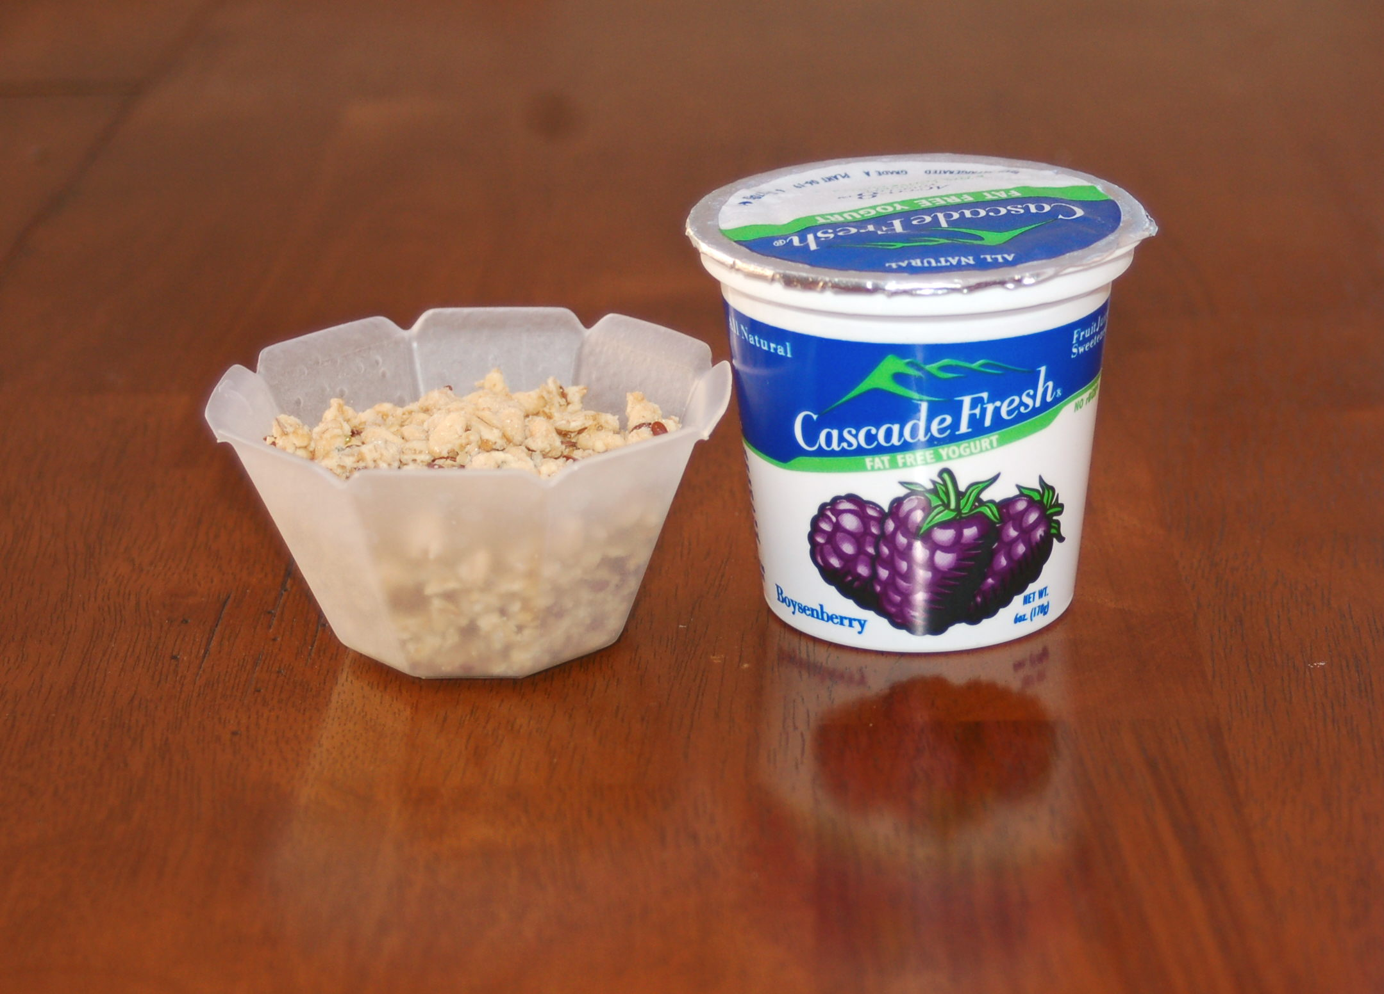
Snack
N/A
Granola
Yogurt
N/A

Slide 34
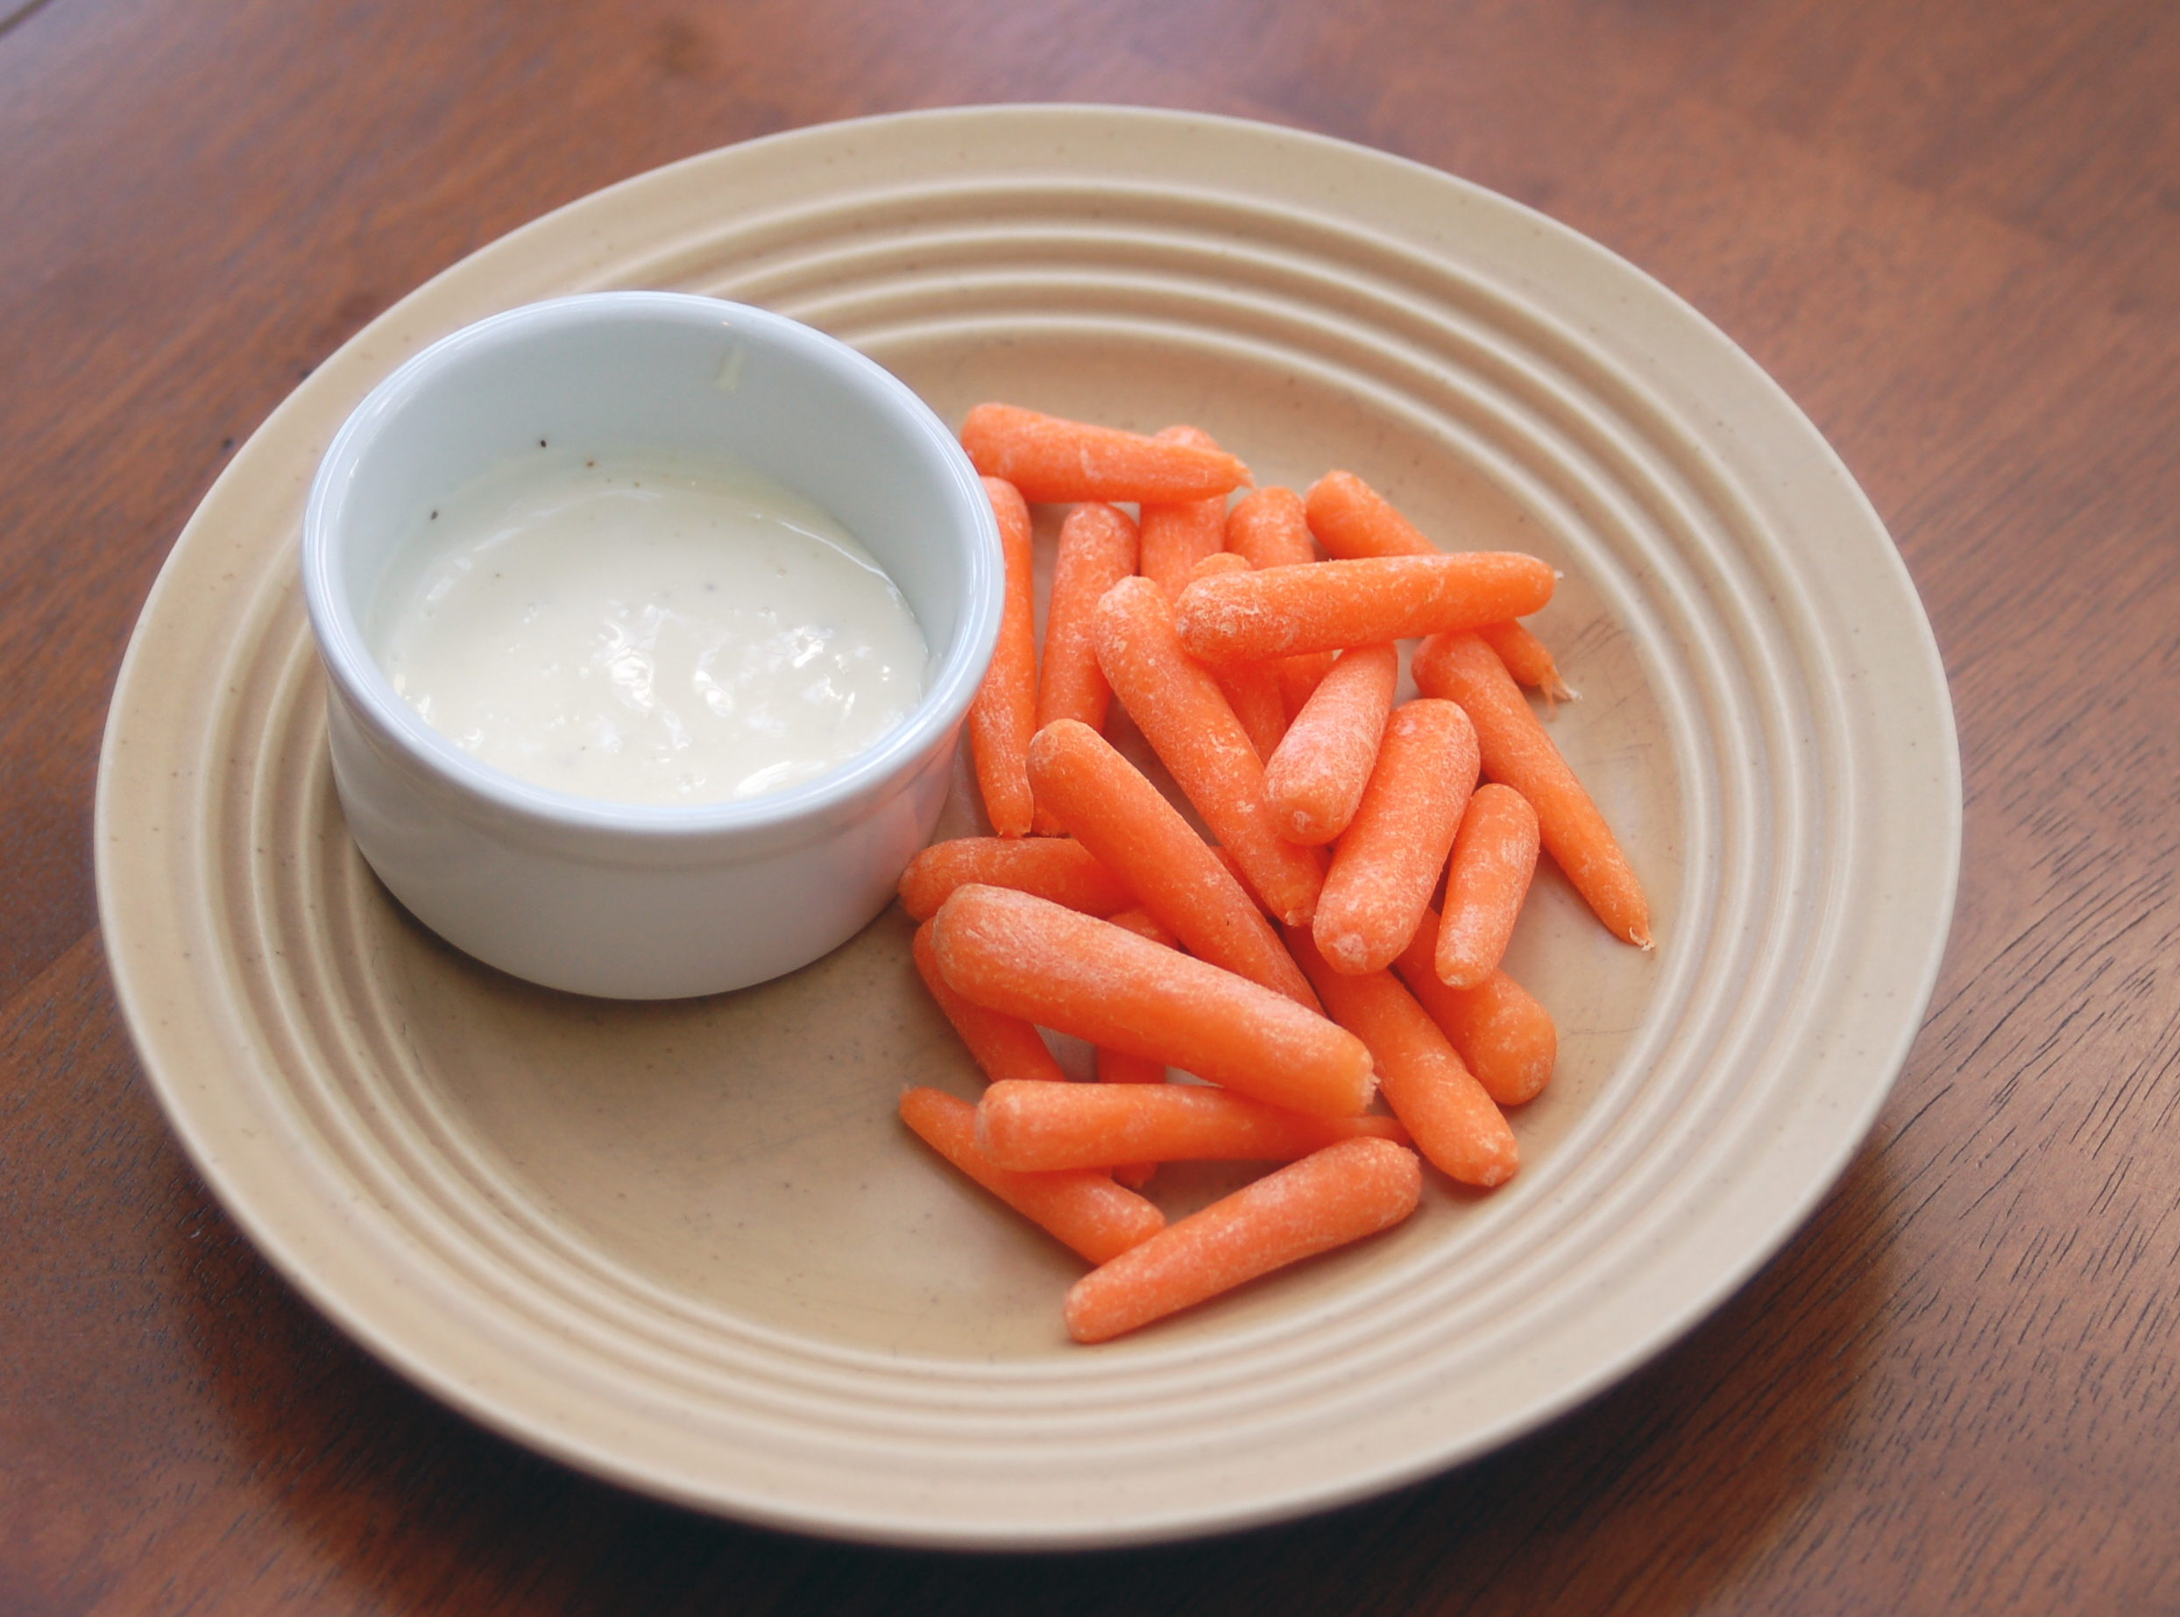
Snack
Carrots
N/A
N/A
Vegetable Dip

Slide 35
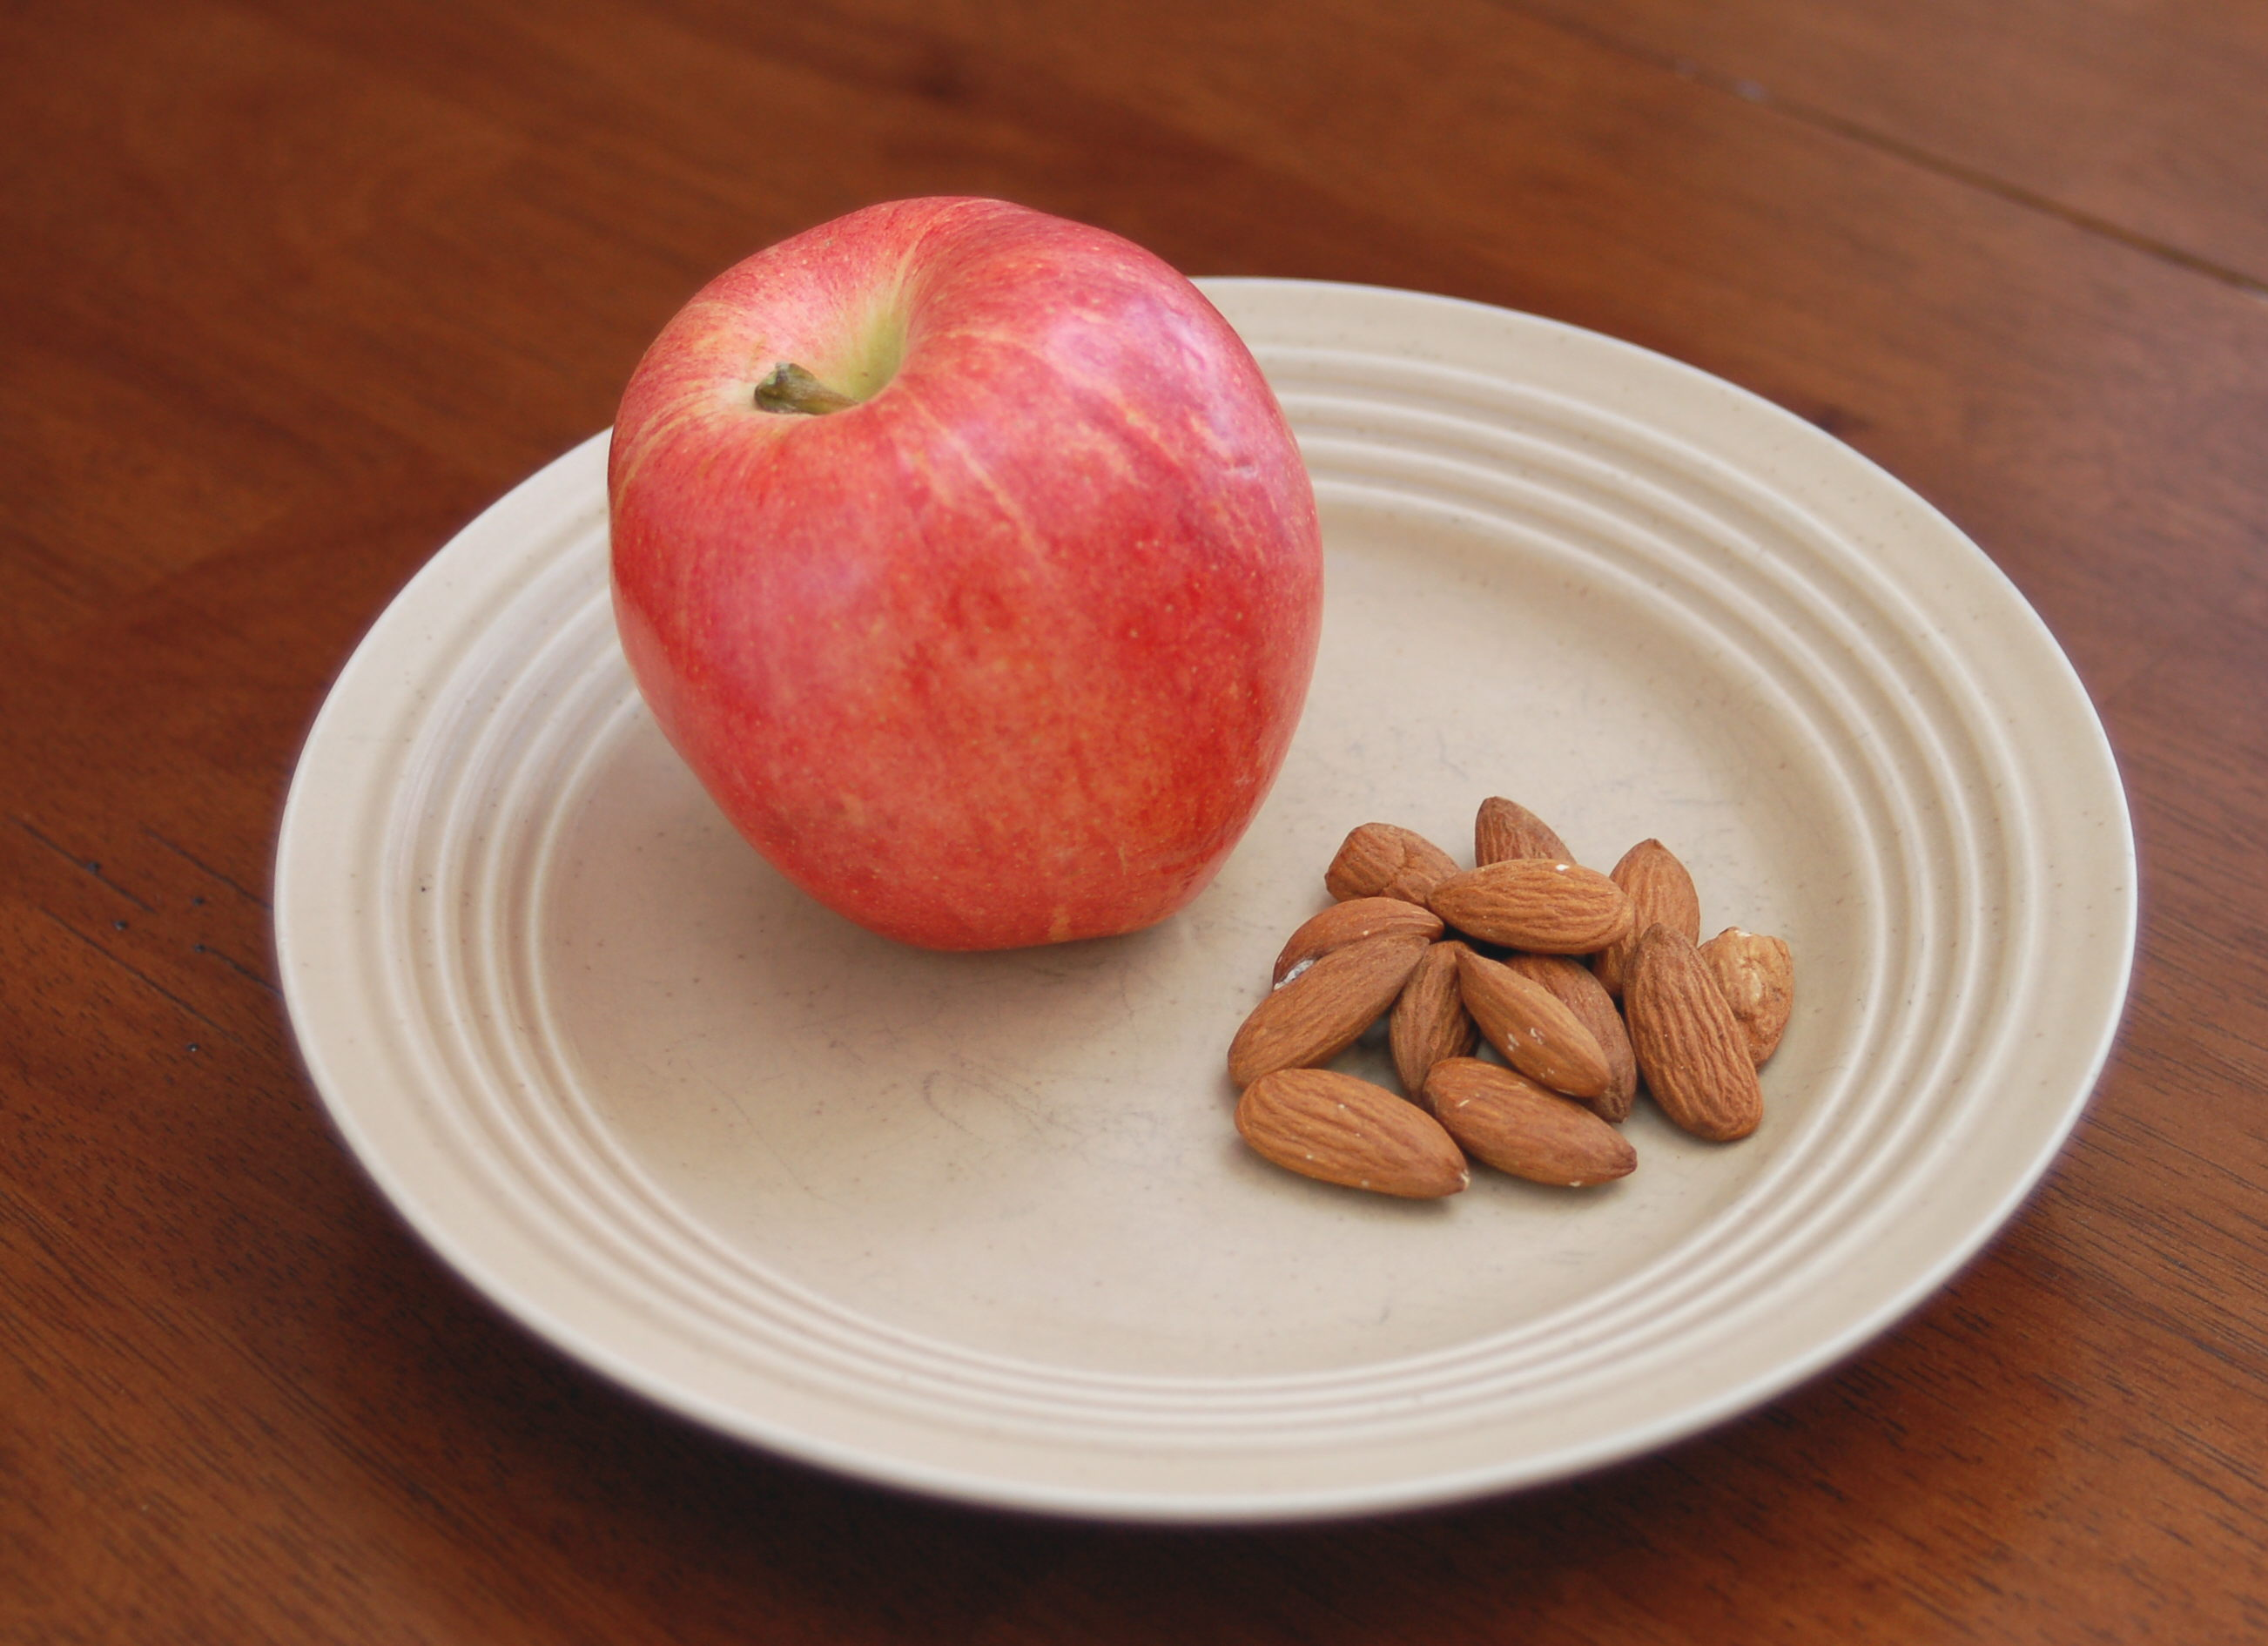
Snack
Apple
N/A
N/A
Almonds

Slide 36
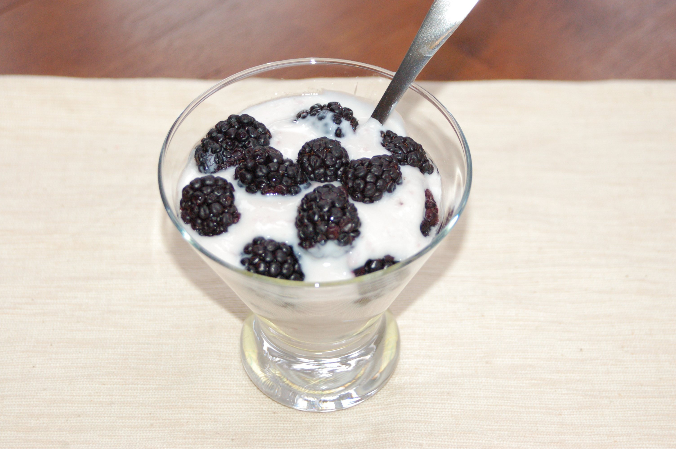
Snack
Blackberries
N/A
Yogurt
N/A

Slide 37
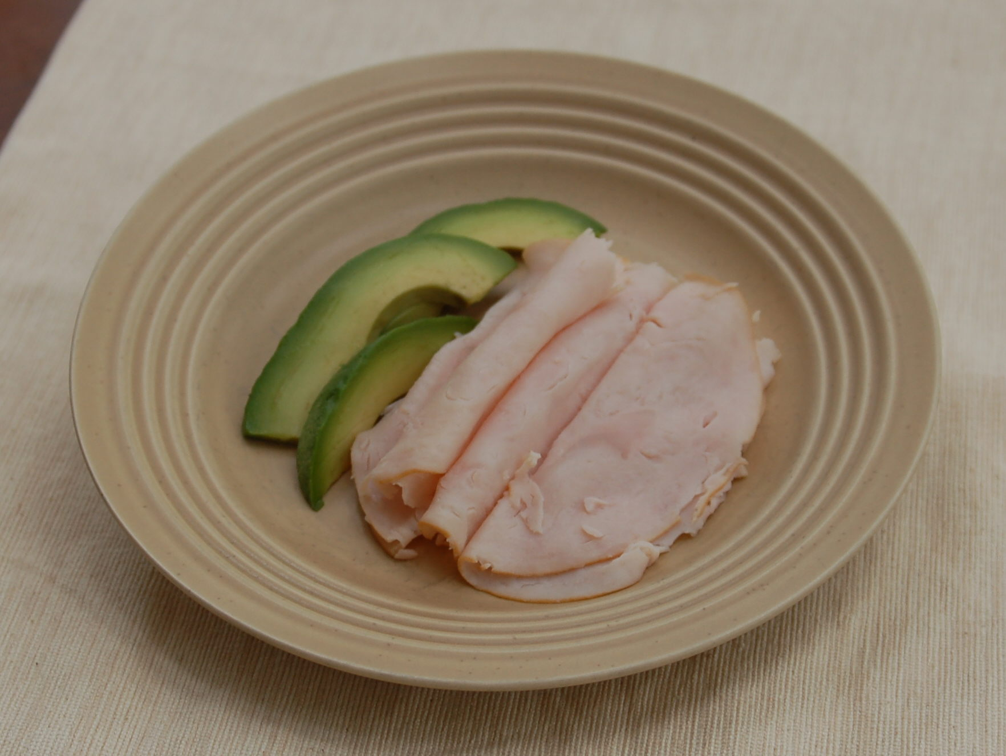
Snack
N/A
N/A
Turkey
Avocado

Slide 40
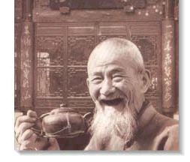
GOOD
HEALTH!

