Slide 1
Project b3 Body-Brain-Biome
Shawn Talbott, PhD

Slide 2
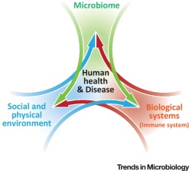
Biome
Body
Brain

Slide 3
Problem
Weight Loss is a “Body” Issue…
Calories in / out
Poor diet
Appetite / cravings / “willpower”
Metabolism / metabolic rate
Hormones
Genetics
NO – actually a “Brain-Body-Biome” issue
Just as mental wellness issues are not ”just brain” issues – they are “gut-brain” issues (which are modifiable with natural approaches)

Slide 4
Epidemic of Epidemics…(perfect storm)

Slide 5
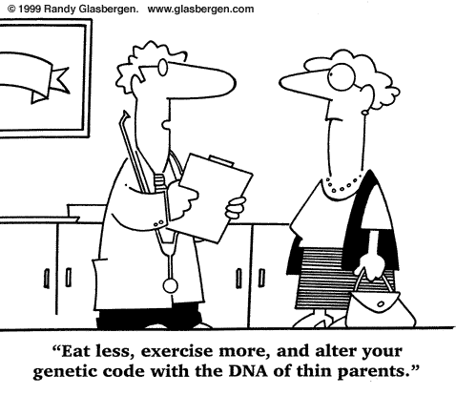
What causes weight gain/loss?
Calories “IN” versus Calories “OUT”
Appetite regulation
“Metabolic Rate” (??)
Genetics??
Habits??
Society??
“Toxic Environment”

Slide 6
Virtually any diet will help you lose weight
Diet Program
Concept
Calories
Atkins
High protein/fat, Low carb
~1,500-1,800
Keto
High protein/fat, Low carb
~1,500-1,800
Zone (Sears)
Moderate 40/30/30
~1,500-1,800
Pritikin
Low fat, high carb
~1,500-1,800
Ornish
Low fat, high carb (vegan)
~1,500-1,800
South Beach
High protein/fat, Low carb
~1,500-1,800
Paleolithic
High protein/fat, Low carb
~1,500-1,800
Weight Watchers
Low fat, balanced protein/carbs
~1,500-1,800

Slide 10
Solution
Restore balance across Brain-Body-Biome Axis
Microbiome
Gut integrity
Immune system
Inflammation
Neurotransmitters
Mood, Stress, Tension, Energy, Vigor (motivation)
SENSE = stress/sleep, exercise, nutrition, supplements, evaluation

Slide 11
What to DO? (simple)
Daily
Fundamentals (Mentabiotics, MentaFocus, MentaSync)
VitaGBX (breakfast & dinner)
GBX Shake/Smoothie (Protein, SuperFood, SeedFiber) – breakfast/lunch?
Eat REAL Food! (Helping Hand)
Project B3 FB Group (check-in)
Weekly
HIIT – 3x
Weights – 2x
Project B3 Seminar (education/reinforcement)

Slide 12
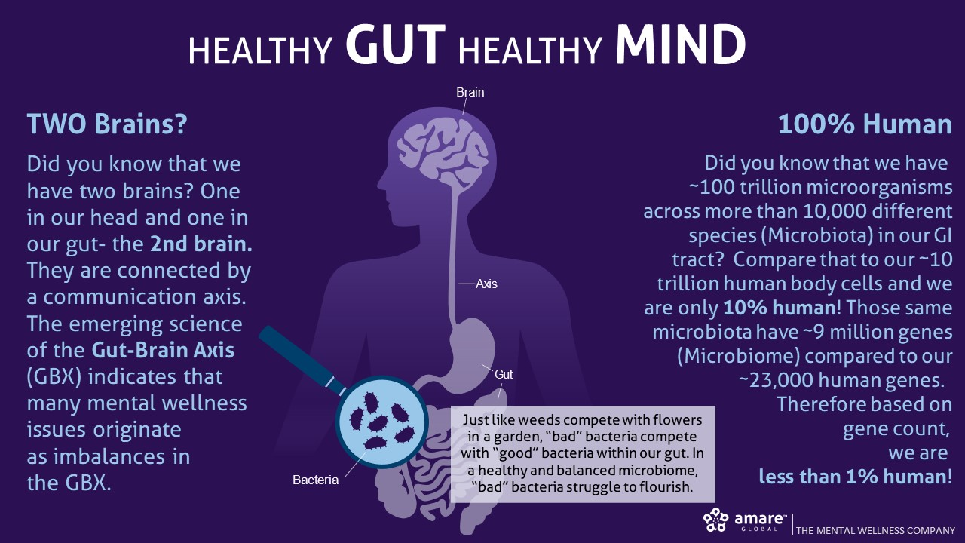

Slide 13


Slide 14
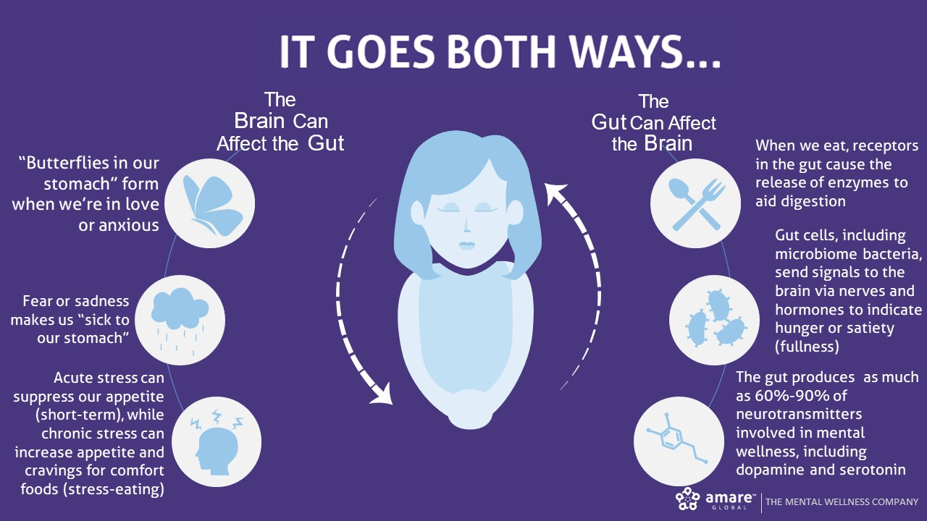

Slide 15
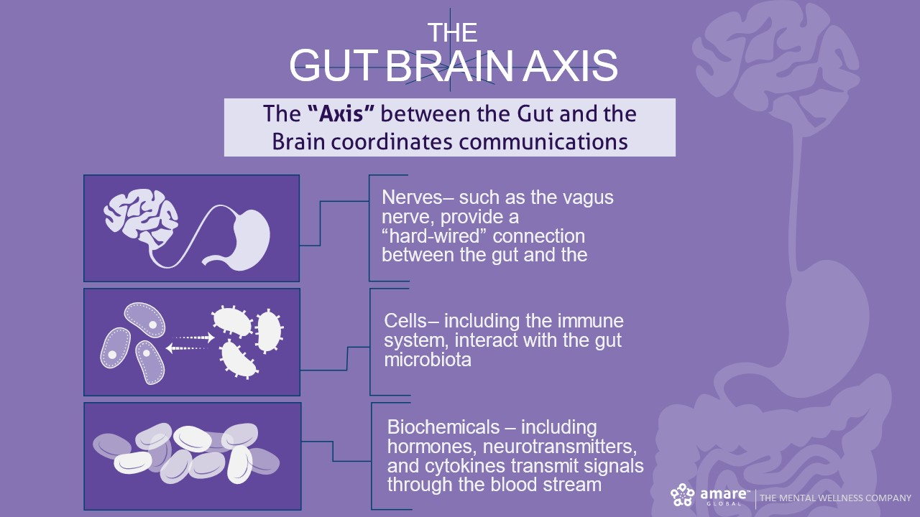

Slide 16
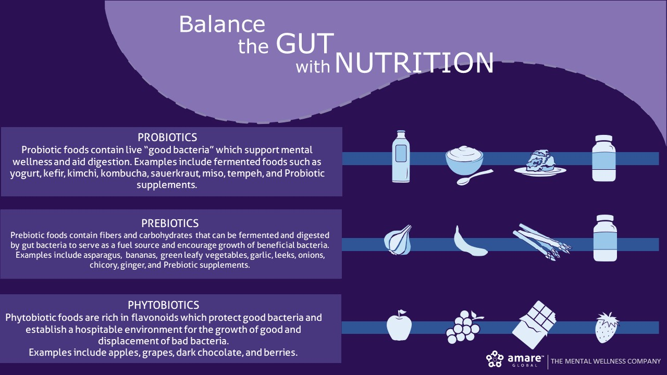

Slide 17
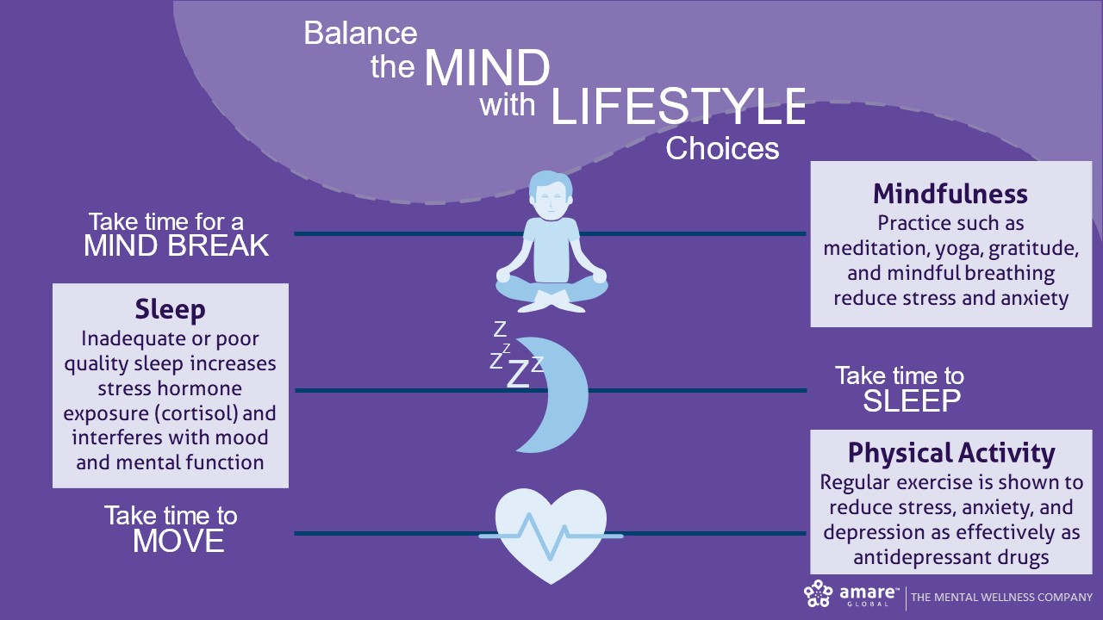

Slide 18
What to DO? (simple)
Daily
Fundamentals (Mentabiotics, MentaFocus, MentaSync)
VitaGBX (breakfast & dinner)
GBX Shake/Smoothie (Protein, SuperFood, SeedFiber) – breakfast/lunch?
Eat REAL Food! (Helping Hand)
Project B3 FB Group (check-in)
Weekly
HIIT – 3x
Weights – 2x
Project B3 Seminar (education/reinforcement)

Slide 19


Slide 21
Interval Training
Alternates between high intensity and low intensity exercise
Warm-up (6min)
1 minute high / 1 minute low intensity
2 minutes high / 2 minutes low intensity
3 minutes high / 3 minutes low intensity
2 minutes high / 2 minutes low intensity
1 minute high / 1 minute low intensity
Cool-down (6min)
18min Interval Training + 12 min warm/cooldown = 30min total
3x per week

Slide 22

Strength Training
Builds lean muscle mass, which increases BMR
Tones and defines the muscles
Improves posture
Helps maintain bone mineral density
Reduces stress + improves mood
20min / 2x per week

Slide 23
Topic Schedule (Wednesday 6-7pm)
Feb 13 (week 0) = Overview / Supplementation
Feb 20 (week 1) = Body/Brain/Biome
Feb 27 (week 2) = Exercise
March 6 (week 3) = Nutrition
March 13 (week 4) = Stress/Sleep (Wisconsin)
March 20 (week 5) = Evaluation (St. George)
March 27 (week 6) = Review
March 28 (Th) – 29 (Fri) = Final Measurements

Slide 24
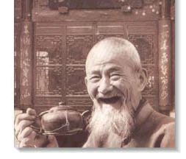
GOOD
HEALTH!

