Slide 1






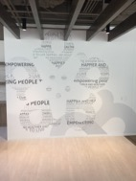
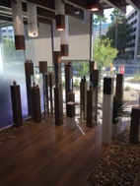
Vision: Leading the mental wellness revolution.
Mission: To create a holistic mental wellness platform that
connects a purpose-driven community of passionate people.
Headquarters located in Irvine, California

Slide 2




.
START UP COMPANY
UNIQUE PRODUCTS
Our vision
is to lead
the global mental wellness revolution
TIMING
TIMING
TIMING
SOCIAL SHIFT
MASSIVE NEED
NEW ERA SCIENCE
TIMING MATTERS!

Slide 3
THE THREE THINGS YOU SHOULD KNOW ABOUT
MENTAL WELLNESS
How you feel is not just in your head – it’s also in your gut.
Our “second brain” includes the Microbiome and plays a major role in mental wellness.
You can now DO something NATURALLY to improve your mental wellness.
WHERE ARE YOU ON THE MENTAL WELLNESS CONTINUUM? (Circle your current number)
1
2
3
4
5
6
7
8
9
10
DISEASE STATUS
“TYPICAL”
OPTIMIZED
Depression
Anxiety
Diabetes
Obesity
Heart Disease
Autoimmune
Arthritis
Fibromyalgia
CFS
Dementia
ADD / ADHD
Alzheimer’s
Fatigue
Tension
Sad
Brain Fog
Headaches
Acne
Eczema
Congestion
URTI’s
Joint Pain
Muscle Pain
Bloated
Chubby
Energetic
Calmness
Happy
Sharp
Creative
Clear Skin
Rarely Sick
Flexible
Lean
Strong
Resilient
RED
ORANGE
YELLOW
GREEN
BLUE
INDIGO
VIOLET

Slide 4
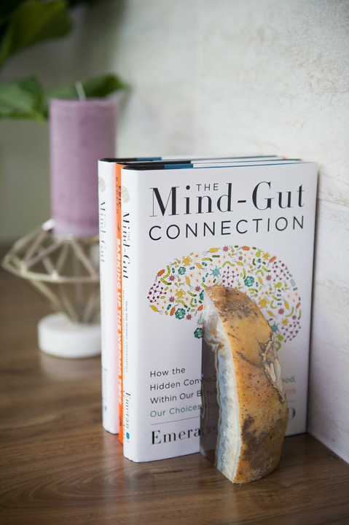

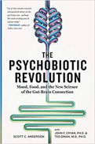



RECENT SCIENTIFIC
DISCOVERIES
NEW ERA SCIENCE
The Gut Microbiome solution is
another “national conversation”

Slide 5
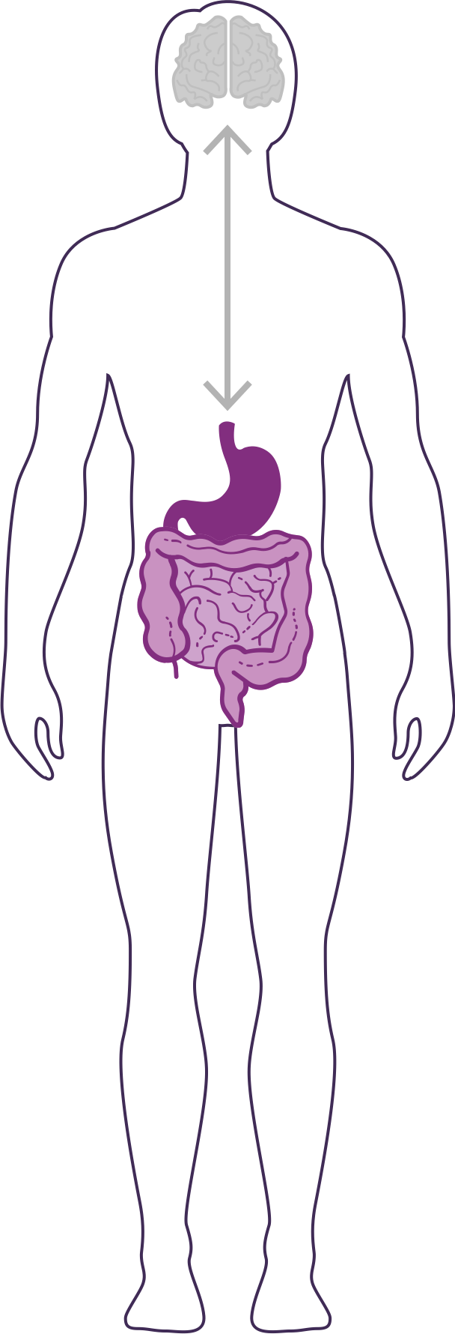
DID YOU KNOW?
NEW ERA SCIENCE
90% of the cells in your body are non-human
  Human genes = ~23,000
  Bacterial genes= ~20 million
  (~1,000x MORE than human genes)
The microbiome is an ecological community of trillions of bacteria living symbiotically in/on our body
  “2nd Brain” = 3-4 lbs (approximately the same size as our 1st brain)
YOUR GUT IS CONSIDERED YOUR SECOND BRAIN

Slide 6
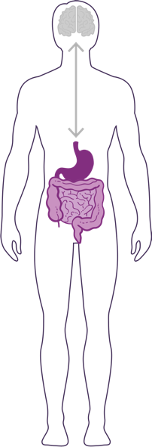

HOW IMPORTANT IS YOUR
MICROBIOME?
Communicates with the brain to regulate health, weight, immune function, digestive function, mood, and overall mental health.
What we put in our bodies affects the microbiome, which in turn affects our mind and other crucial bodily systems
The microbiome plays an important role in the way you feel mentally & physically.
IN BALANCE
NEW ERA SCIENCE
Feeling Great
This explains why you have those “GUT-FEELINGS”
OUT OF BALANCE
Feeling fatigue, sad, tense, hungry, heavy, bloated, confused, stiff/sore

Slide 7
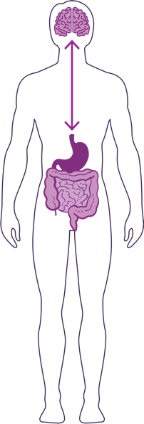
HOW DO YOUR “TWO BRAINS”
COMMUNICATE?
Our “two brains” communicate through a highly extensive network, known as the gut-brain axis (GBX).
NEW ERA SCIENCE
NETWORK CONSISTS OF:
“wires” – nerves
“chemicals” – neurotransmitters/hormones
“cells” – immune system
The GBX connects our
nervous system (brain)
immune system (axis)
and gastrointestinal system (gut)
with a vast array of cellular and biochemical messengers throughout the entire body, which include the microbiome, hormones, cytokines, and neurotransmitters.

Slide 8
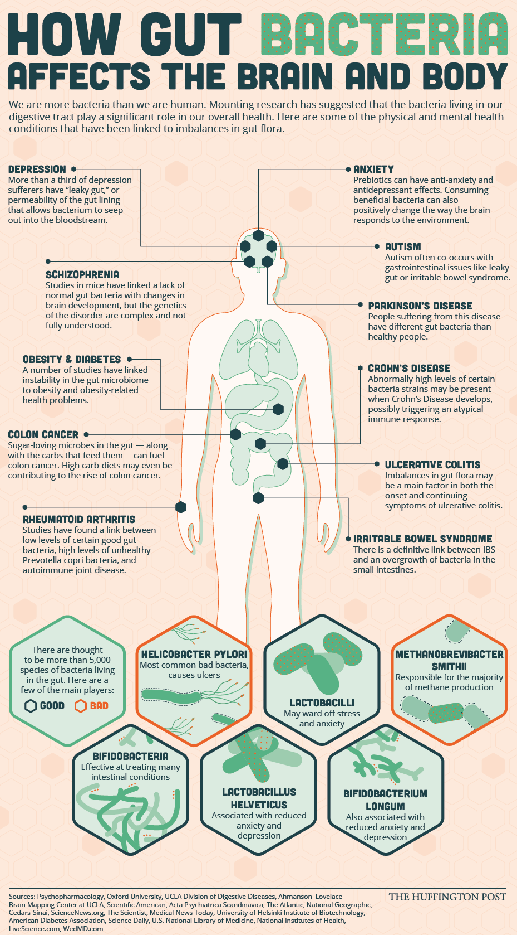

Slide 9
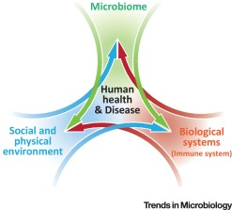
Biome
Body
Brain

Slide 10

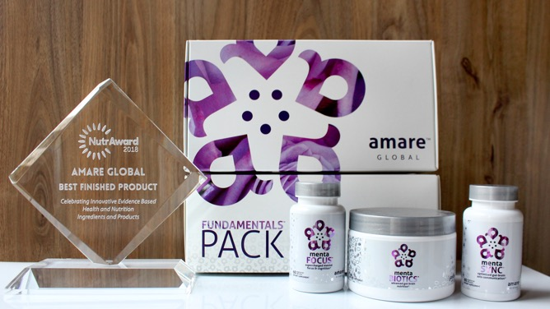
World’s First Award-Winning
Gut-Brain Axis Nutrition System!
The NutrAward recognizes companies that are investing in rigorous and measurable scientific studies to prove the efficacy of their proprietary ingredients or technologies.
Submissions are judged on their merit in the following areas:
Viable product
Emerging Category
Creative product concept
Distinct health application
Unique packaging
Matchless marketing

Slide 11

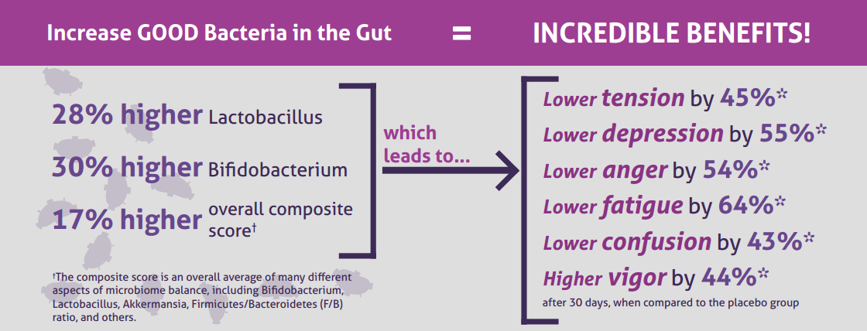
CLINICAL STUDY
The Amare FundaMentals Pack has been clinically proven to:

Slide 12

MENTABIOTICS SUGAR FREE
MW3™ Probiotic Proprietary Blend
™
Our blend contains unique and specific probiotic strains targeted to enhance overall mental wellness.*
MW3 Probiotic Strains:
Lactobacillus rhamnosus R0011 — Reduces stress by lowering cortisol exposure and improves GABA neurotransmission*
Bifidobacterium longum R0175 — Enhances calmness by decreasing anxiety indices and improves cognitive function*
Lactobacillus helveticus R0052 — Improves mood by decreasing neuro-inflammation and increasing serotonin*
*These statements have not been evaluated by the Food and Drug Administration. This product is not intended to diagnose, treat, cure, or prevent any disease.

Slide 13

MENTABIOTICS SUGAR FREE
MW3™ Prebiotic Proprietary Blend
™
Our MW3 Prebiotic Proprietary Blend provides optimal gut support by feeding the specific mental wellness probiotic strains found in our MW3 Probiotic Proprietary Blend.*
MW3 Prebiotic Fibers:
IsoFiber™ (Iso-Malto-Oligosaccharides) — Contains a combination of naturally occurring prebiotic plant fibers that are clinically shown to improve the growth of specific probiotic strains featured in Kids FundaMentals™ and now MentaBiotics™ Sugar Free!
Bimuno® (Galacto-Oligo-Saccharides) — Resets and increases friendly gut bacteria, maintains immune health, controls inflammation in the body and supports microbiome balance. Is highly effective and a natural way of increasing preferred bacteria in the gut. Plays an important role in feeding Bifidobacteria probiotic strains.*
SunFiber® (Galactomannan Fiber) — Helps improve the growth and vitality of beneficial bacteria, including Bifidobacteria and Lactobacillus.*
*These statements have not been evaluated by the Food and Drug Administration. This product is not intended to diagnose, treat, cure, or prevent any disease.

Slide 14
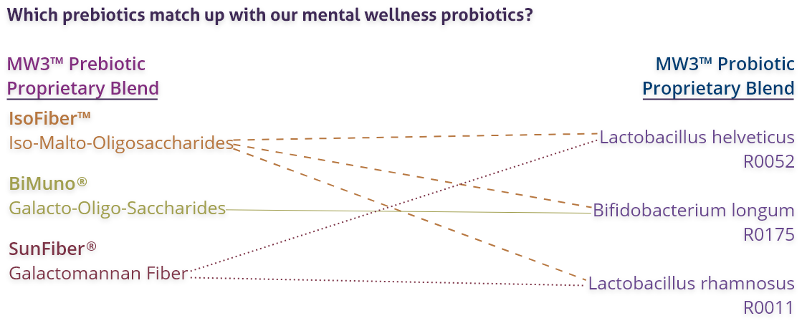
MENTABIOTICS SUGAR FREE
MW3™ Prebiotic/Probiotic Proprietary Blend
™
*These statements have not been evaluated by the Food and Drug Administration. This product is not intended to diagnose, treat, cure, or prevent any disease.

Slide 15


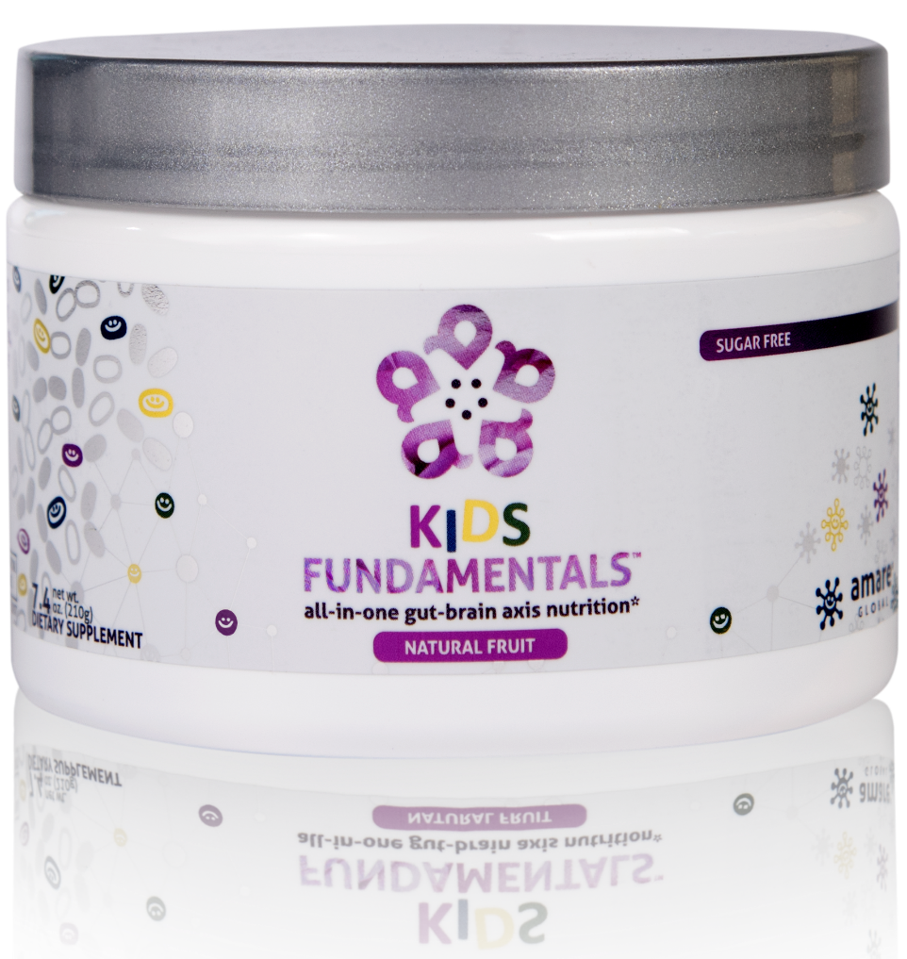
INGREDIENTS SHOWN TO IMPROVE MENTAL WELLNESS*
SUPPORTS ENTIRE GUT-BRAIN AXIS*
EASY-TO-DIGEST FORMULA
all-in-one gut-brain axis nutrition for kids & teens*
Kids FundaMentals™ is an all-in-one product that supports the entire gut-brain axis (GBX) of growing kids and teens. Featuring nutrients scientifically shown to improve mental wellness, this easy-to-digest formula is perfect for kids and teens of all ages.*
*These statements have not been evaluated by the Food and Drug Administration. This product is not intended to diagnose, treat, cure, or prevent any disease.
Notes:
Add callouts

Slide 16
Why is Fundamentals Different?
World’s 1st comprehensive/holistic GBX System
  Addresses each level of GBX balance
  Microbiome modulation
  Gut integrity
  Immune priming
  Inflammatory balance
  Neurotransmitter signaling
Specific probiotic strains for depression/anxiety/stress
Specific prebiotics fibers for stress/resilience
Patent-pending phytonutrients for GBX support
Scientifically-supported formula
  6 peer-reviewed presentations

Slide 17
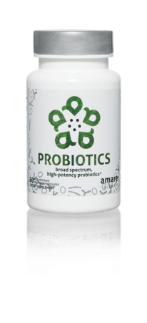
Why is Probiotics Different?
Bifidobacterium bifidum (Bb-06)
Maintains microflora balance by producing lactic acid and acetic acid to compete with “bad” bacteria (Staph. aureus, E. coli, Camplylobacter jejuni, etc).
Bifidobacterium longum (Bl-05)
Highly resistant to low pH and bile salts and is well-suited to the intestinal environment to help reduce inflammation. Helps reduce gastrointestinal discomfort caused by stress.
Lactobacillus acidophilus (La-14)
Ferments carbohydrates to lactic acid, which competes with “bad” bacteria for adhesion spaces on the intestinal mucosa. Increases mineral bioavailability (incl copper, magnesium, calcium, and manganese).
Lactobacillus casei (LC-11)
Wide range of benefits for improved digestion, reduced cholesterol, modulation of inflammation/allergies.
Lactobacillus rhamnosus (Lr-32)
Promotes general GI health and function – especially beneficial to prevent/treat occasional diarrhea and constipation after probiotic treatment.

Slide 18
THE THREE THINGS YOU SHOULD KNOW ABOUT
MENTAL WELLNESS
How you feel is not just in your head – it’s also in your gut.
Our “second brain” includes the Microbiome and plays a major role in mental wellness.
You can now DO something NATURALLY to improve your mental wellness.
WHERE ARE YOU ON THE MENTAL WELLNESS CONTINUUM? (Circle your current number)
1
2
3
4
5
6
7
8
9
10
DISEASE STATUS
“TYPICAL”
OPTIMIZED
Depression
Anxiety
Diabetes
Obesity
Heart Disease
Autoimmune
Arthritis
Fibromyalgia
CFS
Dementia
ADD / ADHD
Alzheimer’s
Fatigue
Tension
Sad
Brain Fog
Headaches
Acne
Eczema
Congestion
URTI’s
Joint Pain
Muscle Pain
Bloated
Chubby
Energetic
Calmness
Happy
Sharp
Creative
Clear Skin
Rarely Sick
Flexible
Lean
Strong
Resilient
RED
ORANGE
YELLOW
GREEN
BLUE
INDIGO
VIOLET

