Slide 1
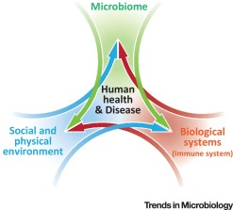
Project B3 PILOT Exercise
Shawn Talbott, PhD
Biome
Body
Brain

Slide 2
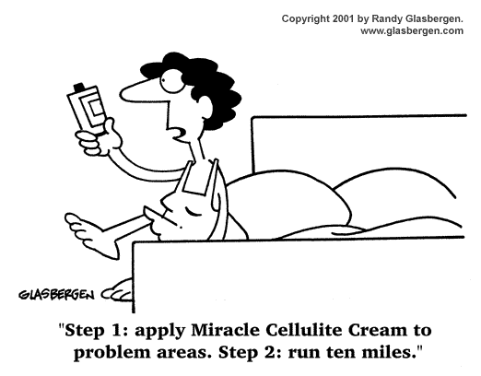

Slide 3
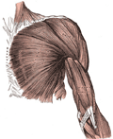
Basal Metabolic Rate (BMR)
BMR is the rate at which our body burns fuel (calories)
When we diet, our body adjusts by slowing down our BMR

Slide 4
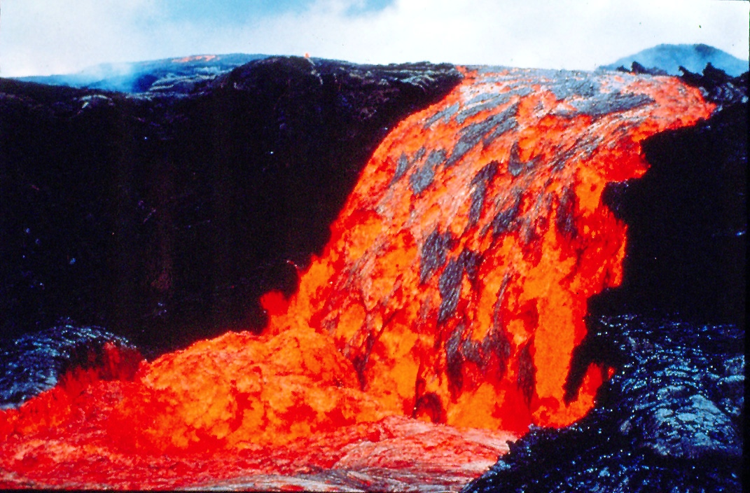

Slide 5


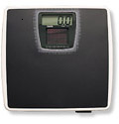
Why Target BMR?
Lean muscle mass requires more energy to sustain itself. You can burn more calories throughout the day and reach your weight management goals!
5 lbs lean muscle = 200 extra calories

Slide 6
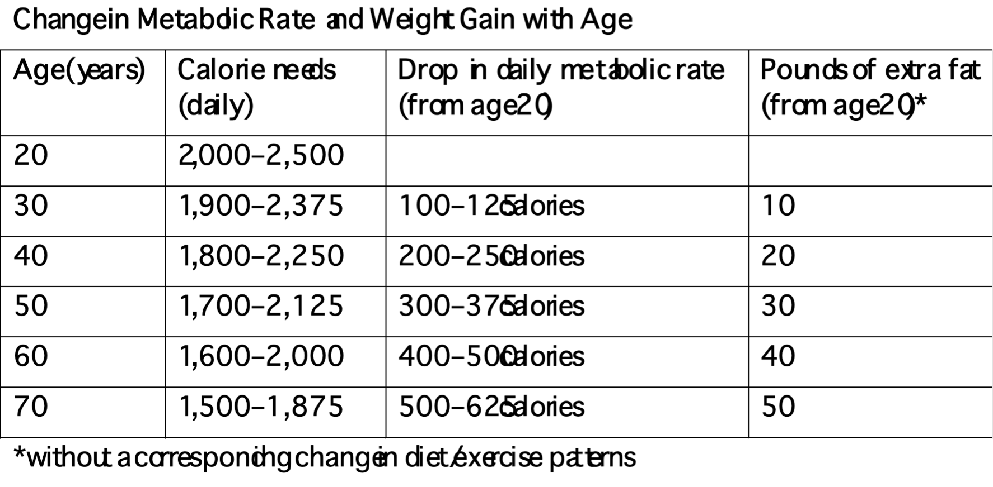
Metabolic Rate tends to Drop with Age

Slide 7

Aerobic Exercise
Ability to perform work in the presence of oxygen
Any movement that involves the large muscles groups
Raises the heart rate for an extended period of time
Recommendation: 20 minutes, 3x per week

Slide 8

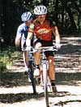


Aerobic Exercise
Running
Cycling
Power Walking
Hiking
Swimming
Aerobics

Slide 9
Interval Training
One approach to increasing caloric expenditure:
Alternates between high intensity and low intensity exercise
Warm-up
1 minute high / 1 minute low intensity
2 minutes high / 2 minutes low intensity
3 minutes high / 3 minutes low intensity
2 minutes high / 2 minutes low intensity
1 minute high / 1 minute low intensity
Cool-down
18 minutes of Interval Training

Slide 10
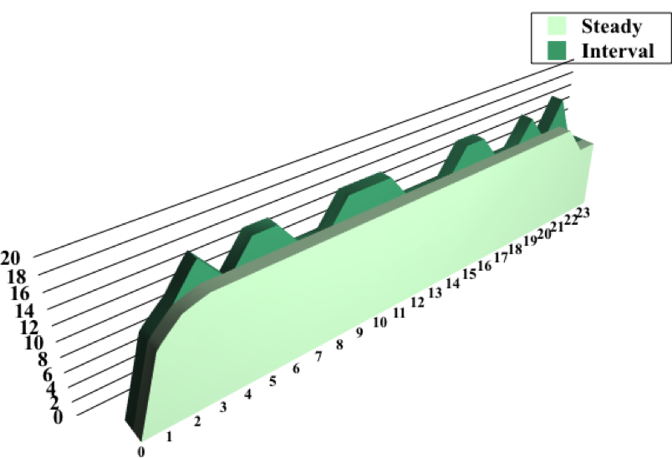
Interval Training vs. Steady State Exercise
More Total Work Accomplished
Higher Average Heart Rate
More Calories Expended
Higher Residual Caloric Expenditure (after)
Cool-down
401 calories
189 calories
Warm-up
20 minutes of exercise

Slide 11
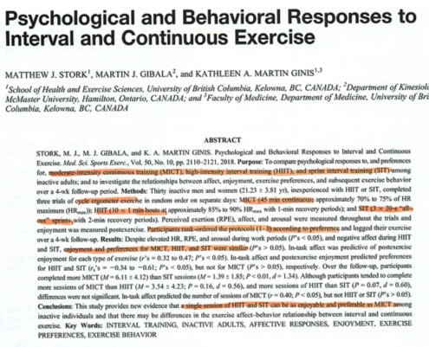

Slide 12

Strength Training
Builds lean muscle mass, which increases BMR
Tones and defines the muscles
Improves posture
Helps maintain bone mineral density

Slide 13
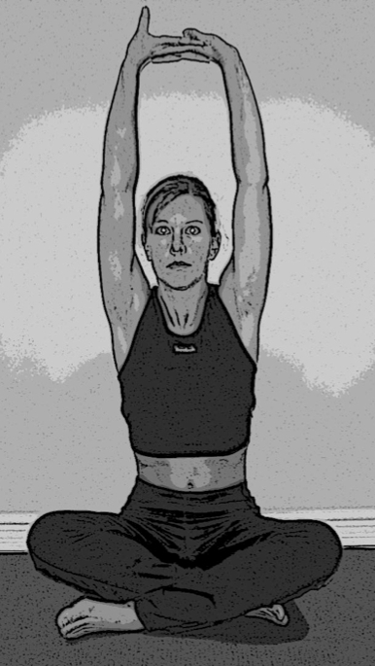
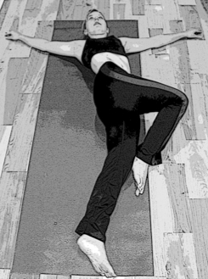
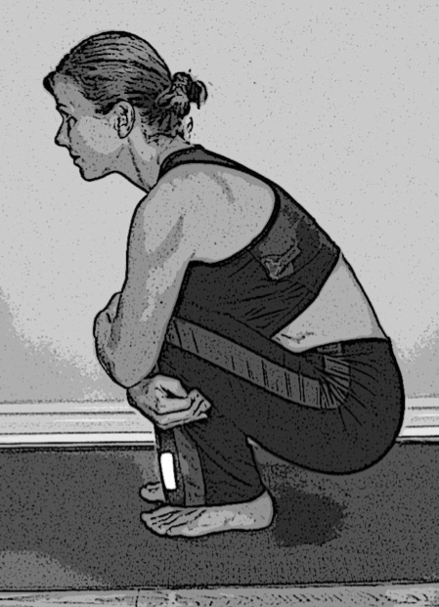
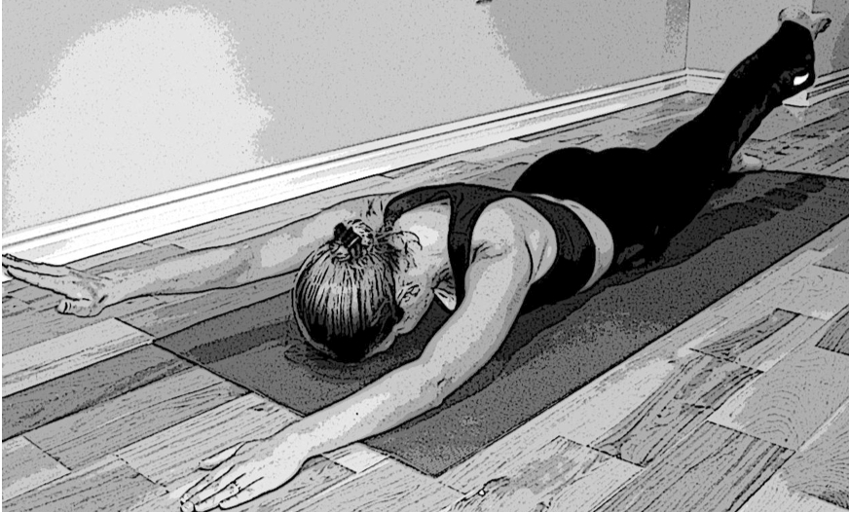
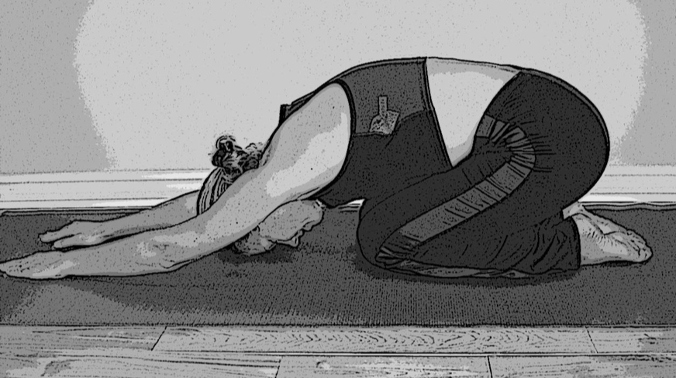
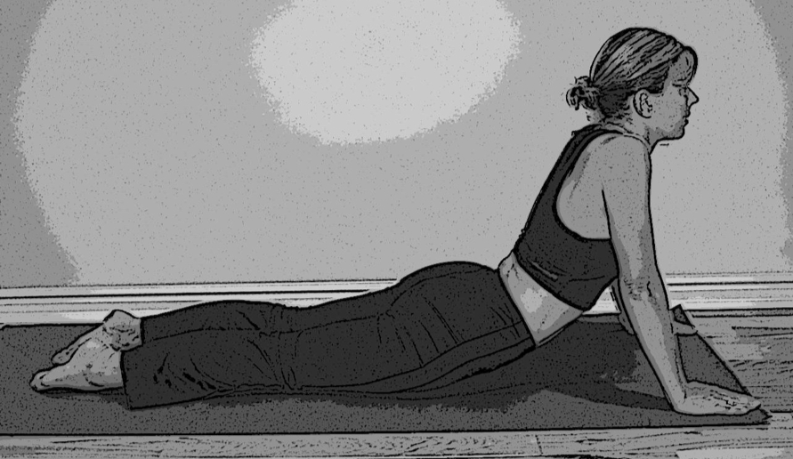
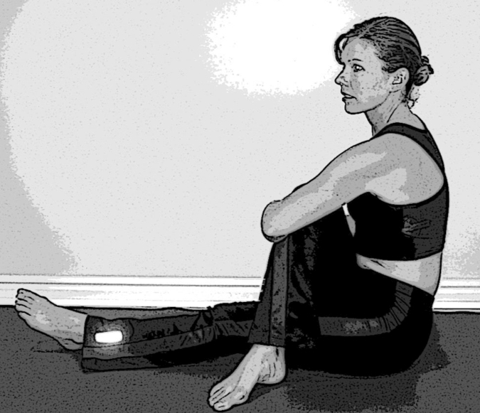
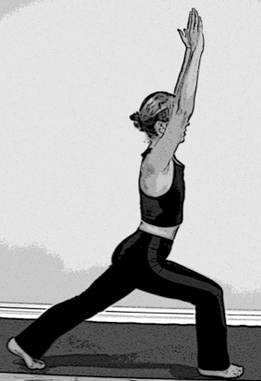
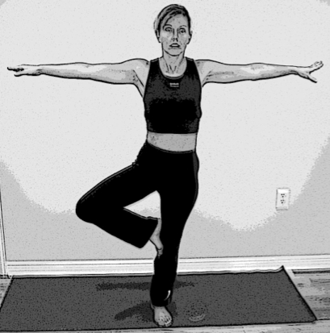
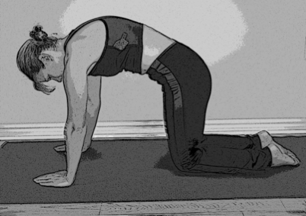
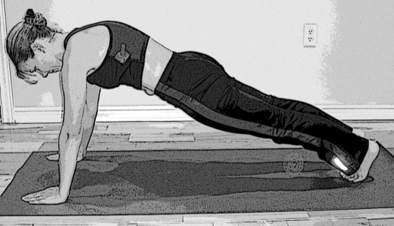
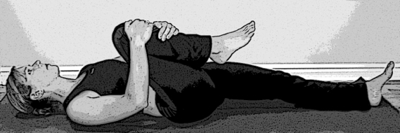
FlexSkills

Slide 14
