Slide 1
Project B3 PILOT Overview
Shawn Talbott, PhD

Slide 2


Slide 3


Slide 4
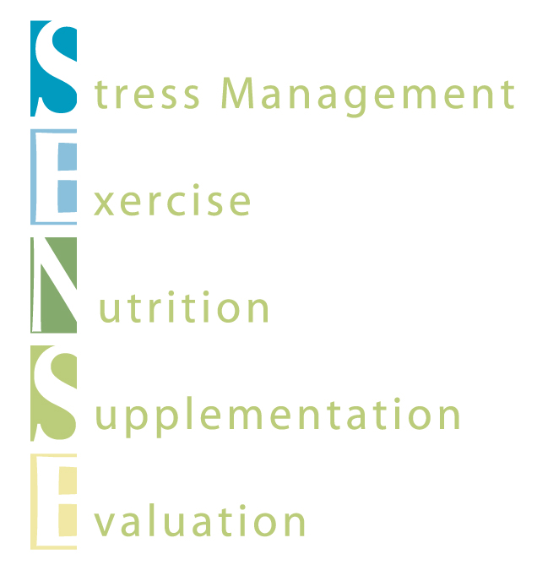

Slide 5


Slide 6
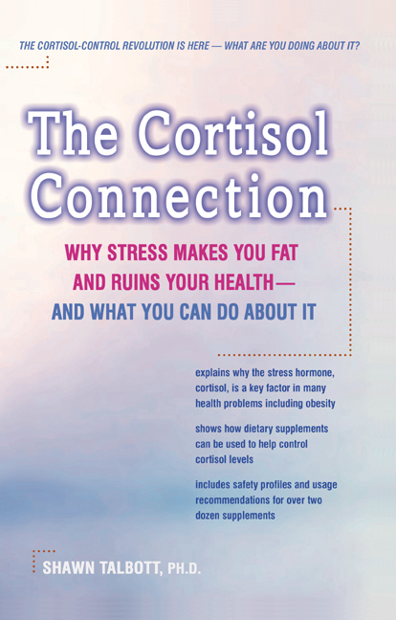
  The SENSE Program
  Stress / Sleep Management Techniques
    Meditation, Coping strategies, etc…
  Exercise
      Daily, moderate aerobic and strength training
  Nutrition
      Balance carbohydrates with protein
      Maintain adequate hydration
      Limit caffeine (200-300mg/day = 2 Starbucks)
  Supplements
      Avoid stimulants
      Cortisol-controlling supplements (Calcium, Vitamin C...)
      Relaxation supplements (Magnolia bark, Theanine…)
      Gut-Brain-Axis supplements (Probiotics, Prebiotics, Phytobiotics…)
  Evaluation (every week/month to see how you are doing)

Slide 7
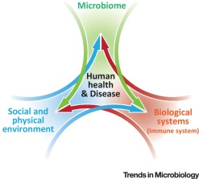
Biome
Body
Brain

Slide 8
What Benefits Should I Expect?
Improve Gut Health
Balance Microbiome
Optimize Gut-Brain-Axis Function
Reduce Stress
Improve Vigor
Boost Energy
Maximize Sleep Quality
Sharpen Mental Clarity
Enhance Skin Tone
Reduced Cravings
Improve Body Composition = Fat/Lean

Slide 9
Topic Schedule
Nov 1 (week 0) = Overview
Nov 8 (week 1) = Reboot/Biome
Nov 15 (week 2) = Body/Brain
Nov 22 (week 3) = OFF – Thanksgiving
Nov 29 (week 4) = Stress / Sleep
Dec 6 (week 5) = Exercise
Dec 13 (week 6) = Nutrition
Dec 20 (week 7) = Supplementation
Dec 27 (week 8) = Evaluation
Jan 3 = start 2019 RIGHT!

Slide 10
Recommended “Core” Products
Reboot+
FundaMentals (MentaBiotics, MentaFocus, MentaSync)
GBX Protein (1-2)
GBX SuperFood (1-2)
GBX SeedFiber (1-2)
VitaGBX
Optional (but highly recommended)
    Mood+
    Sleep+
    Energy+
Optional (but encouraged)
                OmMega (optional)
                Digestive (optional)
                Probiotics (optional)

Slide 11

Effect of a 8-week Lifestyle Program on Weight, Metabolism, and Blood Lipids in Overweight Subjects
S. M. Talbott, A.M. Christopulos, & C. Ekberg
SupplementWatch, Inc. & Treehouse Athletic Club
Salt Lake City (Draper), Utah

Slide 12
METHODS
Thirty-two subjects started the program and 29 completed the program (21 women & 8 men) = 9% attrition rate
Weekly group educational seminars (SENSE)
  Stress management - yoga, guided imagery, deep breathing, etc.
  Exercise - customized by CPT - 5d/wk (3 aerobic/2 strength)
  Nutrition - based on RMR for no more than 500 kcal/d deficit
  Supplementation - Citrus polymethoxylated flavonoids (150mg) + Eurycoma longifolia extract (50mg)
  Evaluation - identification of stressful events and interventions
Baseline Characteristics
Age (y)
BW (kg)
BF (%)
BMI
N = 29
44 + 8
84.1 + 39.5
35.1% + 9.9%
29.5 + 5.6

Slide 13
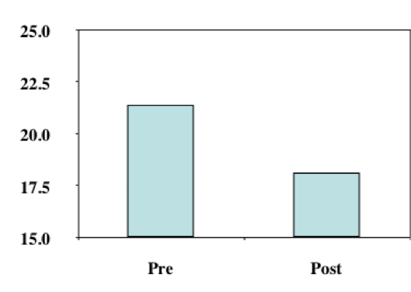
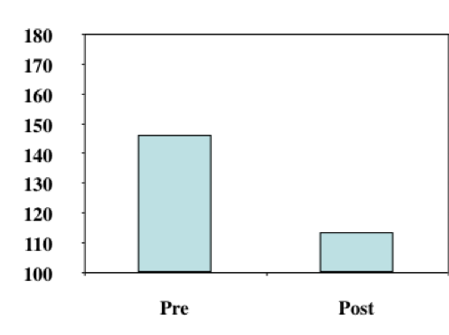
RESULTS
Global Mood State & Subjective Stress Levels
Global Mood State (POMS)
Subjective Stress
22% improvement
14% improvement
Both, p < 0.05 compared to pre value

Slide 14
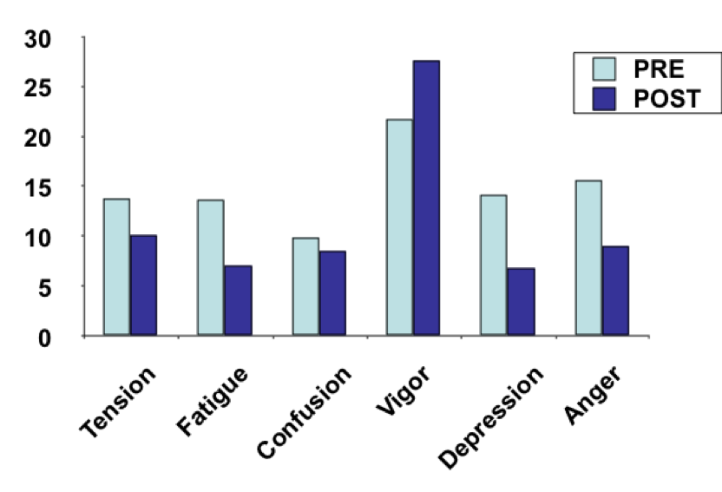
RESULTS
Profile of Mood States (POMS)
+27%
-48%
-52%
-42%
-27%
-14%
All, p < 0.05 compared to pre value

Slide 15
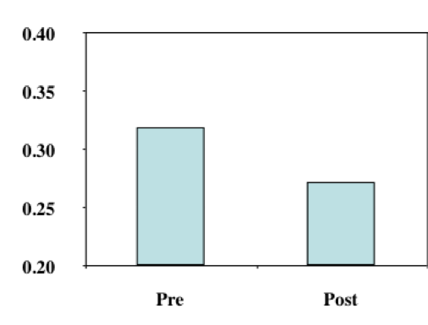
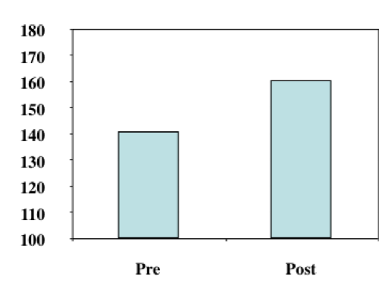
RESULTS
Salivary Testosterone & Testosterone:Cortisol Ratio
Testosterone (pg/mL)
C:T Ratio (x100)
+14%
-15%
Both, p < 0.05 compared to pre value

Slide 16
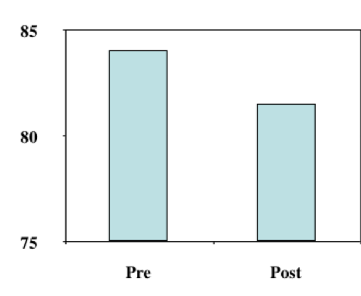
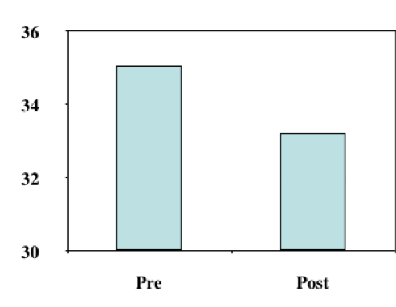
RESULTS
Body Weight & Body Fat Percentage
Body Weight (kg)
Body Fat (%)
-2.5kg
-1.9%
Both, p < 0.05 compared to pre value

Slide 17
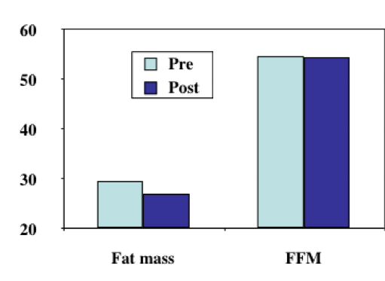
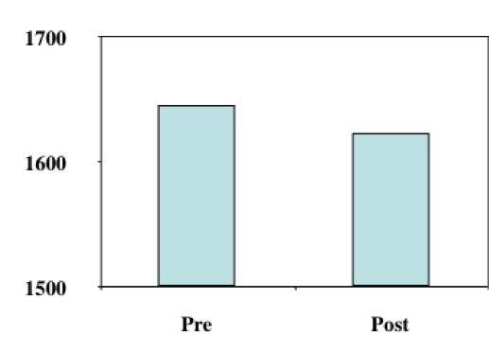
RESULTS
Body Composition & Resting Metabolic Rate
Fat Mass & Lean Mass (kg)
RMR (kcal)
-0.1kg (NS)
-23 kcal (NS)
-2.4kg
Fat Mass, p < 0.05 compared to pre value

Slide 18
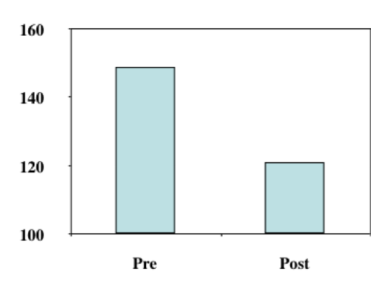
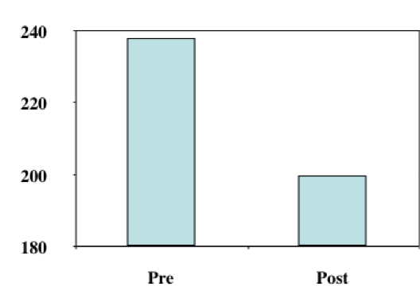
RESULTS
Serum Total Cholesterol & LDL
Total Cholesterol (mg/dL)
LDL (mg/dL)
-16%
-20%
Both, p < 0.05 compared to pre value

Slide 19
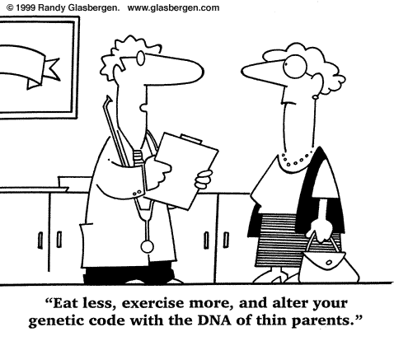
What causes weight gain/loss?
Calories “IN” versus Calories “OUT”
Appetite regulation
“Metabolic Rate” (??)
Genetics??
Habits??
Society??
“Toxic Environment”

Slide 20
Virtually any diet will help you lose weight
Diet Program
Concept
Calories
Atkins
High protein/fat, Low carb
~1,500-1,800
Keto
High protein/fat, Low carb
~1,500-1,800
Zone (Sears)
Moderate 40/30/30
~1,500-1,800
Pritikin
Low fat, high carb
~1,500-1,800
Ornish
Low fat, high carb (vegan)
~1,500-1,800
South Beach
High protein/fat, Low carb
~1,500-1,800
Paleolithic
High protein/fat, Low carb
~1,500-1,800
Weight Watchers
Low fat, balanced protein/carbs
~1,500-1,800

Slide 21
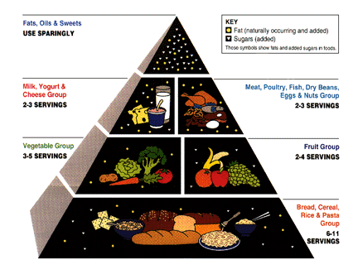

Slide 22
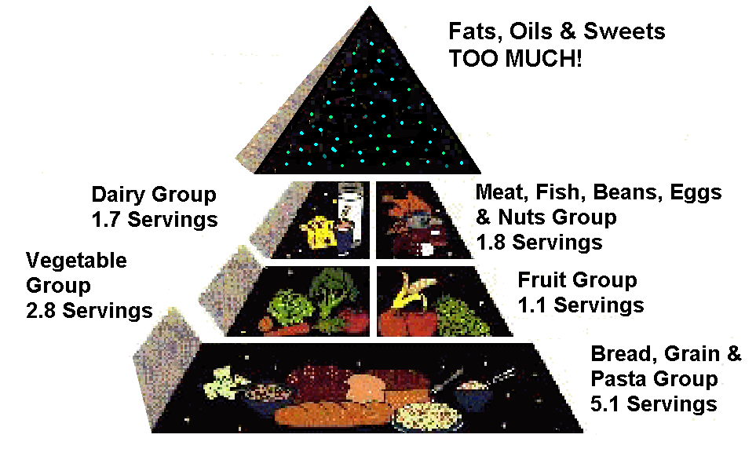

Slide 23
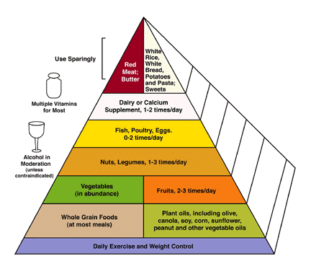

Slide 25


How effective is exercise for weight control?
Exercise needed to promote negative energy balance
  A LOT! (more than most of us do).
  Taco Bell Burrito = 5 mile run
  12 Hershey kisses = 30 min Lap swimming
  6 Oreos = 30 min brisk walking
  Researchers at the U Virginia have determined 250,00 crunches needed to burn 1 pound of fat. (100 crunches per day……………….…for 7 years!)
  Duke University study = 30m/d brisk walking needed to PREVENT weight gain
    no exercise = 2.5lbs gain in 8 months
    jog 17 mile /week = 10lbs fat loss (in 8 months)
    Average is 1lb fat gain/yr from age 25-55y
  Moral = exercise alone stinks for weight loss
You MUST cut calories from the diet

Slide 26
National Weight Control Registry
Database of 3,000+ “successful losers”
  30lb. weight loss maintained for 1+ years (avg. = 66lbs)
  60-80 min/day of physical activity
  1500-1800 calories/day
Get a buddy!
  Participating with friends = 33% more weight loss and 2-3x better maintenance (versus solo dieters)
  E-mail correspondence = doubles your weight loss (JAMA, April 2003)

Slide 27
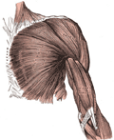
Basal Metabolic Rate (BMR)
BMR is the rate at which our body burns fuel (calories)
When we diet, our body adjusts by slowing down our BMR

Slide 28


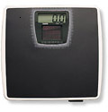
Why Target BMR?
Lean muscle mass requires more energy to sustain itself. You can burn more calories throughout the day and reach your weight management goals!
5 lbs lean muscle = 200 extra calories

Slide 29
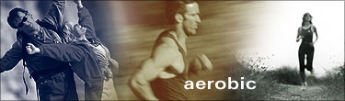
Aerobic Exercise
Ability to perform work in the presence of oxygen
Any movement that involves the large muscles groups
Raises the heart rate for an extended period of time
Recommendation: 20 minutes, 3x per week

Slide 30

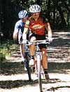


Aerobic Exercise
Running
Cycling
Power Walking
Hiking
Swimming
Aerobics

Slide 31
Interval Training
One approach to increasing caloric expenditure:
Alternates between high intensity and low intensity exercise
Warm-up
1 minute high / 1 minute low intensity
2 minutes high / 2 minutes low intensity
3 minutes high / 3 minutes low intensity
2 minutes high / 2 minutes low intensity
1 minute high / 1 minute low intensity
Cool-down
18 minutes of Interval Training

Slide 32
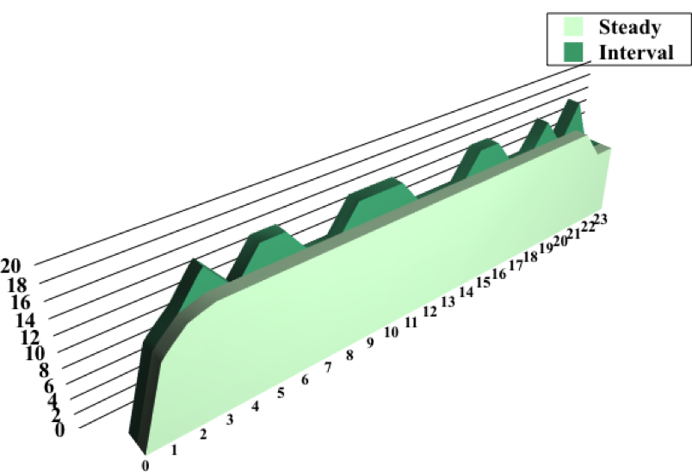
Interval Training vs. Steady State Exercise
More Total Work Accomplished
Higher Average Heart Rate
More Calories Expended
Higher Residual Caloric Expenditure (after)
Cool-down
401 calories
189 calories
Warm-up
20 minutes of exercise

Slide 33

Strength Training
Builds lean muscle mass, which increases BMR
Tones and defines the muscles
Improves posture
Helps maintain bone mineral density

Slide 34
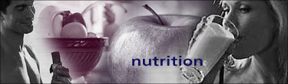
Nutrition
5-6 well-proportioned meals/snacks
Portion of protein and carbohydrates and fat
Unlimited fruits & vegetables
Protein for lean muscle maintenance
Carbohydrate for energy and metabolism
Fat for flavor & satiety
Fiber for digestion & satiety

Slide 36

Carbohydrates
Carbohydrates are the body’s main source of energy
Carbohydrates are broken down in the body to glucose
“Fat Burns in the Flame of Carbohydrate”

Slide 37
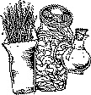
Soluble/Insoluble Fiber
Recommended intake is 25-35 grams per day
Absorbs water in the intestines, providing a feeling of fullness
Slows down the absorption of carbohydrates
Good for digestion and intestinal health
Supports microbiome balance (prebiotics)

Slide 38
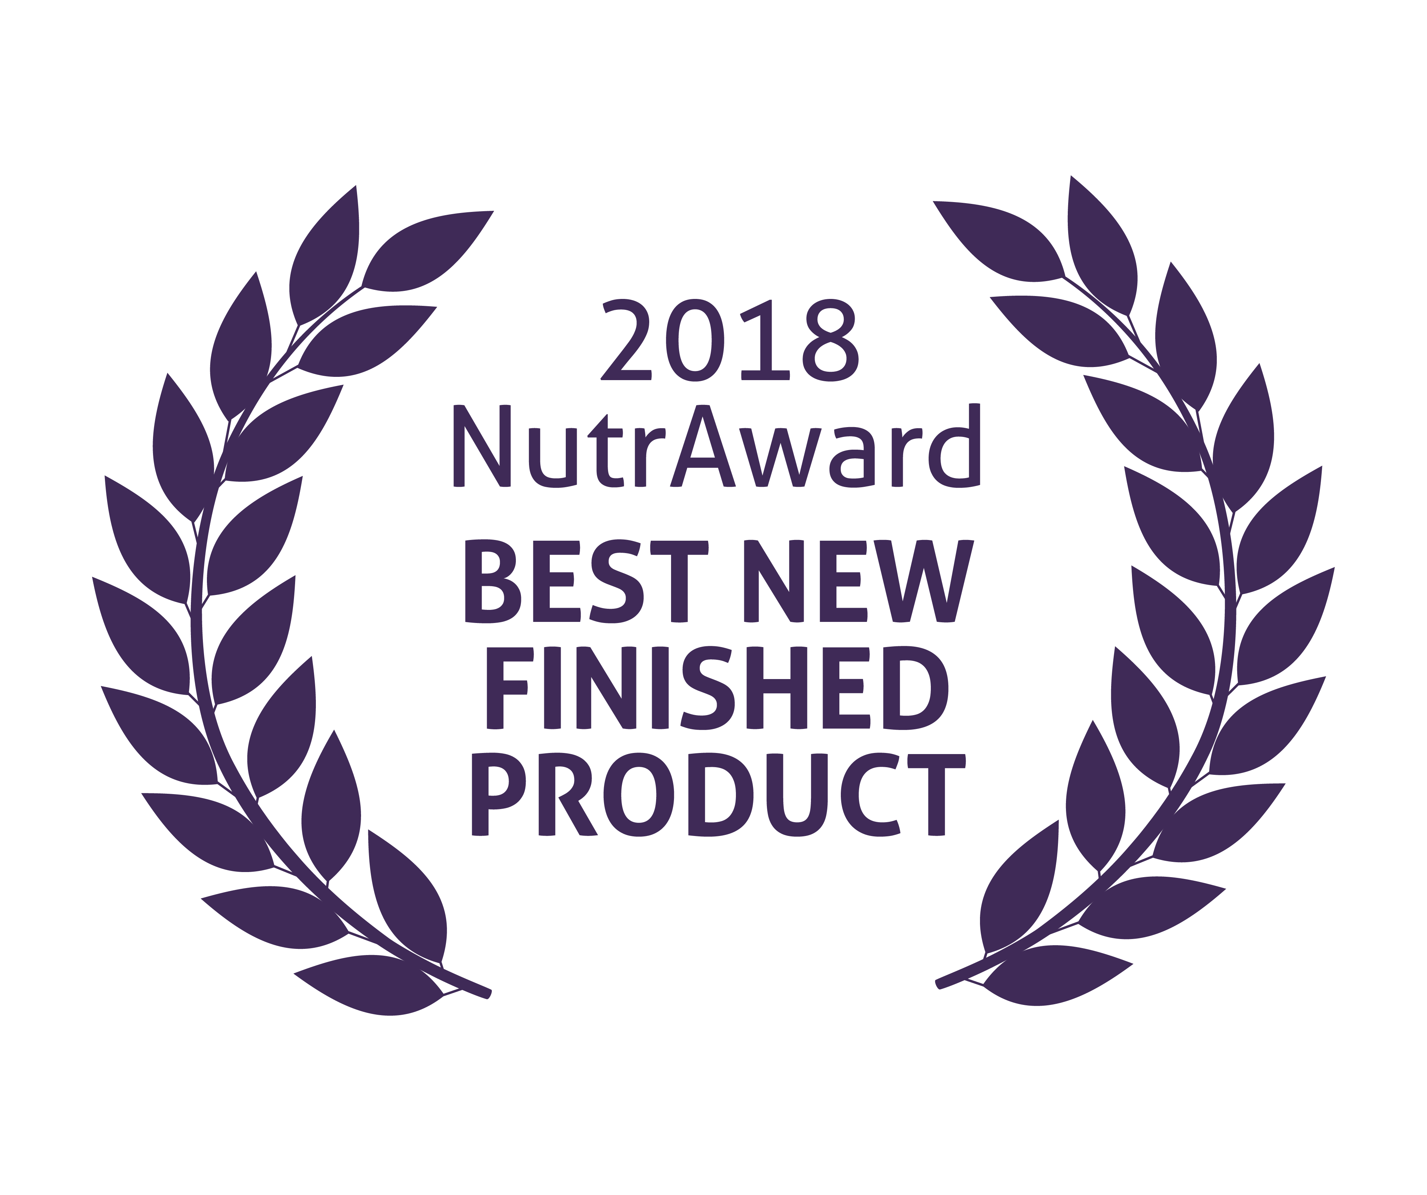

World’s First Award-Winning
Gut-Brain Axis Nutrition System!
The NutrAward recognizes companies that are investing in rigorous and measurable scientific studies to prove the efficacy of their proprietary ingredients or technologies.
Submissions are judged on their merit in the following areas:
Viable product
Emerging category
Creative product concept
Distinct health application
Unique packaging
Matchless marketing

Slide 39



Microbiome-Boosting Nutrition*
REBOOT with GBX FOODS
™
Benefits:
No more wasting time grocery shopping.
Saves you money!
Takes the hassle out of planning for your Reboot.
Convenient — products sent to straight to your door step.
Provides the microbiome-boosting nutrition you need every day.
Quick, easy, delicious products.
*These statements have not been evaluated by the Food and Drug Administration. This product is not intended to diagnose, treat, cure, or prevent any disease.

Slide 40
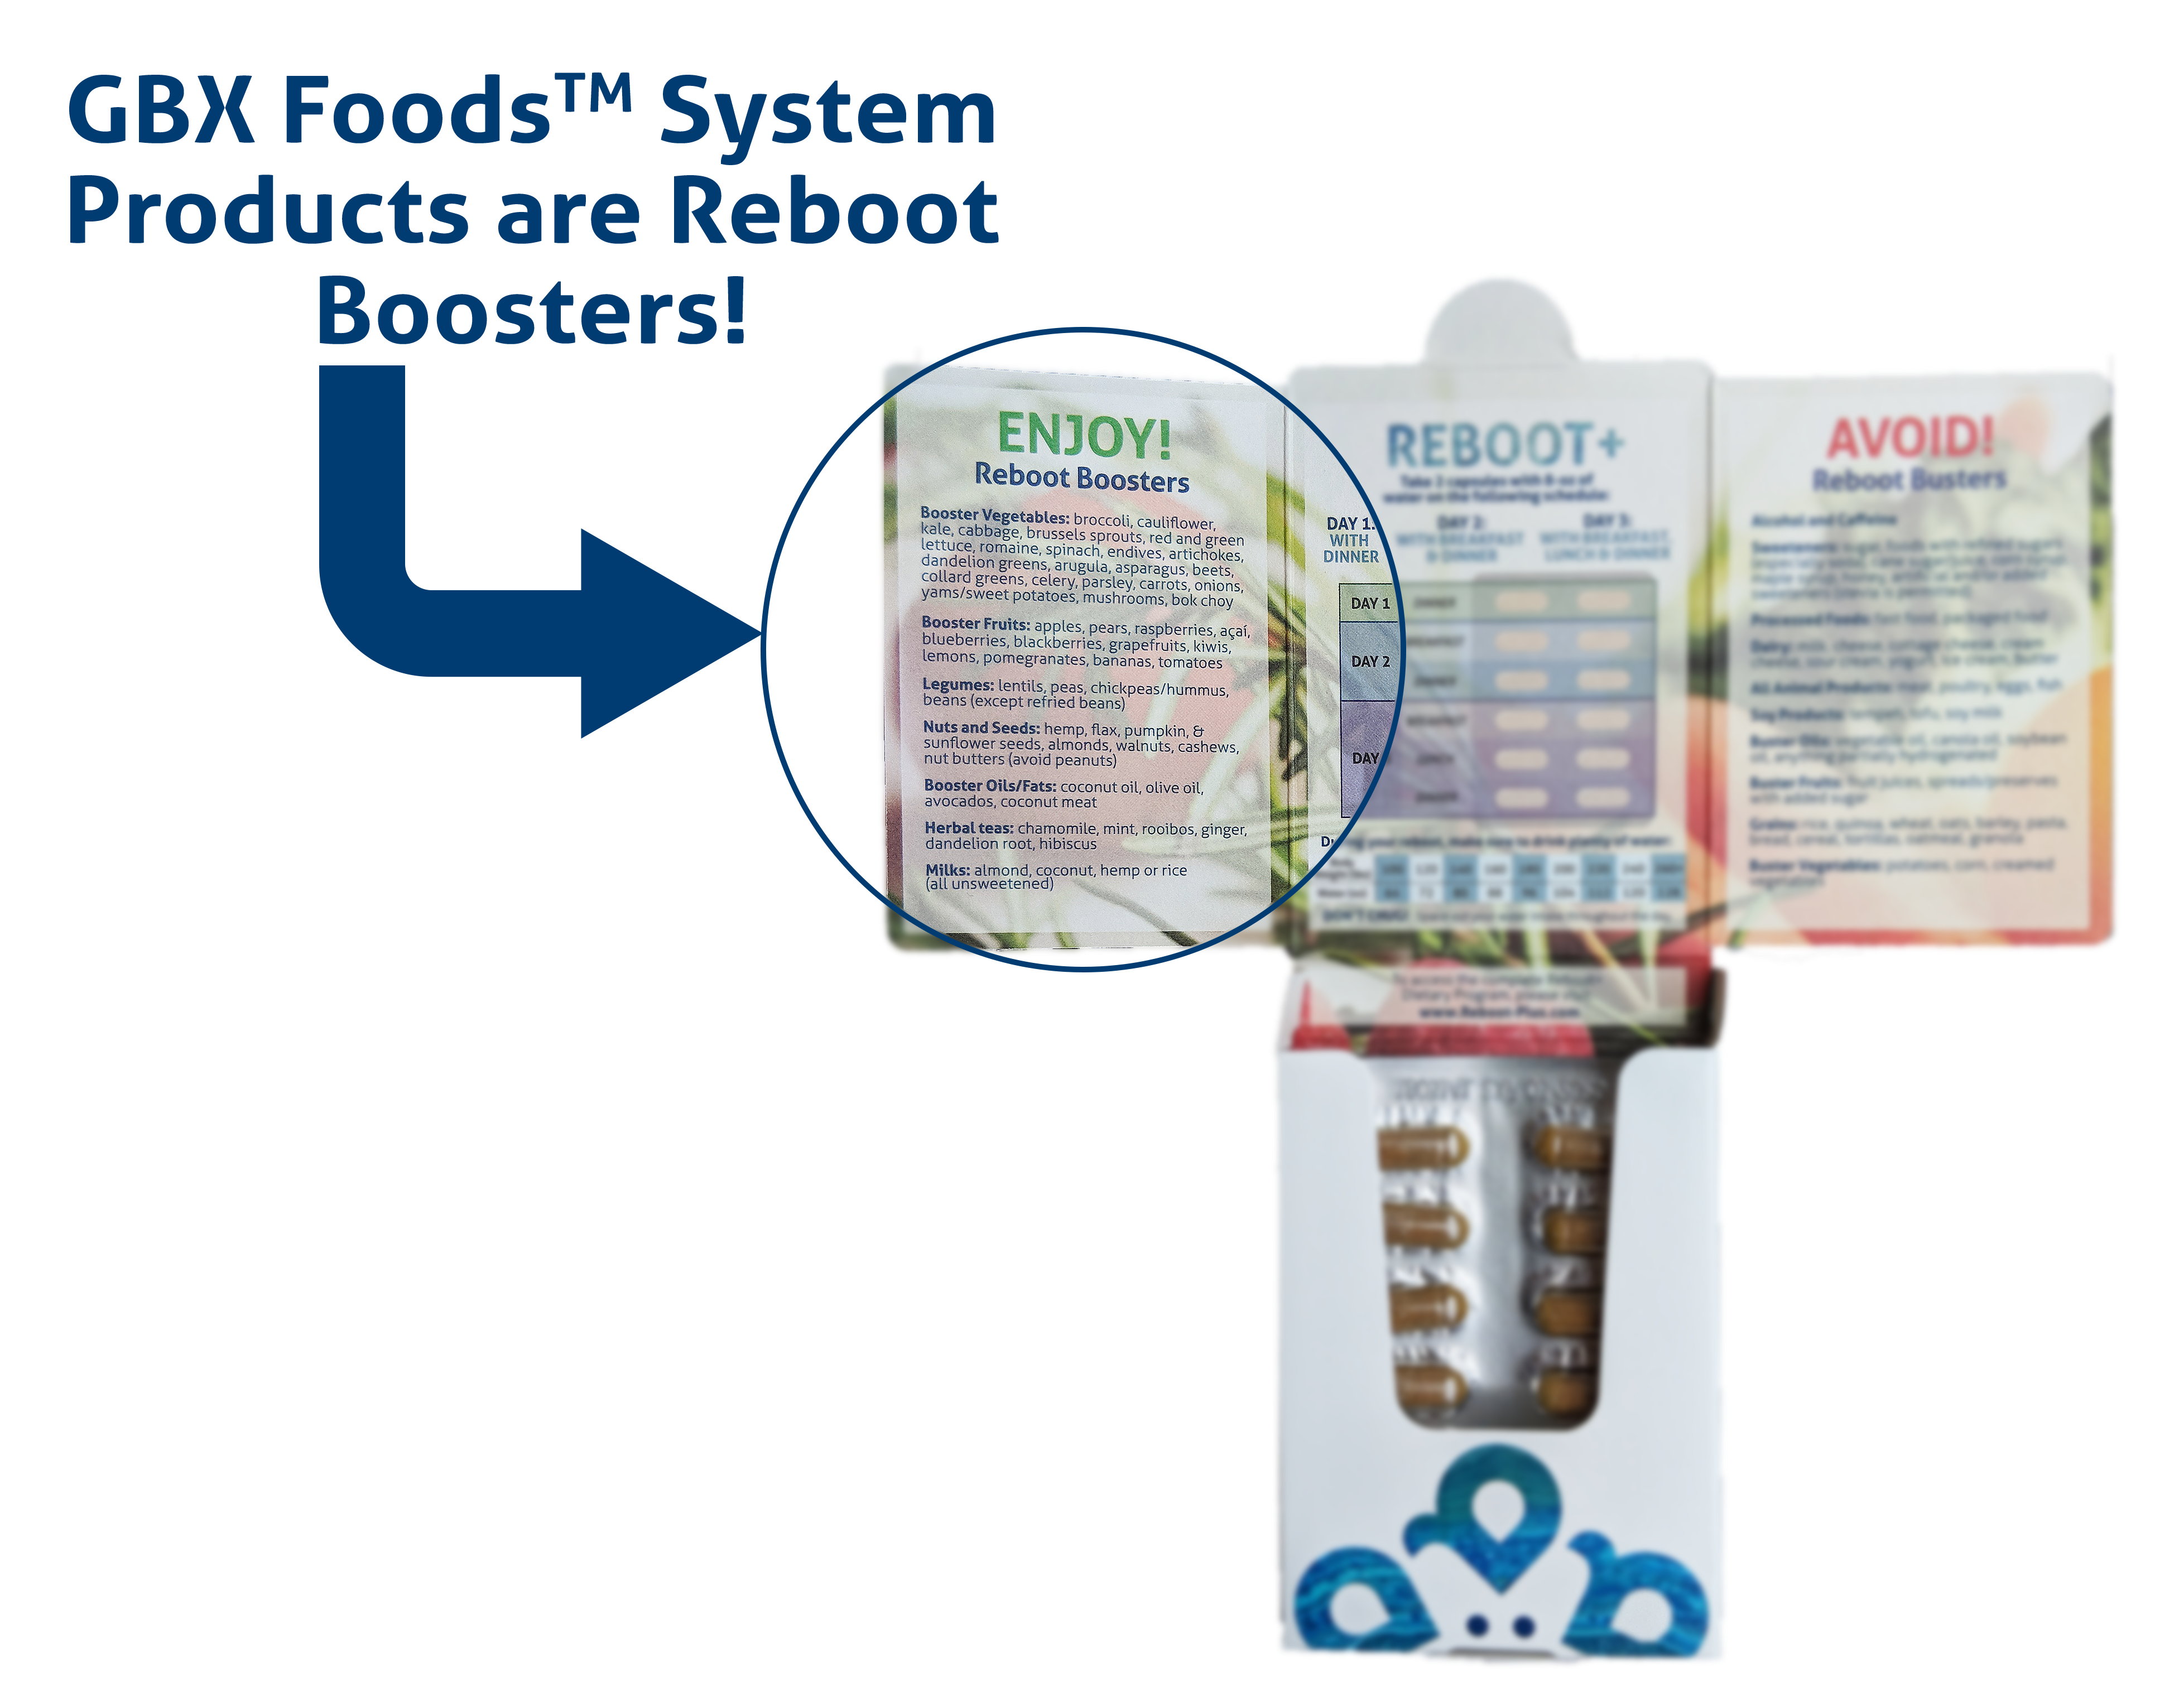
Microbiome-Boosting Nutrition*
GBX FOODS ARE REBOOT-FRIENDLY
™
*These statements have not been evaluated by the Food and Drug Administration. This product is not intended to diagnose, treat, cure, or prevent any disease.

Slide 41

Small + Simultaneous + Sustained = Success!
Microbiome
Serotonin
Cortisol
Norepinephrine
Blood sugar
Thyroid hormones
Thermogenesis

Slide 42
Topic Schedule
Nov 1 (week 0) = Overview
Nov 8 (week 1) = Reboot/Biome
Nov 15 (week 2) = Body/Brain
Nov 22 (week 3) = OFF – Thanksgiving
Nov 29 (week 4) = Stress / Sleep
Dec 6 (week 5) = Exercise
Dec 13 (week 6) = Nutrition
Dec 20 (week 7) = Supplementation
Dec 27 (week 8) = Evaluation
Jan 3 = start 2019 RIGHT!

Slide 43
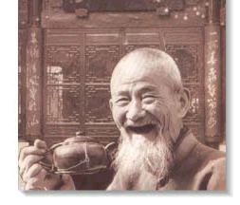
GOOD
HEALTH!

