Slide 1
Project B3 PILOT
Stress / Sleep
Shawn Talbott, PhD

Slide 2
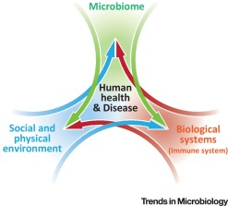

Biome
Body
Brain
THE MENTAL WELLNESS COMPANY

Slide 3
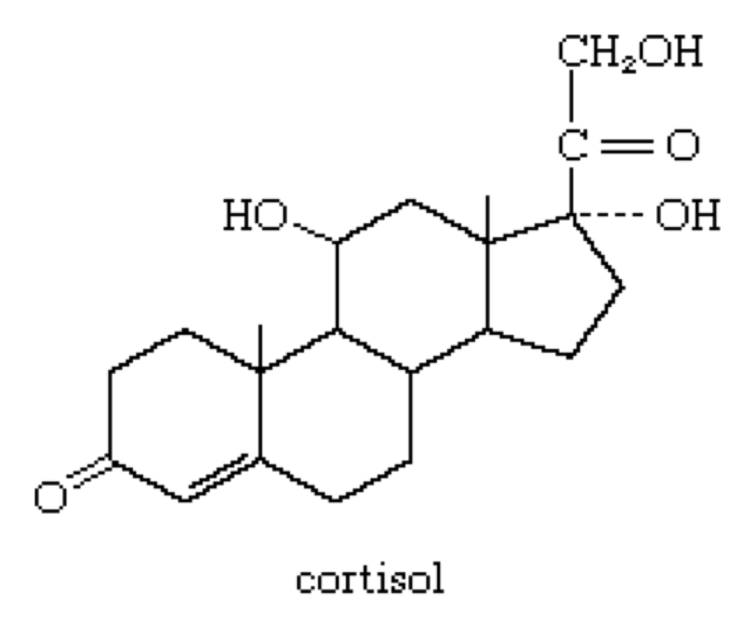
What is Cortisol?
Cortisol is the body’s primary stress hormone
  “Fight-or-Flight” response
  Regulates inflammation, carbohydrate metabolism, blood pressure, cardiovascular function, etc…
BUT too much cortisol for too long leads to problems
Analogy...
Cholesterol: hormone synthesis and cell membrane structure
Too much cholesterol: leads to arterial plaque and heart disease (bad)
Solution: control cholesterol (reduce it, don’t obliterate it)

Slide 4
STRESS
ACUTE STRESS
brief
normal circadian rhythm
adaptive
CHRONIC STRESS
prolonged & repeated
disrupted circadian rhythm
maladaptive

Slide 5
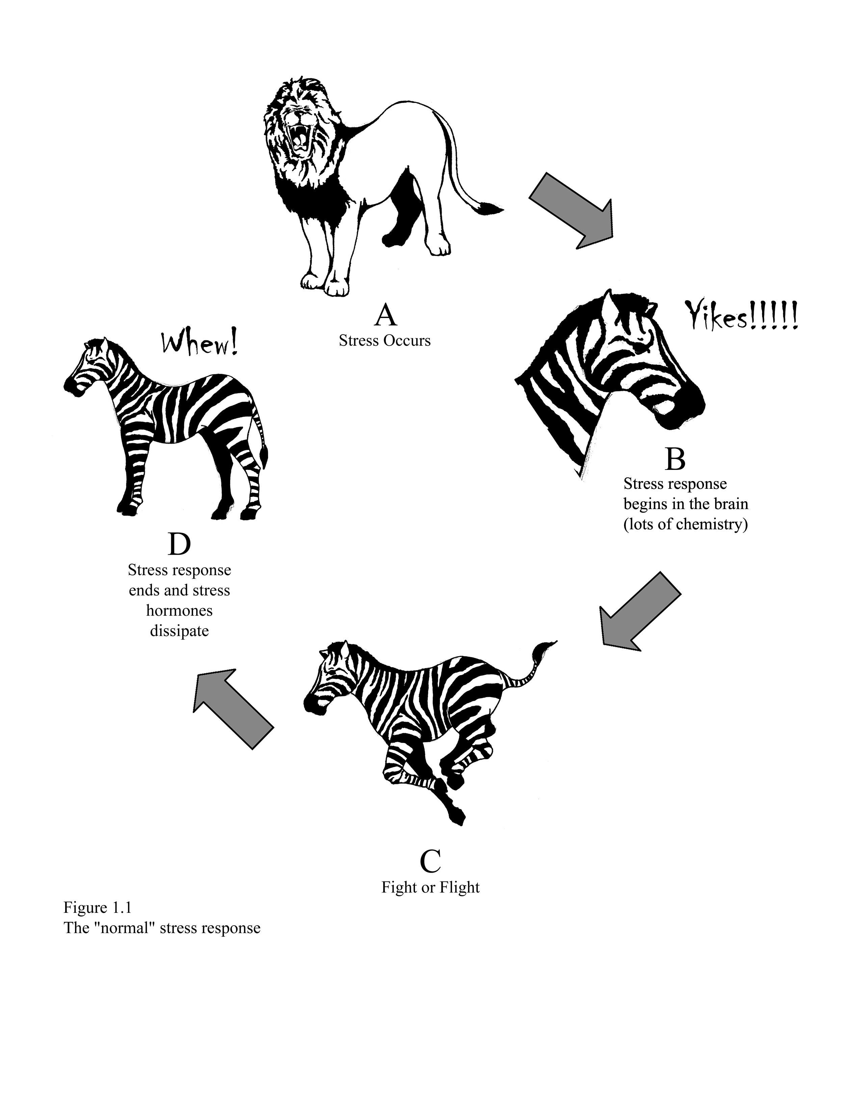

Why Zebras Don’t Get Ulcers…
Robert Sapolsky, PhD
Stanford University
Stress Physiology

Slide 6
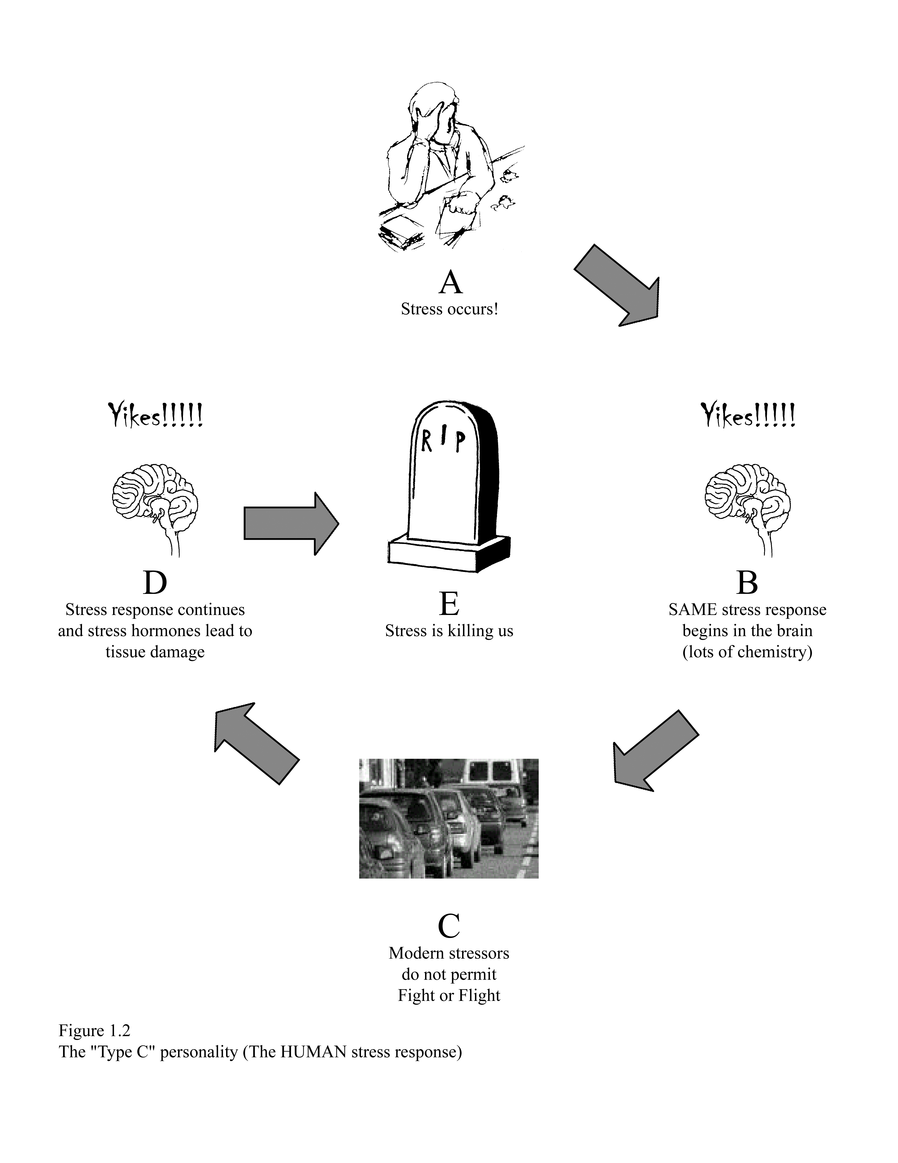
Humans are not Zebras…
…and are not meant to harbor chronic stress

Slide 7
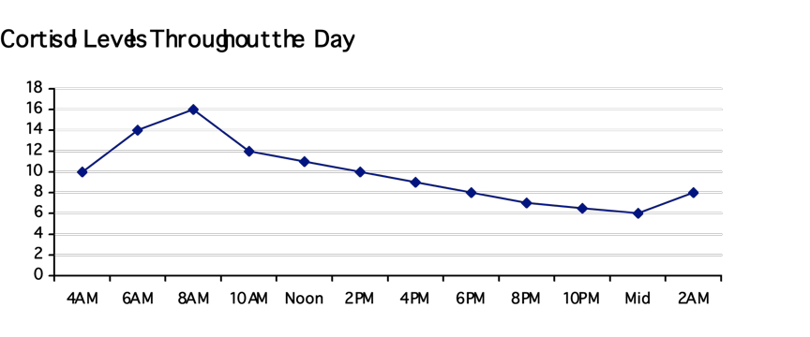
“Normal” Diurnal Cortisol Rhythm

Slide 8
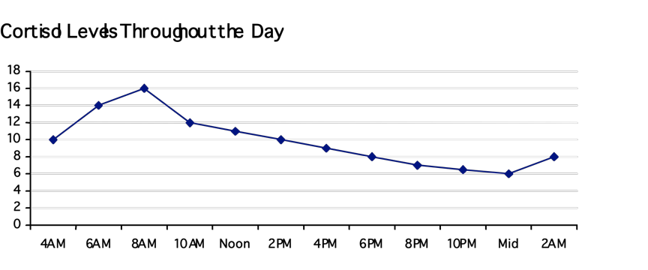
“Modern” Cortisol Rhythm
Rush kids to school
Errands Work Stress
Rush home for dinner

Slide 9

Psycho-Neuro-Immunology
stress
anxiety
conflict
depression
personality
bereavement
nervous system
endocrine system
immune system
HEALTH

Slide 10
Prevalence of Chronic Stress
Studies show that 50-60% of all lost working days are related to stress
Work-related stress costs the EU more than 265 billion Euros annually
Chronic stress is an important determinant of depression, heart disease, diabetes, and syndrome X
Stress contributes to half of all illnesses in the U.S.
70-80% of all doctor visits are for stress-related illnesses
More than half of all deaths before age 65 result from stressful lifestyles
Generalized anxiety disorder affects approx 183 million people worldwide
People with high anxiety are 4.5x more likely to die of a heart attack or stroke
80% of workers report feeling stress on the job
Sources:
Working on Stress - European Agency for Safety and Health at Work (http://agency.osha.eu.int)
U.S. Center for Disease Control
World Health Organization; www.whmc.af.mil
Gallup Poll “Attitudes in the American Workplace”

Slide 11
Conditions Linked to Cortisol Dysregulation
Obesity
Appetite Regulation
Diabetes/Metabolic Syndrome X
Cardiovascular Dysfunction
Hypertension
Impaired Immune Response
Premenstrual Syndrome
Menopausal Symptoms
Osteoporosis
Depression (some)
Anxiety disorders (some)
Memory/Learning Impairment
Mania
Acne/Skin Wrinkling
Sleep deprivation
Chronic migraine headaches
Cushing’s syndrome
Hyperthyroidism
Atypical seasonal depression
Chronic fatigue syndrome
Fibromyalgia
Hypothyroidism
Nicotine withdrawal
Rheumatoid arthritis
Based on data from G. Chrousos and P. Gold, NIH, and B. McEwen, Rockefeller

Slide 12
Elevated Cortisol, Obesity & Metabolic Syndrome
High cortisol secretion is associated with abdominal fat
Abdominal fat is most highly associated with illness and death from:
  cardiovascular disease, diabetes, and metabolic syndrome,
  including hypertension, hyperlipidemia, hyperinsulinemia,
  and insulin resistance¹
High cortisol secretion may be a contributing factor to the abnormal metabolism often seen in abdominal obesity²
1. Peeke PM, Chrousos GP. Ann NY Acad Sci 1995;771:665-76.
2. Bjorntorp P, Rosmond R. Nutrition 2000;16(10):924-36.

Slide 13
Abdominal Obesity & Stress-Related Cortisol
Abdominal Obesity
Stress-related cortisol
24
P<0.05
0.5
P<0.05
22.5
±3.7
0.34
±0.5
23
0.4
21.5
±4.1
cm
22
nmol/L
0.3
20.6
±2.2
0.15
±0.6
21
0.2
0.04
±0.3
20
0.1
19
0
<10
11-20
>21
<10
11-20
>21
Years in work
Rosmond, et al. Obes Res 2000;8:445-450.

Slide 14
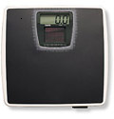
Elevated Cortisol and Appetite
Women with high cortisol response (compared to a low cortisol response):
    consumed more calories
    ate significantly more sweet foods
    had more negative moods
High dietary restraint is associated with high urinary cortisol excretion
    Dietary Restraint = Consciously trying to limit food intake
    to achieve or maintain a desired body weight
1. Epel ES, et al. Psychoneuroendocrinology 2001;26:37-49.
2. McLean JA, Barr SI, Prior JC. Am J Clin Nutr 2001;73:7-12.

Slide 15

Additional Research
Elevated Cortisol and Osteoporosis
High cortisol excretion associated with high dietary restraint may cause long-term implications for bone health through the effect on ovulatory function.¹
Elevated Cortisol and Depression
Fifty percent of women suffering from depression have high cortisol²
Additional research has also focused on cardiovascular disease, diabetes, mental function, and fatigue
1. McLean JA, Barr SI, Prior JC. Am J Clin Nutr 2001;73:7-12.
2. Sheline YI, et al. J Neuroscience 1999;19(12):5034-5043.

Slide 16
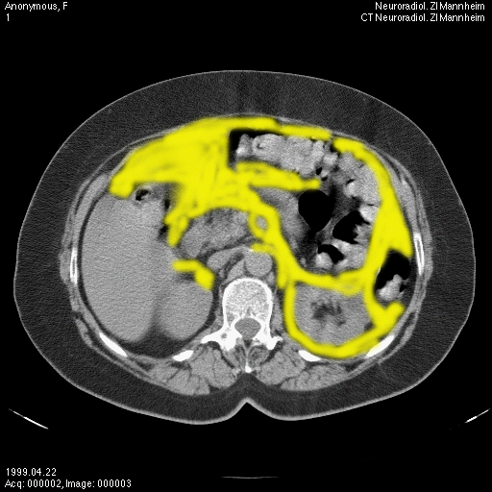
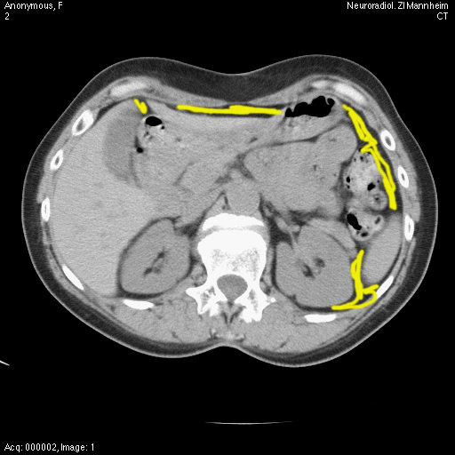
Abdominal Fat Accumulation
High Stress / High Cortisol
Normal Stress / Normal Cortisol

Slide 17
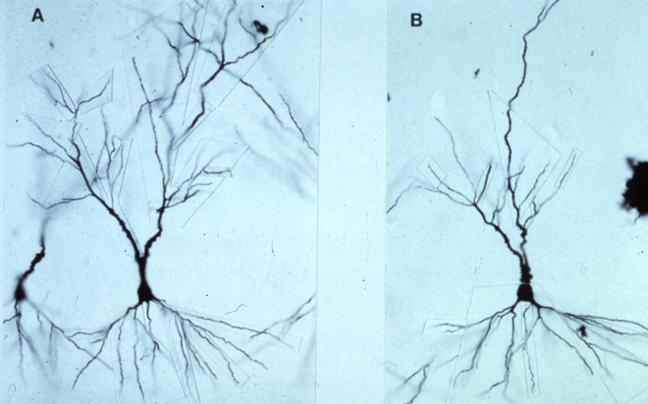
Neuronal Atrophy
(dead brain cells)
Normal Stress / Normal Cortisol
Healthy, Large, Many Projections, Optimal Function
High Stress / High Cortisol
Small, Thin, Disrupted
Structural Damage, Poor Function

Slide 18

Cortisol Levels Are Elevated In...
  Chronic Stress
  Sleep Deprivation
  Dieting / Restrained Eating

Slide 19
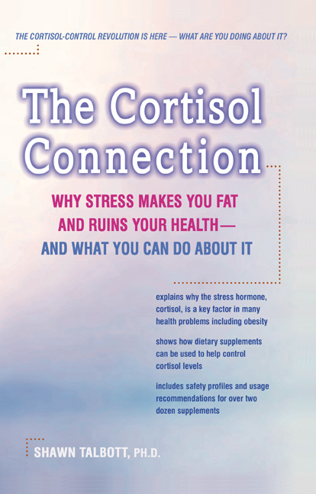
  You can control cortisol levels via:
Stress / Sleep Management Techniques
Exercise
Nutrition
Supplements
  Evaluation (every month to see how you are doing)

Slide 20
% Change in Abdominal Fat After CBSM
Treatment
Control
1.0
0.5
0.0
-0.5
Abdominal Fat (%)
-1.0
-1.5
*
-2.0
-2.5
TREATMENT
baseline
post-tx (3 mo.)
follow-up (6 mo.)
Time
F=9.7, p< .008
Epel et al. Psychosom Med 2000;62(5):623-32.

Slide 21

Why control blood-sugar levels?
Enhances fat burning
Enhances appetite control
“too high” = fat burning stops because you have all that sugar in your system
“too low” = body stops burning fat because it lacks enough glucose to “prime” your metabolic fat-burning engine
“too low” = sets off alarm bells in the brain (which relies on glucose as its primary fuel source), and the brain responds with its own set of signals that increase your appetite — especially for more carbohydrates.

Slide 22
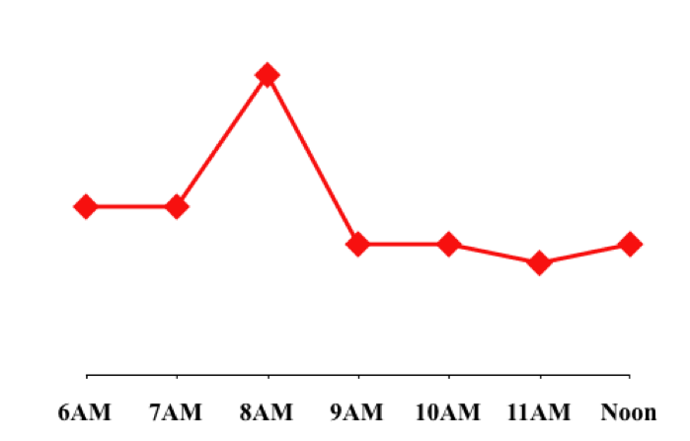
The Glycemic Response
Insulin Surge!
Eat
Desirable range
after eating
Blood glucose Level
HUNGER!
CRAVINGS!

Slide 23
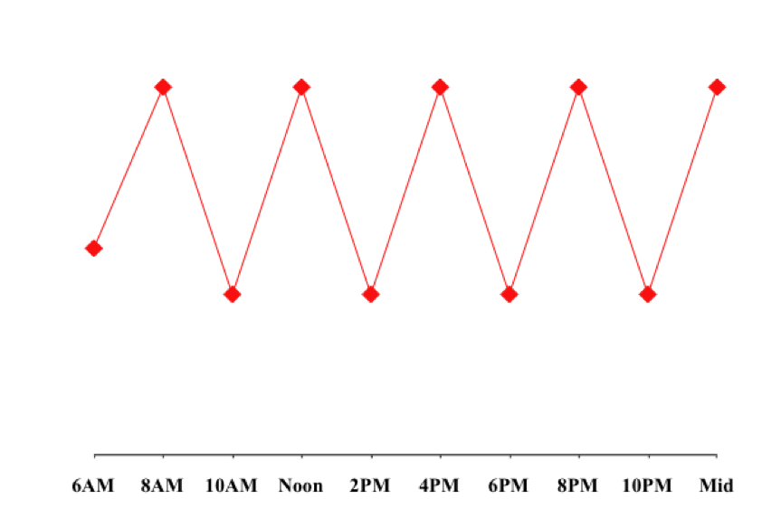
Poor Glycemic Control = Poor Eating Behavior
Desirable range
after eating
Blood glucose Level
HUNGER! CRAVINGS!

Slide 24
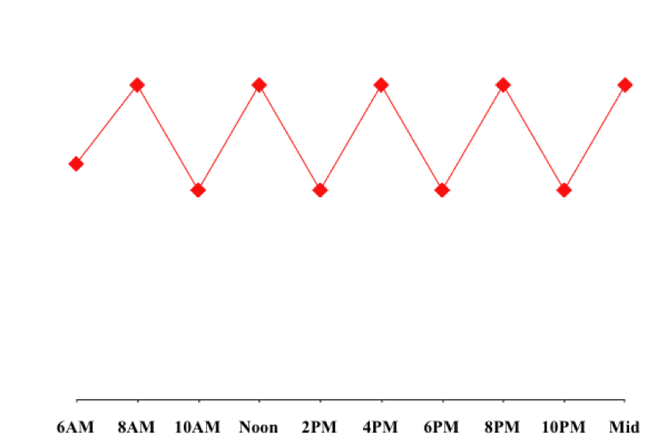
Tight Glycemic Control = Controlled Eating Behavior
Desirable range
after eating
Blood glucose Level
HUNGER! CRAVINGS!

Slide 25
The Impact of Insulin
Regulates blood-sugar levels
Sometimes called a “storage hormone”
fat stored in our fat cells (adipose tissue)
sugar stored in our liver and muscle cells (as glycogen)
amino acids directed toward protein synthesis (to build muscle)
Because insulin stimulates fat synthesis and promotes fat storage, there is a widespread belief that insulin circulating in the body induces weight gain
normal insulin response to meals (temporarily elevated, but returns to normal)
abnormal insulin metabolism (insulin levels stay elevated)
insulin resistance = reduction in the body’s cellular response to insulin, which interferes with regulation of blood sugar, increases appetite, and blocks the body’s ability to burn fat
“Helping Hand Diet”
insulin and leptin rise appropriately following meals (appetite-controlling benefits)
Also fall appropriately (metabolic and thermogenic benefits to encourage weight loss)

Slide 26

The Link Between Cortisol and Blood Sugar
Controlling your cortisol levels is important at all times
Control of blood-sugar levels at specific times (few hours following each meal)
Sleep deprivation and elevated cortisol levels
American Diabetes Association / University of Chicago sleep researchers…
Inadequate sleep leads to:
Increased cortisol levels
Insulin resistance
Higher blood-sugar levels
Elevated appetite
Weight gain
“normal” sleepers (averaging 7.5 to 8.5 hours of sleep per night)
“short” sleepers (averaging less than 6.5 hours of sleep per night)
50 percent more cortisol and insulin
40 percent less sensitive to the effects of insulin

Slide 27
Sleep Loss and Weight Gain
In the last 50 years - daily sleep duration in the USA has fallen by 1-2 hours
Proportion of adults sleeping less than 7 hours/night has nearly tripled
  1960 = 15.6%
  2010 = 47.1%
    (National Sleep Foundation)

Slide 28
Obesity Tied to Lack of Sleep
NHANES (National Health and Nutrition Examination Survey)
8,000 people across 5 years
<7 hours of sleep = more likely to be obese
<5 hours = 73% more likely to be obese
  compared to 7-9h of sleep nightly
Sleep deprivation
  leptin falls (less satiety)
  ghrelin rises (more hunger/appetite)
  cortisol rises (more cravings, especially sweet/carb cravings)

Slide 29


Sleep Loss = Fat Gain
Archive of Internal Medicine
  Direct relationship between higher BMI (weight/height) and sleep loss (990 adults)
  Each 1-hour decrease in sleep = 3 pounds gain
Obesity
  740 adults, aged 21-64 years
  Normal sleepers (7-8 hours)
  “Short” sleepers (5-6 hours)
  “Good” sleepers (9-10 hours)

Slide 30
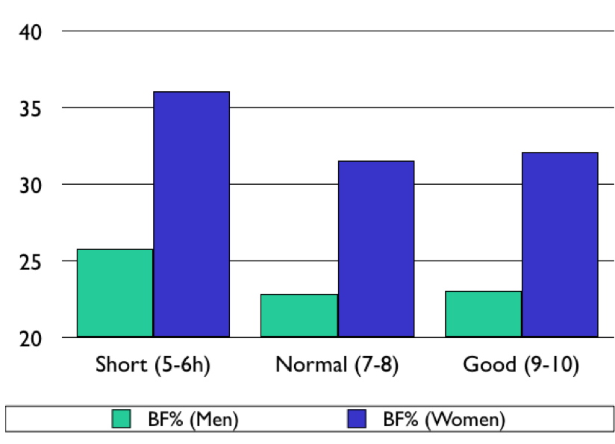
Body Fat % and Sleep

Slide 31
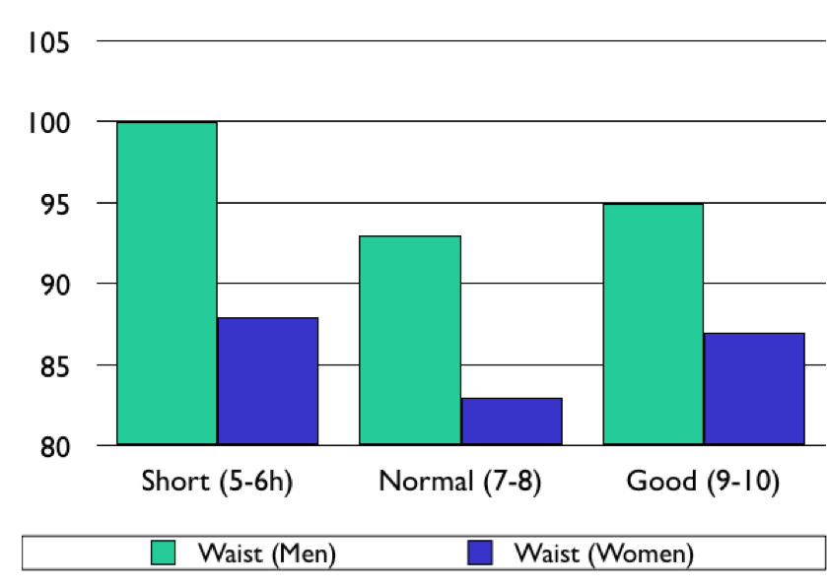
Waist Girth (cm) and Sleep

Slide 32
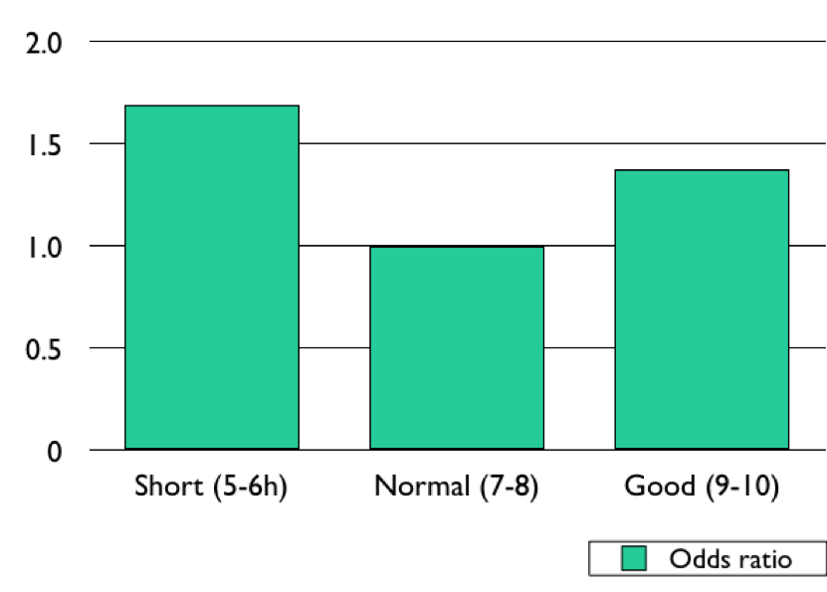
Sleep and Risk of Weight Gain
1.69
1.38

Slide 33
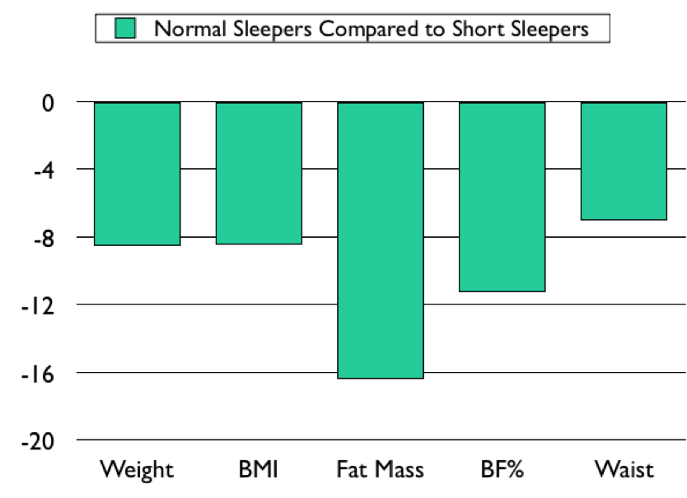
Sleep Yourself Thin?
-7%
-8.5%
-8.4%
-11.2%
-16.4%

Slide 34
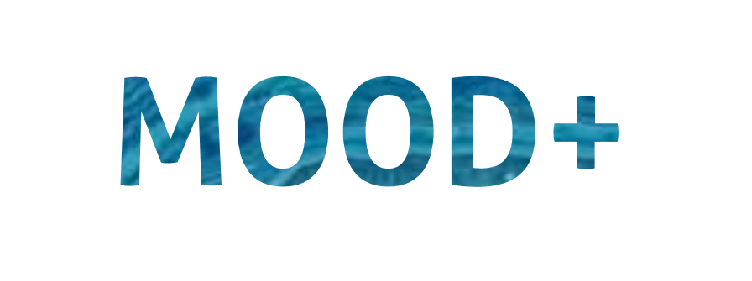

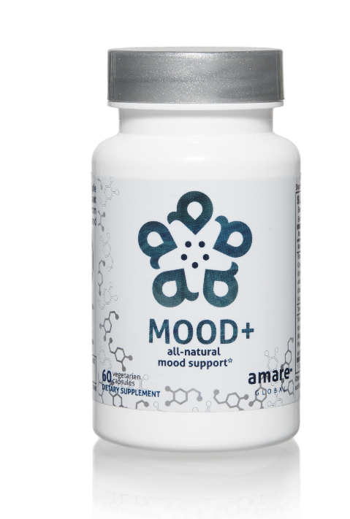
MOOD ELEVATING
PROMOTES RELAXATION
TENSION REDUCING
all-natural
mood support*
The key ingredients in Mood+ have multiple scientific studies that show significant benefits for mood support such as relief from anxious feelings, sadness, restlessness, and overall
stress relief.*
Item Code:
Retail Price:
Wholesale Price:
Subscribe & Save:
S006
$80.00
$59.95 / 52 PV
$53.95 / 46 PV
*These statements have not been evaluated by the Food and Drug Administration. This product is not intended to diagnose, treat, cure, or prevent any disease.

Slide 35

MOOD+
KEY BENEFITS & FEATURES
Enhances feelings of well-being and supports a healthy, positive mood*
Promotes a calming, relaxing state of mind*
Reduces feelings of negativity and stress*
Lessens occasional anxiousness and feelings of sadness*
Increases motivation and drive*
Supports natural serotonin and dopamine production for enhanced mood benefits*
*These statements have not been evaluated by the Food and Drug Administration. This product is not intended to diagnose, treat, cure, or prevent any disease.

Slide 36
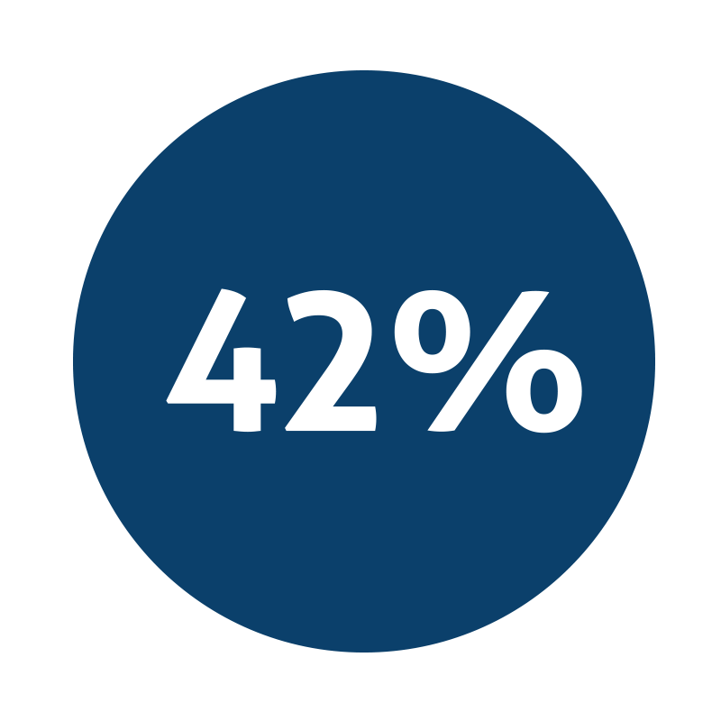
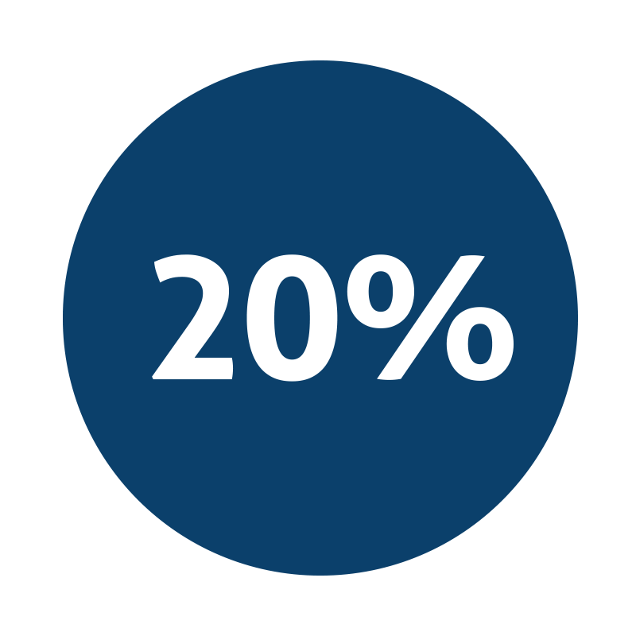
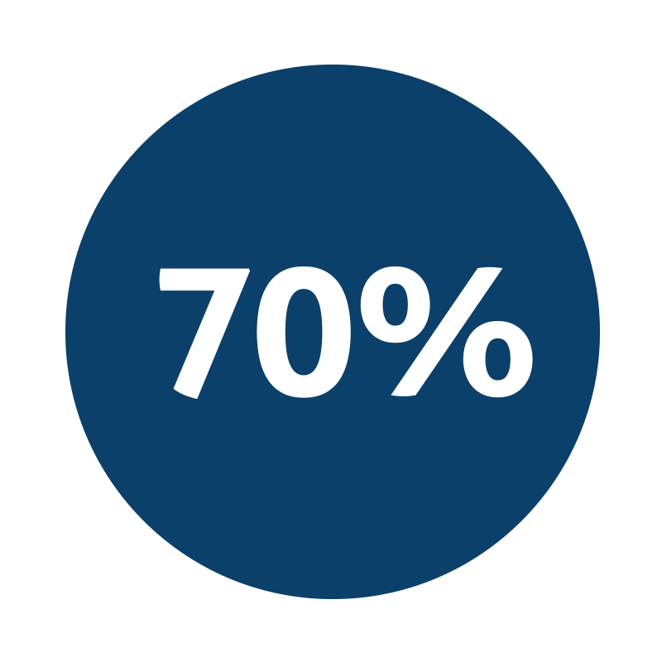
all-natural
mood support*
Decrease in feelings of anger*
Decrease in feelings of sadness*
Reduction of stress related symptoms*
*These statements have not been evaluated by the Food and Drug Administration. This product is not intended to diagnose, treat, cure, or prevent any disease.
Notes:
http://www.interhealthusa.com/wp-content/uploads/2015/12/Relora-E-Download-2015.pdf

Slide 37

MOOD+
KEY INGREDIENTS
Venetron, Rafuma
Depression
*These statements have not been evaluated by the Food and Drug Administration. This product is not intended to diagnose, treat, cure, or prevent any disease.
Notes:
47% reduction in Overall Depression Scores
Venetron® brochure, Tokiwa Phytochemical Co., Ltd.,
KGK Synergize Inc. Effect of VENETRON on Symptoms of Depression in Individuals with Mild Depression
Yang, J. et al. 2009. Safety study of Apocynum venetum extract in healthy adults. Journal of Nutritional Food, no. 12:1–9.

Slide 38

MOOD+
KEY INGREDIENTS
Zembrin, Kanna
Depression
*These statements have not been evaluated by the Food and Drug Administration. This product is not intended to diagnose, treat, cure, or prevent any disease.
Notes:
From the Zembrin product brochure – PLT Health

Slide 39
fMRI Study Results Show Reduced Stress Response
MOOD+
KEY INGREDIENTS
ZEMBRIN MAY HELP IN THE MANAGEMENT OF STRESS IN EVERYDAY LIFE
A single dose of Zembrin attenuates reactivity within the part of the brain (amygdala) that responds to threat/stress
®
®
*These statements have not been evaluated by the Food and Drug Administration. This product is not intended to diagnose, treat, cure, or prevent any disease.
Notes:
Terburg et al. Acute Effects of Sceletium tortuosum (Zembrin), a Dual
5-HT Reuptake and PDE4 Inhibitor, in the Human Amygdala and its Connection to the Hypothalamus. Neuropsychopharmacology (2013), 1–9.

Slide 40
Cognitive Set Flexibility
MOOD+
KEY INGREDIENTS
COGNITIVE FLEXIBILITY
Ability to shift attention between two or more tasks and the ability to adapt to rapidly changing directions and intelligently utilize the information.
Necessary for decision-making, impulse control and strategy formation.
CNS VitalSign has been used for testing neurocognitive function by over 5000 clinicians in 52 countries
®
*These statements have not been evaluated by the Food and Drug Administration. This product is not intended to diagnose, treat, cure, or prevent any disease.
Notes:
Chiu et al. Proof-of-Concept Randomized Controlled Study of Cognition Effects of the Proprietary Extract Sceletium tortuosum (Zembrin) Targeting Phosphodiesterase-4 in Cognitively Healthy Subjects: Implications for Alzheimer’s Dementia. Evidence-Based Complementary and Alternative Medicine Volume 2014, Article ID 682014

Slide 41

MOOD+
KEY INGREDIENTS
Sensoril, Ashwagandha
Anxiety
*These statements have not been evaluated by the Food and Drug Administration. This product is not intended to diagnose, treat, cure, or prevent any disease.
Notes:
Auddy et al. A Standardized Withania Somnifera Extract Significantly Reduces Stress-Related Parameters in Chronically Stressed Humans: A Double-Blind, Randomized, Placebo-Controlled Study. Journal of the American Nutraceutical Association Vol.11,No.1, 2008 pp50-56.

Slide 42
MOOD+
KEY INGREDIENTS
Sensoril, Ashwagandha
Anxiety
*These statements have not been evaluated by the Food and Drug Administration. This product is not intended to diagnose, treat, cure, or prevent any disease.
Notes:
Auddy et al. A Standardized Withania Somnifera Extract Significantly Reduces Stress-Related Parameters in Chronically Stressed Humans: A Double-Blind, Randomized, Placebo-Controlled Study. Journal of the American Nutraceutical Association Vol.11,No.1, 2008 pp50-56.

Slide 43
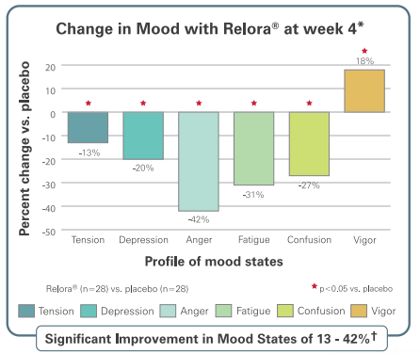

MOOD+
KEY INGREDIENTS
Relora, Magnolia & Phellondendron
Anxiety
*These statements have not been evaluated by the Food and Drug Administration. This product is not intended to diagnose, treat, cure, or prevent any disease.
Notes:
Talbott et al. Effect of Magnolia officinalis and Phellodendron amurense (Relora®) on cortisol and psychological mood state in moderately stressed subjects. Journal of the International Society of Sports Nutrition 2013, 10:37
Garrison et al. Effect of a proprietary Magnolia and Phellodendron extract on weight management: a pilot, double-blind, placebo-controlled clinical trial. Altern Ther Health Med. 2006;12(1):50-54.
Kalman et al. Effect of a proprietary Magnolia and Phellodendron extract on stress levels in healthy women: a pilot, double-blind, placebo-controlled clinical trial. Nutrition Journal 2008, 7:11

Slide 44
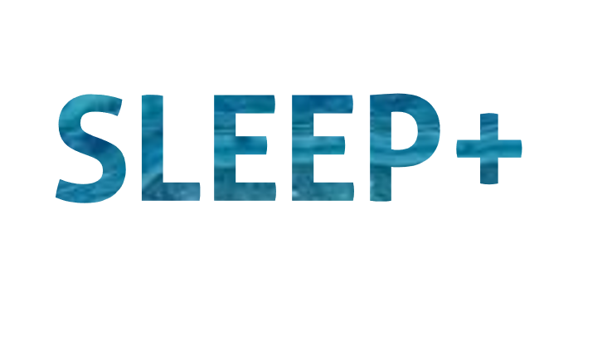
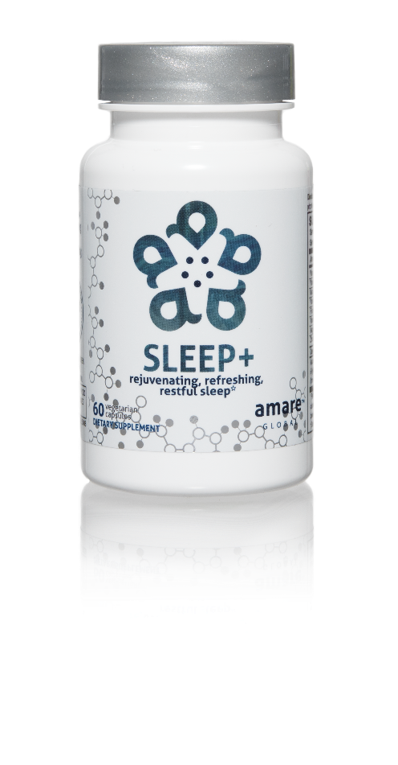

FALL ASLEEP FASTER
STAY ASLEEP LONGER
IMPROVES SLEEP QUALITY
rejuvenating, refreshing,
restful sleep*
The key ingredients in Sleep+ have multiple scientific studies that show significant benefits including helping you to fall asleep faster, stay asleep longer, and experience higher quality plus more rejuvenating sleep.*
Item Code:
Retail Price:
Wholesale Price:
Subscribe & Save:
S008
$80.00
$59.95 / 52 PV
$53.95 / 46 PV
*These statements have not been evaluated by the Food and Drug Administration. This product is not intended to diagnose, treat, cure, or prevent any disease.

Slide 45

SLEEP+
KEY BENEFITS & FEATURES
Relieves occasional sleeplessness*
Provides a soothing and refreshing night’s sleep, without morning grogginess*
Improves quality of sleep and ease of falling asleep*
Encourages restful sleep, calms the nervous system, and helps reduce stress*
Decreases the number of nighttime awakenings and sleepless nights*
*These statements have not been evaluated by the Food and Drug Administration. This product is not intended to diagnose, treat, cure, or prevent any disease.

Slide 46
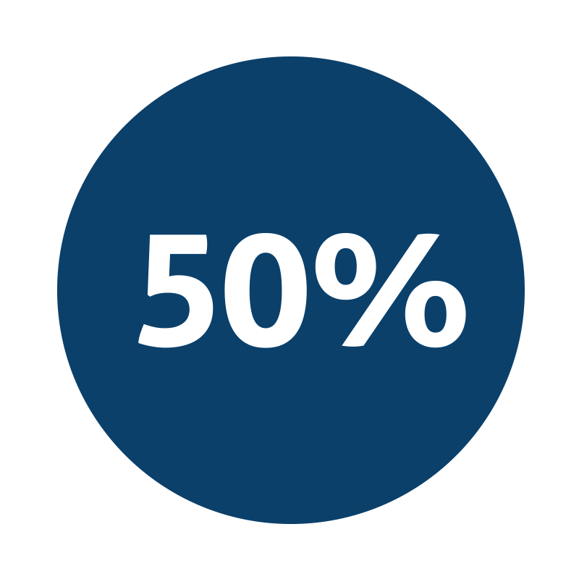
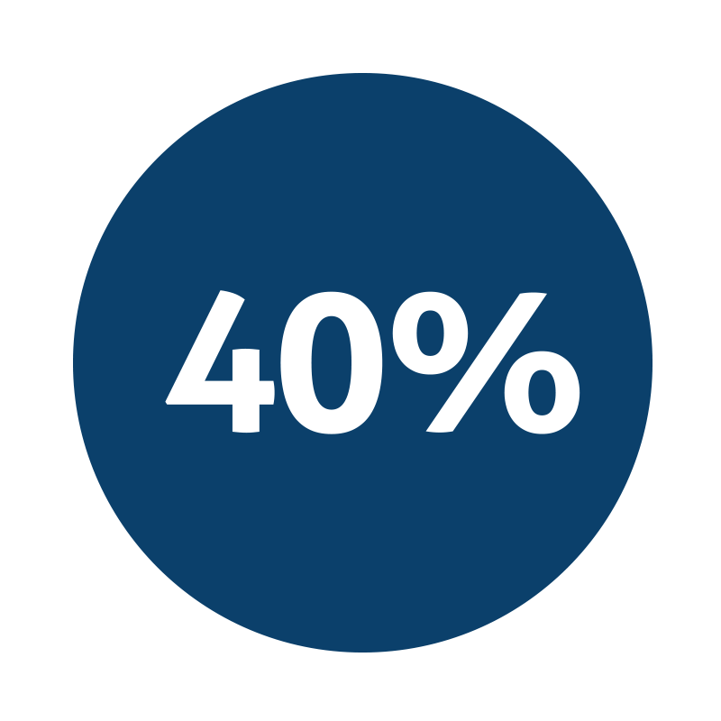

rejuvenating, refreshing,
restful sleep*
Improvement in sleep efficiency*
Improvement in sleep quality*
Fall asleep faster by 33% and wake up fewer times each night by 30%*
*These statements have not been evaluated by the Food and Drug Administration. This product is not intended to diagnose, treat, cure, or prevent any disease.
Notes:
Talbott and Talbott: Effect of Monocot Grass Extract (MGE) on mood state and sleep patterns in moderately stress subjects. Journal of the International Society of Sports Nutrition 2013 10(Suppl 1):P26.

Slide 47
Summary
Stress/Cortisol = increases appetite/cravings/belly fat storage
  Interferes with insulin/thyroid function
  Disrupts blood glucose control (reduces fat-burning, increases appetite)
  Blocks neurotransmitter function
  Leads to stress-eating
Poor Sleep = unique “stress” on body
  Elevates cortisol (increases ghrelin, suppresses leptin)
  Blocks insulin / disrupts glucose
  Changes appetite / cravings
  Enhances belly fat storage
Fight back with Mood+ and Sleep+

Slide 48
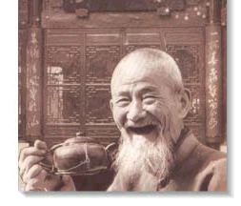
Get Some Sleep!

