Slide 1
Project B3 PILOT Evaluation
Shawn Talbott, PhD

Slide 2
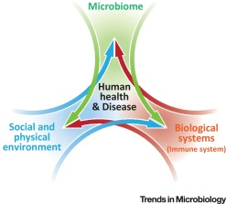

Biome
Body
Brain
THE MENTAL WELLNESS COMPANY

Slide 3
Topic Schedule
Nov 1 (week 0) = Overview
Nov 8 (week 1) = Reboot/Biome
Nov 15 (week 2) = Body/Brain
Nov 22 (week 3) = OFF – Thanksgiving
Nov 29 (week 4) = Stress / Sleep
Dec 6 (week 5) = Exercise
Dec 13 (week 6) = Nutrition
Dec 20 (week 7) = Supplementation
Dec 27 (week 8) = Evaluation
Jan 3 = start 2019 RIGHT!
8-week Survey!
Wednesday January 2 at 2 PM PST
https://zoom.us/j/381260666

Slide 4
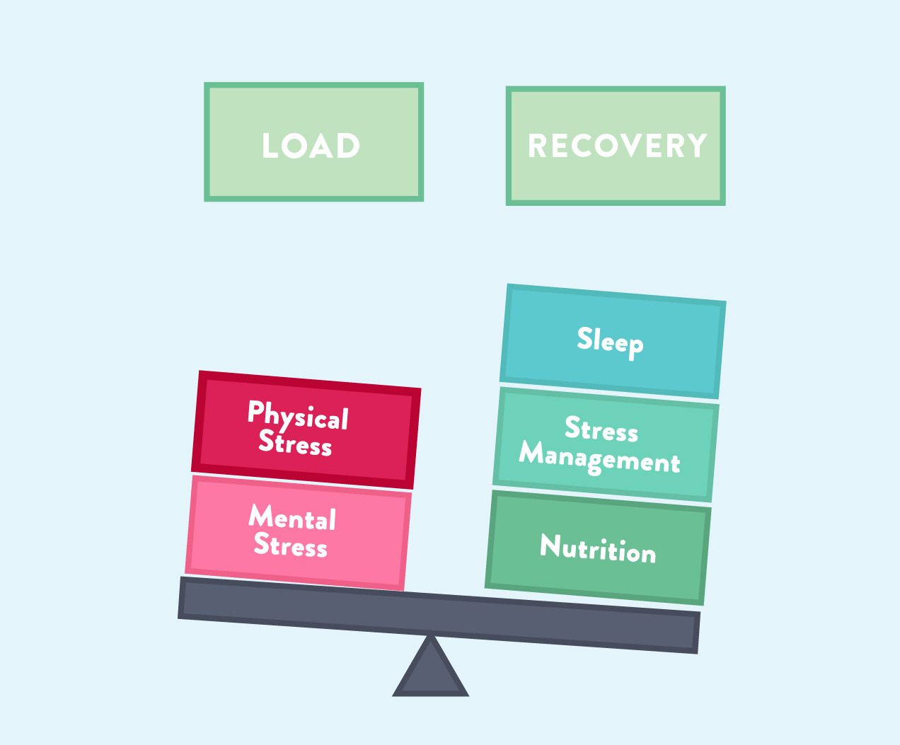

Slide 5
Putting it all together…
Move!
HIIT and/or FlexSkills
Burns calories / thermogenic / BMR maintenance
Improves insulin/blood sugar control
Improves cortisol control / stress response / thyroid function
Improves serotonin/norepinephrine/mood better than SSRI/anxiolytic drugs
Eat! (Mindfully)
National Weight Control Registry (1500-1800 calories/day)
Always combine pro/carbs/fat/fiber (Helping Hand)
Choose less processed (whole) foods whenever possible
Mediterranean style meals
Targeted Supplementation
Nourishes microbiome & optimizes gut-brain-axis
Provides the foundation in terms of the main areas of metabolism…
Cortisol (stress) / Testosterone (muscle mass & libido) / Insulin (blood sugar) / Norepinephrine (mental focus)
Serotonin (mood) / Thyroid (metabolism) / Dopamine (motivation)

Slide 6
Weekly Check-Ins
Move
Eat (mindfully)
Breathe / Meditate
5-5-5 triangle x 4 = 60 seconds
Do this a few times, focusing on your breath
Refocus a wandering mind as needed back to breath
Prioritize
You can’t do it all (really, you can’t)
What are the MOST important things to get done TODAY? (big rocks)
Connect
Phone a Friend - Talk is better than text or email
Gratitude
What went well today, yesterday, this week?
Gratitude Journal (phone notebook, sticky notes near bed…)

Slide 7
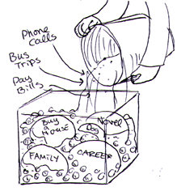
Stephen Covey
First Things First
https://www.youtube.com/watch?v=zV3gMTOEWt8

Slide 8
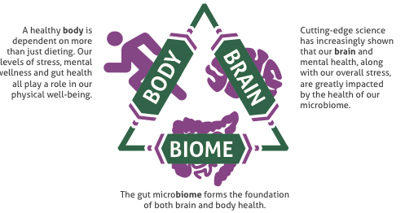

Slide 9
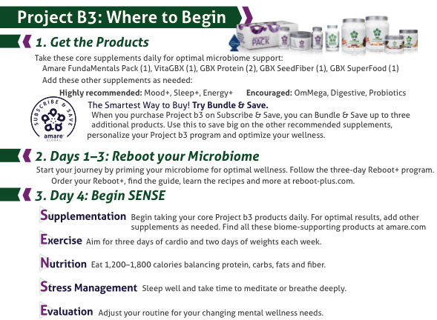

Slide 10
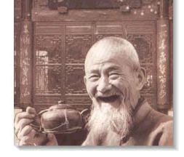
Thank You!

