Slide 1
Project B3 PILOT
Supplementation
Shawn Talbott, PhD

Slide 2
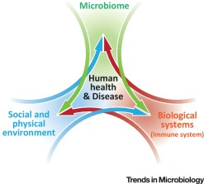

Biome
Body
Brain
THE MENTAL WELLNESS COMPANY

Slide 3
Topic Schedule
Nov 1 (week 0) = Overview
Nov 8 (week 1) = Reboot/Biome
Nov 15 (week 2) = Body/Brain
Nov 22 (week 3) = OFF – Thanksgiving
Nov 29 (week 4) = Stress / Sleep
Dec 6 (week 5) = Exercise
Dec 13 (week 6) = Nutrition
Dec 20 (week 7) = Supplementation
Dec 27 (week 8) = Evaluation
Jan 3 = start 2019 RIGHT!

Slide 4
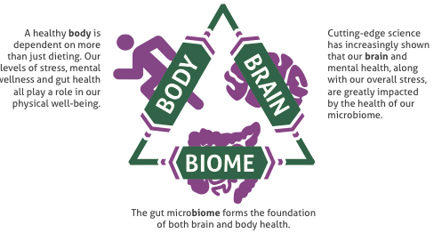

Slide 5
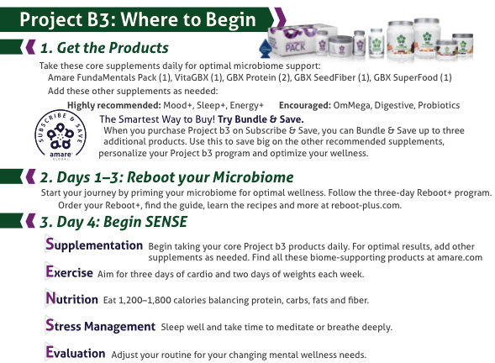

Slide 6
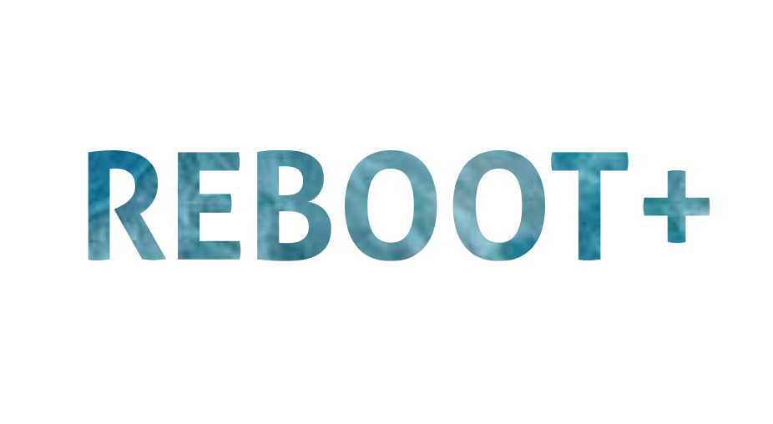

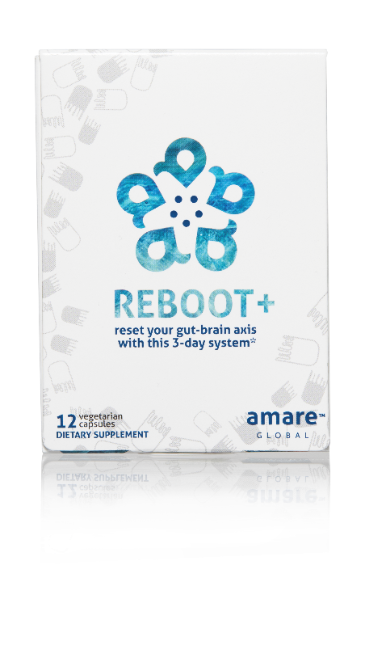
REMOVES WASTE & TOXINS
3-DAY PROGRAM
NATURAL CLEANSING
reset your gut-brain axis
with this 3-day system*
A synergistic blend of natural cleansing herbs and phytonutrients to assist the body’s own detoxification process – specifically formulated to reboot your gut-brain axis in 3-days.*
Item Code:
Retail Price:
Wholesale Price:
Subscribe & Save:
S004
$34.00
$24.95 / 21 PV
$21.95 / 19 PV
*These statements have not been evaluated by the Food and Drug Administration. This product is not intended to diagnose, treat, cure, or prevent any disease.

Slide 7
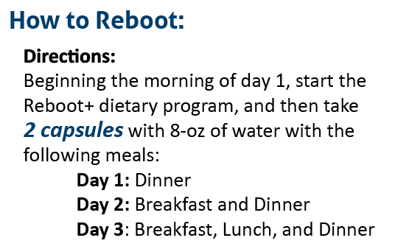
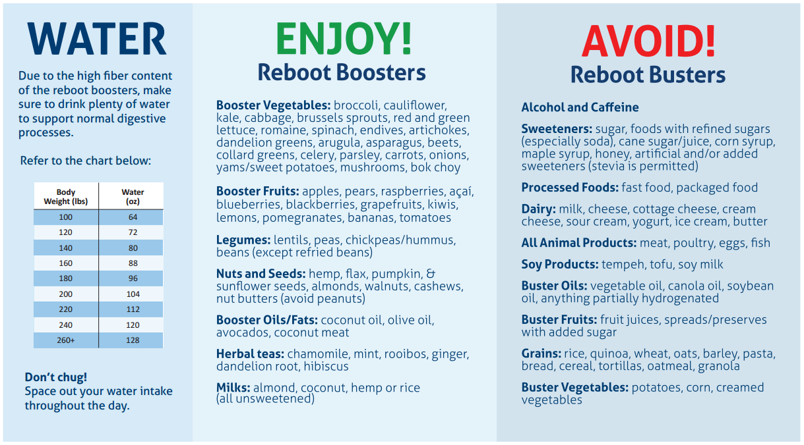
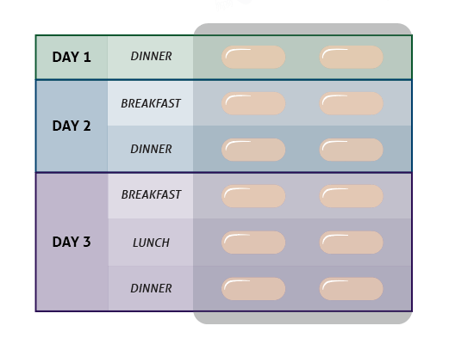
REBOOT+
DIETARY SUGGESTIONS

Slide 8
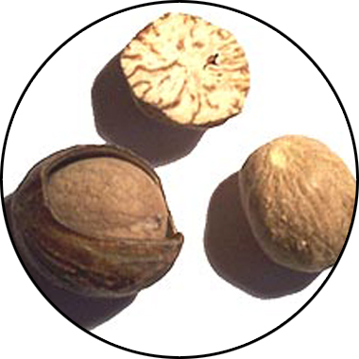
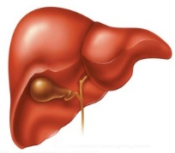
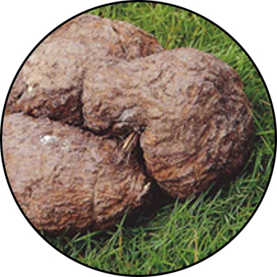
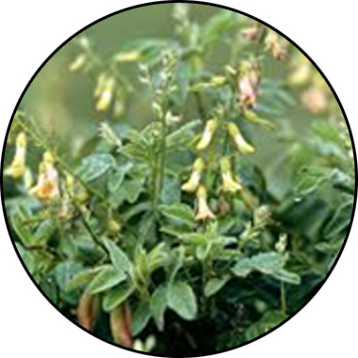
REBOOT+
KEY INGREDIENTS
Sebatin
Synergistic Effects of Sebatin™
™
Anti-inflammatory
Antioxidant
Hepatoprotective
Poria
lanostane triterpene acids
Panchyman (1,3-β-D-glucan)
Inhibition of iNOS & TNF-α production
Myristica
Phenylpropanoids
Induction of glutathion
S-transferase
Astragalus
Saponins & Polysacharin
Increase tissue SOD and GSH
Free radical scavenging
*These statements have not been evaluated by the Food and Drug Administration. This product is not intended to diagnose, treat, cure, or prevent any disease.

Slide 9
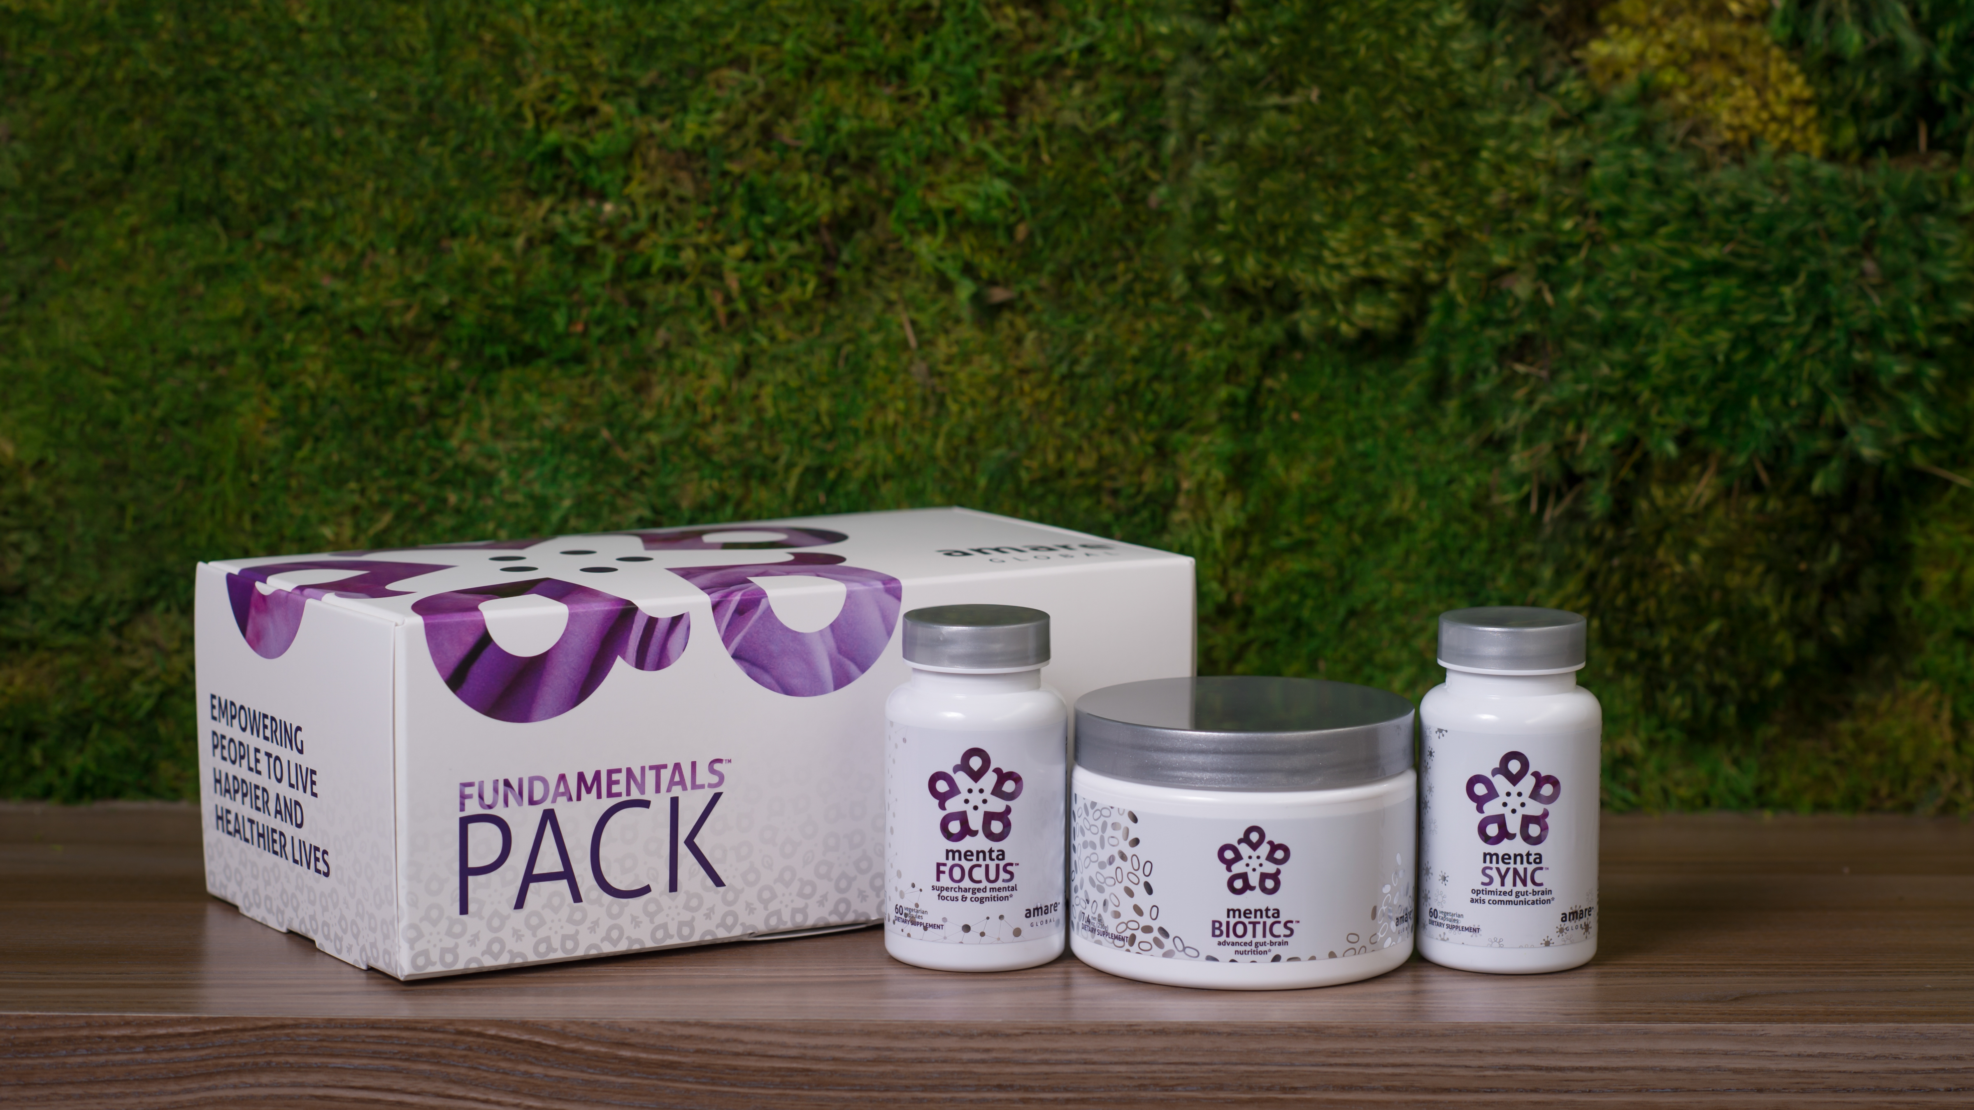

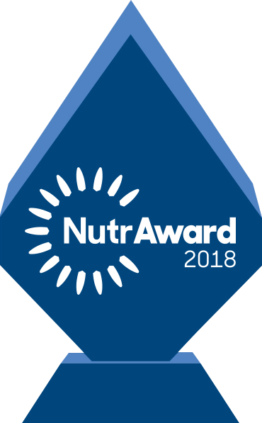
The World’s First Award-Winning Gut-Brain Axis
Nutrition System
AMARE FUNDAMENTALS PACK
™
2018 NutrAward Winner for
“BEST NEW FINISHED PRODUCT”
*These statements have not been evaluated by the Food and Drug Administration. This product is not intended to diagnose, treat, cure, or prevent any disease.

Slide 10
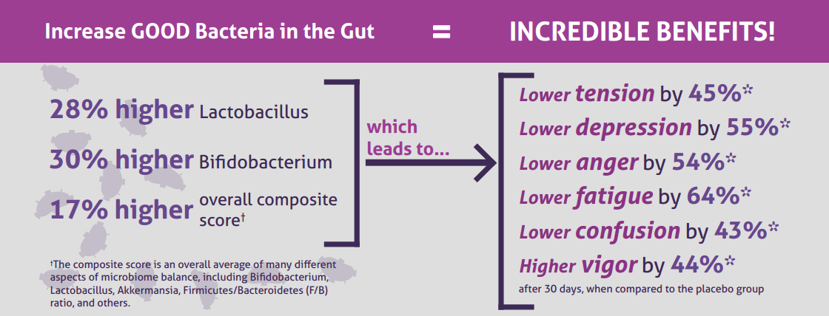
CLINICAL STUDY
The Amare FundaMentals Pack has been clinically proven to:

Slide 11
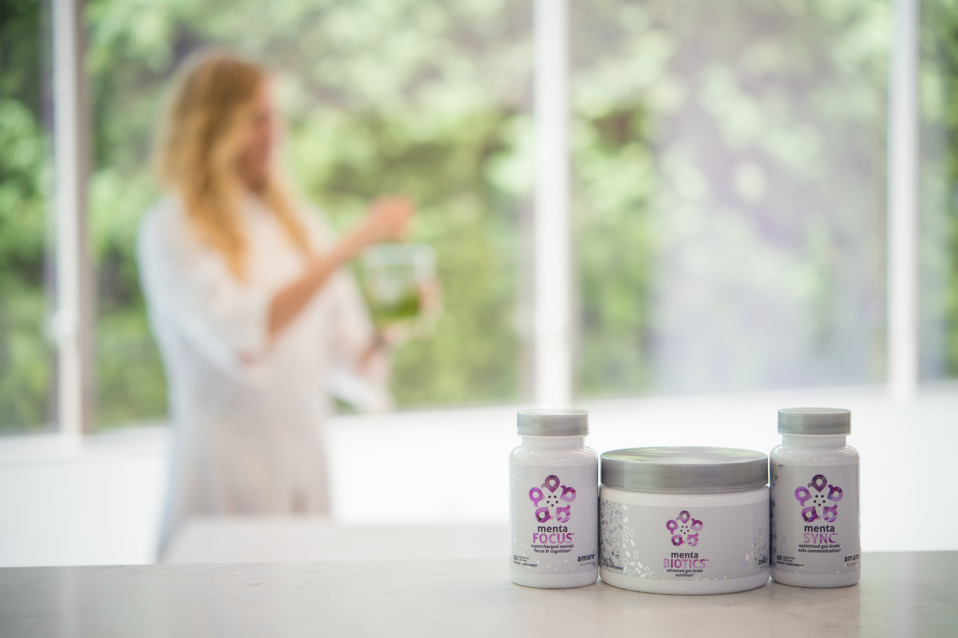
CLINICAL STUDY
The subjects in this study were “healthy stressed” individuals - meaning they represent the vast majority of the population who have stress, fatigue, brain fog, and the modern 21st century “syndrome of the blahs”.

Slide 12



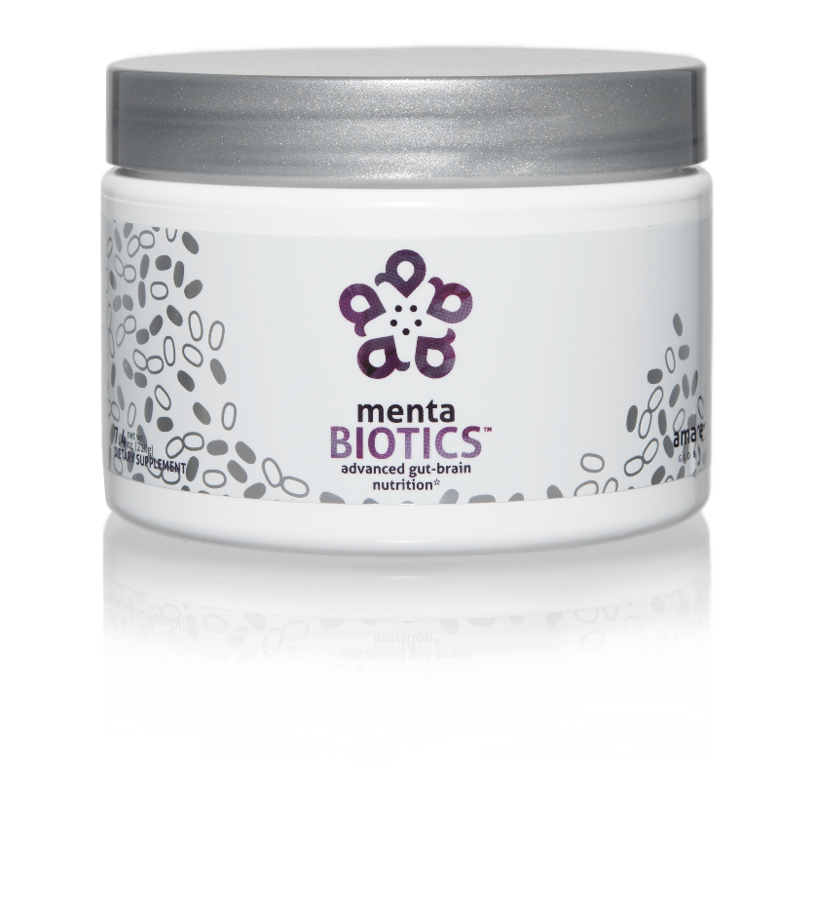
AMARE’S FLAGSHIP PRODUCT
SUPPORTS FEEL-GOOD NEUROTRANS-MITTERS
INCREASES GOOD BACTERIA
The most comprehensive combination of unique strains of probiotics, prebiotics, and phytobiotics that have been scientifically shown to improve mental wellness.*
Item Code:
Retail Price:
Wholesale Price:
Subscribe & Save:
S001
$100.00
$74.95 / 65 PV
$66.95 / 58 PV
*These statements have not been evaluated by the Food and Drug Administration. This product is not intended to diagnose, treat, cure, or prevent any disease.

Slide 13
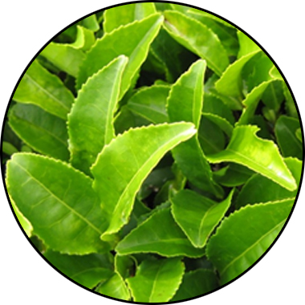
MENTABIOTICS
KEY INGREDIENTS
™
Suntheanine
Increases Alpha Waves
“Relaxed alertness”
*These statements have not been evaluated by the Food and Drug Administration. This product is not intended to diagnose, treat, cure, or prevent any disease.

Slide 14
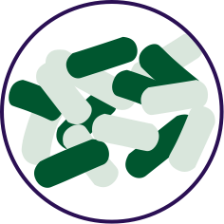


FOR YOUR GUT…
THE PROBIOTIC STRAIN MATTERS
Lactobacillus rhamnosus R0011:
Reduces stress by lowering cortisol exposure and improves GABA neurotransmission*
Stress
Bifidobacterium longum R0175:
Enhances calmness by decreasing anxiety indices and improves cognitive function*
Anxiety/
Cognition
Lactobacillus helveticus R0052:
Improves mood by decreasing neuro-inflammation and increasing serotonin*
Mood
*These statements have not been evaluated by the Food and Drug Administration. This product is not intended to diagnose, treat, cure, or prevent any disease.

Slide 15


Prebiotic proprietary blend…
Supports the growth of preferred bacteria
These prebiotics support the growth and vitality of a range of beneficial gut bacteria, particularly Lactobacillus and Bifidobacterium species (featured in MentaBiotics).
Bimuno® GOS (Galacto-Oligo-Saccharides)
Resets and increases friendly gut bacteria, maintains immune health, controls inflammation in the body, supports your microbiome balance, highly effective and natural way of increasing preferred bacteria in your gut.*
SunFiber® , Galactomannan Fiber – aka PHGG (partially hydrolyzed guar gum)
Helps improve the growth and vitality of beneficial bacteria, including Bifidobacteria and Lactobacillus.*
*These statements have not been evaluated by the Food and Drug Administration. This product is not intended to diagnose, treat, cure, or prevent any disease.

Slide 16

MENTABIOTICS SUGAR FREE
MW3™ Prebiotic Proprietary Blend
™
Our MW3 Prebiotic Proprietary Blend provides optimal gut support by feeding the specific mental wellness probiotic strains found in our MW3 Probiotic Proprietary Blend.*
MW3 Prebiotic Fibers:
IsoFiber™ (Iso-Malto-Oligosaccharides) — Contains a combination of naturally occurring prebiotic plant fibers that are clinically shown to improve the growth of specific probiotic strains featured in Kids FundaMentals™ and now MentaBiotics™ Sugar Free!
Bimuno® (Galacto-Oligo-Saccharides) — Resets and increases friendly gut bacteria, maintains immune health, controls inflammation in the body and supports microbiome balance. Is highly effective and a natural way of increasing preferred bacteria in the gut. Plays an important role in feeding Bifidobacteria probiotic strains.*
SunFiber® (Galactomannan Fiber) — Helps improve the growth and vitality of beneficial bacteria, including Bifidobacteria and Lactobacillus.*
*These statements have not been evaluated by the Food and Drug Administration. This product is not intended to diagnose, treat, cure, or prevent any disease.

Slide 17
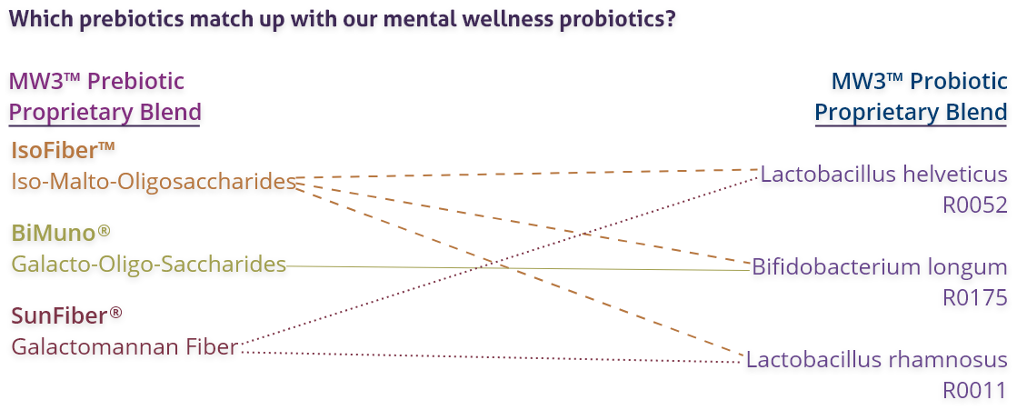
MENTABIOTICS SUGAR FREE
MW3™ Prebiotic/Probiotic Proprietary Blend
™
*These statements have not been evaluated by the Food and Drug Administration. This product is not intended to diagnose, treat, cure, or prevent any disease.

Slide 18
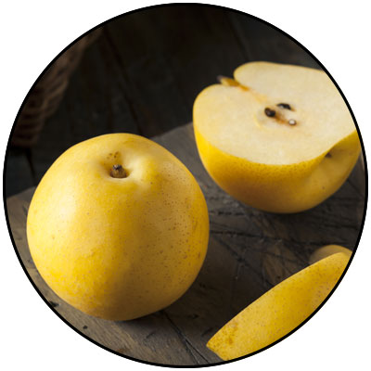
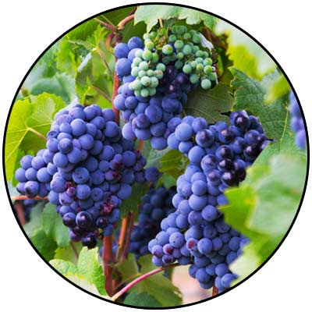
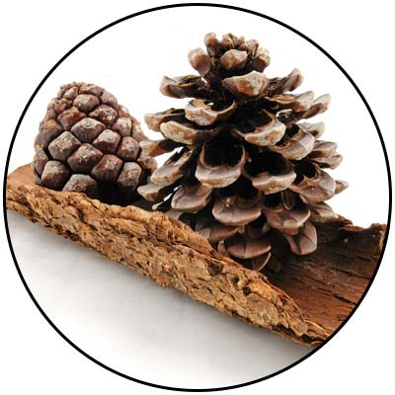
GBX+ proprietary blend…
Patent Pending and Exclusive to Amare
Applephenon: Asian Apple Fruit extract
Supports gut health, immune function, & inflammatory balance*
Enovita: French Grape Seed extract
Enhances blood flow, cardiovascular tone, & cellular defenses*
Enzogenol: New Zealand Pine Bark extract
Improves neurotransmitter balance, mental focus, & psychological vigor*
*These statements have not been evaluated by the Food and Drug Administration. This product is not intended to diagnose, treat, cure, or prevent any disease.

Slide 19

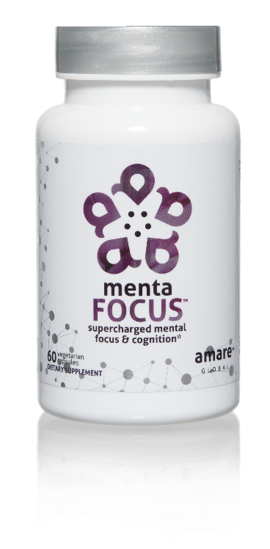
AMPLIFIES ATTENTION & ALERTNESS
ENHANCES BRAIN ACTIVATION
PROMOTES CLARITY COGNITION CREATIVITY
Supercharge your brain with key phytonutrients clinically shown to support focus, mental sharpness, clarity, creativity, and cognitive functioning.*
Item Code:
Retail Price:
Wholesale Price:
Subscribe & Save:
S002
$60.00
$44.95 / 39 PV
$39.95 / 35 PV
*These statements have not been evaluated by the Food and Drug Administration. This product is not intended to diagnose, treat, cure, or prevent any disease.

Slide 20
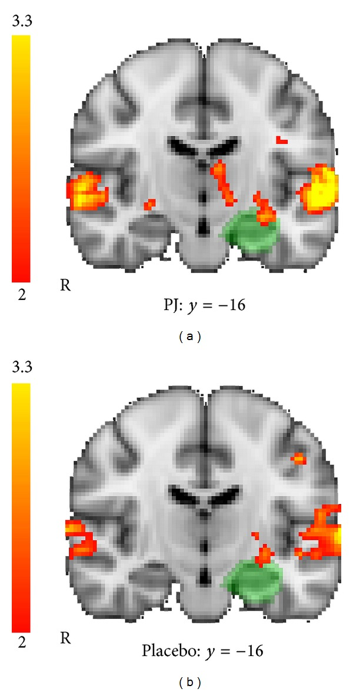
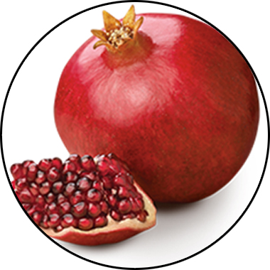
MENTAFOCUS
KEY INGREDIENTS
™
POMx
Enhances Brain Activation
*These statements have not been evaluated by the Food and Drug Administration. This product is not intended to diagnose, treat, cure, or prevent any disease.

Slide 21
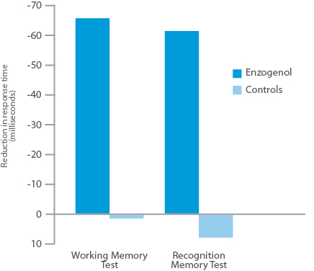
MENTAFOCUS
KEY INGREDIENTS
™
Enzogenol
Improves Memory
*These statements have not been evaluated by the Food and Drug Administration. This product is not intended to diagnose, treat, cure, or prevent any disease.

Slide 22
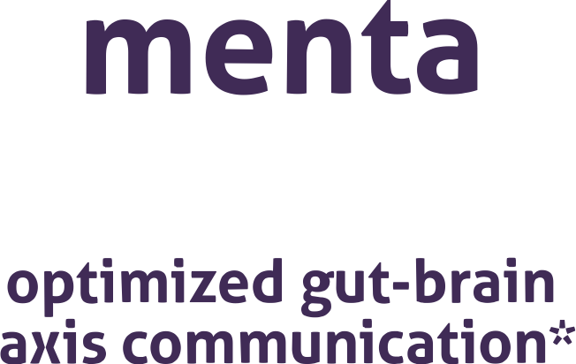

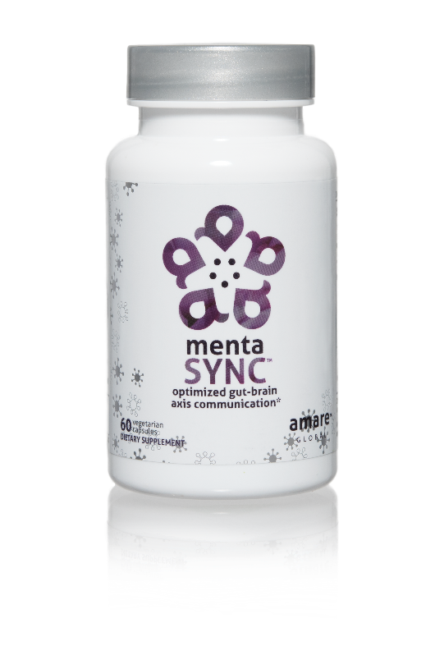
IMPROVES
GUT-BRAIN COMMUNICATION
BALANCES SIGNALING BETWEEN CELLS
ENHANCES
BIO-CHEMICAL COMMUNICATION
Optimize the communication sync of chemical messengers between your brain and your gut with the clinically studied key ingredients in MentaSync.*
Item Code:
Retail Price:
Wholesale Price:
Subscribe & Save:
S003
$74.00
$54.95 / 47 PV
$48.95 / 42 PV
*These statements have not been evaluated by the Food and Drug Administration. This product is not intended to diagnose, treat, cure, or prevent any disease.

Slide 23
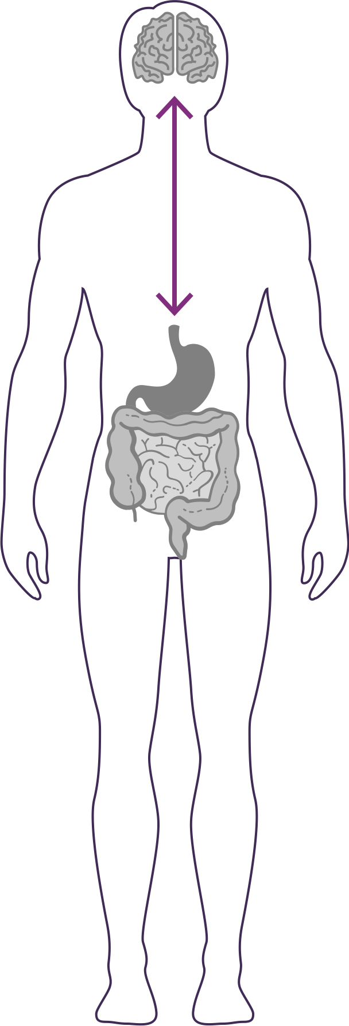


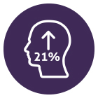
GUT – BRAIN - AXIS
The gut & brain are connected by a link known as the “axis”, which is an important component of the gut-brain axis system. It is the primary connection between our two brains and is greatly responsible for our overall well-being.
Balances normal signaling between cells of the gut, brain, and immune system.*‡
Enhances GBX (gut-brain axis) signaling and gut barrier function via alpha-glucans, beta-glucans, SCFAs (butyrate) and zinc-carnosine*‡
Increases psychological vigor by 21%*‡
*These statements have not been evaluated by the Food and Drug Administration. This product is not intended to diagnose, treat, cure, or prevent any disease.
‡BASED ON KEY INGREDIENTS CLINICAL STUDIES

Slide 24
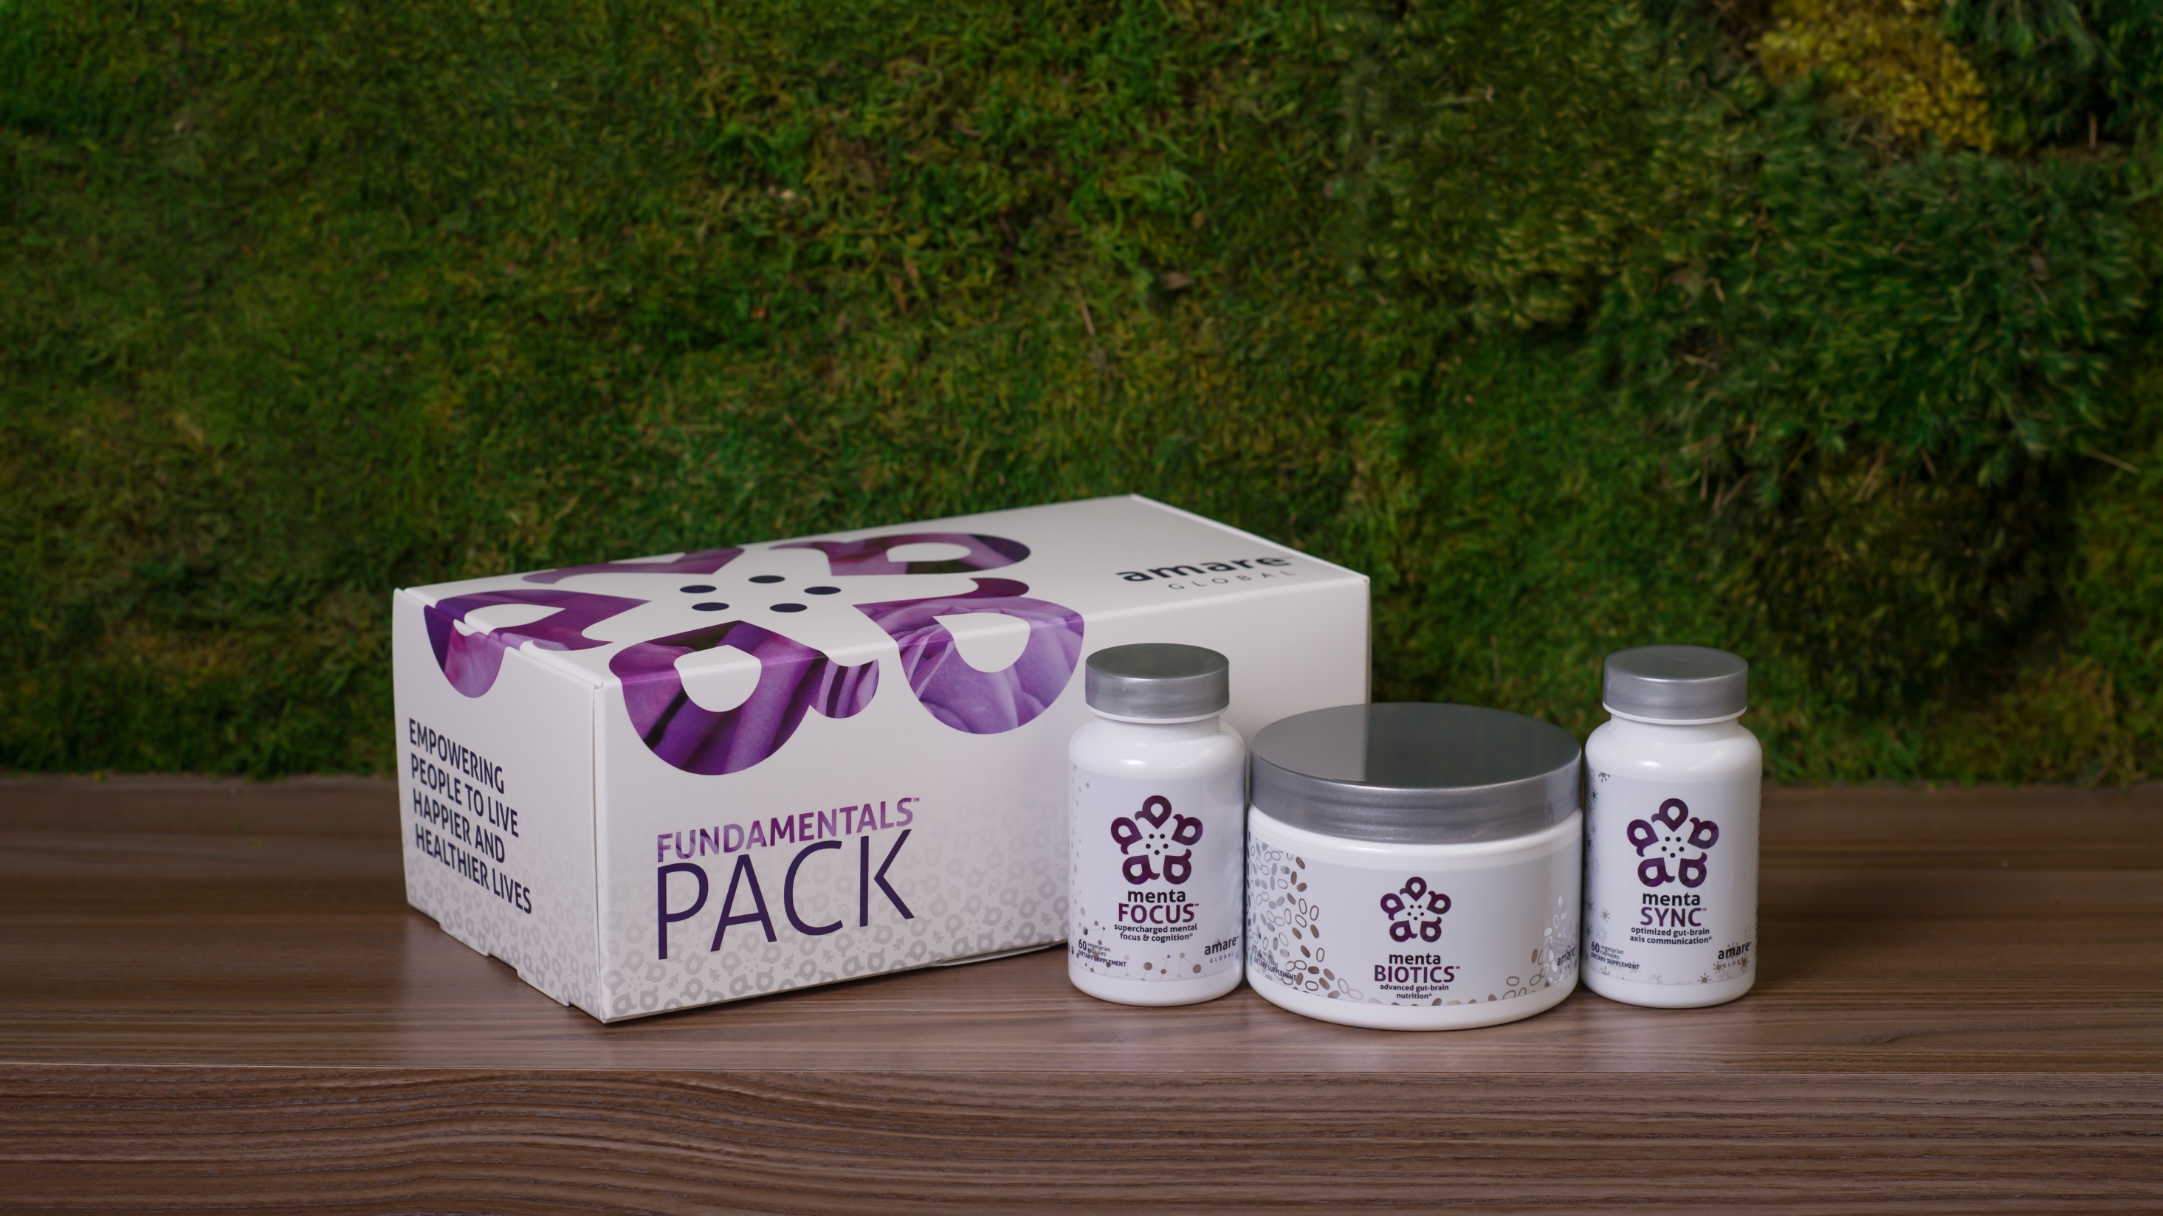
World’s First Award-Winning Gut-Brain Axis Nutrition System
AMARE FUNDAMENTALS PACK
™
2018 NutrAward Winner for
“BEST NEW FINISHED PRODUCT”
Item Code:
Retail Price:
Wholesale Price:
Subscribe & Save:
P001
$234.00
$149.95 / 120 PV
$134.95 / 108 PV
*These statements have not been evaluated by the Food and Drug Administration. This product is not intended to diagnose, treat, cure, or prevent any disease.

Slide 25
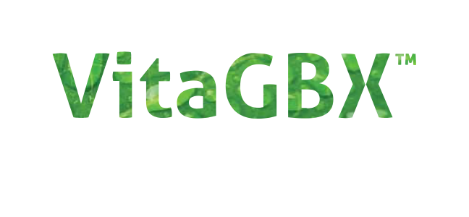

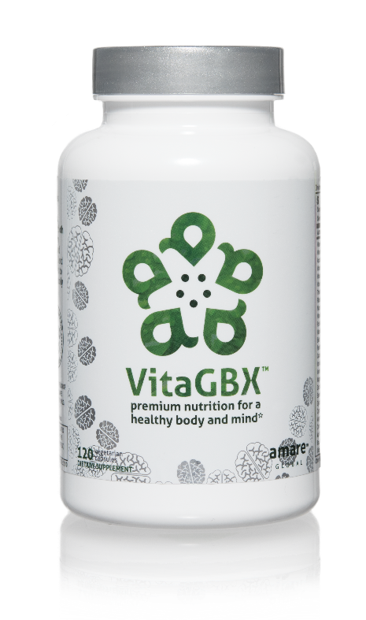
MULTIVITAMIN + MIND COMBO
FILLS GAPS IN DAILY NUTRITION
UNIQUE BRIGHT MIND BLEND
premium nutrition for a
healthy body and mind*
VitaGBX is a premium multivitamin that combines more than 50 vitamins, minerals, amino acids, and phytonutrients. It features both our Bright Mind Proprietary Blend (for mind support) and Amare GBX+ Proprietary Blend (for gut-brain axis support) to empower a well-balanced body and mind.*
Item Code:
Retail Price:
Wholesale Price:
Subscribe & Save:
S010
$54.00
$39.95 / 32 PV
$35.95 / 29 PV
*These statements have not been evaluated by the Food and Drug Administration. This product is not intended to diagnose, treat, cure, or prevent any disease.

Slide 26

VitaGBX
KEY BENEFITS & FEATURES
™
Contains key nutrients that are essential for daily overall wellness*
Supports bone health with calcium, magnesium, zinc, and vitamin D*
Supports healthy immune function*
Packed with free radical fighting antioxidants*
Proper physiological ingredient amounts – no mega doses*
Balances body and mind via key nutrients often not consumed in your daily meals*
Improves concentration, attention, and alertness*
Empowers and sustains a sense of mental focus*
*These statements have not been evaluated by the Food and Drug Administration. This product is not intended to diagnose, treat, cure, or prevent any disease.

Slide 27



premium nutrition for a
healthy body and mind*
Contains a Bright Mind Blend which helps improve concentration, attention, and alertness*
Combines 50+ vitamins, minerals, amino acids, and phytonutrients to deliver micronutrient nutrition for a well-balanced body and mind*
Contains our Amare GBX+ Proprietary Blend that enhances optimal functionality of the
gut-brain axis*
*These statements have not been evaluated by the Food and Drug Administration. This product is not intended to diagnose, treat, cure, or prevent any disease.

Slide 28

Microbiome-Boosting Nutrition*
GBX FOODS
™

Slide 29
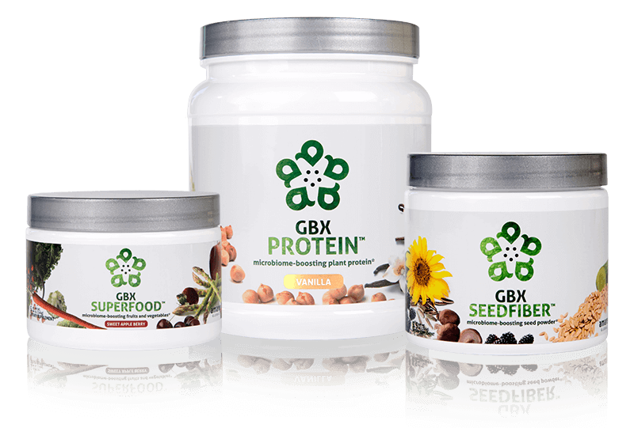






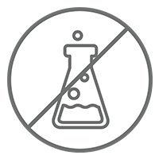
Microbiome-Boosting Nutrition*
GBX FOODS
™
Vegan /
All Natural*
Non-GMO and Gluten Free*
Sugar Free*
Soy and Dairy Free*
No Preservatives, Artificial Colors, Flavors and Sweeteners*
*These statements have not been evaluated by the Food and Drug Administration. This product is not intended to diagnose, treat, cure, or prevent any disease.
*These statements have not been evaluated by the Food and Drug Administration. This product is not intended to diagnose, treat, cure, or prevent any disease.

Slide 30

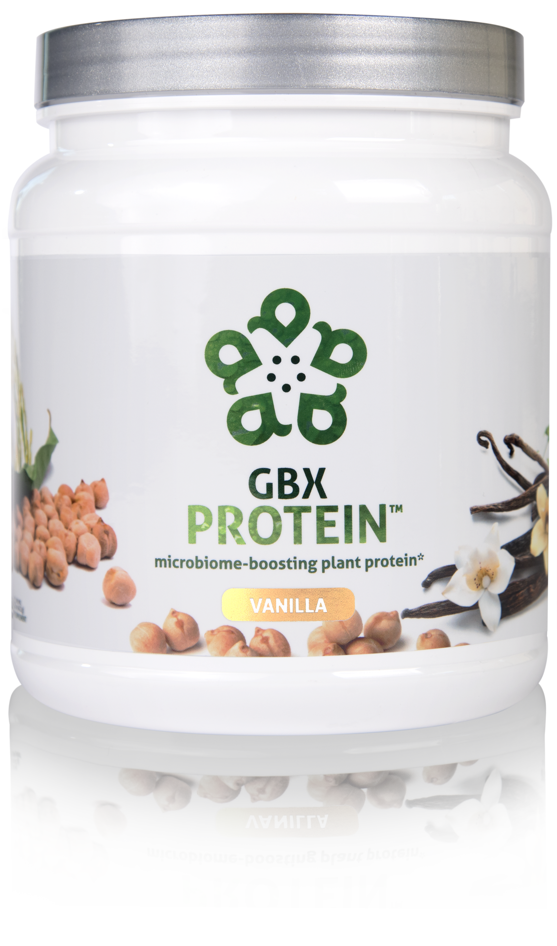
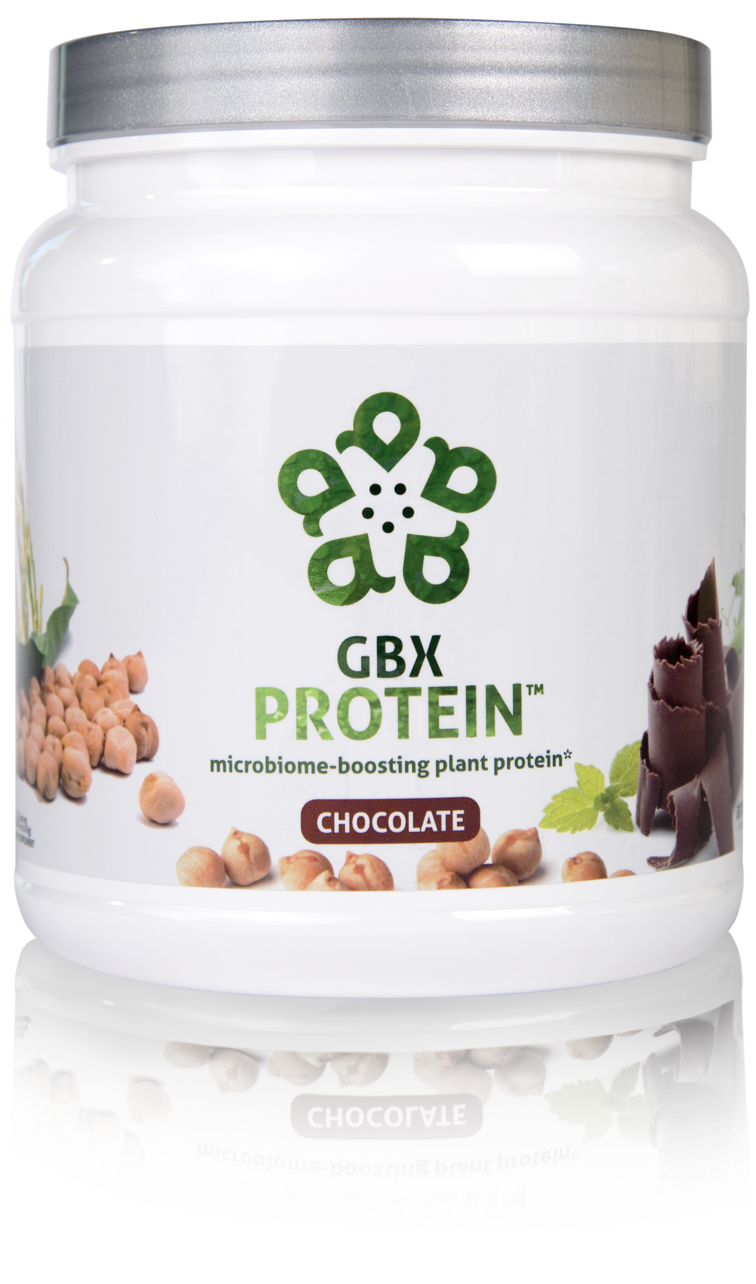
HELPS CONTROL APPETITE AND SUPPORTS MUSCLE MASS*
17 GRAMS OF ULTRA-PURE, PLANT-BASED PROTEIN*
NOURISHES GOOD GUT BACTERIA*
microbiome-boosting plant protein*
GBX Protein™ delivers 17 grams of pure plant protein. This unique chickpea, brown rice, and pea protein blend nourishes good bacteria in the gut and improves microbiome balance, while controlling appetite and supporting muscle mass. Fully-loaded with only functional ingredients, this potent formula supports the gut microbiome, helping fuel a healthy lifestyle.*
Item Code (Vanilla):
Item Code (Chocolate):
Retail Price:
Wholesale Price:
Subscribe & Save:
S015
S016
$54.00
$39.95 / 26 PV
$35.95 / 22 PV
*These statements have not been evaluated by the Food and Drug Administration. This product is not intended to diagnose, treat, cure, or prevent any disease.

Slide 31
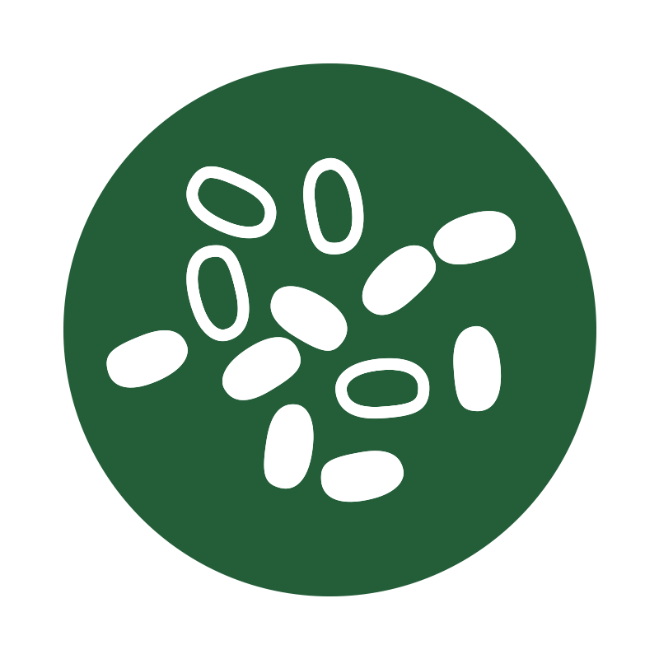


microbiome-boosting plant protein*
Improves
microbiome
balance*
Helps control appetite*
Increases
energy*
*These statements have not been evaluated by the Food and Drug Administration. This product is not intended to diagnose, treat, cure, or prevent any disease.

Slide 32

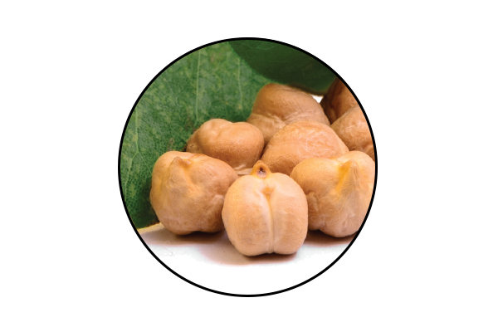
GBX Protein
KEY INGREDIENTS
™
Artesa® Chickpea Protein
Premium, sustainably sourced chickpeas from Western Canada and North America*
Unique microbiome-boosting phytonutrients*
Smooth flavor and taste
*These statements have not been evaluated by the Food and Drug Administration. This product is not intended to diagnose, treat, cure, or prevent any disease.

Slide 33
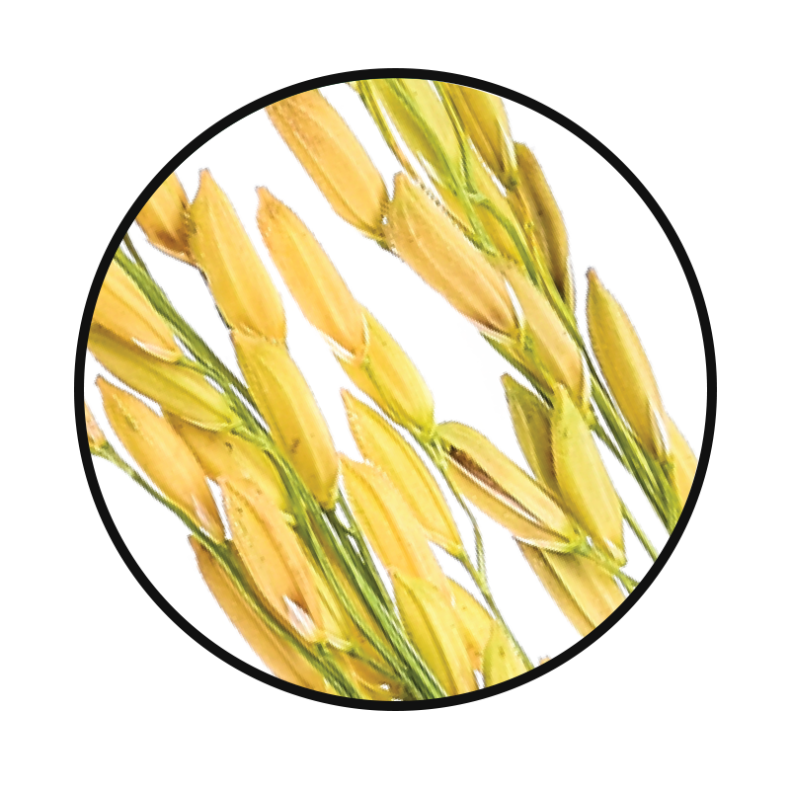
GBX Protein
KEY INGREDIENTS
™
Brown Rice Protein
Helps with weight loss and speeds metabolism*
Improves liver function*
Promotes cardiovascular health*
*These statements have not been evaluated by the Food and Drug Administration. This product is not intended to diagnose, treat, cure, or prevent any disease.

Slide 34
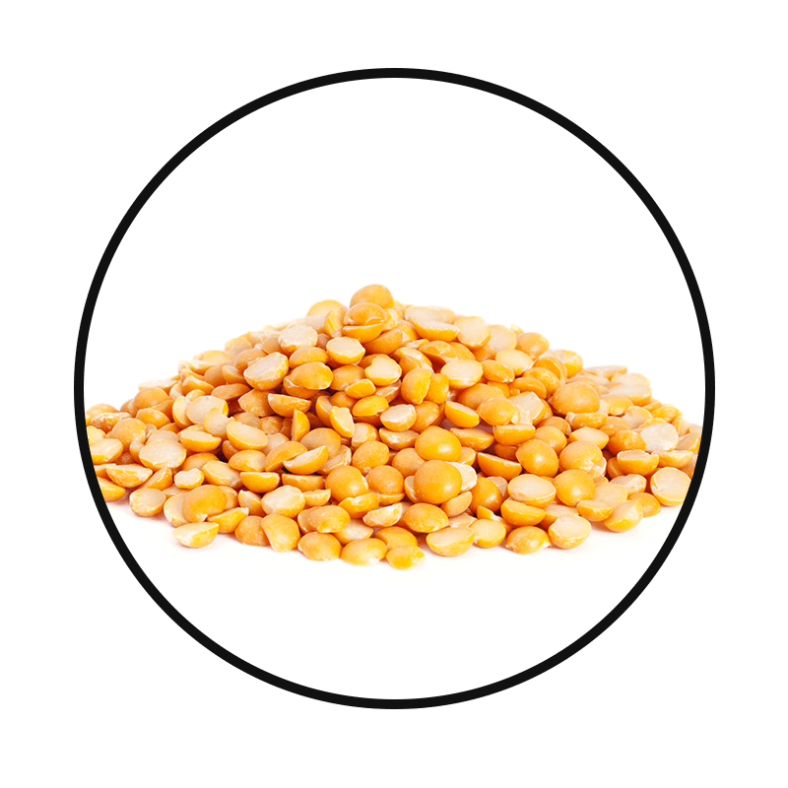
GBX Protein
KEY INGREDIENTS
™
Pea Protein
Helps maintain muscle mass*
Aids in weight loss*
Supports heart health*
*These statements have not been evaluated by the Food and Drug Administration. This product is not intended to diagnose, treat, cure, or prevent any disease.

Slide 35

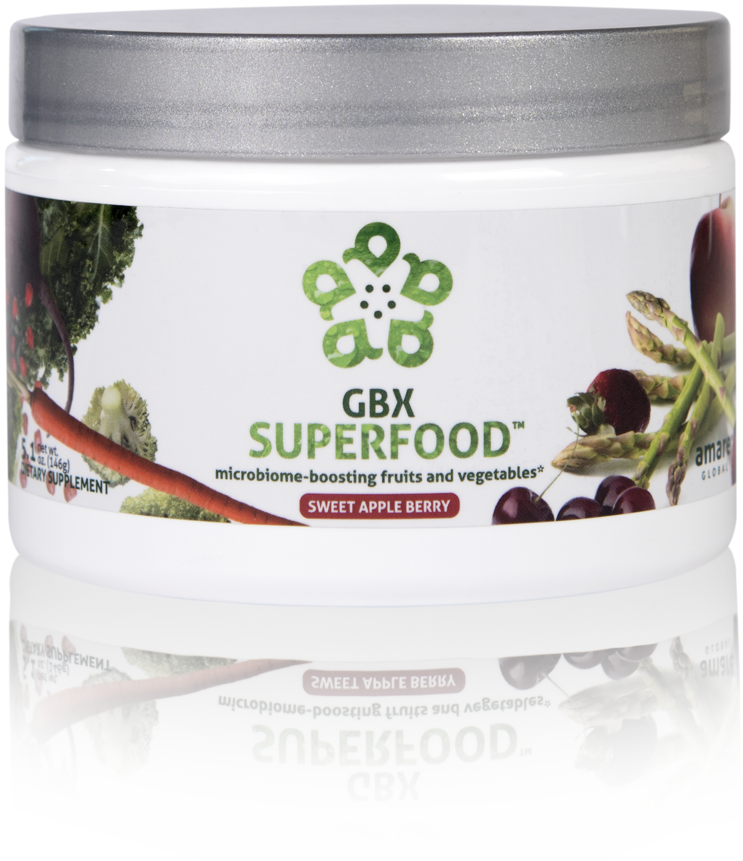
NUTRIENTS EQUIVALENT TO 3 SERVINGS OF FRUITS AND VEGETABLES*
NOURISHES GOOD GUT BACTERIA*
PROVIDES CELLULAR ANTI-STRESS BENEFITS*
microbiome-boosting fruits and vegetables*
GBX SuperFood™ provides the phytonutrient equivalent of three servings of fruits and vegetables per scoop. This phytobiotic-rich blend delivers cellular level anti-stress benefits and helps protect cells from a variety of different stressors, helping the brain and gut run at peak efficiency.*
Item Code:
Retail Price:
Wholesale Price:
Subscribe & Save:
S018
$40.00
$29.95 / 21 PV
$26.95 / 18 PV
*These statements have not been evaluated by the Food and Drug Administration. This product is not intended to diagnose, treat, cure, or prevent any disease.

Slide 36



microbiome-boosting fruits and vegetables*
Increases Heat Shock Protein expression*
Enhances internal cellular cleanup (autophagy)*
Stress resilience benefits that you can FEEL at the cellular level*
*These statements have not been evaluated by the Food and Drug Administration. This product is not intended to diagnose, treat, cure, or prevent any disease.

Slide 37
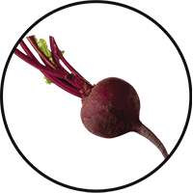
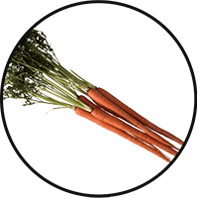
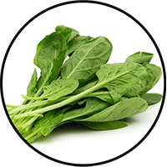
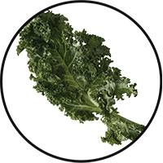
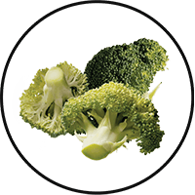
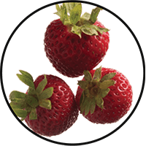
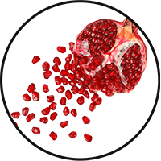

GBX SuperFood
KEY INGREDIENTS:
™
Anti-Stress Phytobiotic Proprietary Blend
Fruits and Vegetables
Provides three servings of natural fruits and veggies for comprehensive nutrition in a convenient, single serving*
Beet Root
Carrot
Spinach
Kale
Broccoli
Strawberry
Pomegranate
Tart Cherry
*These statements have not been evaluated by the Food and Drug Administration. This product is not intended to diagnose, treat, cure, or prevent any disease.

Slide 38

GBX SuperFood
KEY INGREDIENTS:
™
Anti-Stress Phytobiotic Proprietary Blend
Spirulina
A natural algae that provides potent nutrients and is a good source of antioxidants and B vitamins — high in proteins and helps with gastric integrity/balance*
*These statements have not been evaluated by the Food and Drug Administration. This product is not intended to diagnose, treat, cure, or prevent any disease.

Slide 39


GBX SuperFood
KEY INGREDIENTS:
™
Anti-Stress Phytobiotic Proprietary Blend
ETAS™: Enzyme-Treated Japanese Asparagus
Supports mood and cognitive function*
Protects neuronal cells*
Induces the production of natural anti-stress molecules called Heat Shock Proteins*
*These statements have not been evaluated by the Food and Drug Administration. This product is not intended to diagnose, treat, cure, or prevent any disease.
Notes:
ETAS™: Enzyme-Treated Japanese Asparagus
Uniquely sourced from Japan
Has been used for > 5,000 years
Derived from the lower stalk portion of asparagus stalks, where the most phytonutrients are found.
Rich in hydroxymethylfurfural derivatives, which is a necessary compound that induces HSP70 microRNA expression.
ETAS™: Mechanism of Action
What is HSP70? Heat Shock Proteins
ETAS works by increasing the production of HSP70: an intracellular protein produced naturally by the body when it encounters a stressor, such as extreme heat.
Clinical Studies have shown ETAS induces a significant production of HSP70 microRNA expression activities that helps with biological activities such as cellular protection, cellular repair, reduced cell death, blood flow, cellular stress, anti inflammatory activity, sleep, mood, energy, and antioxidant activity.
ETAS™: Mechanism of Action
Why is HSP70 production important?
As we age, the Heat Shock Protein production to stressors decrease with age.
ETAS helps preserve and maintain the appropriate HSP70 expression to promote brain health, stress response and cognitive performance as we age!
HSP70 has a number of beneficial, physiological effects in the body, including reduced cell death, anti-inflammatory activity and antioxidant activity.
There is no reason why you shouldn’t feel 25, when you’re 50!

Slide 40
GBX SuperFood
KEY INGREDIENTS:
™
Gut-Integrity Prebiotic Proprietary Blend
IsoFiber™:
IsoFiber is a special Iso-Malto-Oligosaccharide that is a combination of naturally occurring prebiotic plant fibers that are clinically shown to improve the growth of specific probiotic strains used in our MentaBiotics™.
IsoFiber is digestive resistant, and has a very low glycemic index.
IsoFiber helps with gastric motility and digestive health throughout the digestive tract.
*These statements have not been evaluated by the Food and Drug Administration. This product is not intended to diagnose, treat, cure, or prevent any disease.

Slide 41



GBX SuperFood
KEY INGREDIENTS:
™
Gut-Integrity Prebiotic Proprietary Blend
Apple Fiber
Helps with bulking in the intestinal tract, and heart health*
Chia Seed
Good source of Omega-3 fatty acids, fiber, antioxidants, proteins and calcium*
Good for heart and brain health*
Flax Seed
Good natural source of Omega-3 fatty acids, lignans and fiber*
Helps with heart and brain health*
*These statements have not been evaluated by the Food and Drug Administration. This product is not intended to diagnose, treat, cure, or prevent any disease.

Slide 42


NEXT-GENERATION APPROACH TO OPTIMIZING GUT-BRAIN AXIS*
CONTAINS NATURAL MICROBIOME-BOOSTING FIBERS*
HELPS MANAGE FEELINGS OF STRESS, TENSION AND ANXIETY*
microbiome-boosting seed powder*
GBX SeedFiber™ is the next-generation approach to optimizing the gut-brain axis. This phytobiotic-rich formula contains seeds as sources of natural microbiome-boosting fibers, helping you feel fuller, longer. Featuring a cultured mushroom mycelia extract to support microRNA signaling between the microbiome and central nervous system, this unique blend helps manage feelings of stress, tension and anxiety.*
Item Code:
Retail Price:
Wholesale Price:
Subscribe & Save:
S019
$50.00
$36.95 / 26 PV
$32.95 / 21 PV
*These statements have not been evaluated by the Food and Drug Administration. This product is not intended to diagnose, treat, cure, or prevent any disease.

Slide 43



microbiome-boosting seed powder*
Optimizes gut-brain axis communication*
Naturally supports microRNA signaling*
Helps manage feelings of tension and anxiety*
*These statements have not been evaluated by the Food and Drug Administration. This product is not intended to diagnose, treat, cure, or prevent any disease.

Slide 44



GBX SeedFiber
KEY INGREDIENTS:
™
Cold-Pressed Natural Seeds
Sunflower Seed
One of the top natural sources of good fats, copper, selenium, folate and vitamin E*
Cucumber Seed
Great source of fiber and beta carotene, which helps with immunity, and skin and eye health*
Cranberry Seed
Great source of vitamin E, Omega-3, -6 and -9, and also acts as an antioxidant to protect the body from stressors*
*These statements have not been evaluated by the Food and Drug Administration. This product is not intended to diagnose, treat, cure, or prevent any disease.

Slide 45



GBX SeedFiber
KEY INGREDIENTS:
™
Cold-Pressed Natural Seeds
Black Cumin Seed
Contains B vitamins and antioxidants, and helps boost the immune system*
Blackberry Seed
Rich in Omega-3 (alpha-linolenic acid) and Omega-6 (linolenic acid) fats, which are good for heart and brain health*
Concord Grape Seed
Great natural source of vitamin A and E, which is crucial for skin, circulation, cholesterol, and has antioxidant effects*
*These statements have not been evaluated by the Food and Drug Administration. This product is not intended to diagnose, treat, cure, or prevent any disease.

Slide 46

GBX SeedFiber
KEY INGREDIENTS
™
AHCC®: Active Hexose Correlated Compound
Cultured mushroom mycelia extract
Effective for immune support*
Rich in alpha-glucans*
Supports microRNA signaling between the microbiome and the central nervous system*
*These statements have not been evaluated by the Food and Drug Administration. This product is not intended to diagnose, treat, cure, or prevent any disease.
Notes:
AHCC®: Active Hexose Correlated Compound
Is a compound of cultured, mushroom mycelia extract that is rich in alpha-glucans.
It is uniquely sourced in Japan, at the highest quality standards.
Known as the #1 supplement in Japan for immune function for over 25 years.
AHCC®:
Extracted through a special lipid culturing process that delivers an extract that has superior bio-absorption and efficacy.
AHCC contains a partially acylated alpha glucan 1,4 that is known to have positive effects on immune cell production, intestinal immunity, T cell activity, cytokine production, antioxidant effects, and microRNA signaling from the microbiome to the central nervous system.
AHCC helps reduce the production of glucocorticoids in the cases of stress. This manifests in improved mood and energy.
AHCC is beneficial for gut health, in which it reduces intestinal inflammation to favor the development of a healthy gut microflora specific to the strains we use in our Probiotics and MentaBiotics™ (more Bifidobacterium, less Clostridium).
Helps improves gut integrity by providing protection from Candida, Pseudomonas and other detrimental bacteria types.
Facilitating and building a responsive immune system allows our body to repair, rebuild and maintain itself at a cellular level, allowing the most efficient communication between your microbiome and your central nervous system.

Slide 47




Roles of AHCC in the Gut-Brain Axis
Anti-inflammatory/immune Homeostasis
Prebiotic (TLR2/4)
miRNAs
Mallet et al.,
European Journal of Nutrition 2015
Mallet et al.,
European Journal of Nutrition 2015
Graham et al., Cancer Biology and Therapy 2017

Slide 48

Microbiome-Boosting Nutrition*
GBX FOODS SYSTEM
™
Item Code:
Retail Price:
Wholesale Price:
Subscribe & Save:
S021
$144.00
$95.95 / 62 PV
$85.95 / 52 PV
*These statements have not been evaluated by the Food and Drug Administration. This product is not intended to diagnose, treat, cure, or prevent any disease.

Slide 49


MOOD ELEVATING
PROMOTES RELAXATION
TENSION REDUCING
all-natural
mood support*
The key ingredients in Mood+ have multiple scientific studies that show significant benefits for mood support such as relief from anxious feelings, sadness, restlessness, and overall
stress relief.*
Item Code:
Retail Price:
Wholesale Price:
Subscribe & Save:
S006
$80.00
$59.95 / 52 PV
$53.95 / 46 PV
*These statements have not been evaluated by the Food and Drug Administration. This product is not intended to diagnose, treat, cure, or prevent any disease.

Slide 50

MOOD+
KEY INGREDIENTS
Venetron, Rafuma
Depression
*These statements have not been evaluated by the Food and Drug Administration. This product is not intended to diagnose, treat, cure, or prevent any disease.

Slide 51

MOOD+
KEY INGREDIENTS
Zembrin, Kanna
Depression
*These statements have not been evaluated by the Food and Drug Administration. This product is not intended to diagnose, treat, cure, or prevent any disease.

Slide 52
fMRI Study Results Show Reduced Stress Response
MOOD+
KEY INGREDIENTS
ZEMBRIN MAY HELP IN THE MANAGEMENT OF STRESS IN EVERYDAY LIFE
A single dose of Zembrin attenuates reactivity within the part of the brain (amygdala) that responds to threat/stress
®
®
*These statements have not been evaluated by the Food and Drug Administration. This product is not intended to diagnose, treat, cure, or prevent any disease.
Notes:
Terburg et al. Acute Effects of Sceletium tortuosum (Zembrin), a Dual
5-HT Reuptake and PDE4 Inhibitor, in the Human Amygdala and its Connection to the Hypothalamus. Neuropsychopharmacology (2013), 1–9.

Slide 53
Cognitive Set Flexibility
MOOD+
KEY INGREDIENTS
COGNITIVE FLEXIBILITY
Ability to shift attention between two or more tasks and the ability to adapt to rapidly changing directions and intelligently utilize the information.
Necessary for decision-making, impulse control and strategy formation.
CNS VitalSign has been used for testing neurocognitive function by over 5000 clinicians in 52 countries
®
*These statements have not been evaluated by the Food and Drug Administration. This product is not intended to diagnose, treat, cure, or prevent any disease.
Notes:
Chiu et al. Proof-of-Concept Randomized Controlled Study of Cognition Effects of the Proprietary Extract Sceletium tortuosum (Zembrin) Targeting Phosphodiesterase-4 in Cognitively Healthy Subjects: Implications for Alzheimer’s Dementia. Evidence-Based Complementary and Alternative Medicine Volume 2014, Article ID 682014

Slide 54

MOOD+
KEY INGREDIENTS
Sensoril, Ashwagandha
Anxiety
*These statements have not been evaluated by the Food and Drug Administration. This product is not intended to diagnose, treat, cure, or prevent any disease.
Notes:
Auddy et al. A Standardized Withania Somnifera Extract Significantly Reduces Stress-Related Parameters in Chronically Stressed Humans: A Double-Blind, Randomized, Placebo-Controlled Study. Journal of the American Nutraceutical Association Vol.11,No.1, 2008 pp50-56.

Slide 55
MOOD+
KEY INGREDIENTS
Sensoril, Ashwagandha
Anxiety
*These statements have not been evaluated by the Food and Drug Administration. This product is not intended to diagnose, treat, cure, or prevent any disease.
Notes:
Auddy et al. A Standardized Withania Somnifera Extract Significantly Reduces Stress-Related Parameters in Chronically Stressed Humans: A Double-Blind, Randomized, Placebo-Controlled Study. Journal of the American Nutraceutical Association Vol.11,No.1, 2008 pp50-56.

Slide 56


MOOD+
KEY INGREDIENTS
Relora, Magnolia & Phellondendron
Anxiety
*These statements have not been evaluated by the Food and Drug Administration. This product is not intended to diagnose, treat, cure, or prevent any disease.
Notes:
Talbott et al. Effect of Magnolia officinalis and Phellodendron amurense (Relora®) on cortisol and psychological mood state in moderately stressed subjects. Journal of the International Society of Sports Nutrition 2013, 10:37
Garrison et al. Effect of a proprietary Magnolia and Phellodendron extract on weight management: a pilot, double-blind, placebo-controlled clinical trial. Altern Ther Health Med. 2006;12(1):50-54.
Kalman et al. Effect of a proprietary Magnolia and Phellodendron extract on stress levels in healthy women: a pilot, double-blind, placebo-controlled clinical trial. Nutrition Journal 2008, 7:11

Slide 57



FALL ASLEEP FASTER
STAY ASLEEP LONGER
IMPROVES SLEEP QUALITY
rejuvenating, refreshing,
restful sleep*
The key ingredients in Sleep+ have multiple scientific studies that show significant benefits including helping you to fall asleep faster, stay asleep longer, and experience higher quality plus more rejuvenating sleep.*
Item Code:
Retail Price:
Wholesale Price:
Subscribe & Save:
S008
$80.00
$59.95 / 52 PV
$53.95 / 46 PV
*These statements have not been evaluated by the Food and Drug Administration. This product is not intended to diagnose, treat, cure, or prevent any disease.

Slide 58



rejuvenating, refreshing,
restful sleep*
Improvement in sleep efficiency*
Improvement in sleep quality*
Fall asleep faster by 33% and wake up fewer times each night by 30%*
*These statements have not been evaluated by the Food and Drug Administration. This product is not intended to diagnose, treat, cure, or prevent any disease.
Notes:
Talbott and Talbott: Effect of Monocot Grass Extract (MGE) on mood state and sleep patterns in moderately stress subjects. Journal of the International Society of Sports Nutrition 2013 10(Suppl 1):P26.

Slide 59
THE THREE THINGS YOU SHOULD KNOW ABOUT
MENTAL WELLNESS
How you feel is not just in your head – it’s also in your gut.
Our “second brain” includes the Microbiome and plays a major role in mental wellness.
You can now DO something NATURALLY to improve your mental wellness.
WHERE ARE YOU ON THE MENTAL WELLNESS CONTINUUM? (Circle your current number)
1
2
3
4
5
6
7
8
9
10
DISEASE STATUS
“NORMAL”
OPTIMIZED
Depression
Anxiety
Diabetes
Obesity
Heart Disease
Autoimmune
Arthritis
Fibromyalgia
CFS
Dementia
ADD / ADHD
Alzheimer’s
Fatigue
Tension
Sad
Brain Fog
Headaches
Acne
Eczema
Congestion
URTI’s
Joint Pain
Muscle Pain
Bloated
Chubby
Energetic
Calmness
Happy
Sharp
Creative
Clear Skin
Rarely Sick
Flexible
Lean
Strong
Resilient
RED
ORANGE
YELLOW
GREEN
BLUE
INDIGO
VIOLET

