Slide 1


MENTAL WELLNESS

Slide 2

GRIM REALITY
Americans spend over $100 billion annually on “feel better” products, from painkillers and anti-depressants to alternative and complementary therapies
100 million Americans suffer from chronic pain – this is one of the top reasons for the $100 billion expenditure
350 million people globally are affected by depression each year – another major reason for the $100 billion expenditure
90% of adolescents have a depressive disorder before the age of 18
Notes:
Americans spend over $100 billion annually on “feel better” products, from painkillers and anti-depressants to alternative and complementary therapies
Nearly 100 million Americans suffer from occasional aches and pains – and is one of the most common reasons that people look to complementary and alternative medicine (CAM) for non-pharmaceutical options
Globally, more than 350 million people are affected by feelings of depression each year
Nearly 90% of adolescents struggle with feelings of depression and anxiety before the age of 18
Globally, more than 800,000 people die by suicide every year – around one person every 40 seconds. In the United States, more than 40,000 Americans commit suicide each year – that’s more than 100 suicides per day
Every year, more than 24 million people, some as young as 12 years old, receive treatment for illicit drug or alcohol abuse
Approximately 1 in 5 new mothers in the U.S. have postpartum depression each year
The World Health Organization calls stress “the health epidemic of the 21st century” with more than 350 million people affected around the world
More than 80% of the nation’s 20 million college students feel “exhausted and overwhelmed by stress” - and more than one-third feel “depressed” to the point of dysfunction

Slide 3
GRIM REALITY
800,000 people die of suicide each year – that’s over 2000 suicides per day
24 million people, some as young as 12 years old, received treatment for illicit drug or alcohol abuse in 2016
1 in 5 new mothers in the U.S. report postpartum depression each year
The World Health Organization calls stress “the health epidemic of the 21st century”
85% of the nation’s 20 million college students reported feeling overwhelmed by stress - and more than 35% reported feeling “depressed” to the point of dysfunction
Notes:
Shawn’s verbiage:
Americans spend over $100 billion annually on “feel better” products, from painkillers and anti-depressants to alternative and complementary therapies
Nearly 100 million Americans suffer from occasional aches and pains – and is one of the most common reasons that people look to complementary and alternative medicine (CAM) for non-pharmaceutical options
Globally, more than 350 million people are affected by feelings of depression each year
Nearly 90% of adolescents struggle with feelings of depression and anxiety before the age of 18
Globally, more than 800,000 people die by suicide every year – around one person every 40 seconds. In the United States, more than 40,000 Americans commit suicide each year – that’s more than 100 suicides per day
Every year, more than 24 million people, some as young as 12 years old, receive treatment for illicit drug or alcohol abuse
Approximately 1 in 5 new mothers in the U.S. have postpartum depression each year
The World Health Organization calls stress “the health epidemic of the 21st century” with more than 350 million people affected around the world
More than 80% of the nation’s 20 million college students feel “exhausted and overwhelmed by stress” - and more than one-third feel “depressed” to the point of dysfunction
SOURCES:
Grim Reality Statistics
Americans spend over $100 billion annually on “feel better” products, from painkillers and anti-depressants to alternative and complementary therapies
Centers for Disease Control and Prevention (CDC) https://www.cdc.gov/nchs/data/hus/hus13.pdf;
Journal of the American Medical Association (JAMA) Trends in Prescription Drug Use Among Adults in the United States From 1999-2012 http://jamanetwork.com/journals/jama/fullarticle/2467552; National Survey on Drug Use and Health https://nsduhweb.rti.org/respweb/homepage.cfm; National Center for Complementary and Integrative Medicine (NCCIM) https://nccih.nih.gov/news/press/cost-spending-06222016
Nearly 100 million Americans suffer from occasional aches and pains – and is one of the most common reasons that people look to complementary and alternative medicine (CAM) for non-pharmaceutical options
National Institutes of Health (NIH), National Center for Complementary and Integrative Medicine (NCCIM), National Health Interview Survey (NHIS) https://nccih.nih.gov/news/press/08112015; Washington Post https://www.washingtonpost.com/news/to-your-health/wp/2015/08/11/nih-more-than-1-in-10-american-adults-experience-chronic-pain/?utm_term=.4dd603a1f016
Globally, more than 350 million people are affected by feelings of depression each year
National Institute for Mental Health (NIMH) https://www.nimh.nih.gov/health/publications/depression/index.shtml; Healthline http://www.healthline.com/health/depression/facts-statistics-infographic; National Alliance on Mental Illness (NAMI) https://www.nami.org
Nearly 90% of adolescents struggle with feelings of depression and anxiety before the age of 18
Depression in Children and Teens, WebMD http://www.webmd.com/depression/tc/depression-in-childhood-and-adolescence-topic-overview#1; National Institute of Mental Health (NIMH) https://www.nimh.nih.gov/health/statistics/prevalence/any-disorder-among-children.shtml
Globally, more than 800,000 people die by suicide every year – around one person every 40 seconds. In the United States, more than 40,000 Americans commit suicide each year – that’s more than 100 suicides per day.
Centers for Disease Control & Prevention, National Center for Health Statistics, Increase in Suicide in the United States, 1999–2014, NCHS Data Brief No. 241, April 2016; New York Times https://www.nytimes.com/2016/04/22/health/us-suicide-rate-surges-to-a-30-year-high.html?_r=0; World Health Organization (WHO) http://www.who.int/mediacentre/news/releases/2014/suicide-prevention-report/en/
Every year, more than 24 million people, some as young as 12 years old, receive treatment for illicit drug or alcohol abuse
National Institutes of Health (NIH); National Institute on Drug Abuse (NIDA) https://www.drugabuse.gov/related-topics/trends-statistics; Substance Abuse and Mental Health Services Administration’s (SAMHSA’s) National Survey on Drug Use and Health https://www.drugabuse.gov/publications/drugfacts/treatment-statistics
Approximately 1 in 5 new mothers in the U.S. have postpartum depression each year
Centers for Disease Control and Prevention https://www.cdc.gov/reproductivehealth/depression/index.htm; Postpartum Progress http://postpartumprogress.org/the-facts-about-postpartum-depression/; American Psychological Association (APA) http://www.apa.org/pi/women/resources/reports/postpartum-depression.aspx
The World Health Organization calls stress “the health epidemic of the 21st century” with more than 350 million people affected around the world
World Health Organization (WHO) http://www.who.int/mediacentre/factsheets/fs369/en/; http://www.who.int/mediacentre/factsheets/fs396/en/; Business News Daily http://www.businessnewsdaily.com/2267-workplace-stress-health-epidemic-perventable-employee-assistance-programs.html; Stress: Concepts, Cognition, Emotion, and Behavior http://scitechconnect.elsevier.com/stress-health-epidemic-21st-century/; WHO World Mental Health http://www.who.int/mental_health/world-mental-health-day/2016/en/
More than 80% of the nation’s 20 million college students feel “exhausted and overwhelmed by stress” - and more than one-third feel “depressed” to the point of dysfunction
American College Health Association http://www.acha.org/ACHA/Resources/Topics/MentalHealth.aspx; American Psychological Association (APA) http://www.apa.org/monitor/2014/09/cover-pressure.aspx;

Slide 4
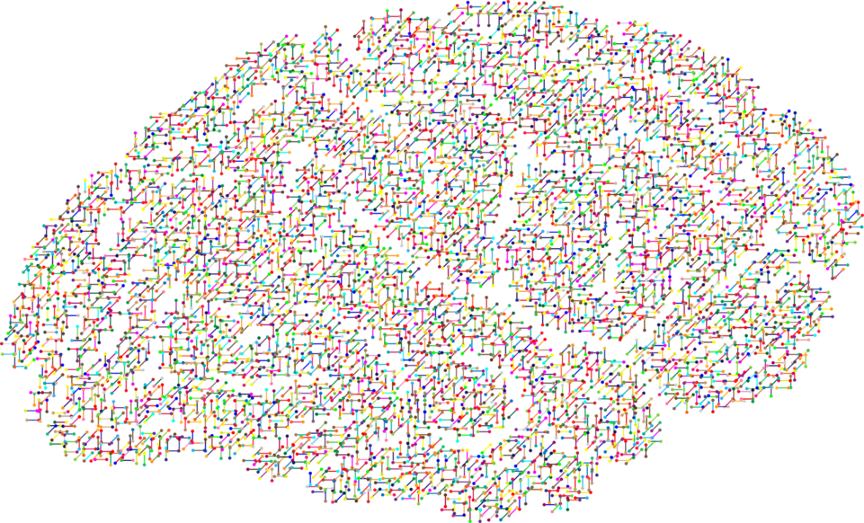
The NEW Science of
Mental Wellness
Science has forever focused on the BRAIN as the primary source to addressing mental wellness problems & answers.
We’ve been relying highly on antidepressants and other forms of serotonin reuptake inhibitors (SSRIs) to resolve these issues.
BUT IS THIS THE RIGHT SOLUTON?

Slide 5
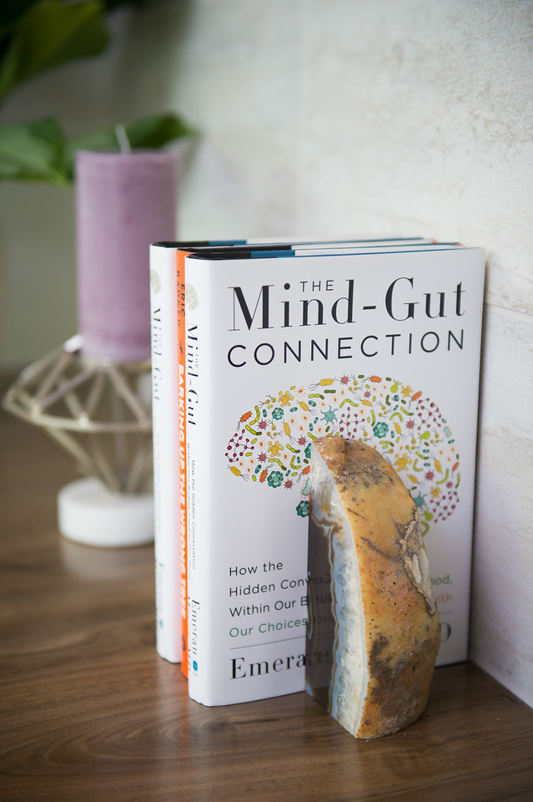
RECENT SCIENTIFIC
DISCOVERIES
Science now tells us that we actually have a SECOND BRAIN!
There has been a massive scientific shift towards the MICROBIOME, also known as our gut and second brain, as being the source to addressing mental wellness issues.

Slide 6
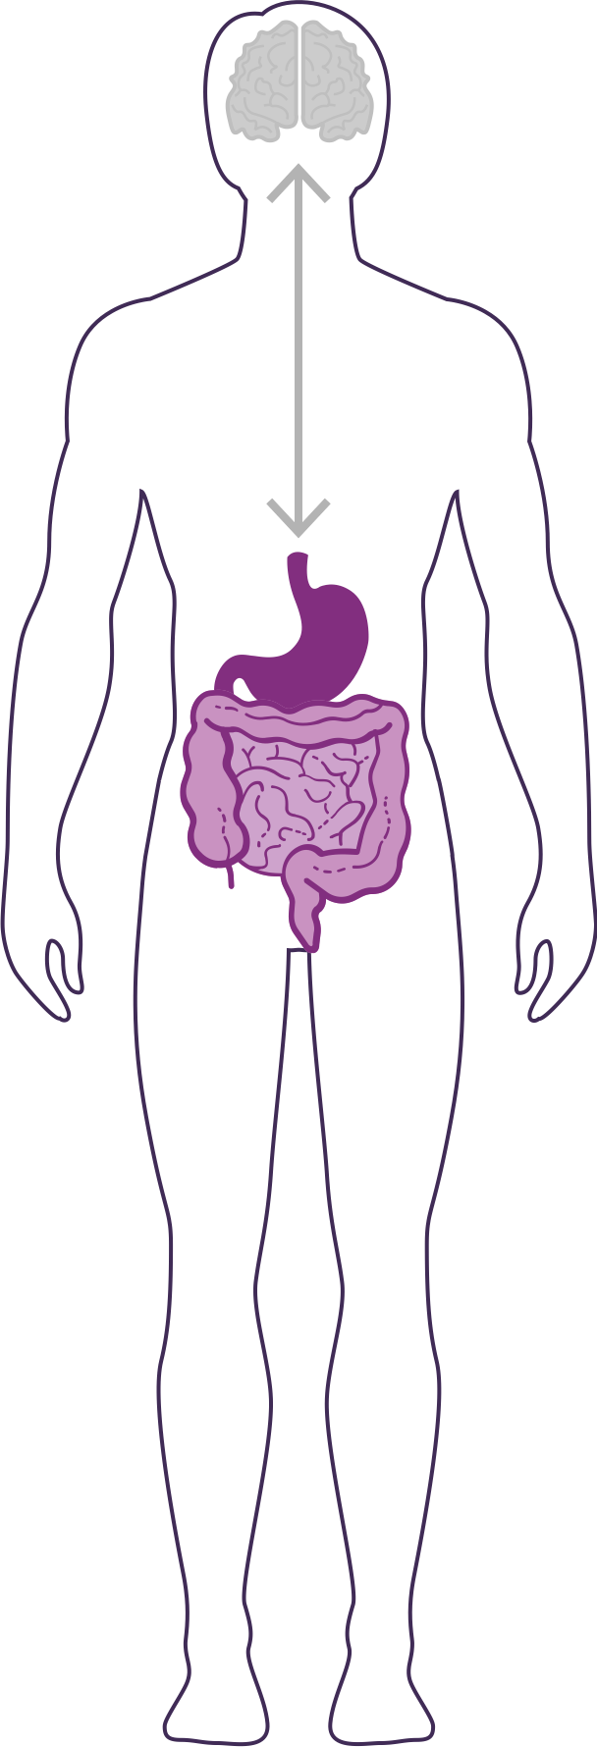
DID YOU KNOW?
90% of the cells in your body are non-human
  Human genes = ~23,000
  Bacterial genes= ~20 million
  (~1,000x MORE than human genes)
The microbiome is an ecological community of trillions of bacteria living symbiotically in/on our body
  “2nd Brain” = 3-4 lbs (approximately the same size as our 1st brain)
YOUR GUT IS CONSIDERED YOUR SECOND BRAIN

Slide 7

HOW IMPORTANT IS YOUR
MICROBIOME?
Communicates with the brain to regulate health, weight, immune function, digestive function, mood, and overall mental health.
What we put in our bodies affects the microbiome, which in turn affects our mind and other crucial bodily systems
The microbiome plays an important role in the way you feel mentally & physically.
IN BALANCE
Feeling Great
OUT OF BALANCE
This explains why you have those “GUT FEELINGS”
Feeling fatigue, sad, tense, hungry, heavy, bloated, confused, stiff/sore

Slide 8
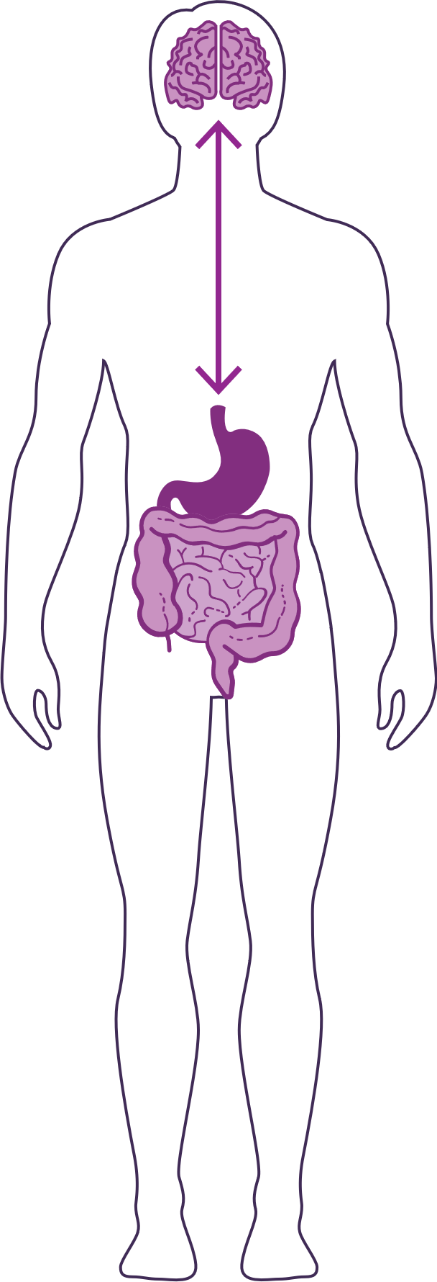
HOW DO YOUR “TWO BRAINS”
COMMUNICATE?
Our “two brains” communicate through a highly extensive, multi-directional network, known as the gut-brain axis or what we refer to as the GBX.
THE NETWORK CONSISTS OF:
“wires” – nerves
“chemicals” – neurotransmitters/hormones
“cells” – immune system
The GBX connects our
nervous system (brain)
immune system (axis)
and gastrointestinal system (gut)
with a vast array of cellular and biochemical messengers throughout the entire body, which include the microbiome, hormones, cytokines, and neurotransmitters.

Slide 9
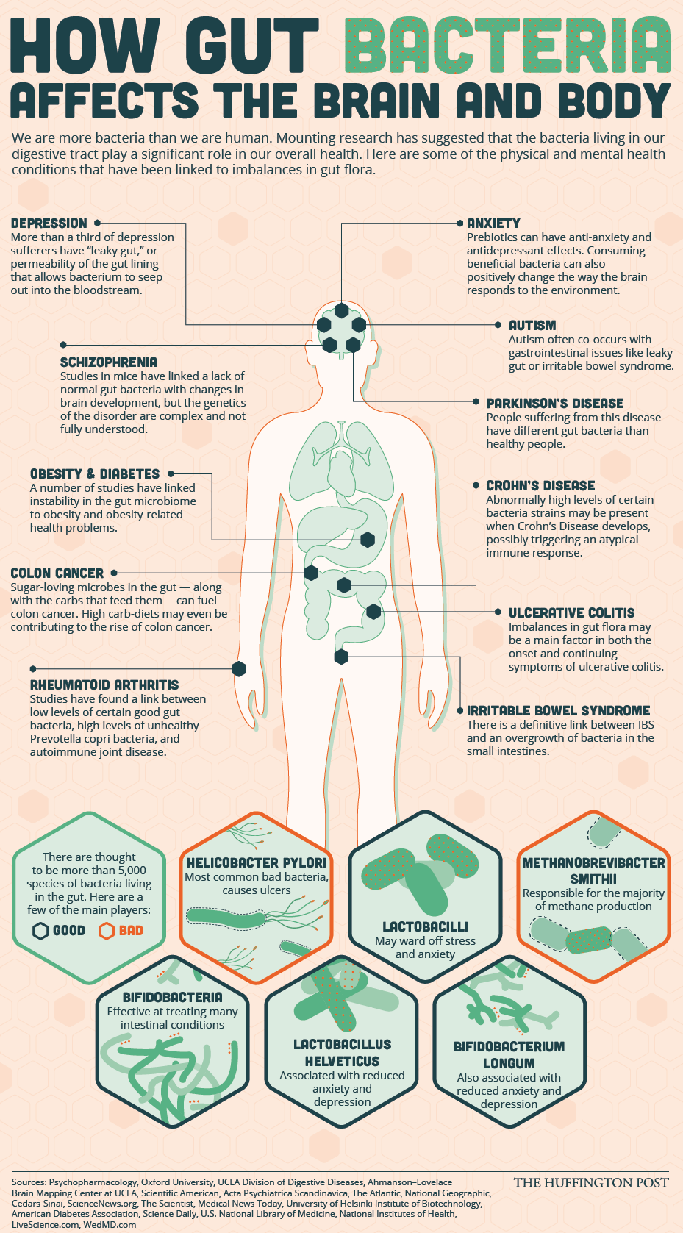

Slide 10
Making Sense of… the Microbiome in Psychiatry.
Int J Neuropsychopharmacol. 2018 Aug 7
Bastiaanssen TFS, Cowan CSM, Claesson MJ, Dinan TG, Cryan JF
…On average, the gut hosts microbes from more than 60 genera and contains more cells than the human body.
…The human gut microbiome has been shown to influence many aspects of host health including more recently the brain.
…Several modes of interaction between the gut and the brain have been discovered, including via the synthesis of metabolites and neurotransmitters, activation of the vagus nerve and activation of the immune system.
…A growing body of work is implicating the microbiome in a variety of psychological processes and neuropsychiatric disorders. These include mood and anxiety disorders, neurodevelopmental disorders such as autism spectrum disorder and schizophrenia, and even neurodegenerative disorders such as Alzheimer's and Parkinson's Disease.
…bidirectional role of the microbiome in brain health, age-associated cognitive decline, neurological and psychiatric disorders.
…exciting research area which is permeating all areas of biological psychiatry research.

Slide 11
How the Microbiome Is Fundamentally Changing Mental Wellness
Stress Regulation and HPA Axis activation
ADHD
Autism Spectrum Disorder
Schizophrenia
Bipolar disorder
Depression
Anxiety
Chronic Fatigue Syndrome
Obsessive Compulsive Disorders (OCD) / Eating Disorders
Cognitive Impairment (”inflammaging”)
Migraines
Fibromyalgia
Alzheimer’s Disease
Parkinson’s Disease
Multiple Sclerosis

Slide 12
How the Microbiome Is Fundamentally Changing Physical Health
Irritable Bowel Syndrome (IBS)
Inflammatory Bowel Disorders (IBD)
Crohn’s Disease
Colitis/Diverticulitis
Leaky Gut
Menopausal Symptoms
Autoimmune (rheumatoid arthritis, lupus, allergy)
Skin (acne, psoriasis, eczema, wrinkles, wound repair)
Obesity
Diabetes
Exercise Performance (mental and physical)
Heart Disease (high cholesterol, high blood pressure, blood flow)
Cancer
Most people tend to have more than one health complaint at a time
  = “comorbidities” = inflammation/immune
Microbiome “patterns” related to state of general health (but expressed via individual genetics)

Slide 13
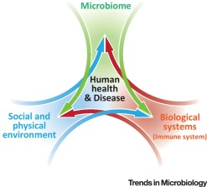
Biome
Body
Brain

Slide 14
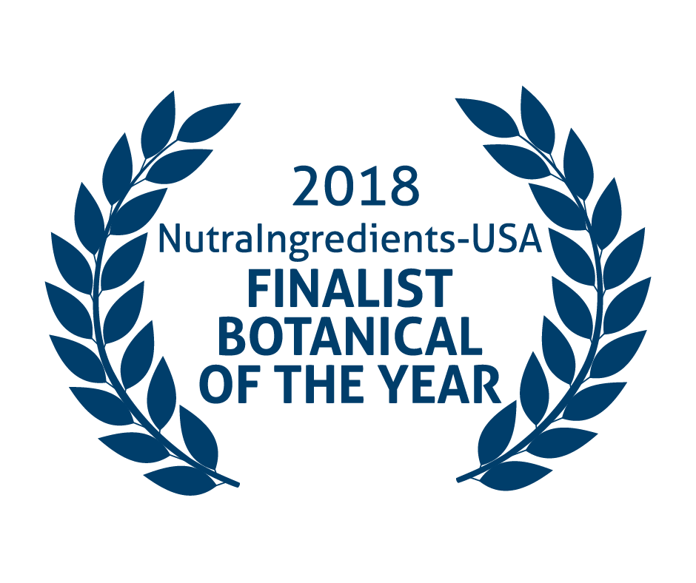
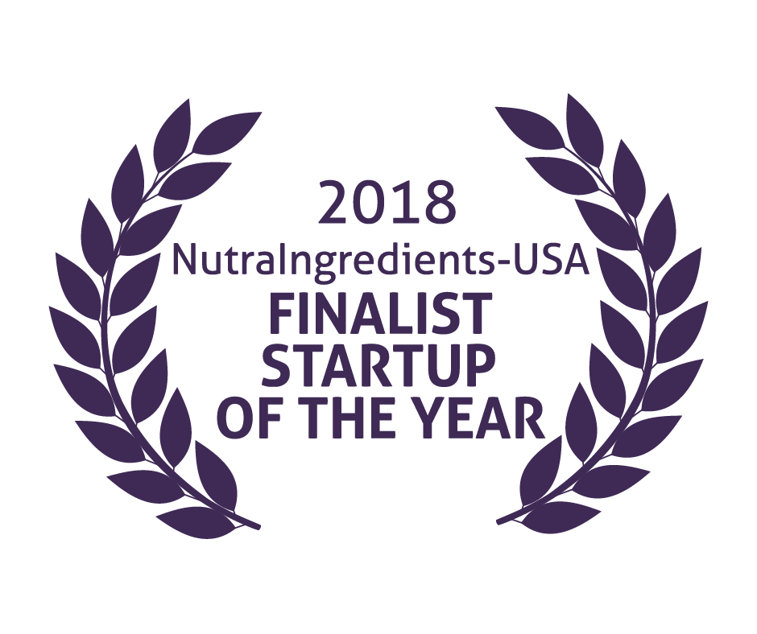
Mood+
Amare Global

Slide 15
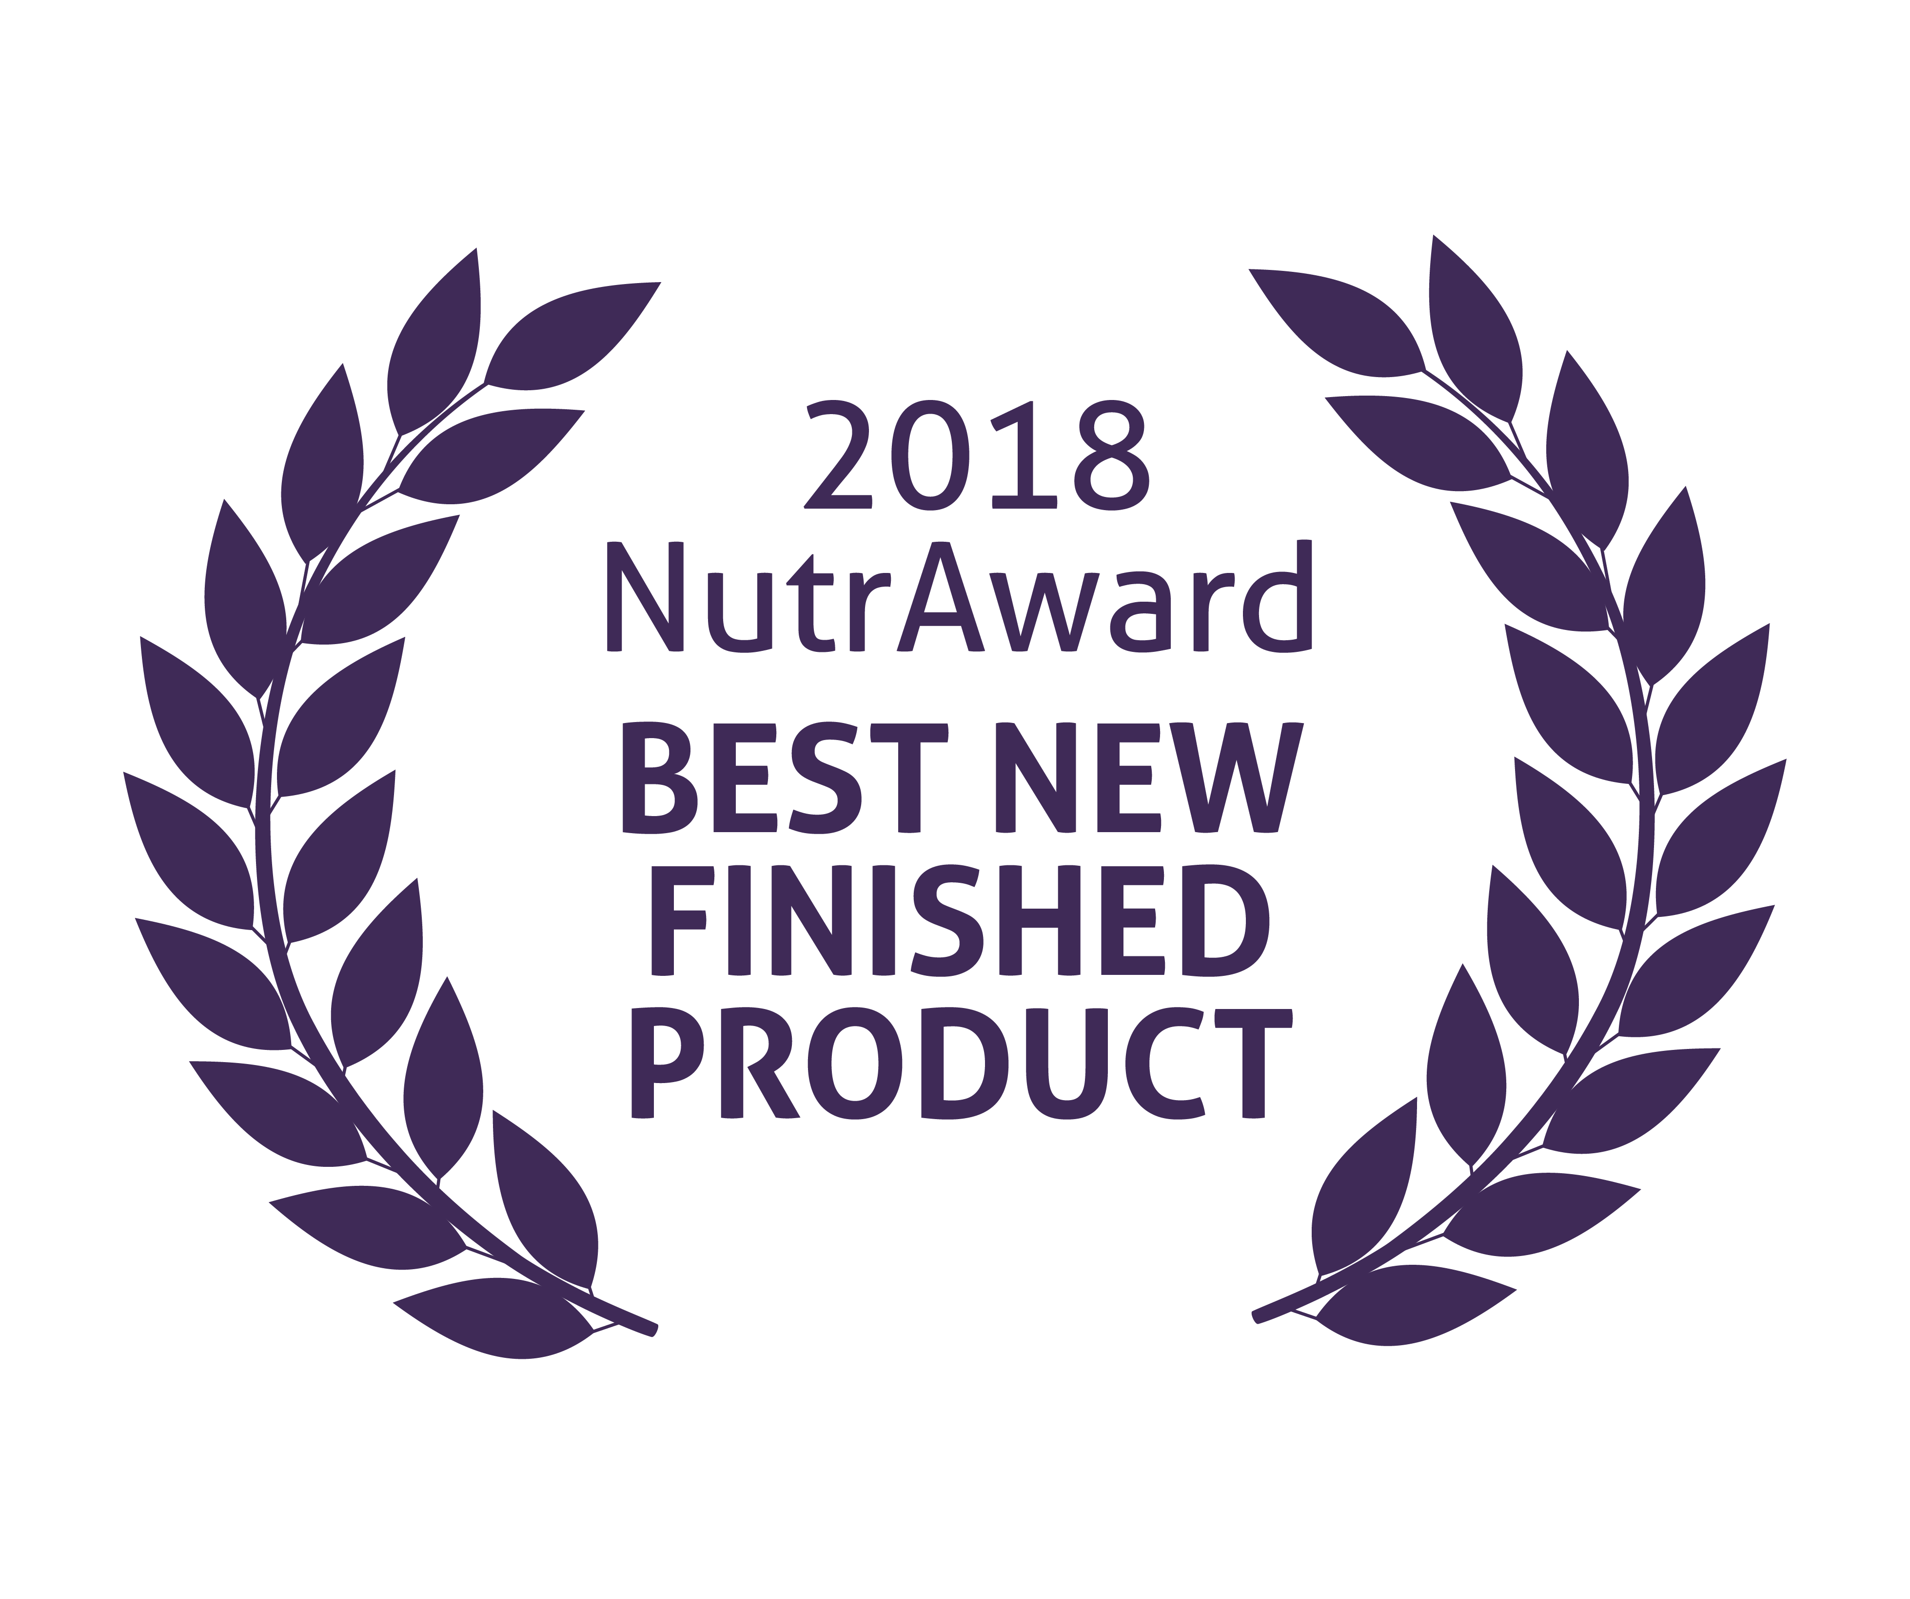
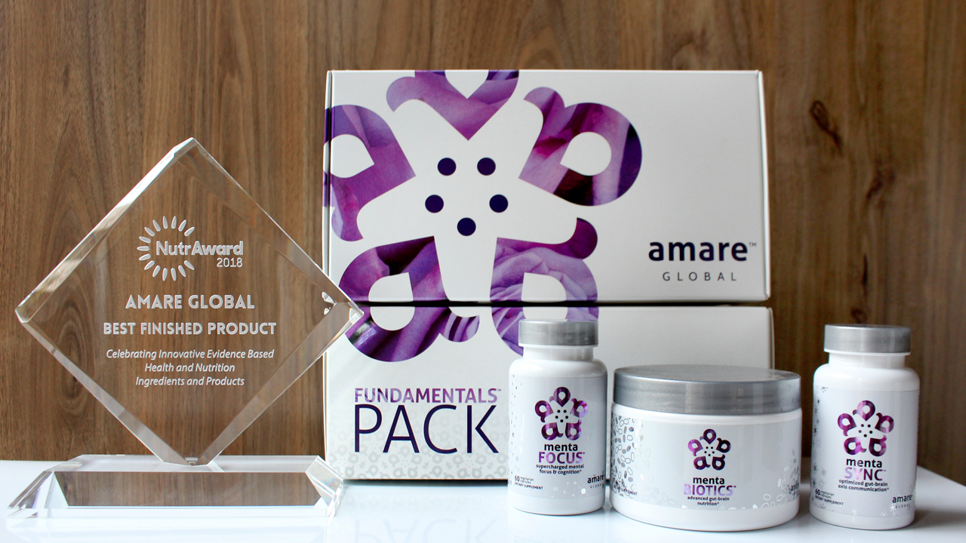
World’s First Award-Winning
Gut-Brain Axis Nutrition System!
The NutrAward recognizes companies that are investing in rigorous and measurable scientific studies to prove the efficacy of their proprietary ingredients or technologies.
Submissions are judged on their merit in the following areas:
Viable product
Emerging category
Creative product concept
Distinct health application
Unique packaging
Matchless marketing

Slide 16
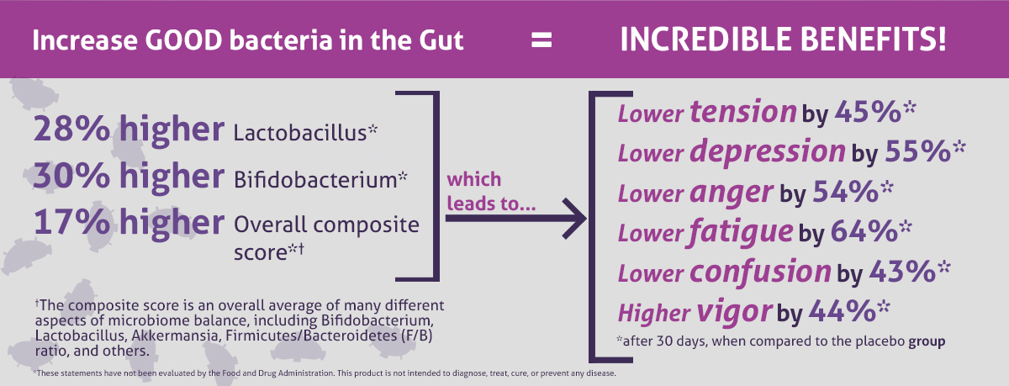
CLINICAL STUDY
The Amare FundaMentals Pack™ has been clinically proven to:

Slide 17
Portions of Data Presented at:
American College of Nutrition
  November 2017 – Alexandria VA (“Outstanding Research” Award)
Experimental Biology
  April 2018 – San Diego, CA
American College of Sports Medicine
  May 2018 – Minneapolis, MN
Mental Health America – Fit for the Future Conference
  June 2018 – Washington DC
Microbiome Movement – Gut Brain Axis
  November 2018 – Boston, MA
American Mental Wellness Awareness Association
  November 2018 – Hershey, PA
Medical, Nutrition, Biochemistry, Molecular Biology, Physiology, Psychology, Counselors, Policy…

Slide 18
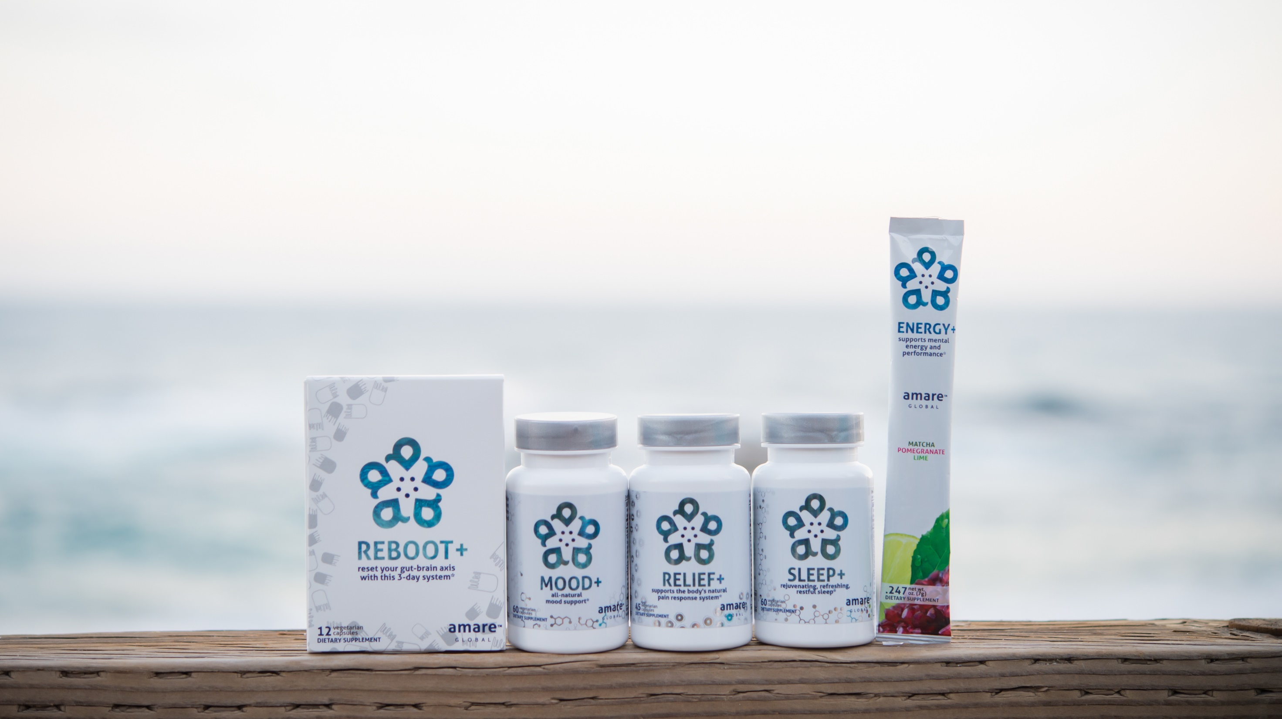

All-Natural Support Solutions for Energy, Mood, Pain, and Sleep*
MENTATHERAPEUTICS
™
*These statements have not been evaluated by the Food and Drug Administration. This product is not intended to diagnose, treat, cure, or prevent any disease.

Slide 19
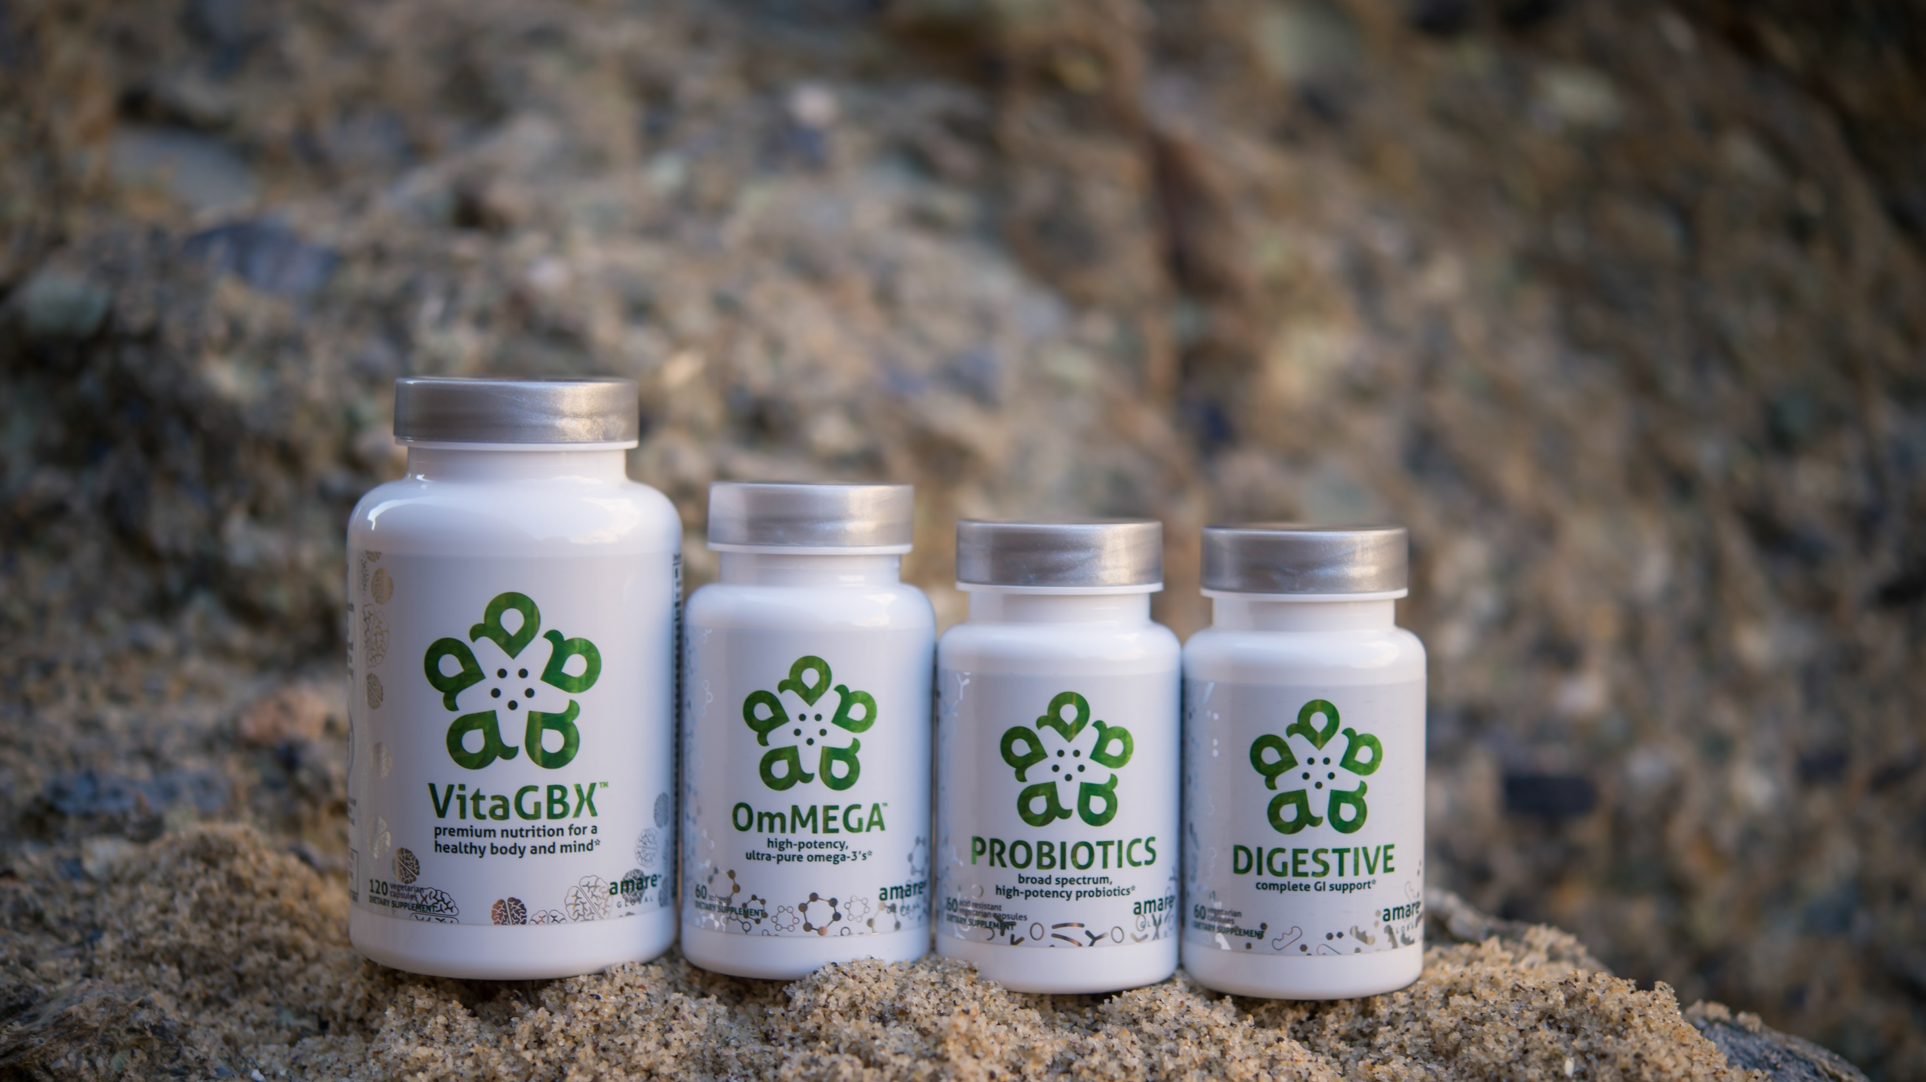
Pure & Potent Daily Essential Nutrients*
MENTAESSENTIALS
™
*These statements have not been evaluated by the Food and Drug Administration. This product is not intended to diagnose, treat, cure, or prevent any disease.

Slide 20
THE THREE THINGS YOU SHOULD KNOW ABOUT
MENTAL WELLNESS
How you feel is not just in your head — it’s also in your gut.
Our “second brain” includes the microbiome and plays a major role in mental wellness.
You can now DO something NATURALLY to improve your mental wellness.
WHERE ARE YOU ON THE MENTAL WELLNESS CONTINUUM? (Circle your current number)
1
2
3
4
5
6
7
8
9
10
DISEASE STATUS
“NORMAL”
OPTIMIZED
Depression
Anxiety
Diabetes
Obesity
Heart Disease
Autoimmune
Arthritis
Fibromyalgia
CFS
Dementia
ADD / ADHD
Alzheimer’s
Fatigue
Tension
Sad
Brain Fog
Headaches
Acne
Eczema
Congestion
URTI’s
Joint Pain
Muscle Pain
Bloated
Chubby
Energetic
Calmness
Happy
Sharp
Creative
Clear Skin
Rarely Sick
Flexible
Lean
Strong
Resilient
RED
ORANGE
YELLOW
GREEN
BLUE
INDIGO
VIOLET

Slide 21
Modern Nutrition Problems
Problem = Low fruit and veggie intake
Solution = 5 servings per day (convenient and delicious)
Problem = Stress-induced cellular aging
Solution = Enhance cellular cleanup and stress resilience
Problem = Feelings of unease (faulty GBX signals)
Solution = microRNA signaling — next generation microbiome
Kids (stressed and picky)
  Problem = low nutrition and high sugar multivitamins
  Solution = high nutrition with great taste (sugar-free)

Slide 22
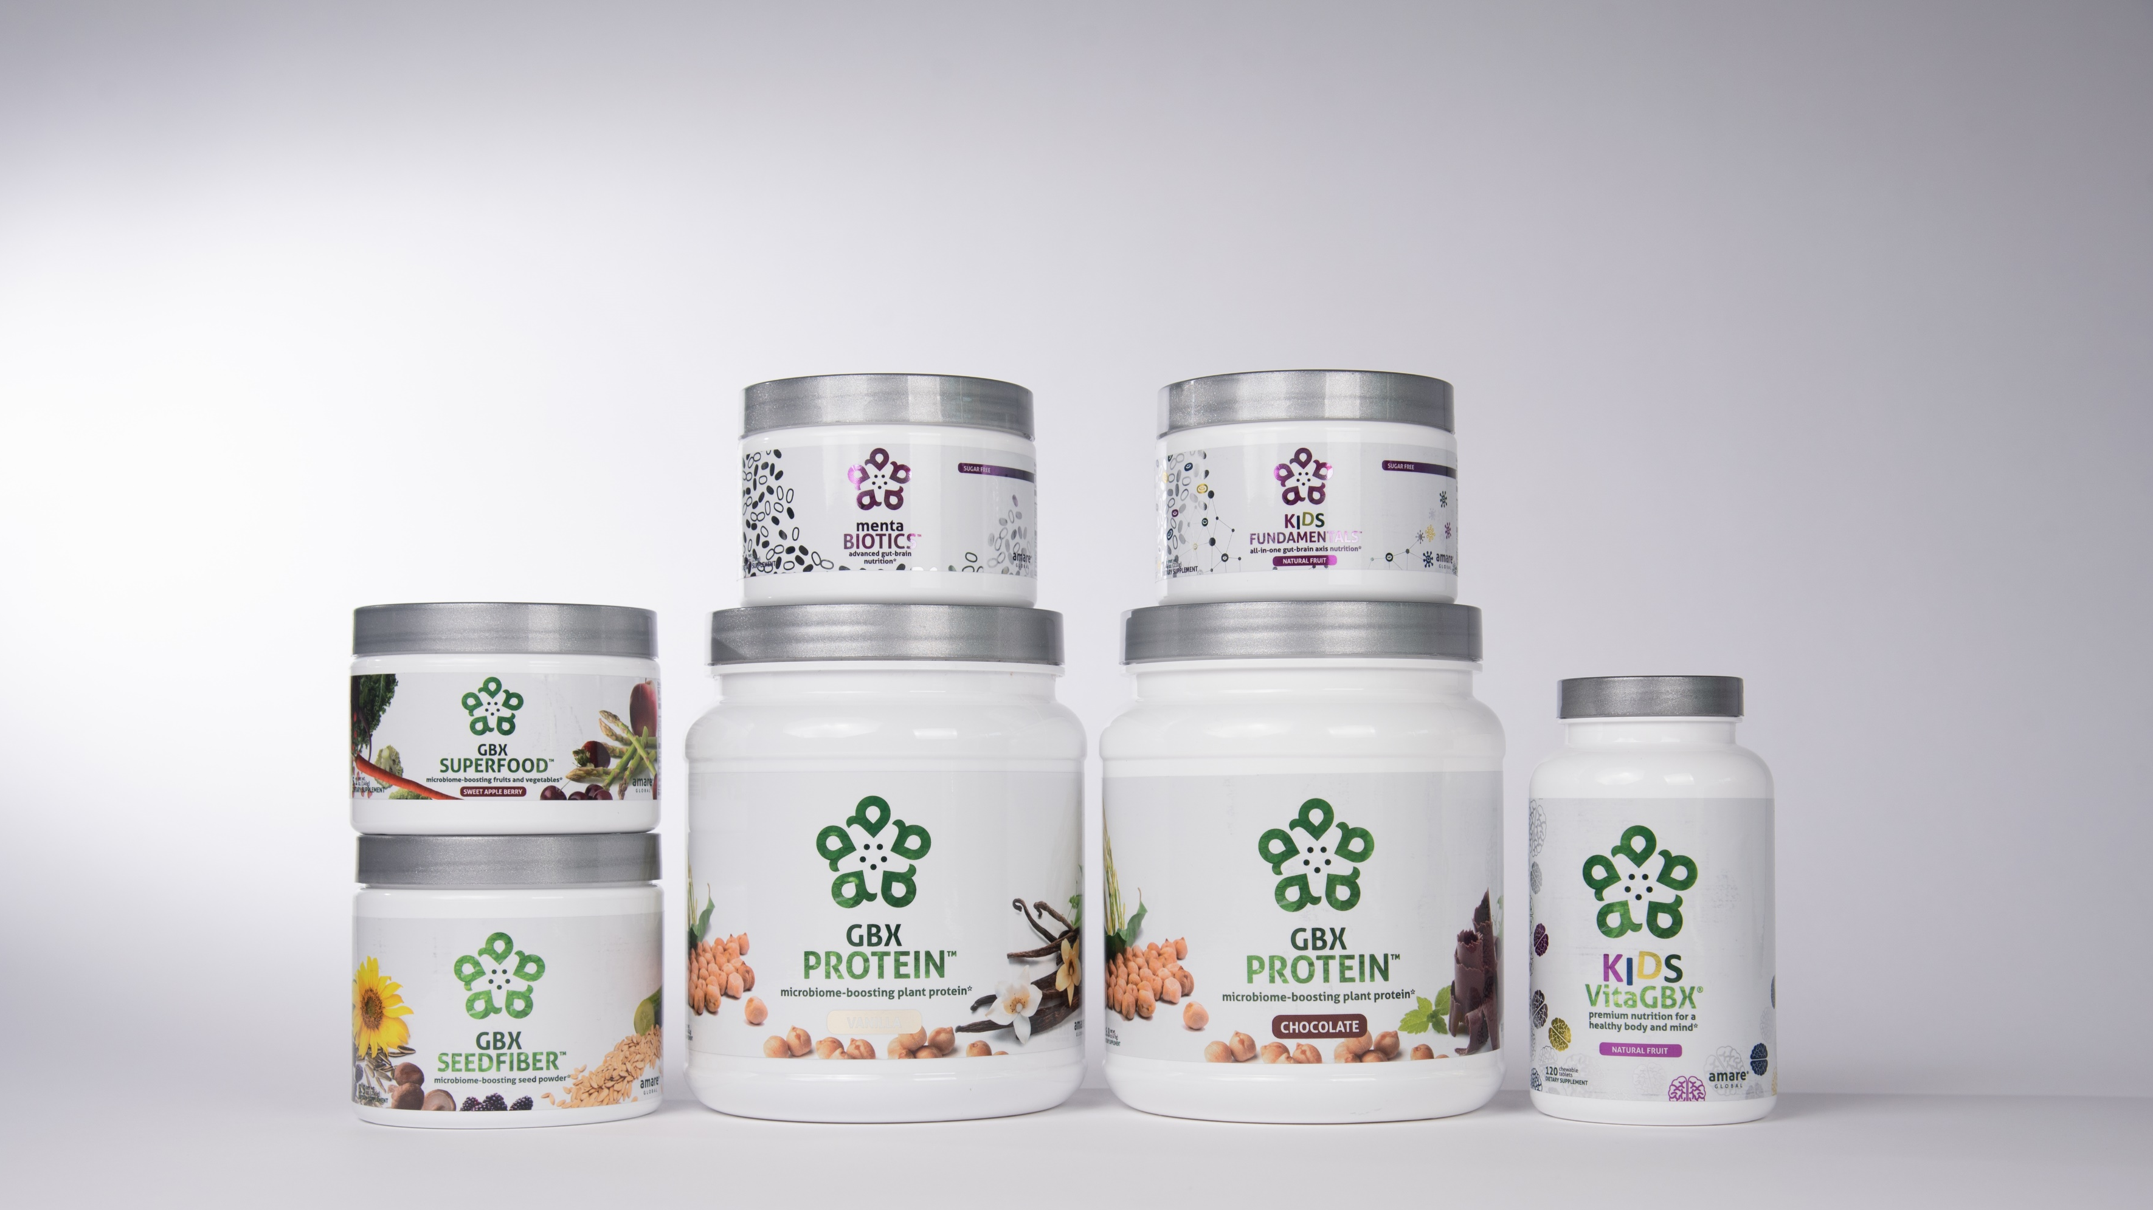

INTRODUCING NEW AMARE PRODUCTS

Slide 23







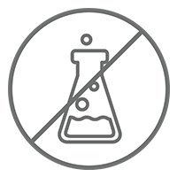
Microbiome-Boosting Nutrition*
GBX FOODS
™
Vegan /
All Natural*
Non-GMO and Gluten Free*
Sugar Free*
Soy and Dairy Free*
No Preservatives, Artificial Colors, Flavors and Sweeteners*
*These statements have not been evaluated by the Food and Drug Administration. This product is not intended to diagnose, treat, cure, or prevent any disease.

Slide 24


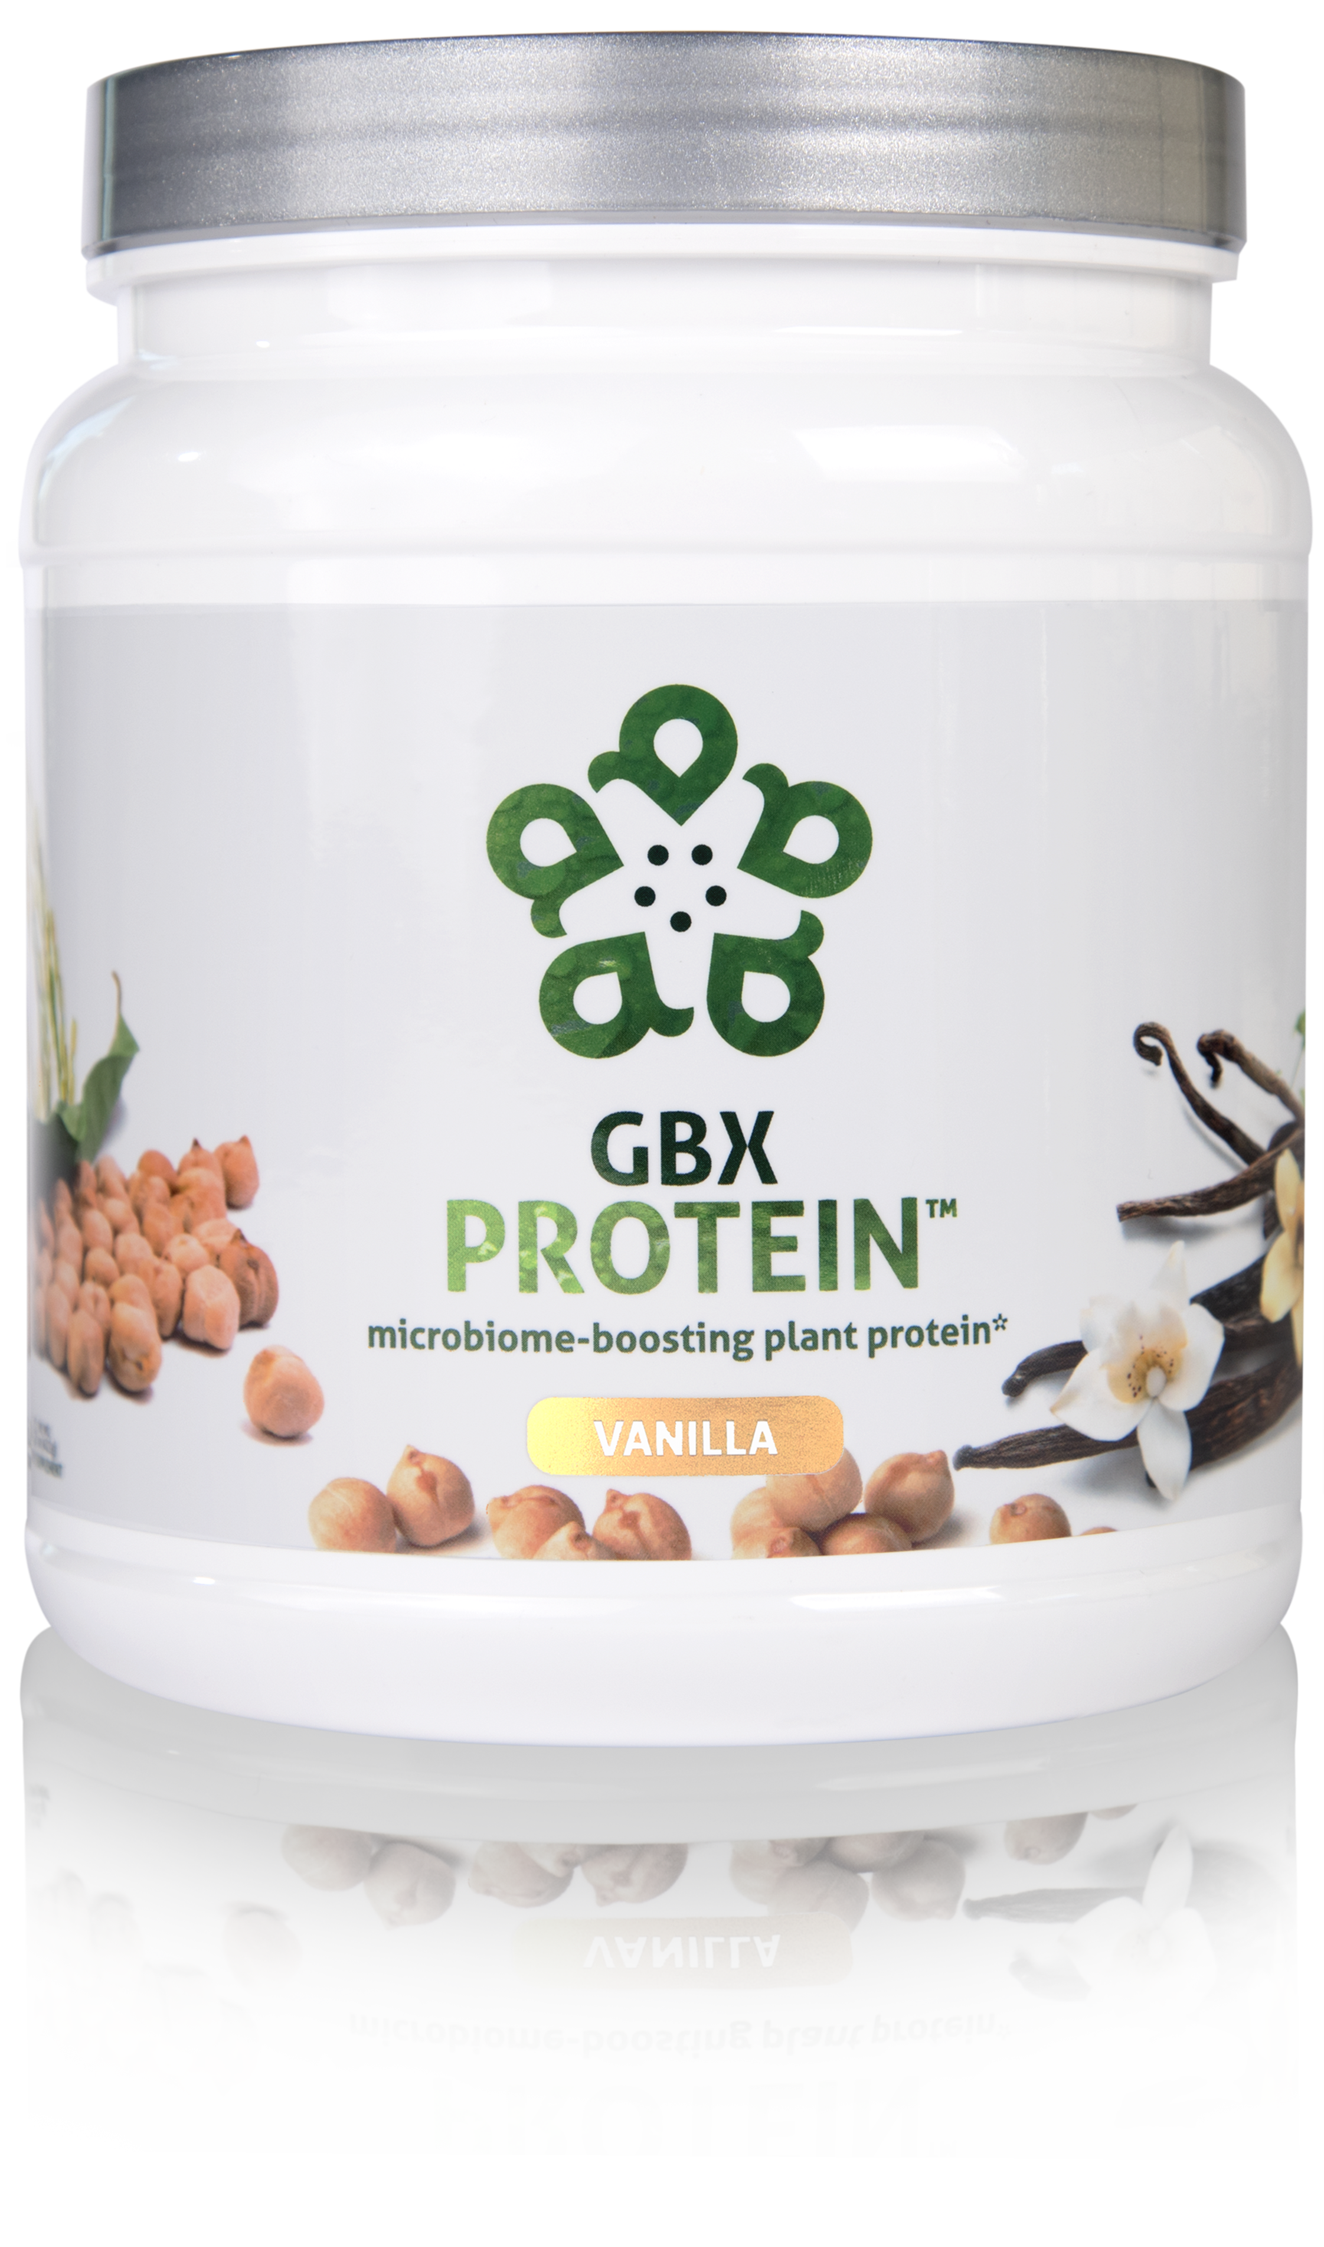
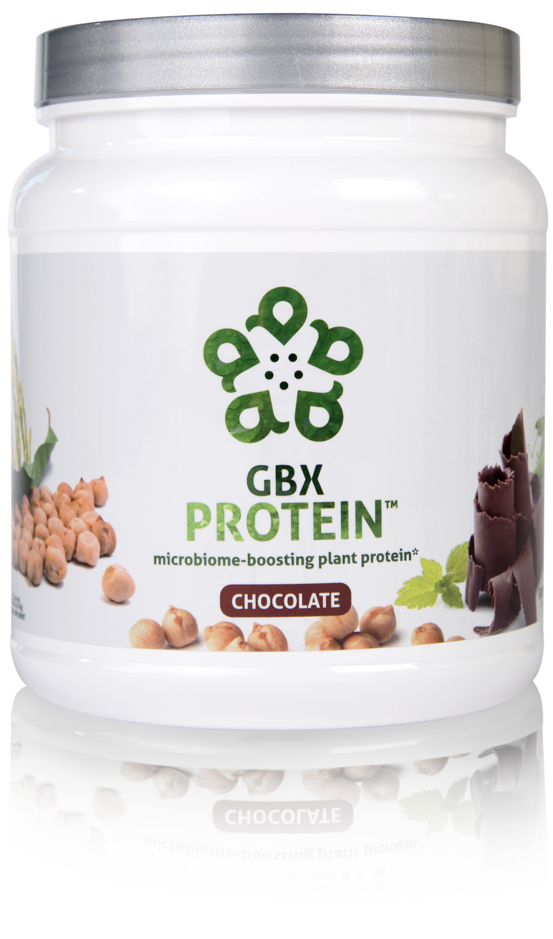
HELPS CONTROL APPETITE AND SUPPORTS MUSCLE MASS*
17 GRAMS OF ULTRA-PURE, PLANT-BASED PROTEIN*
NOURISHES GOOD GUT BACTERIA*
microbiome-boosting plant protein*
GBX Protein™ delivers 17 grams of pure plant protein. This unique chickpea, brown rice, and pea protein blend nourishes good bacteria in the gut and improves microbiome balance, while controlling appetite and supporting muscle mass. Fully-loaded with only functional ingredients, this potent formula supports the gut microbiome, helping fuel a healthy lifestyle.*
Item Code (Vanilla):
Item Code (Chocolate):
Retail Price:
Wholesale Price:
Subscribe & Save:
S015
S016
$54.00
$39.95 / 26 PV
$35.95 / 22 PV
*These statements have not been evaluated by the Food and Drug Administration. This product is not intended to diagnose, treat, cure, or prevent any disease.

Slide 25
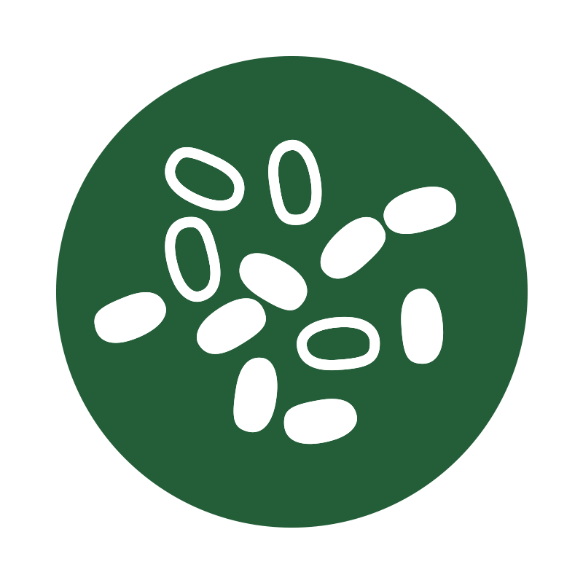


microbiome-boosting plant protein*
Improves
microbiome
balance*
Helps control appetite*
Increases
energy*
*These statements have not been evaluated by the Food and Drug Administration. This product is not intended to diagnose, treat, cure, or prevent any disease.

Slide 26
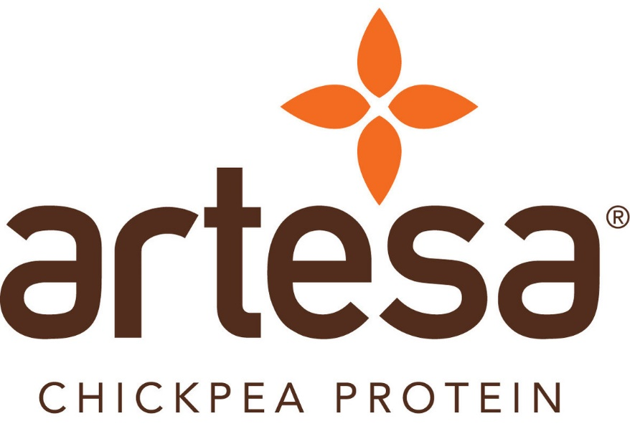
GBX Protein
KEY INGREDIENTS
™
Artesa® Chickpea Protein
An extraordinary, plant-based protein that is 96% absorbed by the human body, which is amongst the highest Protein Digestibility Corrected Amino Acid Score (PDCAAS) scores at 0.80 in the WORLD of plants!
Also acts as a prebiotic fiber that helps with gut integrity, bacteria diversification and gastric motility.
Incredible organoleptic profile compared to ALL other protein types out there.
*These statements have not been evaluated by the Food and Drug Administration. This product is not intended to diagnose, treat, cure, or prevent any disease.

Slide 27
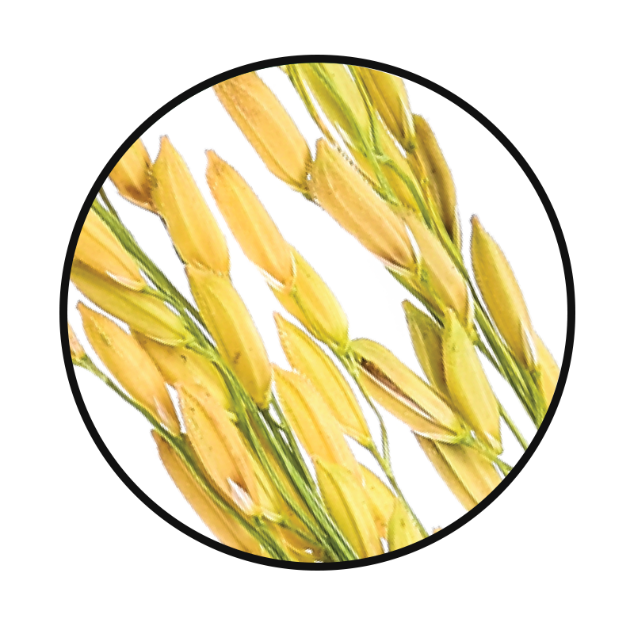
GBX Protein
KEY INGREDIENTS
™
Brown Rice Protein
Helps with weight loss and speeds metabolism*
Improves liver function*
Promotes cardiovascular health*
*These statements have not been evaluated by the Food and Drug Administration. This product is not intended to diagnose, treat, cure, or prevent any disease.

Slide 28
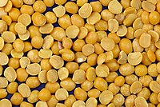
GBX Protein
KEY INGREDIENTS
™
Pea Protein
Helps maintain muscle mass*
Aids in weight loss*
Supports heart health*
*These statements have not been evaluated by the Food and Drug Administration. This product is not intended to diagnose, treat, cure, or prevent any disease.

Slide 29

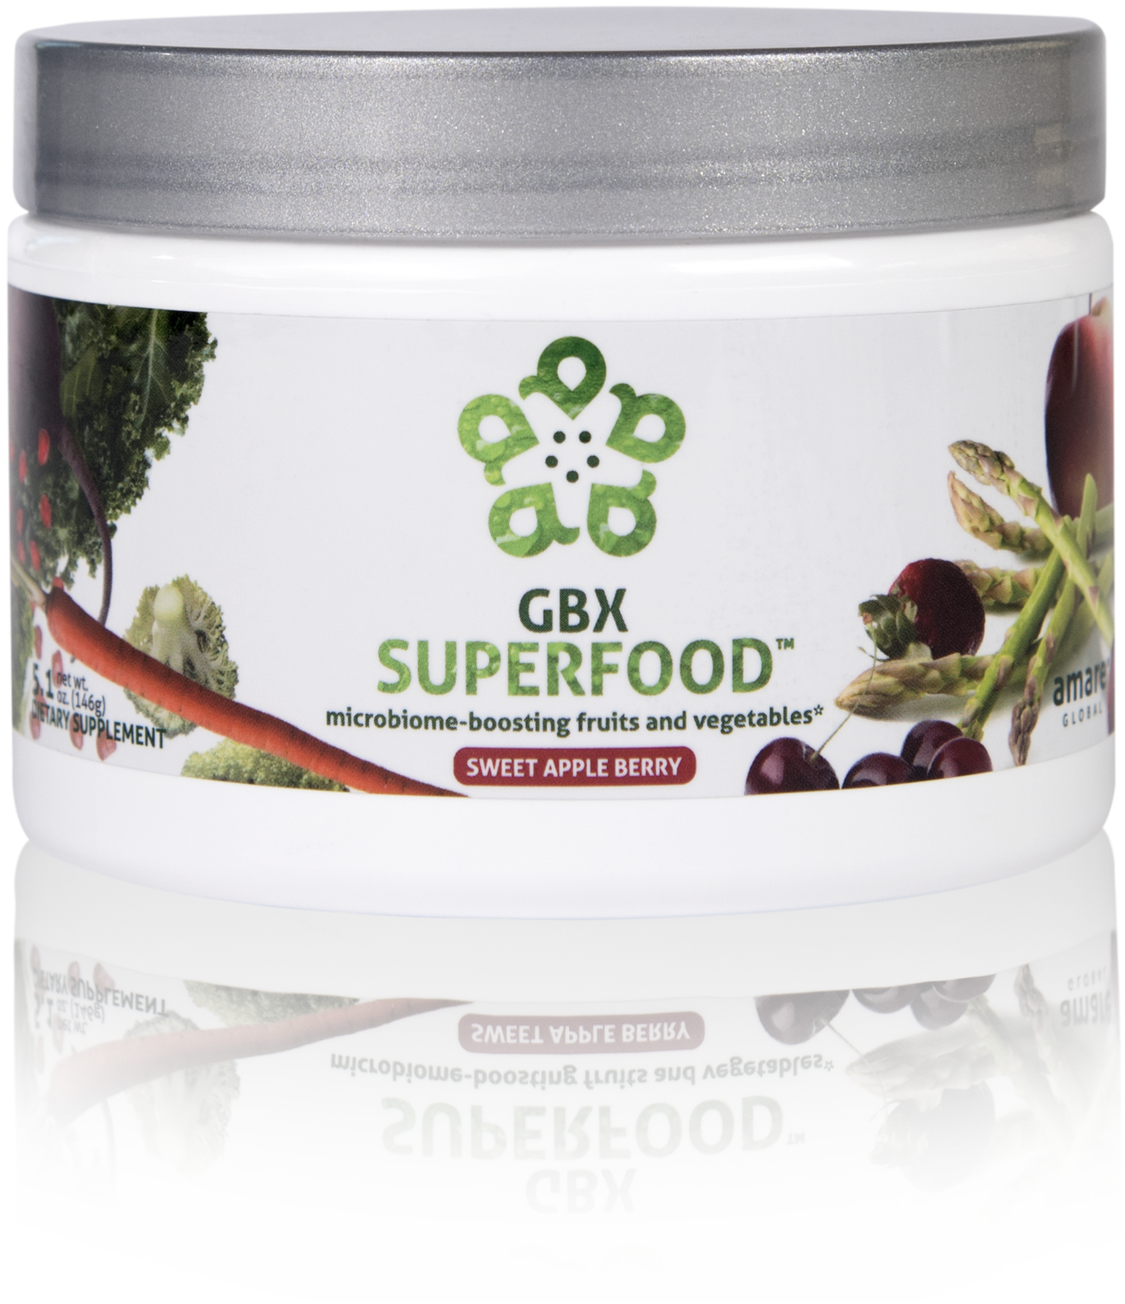
NUTRIENTS EQUIVALENT TO 3 SERVINGS OF FRUITS AND VEGETABLES*
NOURISHES GOOD GUT BACTERIA*
PROVIDES CELLULAR ANTI-STRESS BENEFITS*
microbiome-boosting fruits and vegetables*
GBX SuperFood™ provides the phytonutrient equivalent of three servings of fruits and vegetables per scoop. This phytobiotic-rich blend delivers cellular level anti-stress benefits and helps protect cells from a variety of different stressors, helping the brain and gut run at peak efficiency.*
Item Code:
Retail Price:
Wholesale Price:
Subscribe & Save:
S018
$40.00
$29.95 / 21 PV
$26.95 / 18 PV
*These statements have not been evaluated by the Food and Drug Administration. This product is not intended to diagnose, treat, cure, or prevent any disease.

Slide 30



microbiome-boosting fruits and vegetables*
Increases Heat Shock Protein expression*
Enhances internal cellular cleanup (autophagy)*
Stress resilience benefits that you can FEEL at the cellular level*
*These statements have not been evaluated by the Food and Drug Administration. This product is not intended to diagnose, treat, cure, or prevent any disease.

Slide 31
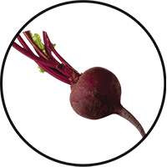
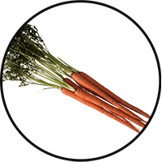
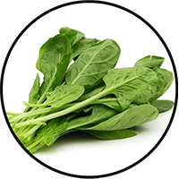
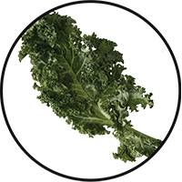
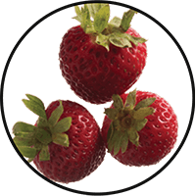
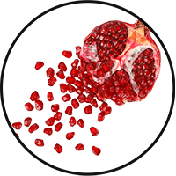
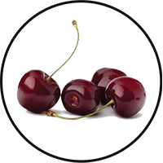
GBX SuperFood
KEY INGREDIENTS:
™
Anti-Stress Phytobiotic Proprietary Blend
Fruits and Vegetables
Provides three servings of natural fruits and veggies for comprehensive nutrition in a convenient, single serving*
Beet Root
Carrot
Spinach
Kale
Strawberry
Pomegranate
Tart Cherry
*These statements have not been evaluated by the Food and Drug Administration. This product is not intended to diagnose, treat, cure, or prevent any disease.

Slide 32
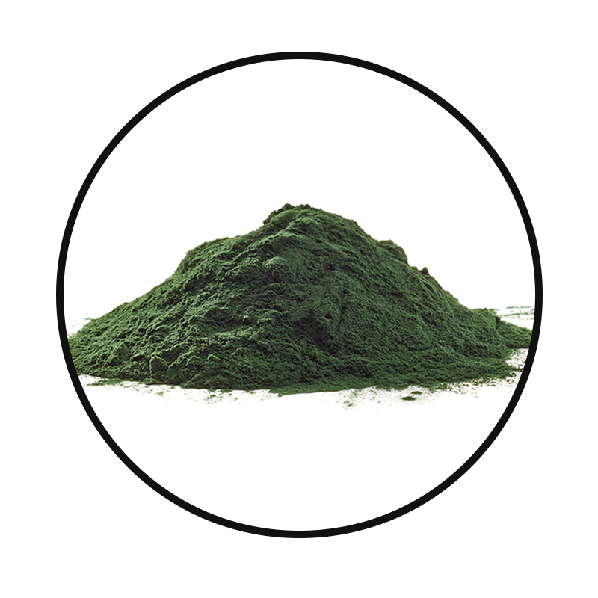
GBX SuperFood
KEY INGREDIENTS:
™
Anti-Stress Phytobiotic Proprietary Blend
Spirulina
A natural algae that provides potent nutrients and is a good source of antioxidants and B vitamins — high in proteins and helps with gastric integrity/balance*
*These statements have not been evaluated by the Food and Drug Administration. This product is not intended to diagnose, treat, cure, or prevent any disease.

Slide 33
GBX SuperFood
KEY INGREDIENTS:
™
Gut-Integrity Prebiotic Proprietary Blend
IsoFiber™:
IsoFiber is a special Iso-Malto-Oligosaccharide that is a combination of naturally occurring prebiotic plant fibers that are clinically shown to improve the growth of specific probiotic strains used in our MentaBiotics™.
IsoFiber is digestive resistant, and has a very low glycemic index.
IsoFiber helps with gastric motility and digestive health throughout the digestive tract.
*These statements have not been evaluated by the Food and Drug Administration. This product is not intended to diagnose, treat, cure, or prevent any disease.

Slide 34
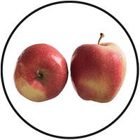
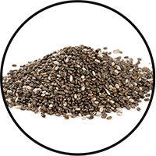
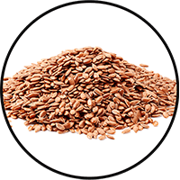
GBX SuperFood
KEY INGREDIENTS:
™
Gut-Integrity Prebiotic Proprietary Blend
Apple Fiber
Helps with bulking in the intestinal tract, and heart health
Chia Seed
Good source of Omega-3 fatty acids, fiber, antioxidants, proteins and calcium*
Good for heart and brain health*
Flax Seed
Good natural source of Omega-3 fatty acids, lignans and fiber*
Helps with heart and brain health*
*These statements have not been evaluated by the Food and Drug Administration. This product is not intended to diagnose, treat, cure, or prevent any disease.

Slide 35

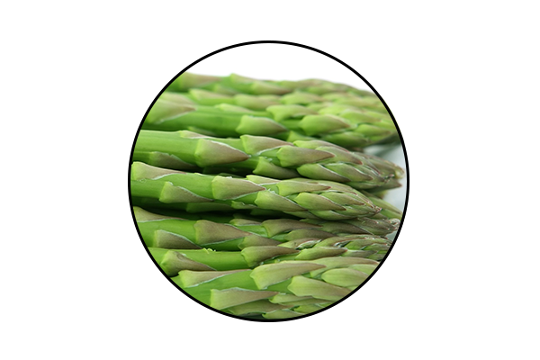
GBX SuperFood
KEY INGREDIENTS:
™
Anti-Stress Phytobiotic Proprietary Blend
ETAS™: Enzyme-Treated Japanese Asparagus
Supports mood and cognitive function*
Protects neuronal cells*
Induces the production of natural anti-stress molecules called Heat Shock Proteins*
*These statements have not been evaluated by the Food and Drug Administration. This product is not intended to diagnose, treat, cure, or prevent any disease.
Notes:
ETAS™: Enzyme-Treated Japanese Asparagus
Uniquely sourced from Japan
Has been used for > 5,000 years
Derived from the lower stalk portion of asparagus stalks, where the most phytonutrients are found.
Rich in hydroxymethylfurfural derivatives, which is a necessary compound that induces HSP70 microRNA expression.
ETAS™: Mechanism of Action
What is HSP70? Heat Shock Proteins
ETAS works by increasing the production of HSP70: an intracellular protein produced naturally by the body when it encounters a stressor, such as extreme heat.
Clinical Studies have shown ETAS induces a significant production of HSP70 microRNA expression activities that helps with biological activities such as cellular protection, cellular repair, reduced cell death, blood flow, cellular stress, anti inflammatory activity, sleep, mood, energy, and antioxidant activity.
ETAS™: Mechanism of Action
Why is HSP70 production important?
As we age, the Heat Shock Protein production to stressors decrease with age.
ETAS helps preserve and maintain the appropriate HSP70 expression to promote brain health, stress response and cognitive performance as we age!
HSP70 has a number of beneficial, physiological effects in the body, including reduced cell death, anti-inflammatory activity and antioxidant activity.
There is no reason why you shouldn’t feel 25, when you’re 50!

Slide 36

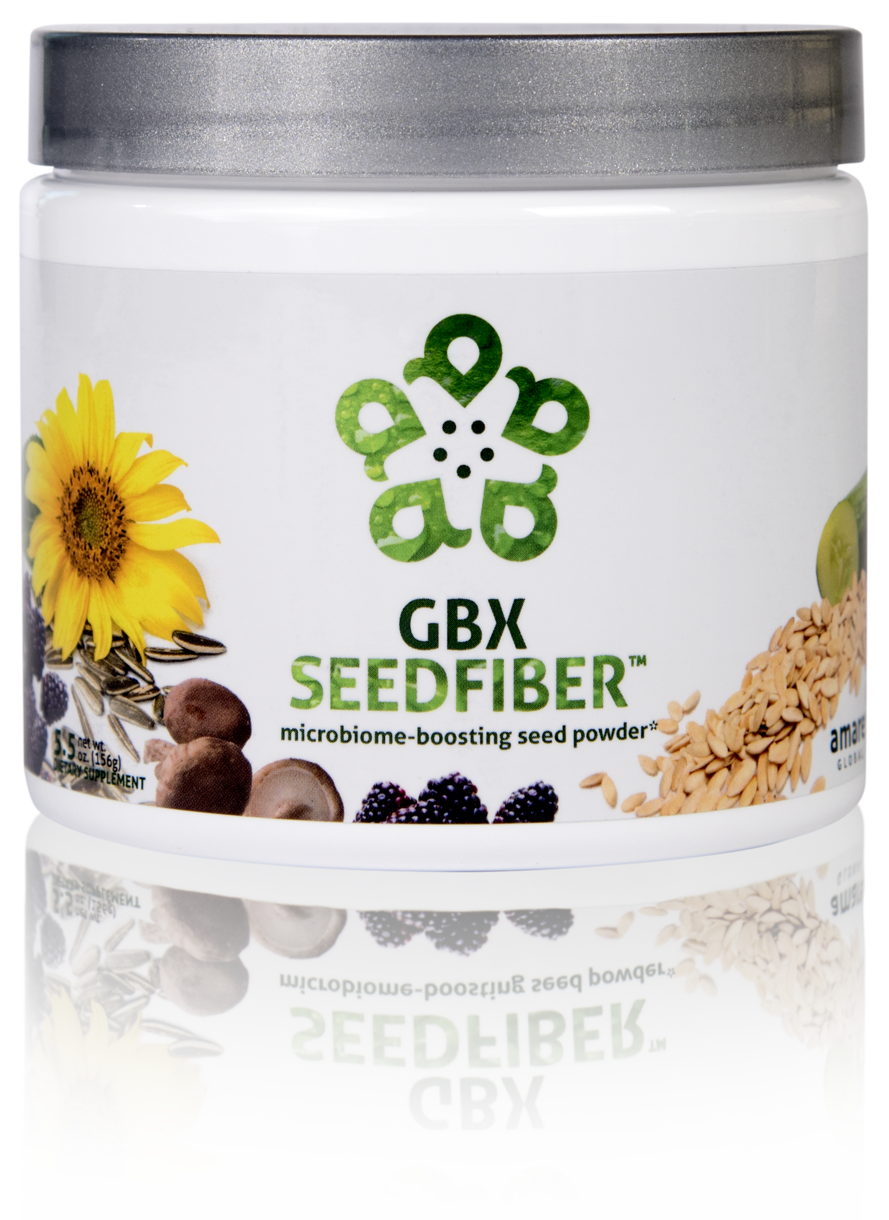
NEXT-GENERATION APPROACH TO OPTIMIZING GUT-BRAIN AXIS*
CONTAINS NATURAL MICROBIOME-BOOSTING FIBERS*
HELPS MANAGE FEELINGS OF STRESS, TENSION AND ANXIETY*
microbiome-boosting seed powder*
GBX SeedFiber™ is the next-generation approach to optimizing the gut-brain axis. This phytobiotic-rich formula contains seeds as sources of natural microbiome-boosting fibers, helping you feel fuller, longer. Featuring a cultured mushroom mycelia extract to support microRNA signaling between the microbiome and central nervous system, this unique blend helps manage feelings of stress, tension and anxiety.*
Item Code:
Retail Price:
Wholesale Price:
Subscribe & Save:
S019
$50.00
$36.95 / 26 PV
$32.95 / 21 PV
*These statements have not been evaluated by the Food and Drug Administration. This product is not intended to diagnose, treat, cure, or prevent any disease.

Slide 37
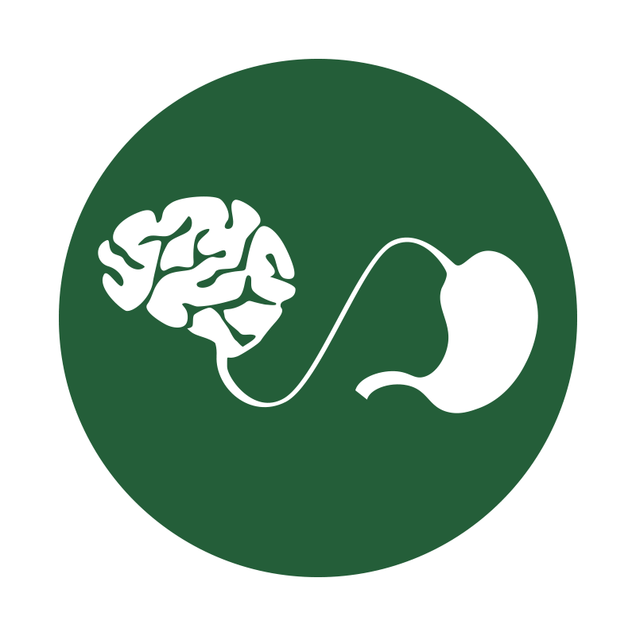

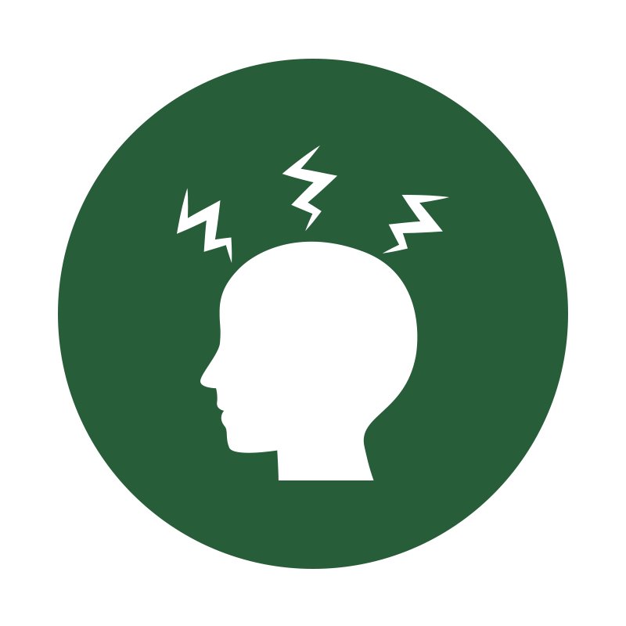
microbiome-boosting seed powder*
Optimizes gut-brain axis communication
Naturally supports microRNA signaling
Helps manage feelings of tension and anxiety*
*These statements have not been evaluated by the Food and Drug Administration. This product is not intended to diagnose, treat, cure, or prevent any disease.

Slide 38
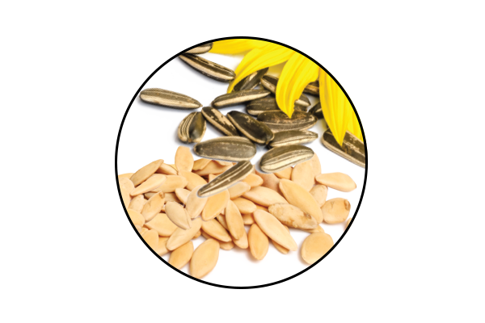
GBX SeedFiber
KEY INGREDIENTS
™
Cold-Pressed Natural Seeds
Natural innovative method to obtaining the most potent, pure and natural powder.
The cold-pressed seed process only uses physical forces of pressing, unlike the heated, accelerated or chemically involved processes.
Many of the heat and chemical processes often times alter the efficacy, potency or composition of the original seed.
*These statements have not been evaluated by the Food and Drug Administration. This product is not intended to diagnose, treat, cure, or prevent any disease.
Notes:
An all-natural, nutrient-dense blend of cold-pressed seed powders with exceptionally high antioxidant activity level – primarily polyphenol ellagitannins and proanthocyanidins – to fortify raw food creations, blended beverages & healthy baked goodies.... perfect to incorporate into a natural mental wellness lifestyle.
“Next-Generation” microbiome modulation provides improved coordination of “microRNA” signaling to regulate central nervous system (CNS) gene translation (amygdala/pre-frontal cortex processing of anxiety signals)

Slide 39
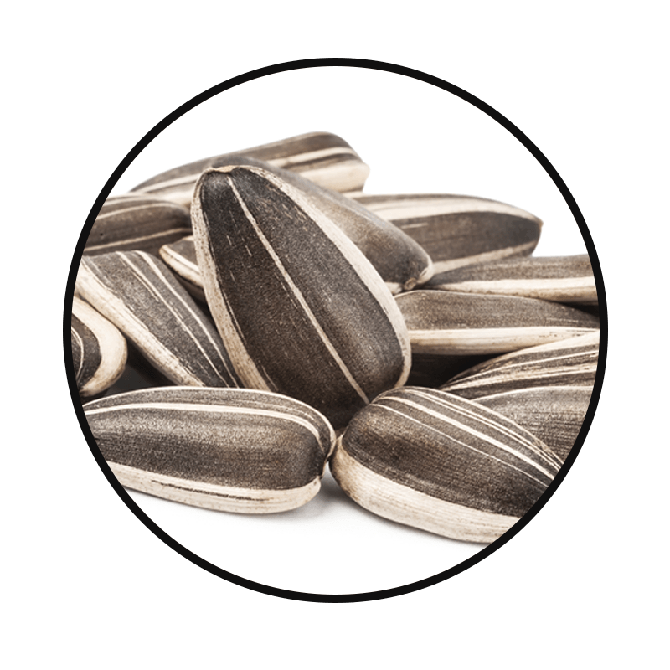
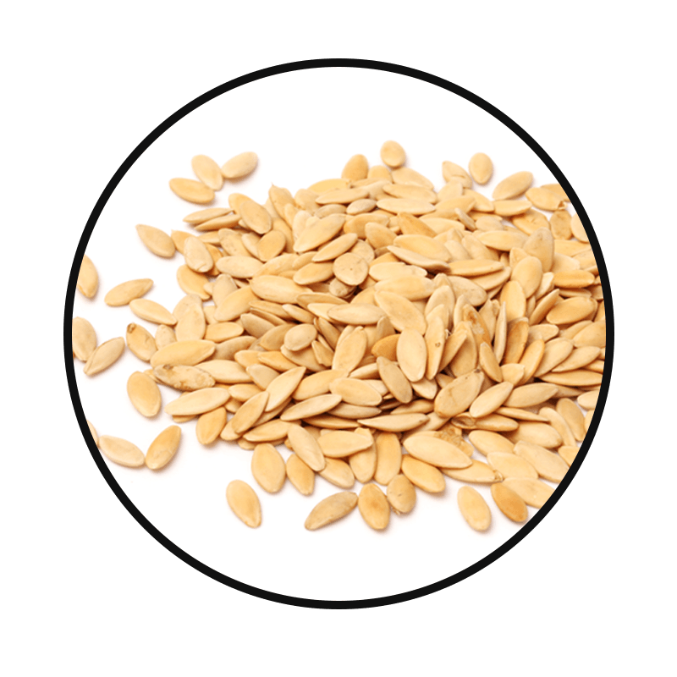
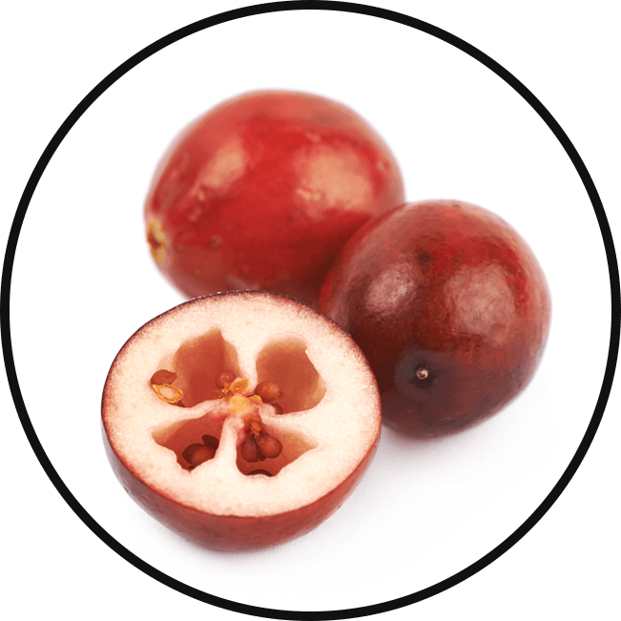
GBX SeedFiber
KEY INGREDIENTS:
™
Cold-Pressed Natural Seeds
Sunflower Seed
One of the top natural sources of good fats, copper, selenium, folate and vitamin E*
Cucumber Seed
Great source of fiber and beta carotene, which helps with immunity, and skin and eye health*
Cranberry Seed
Great source of vitamin E, Omega-3, -6 and -9, and also acts as an antioxidant to protect the body from stressors*
*These statements have not been evaluated by the Food and Drug Administration. This product is not intended to diagnose, treat, cure, or prevent any disease.

Slide 40
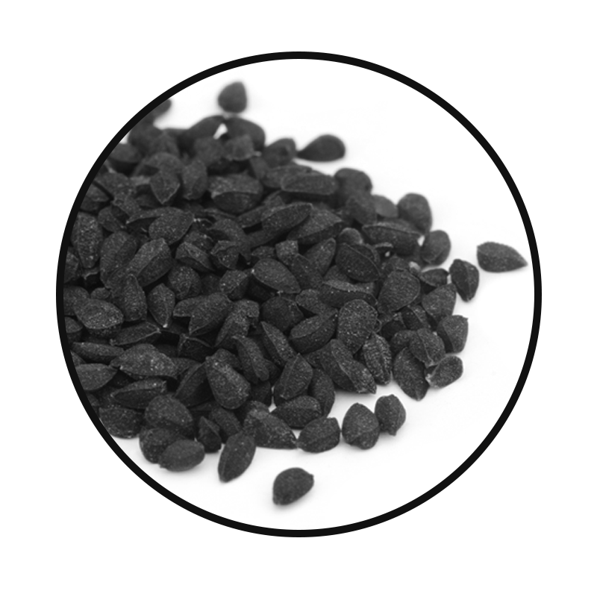
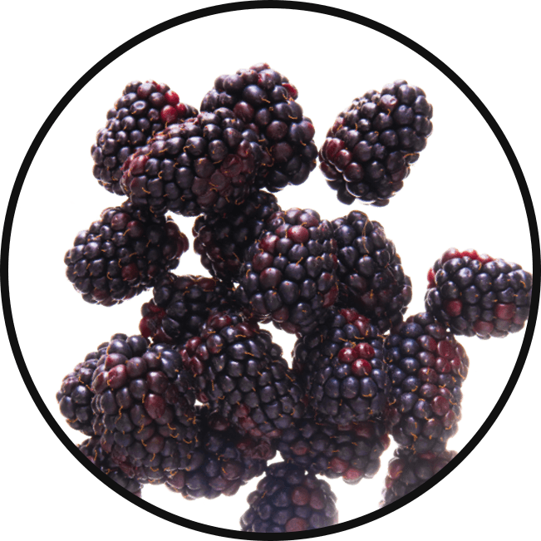
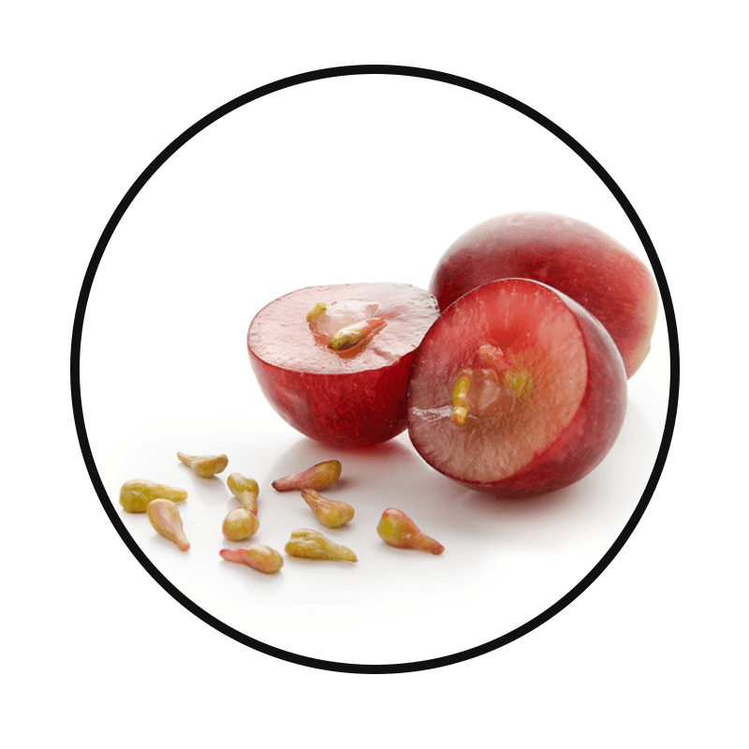
GBX SeedFiber
KEY INGREDIENTS:
™
Cold-Pressed Natural Seeds
Black Cumin Seed
Contains B vitamins and antioxidants, and helps boost the immune system*
Blackberry Seed
Rich in Omega-3 (alpha-linolenic acid) and Omega-6 (linolenic acid) fats, which are good for heart and brain health*
Concord Grape Seed
Great natural source of vitamin A and E, which is crucial for skin, circulation, cholesterol, and has antioxidant effects*
*These statements have not been evaluated by the Food and Drug Administration. This product is not intended to diagnose, treat, cure, or prevent any disease.

Slide 41
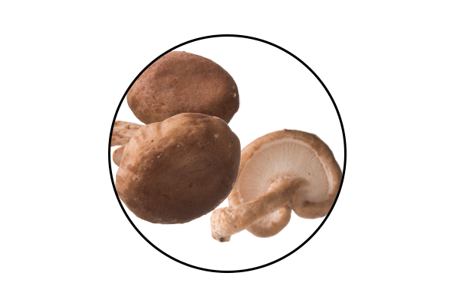
GBX SeedFiber
KEY INGREDIENTS
™
AHCC®: Active Hexose Correlated Compound
Cultured mushroom mycelia extract
Effective for immune support*
Rich in alpha-glucans*
Supports microRNA signaling between the microbiome and the central nervous system*
*These statements have not been evaluated by the Food and Drug Administration. This product is not intended to diagnose, treat, cure, or prevent any disease.
Notes:
AHCC®: Active Hexose Correlated Compound
Is a compound of cultured, mushroom mycelia extract that is rich in alpha-glucans.
It is uniquely sourced in Japan, at the highest quality standards.
Known as the #1 supplement in Japan for immune function for over 25 years.
AHCC®:
Extracted through a special lipid culturing process that delivers an extract that has superior bio-absorption and efficacy.
AHCC contains a partially acylated alpha glucan 1,4 that is known to have positive effects on immune cell production, intestinal immunity, T cell activity, cytokine production, antioxidant effects, and microRNA signaling from the microbiome to the central nervous system.
AHCC helps reduce the production of glucocorticoids in the cases of stress. This manifests in improved mood and energy.
AHCC is beneficial for gut health, in which it reduces intestinal inflammation to favor the development of a healthy gut microflora specific to the strains we use in our Probiotics and MentaBiotics™ (more Bifidobacterium, less Clostridium).
Helps improves gut integrity by providing protection from Candida, Pseudomonas and other detrimental bacteria types.
Facilitating and building a responsive immune system allows our body to repair, rebuild and maintain itself at a cellular level, allowing the most efficient communication between your microbiome and your central nervous system.

Slide 42
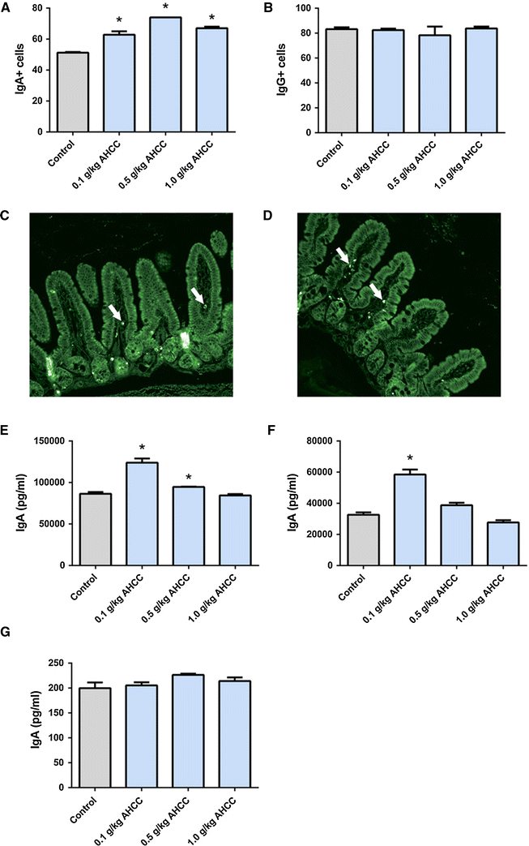
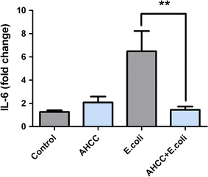
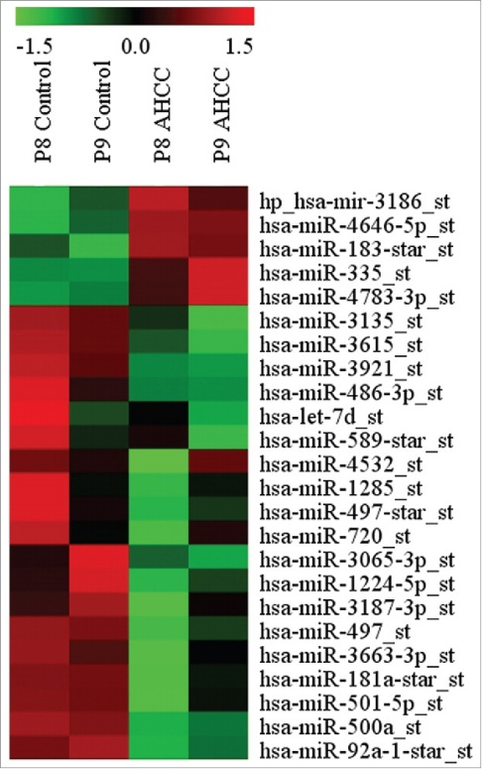
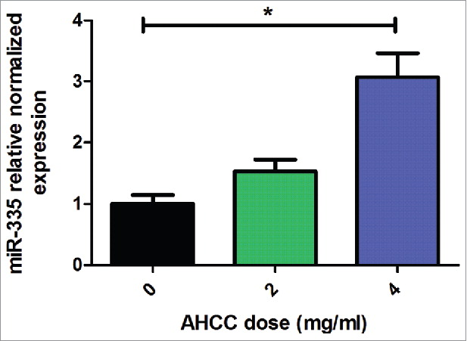
Roles of AHCC in Gut-Brain Axis
Anti-inflammatory/immune Homeostasis
Prebiotic (TLR2/4)
miRNAs
Mallet et al.,
European Journal of Nutrition 2015
Mallet et al.,
European Journal of Nutrition 2015
Graham et al., Cancer Biology and Therapy 2017

Slide 43
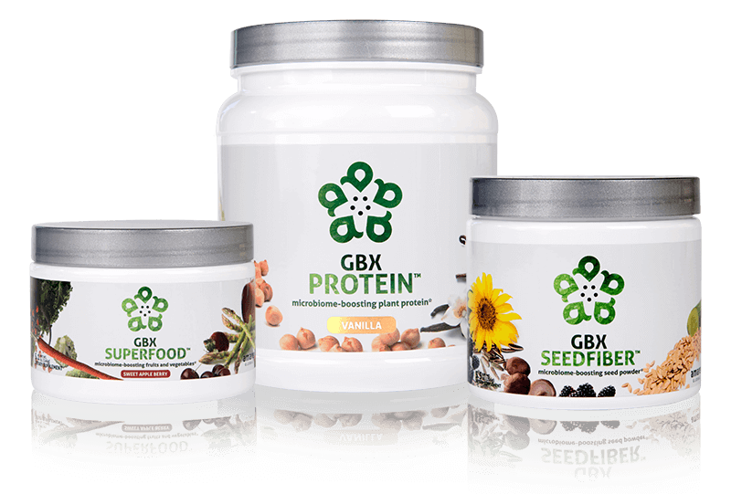
Microbiome-Boosting Nutrition*
GBX FOODS SYSTEM
™
Item Code:
Retail Price:
Wholesale Price:
Subscribe & Save:
S021
$144.00
$95.95 / 62 PV
$85.95 / 52 PV
*These statements have not been evaluated by the Food and Drug Administration. This product is not intended to diagnose, treat, cure, or prevent any disease.

Slide 44

Daily Essential Nutrients for Healthy Kids and Teens*
AMARE KIDS
™
*These statements have not been evaluated by the Food and Drug Administration. This product is not intended to diagnose, treat, cure, or prevent any disease.

Slide 45



INGREDIENTS SHOWN TO IMPROVE MENTAL WELLNESS*
SUPPORTS ENTIRE GUT-BRAIN AXIS*
EASY-TO-DIGEST FORMULA
all-in-one gut-brain axis nutrition for kids & teens*
Kids FundaMentals™ is an all-in-one product that supports the entire gut-brain axis (GBX) of growing kids and teens. Featuring nutrients scientifically shown to improve mental wellness, this easy-to-digest formula is perfect for kids and teens of all ages.*
Item Code:
Retail Price:
Wholesale Price:
Subscribe & Save:
S017
$90.00
$66.95 / 56 PV
$59.95 / 50 PV
*These statements have not been evaluated by the Food and Drug Administration. This product is not intended to diagnose, treat, cure, or prevent any disease.
Notes:
Add callouts

Slide 46



all-in-one gut-brain axis nutrition for kids & teens*
Have equivalent benefits to the Amare FundaMentals PackTM in a one scoop serving for kids and teens of all ages*
Supports the growth and vitality of a range of beneficial gut bacteria*
Increases short-term and long-term memory by increasing visual and verbal recall by 28%*
*These statements have not been evaluated by the Food and Drug Administration. This product is not intended to diagnose, treat, cure, or prevent any disease.
‡BASED ON KEY INGREDIENTS CLINICAL STUDIES
Notes:
Bullet colors are different colors

Slide 47

Kids FundaMentals
MW3™ Probiotic Proprietary Blend
™
Our blend contains unique and specific probiotic strains targeted to enhance overall mental wellness.*
MW3 Probiotic Strains:
Lactobacillus rhamnosus R0011 — Reduces stress by lowering cortisol exposure and improves GABA neurotransmission*
Bifidobacterium longum R0175 — Enhances calmness by decreasing anxiety indices and improves cognitive function*
Lactobacillus helveticus R0052 — Improves mood by decreasing neuro-inflammation and increasing serotonin*
*These statements have not been evaluated by the Food and Drug Administration. This product is not intended to diagnose, treat, cure, or prevent any disease.

Slide 48

Kids FundaMentals
MW3™ Prebiotic Proprietary Blend
™
Our MW3 Prebiotic Proprietary Blend provides optimal gut support by feeding the specific mental wellness probiotic strains found in our MW3 Probiotic Proprietary Blend.*
MW3 Prebiotic Fibers:
IsoFiber™ (Iso-Malto-Oligosaccharides) — Contains a combination of naturally occurring prebiotic plant fibers that are clinically shown to improve the growth of specific probiotic strains featured in Kids FundaMentals™ and now MentaBiotics™ Sugar Free!
Bimuno® (Galacto-Oligo-Saccharides) — Resets and increases friendly gut bacteria, maintains immune health, controls inflammation in the body and supports microbiome balance. Is highly effective and a natural way of increasing preferred bacteria in the gut. Plays an important role in feeding Bifidobacteria probiotic strains.*
SunFiber® (Galactomannan Fiber) — Helps improve the growth and vitality of beneficial bacteria, including Bifidobacteria and Lactobacillus.*
*These statements have not been evaluated by the Food and Drug Administration. This product is not intended to diagnose, treat, cure, or prevent any disease.

Slide 49

Kids FundaMentals
MW3™ Prebiotic/Probiotic Proprietary Blend
™
*These statements have not been evaluated by the Food and Drug Administration. This product is not intended to diagnose, treat, cure, or prevent any disease.

Slide 50

Kids FundaMentals
Amare GBX+ Proprietary Blend
™
Asian Apple
Sourced from a region in Central Asia
Powerful antioxidant properties and improves the nutrition of beneficial bacteria in the gut*
French Grape
Contains flavonoids*
Provides antioxidant and anti-inflammatory properties and supports gut-brain axis communication*
New Zealand Pine Bark
Nature’s super antioxidant; Nootropic — supports mental function*
Boosts energy, reduces fatigue and improves concentration without the side effects*
*These statements have not been evaluated by the Food and Drug Administration. This product is not intended to diagnose, treat, cure, or prevent any disease.

Slide 51

Kids FundaMentals
Gut-Axis Support Blend
™
Artichoke Leaf Extract
Reduces swelling, sense of gastric fullness and digestive upset*
When combined with ginger, it has been clinically shown to manage digestive discomfort and gastric motility*
Ginger Root
Has been known to be a remedy for travel sickness, nausea and digestive upset*
When combined with artichoke leaf extract, it has been clinically proven to be highly effective at promoting digestive function and helping regulate gastrointestinal motility*
*These statements have not been evaluated by the Food and Drug Administration. This product is not intended to diagnose, treat, cure, or prevent any disease.

Slide 52



CONTAINS BENEFICIAL VITAMINS AND MINERALS
CONTAINS MORE THAN 50 NUTRIENTS*
PERFECT FOR KIDS AND TEENS OF ALL AGES*
premium nutrition for a healthy body and mind*
Kids VitaGBX® is a comprehensive multivitamin for kids and teens that combines more than 50 vitamins, minerals, amino acids, and phytonutrients. Packed with pure nutrients kids need as they grow and develop, our easy-to-digest chewable tablets feature both our Bright Mind Proprietary Blend (for mind support) and Amare GBX+ Proprietary Blend (for gut-brain axis support) to empower a well-balanced body and mind. Features a delicious, fruity flavor — perfect for kids and teens of all ages.*
Item Code:
Retail Price:
Wholesale Price:
Subscribe & Save:
S020
$48.00
$35.95 / 25 PV
$31.95 / 22 PV
*These statements have not been evaluated by the Food and Drug Administration. This product is not intended to diagnose, treat, cure, or prevent any disease.

Slide 53



premium nutrition for a healthy body and mind*
Deliver more than 50 vitamins, minerals, amino acids and phytonutrients for a well-balanced body and mind specifically for kids and teens.*
Improve concentration, attention and alertness in the developing brain.*
Enhance optimal functionality of the gut-brain axis specifically for kids and teens.*
*These statements have not been evaluated by the Food and Drug Administration. This product is not intended to diagnose, treat, cure, or prevent any disease.

Slide 54


Kids VitaGBX
KEY INGREDIENTS
™
Beneficial Vitamins
Contains vitamins that support eye, skin, bones, tissues, heart and liver health*
Specific Minerals
Contains minerals essential for bone, nerve and cognitive health*
Amare GBX+ Proprietary Blend
Includes our unique blend of natural ingredients clinically shown to support the brain and axis*
*These statements have not been evaluated by the Food and Drug Administration. This product is not intended to diagnose, treat, cure, or prevent any disease.

Slide 55
Microbiome-Boosting Nutrition*
GBX FOODS SYSTEM
™
Get all the microbiome-boosting nutrition you need every day from the GBX Foods System
All three GBX Foods for 10% off!

Slide 56
Microbiome-Boosting Nutrition*
GBX FOODS SYSTEM
™
Item Code:
Retail Price:
Wholesale Price:
Subscribe & Save:
S021
$144.00
$95.95 / 62 PV
$85.95 / 52 PV
Great Savings!
*These statements have not been evaluated by the Food and Drug Administration. This product is not intended to diagnose, treat, cure, or prevent any disease.

Slide 57


Microbiome-Boosting Nutrition*
GBX FOODS ARE REBOOT-FRIENDLY
™
*These statements have not been evaluated by the Food and Drug Administration. This product is not intended to diagnose, treat, cure, or prevent any disease.

Slide 58
Microbiome-Boosting Nutrition*
REBOOT with GBX FOODS
™
Benefits:
No more wasting time grocery shopping.
Saves you money!
Takes the hassle out of planning for your Reboot.
Convenient — products sent to straight to your door step.
Provides the microbiome-boosting nutrition you need every day.
Quick, easy, delicious products.
*These statements have not been evaluated by the Food and Drug Administration. This product is not intended to diagnose, treat, cure, or prevent any disease.

Slide 59




RISE Tour Promotion!
$224.95
(Save $115.60!)
*Limit 3 Per Account*
www.amare.com/#####/tour
PV: 135.00
ONLY on the Tour!
Special Price on ALL the NEW Products!
Plus three FREE Gifts:
FREE MentaBiotics (Sugar-Free)
FREE Amare Capsule Organizer
FREE Amare Shaker Bottle
$340.55
Total Value

