Slide 1
The Future of Mental Wellness
Shawn Talbott, PhD
Chief Science Officer

Slide 2
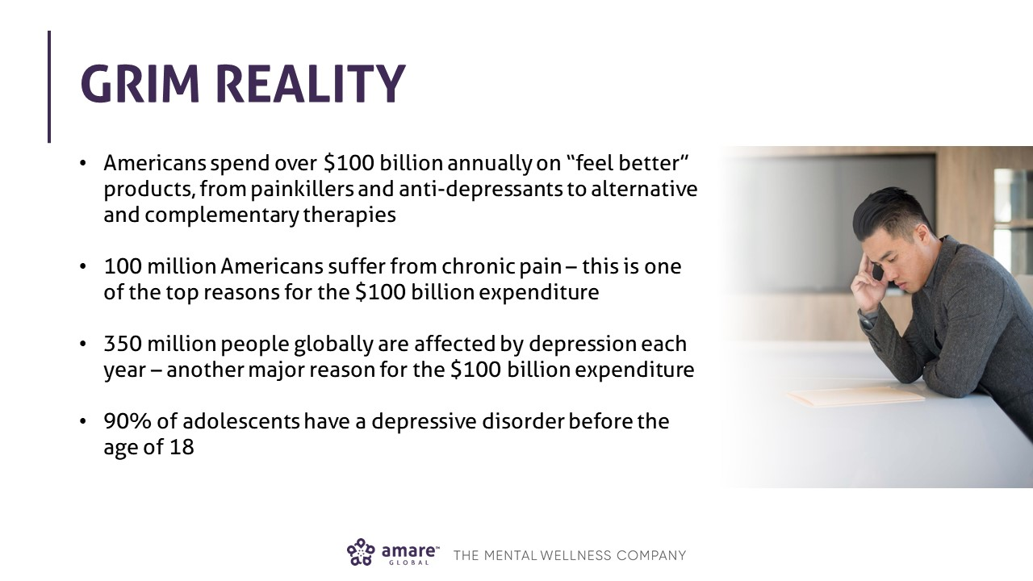

Slide 3
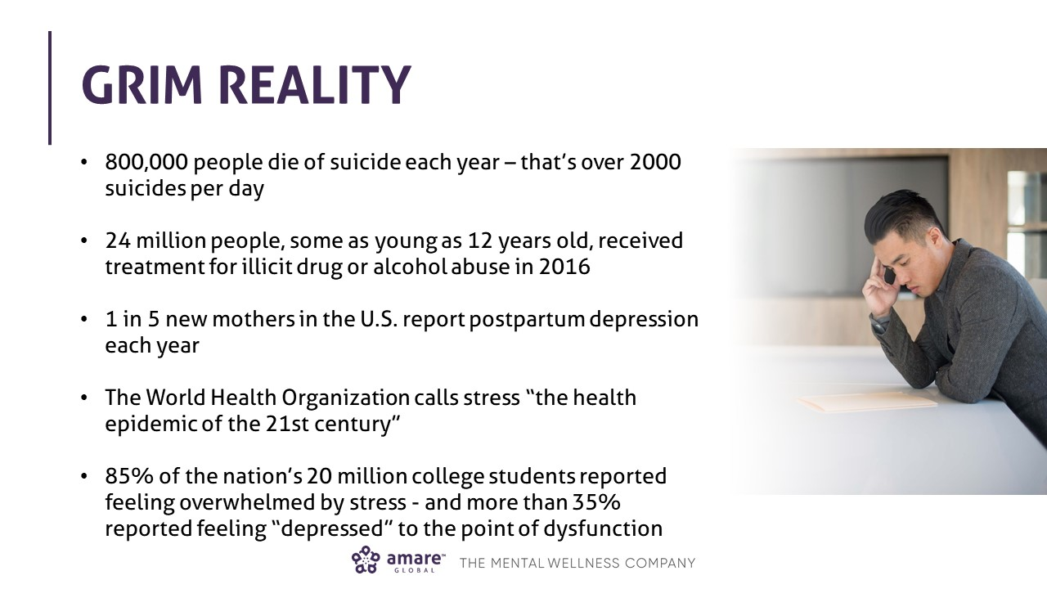

Slide 4
World Health Organization:
2004 = depression 3rd leading cause of global disease burden
2030 = was predicted to be #1
March 2017 = Depression is already the leading cause of disability worldwide

Slide 5
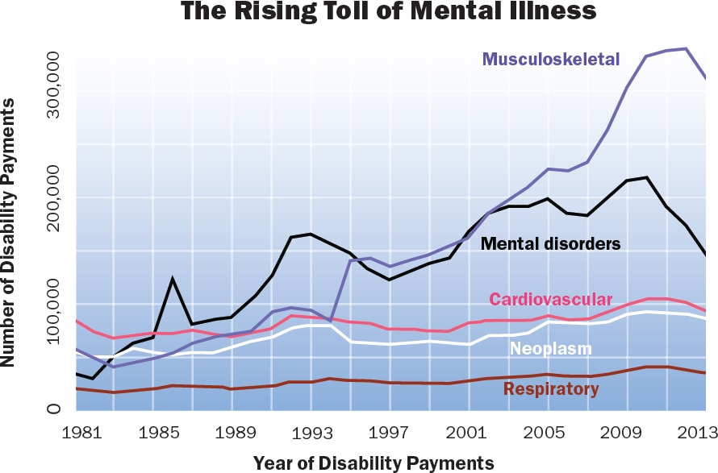
Over past 2 decades, mental illness has become 2nd most common cause of disability in U.S. (1st is musculoskeletal disorders)

Slide 6
Out-of-pocket costs for CAM among adults ~$34B
Non-vitamin, non-mineral, natural products
Top 5 conditions:
Back pain
Neck pain
Joint pain
Arthritis
Anxiety
Self-care costs
$22.0 Billion
(64.8%)
$14.8 B
(43.7%)
$4.1 B
(12.0%)
Yoga, tai chi, qigong classes
$11.9 B
(35.2%)
Practitioner costs
$11.9 Billion
(35.2%)
$2.9 B
(8.7%)
Homeopathic medicine
Relaxation techinques
$0.2 B (0.6%)
U.S. consumer supplement sales
= $52.5B by 2020

Slide 7




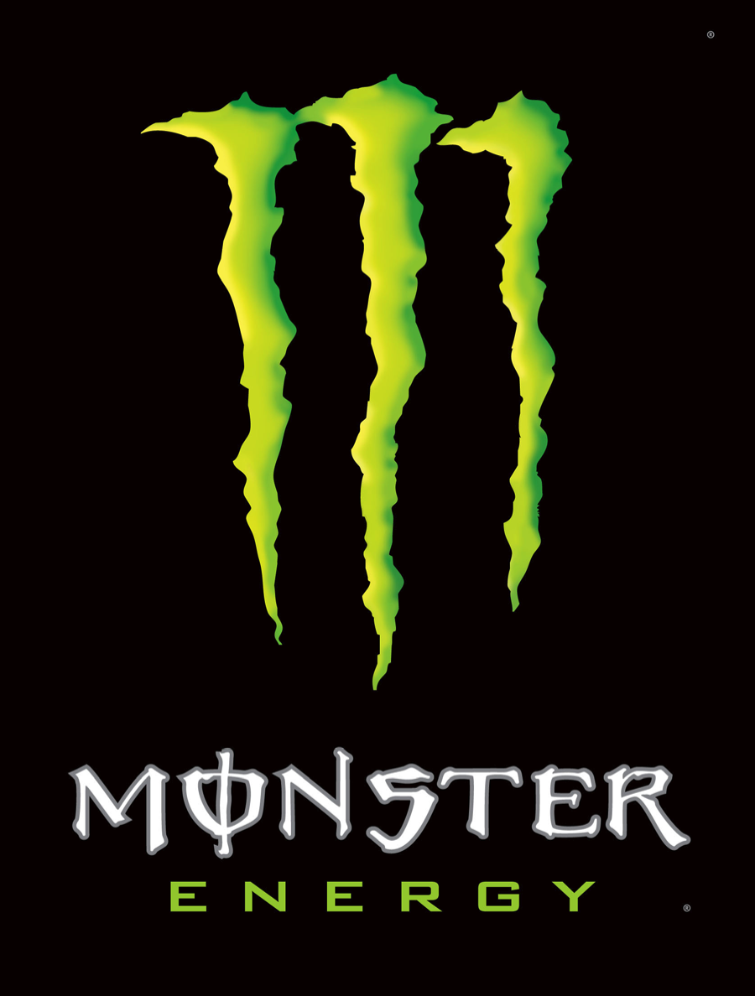










$100B+

Slide 8
“If I look at the mass, I will never act.
If I look at one, I will.”
- Mother Teresa

Slide 9

Cultural Change Around Mental Wellness

Slide 10
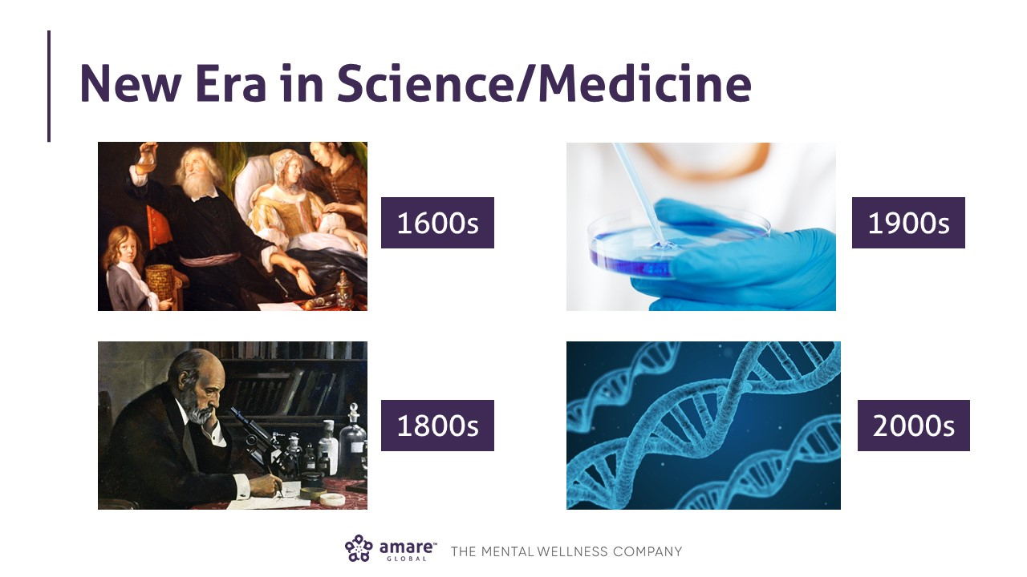

Slide 11
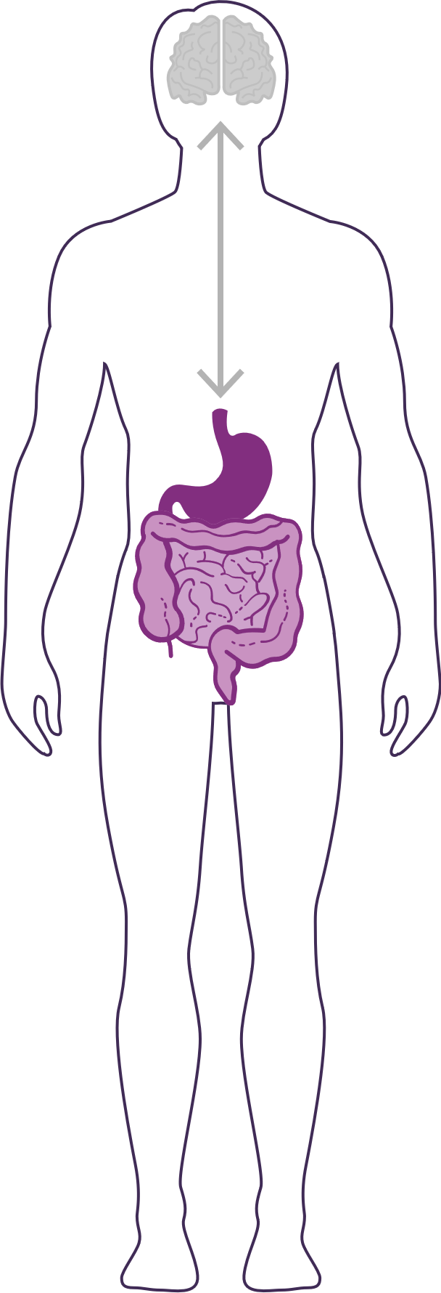
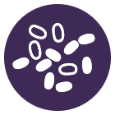
HOW IMPORTANT IS YOUR
MICROBIOME?
The microbiome plays an important role in the way you feel mentally & physically.
Communicates with the brain to regulate health, weight, immune function, digestive function, mood, and overall mental health.
What we put in our bodies affects the microbiome, which in turn affects our mind and other crucial bodily systems
IN BALANCE
Feeling Great
This explains why you have those “GUT-FEELINGS”
OUT OF BALANCE
Feeling fatigue, sad, tense, hungry, heavy, bloated, confused, stiff/sore

Slide 12
Over 90% of the more than 4,000 articles on the microbiome and gut-brain-axis were published in PubMed in the last 5 years.
Brain, Behavior, and Immunity
Volume 66, November 2017, Pages 9-17
Invited Review
Microbes and mental health: A review
Author links open overlay panel
RyanRiederaPaul J.WisniewskibcdBrandon L.AldermanbSara C.Campbellbcd

Slide 13
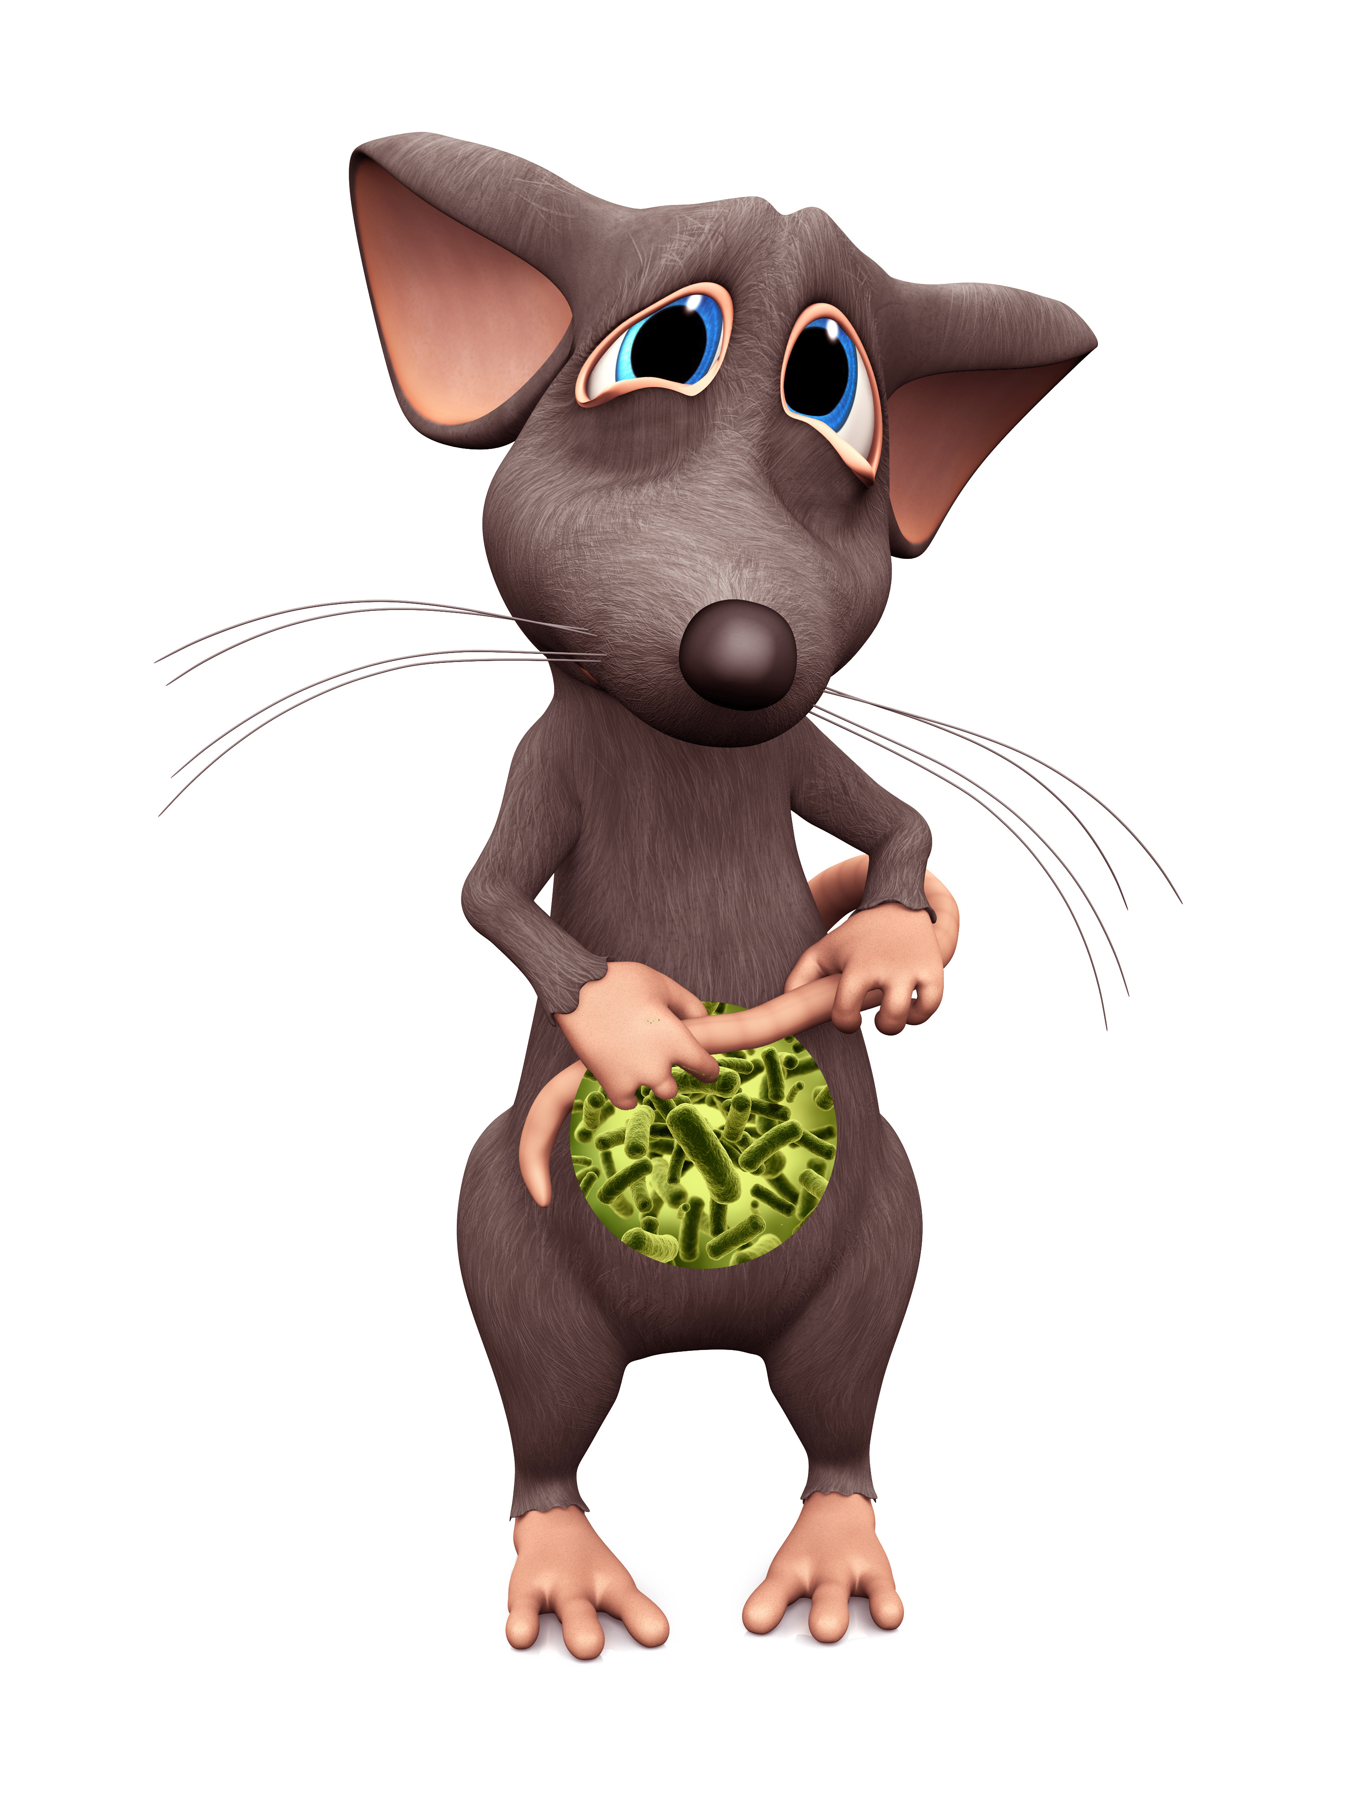
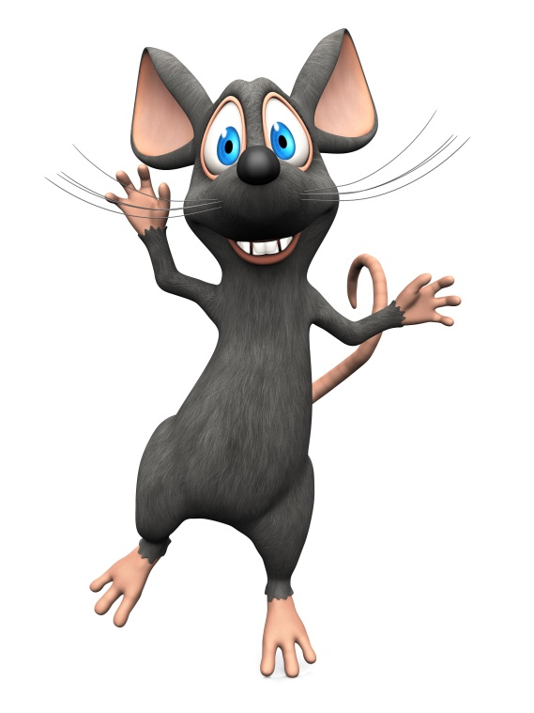
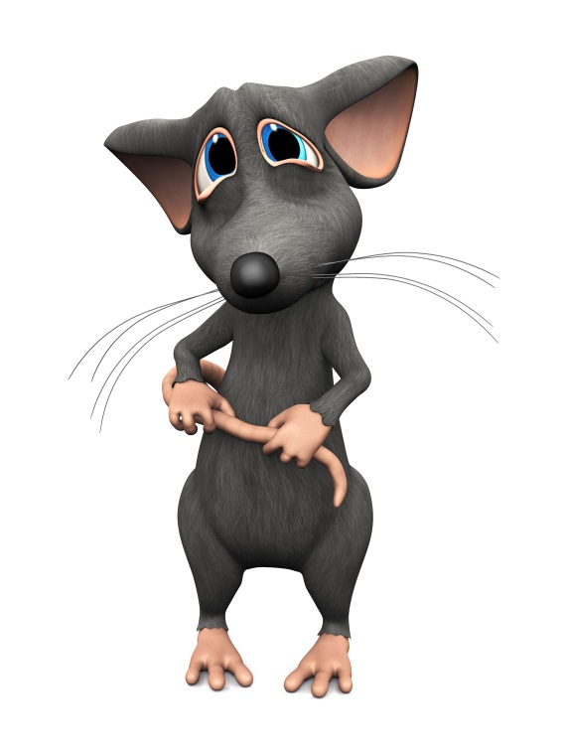
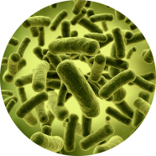
Timid
“Introvert”
Outgoing
“Extrovert”
Timid
“Introvert”
Normal gut microbes
Germ-free
Transplanted

Slide 14
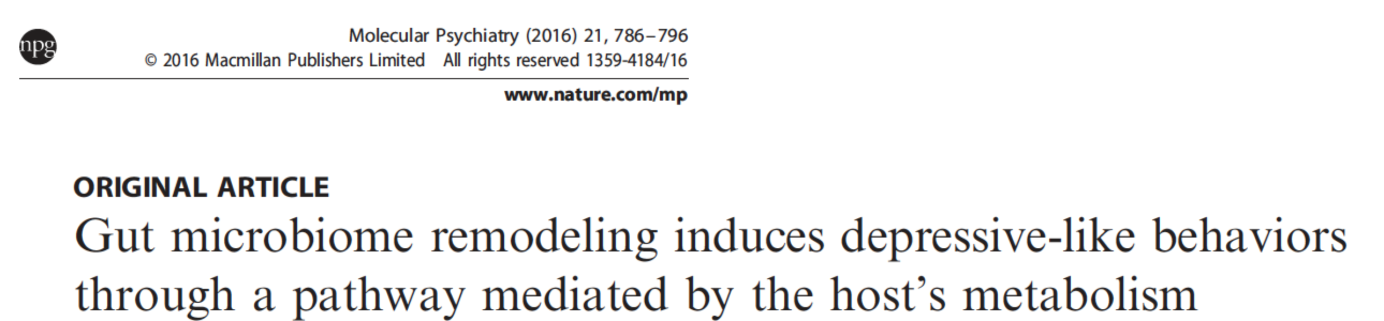
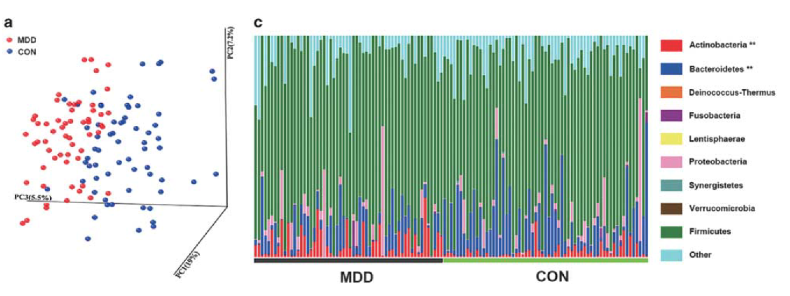
Depression
Zheng P et al, 2016

Slide 15
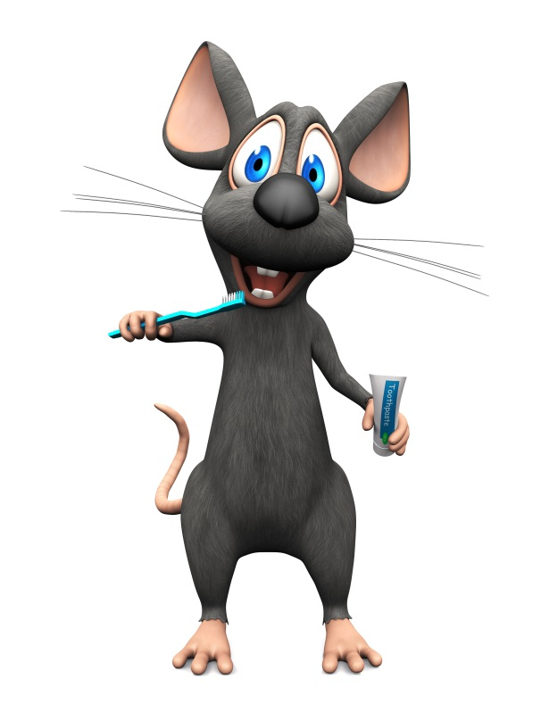
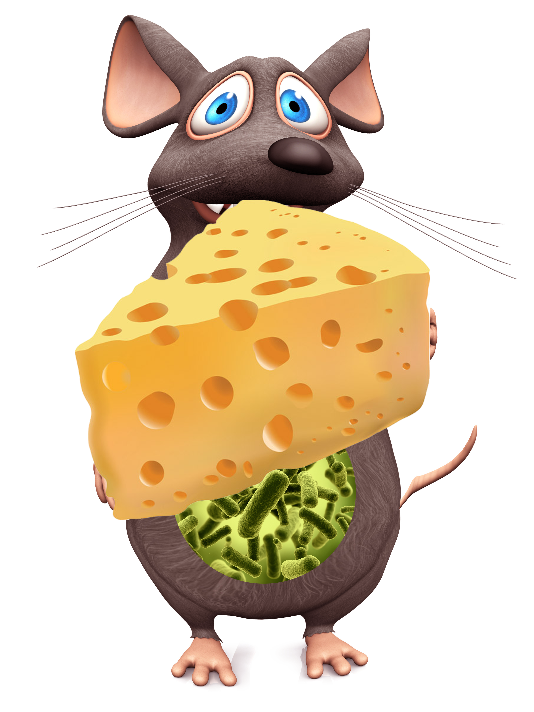
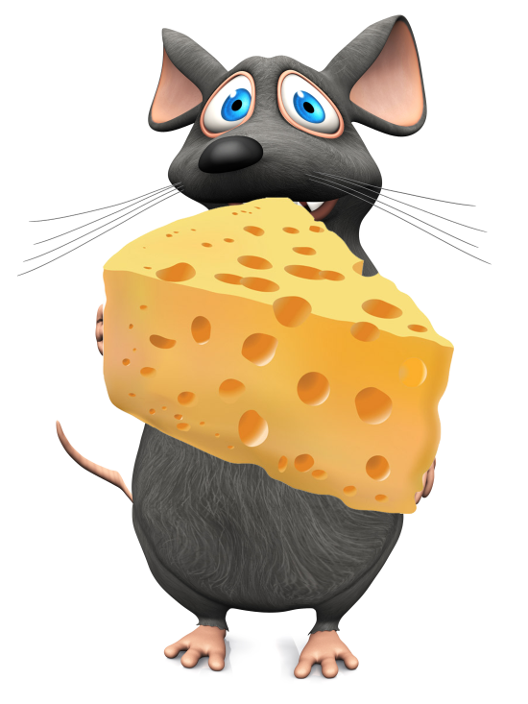
Obese
Overeating
Lean
Obese
Overeating
Obesogenic microbiota
Germ-free
Obesogenic microbiota

Slide 16
Gut-Based Decision Making
Rational decision making:
Slow, linear, objective, weighing multiple options (+/- lists), advice from others, evaluating data
Gut-based decision making:
Rapid, intuitive, subjective, deeply personal,
The “secret author of many of the choices and judgements [we]… make.” Daniel Kahneman

Slide 17
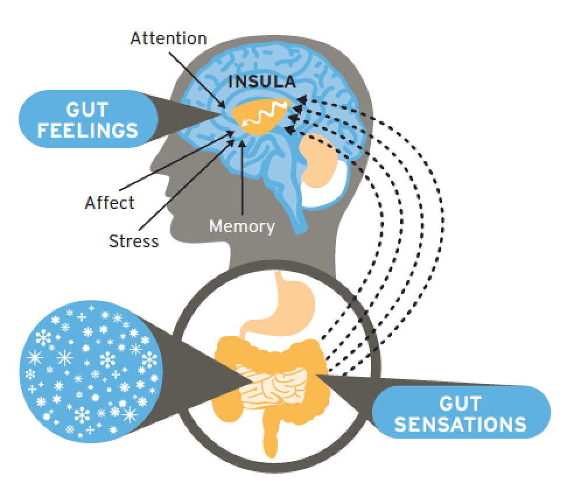
Decisions
Notes:
Gut feelings and gut based decisions

Slide 19
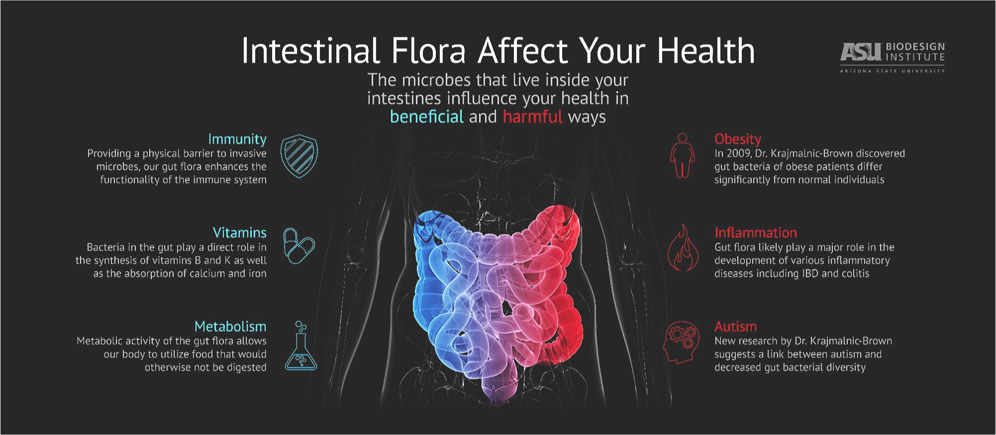

Slide 20
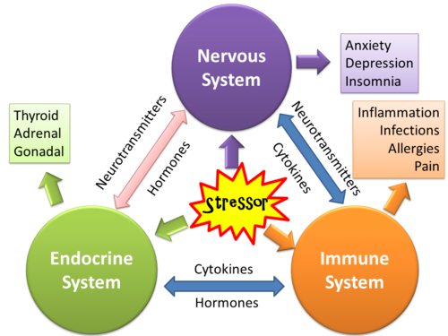
Hypothalamus = homeostatic interface between electricity of nervous system & hormones/neurotransmitters of endocrine/immune systems

Slide 21
Qi
Prana
Life Force
Vitality
Vigor
Motivation

Slide 22
Multi-Factorial Problem
Microbiome
Depression
Anxiety
Stress
Brain Fog
Fatigue
Pain
Tension
Irritability
Burnout
Stressors
Neurotransmitters
Thoughts
Immune System
Inflammation

Slide 23
Multi-Factorial Solution
Emotional
Self-Love/Compassion
Gratitude
Social Connection
Happiness
Energy
Motivation
Flexibility
Relaxation
Calmness
Clarity
Vigor
Professional
Financial
Work-Life Balance
Goals
Physical
GBX Diet
Exercise
Yoga
Personal
Who am I?
What do I want?
Hobbies
Psychological
Relaxation
Mindfulness
Aromatherapy
Spiritual
Why?
Inspiration
Meaning/Purpose

Slide 24
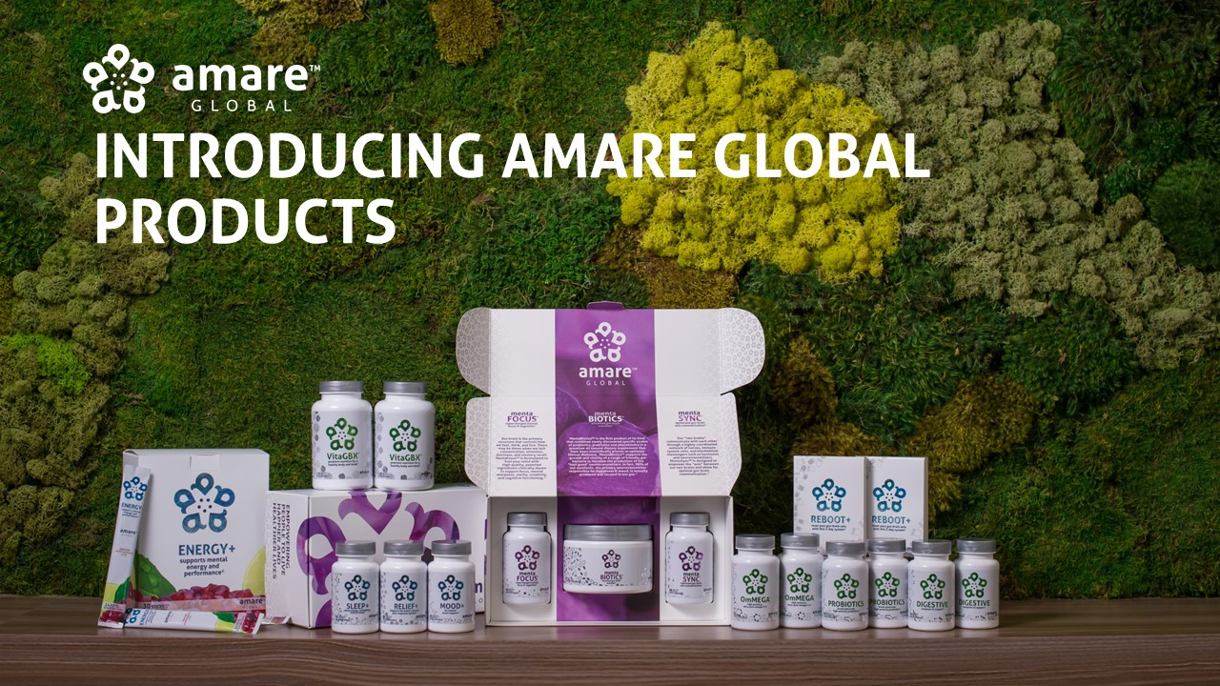

Slide 25
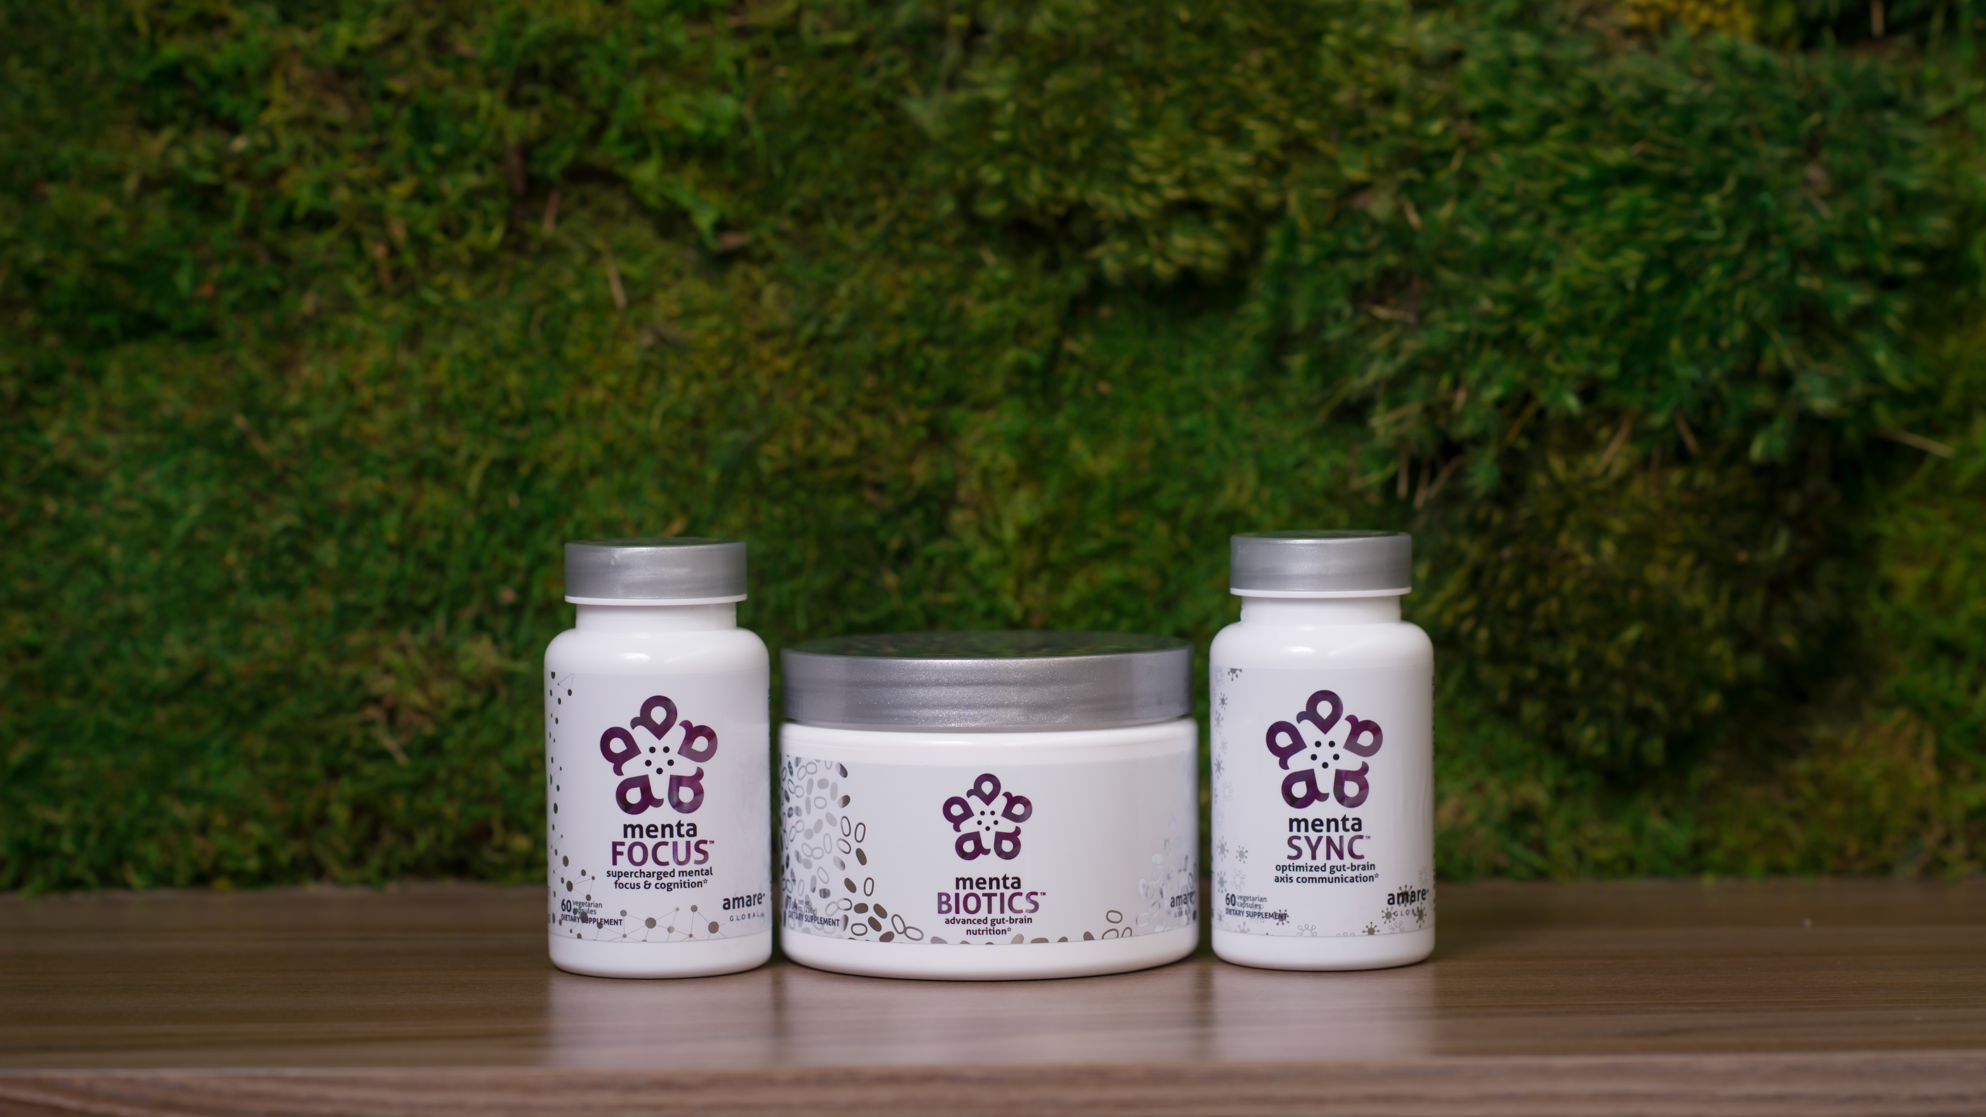

Amare’s flagship product line features our most popular cornerstone products!
The products are designed to improve every aspect of the gut-brain axis for optimal
mental wellness.*
FUNDAMENTALS
™
*These statements have not been evaluated by the Food and Drug Administration. This product is not intended to diagnose, treat, cure, or prevent any disease.

Slide 26
Effect of Amare FundaMentals System on Microbiome Balance
and Psychological Mood State in Healthy Stressed Adults

Slide 27
Effect of Amare FundaMentals System on Microbiome Balance
and Psychological Mood State in Healthy Stressed Adults

Slide 28
Effect of Amare FundaMentals System on Microbiome Balance
and Psychological Mood State in Healthy Stressed Adults
Bifidobacterium
Lactobacillus
Akkermansia
Firmicutes/Bacteroidetes (F/B) ratio

Slide 29
Effect of Amare FundaMentals System on Microbiome Balance
and Psychological Mood State in Healthy Stressed Adults

Slide 30
Effect of Amare FundaMentals System on Microbiome Balance
and Psychological Mood State in Healthy Stressed Adults

Slide 31

“Outstanding Research” Award
2017 Annual Scientific Conference (November)
SHAPE Magazine Dec 21, 2017
The Surprising Way Your Brain and Gut Are Connected
Can your microbiome affect your risk of mental illness?
"We know that the benefits of probiotics are very 'strain dependent.' Some strains are good for depression (like lactobacillus helveticus R0052); some are good for anxiety (like bifidobacterium longum R0175); and some are good for stress (like lactobacillus rhamnosus R0011), while still others are good for constipation or diarrhea or immune support or reducing inflammation or cholesterol or gas,"
Food for Thought – Nutritional Psychology and the Role of Nutrition in Mental Wellness

Slide 32
The world is only going to get
“more mental”
2018 – Feel Better
Microbiome
Gut-Brain-Axis
Targeted Therapeutics
Essential Nutrients
Adults – and KIDS!
2019 – Transformation
Tradition meets Science
Physiology meets Biochemistry
Functional meets Structural
Product/Program Synergy
Brain Plasticity
2020 – Skin Microbiome?
2021 – Body Biome?

Slide 33
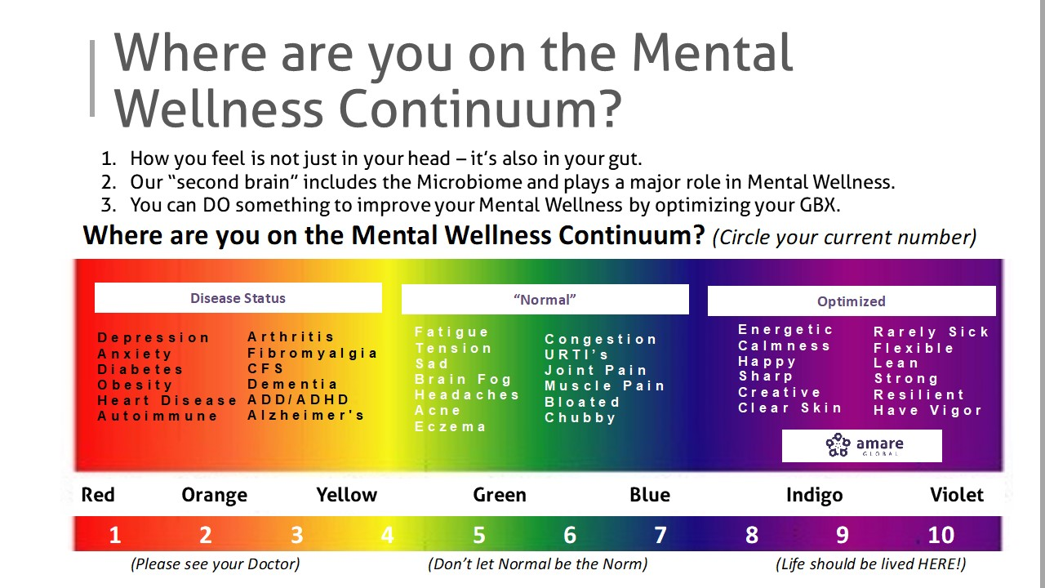

Slide 34
Martin Luther King Jr. once said:
Life's most persistent
and urgent question is,
'What are you doing for others?'

Slide 35
Market
Science
Resources
Timing
”What are you doing for others?”
What are you doing for yourself?

