Slide 1

The Mental Wellness Company®
Notes:
Welcome! We are excited to introduce you to Amare®, The Mental Wellness Company®.

Slide 2

amare
“to love”
Love yourself first and everything else falls into place
Notes:
Our company’s name has real meaning.
In latin, Amare means “to love”
We believe that in order to be well and make a difference, you must learn to love yourself first and everything else falls into place.

Slide 3

Notes:
Before we had any products or even knew we were The Mental Wellness Company, we spent two full days identifying our core values.
All of our decisions come from our core values. The genesis of our entire company was our five core values:
Love, Integrity, Innovation, Service, and Humility
We believe in living our core values in both our professional and personal lives, with full authenticity. It’s just who we are.

Slide 4

Our Vision
To Lead the Global Mental Wellness Revolution
Notes:
Our vision is to lead the global mental wellness revolution.
Mental Wellness is a revolution. This is the end of one-dimensional wellness. This is the beginning of true change in the world. Wellness isn’t just physical. It isn’t isolated. Wellness is interconnected. It is the realization of your best self and the impact you can have in the world.
This is the revolution. The connection of ancient knowledge and innovative technology.
The interwoven connection of our bodies, and our brains.
Our physical health with our mental health.

Slide 5

Our Mission…
is to create a holistic mental wellness platform of products, programs, and people.
Notes:
From day 1, we have believed that leading the mental wellness revolution was not just about products. It wasn’t just about behavioral programs. It wasn’t just about great people supporting and serving each other.
Our belief and our mission is that to lead the mental wellness revolution, we needed to create a holistic mental wellness PLATFORM of products, programs, and people.

Slide 6

20+ years developing nutritional products.
Fellow of the American College of Nutrition, the American College of Sports Medicine, and the American Institute of Stress.
Author of two academic textbooks, an award-winning documentary film, and several best-selling books
Featured guest on the “Dr. Oz Show,” “Ask Dr. Nandi,” The TED stage, and the White House.
Served as a nutrition educator for elite-level athletes.
Diplomate of the International Olympic Committee’s (IOC) Sports Nutrition program.
Dr. Shawn Talbott
Amare’s Chief Science Officer
PhD, CNS, LDN, FACSM, FAIS, FACN
Notes:
Amare’s Chief Science Officer, Dr. Shawn Talbott
Scientist + Accomplished Athlete (Triathlons/Iron Man medal winner!)
20+ years developing products in the nutrition space
Fellow of the American College of Nutrition, the American College of Sports Medicine, and the American Institute of Stress.
Author of two academic textbooks, an award-winning documentary film, and several best-selling books
Featured guest on the “Dr. Oz Show,” “Ask Dr. Nandi,” The TED stage, and the White House.
Served as a nutrition educator for elite-level athletes.
Diplomate of the International Olympic Committee’s (IOC) Sports Nutrition program.

Slide 7
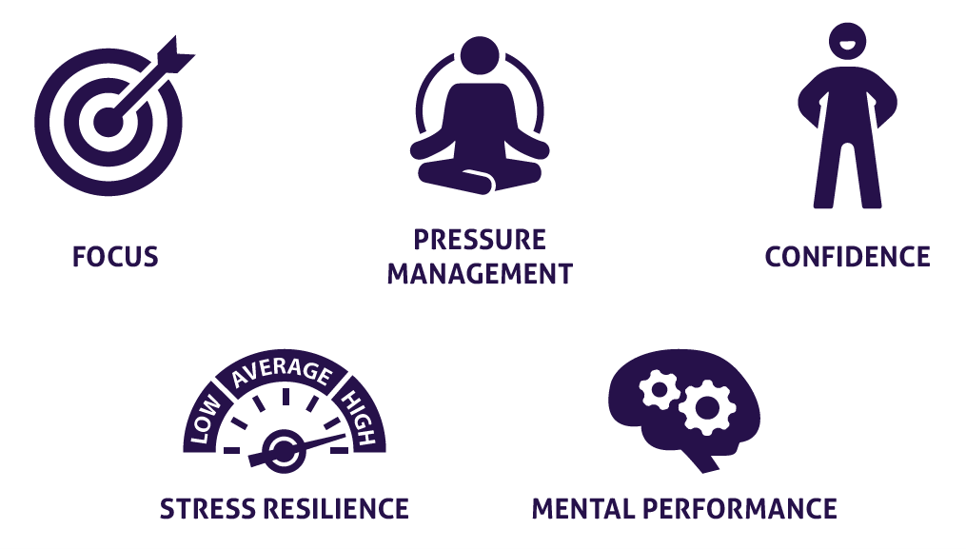


What is Mental Wellness?
Notes:
Mental WELLNESS, not mental ILLNESS!
Focus
Pressure Management
Confidence
Stress Resilience
Mental Performance
Physical Performance

Slide 8
The Mental Wellness Continuum
How you feel is not just in your head — it’s also in your gut and heart.
You can now DO something NATURALLY to improve your mental wellness.
WHERE ARE YOU ON THE MENTAL WELLNESS CONTINUUM?
1
2
3
4
5
6
7
8
9
10
DISEASE STATUS
“NORMAL”
OPTIMIZED
Depression
Anxiety
Diabetes
Obesity
Heart Disease
Autoimmune
Arthritis
Fibromyalgia
CFS
Dementia
ADD / ADHD
Alzheimer’s
Fatigue
Tension
Sad
Brain Fog
Headaches
Acne
Eczema
Congestion
URTIs
Joint Pain
Muscle Pain
Bloated
Chubby
Energetic
Calmness
Happy
Sharp
Creative
Clear Skin
Rarely Sick
Flexible
Lean
Strong
Resilient
RED
ORANGE
YELLOW
GREEN
BLUE
INDIGO
VIOLET
Notes:
Wherever you are today on the mental wellness continuum, you can ”move to the right”

Slide 9
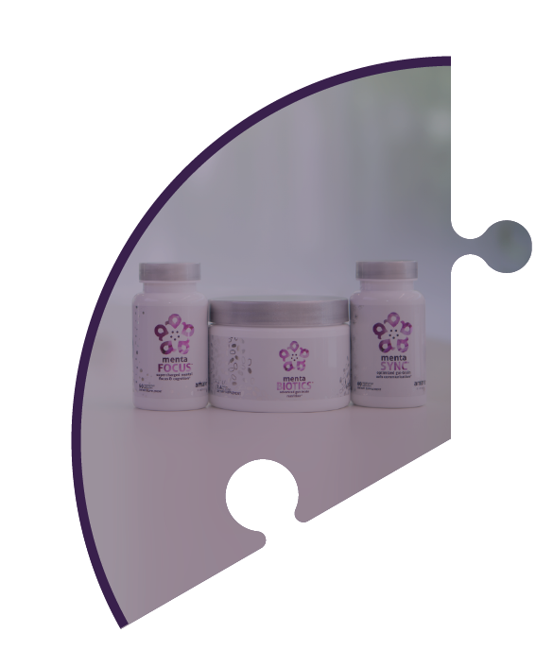


Our Platform of:
Products
People
Programs
Notes:
Our platform consists of the Three P’s: Products, Programs, and People.
(click to reveal) 1. Products – cutting-edge science based products with real clinical studies and proven results!
(click to reveal )2. Programs – we have produced life-changing programs in the areas of mindfulness, nutrition, and movement (exercise) for mental wellness!
(click to reveal) 3. People – we bring people together around our 5 core values, creating a positive community of passionate people that build each other up!
Amare is the revolutionary connection of cutting-edge products, life-changing programs, and heart-centered people.

Slide 10

The Market Size
“Cultural change” is emerging in the global attitude toward stress and mental health
Over the next 10-20 years there will be no bigger focus in the natural nutrition or pharmaceutical industries, than brain health and mental wellness ($1 Trillion)
A massive scientific shift
TIMING IS EVERYTHING!
Notes:
- More and more people are talking about their personal mental wellness!
People are just now learning that they can have more control and positively contribute to their mental health through their day to day choices!
Science is proving that supplements and nutrition can improve mental wellness!

Slide 11



.
GROWTH COMPANY
MASSIVE NEED
Our vision
is to lead
the global mental wellness revolution
TIMING
TIMING
TIMING
UNIQUE PRODUCTS
SOCIAL SHIFT
NEW ERA SCIENCE
TIMING MATTERS!
Notes:
Timing Matters! It’s huge!
We have ideal timing in 5 areas:
Massive Need
Social Shift
New Era Science
Unique Products
We are a growth company, very flexible and agile with a ton of room for growth in the future!

Slide 12















MASSIVE NEED
$100B+
Notes:
Americans spend over $100 billion annually on “feel better” products, from painkillers and anti-depressants to alternative and complementary therapies
None of these get to the core source of where good mental wellness can be generated from…

Slide 13



MASSIVE NEED
The World Health Organization calls Stress “the health epidemic of the 21st century” with more than 350 million people affected around the world.
Mental Wellness is becoming
“the national conversation”
Notes:
The World Health Organization calls stress “the health epidemic of the 21st century” with more than 350 million people affected around the world
Look at these national publications covering mental health.
Mental wellness is becoming the national conversation.

Slide 14




Social Shift Around Mental Wellness
SOCIAL SHIFT
Notes:
Iconic figures & leaders in our society are opening up about their own mental wellness journies.
The stigma around mental health is being broken down.
Mental wellness is becoming more and more mainstream and encouraged to be talked about.

Slide 15
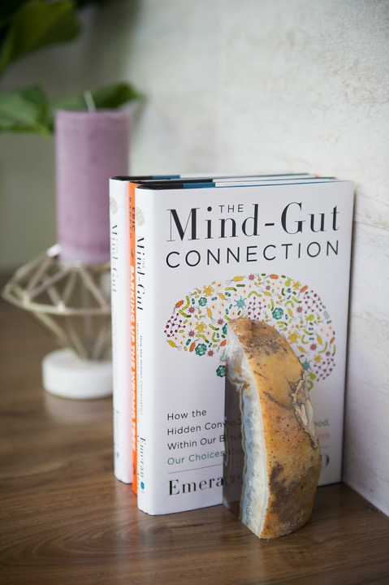
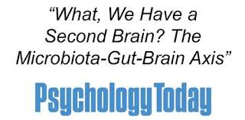
Recent Scientific Discoveries
NEW ERA SCIENCE
Science now tells us that we actually have SECOND and THIRD BRAINS!
There has been a massive scientific shift towards the MICROBIOME, also known as our gut and second brain, as being the source to addressing mental wellness issues.
Notes:
New era science!
Recent scientific discoveries now tell us that we actually have second (our gut) and third (our heart) brains!
Extensive research has been focused on the gut microbiome as a main target to addressing mental wellness issues!
Multiple books on the gut-brain axis, including the most popular one “The Mind-Gut Connection” by Emeran Mayer, who is on Amare’s Scientific Advisory Board and is considered ”the godfather of the gut-brain axis”.

Slide 16





Microbiome
NEW ERA SCIENCE
The Gut Microbiome solution is
another “national conversation”
Notes:
The gut microbiome is another national conversation!
Publications upon publications of new scientific studies on this area in major scientific journals.

Slide 17
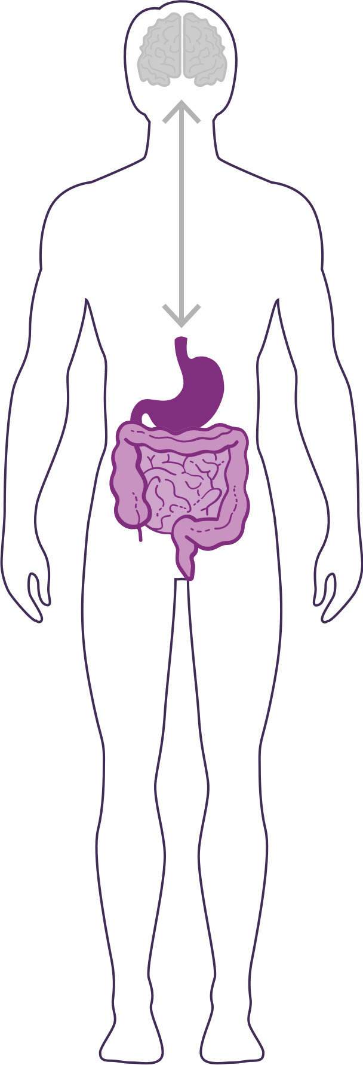
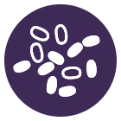
How Important is Your Microbiome?
Communicates with the brain to regulate mood, stress response, immune function, digestive function, weight, and more.
What we put in our bodies affects the microbiome, which in turn affects our mind and other crucial bodily systems.
The microbiome plays an important role in the way you feel mentally and physically.
IN BALANCE
Feeling great
OUT OF BALANCE
This explains why you have those “GUT FEELINGS”
Feeling fatigue, sad, tense, hungry, heavy, bloated, confused, stiff/sore
Notes:
The gut microbiome communicates with your brain via the gut-brain axis to regulate mood, stress response, immune function, digestive function, weight, and more.
What we put in our body affects the microbiome, with in turn affects our mind and other crucial bodily systems.
When your microbiome is in balance, you feel great
When your microbiome is out of balance, you feel fatigued, sad, tense, hungry, heavy, bloated, confused, stiff, sore…
The microbiome plays an important role in the way you feel mentally and physically.

Slide 18
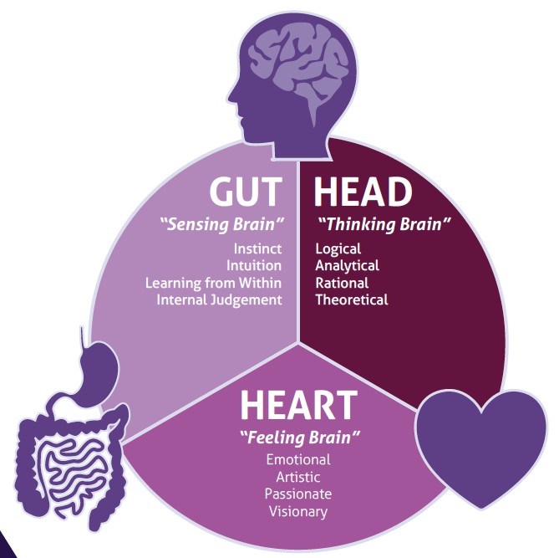
Targeting Mental Wellness Through the
BODY’S THREE BRAINS
Science now tells us that we actually have SECOND & THIRD BRAINS in our gut and heart!
Notes:
Amare targets mental wellness through the body’s THREE brains! Each of these brains contain immense amounts of neurons that can receive and send signals to other areas of the body.
Gut – “Sensing Brain” – gut feelings, instinct, intution, learning from within, internal judgment
Head – “Thinking Brain” – logical, analytical, rational, theoretical
Heart – “Feeling Brain” – Emotional, Artistic, Visionary
Gut feelings and trusting your heart are more than just turns of phrase – science now tells us that the microbes in our gut and the electrical signals from our heart are read by the brain and can dramatically influence our mood and behavior as well as our mental and physical health.

Slide 19
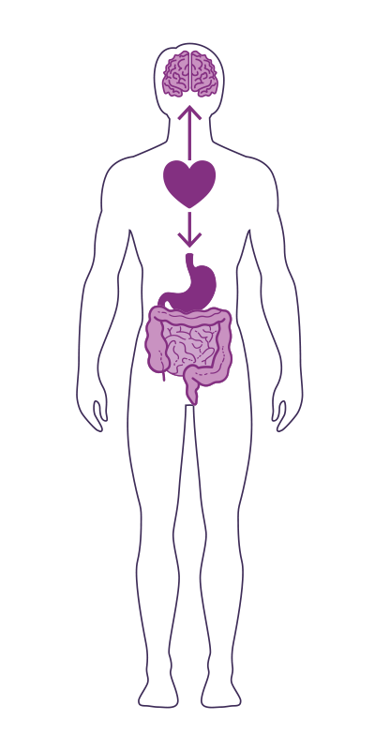
The
GUT-BRAIN-HEART AXIS
Studies have now shown that the heart is the body’s third brain, containing approximately 40,000 neurons that can sense, feel, learn, and remember.
Similar to the gut-brain axis, the heart and brain are also closely connected via the heart-brain axis.
The heart sends messages to the brain about what it needs, how the body feels and more.
Nervous system (brain)
Cardiovascular system (heart)
Immune system (axis)
Gastrointestinal system (gut)
Notes:
Our three brains communicate through a highly extensive, multi-directional network, known as the gut-brain-heart axis.
THE NETWORK CONSISTS OF:
“wires” — nerves
“chemicals” — neurotransmitters/hormones
“cells” — immune system
The Gut-Brain-Heart Axis connects our nervous system (brain), cardiovascular system (heart), immune system (axis), and gastrointestinal system (gut) with a vast array of cellular and biochemical messengers throughout the entire body, which include the microbiome, hormones, cytokines, and neurotransmitters.

Slide 20
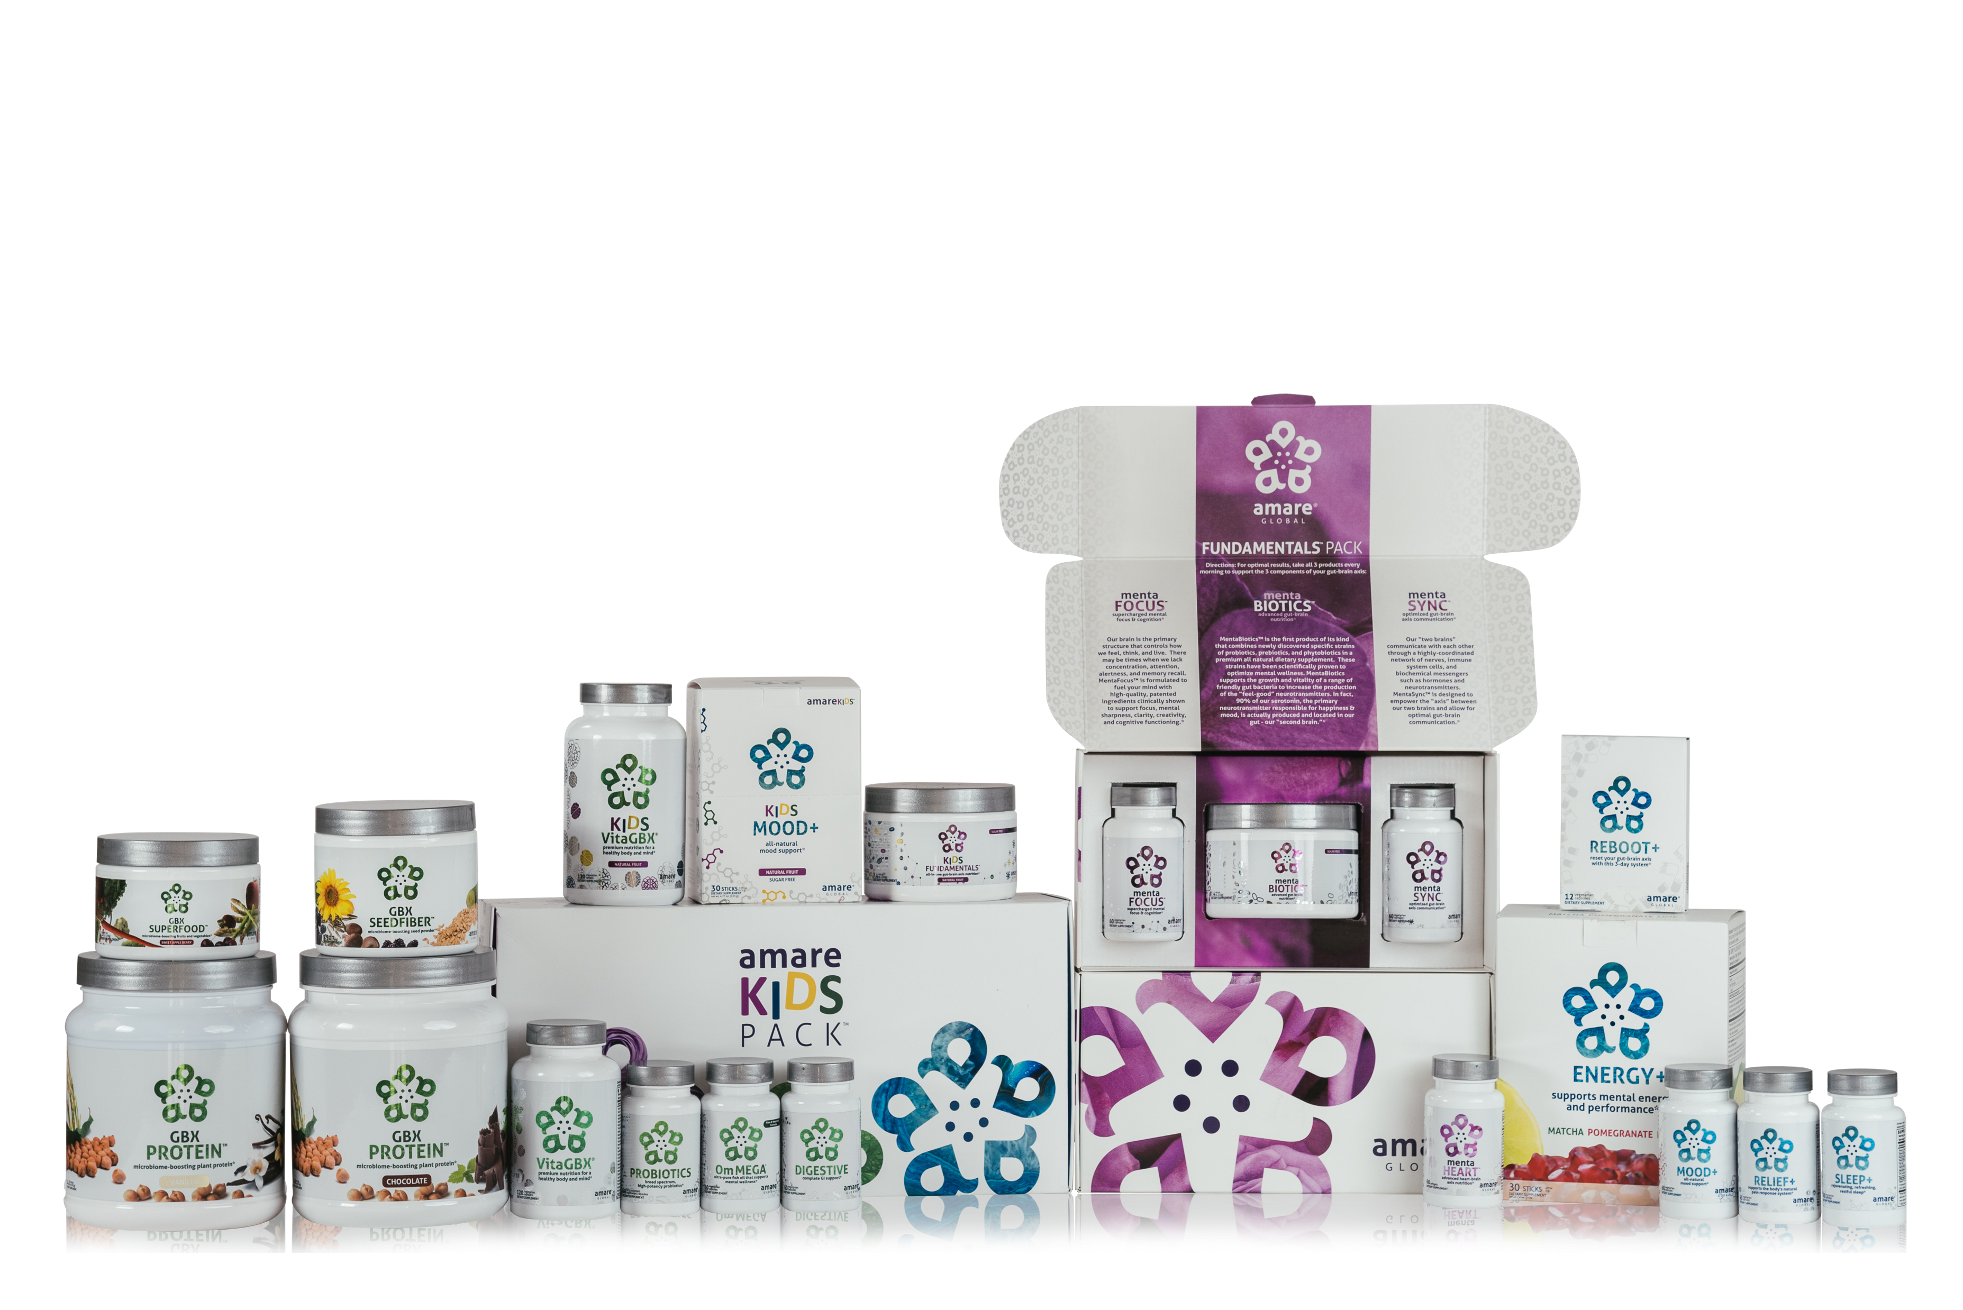
AMARE IS THE ONLY COMPANY DOING WHAT WE’RE DOING!
UNIQUE PRODUCTS
Notes:
No other company is developing a comprehensive lineup of products for mental wellness through the microbiome and gut-brain axis!
We launched with TWELVE of them in 2017! Now we have TWENTY TWO unique products!
We will continue to lead the way!

Slide 21
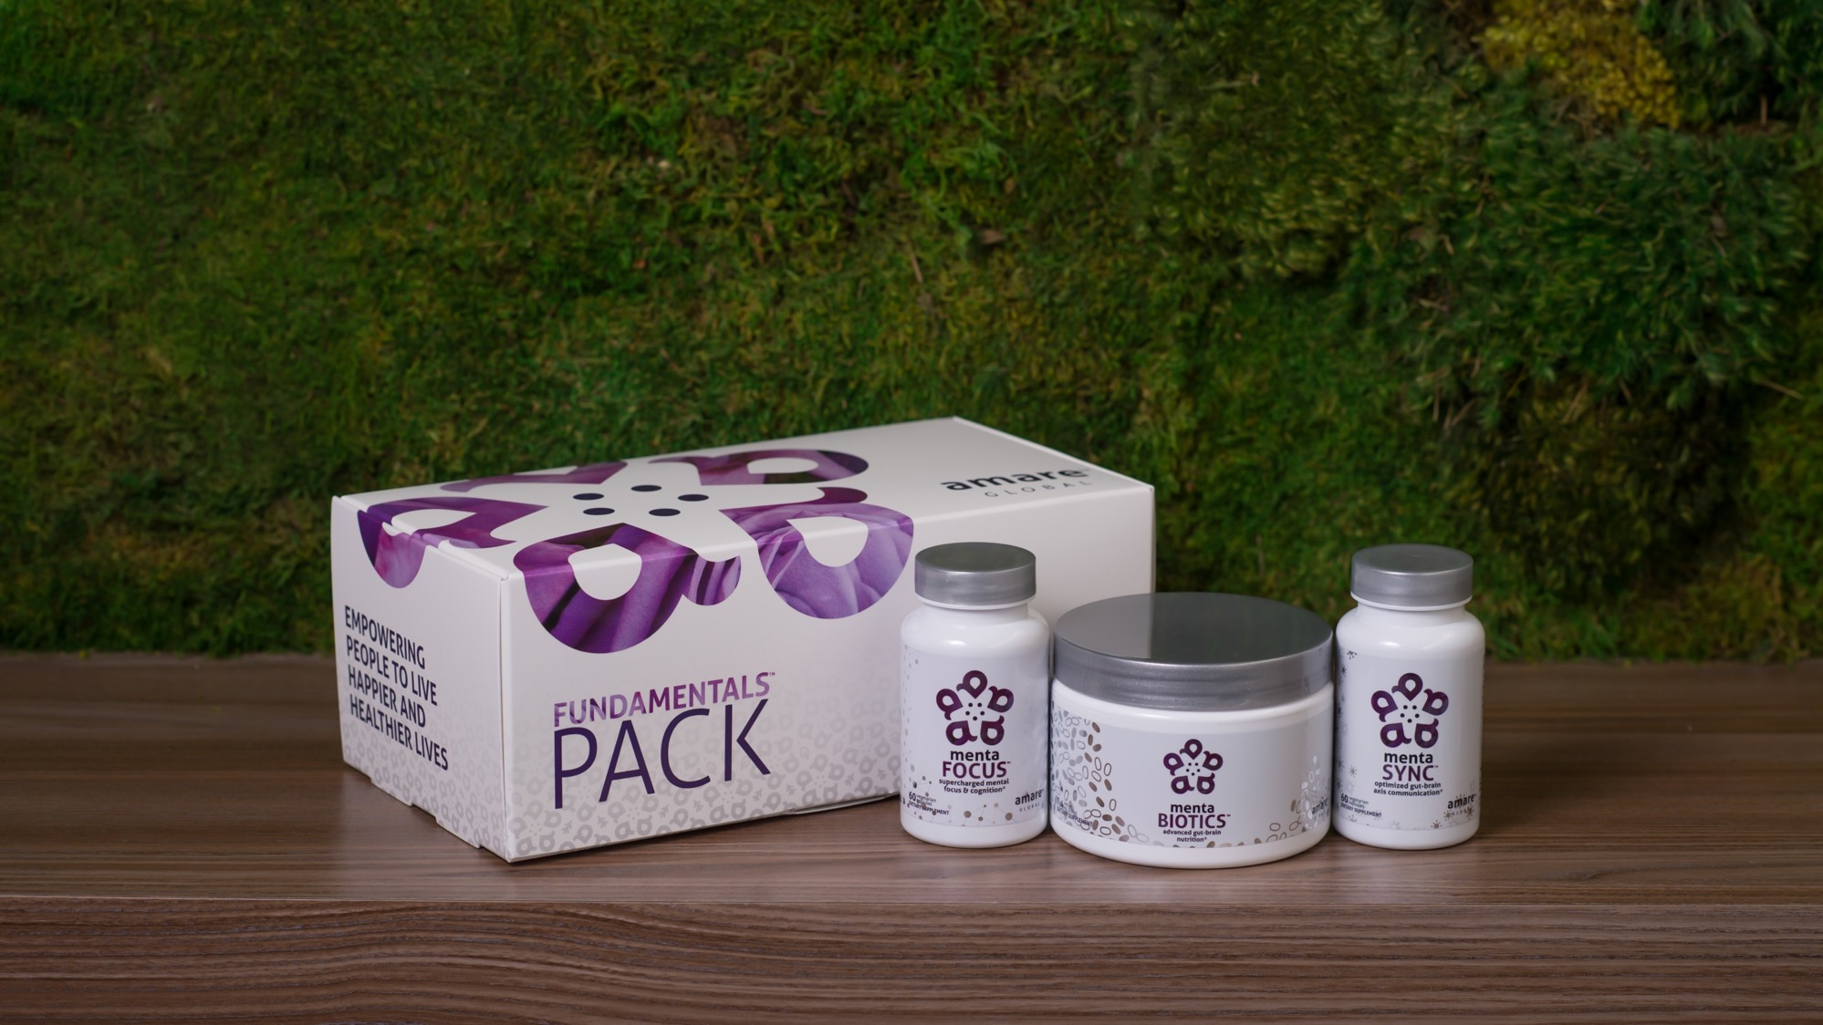

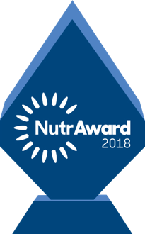
World’s First Award-Winning Gut-Brain Axis Nutrition System
Amare FundaMentals Pack
®
2018 NutrAward Winner for
“BEST NEW FINISHED PRODUCT”
Item Code:
Retail Price:
Wholesale Price:
Subscribe & Save:
P001
$234.00
$149.95 / 120 PV
$134.95 / 108 PV
*These statements have not been evaluated by the Food and Drug Administration. This product is not intended to diagnose, treat, cure, or prevent any disease.
Notes:
Our original flagship pack to uniquely address the gut-brain-axis with the world’s first comprehensive nutrition system to address each component of the gut-brain axis!
Award Winning - 2018 NutrAward winner for “Best New Finished Product” – this is like the Academy Awards of Nutritional products, selected from hundreds of companies that submitted for the award. Judged by industry experts, and presented at the country’s largest expo/convention for natural products with nearly 100,000 attendees!
Includes:
MentaBiotics (for the gut)
MentaFocus (for the brain)
MentaSync (for the axis)
Save money compared to buying the products individually! (10% savings)

Slide 22
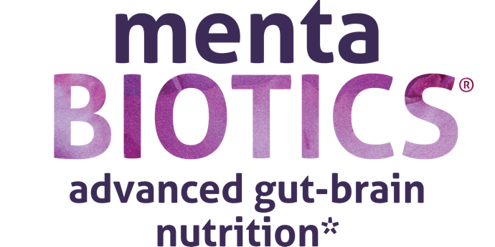

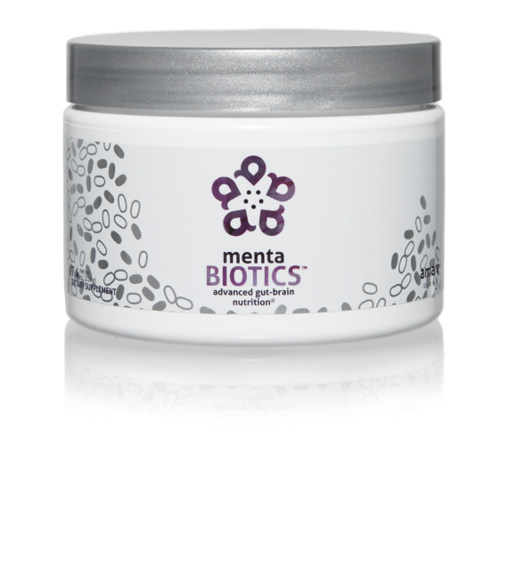
AMARE’S FLAGSHIP PRODUCT
SUPPORTS FEEL-GOOD NEUROTRANS-MITTERS
INCREASES GOOD BACTERIA
The most comprehensive combination of unique strains of probiotics, prebiotics and phytobiotics that have been scientifically shown to improve mental wellness.*
Item Code:
Retail Price:
Wholesale Price:
Subscribe & Save:
S001
$100.00
$74.95 / 65 PV
$66.95 / 58 PV
Also available in
SUGAR FREE
*These statements have not been evaluated by the Food and Drug Administration. This product is not intended to diagnose, treat, cure, or prevent any disease.
Notes:
MentaBiotics (for the gut) – advanced gut-brain nutrition.
The most comprehensive combination of unique strains of probiotics, prebiotics and phytobiotics that have been scientifically shown to improve mental wellness.*
- It’s like 4 products in one!
Amare’s flagship product
Supports feel-good neurotransmitters
Increases good bacteria, which lead to good mood, confidence, and stress resilience.

Slide 23

MENTABIOTICS SUGAR FREE
MW3™ Probiotic Proprietary Blend
™
Our blend contains unique and specific probiotic strains targeted to enhance overall mental wellness.*
MW3 Probiotic Strains:
Lactobacillus rhamnosus R0011 — Reduces stress by lowering cortisol exposure and improves GABA neurotransmission*
Bifidobacterium longum R0175 — Enhances calmness by decreasing anxiety indices and improves cognitive function*
Lactobacillus helveticus R0052 — Improves mood by decreasing neuro-inflammation and increasing serotonin*
*These statements have not been evaluated by the Food and Drug Administration. This product is not intended to diagnose, treat, cure, or prevent any disease.

Slide 24

MENTABIOTICS SUGAR FREE
MW3™ Prebiotic Proprietary Blend
™
Our MW3 Prebiotic Proprietary Blend provides optimal gut support by feeding the specific mental wellness probiotic strains found in our MW3 Probiotic Proprietary Blend.*
MW3 Prebiotic Fibers:
IsoFiber™ (Iso-Malto-Oligosaccharides) — Contains a combination of naturally occurring prebiotic plant fibers that are clinically shown to improve the growth of specific probiotic strains featured in Kids FundaMentals™ and now MentaBiotics™ Sugar Free!
Bimuno® (Galacto-Oligo-Saccharides) — Resets and increases friendly gut bacteria, maintains immune health, controls inflammation in the body and supports microbiome balance. Is highly effective and a natural way of increasing preferred bacteria in the gut. Plays an important role in feeding Bifidobacteria probiotic strains.*
SunFiber® (Galactomannan Fiber) — Helps improve the growth and vitality of beneficial bacteria, including Bifidobacteria and Lactobacillus.*
*These statements have not been evaluated by the Food and Drug Administration. This product is not intended to diagnose, treat, cure, or prevent any disease.

Slide 25
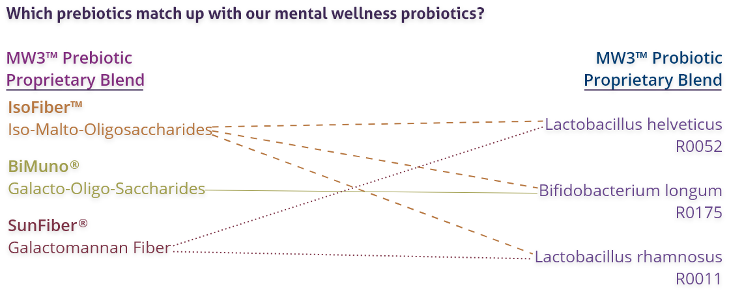
MENTABIOTICS SUGAR FREE
MW3™ Prebiotic/Probiotic Proprietary Blend
™
*These statements have not been evaluated by the Food and Drug Administration. This product is not intended to diagnose, treat, cure, or prevent any disease.

Slide 26


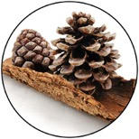
GBX+ Proprietary Blend…
Patent Pending and Exclusive to Amare
Applephenon: Asian Apple Fruit extract
Supports gut health, immune function, & inflammatory balance*
Enovita: French Grape Seed extract
Enhances blood flow, cardiovascular tone, & cellular defenses*
Enzogenol: New Zealand Pine Bark extract
Improves neurotransmitter balance, mental focus, & psychological vigor*
*These statements have not been evaluated by the Food and Drug Administration. This product is not intended to diagnose, treat, cure, or prevent any disease.
Notes:
Shawn: Slide: For Your Gut...: The Probiotic Strain Matters pg.26 -- Part of the reason why this product is so effective, is because we've looked at the research to guide our formulation. One of the very important ways that weve done that is the probiotic strains that we have chosen have already been specifically evaluated for their effects on different mental wellness parameters. This is very important distinction as you go out to talk to people about these products, that probiotics are hot right now, its one of the very important health trends that’s going on. But, the benefits of a probiotic are very very strain dependent. If I just said to you, "Everyone go out and buy some probiotics", and you went to the grocery store to look for probiotics, that would be like me saying, "Go out and get some vitamins." You wouldn’t know what vitamin I was talking about. Did he mean vitamin D or A? Or did he mean Vitamin C or B? All these vitamins do all different things inside the body, its exactly the same with these probiotic strains. So you can see the benefits here, Lactobacillus rhamnosus R0011, that tells us that specific strain does this, it lowers cortisol exposure which is a stress hormone. It increases a neurotransmitter called GABA which is associated with relaxing. Bifidobacterium longum R0175 reduces anxiety and improves cognitive function. Lactobacillus helveticus R0052 decreases neuroinflammation and increases serotonin, so its going to help you with your mood. You know, those benefits are specific to those strains, not to probiotics in general. In our separate probiotic formula, we have different strains that are more associated with more general wellness benefits, diarrhea, constipation, gastro intestinal function, immune system function, inflammation in a different way than your getting here with neural inflammation. In the future, we'll be selecting probiotic strains that are good for the heart-brain axis that is going to compound some of the benefits that we are seeing with this gut-brain axis. It’s a very very exciting area of science, but it’s also very strain-dependent.
There are over 10,000 different species of bacteria in our gut, but there are millions of strains comprising billions of bacteria overall.
Amare’s strains of bacteria are unique and have specific functions around mental wellness.

Slide 27
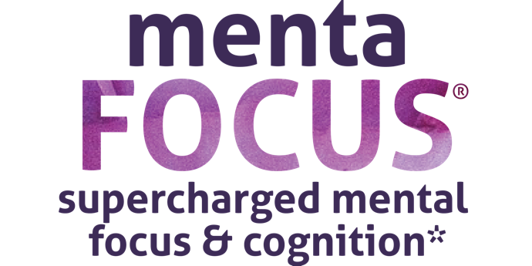
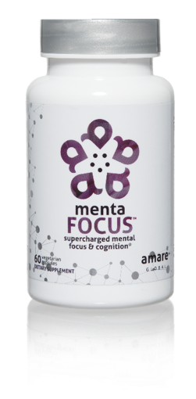
AMPLIFIES ATTENTION & ALERTNESS
ENHANCES BRAIN ACTIVATION
PROMOTES CLARITY COGNITION CREATIVITY
Supercharge your brain with key phytonutrients clinically shown to support focus, mental sharpness, clarity, creativity, and cognitive functioning.*
Item Code:
Retail Price:
Wholesale Price:
Subscribe & Save:
S002
$60.00
$44.95 / 39 PV
$39.95 / 35 PV
*These statements have not been evaluated by the Food and Drug Administration. This product is not intended to diagnose, treat, cure, or prevent any disease.
Notes:
MentaFocus (for the brain) – supercharged mental focus & cognition
Supercharge your brain with key phytonutrients clinically shown to support focus, mental sharpness, clarity, creativity, and cognitive functioning.*
Amplified attention & alertness
Enhances brain activation
Promotes clarity, cognition, and creativity

Slide 28
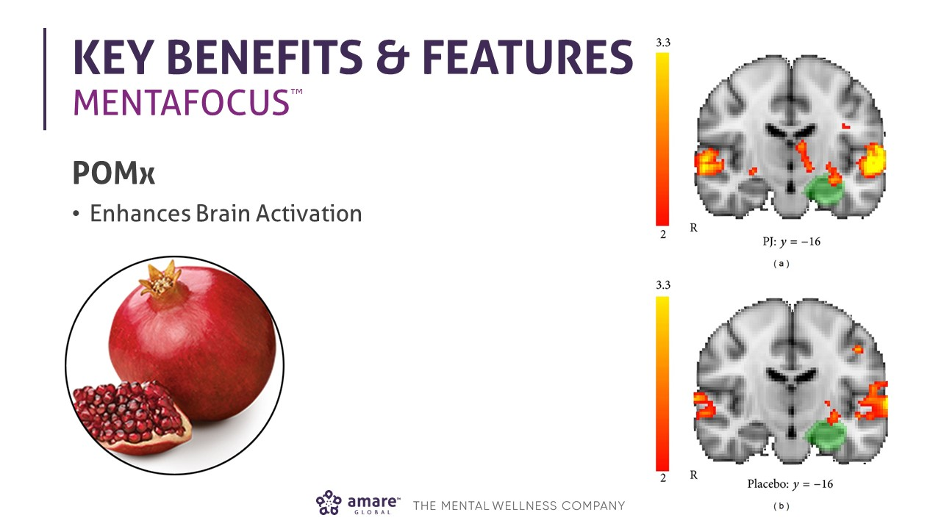

Slide 29
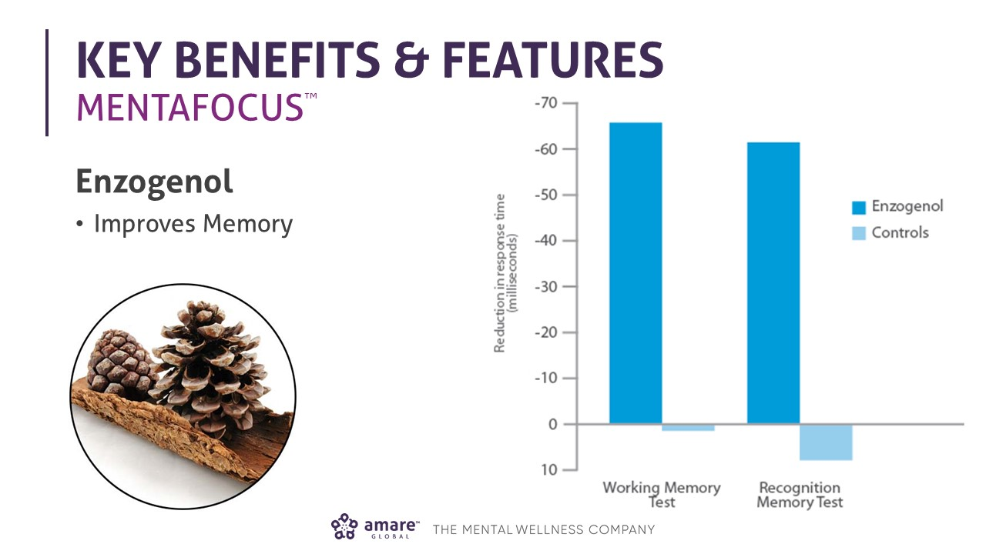

Slide 30
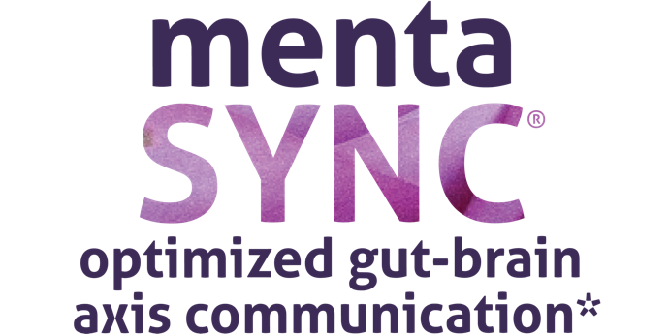
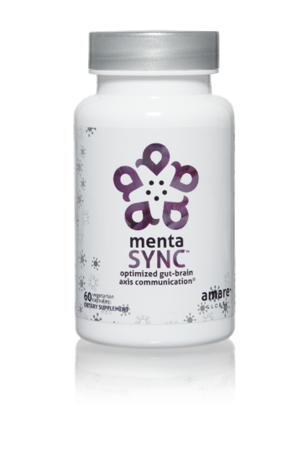
IMPROVES
GUT-BRAIN COMMUNICATION
BALANCES SIGNALING BETWEEN CELLS
ENHANCES
BIO-CHEMICAL COMMUNICATION
Optimize the communication sync of chemical messengers between your brain and your gut with the clinically studied key ingredients in MentaSync.*
Item Code:
Retail Price:
Wholesale Price:
Subscribe & Save:
S003
$74.00
$54.95 / 47 PV
$48.95 / 42 PV
*These statements have not been evaluated by the Food and Drug Administration. This product is not intended to diagnose, treat, cure, or prevent any disease.
Notes:
MentaSync (for the axis) – optimized gut-brain axis communication
Optimize the communication sync of chemical messengers between your brain and your gut with the clinically studied key ingredients in MentaSync.*
Improves gut-brain communication
Balances signaling between cells
Enhances bio-chemical communication
Supports the immune system, a primary pathway in the gut-brain axis.

Slide 31
Why is FundaMentals Different?
World’s 1st comprehensive/holistic GBX system
  Addresses each level of GBX balance
  Microbiome modulation
  Gut integrity
  Immune priming
  Inflammatory balance
  Neurotransmitter signaling
Specific probiotic strains for depression/anxiety/stress
Specific prebiotics fibers for stress/resilience
Patent-pending phytonutrients for GBX support
Scientifically-supported formula
  7 peer-reviewed scientific presentations and publications*
  *Effect of Coordinated Probiotic/Prebiotic/Phytobiotic Supplementation on Microbiome Balance and Psychological Mood State in Healthy Stressed Adults
  Functional Foods in Health & Disease Journal
  FFHD: Online ISSN:2160-3855
  Vol 9, No 4 (2019)
  https://www.ffhdj.com/index.php/ffhd/article/view/599/

Slide 32
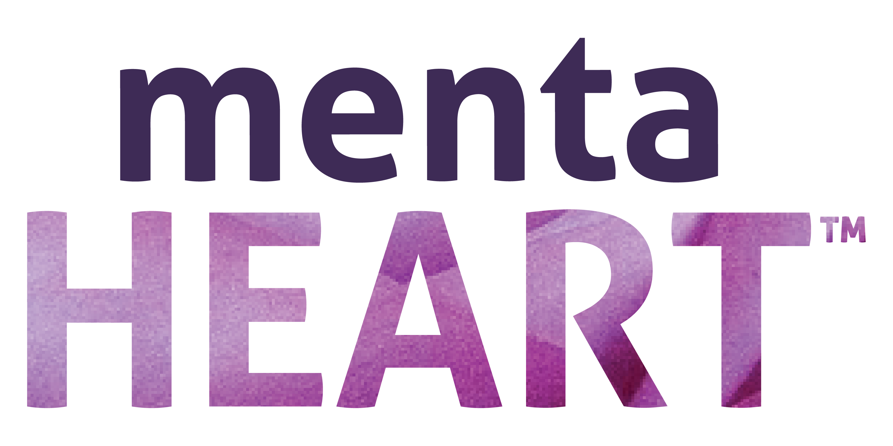
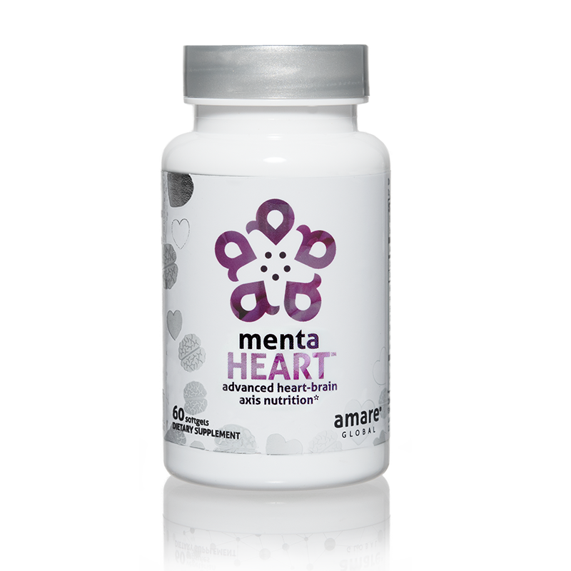
SUPPORTS
THE HEART-BRAIN AXIS*
PROMOTES CARDIOVAS-CULAR EFFICIENCY*
SUPPORTS ALREADY NORMAL CHOLESTEROL*
advanced heart-brain axis nutrition*
The first product of its kind to support mental wellness through the heart-brain axis, MentaHeart features key ingredients backed by multiple clinical studies shown to help optimize the heart, the body’s third brain.*
Item Code:
Retail Price:
Wholesale Price:
Subscribe & Save:
S024
$104.00
$77.95 / 68 PV
$69.95 / 61 PV
*These statements have not been evaluated by the Food and Drug Administration. This product is not intended to diagnose, treat, cure, or prevent any disease.
Notes:
MentaHeart (for the heart) – advanced heart-brain axis nutrition
The first product of its kind to support mental wellness through the heart-brain axis, MentaHeart features key ingredients backed by multiple clinical studies shown to help optimize the heart, the body’s third brain.*
Supports the heart-brain axis
Promotes cardiovascular efficiency
Supports already normal cholesterol

Slide 33
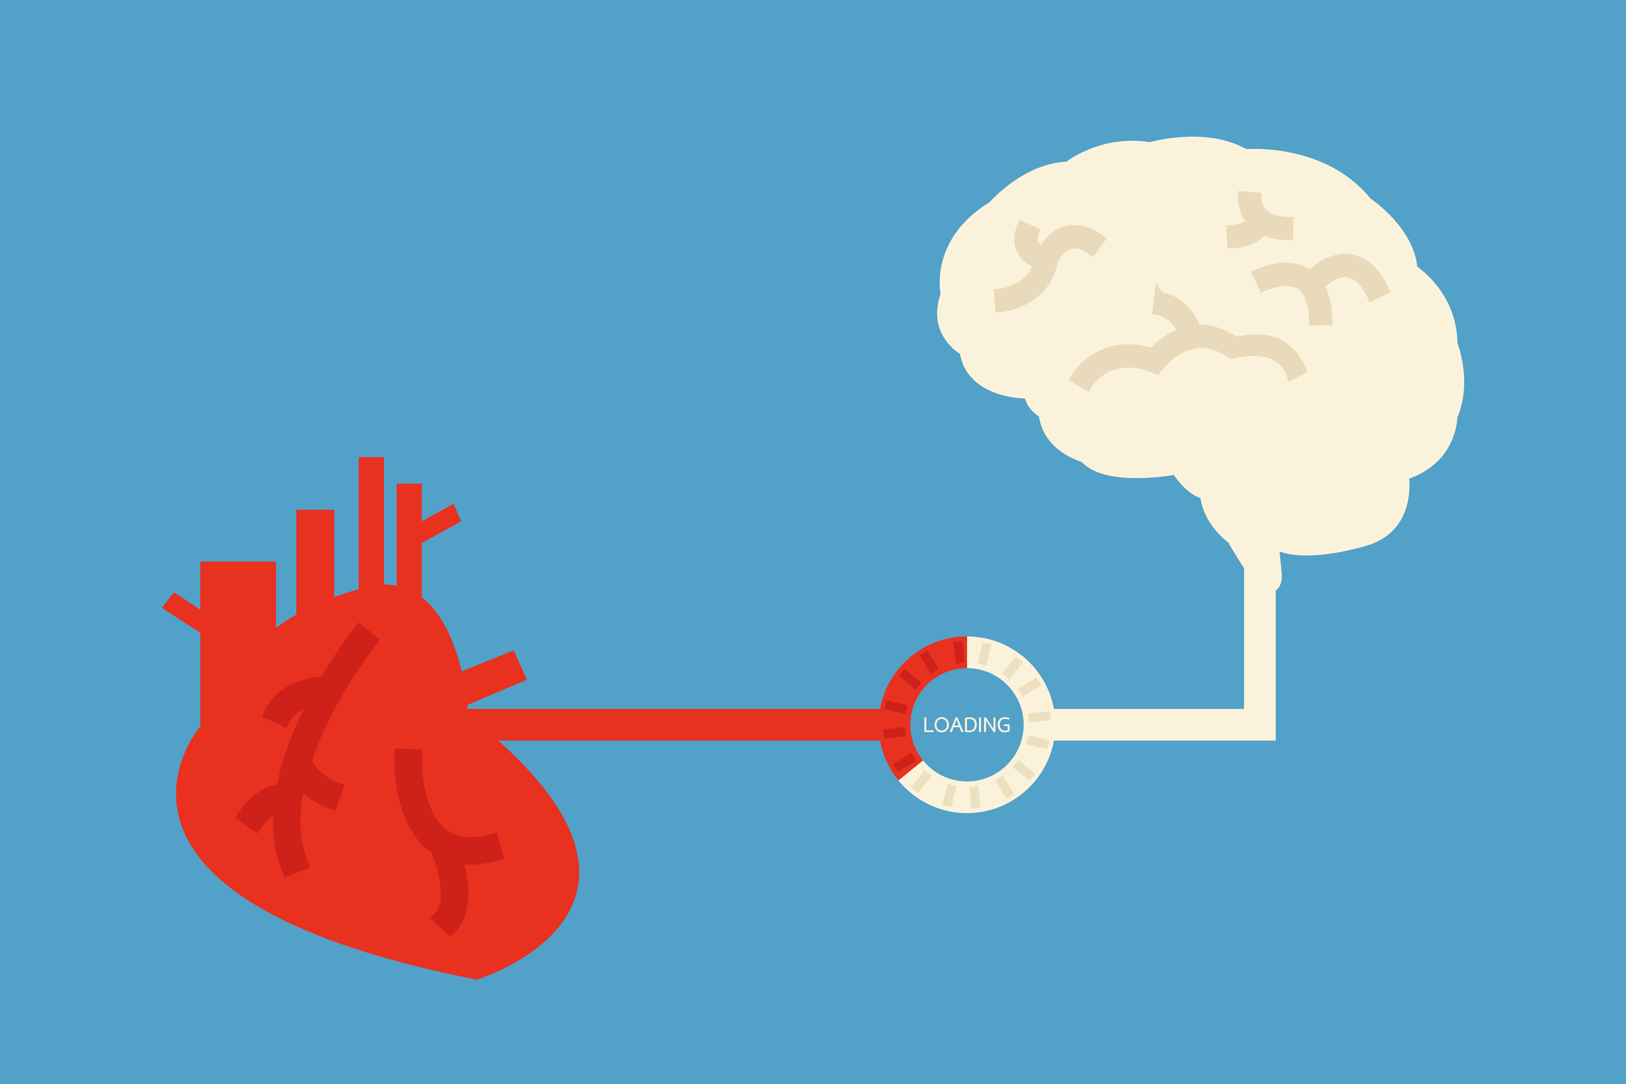
Depressed patients = higher risk for heart attack
Heart attack patients = higher risk for depression

Slide 34




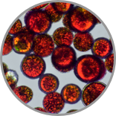

BDNF = Brain-Derived Neuroptrophic Factor
Cardio-Electro-Physiology
Cardiac Rhythm
Cholesterol
Cardiac Efficiency
Inflammation
Cardiac Output
Oxidation (Free Radicals)
Blood Pressure
Blood Flow

Slide 35

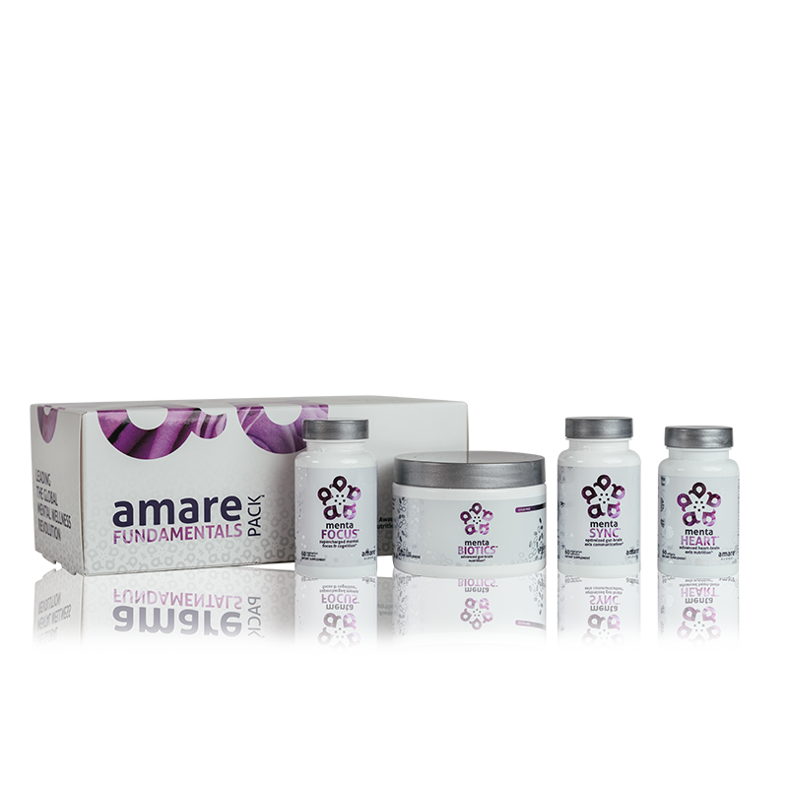
Amare Three Brains FundaMentals Pack
TM
Comprehensive nutrition for all three brains — the gut, brain and heart — the Amare Three Brains FundaMentals Pack™ is designed to target and support the primary physiological drivers of mental wellness.*
Item Code:
Retail Price:
Wholesale Price:
Subscribe & Save:
P019/P020-01
$338.00
$205.95 / 165 PV
$184.90 / 148 PV
Notes:
Amare Three Brain FundaMentals Pack
Flagship gut-brain-heart axis system
FundaMentals Pack is great, but the Three Brains FundaMentals Pack is better!
All three brains!
Comprehensive nutrition for all three brains — the gut, brain and heart — the Amare Three Brains FundaMentals Pack™ is designed to target and support the primary physiological drivers of mental wellness.*

Slide 36
MentaEssentials
Amare Kids
GBX Foods
MentaTherapeutics
™
FundaMentals
™
™
™
™
Notes:
No other company is developing a comprehensive lineup of products for mental wellness through the microbiome and gut-brain axis!
We launched with TWELVE of them! Now we have TWENTY TWO unique products!
We will continue to lead the way!

Slide 37

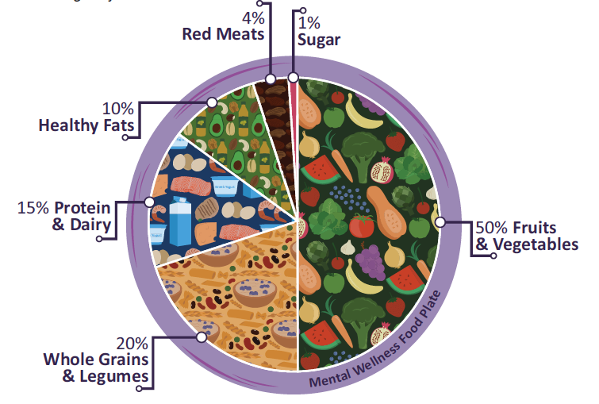

Programs
Notes:
Remember, Amare is creating the mental wellness PLATFORM of products (we just covered that), programs, and people.
Let’s talk about some of the programs!
- The Mental Wellness Diet, Nutrition: Eating the right foods can have a significant impact on your mental wellness. It’s important to consume the right servings of fruits, vegetables, protein, grains, beans/legumes, and healthy fats. The gut relies on a good diet to thrive and stay healthy. Amare’s mental wellness diet show how you can portion your meals accordingly. This eating guide will help you get started on a path to a healthier, more energized you!
Movement/Exercise: Move your body, move your mind! There is a direct link between moving your body and improving your mental performance, acuity, and memory recall. Plus, exercising releases endorphins and supports feel-good neurotransmitters in your body. Achieving the body composition you desire all starts with your beliefs, thoughts, and behaviors – your mental wellness and mental thinking! Our movement programs are designed to support your journey towards optimal mental wellness.
Mindfulness: Science is proving that mindfulness activities such as breathing, meditation, yoga, gratitude journaling, positive visualization, and mindful eating play a direct role in your stress resilience, clarity, cognition, creative thinking, and overall mental performance. Mindfulness is a major component of optimal mental fitness. It is now used by the world’s leading athletes as part of their training regimen to optimize their athletic performance.

Slide 38


People
Notes:
Remember, Amare is creating the mental wellness PLATFORM of products, programs, and PEOPLE.
It starts with our core values: Love, Integrity, Innovation, Service, and Humility
We integrate Love & Service into ALL of our major company events.
In Cancun for our annual incentive trip for our top performers, we assembled bicycles for children in the local village that needed bikes just to get to school.
At our annual Heart2Heart Mental Wellness Symposiums, we haved assembled over 10,000 winter coats, business attire, school supplies, and hygiene kits to benefit the Navajo Nation (2018) and our military veterans (2019).
We bring great people together!
When people come together, they can support each other – a major component of mental wellness is feeling connected and supported by other people.

Slide 39
Financial Health is Part of Your Mental Wellness
Notes:
Let’s be real. Finances can be stressful!
We aren’t here to ignore the elephant in the room…
Financial Health is Part of Your Mental Wellness!!
We all know that money does not promise happiness, but neither will a lack of financial resources or time. For that reason, Amare can provide a happier and healthier life for you, those you care about, and many more around the globe
Nearly half of people don’t have the cash to pay for a $400 emergency, Fed survey finds (marketwatch.com, May 2017)
5 Fast Financial Stress Statistics (https://bestmoneymoves.com/blog/2019/06/03/5-fast-financial-stress-statistics/)
41% don’t set aside any money for their household retirement plan.
25% have charged their credit card for groceries/food and not been able to pay it off right away.
33% said it would take more than 3 years to pay their credit card debt.
29% said if they needed $2,000 for an emergency, they would use a credit card.
20% of those with children in childcare said the cost is as expensive as, or more expensive than, their monthly rent or mortgage payment.
How Debt Impacts Personal and Professional Life
Most Americans carrying debt are suffering in silence. More than 40 percent of Americans said they find it difficult to talk about debt with friends and families, and as we mentioned earlier more than 20 percent would prefer a date with the dentist or the DMV over a discussion about debts and finances.
Americans bring their financial stress with them to work. Nearly 20 percent say the amount of their debt impacts their productivity. Research by PwC found more than 40 percent of employees who are distracted by financial stress spend 3 hours or more at work thinking about or dealing with issues related to their personal finances each week.

Slide 40
Money in the hands of GOOD people can do GREAT things!
Notes:
We believe that money in the hands of GOOD people can do GREAT things!
This is about HUMANITARIAN ENTREPRENEURSHIP
Do well by doing good for others!
Visions of individual foundations for our Servant Leaders in the future!
Vision for the Amare Foundation from corporate as well!

Slide 41

JOIN AMARE
PREFFERED CUSTOMER
  Be Well, Use the Products
  Wholesale Price Break
WELLNESS PARTNER
  Make a Difference, and Earn an Income
Notes:
How to join us?
Preferred Customer:
Wholesale Prices (25% off retail)
FREE product on your first Subscribe & Save Order for $39.95 or more
Wellness Partner
Wholesale Prices (25% off retail)
Earn commissions
Qualify for incentive trips and special events
Personalized website, app, and back office to support your business.

Slide 42


