Slide 1

The Mental Wellness Company®
Notes:
Welcome! We are excited to introduce you to Amare®, The Mental Wellness Company®.

Slide 2

Our Mission…
is to create a holistic mental wellness platform of products, programs, and people.
Notes:
From day 1, we have believed that leading the mental wellness revolution was not just about products. It wasn’t just about behavioral programs. It wasn’t just about great people supporting and serving each other.
Our belief and our mission is that to lead the mental wellness revolution, we needed to create a holistic mental wellness PLATFORM of products, programs, and people.

Slide 3

20+ years developing nutritional products.
Fellow of the American College of Nutrition, the American College of Sports Medicine, and the American Institute of Stress.
Author of two academic textbooks, an award-winning documentary film, and several best-selling books
Featured guest on the “Dr. Oz Show,” “Ask Dr. Nandi,” The TED stage, and the White House.
Served as a nutrition educator for elite-level athletes.
Diplomate of the International Olympic Committee’s (IOC) Sports Nutrition program.
Dr. Shawn Talbott
Amare’s Chief Science Officer
PhD, CNS, LDN, FACSM, FAIS, FACN
Notes:
Amare’s Chief Science Officer, Dr. Shawn Talbott
Scientist + Accomplished Athlete (Triathlons/Iron Man medal winner!)
20+ years developing products in the nutrition space
Fellow of the American College of Nutrition, the American College of Sports Medicine, and the American Institute of Stress.
Author of two academic textbooks, an award-winning documentary film, and several best-selling books
Featured guest on the “Dr. Oz Show,” “Ask Dr. Nandi,” The TED stage, and the White House.
Served as a nutrition educator for elite-level athletes.
Diplomate of the International Olympic Committee’s (IOC) Sports Nutrition program.

Slide 4
















MASSIVE NEED
$100B+
Notes:
Americans spend over $100 billion annually on “feel better” products, from painkillers and anti-depressants to alternative and complementary therapies
None of these get to the core source of where good mental wellness can be generated from…

Slide 5
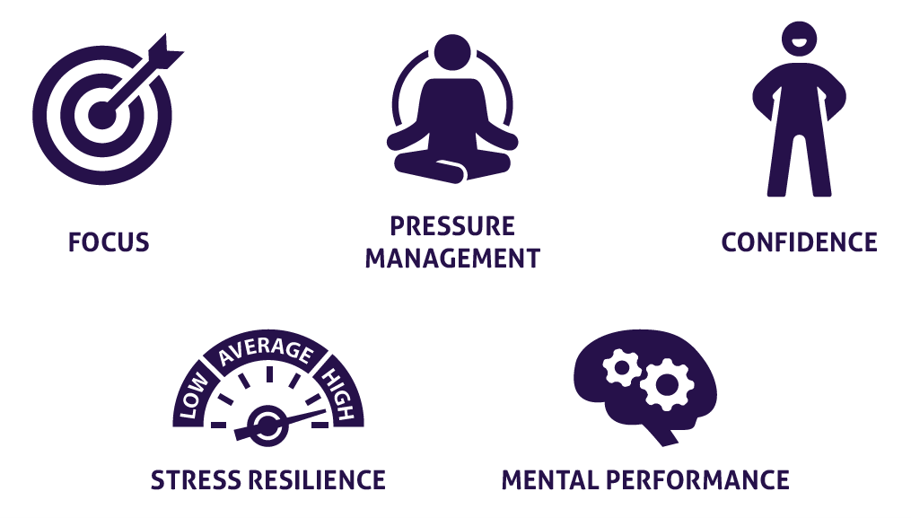


What is Mental Wellness?
Notes:
Mental WELLNESS, not mental ILLNESS!
Focus
Pressure Management
Confidence
Stress Resilience
Mental Performance
Physical Performance

Slide 6
The Mental Wellness Continuum
How you feel is not just in your head — it’s also in your gut and heart. You can now DO something NATURALLY to improve your mental wellness.
WHERE ARE YOU ON THE MENTAL WELLNESS CONTINUUM?
1
2
3
4
5
6
7
8
9
10
DISEASE STATUS
“NORMAL”
OPTIMIZED
Depression
Anxiety
Diabetes
Obesity
Heart Disease
Autoimmune
Arthritis
Fibromyalgia
CFS
Dementia
ADD / ADHD
Alzheimer’s
Fatigue
Tension
Sad
Brain Fog
Headaches
Acne
Eczema
Congestion
URTIs
Joint Pain
Muscle Pain
Bloated
Chubby
Energetic
Calmness
Happy
Sharp
Creative
Clear Skin
Rarely Sick
Flexible
Lean
Strong
Resilient
RED
ORANGE
YELLOW
GREEN
BLUE
INDIGO
VIOLET
Notes:
Wherever you are today on the mental wellness continuum, you can ”move to the right”

Slide 7
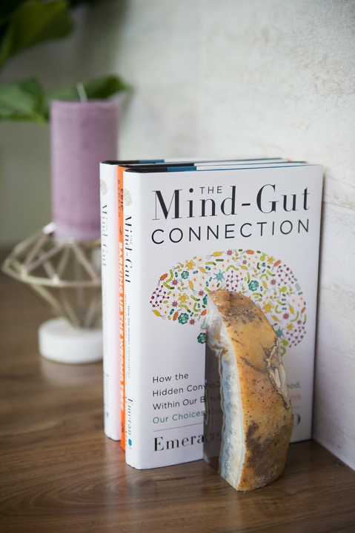
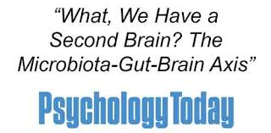
Recent Scientific Discoveries
NEW ERA SCIENCE
Science now tells us that we actually have SECOND and THIRD BRAINS!
There has been a massive scientific shift towards the MICROBIOME, also known as our gut and second brain, as being the source to addressing mental wellness issues.
Notes:
New era science!
Recent scientific discoveries now tell us that we actually have second (our gut) and third (our heart) brains!
Extensive research has been focused on the gut microbiome as a main target to addressing mental wellness issues!
Multiple books on the gut-brain axis, including the most popular one “The Mind-Gut Connection” by Emeran Mayer, who is on Amare’s Scientific Advisory Board and is considered ”the godfather of the gut-brain axis”.

Slide 8
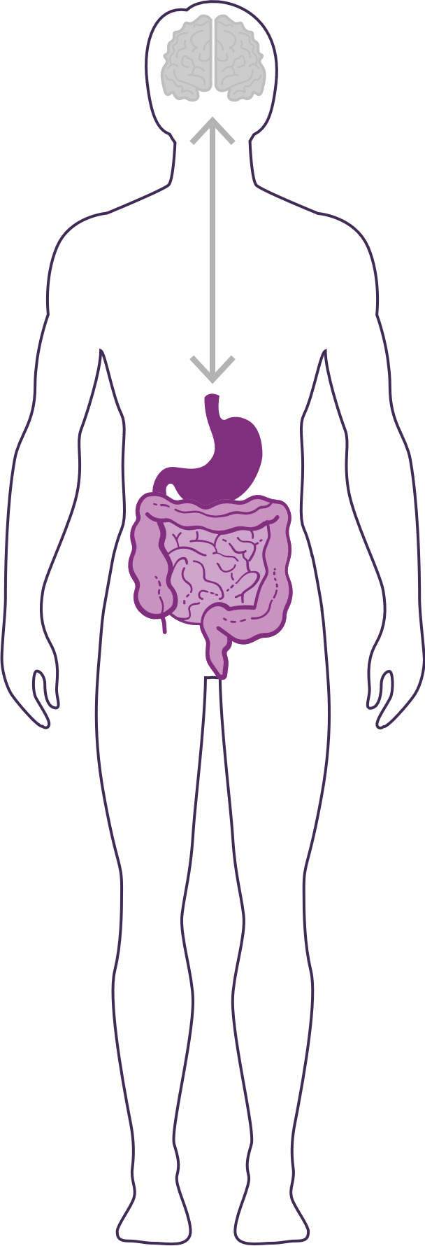
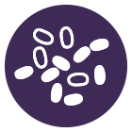
How Important is Your Microbiome?
Communicates with the brain to regulate mood, stress response, immune function, digestive function, weight, and more.
What we put in our bodies affects the microbiome, which in turn affects our mind and other crucial bodily systems.
The microbiome plays an important role in the way you feel mentally and physically.
IN BALANCE
Feeling great
OUT OF BALANCE
This explains why you have those “GUT FEELINGS”
Feeling fatigue, sad, tense, hungry, heavy, bloated, confused, stiff/sore
Notes:
The gut microbiome communicates with your brain via the gut-brain axis to regulate mood, stress response, immune function, digestive function, weight, and more.
What we put in our body affects the microbiome, with in turn affects our mind and other crucial bodily systems.
When your microbiome is in balance, you feel great
When your microbiome is out of balance, you feel fatigued, sad, tense, hungry, heavy, bloated, confused, stiff, sore…
The microbiome plays an important role in the way you feel mentally and physically.

Slide 9
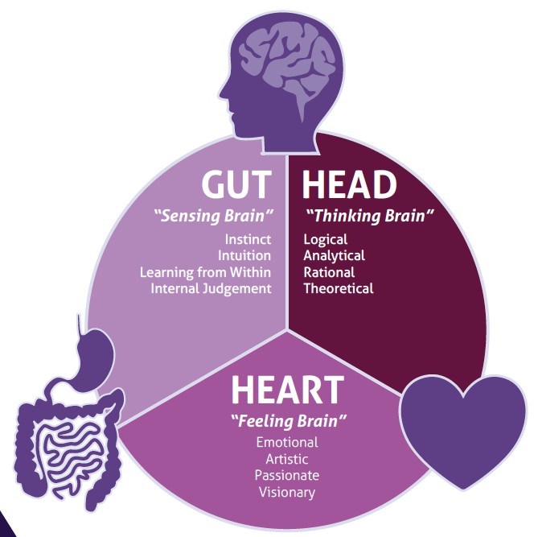
Targeting Mental Wellness Through the BODY’S THREE BRAINS
Science now tells us that we actually have SECOND & THIRD BRAINS in our gut and heart!
Notes:
Amare targets mental wellness through the body’s THREE brains! Each of these brains contain immense amounts of neurons that can receive and send signals to other areas of the body.
Gut – “Sensing Brain” – gut feelings, instinct, intution, learning from within, internal judgment
Head – “Thinking Brain” – logical, analytical, rational, theoretical
Heart – “Feeling Brain” – Emotional, Artistic, Visionary
Gut feelings and trusting your heart are more than just turns of phrase – science now tells us that the microbes in our gut and the electrical signals from our heart are read by the brain and can dramatically influence our mood and behavior as well as our mental and physical health.

Slide 10
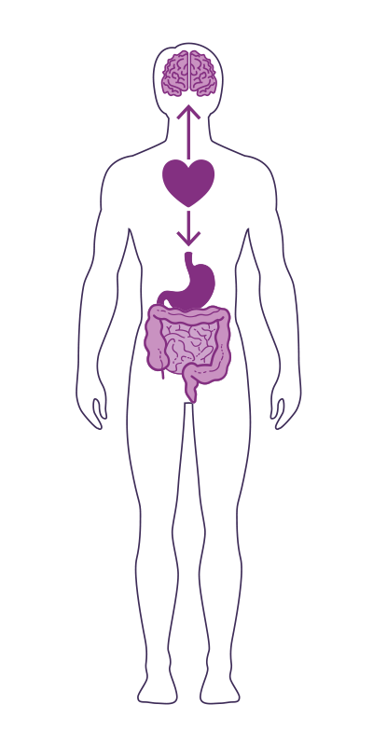
The GUT-BRAIN-HEART AXIS
Studies have now shown that the heart is the body’s third brain, containing approximately 40,000 neurons that can sense, feel, learn, and remember.
Similar to the gut-brain axis, the heart and brain are also closely connected via the heart-brain axis.
The heart sends messages to the brain about what it needs, how the body feels and more.
Nervous system (brain)
Cardiovascular system (heart)
Immune system (axis)
Gastrointestinal system (gut)
Notes:
Our three brains communicate through a highly extensive, multi-directional network, known as the gut-brain-heart axis.
THE NETWORK CONSISTS OF:
“wires” — nerves
“chemicals” — neurotransmitters/hormones
“cells” — immune system
The Gut-Brain-Heart Axis connects our nervous system (brain), cardiovascular system (heart), immune system (axis), and gastrointestinal system (gut) with a vast array of cellular and biochemical messengers throughout the entire body, which include the microbiome, hormones, cytokines, and neurotransmitters.

Slide 11
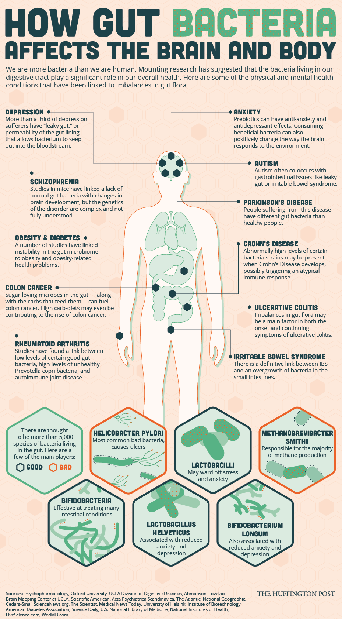

Slide 12
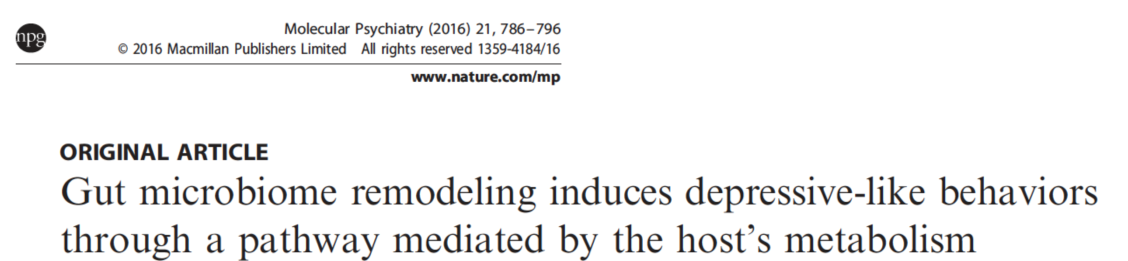
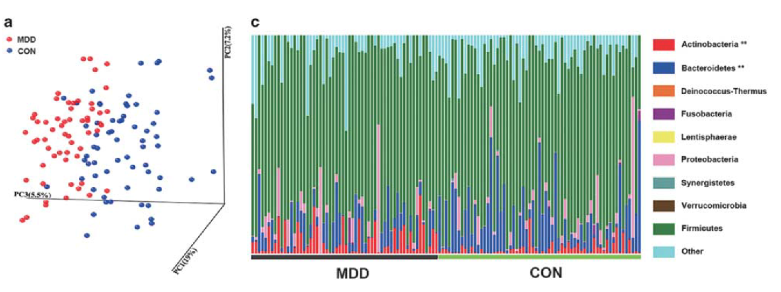

Depression
Zheng P et al, 2016

Slide 13
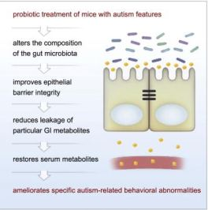

Slide 15
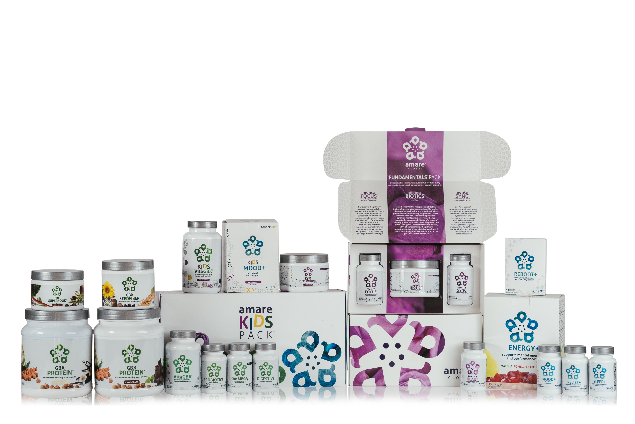
AMARE IS THE ONLY COMPANY DOING WHAT WE’RE DOING!
UNIQUE PRODUCTS
Notes:
No other company is developing a comprehensive lineup of products for mental wellness through the microbiome and gut-brain axis!
We launched with TWELVE of them in 2017! Now we have TWENTY TWO unique products!
We will continue to lead the way!

Slide 16
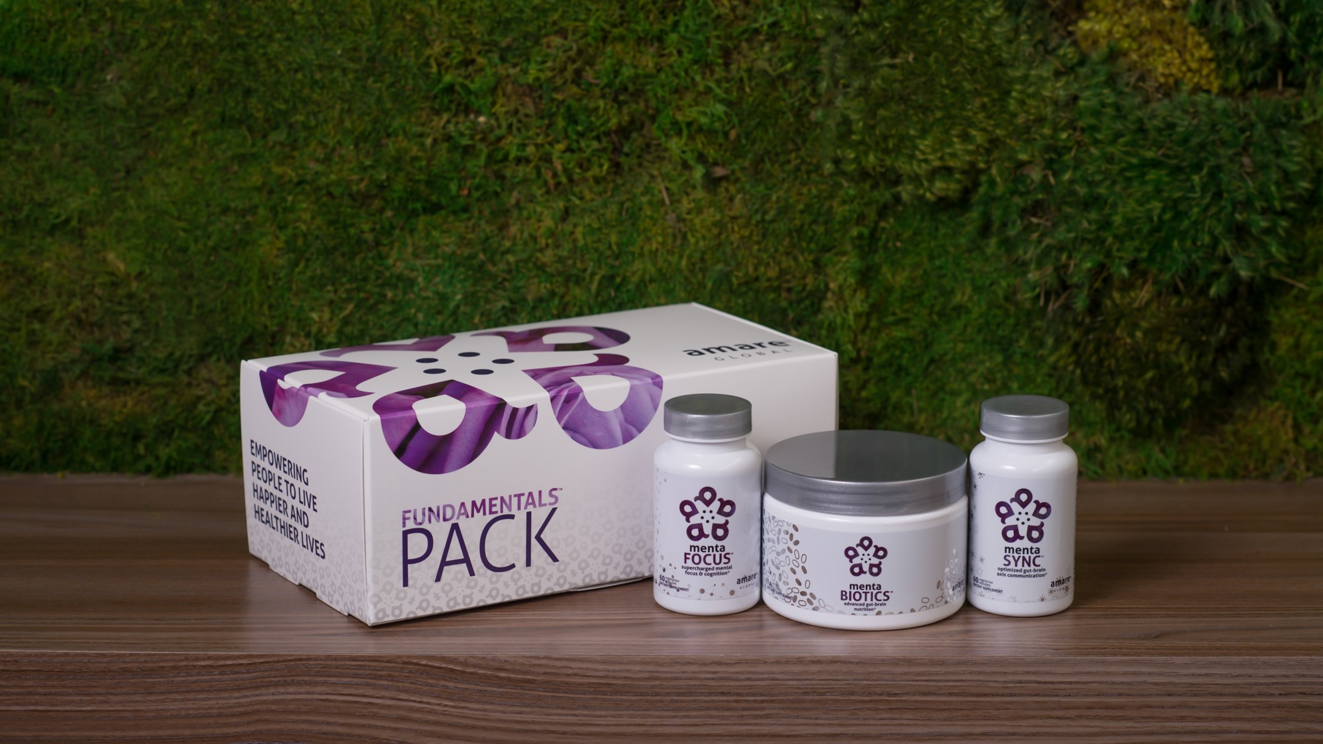

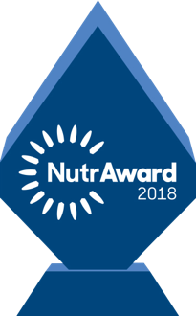
World’s First Award-Winning Gut-Brain Axis Nutrition System
Amare FundaMentals Pack
®
2018 NutrAward Winner for “BEST NEW FINISHED PRODUCT”
Item Code: Retail Price: Wholesale Price: Subscribe & Save:
P001 $234.00 $149.95 / 120 PV $134.95 / 108 PV
*These statements have not been evaluated by the Food and Drug Administration. This product is not intended to diagnose, treat, cure, or prevent any disease.
Notes:
Our original flagship pack to uniquely address the gut-brain-axis with the world’s first comprehensive nutrition system to address each component of the gut-brain axis!
Award Winning - 2018 NutrAward winner for “Best New Finished Product” – this is like the Academy Awards of Nutritional products, selected from hundreds of companies that submitted for the award. Judged by industry experts, and presented at the country’s largest expo/convention for natural products with nearly 100,000 attendees!
Includes:
MentaBiotics (for the gut)
MentaFocus (for the brain)
MentaSync (for the axis)
Save money compared to buying the products individually! (10% savings)

Slide 17
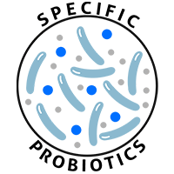
MENTABIOTICS SUGAR FREE MW3™ Probiotic Proprietary Blend
™
Our blend contains unique and specific probiotic strains targeted to enhance overall mental wellness.*
MW3 Probiotic Strains:
Lactobacillus rhamnosus R0011 — Reduces stress by lowering cortisol exposure and improves GABA neurotransmission*
Bifidobacterium longum R0175 — Enhances calmness by decreasing anxiety indices and improves cognitive function*
Lactobacillus helveticus R0052 — Improves mood by decreasing neuro-inflammation and increasing serotonin*
*These statements have not been evaluated by the Food and Drug Administration. This product is not intended to diagnose, treat, cure, or prevent any disease.

Slide 18
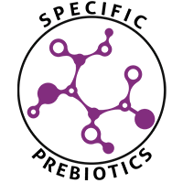
MENTABIOTICS SUGAR FREE MW3™ Prebiotic Proprietary Blend
™
Our MW3 Prebiotic Proprietary Blend provides optimal gut support by feeding the specific mental wellness probiotic strains found in our MW3 Probiotic Proprietary Blend.*
MW3 Prebiotic Fibers:
IsoFiber™ (Iso-Malto-Oligosaccharides) — Contains a combination of naturally occurring prebiotic plant fibers that are clinically shown to improve the growth of specific probiotic strains featured in Kids FundaMentals™ and now MentaBiotics™ Sugar Free!
Bimuno® (Galacto-Oligo-Saccharides) — Resets and increases friendly gut bacteria, maintains immune health, controls inflammation in the body and supports microbiome balance. Is highly effective and a natural way of increasing preferred bacteria in the gut. Plays an important role in feeding Bifidobacteria probiotic strains.*
SunFiber® (Galactomannan Fiber) — Helps improve the growth and vitality of beneficial bacteria, including Bifidobacteria and Lactobacillus.*
*These statements have not been evaluated by the Food and Drug Administration. This product is not intended to diagnose, treat, cure, or prevent any disease.

Slide 19
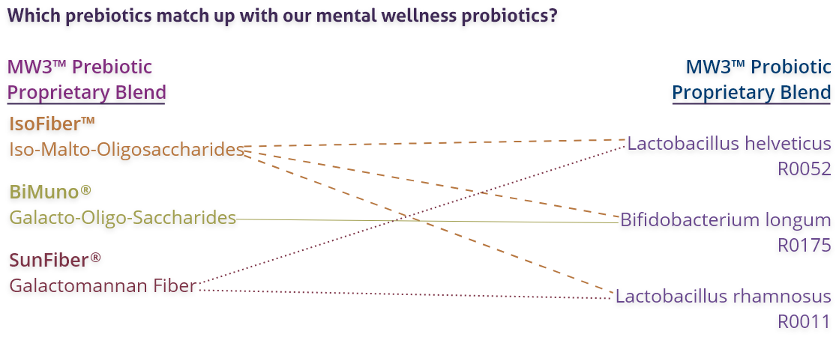
MENTABIOTICS SUGAR FREE MW3™ Prebiotic/Probiotic Proprietary Blend
™
*These statements have not been evaluated by the Food and Drug Administration. This product is not intended to diagnose, treat, cure, or prevent any disease.

Slide 20
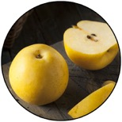

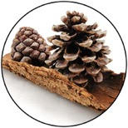
GBX+ Proprietary Blend… Patent Pending and Exclusive to Amare
Applephenon: Asian Apple Fruit extract Supports gut health, immune function, & inflammatory balance*
Enovita: French Grape Seed extract Enhances blood flow, cardiovascular tone, & cellular defenses*
Enzogenol: New Zealand Pine Bark extract Improves neurotransmitter balance, mental focus, & psychological vigor*
*These statements have not been evaluated by the Food and Drug Administration. This product is not intended to diagnose, treat, cure, or prevent any disease.
Notes:
Shawn: Slide: For Your Gut...: The Probiotic Strain Matters pg.26 -- Part of the reason why this product is so effective, is because we've looked at the research to guide our formulation. One of the very important ways that weve done that is the probiotic strains that we have chosen have already been specifically evaluated for their effects on different mental wellness parameters. This is very important distinction as you go out to talk to people about these products, that probiotics are hot right now, its one of the very important health trends that’s going on. But, the benefits of a probiotic are very very strain dependent. If I just said to you, "Everyone go out and buy some probiotics", and you went to the grocery store to look for probiotics, that would be like me saying, "Go out and get some vitamins." You wouldn’t know what vitamin I was talking about. Did he mean vitamin D or A? Or did he mean Vitamin C or B? All these vitamins do all different things inside the body, its exactly the same with these probiotic strains. So you can see the benefits here, Lactobacillus rhamnosus R0011, that tells us that specific strain does this, it lowers cortisol exposure which is a stress hormone. It increases a neurotransmitter called GABA which is associated with relaxing. Bifidobacterium longum R0175 reduces anxiety and improves cognitive function. Lactobacillus helveticus R0052 decreases neuroinflammation and increases serotonin, so its going to help you with your mood. You know, those benefits are specific to those strains, not to probiotics in general. In our separate probiotic formula, we have different strains that are more associated with more general wellness benefits, diarrhea, constipation, gastro intestinal function, immune system function, inflammation in a different way than your getting here with neural inflammation. In the future, we'll be selecting probiotic strains that are good for the heart-brain axis that is going to compound some of the benefits that we are seeing with this gut-brain axis. It’s a very very exciting area of science, but it’s also very strain-dependent.
There are over 10,000 different species of bacteria in our gut, but there are millions of strains comprising billions of bacteria overall. Amare’s strains of bacteria are unique and have specific functions around mental wellness.

Slide 21
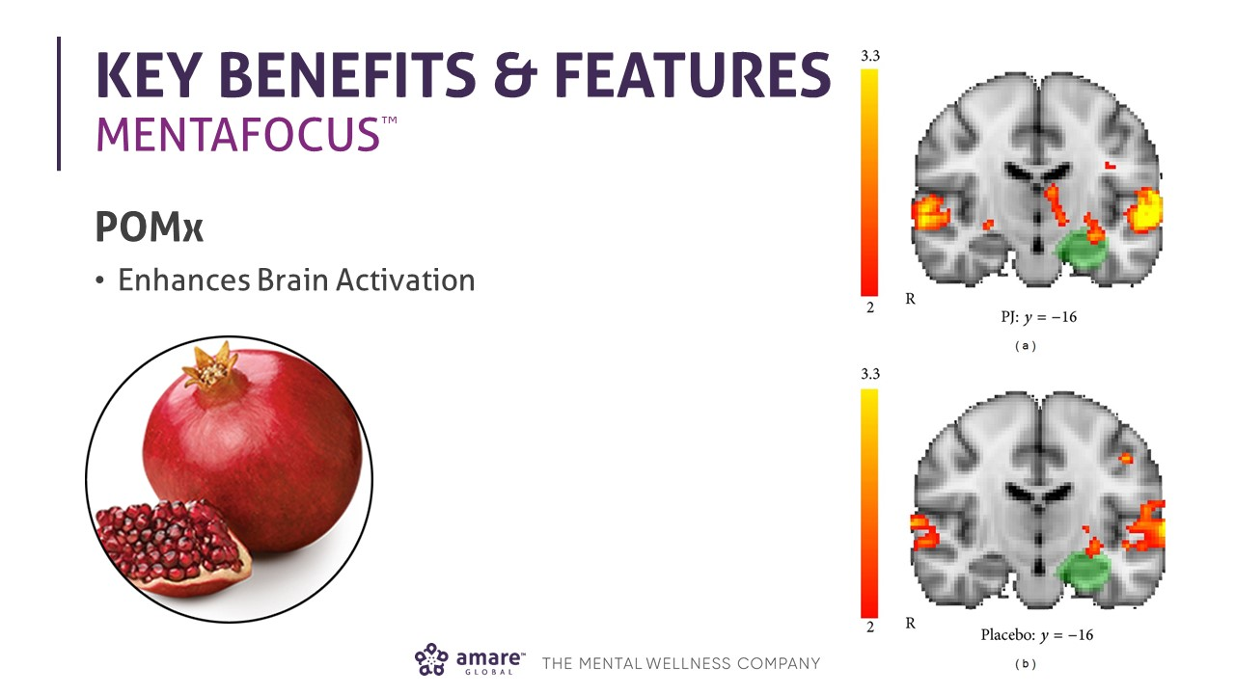

Slide 22
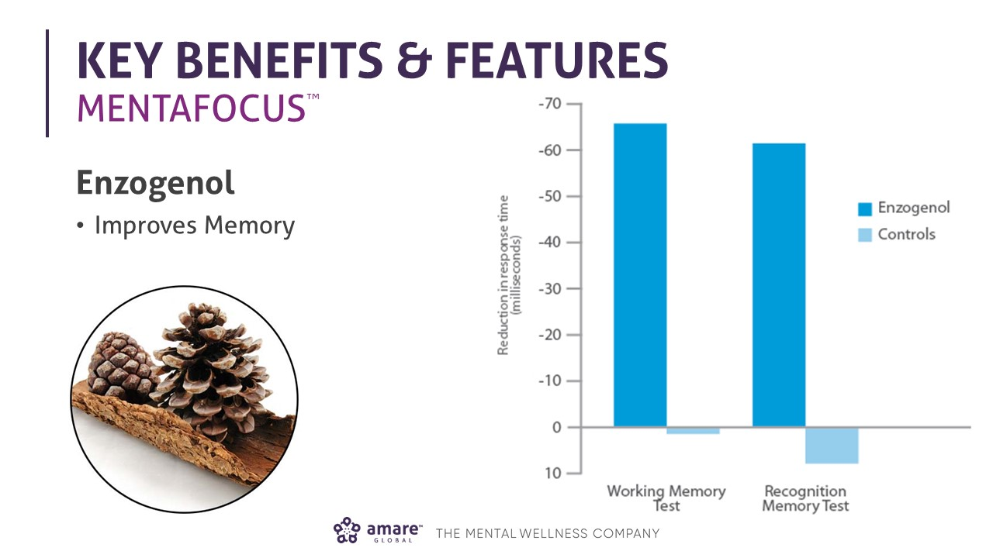

Slide 23




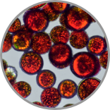
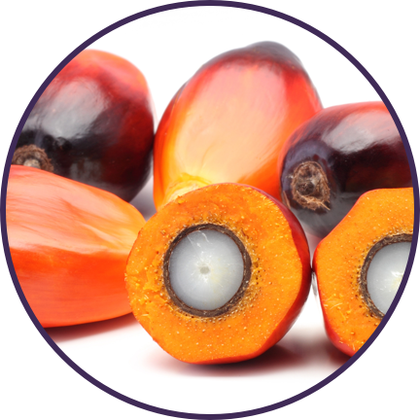
BDNF = Brain-Derived Neuroptrophic Factor
Cardio-Electro-Physiology
Cardiac Rhythm
Cholesterol
Cardiac Efficiency
Inflammation
Cardiac Output
Oxidation (Free Radicals)
Blood Pressure
Blood Flow

Slide 24
Why is FundaMentals Different?
World’s 1st comprehensive/holistic GBX system
Addresses each level of GBX balance
Microbiome modulation
Gut integrity
Immune priming
Inflammatory balance
Neurotransmitter signaling
Specific probiotic strains for depression/anxiety/stress
Specific prebiotics fibers for stress/resilience
Patent-pending phytonutrients for GBX support
Scientifically-supported formula
~12 peer-reviewed scientific presentations and publications*
*Effect of Coordinated Probiotic/Prebiotic/Phytobiotic Supplementation on Microbiome Balance and Psychological Mood State in Healthy Stressed Adults Functional Foods in Health & Disease Journal FFHD: Online ISSN:2160-3855 Vol 9, No 4 (2019) https://www.ffhdj.com/index.php/ffhd/article/view/599/

Slide 25
MentaHeart Clinical Pilot Study
HRV / SDNN (msec)
HRV / RMSSD
+11%
+19%
SDNN = standard deviation of N-N intervals
RMSSD – root mean square of successive differences

Slide 26
MentaHeart Clinical Pilot Study
Global Mood State
POMS Sub-Scales
+22%
+23%
-49%
-39%
-51%
-76%
-62%
SDNN = standard deviation of N-N intervals
RMSSD – root mean square of successive differences

Slide 28
Figure 2
Microbiome Composite Score
Microbiome Species
+90%
+6%
+33%
+8%
+62%

Slide 29
Figure 3
Metabolic Ratio
F/B Ratio

Slide 30
Figure 4
Butyrate Kinase
Cortisol
+89%
-11%

Slide 31
Figure 5
Blood Chemistry
Cardiac Risk
-8%
-5%
-23%
-6%
+3%

Slide 32
Figure 6
POMS Subscales
Global Mood State
+23%
-41%
-38%
-42%
-39%
-31%

Slide 33

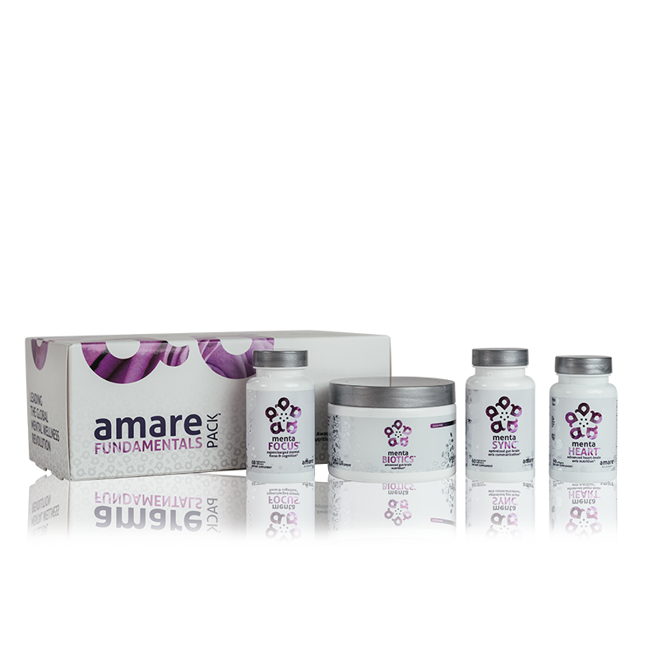
Amare Three Brains FundaMentals Pack
TM
Comprehensive nutrition for all three brains — the gut, brain and heart — the Amare Three Brains FundaMentals Pack™ is designed to target and support the primary physiological drivers of mental wellness.*
Item Code: Retail Price: Wholesale Price: Subscribe & Save:
P019/P020-01 $338.00 $205.95 / 165 PV $184.90 / 148 PV
Notes:
Amare Three Brain FundaMentals Pack
Flagship gut-brain-heart axis system
FundaMentals Pack is great, but the Three Brains FundaMentals Pack is better!
All three brains!
Comprehensive nutrition for all three brains — the gut, brain and heart — the Amare Three Brains FundaMentals Pack™ is designed to target and support the primary physiological drivers of mental wellness.*

Slide 34


