Slide 1
Science Deep Dive
May 17, 2018
Metabolism – Insulin / Thyroid
PRODUCT PRESENTATION

Slide 10
INTRODUCING AMARE GLOBAL PRODUCTS

Slide 11
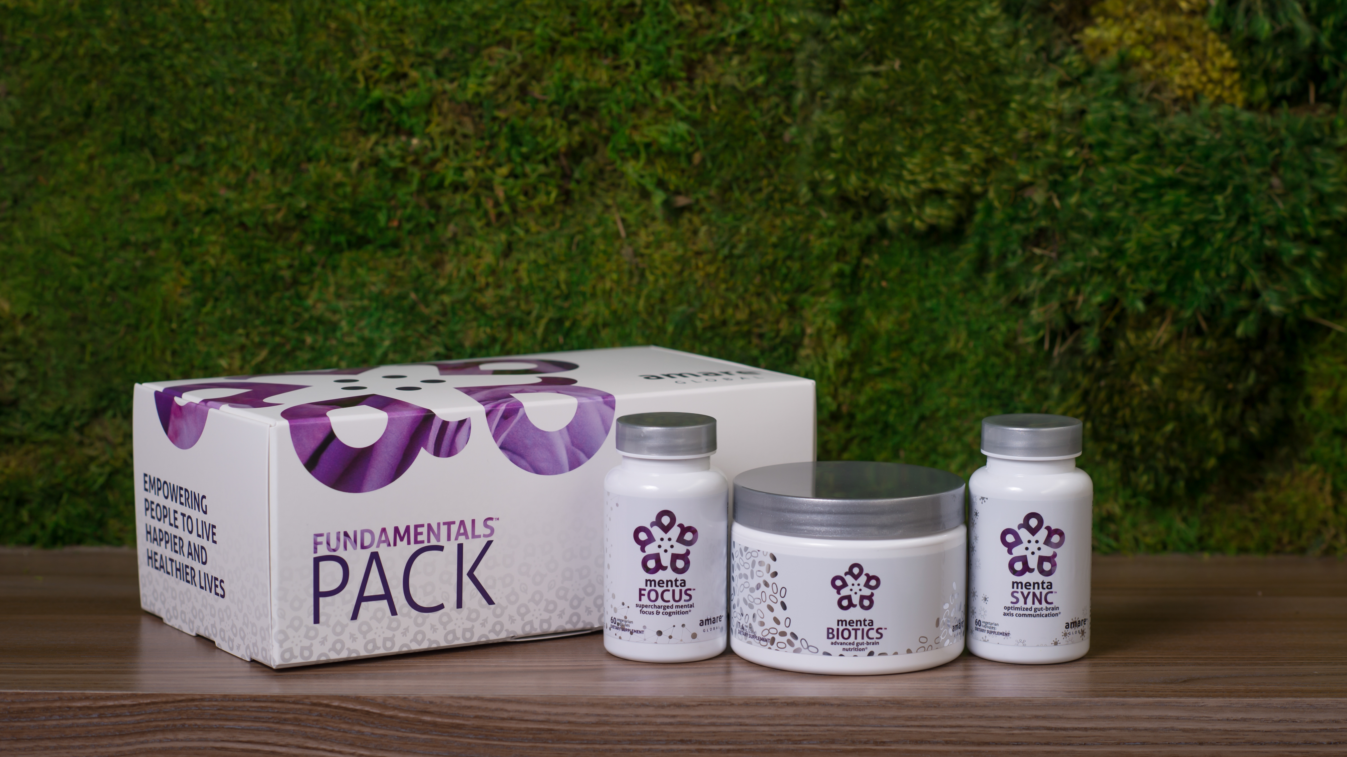

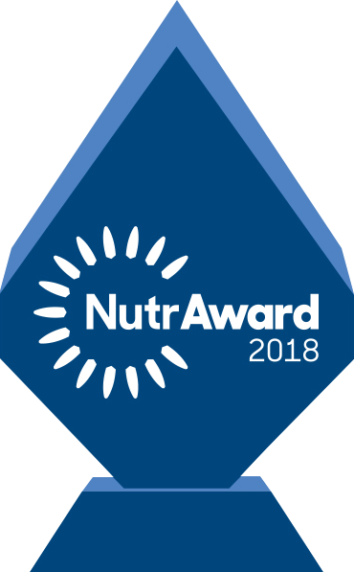
The World’s First Award-Winning Gut-Brain Axis Nutrition System
AMARE FUNDAMENTALS PACK
™
2018 NutrAward Winner for “BEST NEW FINISHED PRODUCT”
*These statements have not been evaluated by the Food and Drug Administration. This product is not intended to diagnose, treat, cure, or prevent any disease.

Slide 12
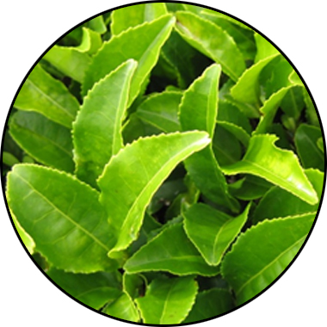
MENTABIOTICS KEY INGREDIENTS
™
Suntheanine
Increases Alpha Waves
“Relaxed alertness”
*These statements have not been evaluated by the Food and Drug Administration. This product is not intended to diagnose, treat, cure, or prevent any disease.
Notes:
Shawn: Slide: Key Ingredients: MentaBiotics pg.25 -- The way we formulated the products is to give you a graded response. Some benefits will come on early, some will come on medium, and some will come on later. So early stage benefits we can deliver through amino acids, such as Suntheanine. Suntheanine is naturally found in green tea leaves. This ingredient cant take your brain from a state of beta-waves that are associated with being tense and anxious or irritable, and shift you within a matter of 60—75 minutes into a state characterized by more alpha-waves. These alpha-waves are associated with a state of relaxed alertness, being in the zone, being more relaxed but not drowsy. Some of the other benefits that you are going to experience, those feelings of good mood, those feelings of less anxiety, that will be days to early weeks. Then the actual re-setting of the microbiome, depending on how out of balance you are, that might be more towards the end of the weeks. That way, we are able to give people early benefits they can feel quickly, and they don’t have to say , "I'm going to take this product for six months before I actually feel anything."
Sources
Nobre et al. L-theanine, a natural constituent in tea, and its effect on mental state Asia Pac J Clin Nutr 2008;17 (S1):167-168

Slide 13
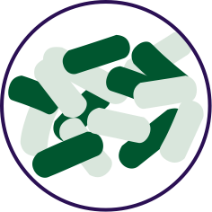


FOR YOUR GUT… THE PROBIOTIC STRAIN MATTERS
Lactobacillus rhamnosus R0011: Reduces stress by lowering cortisol exposure and improves GABA neurotransmission*
Bifidobacterium longum R0175: Enhances calmness by decreasing anxiety indices and improves cognitive function*
Lactobacillus helveticus R0052: Improves mood by decreasing neuro-inflammation and increasing serotonin*
*These statements have not been evaluated by the Food and Drug Administration. This product is not intended to diagnose, treat, cure, or prevent any disease.
Notes:
Shawn: Slide: For Your Gut...: The Probiotic Strain Matters pg.26 -- Part of the reason why this product is so effective, is because we've looked at the research to guide our formulation. One of the very important ways that weve done that is the probiotic strains that we have chosen have already been specifically evaluated for their effects on different mental wellness parameters. This is very important distinction as you go out to talk to people about these products, that probiotics are hot right now, its one of the very important health trends that’s going on. But, the benefits of a probiotic are very very strain dependent. If I just said to you, "Everyone go out and buy some probiotics", and you went to the grocery store to look for probiotics, that would be like me saying, "Go out and get some vitamins." You wouldn’t know what vitamin I was talking about. Did he mean vitamin D or A? Or did he mean Vitamin C or B? All these vitamins do all different things inside the body, its exactly the same with these probiotic strains. So you can see the benefits here, Lactobacillus rhamnosus R0011, that tells us that specific strain does this, it lowers cortisol exposure which is a stress hormone. It increases a neurotransmitter called GABA which is associated with relaxing. Bifidobacterium longum R0175 reduces anxiety and improves cognitive function. Lactobacillus helveticus R0052 decreases neuroinflammation and increases serotonin, so its going to help you with your mood. You know, those benefits are specific to those strains, not to probiotics in general. In our separate probiotic formula, we have different strains that are more associated with more general wellness benefits, diarrhea, constipation, gastro intestinal function, immune system function, inflammation in a different way than your getting here with neural inflammation. In the future, we'll be selecting probiotic strains that are good for the heart-brain axis that is going to compound some of the benefits that we are seeing with this gut-brain axis. It’s a very very exciting area of science, but it’s also very strain-dependent.
There are over 10,000 different species of bacteria in our gut, but there are millions of strains comprising billions of bacteria overall. Amare’s strains of bacteria are unique and have specific functions around mental wellness.

Slide 14
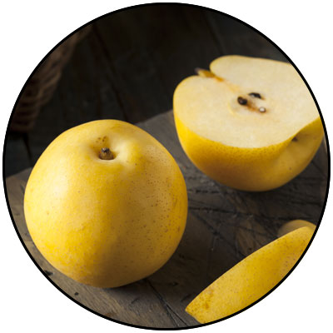
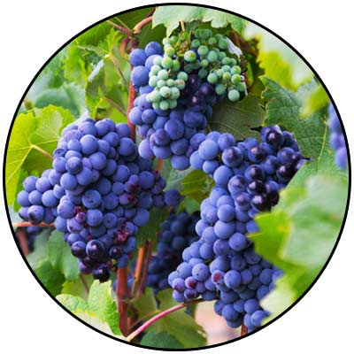
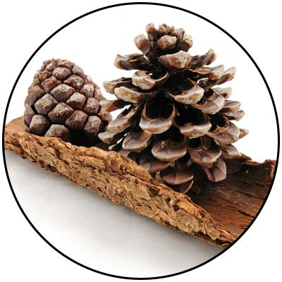
GBX+ proprietary blend… Patent Pending and Exclusive to Amare
Applephenon: Asian Apple Fruit extract Supports gut health, immune function, & inflammatory balance*
Enovita: French Grape Seed extract Enhances blood flow, cardiovascular tone, & cellular defenses*
Enzogenol: New Zealand Pine Bark extract Improves neurotransmitter balance, mental focus, & psychological vigor*
*These statements have not been evaluated by the Food and Drug Administration. This product is not intended to diagnose, treat, cure, or prevent any disease.
Notes:
Shawn: Slide: For Your Gut...: The Probiotic Strain Matters pg.26 -- Part of the reason why this product is so effective, is because we've looked at the research to guide our formulation. One of the very important ways that weve done that is the probiotic strains that we have chosen have already been specifically evaluated for their effects on different mental wellness parameters. This is very important distinction as you go out to talk to people about these products, that probiotics are hot right now, its one of the very important health trends that’s going on. But, the benefits of a probiotic are very very strain dependent. If I just said to you, "Everyone go out and buy some probiotics", and you went to the grocery store to look for probiotics, that would be like me saying, "Go out and get some vitamins." You wouldn’t know what vitamin I was talking about. Did he mean vitamin D or A? Or did he mean Vitamin C or B? All these vitamins do all different things inside the body, its exactly the same with these probiotic strains. So you can see the benefits here, Lactobacillus rhamnosus R0011, that tells us that specific strain does this, it lowers cortisol exposure which is a stress hormone. It increases a neurotransmitter called GABA which is associated with relaxing. Bifidobacterium longum R0175 reduces anxiety and improves cognitive function. Lactobacillus helveticus R0052 decreases neuroinflammation and increases serotonin, so its going to help you with your mood. You know, those benefits are specific to those strains, not to probiotics in general. In our separate probiotic formula, we have different strains that are more associated with more general wellness benefits, diarrhea, constipation, gastro intestinal function, immune system function, inflammation in a different way than your getting here with neural inflammation. In the future, we'll be selecting probiotic strains that are good for the heart-brain axis that is going to compound some of the benefits that we are seeing with this gut-brain axis. It’s a very very exciting area of science, but it’s also very strain-dependent.
There are over 10,000 different species of bacteria in our gut, but there are millions of strains comprising billions of bacteria overall. Amare’s strains of bacteria are unique and have specific functions around mental wellness.

Slide 15
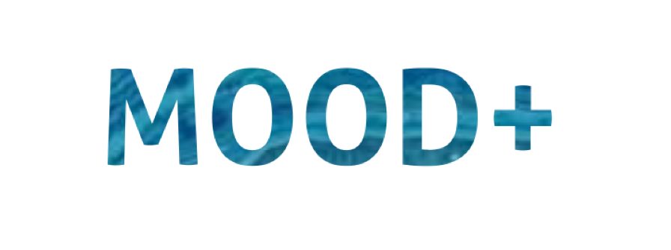

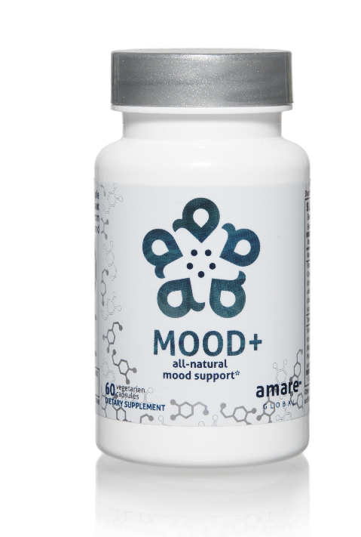
MOOD ELEVATING
PROMOTES RELAXATION
TENSION REDUCING
all-natural mood support*
The key ingredients in Mood+ have multiple scientific studies that show significant benefits for mood support such as relief from anxious feelings, sadness, restlessness, and overall stress relief.*
Item Code: Retail Price: Wholesale Price: Subscribe & Save:
S006 $80.00 $59.95 / 52 PV $53.95 / 46 PV
*These statements have not been evaluated by the Food and Drug Administration. This product is not intended to diagnose, treat, cure, or prevent any disease.

Slide 16
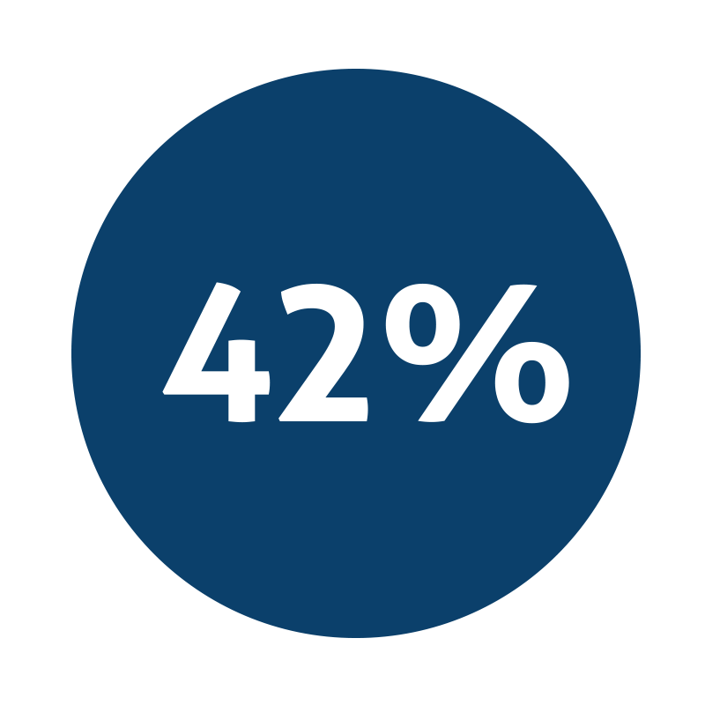
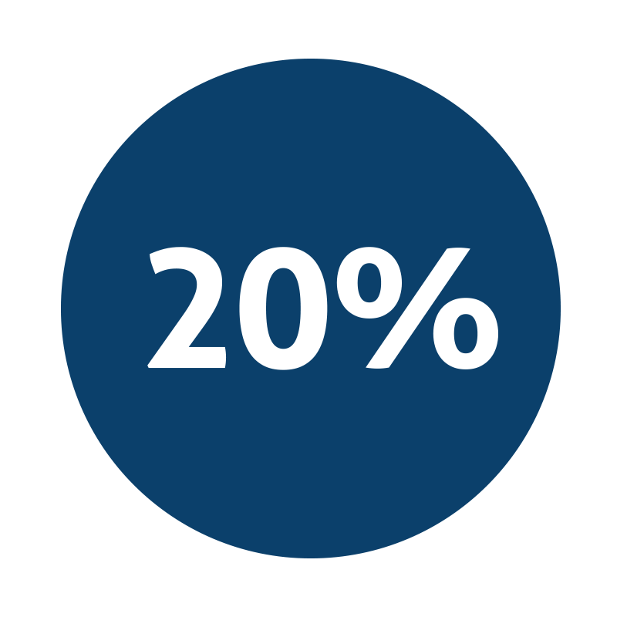
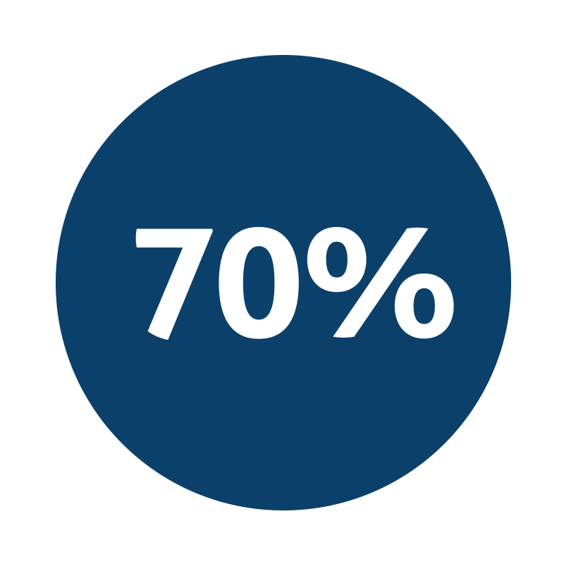
all-natural mood support*
Decrease in feelings of anger*
Decrease in feelings of sadness*
Reduction of stress related symptoms*
*These statements have not been evaluated by the Food and Drug Administration. This product is not intended to diagnose, treat, cure, or prevent any disease.
Notes:
http://www.interhealthusa.com/wp-content/uploads/2015/12/Relora-E-Download-2015.pdf

Slide 17
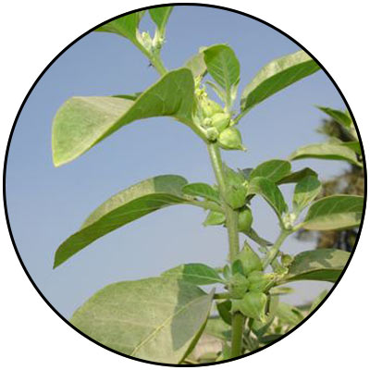
MOOD+ KEY INGREDIENTS
Sensoril, Ashwagandha
Anxiety
*These statements have not been evaluated by the Food and Drug Administration. This product is not intended to diagnose, treat, cure, or prevent any disease.
Notes:
Auddy et al. A Standardized Withania Somnifera Extract Significantly Reduces Stress-Related Parameters in Chronically Stressed Humans: A Double-Blind, Randomized, Placebo-Controlled Study. Journal of the American Nutraceutical Association Vol.11,No.1, 2008 pp50-56.

Slide 18
MOOD+ KEY INGREDIENTS
Sensoril, Ashwagandha
Anxiety
*These statements have not been evaluated by the Food and Drug Administration. This product is not intended to diagnose, treat, cure, or prevent any disease.
Notes:
Auddy et al. A Standardized Withania Somnifera Extract Significantly Reduces Stress-Related Parameters in Chronically Stressed Humans: A Double-Blind, Randomized, Placebo-Controlled Study. Journal of the American Nutraceutical Association Vol.11,No.1, 2008 pp50-56.

Slide 19
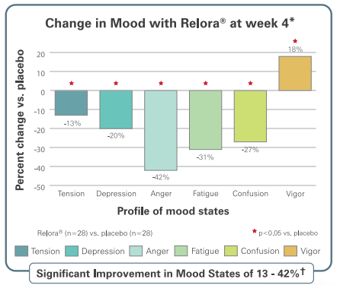
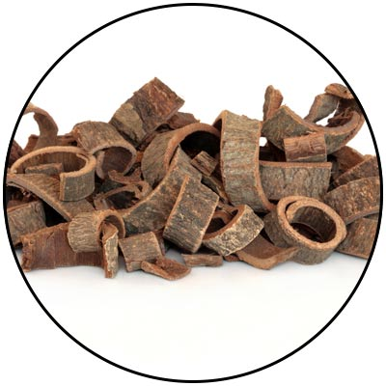
MOOD+ KEY INGREDIENTS
Relora, Magnolia & Phellondendron
Anxiety
*These statements have not been evaluated by the Food and Drug Administration. This product is not intended to diagnose, treat, cure, or prevent any disease.
Notes:
Talbott et al. Effect of Magnolia officinalis and Phellodendron amurense (Relora®) on cortisol and psychological mood state in moderately stressed subjects. Journal of the International Society of Sports Nutrition 2013, 10:37
Garrison et al. Effect of a proprietary Magnolia and Phellodendron extract on weight management: a pilot, double-blind, placebo-controlled clinical trial. Altern Ther Health Med. 2006;12(1):50-54.
Kalman et al. Effect of a proprietary Magnolia and Phellodendron extract on stress levels in healthy women: a pilot, double-blind, placebo-controlled clinical trial. Nutrition Journal 2008, 7:11

Slide 20
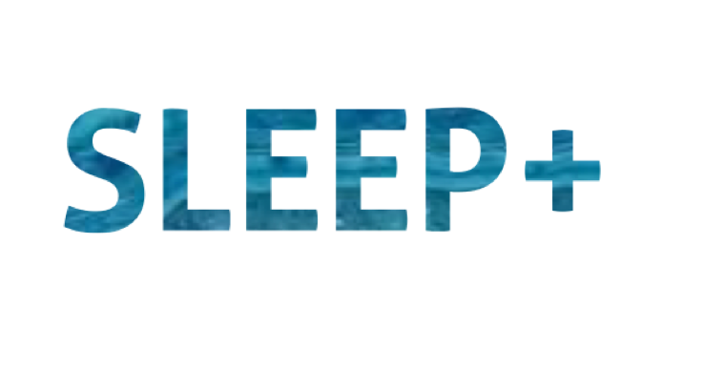
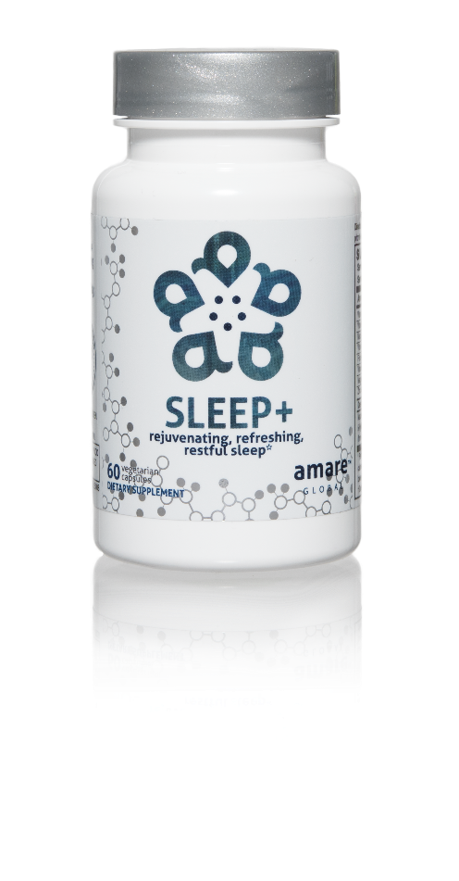

FALL ASLEEP FASTER
STAY ASLEEP LONGER
IMPROVES SLEEP QUALITY
rejuvenating, refreshing, restful sleep*
The key ingredients in Sleep+ have multiple scientific studies that show significant benefits including helping you to fall asleep faster, stay asleep longer, and experience higher quality plus more rejuvenating sleep.*
Item Code: Retail Price: Wholesale Price: Subscribe & Save:
S008 $80.00 $59.95 / 52 PV $53.95 / 46 PV
*These statements have not been evaluated by the Food and Drug Administration. This product is not intended to diagnose, treat, cure, or prevent any disease.

Slide 21
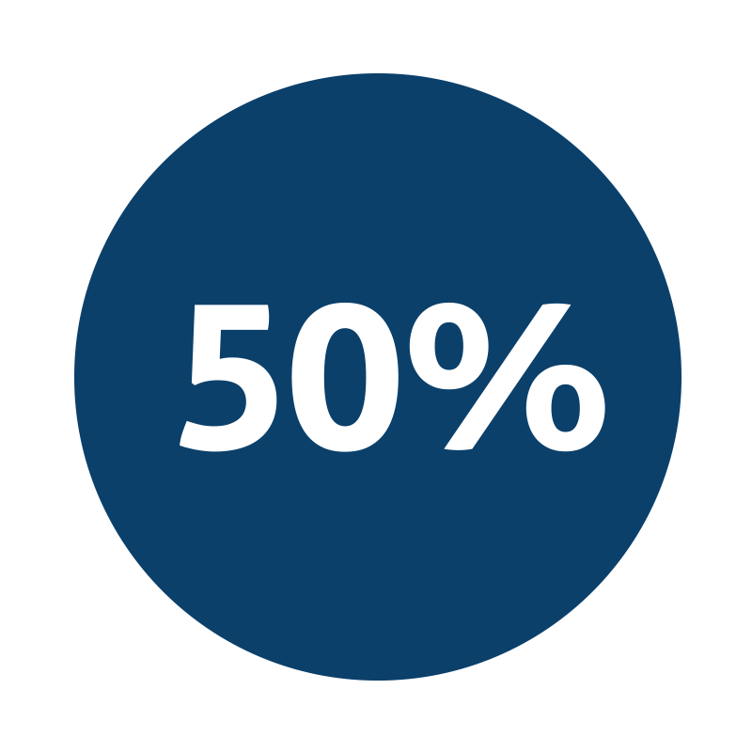
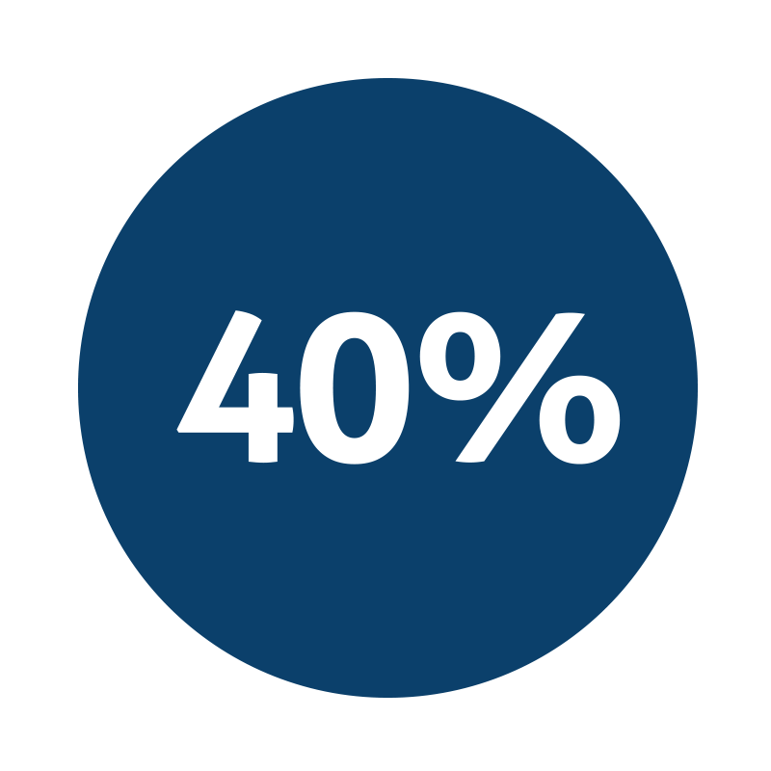

rejuvenating, refreshing, restful sleep*
Improvement in sleep efficiency*
Improvement in sleep quality*
Fall asleep faster by 33% and wake up fewer times each night by 30%*
*These statements have not been evaluated by the Food and Drug Administration. This product is not intended to diagnose, treat, cure, or prevent any disease.
Notes:
Talbott and Talbott: Effect of Monocot Grass Extract (MGE) on mood state and sleep patterns in moderately stress subjects. Journal of the International Society of Sports Nutrition 2013 10(Suppl 1):P26.

Slide 22
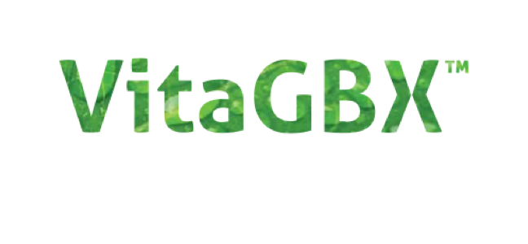

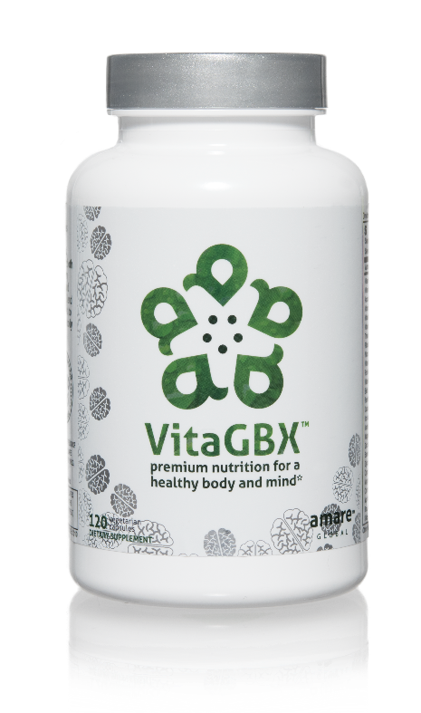
MULTIVITAMIN + MIND COMBO
FILLS GAPS IN DAILY NUTRITION
UNIQUE BRIGHT MIND BLEND
premium nutrition for a healthy body and mind*
VitaGBX is a premium multivitamin that combines more than 50 vitamins, minerals, amino acids, and phytonutrients. It features both our Bright Mind Proprietary Blend (for mind support) and Amare GBX+ Proprietary Blend (for gut-brain axis support) to empower a well-balanced body and mind.*
Item Code: Retail Price: Wholesale Price: Subscribe & Save:
S010 $54.00 $39.95 / 32 PV $35.95 / 29 PV
*These statements have not been evaluated by the Food and Drug Administration. This product is not intended to diagnose, treat, cure, or prevent any disease.

Slide 23
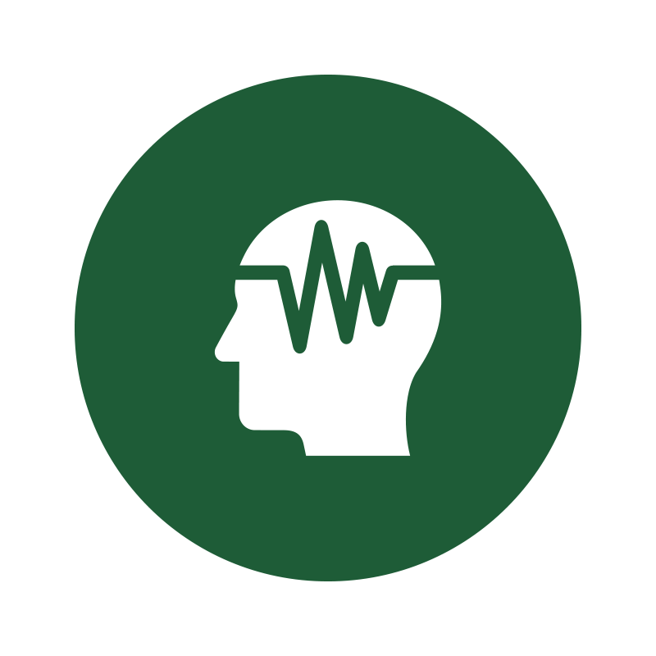


premium nutrition for a healthy body and mind*
Contains a Bright Mind Blend which helps improve concentration, attention, and alertness*
Combines 50+ vitamins, minerals, amino acids, and phytonutrients to deliver micronutrient nutrition for a well-balanced body and mind*
Contains our Amare GBX+ Proprietary Blend that enhances optimal functionality of the gut-brain axis*
*These statements have not been evaluated by the Food and Drug Administration. This product is not intended to diagnose, treat, cure, or prevent any disease.

Slide 24

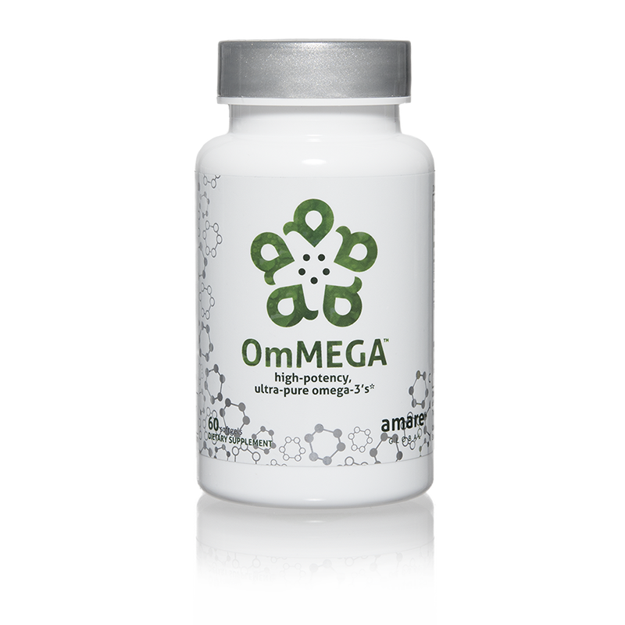
SUPPORTS COGNITIVE HEALTH
HIGH-POTENCY EPA + DHA
MERCURY FREE FISH OIL
high-potency, ultra-pure omega-3’s*
OmMEGA is a high-potency, ultra-pure marine oil concentrate that delivers high levels of the critical omega-3 fatty acids EPA and DHA.*
Item Code: Retail Price: Wholesale Price: Subscribe & Save:
S011 $40.00 $29.95 / 24 PV $26.95 / 22 PV
*These statements have not been evaluated by the Food and Drug Administration. This product is not intended to diagnose, treat, cure, or prevent any disease.

Slide 25



high-potency, ultra-pure omega-3’s*
Contains ultra-pure and ultra-potent omega-3 content that is approx. 70% more omega-3 (EPA/DHA) than standard fish oils*
Promotes cardiovascular health*
Supports memory and cognitive functions, while promoting a healthy nervous system*
*These statements have not been evaluated by the Food and Drug Administration. This product is not intended to diagnose, treat, cure, or prevent any disease.

Slide 26
THE THREE THINGS YOU SHOULD KNOW ABOUT MENTAL WELLNESS
How you feel is not just in your head – it’s also in your gut.
Our “second brain” includes the Microbiome and plays a major role in mental wellness.
You can now DO something NATURALLY to improve your mental wellness.
WHERE ARE YOU ON THE MENTAL WELLNESS CONTINUUM? (Circle your current number)
1
2
3
4
5
6
7
8
9
10
DISEASE STATUS
“NORMAL”
OPTIMIZED
Depression
Anxiety
Diabetes
Obesity
Heart Disease
Autoimmune
Arthritis
Fibromyalgia
CFS
Dementia
ADD / ADHD
Alzheimer’s
Fatigue
Tension
Sad
Brain Fog
Headaches
Acne
Eczema
Congestion
URTI’s
Joint Pain
Muscle Pain
Bloated
Chubby
Energetic
Calmness
Happy
Sharp
Creative
Clear Skin
Rarely Sick
Flexible
Lean
Strong
Resilient
RED
ORANGE
YELLOW
GREEN
BLUE
INDIGO
VIOLET

