Slide 1


Slide 2
THE THREE THINGS YOU SHOULD KNOW ABOUT MENTAL WELLNESS
How you feel is not just in your head – it’s also in your gut.
Our “second brain” includes the Microbiome and plays a major role in mental wellness.
You can now DO something NATURALLY to improve your mental wellness.
WHERE ARE YOU ON THE MENTAL WELLNESS CONTINUUM? (Circle your current number)
1
2
3
4
5
6
7
8
9
10
DISEASE STATUS
“TYPICAL”
OPTIMIZED
Depression
Anxiety
Diabetes
Obesity
Heart Disease
Autoimmune
Arthritis
Fibromyalgia
CFS
Dementia
ADD / ADHD
Alzheimer’s
Fatigue
Tension
Sad
Brain Fog
Headaches
Acne
Eczema
Congestion
URTI’s
Joint Pain
Muscle Pain
Bloated
Chubby
Energetic
Calmness
Happy
Sharp
Creative
Clear Skin
Rarely Sick
Flexible
Lean
Strong
Resilient
RED
ORANGE
YELLOW
GREEN
BLUE
INDIGO
VIOLET

Slide 5
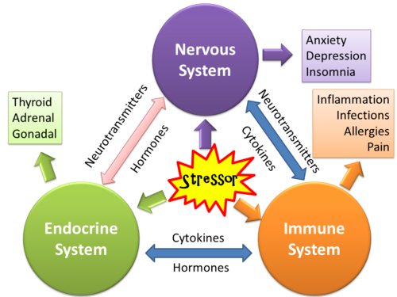

Slide 6
Multi-Factorial Problem
Microbiome
Depression
Anxiety
Stress
Brain Fog
Fatigue
Pain
Tension
Irritability
Burnout
Stressors
Neurotransmitters
Thoughts
Immune System
Inflammation

Slide 7
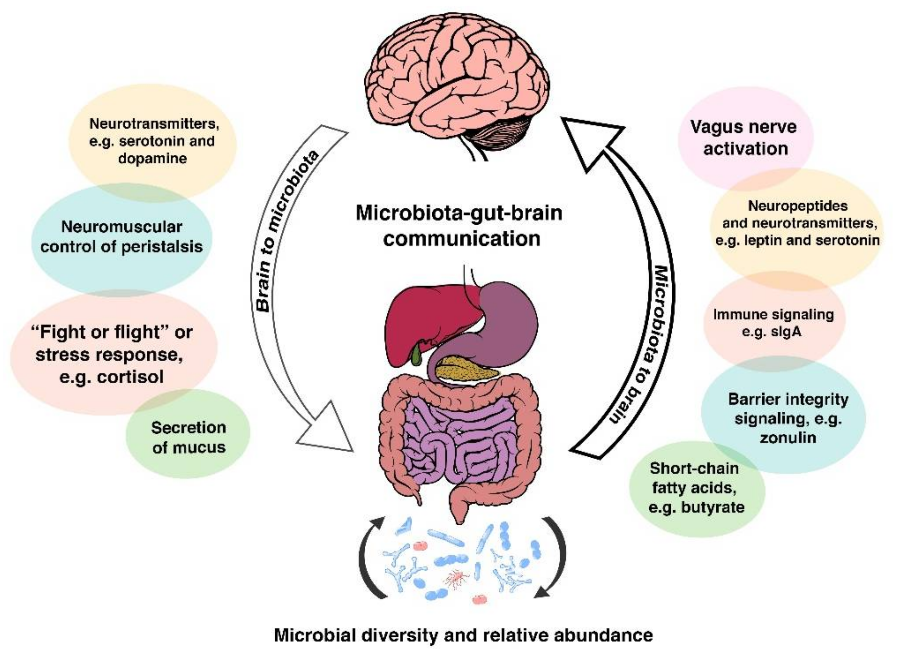

Slide 8
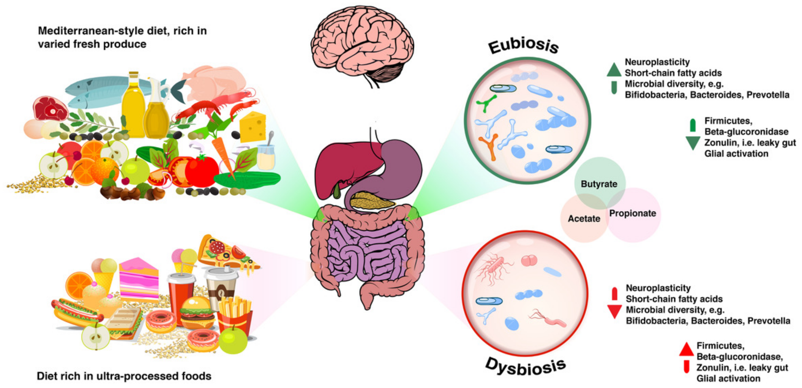

Slide 9
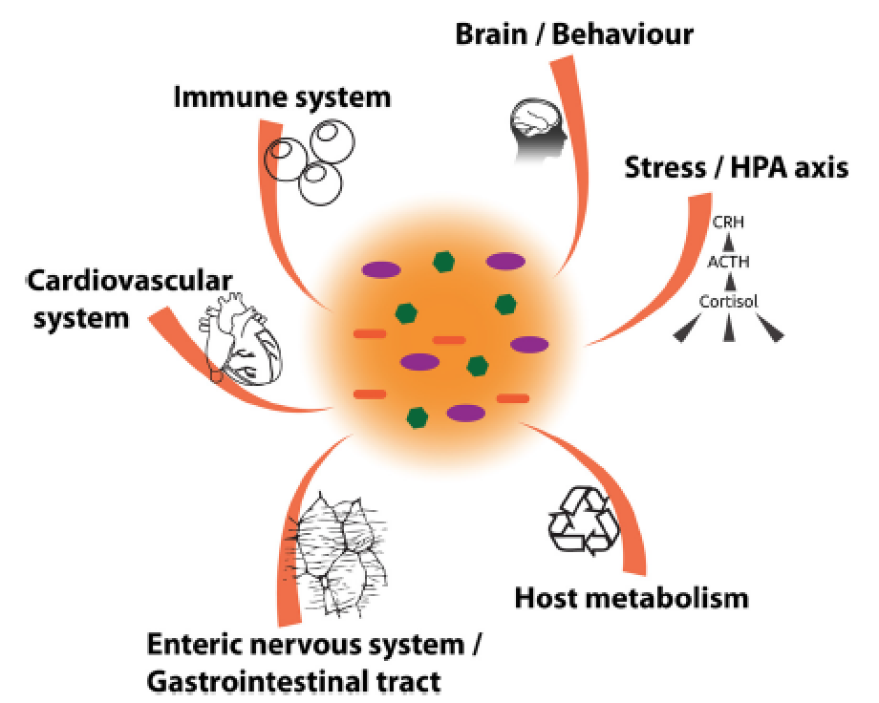
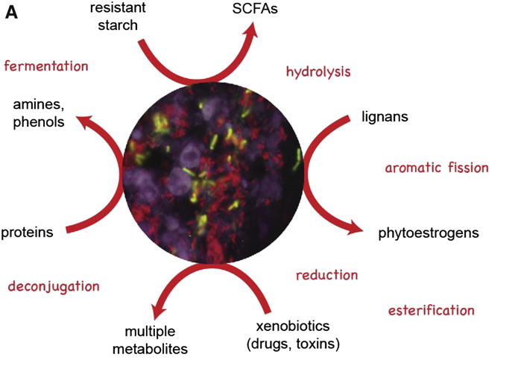
What Gut Microbes Do Most of the Time
What they produce
With whom they communicate
Baeckhed et al, 2012

Slide 10
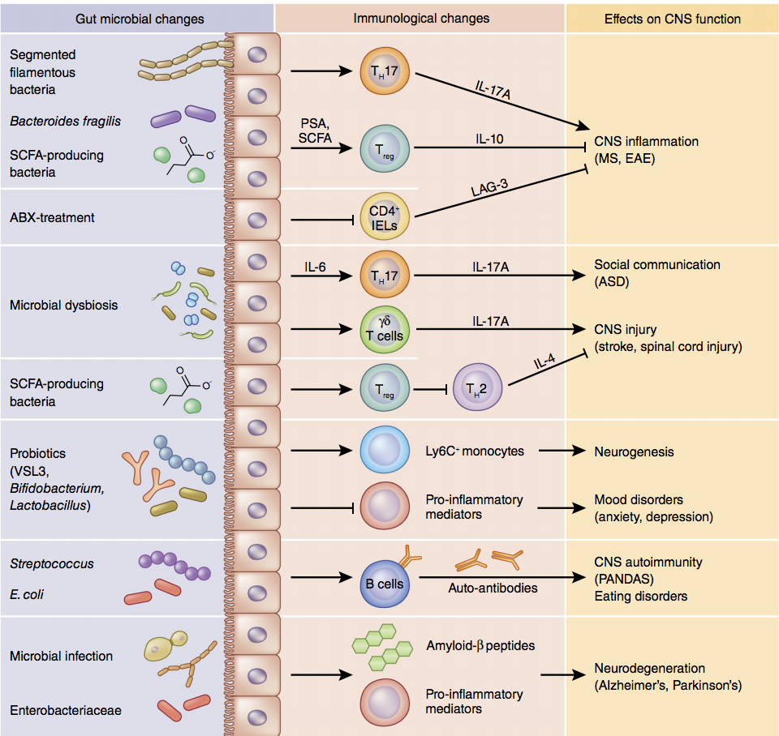

Slide 11

The New Ecological View of Health and Disease
Genetics
Environment
Lifestyle
Early life experiences
Social connectedness
Diet
Mind
Complete physical, mental, emotional, spiritual and social well being

Slide 12
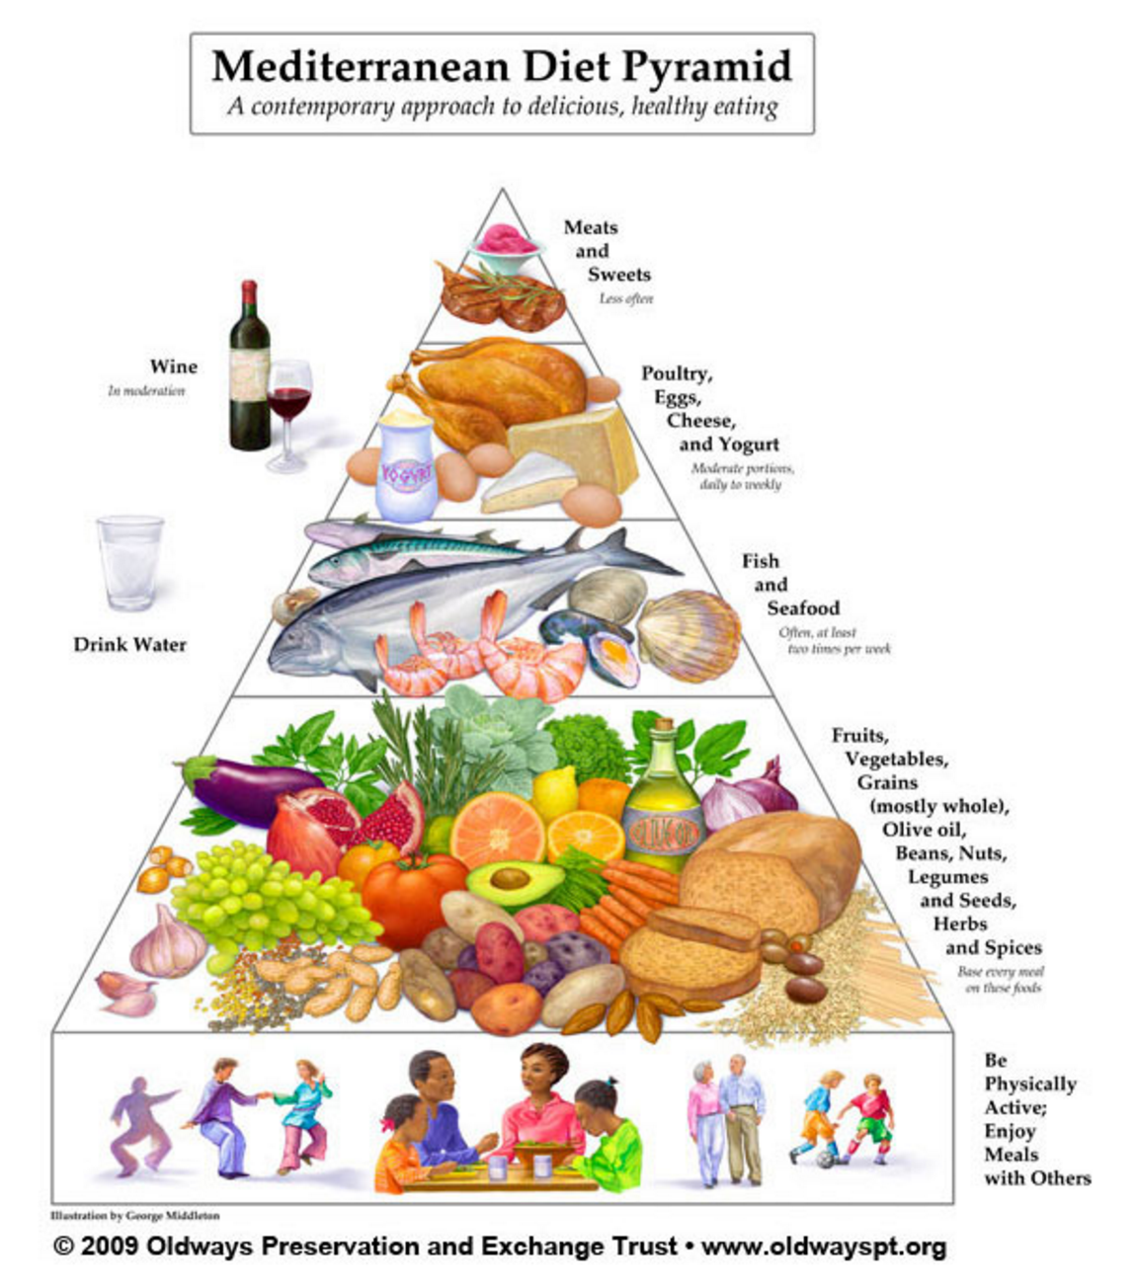
The Mediterranean Diet Pyramid

Slide 13
Well Documented Health Benefits of the Mediterranean Diet
Cardiovascular disease
Cancer
Metabolic syndrome
Brain structure and function
Cognitive impairment (Alzheimer’s)
Depression
Estruch et al, NEJM 2013

Slide 14
Why is a Mediterranean Type Diet Good for Your Health?
Good for your gut microbes:
High ratio of plant to animal based foods
High ratio of plant based (unsaturated fats) to animal based fats
Anti inflammatory effects on the gut, brain and body
High concentration of antioxidants and polyphenols produced by plants for their own protection (olive oil, red wine, roots, leaves) which require the gut microbiota to digest
Social interactions

Slide 15


