Slide 1
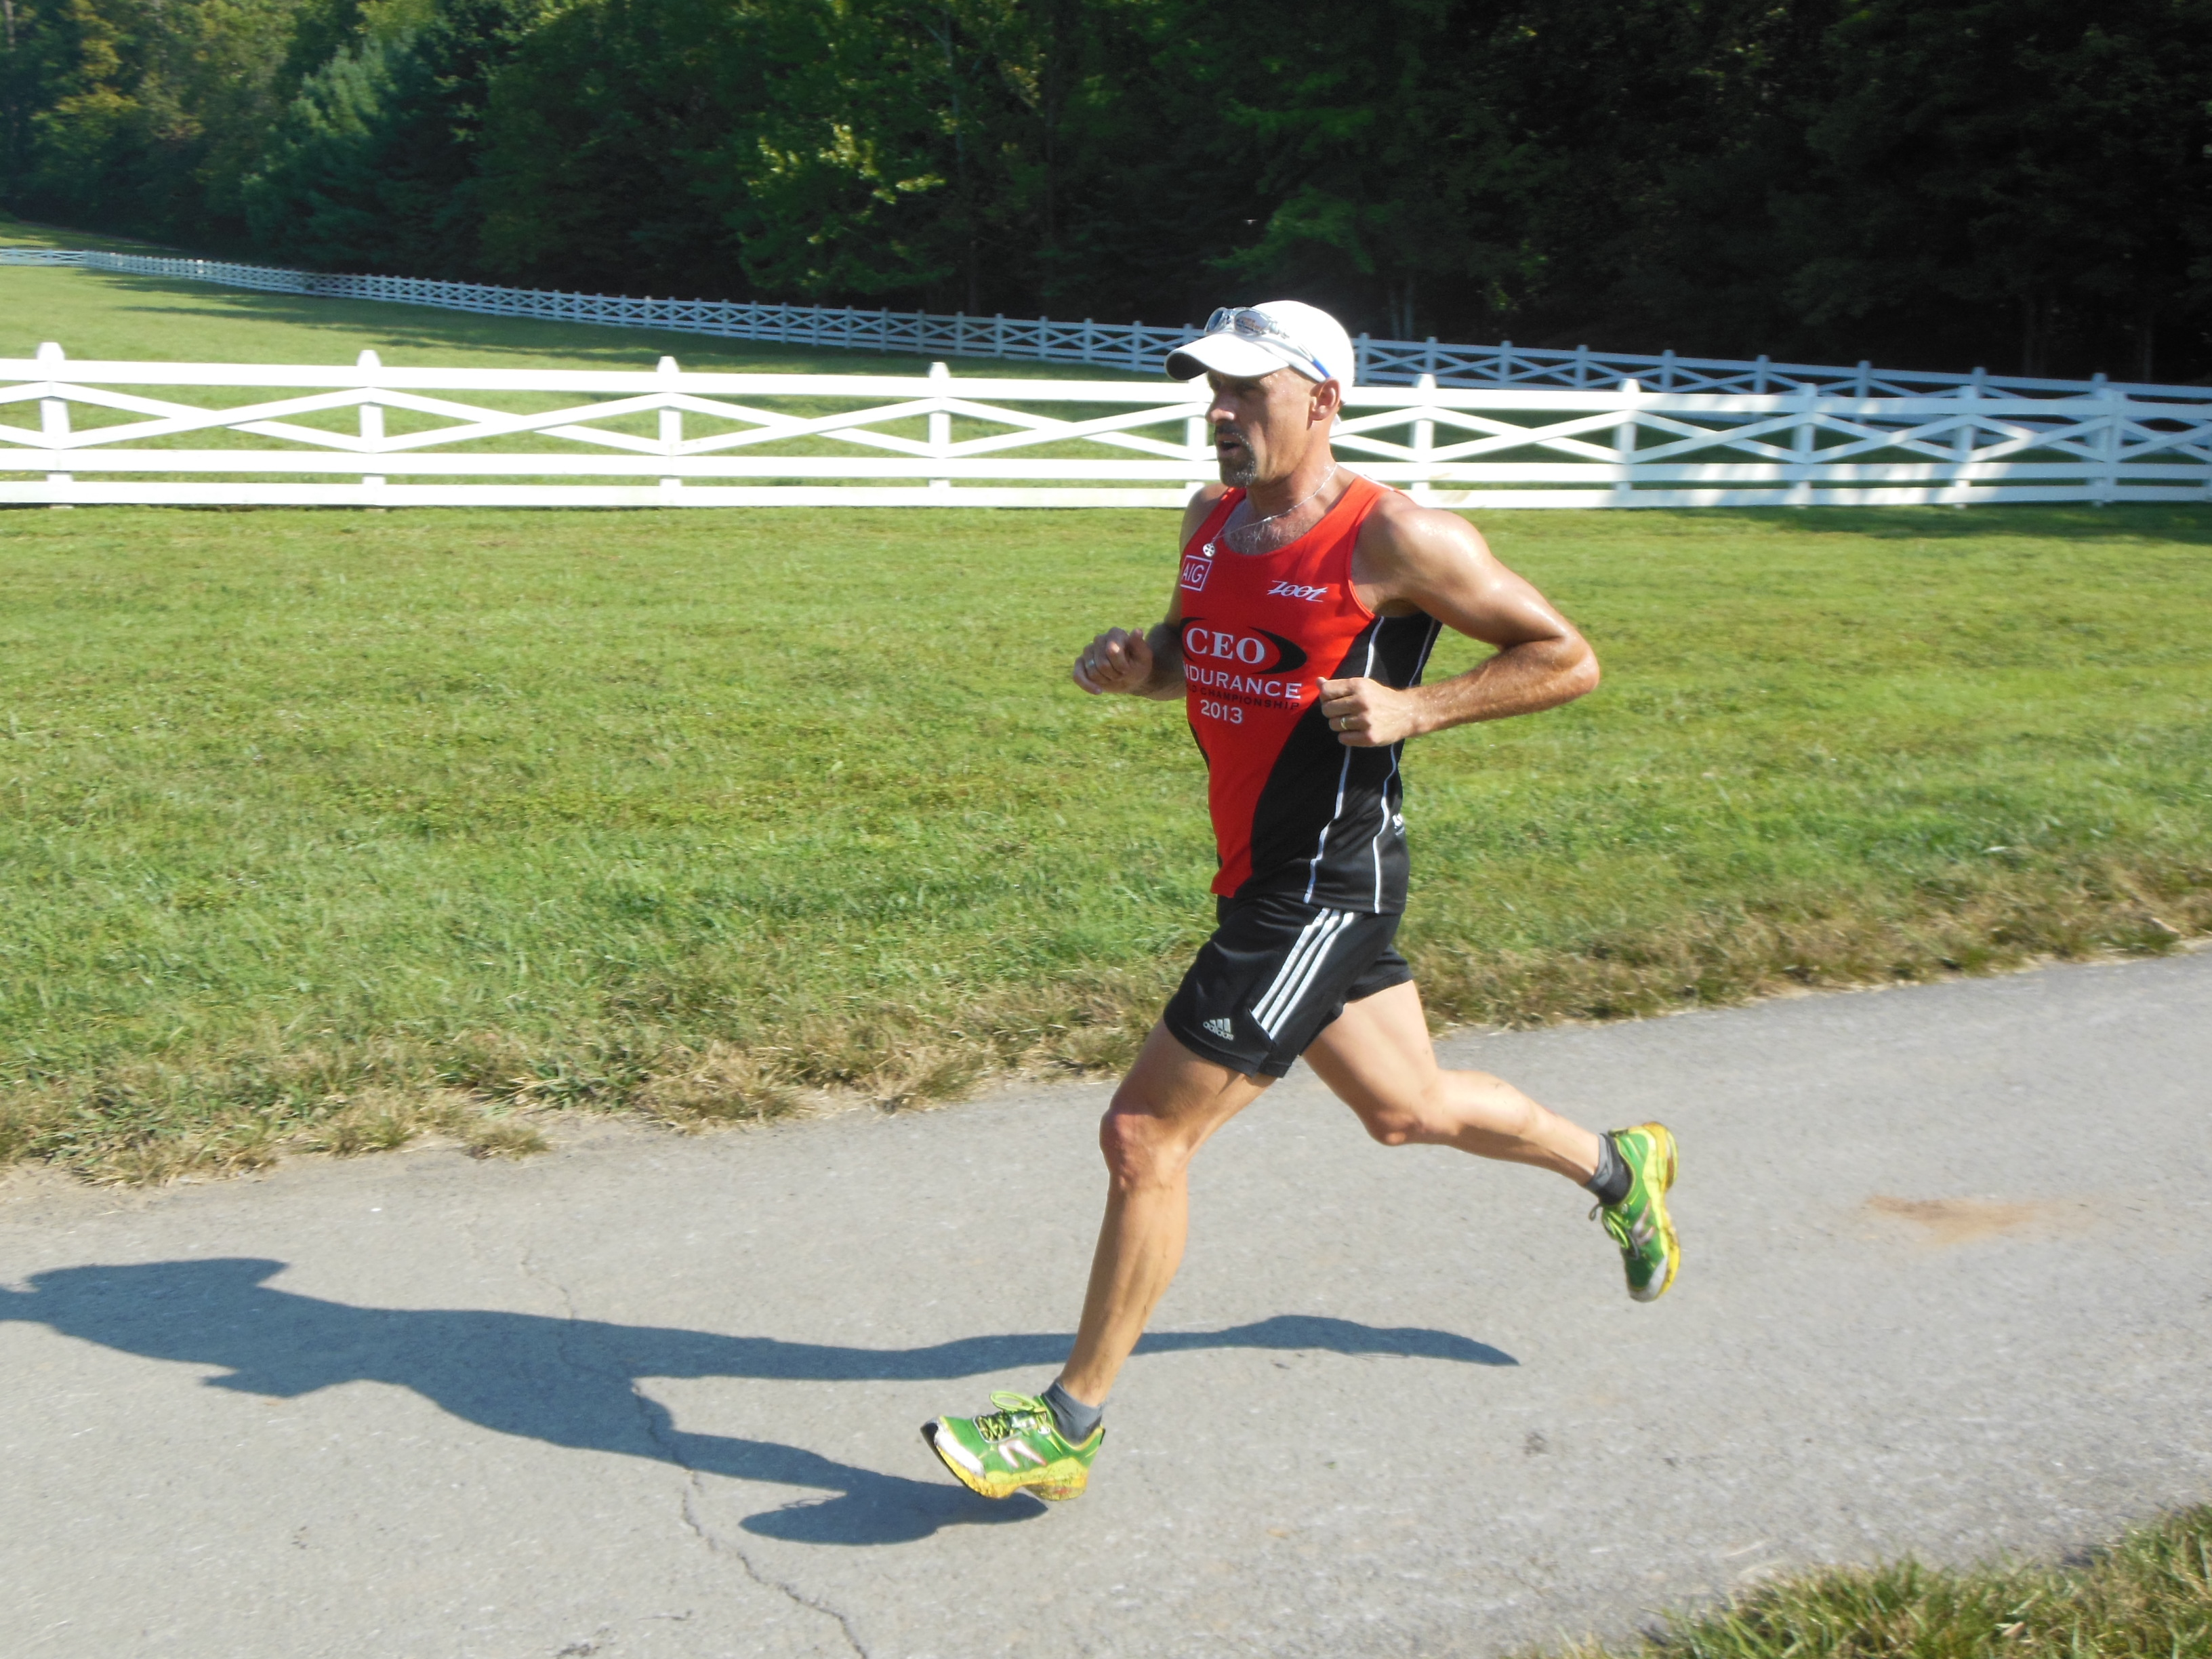
12 Fitness Tips from the “World’s Fittest CEO”
Shawn M. Talbott, PhD, LDN, CNS, FACSM, FACN, FAIS

Slide 2

Fittest CEO?
3 days / 7 events
Road cycling
Trail Running
Stair climb
Mountain Biking
Open Water Swim
PT Test
Spartan Obstacle Race

Slide 3
Top 12 “VIPs”
VIPs = Vigor Improvement Practices (Secret of Vigor book)
5 Nutrition
4 Fitness
3 Mental
Vigor = 3-tiered mood state
Physical Energy
Mental Acuity
Emotional Well-Being

Slide 4
Eat By Color
choose bright
avoid white
Avoid processed foods based on white flour – such as white bread, rolls, and baked goods
Include at least one of each “color” in your diet every day (protective phytonutrients)
Red (lycopene from tomatoes)
Orange (beta-carotene from carrots)
Yellow (lutein from corn/egg yolks)
Green (chlorophyll from spinach)
Blue (anthocyanidins from blueberries)
Indigo (catechins from blackberries)
Purple (quercetin from grapes)
#1 – Nutrition 1

Slide 5
Is it calorie worthy?
Ask yourself whether or not the food you’re thinking about eating is really “worth” the calories that you’re about to “spend” on eating it.
Good cookie - or GREAT cookie?
Low-fat fruit yogurt (calcium, magnesium, vitamin D, protein, and probiotics)
Noosa (Australian)
Chobani (Greek)
#2 – Nutrition 2

Slide 6
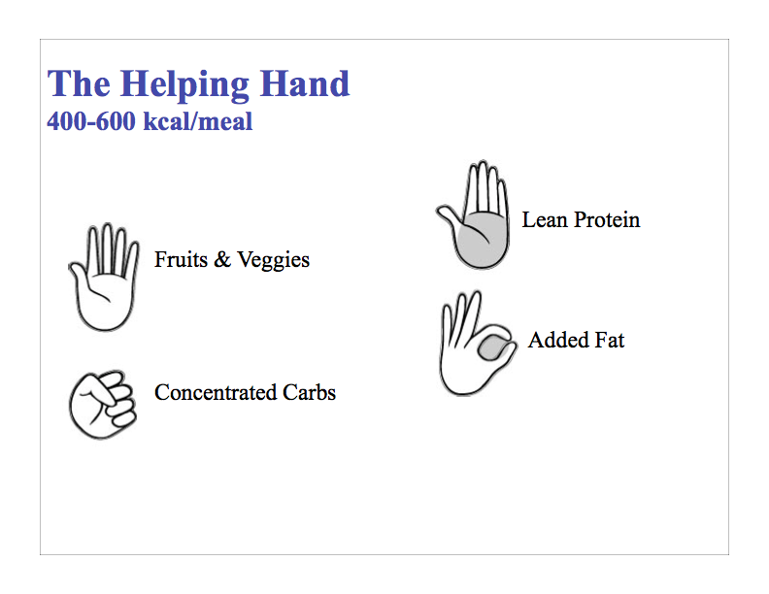
Practice pairing of macronutrients
Always combine a carbohydrate with a protein and fat
More refined (less “whole”) the carb is, the more likely it is to raise blood sugar levels, leading to oxidation, inflammation, and problems with muscle building and recovery
Combining any carb source with some protein and fat will slow it’s absorption and lessen it’s oxidizing/inflammatory effects
#3 – Nutrition 3

Slide 7
Eat more healthy (omega-3) fats and fewer unhealthy (omega-6) fats
Fatty fish – like mackerel, bluefish, wild salmon, and tuna are rich omega-3s that improve circulation, reduce inflammation, and reduce the risk of heart disease
Reduce your intake of inflammatory omega-6 fatty acids found in high concentrations in vegetable oils such as corn/soybean/sunflower oil
Supplements = OmMega
#4 – Nutrition 4

Slide 8
Supplement wisely
Probiotics (MentaBiotics) – gut permeability
Prebiotics (MentaBiotics)
Turmeric (Relief+) - inflammation
Green tea (Energy+) - metabolism
Pomegranate (MentaFocus) – blood flow
Ashwagandha (Mood+) - adaptogen
New Zealand pine bark (GBX Blend) – entire GBX
Theanine (MentaBiotics) – “zone”
CDR modulation (VitaGBX) – protection / recovery
Brain Ergogenics (Energy+) – mental edge
#5 – Nutrition 5

Slide 9
Practice “MIM”
“Most Important Meeting” of the day = your workout
Research shows that exercise is even MORE effective that prescription antidepressants or ADHD drugs for improving mood and maintaining mental focus
#6 – Exercise 1

Slide 10
No “junk” workouts
Every workout needs to have a focus
Speed (hard/fast intervals)
Endurance (long/slow distance)
Strength (weights/Crossfit)
Balance (yoga, plyometrics, etc)
Don’t fall into the trap of going at “medium” intensity all the time just to feel like you got a “good” workout – that’s the path to mediocre performance
#7 – Exercise 2

Slide 11
Get In, Get Out, Recover
Quality over Quantity
I train a maximum of 8-10 hours per week, even when I’m training for an Ironman or an ultra marathon
Avoid overtraining syndrome
When in doubt, Rest!
#8 – Exercise 3

Slide 12
Take a full day off each week
A “day off” means no work – or workouts
Take this day to relax, reflect, and recharge, regardless of whether or not a “Sabbath” day of rest has any religious connotations for you
You will feel more physically and mentally refreshed than you could possibly imagine
Doing nothing will give you back a lot
#9 – Exercise 4

Slide 13
Get some sleep!
Top stress-management technique
Yale University study of 1,709 men found that those who regularly got less than six hours of shut-eye doubled their risk of weight gain and diabetes because of elevated cortisol and its interference with insulin metabolism and blood-sugar control
Control your stress response
Improve weight loss
Boost energy levels
Improve mood
Increased Vigor
#10 – Mental 1

Slide 14
Manage electronic interruptions
Your cell phone is there for your convenience – not the convenience of others
Most e-mail programs are automatically set to check for new messages every 5 minutes (96 times in 8-hr day)
Shut off your e-mail program during certain parts of the day, enabling you to get your “important” work accomplished whenever you’re most mentally fresh
#11 – Mental 2

Slide 15
Whenever possible, leave the cell phone behind
Leave it behind – especially during your workout
Part of your mind still waits for it to ring, or buzz, or play your favorite ringtone
Let that part of your brain relax and forget about the phone every now and then
#12 – Mental 3

Slide 16

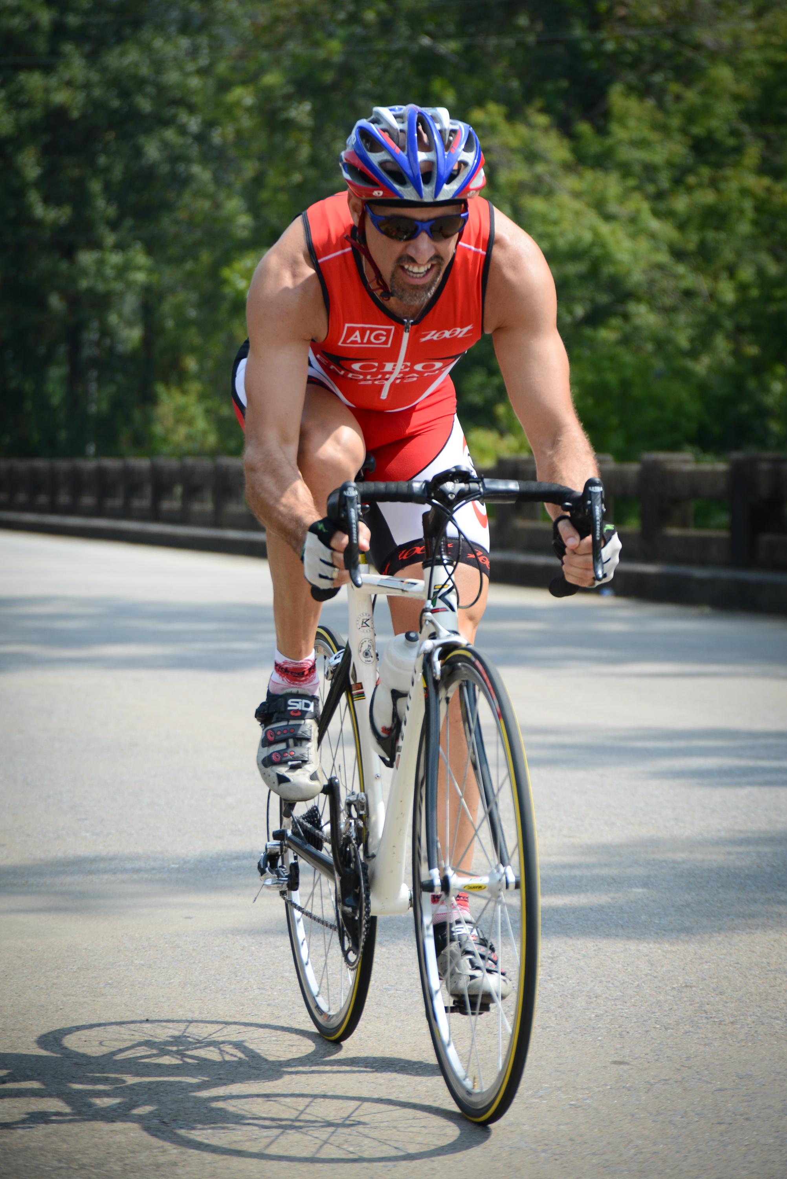
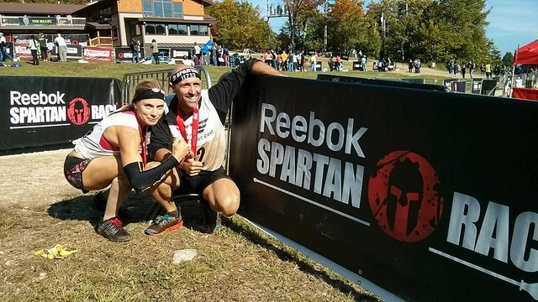
Thank You!

