Slide 1

New Ommega deep dive
Michael Quach, MHS

Slide 2


Notes:
Talking Points:
Thanks Shawn, Hey everyone, so my name is Michael Quach and if you haven’t seen or met me before and I run the R&D department with Dr Shawn, and we are so excited to share with you what we’ve been working on. Before we get into it.
How many people are currently taking a fish oil that look like one of these? (Yellow, brown, orange?) Blah blah
How many people know what a fish oil burp smells like? Blah blah blah
How many people know how important fish oil is for brain health? Blah blah

Slide 3
WHY Fish oil WHY SIGNIFICANT? FISH OIL CONTAINS OMEGA 3s AKA (PUFA) polyunsaturated fatty acids that are beneficial for their cellular benefits in multiple areas of our bodies. Docosahexaenoic acid, or DHA, and eicosapentaenoic acid, or EPA, are THE MAIN OMEGA 3s and are beneficial forms of omega-3 fatty acids. There ARE countless data points in science that show that DHA and EPA may be valuable in COGNITIVE HEALTH, BRAIN HEALTH, JOINT HEALTH, ,RA, CARDIOVASCULAR HEALTH and MANY OTHERS. A diet rich in omega-3 fatty acids should be viewed as an essential supplementation for overall health, and brain maintenance!

Slide 4
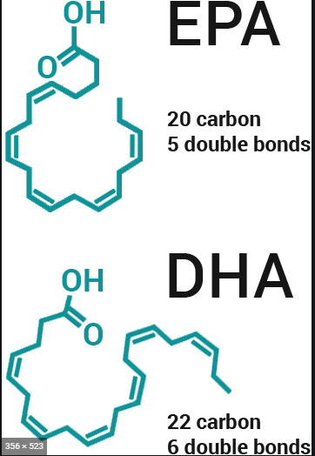
The main structures of omega 3 fatty acids FOUND IN TYPICAL FISH OILs

Slide 5
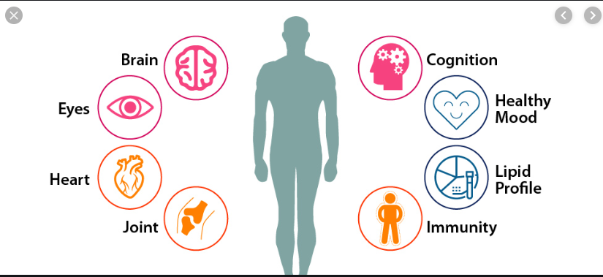
The general benefits of dha and epa.
Notes:
https://www.healthline.com/nutrition/13-benefits-of-fish-oil#section4
https://www.healthline.com/nutrition/17-health-benefits-of-omega-3#section9

Slide 6
HOW DOES EPA and DHA impact brain health/mental wellness?
EPA levels are linked to a reduced risk of depression. These fats support serotonin — a nerve messenger that helps balance your mood. In addition, they have anti-inflammatory effects on nerve cells, which may reduce depression risk as well! (aside from their general health benefits)
DHA is a major structural and functional fat found in the brain and eyes and is also a key component of the tissue found in the heart and cardiovascular system. DHA is one of the omega-3 fats recommended by the American Heart Association and USDA Dietary Guidelines for good cardiovascular health.
EPA and DHA do different things, so you need them both, especially for the brain. If your goal is reducing cellular inflammation, then you probably need more EPA than DHA. How much more? Probably twice the levels or four times the levels, nonetheless you always cover your bets with omega-3 fatty acids by using both EPA and DHA at the same time. They are synergistic and help eachother.

Slide 7
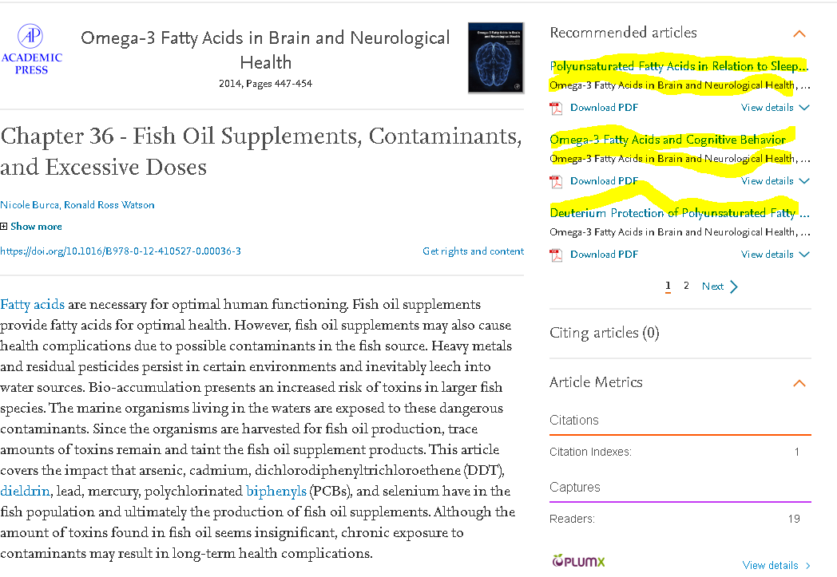
CLINICAL STUDIES FOR OVER 40 YEARS OF PUFAS
Notes:
There has been decades and hundreds of thousands of clinical studies that review the different benefits of PUFAs. PUFAs have just gained traction in the neurological and brain health arena within the last 20 years.

Slide 8
Why FISH SOURCE vs plant source for omega 3s?
Plant based omega 3s that you would find in fruits, vegetables, nuts, seeds, etc. are good, but typically do not contain DHA or EPA. They have an omega 3 called ALA (alpha lineolic acid) which is a structurally shorter chain of PUFA that is much less effective in cellular growth. The main problem with ALA is that to have the good effects attributed to omega-3s, it must be converted by a limited supply of enzymes into EPA and DHA.
If your body can’t convert it, then the ALA is exponentially less effective. Fish contains the highest concentration of EPA and DHA which are the omega 3s that are beneficial to human health. Therefore fish oil remains the best source of EPA and DHA concentrations today. Studies show that about 5% - 8% of dietary ALA is converted to EPA in the human body. You would have to consume a TON of plant-based omega 3s (ALA) to achieve half of the amount of EPA and DHA necessary for the benefits targeted here.

Slide 9
What are the most important considerations when choosing a fish oil supplement? 1. Sourcing 2. quality/contaminates 3.Mechanism of action 4. Substantiation 5. ratio of omega 3s delivered 6. total omega 3 CONTENT 7. cost

Slide 10


Ultra Quality Sourcing
Wild caught in the South Pacific Ocean from Arica, Chile. (not farmed)
Single species sourced Anchovies (no variation)
Low on the food chain (they can only consume smaller organisms)
Low biomagnification (lowest concentration of contaminates)
High purity and potency
Notes:
Talking Points:
Our new fish oil is SINGLE SOURCED ONLY from wild caught anchovies on the coast of Arica, Chile.
One of the MOST important things that most people forget to look at in fish oil products is the quality and sourcing of the fish. If you look at the back of a fish oil product, you’ll see that most fish oils on the market come from a VARIATION of fish like salmon, cod, mackerel, tuna which fall under the category of large fish. Some people hear that, “oh! It comes from Salmon or tuna? It must be good!”
In addition, when you have variation in fish in your sourcing, you have variation in the quality of your fish oil. Which is why you see some fish oils that are yellow, brown, orange, etc.
But here is why it is bad! There is something called biomagnification, which is shown on this slide here. It is defined as on the concentration of toxic chemicals found in living organisms as they move up the food chain. (mercury, DDT, PCBs, Heavy Metals)
The bottom represents the smallest forms of species, and the top represents the largest forms of species. On your left, we have the contamination gradient that represents how many parts per millions are typically found in each of these levels.
For example, COD, TUNA, and Marine mammals at the top that are physically large are the most contaminated and actually test higher for DDT, PCB, Mercury, and heavy metals? Why? They eat smaller fish that are contaminated, and they are able to eat other objects that are contaminated as well!(like trash, plastic, etc) Once the fish consumes it, the toxins become part of their body, and the concentrations of these metals become higher! (This level of fish typically sees about 5PPM of contaminates.)
As we move down each level of biomagnification, the contamination levels decrease 10 times (1000%), which is a TREMENDOUS amount. What this means the smaller the species, the lower contamination. Anchovies are physically tiny, have a low concentration of contaminates, and cannot consume other contaminated species easily, like tuna, salmon, etc.
When we can certify that we are single sourced, remove variation in species, (tiny anchovies only), We get a fish oil that is 10x less chance of contaminated oil, with the highest potency and purity at the end of the day.

Slide 11
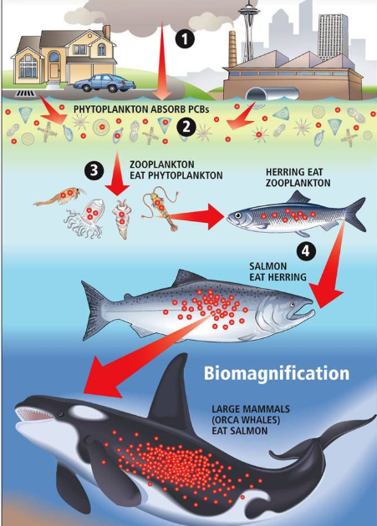
Bioaccumulation refers to the accumulation of a toxic chemical in the tissue of a particular organism.
Biomagnification refers to the increased concentration of a toxic chemical the higher an animal is on the food chain.
Why don’t we use phytoplankton or Krill for omega 3s? They are much higher in iodine and have a higher allergy probability with lower concentrations of omega 3s.
Notes:
Our new fish oil is SINGLE SOURCED ONLY from wild caught anchovies on the coast of Arica, Chile.
One of the MOST important things that most people forget to look at in fish oil products is the quality and sourcing of the fish. If you look at the back of a fish oil product, you’ll see that most fish oils on the market come from a VARIATION of fish like salmon, cod, mackerel, tuna which fall under the category of large fish. Some people hear that, “oh! It comes from Salmon or tuna? It must be good!”
In addition, when you have variation in fish in your sourcing, you have variation in the quality of your fish oil. Which is why you see some fish oils that are yellow, brown, orange, etc.
But here is why it is bad! There is something called biomagnification, which is shown on this slide here. It is defined as on the concentration of toxic chemicals found in living organisms as they move up the food chain. (mercury, DDT, PCBs, Heavy Metals)
The bottom represents the smallest forms of species, and the top represents the largest forms of species. On your left, we have the contamination gradient that represents how many parts per millions are typically found in each of these levels.
For example, COD, TUNA, and Marine mammals at the top that are physically large are the most contaminated and actually test higher for DDT, PCB, Mercury, and heavy metals? Why? They eat smaller fish that are contaminated, and they are able to eat other objects that are contaminated as well!(like trash, plastic, etc) Once the fish consumes it, the toxins become part of their body, and the concentrations of these metals become higher! (This level of fish typically sees about 5PPM of contaminates.)
As we move down each level of biomagnification, the contamination levels decrease 10 times (1000%), which is a TREMENDOUS amount. What this means the smaller the species, the lower contamination. Anchovies are physically tiny, have a low concentration of contaminates, and cannot consume other contaminated species easily, like tuna, salmon, etc.
When we can certify that we are single sourced, remove variation in species, (tiny anchovies only), We get a fish oil that is 10x less chance of contaminated oil, with the highest potency and purity at the end of the day.

Slide 12
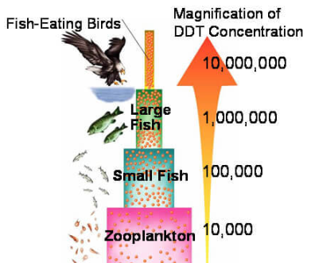

What kinds of contaminates do we see in fish oil?
Mercury
DDT
PCBs
Lead
Trash byproducts (plastics, papers, filters, etc)

Slide 13
Why do all these contaminates and sourcing matter to humans? US?
Some toxins have an antagonistic (inhibitory) effect. In this case, the nerve impulse is blocked and symptoms include muscle paralysis and a low heart rate (bradycardia). Some neurotoxins inhibit the enzyme that breaks down the neurotransmitter–receptor complex, which also causes overstimulation of that neural pathway.
Mercury induces changes in the central nervous system, potentially resulting in irritability, fatigue, behavioral changes, tremors, headaches, hearing and cognitive loss, dysarthria, incoordination, hallucinations, and death
DDT at low environmental doses are unknown. Following exposure to high doses, human symptoms can include vomiting, tremors or shakiness, and seizures. Laboratory animal studies showed effects on the liver and reproduction. DDT is considered a possible human carcinogen.
Polychlorinated biphenyl or PCBs exposure either via the skin, by consumption through fish, or in the air, have experienced irritation of the nose and lungs, skin irritations such as severe acne (chloracne) and rashes, hormone issues, metabolic stress and eye problems.
Lead can contribute to biochemical and physiological health issues that could be very serious.

Slide 14
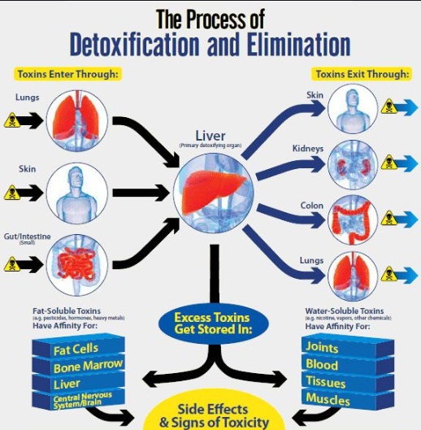
If we are not mindful of biomagnification and bioaccumulation, once we consume these contaminates, this is the stress you put your body through!
It would almost be counter productive to take a fish oil that had poor sourcing and poor-quality control.

Slide 15
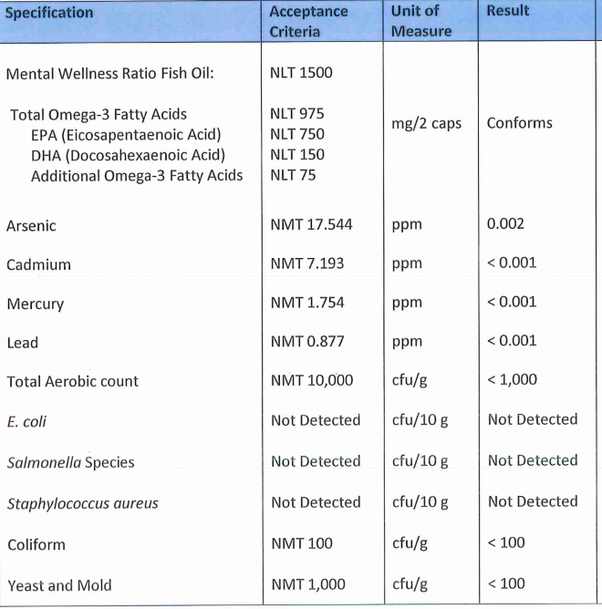
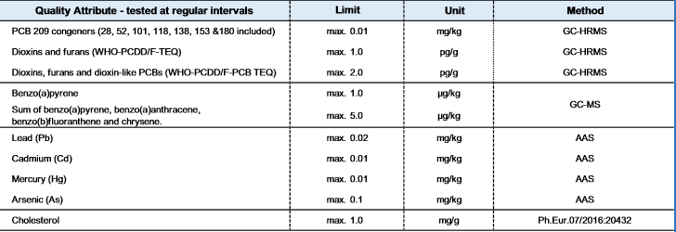
3RD PARTY TESTING/SEALS
We run a COA at a 3rd party laboratory at 3 levels of product development to ensure that these contaminates are next to none and are a step above the compliance standards in the USA.
RAW MATERIAL LEVEL: LAB 1
PRODUCTION LEVEL: LAB 2

Slide 16
Mental Wellness specific Blend
Specific 5:1 Ratio of EPA to DHA
EPA Upregulates cLPA2
Neuroinflammation in the HPA
Neurotrophic Factor = More Neurogenesis
Clinically studied that EPA concentration is a key player in brain/cognitive health
Notes:
Talking Points:
We have developed the worlds first, mental wellness specific fish oil that has a unique ratio of EPA/DHA that has been clinically studied to help with brain health and mental wellness.
It has a 5:1 ratio of EPA to DHA, which is incredibly different compared to the typical fish oil that you see in the market, which is normally a 2:1 or a 3:1 ratio of EPA to DHA. While those ratios are good for you, studies continue to show us that high EPA ratios are much better specifically for cognitive health, brain health, and neuroinflammation.
How does it work? High EPA ratios upregulate something called cLPA2, which is an enzyme that is responsible for inflammation in the HPA (hypothalamic-pituitary-adrenal) axis in our brain. This is the stress pathway, or neurogenetic pathway that is important for neurogenesis and memory function. So what that means is, with this specific blend of EPA:DHA your cells will communicate better, your brain will function more efficiently, your neurons will have the right nutrients to perform how they should!

Slide 17
What is CLPA2
cPLA2 is an enzyme called a cytosolic phospholipase and it is a calcium dependent phosopho-lipase that is involved in cell signaling processes, such as inflammatory response.
They release arachidonic acid from membrane phospholipids. Arachidonic acid is both a signaling molecule and the precursor for the synthesis of other signaling molecules.
When we increase cLPA2, we ultimately see less inflammatory response, resulting in a higher chance of neurogenesis, and less chance of depressive like symptoms.

Slide 18
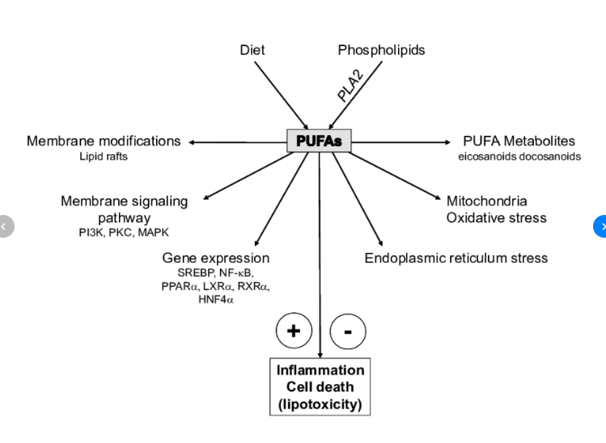
Mechanism of action 2 HOW DOES THIS WORK
Inflammation→ cellular stress → cellular inefficiency→ Poor cellular communication → Poor systemic efficiency → Feeling terrible -> Poor Mental Wellness

Slide 19
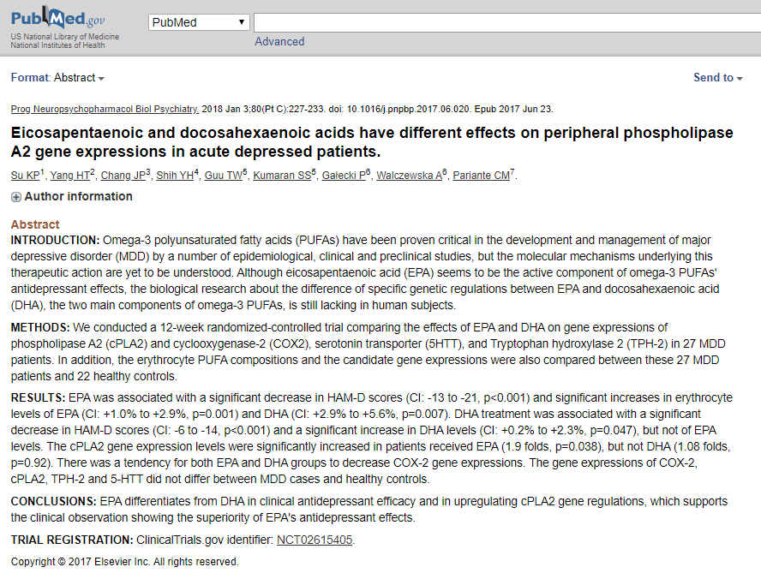
Notes:
https://www.ncbi.nlm.nih.gov/pubmed/28648567

Slide 20
WHY a 5:1 ratio of epa to dha?
EPA has a much better efficacy on mood/brain/depressive like symptoms and is much more effective than DHA. It is stepping in the right direction to focus in on mental health/brain issues that are neurochemically rooted.
There are VARIOUS clinical applications that show that those who use HIGH RATIOS of EPA have a better mental health/wellness status due to the ant- inflammatory effects, antioxidant effects, enzyme upregulation, and increase of BDNF/neurotrophic factor in the brain.
How do we know this?

Slide 21
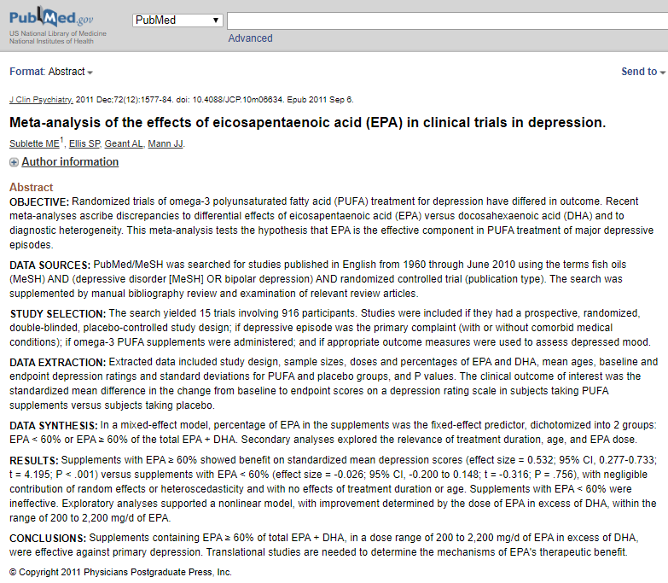
Notes:
https://www.ncbi.nlm.nih.gov/pubmed/21939614
This is one of the first studies that review a COLLECTION of studies on the topic of EPA and clinical efficacy in depression cases. A meta analysis is a study that looks at studies over the course of years to understand a collection of findings or conclusions. They reviewed studies that were published over the last 50 years on the topic of fish oil and depression and brain health to see if EPA was effective in each study. They saw 15 different studies that included close to 1000 people in which they all had a study design of exposing one group to EPA and one group and a placebo to the other. They saw that those who used a low EPA fish oil were deemed ineffective. They saw that those supplements that contained EPA at a concentration amount of 60% or more than DHA yielded therapeutic efficacy in those with depression like symptoms.

Slide 22
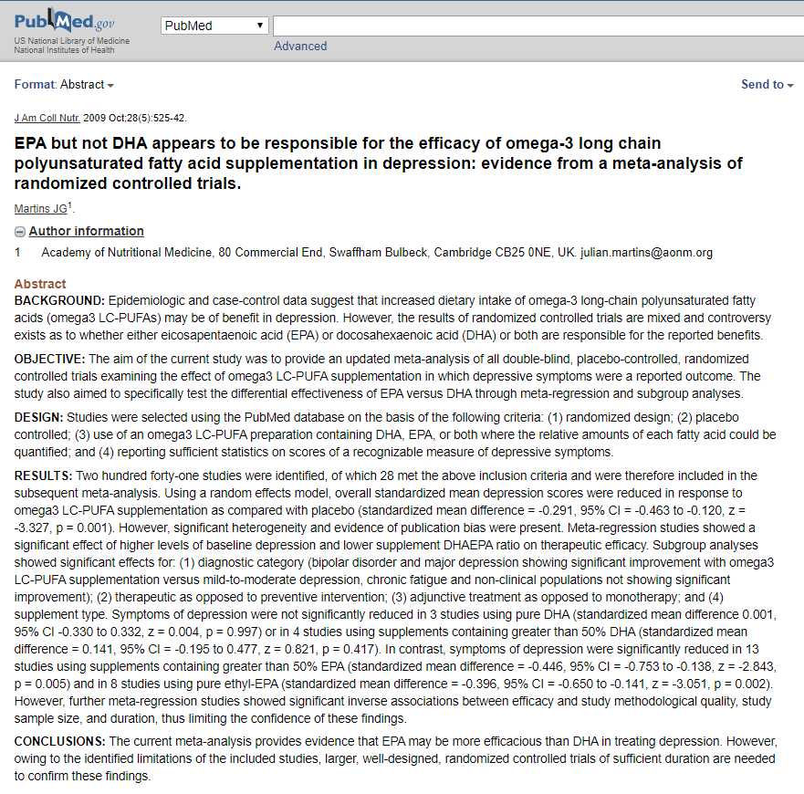
Notes:
https://www.ncbi.nlm.nih.gov/pubmed/20439549
This study was also a study that reviewed hundreds of studies in the history of PUFA studies. It looked at 241 studies over the course of 50 years in which they observed the EPA to DHA ratios in how many people saw improvement in their brain health and depressive like symptoms. It saw that the baseline of improvement starts at supplements that contain greater than 50% EPA to DHA. 2:1 Ratio when it comes to BRAIN health and depressive like symptoms!

Slide 23
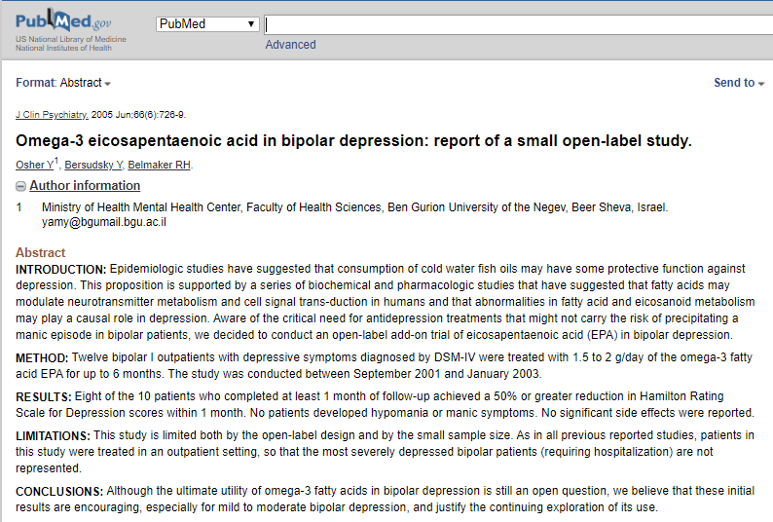
Notes:
https://www.ncbi.nlm.nih.gov/pubmed/15960565
This is another study that stated the the consumption of cold water fish oils can have protective functions and that fatty acids may help with the neurotransmitter metabolism and production through signaling in various aspects of brain health. This was published in a clinical psychiatry journal in Israel. They looked at 12 patients with depressive like symptoms and gave them 1.5gms to 2gms of EPA for 6 months. 80% of the participants saw an improvement in cognitive, behaviorial, and brain improvement within 1 month. They used very standardized surveying methods like the Hamilton-D, in which they did not see side effects as well.

Slide 24
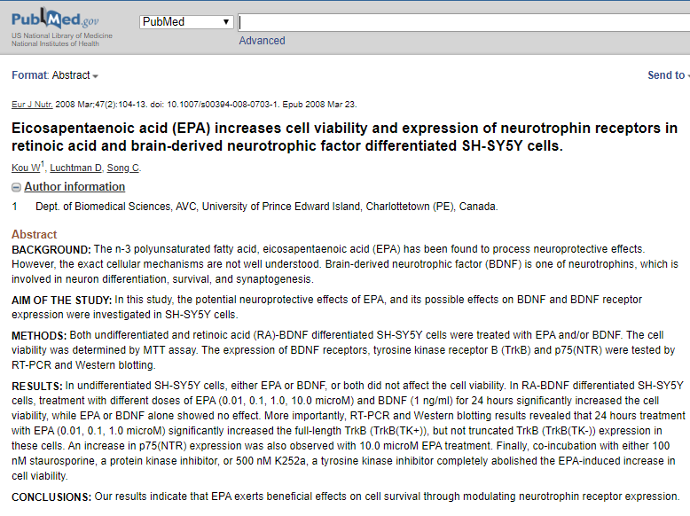
Notes:
https://www.ncbi.nlm.nih.gov/pubmed/18360785
This is a study that was done by a University in Canada. They looked at EPA and how it has been found to encourage neuroprotective like mechanisms. They saw that that EPA and BDNF contribute to the neuron differentiation, survival and synaptogenesis of neurons. What this means is that the neuronal cells viability increase with the consumption of EPA. This means that the results indicates that EPA exerts beneficial effects on neuron cell survival through modulating neurotrophin receptor expression. When this occurs, we ultimately encourage a process of neurogenesis, which is the growth of nervous tissue in our brain. Which is also fundamental to great brain health, memory, sharpness, brain processing, great mental wellness! (when we look at MRIs for Alzheimer's/dementia and brain tissue injuries like TBI, etc, we see that there is a reduced level of nervous tissue or loss of nervous tissue; which is why many of these people that are experiencing these things have prescriptions for Omega 3 supplements.)

Slide 25
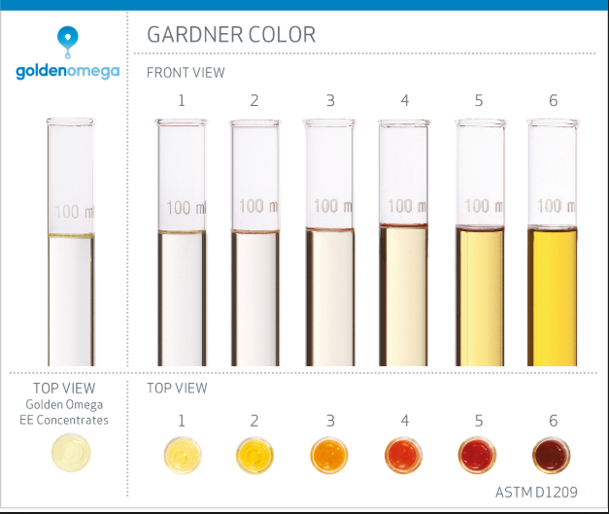
RAW MATERIAL IN THEORY
Notes:
Talking Points:
BECAUSE our fish oil source is so pure, potent, and high quality, the fish oil is visually CLEAR, compared to the typical fish oils that you see on the market that are yellow, orange, brown, or inconsistent. Take a look at it! Ours is on the far left and what most people see is the for right from different fishes and different sources with much variation! Take a look at it, it speaks for itself!

Slide 26
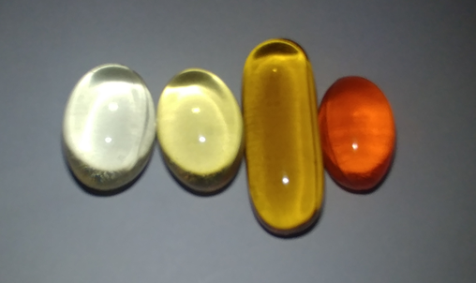
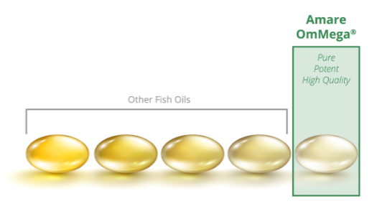
APPLICATION/ACTUAL PRODUCT
Notes:
Talking Points:
BECAUSE our fish oil source is so pure, potent, and high quality, the fish oil is visually CLEAR, compared to the typical fish oils that you see on the market that are yellow, orange, brown, or inconsistent. Take a look at it! Ours is on the far left and what most people see is the for right from different fishes and different sources with much variation! Take a look at it, it speaks for itself!

Slide 27

Innovative DESIGN
First fish oil in the world that is lavender infused.
Lavender is known to have calming benefits and a pleasant scent!
No more fishy burps!
Notes:
Talking Points:
If the mental wellness ratio, ultra quality sourcing, and “quality you can see” isn’t enough, we made sure to put the icing on the cake. We’ve seen other companies try to make their fish oil smell better with citrus, and various artificial flavors, but they just add sugar/caloric value to their fish oil. (WHICH IS NO GOOD!) We’ve infused the fish oil with a pinch of natural lavender oil to mitigate the typical fish oil scent with the calming aroma of lavender. This is the first fish oil in the world that is lavender infused. So those awful fish burps might be much better now!

Slide 28
Why Lavender?
Lavender use has been documented for over 2500 years. The ancient Egyptians used lavender for mummification and perfume. Romans used lavender oils for cooking, bathing and scenting the air and the name is derived from the Latin verb lavare—which means, “to wash.
The two primary terpenoid constituents of lavender essential oil, linalool and linalyl acetate, produce an anxiolytic (calming) effect in combination. Investigators believe this occurs due to inhibition of voltage-gated calcium channels, reduction of 5HT1A receptor activity, and increased parasympathetic tone.
While these are the historical and clinical aspects of lavender, we included it for the aroma, its history, and its contribution to mental wellness as a whole!
Notes:
https://www.ncbi.nlm.nih.gov/pmc/articles/PMC3612440/

Slide 29
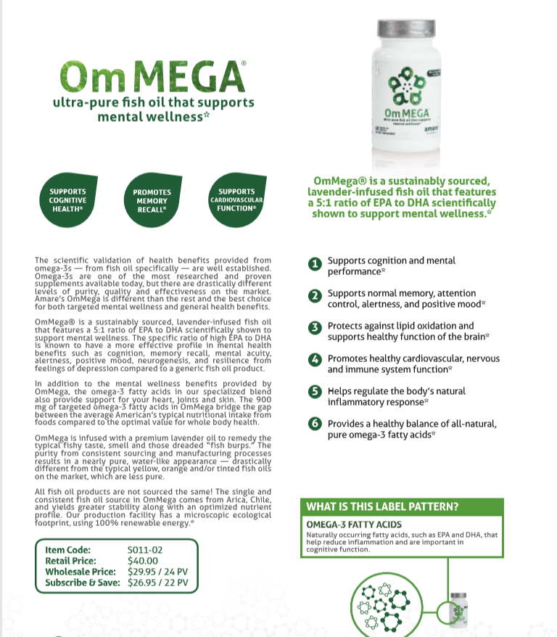

Slide 30
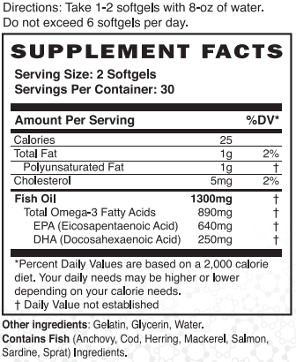
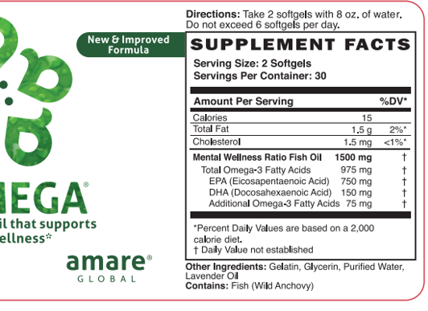
Redesigned, improved, specific.
Previous Fish Oil
NEW Fish Oil
Notes:
Talking Points:
This is the ACTUAL label of our reformulated OmMega! I want to mention, that just because we changed the formula, it does not mean you don’t get the benefits from the old formula or your typical ommega 3 products. You still get the and same benefits of your typical fish oil product (heart health, brain health, joint health) but SO MUCH MORE. You get a total of 1500mg of omega 3s, which includes the MW 5:1 ratio of EPA to DHA that we talked about earlier! (750mg of EPA and 150mg of DHA),The best part, is that you get all the extra benefits for the SAME PRICE!
Conclusion: Our updated OmMega; is by far, the best, most innovative, and the one and only fish oil on the market that is focused on brain health, mental wellness, cognitive performance. (that smells great!) With that being said, Ill turn it back over to doc!

Slide 31
This is available 11/20/19

