Slide 1
PRODUCT PRESENTATION

Slide 2


MENTAL WELLNESS

Slide 3
THE THREE THINGS YOU SHOULD KNOW ABOUT MENTAL WELLNESS
How you feel is not just in your head – it’s also in your gut.
Our “second brain” includes the Microbiome and plays a major role in mental wellness.
You can now DO something NATURALLY to improve your mental wellness.
WHERE ARE YOU ON THE MENTAL WELLNESS CONTINUUM? (Circle your current number)
1
2
3
4
5
6
7
8
9
10
DISEASE STATUS
“NORMAL”
OPTIMIZED
Depression
Anxiety
Diabetes
Obesity
Heart Disease
Autoimmune
Arthritis
Fibromyalgia
CFS
Dementia
ADD / ADHD
Alzheimer’s
Fatigue
Tension
Sad
Brain Fog
Headaches
Acne
Eczema
Congestion
URTI’s
Joint Pain
Muscle Pain
Bloated
Chubby
Energetic
Calmness
Happy
Sharp
Creative
Clear Skin
Rarely Sick
Flexible
Lean
Strong
Resilient
RED
ORANGE
YELLOW
GREEN
BLUE
INDIGO
VIOLET

Slide 4
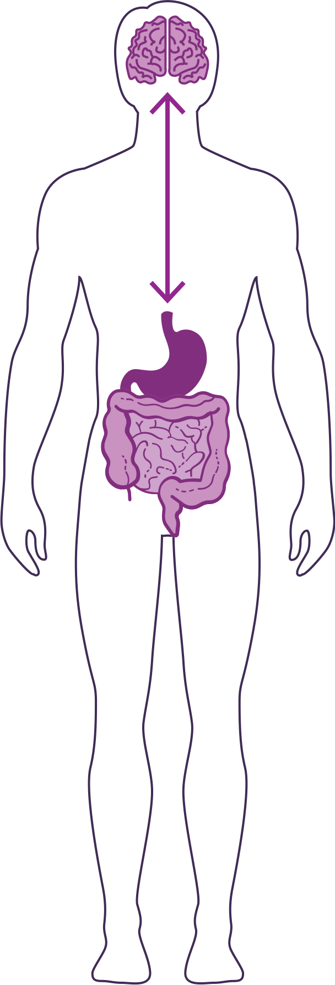
HOW DO YOUR “TWO BRAINS” COMMUNICATE?
Our “two brains” communicate through a highly extensive, multi-directional network, known as the gut-brain axis or what we refer to as the GBX.
THE NETWORK CONSISTS OF:
“wires” – nerves
“chemicals” – neurotransmitters/hormones
“cells” – immune system
The GBX connects our
nervous system (brain)
immune system (axis)
and gastrointestinal system (gut)
with a vast array of cellular and biochemical messengers throughout the entire body, which include the microbiome, hormones, cytokines, and neurotransmitters.

Slide 5


Slide 6
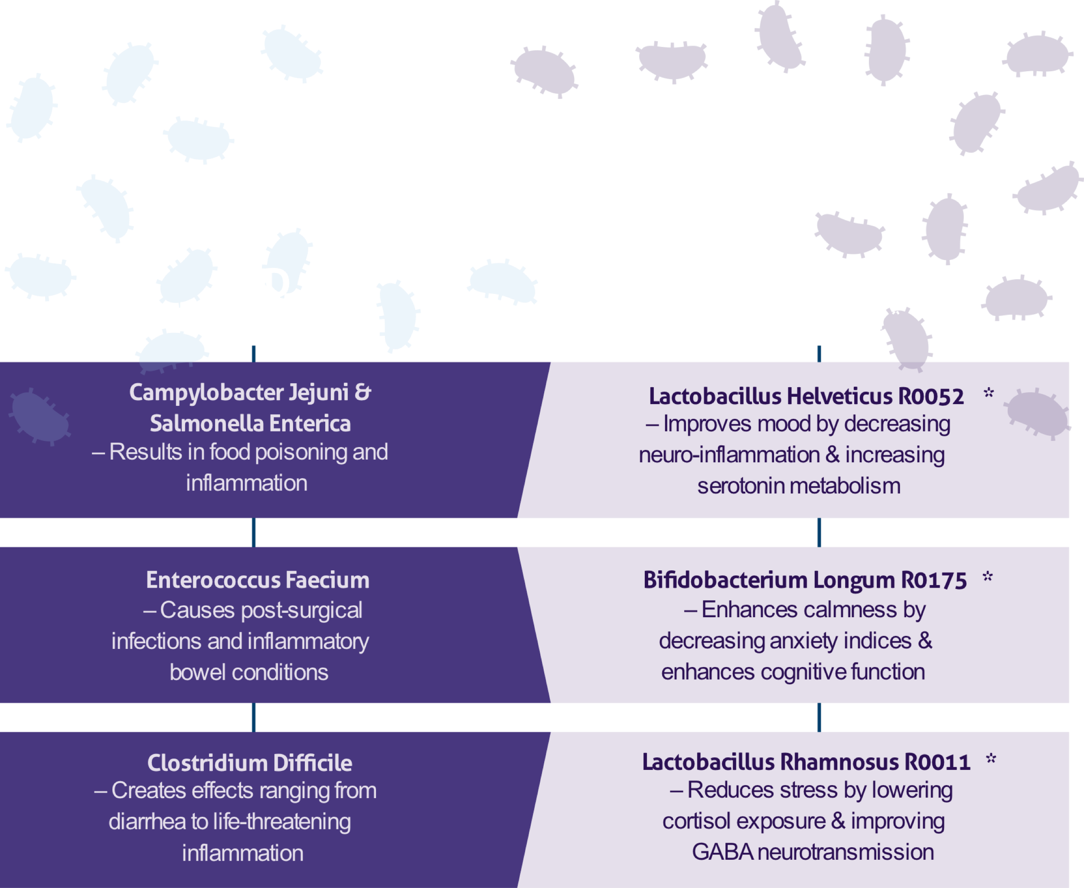




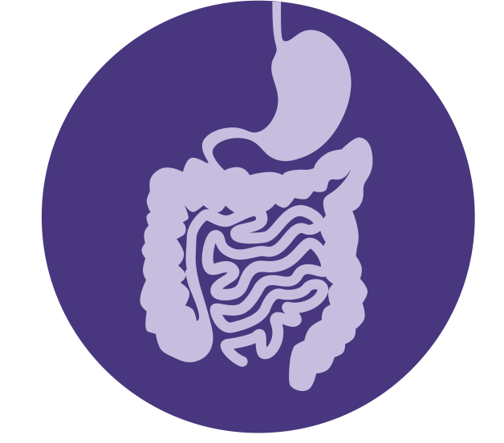

Healthy Inflammatory Balance
Robust Immune Protection
Optimal Digestive Process
THE MENTAL WELLNESS COMPANY

Slide 7








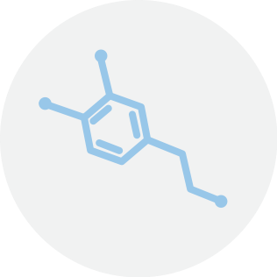
IT GOES BOTH WAYS…
“Butterflies in our stomach” form when we’re in love or anxious
When we eat, receptors in the gut cause the release of enzymes to aid digestion
Gut cells, including microbiome bacteria, send signals to the brain via nerves and hormones to indicate hunger or satiety (fullness)
Fear or sadness makes us “sick to our stomach”
Acute stress can suppress our appetite (short-term), while chronic stress can increase appetite and cravings for comfort foods (stress-eating)
The gut produces as much as 60%-90% of neurotransmitters involved in mental wellness, including dopamine and serotonin
THE MENTAL WELLNESS COMPANY

Slide 8




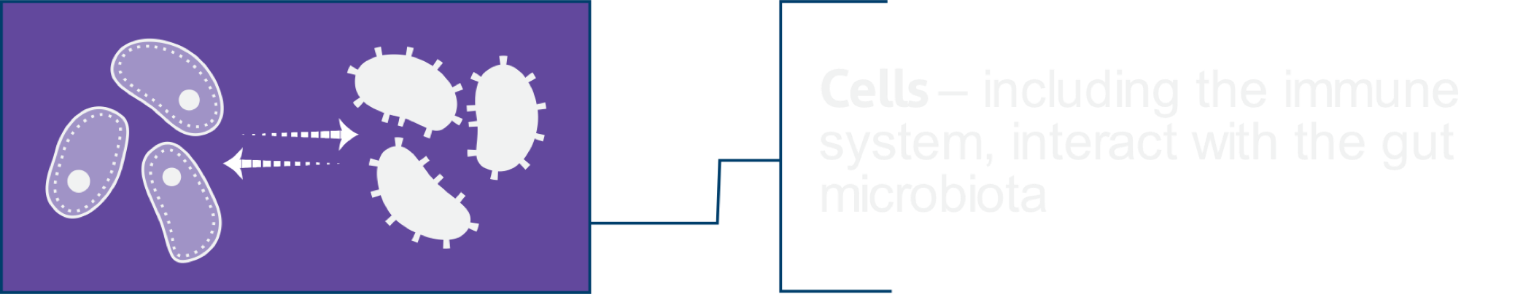
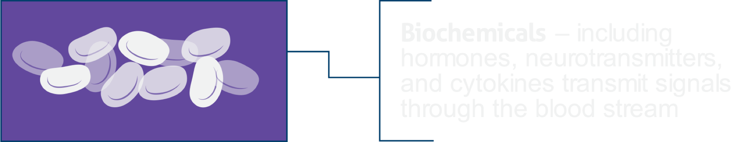
The “Axis” between the Gut and the Brain coordinates communications
THE MENTAL WELLNESS COMPANY

Slide 9

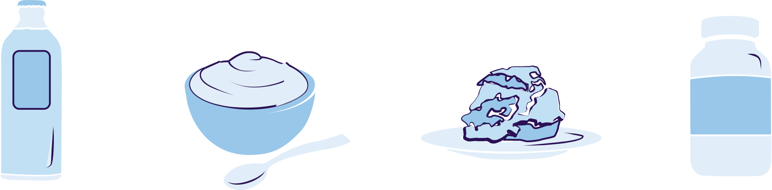

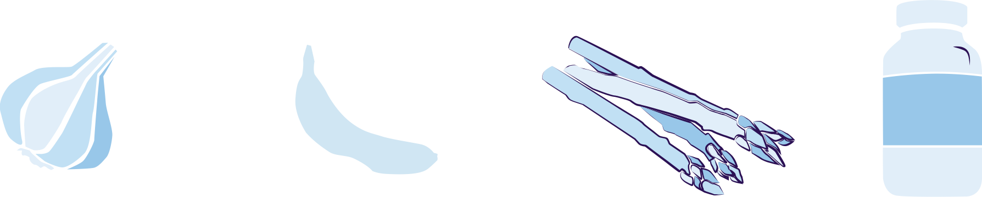

Balance
the GUT
with NUTRITION
PROBIOTICS
Probiotic foods contain live “good bacteria” which support mental wellness and aid digestion. Examples include fermented foods such as yogurt, kefir, kimchi, kombucha, sauerkraut, miso, tempeh, and probiotic supplements.
PREBIOTICS
Prebiotic foods contain fibers and carbohydrates that can be fermented and digested by gut bacteria to serve as a fuel source and encourage growth of beneficial bacteria. Examples include asparagus, bananas, green leafy vegetables, garlic, leeks, onions, chicory, ginger, and prebiotic supplements.
PHYTOBIOTICS
Phytobiotic foods are rich in flavonoids which protect good bacteria and establish a hospitable environment for the growth of good and displacement of bad bacteria.
Examples include apples, grapes, dark chocolate, and berries.
THE MENTAL WELLNESS COMPANY

Slide 10
INTRODUCING AMARE GLOBAL PRODUCTS

Slide 11



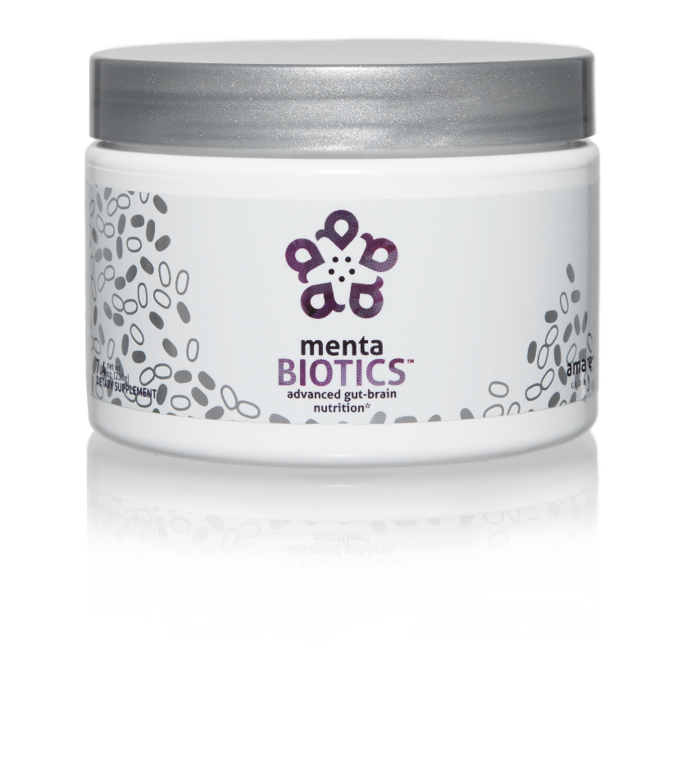
AMARE’S FLAGSHIP PRODUCT
SUPPORTS FEEL-GOOD NEUROTRANS-MITTERS
INCREASES GOOD BACTERIA
The most comprehensive combination of unique strains of probiotics, prebiotics, and phytobiotics that have been scientifically shown to improve mental wellness.*
Item Code: Retail Price: Wholesale Price: Subscribe & Save:
S001 $100.00 $74.95 / 65 PV $66.95 / 58 PV
*These statements have not been evaluated by the Food and Drug Administration. This product is not intended to diagnose, treat, cure, or prevent any disease.
Notes:
Shawn: Slide: MentaBiotics pg.22 --When we look at your MentaBiotics, that powder that we have as the flagship. You can consider this to be our gut product. It really is four products in one. It’s a blend of probiotics, prebiotics, phytobiotics and also digestive performance ingredients to get all of that gut axis together. It supports feel good neurotransmitters, and a big part of what it does is increases the ratio between good bacteria and bad bacteria.

Slide 12
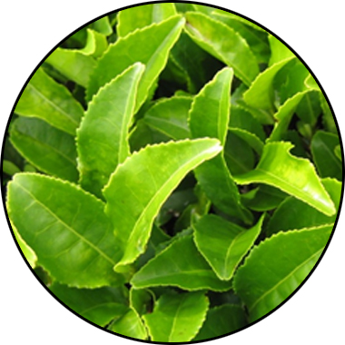
MENTABIOTICS KEY INGREDIENTS
™
Suntheanine
Increases Alpha Waves
“Relaxed alertness”
*These statements have not been evaluated by the Food and Drug Administration. This product is not intended to diagnose, treat, cure, or prevent any disease.
Notes:
Shawn: Slide: Key Ingredients: MentaBiotics pg.25 -- The way we formulated the products is to give you a graded response. Some benefits will come on early, some will come on medium, and some will come on later. So early stage benefits we can deliver through amino acids, such as Suntheanine. Suntheanine is naturally found in green tea leaves. This ingredient cant take your brain from a state of beta-waves that are associated with being tense and anxious or irritable, and shift you within a matter of 60—75 minutes into a state characterized by more alpha-waves. These alpha-waves are associated with a state of relaxed alertness, being in the zone, being more relaxed but not drowsy. Some of the other benefits that you are going to experience, those feelings of good mood, those feelings of less anxiety, that will be days to early weeks. Then the actual re-setting of the microbiome, depending on how out of balance you are, that might be more towards the end of the weeks. That way, we are able to give people early benefits they can feel quickly, and they don’t have to say , "I'm going to take this product for six months before I actually feel anything."
Sources
Nobre et al. L-theanine, a natural constituent in tea, and its effect on mental state Asia Pac J Clin Nutr 2008;17 (S1):167-168

Slide 13
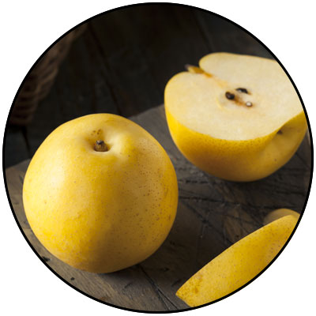
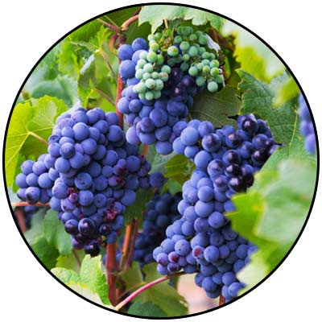
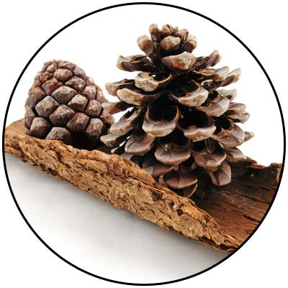
GBX+ proprietary blend… Patent Pending and Exclusive to Amare
Applephenon: Asian Apple Fruit extract Supports gut health, immune function, & inflammatory balance*
Enovita: French Grape Seed extract Enhances blood flow, cardiovascular tone, & cellular defenses*
Enzogenol: New Zealand Pine Bark extract Improves neurotransmitter balance, mental focus, & psychological vigor*
*These statements have not been evaluated by the Food and Drug Administration. This product is not intended to diagnose, treat, cure, or prevent any disease.
Notes:
Shawn: Slide: For Your Gut...: The Probiotic Strain Matters pg.26 -- Part of the reason why this product is so effective, is because we've looked at the research to guide our formulation. One of the very important ways that weve done that is the probiotic strains that we have chosen have already been specifically evaluated for their effects on different mental wellness parameters. This is very important distinction as you go out to talk to people about these products, that probiotics are hot right now, its one of the very important health trends that’s going on. But, the benefits of a probiotic are very very strain dependent. If I just said to you, "Everyone go out and buy some probiotics", and you went to the grocery store to look for probiotics, that would be like me saying, "Go out and get some vitamins." You wouldn’t know what vitamin I was talking about. Did he mean vitamin D or A? Or did he mean Vitamin C or B? All these vitamins do all different things inside the body, its exactly the same with these probiotic strains. So you can see the benefits here, Lactobacillus rhamnosus R0011, that tells us that specific strain does this, it lowers cortisol exposure which is a stress hormone. It increases a neurotransmitter called GABA which is associated with relaxing. Bifidobacterium longum R0175 reduces anxiety and improves cognitive function. Lactobacillus helveticus R0052 decreases neuroinflammation and increases serotonin, so its going to help you with your mood. You know, those benefits are specific to those strains, not to probiotics in general. In our separate probiotic formula, we have different strains that are more associated with more general wellness benefits, diarrhea, constipation, gastro intestinal function, immune system function, inflammation in a different way than your getting here with neural inflammation. In the future, we'll be selecting probiotic strains that are good for the heart-brain axis that is going to compound some of the benefits that we are seeing with this gut-brain axis. It’s a very very exciting area of science, but it’s also very strain-dependent.
There are over 10,000 different species of bacteria in our gut, but there are millions of strains comprising billions of bacteria overall. Amare’s strains of bacteria are unique and have specific functions around mental wellness.

Slide 14
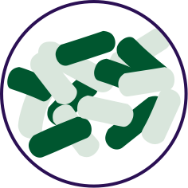


FOR YOUR GUT… THE PROBIOTIC STRAIN MATTERS
Lactobacillus rhamnosus R0011: Reduces stress by lowering cortisol exposure and improves GABA neurotransmission*
Bifidobacterium longum R0175: Enhances calmness by decreasing anxiety indices and improves cognitive function*
Lactobacillus helveticus R0052: Improves mood by decreasing neuro-inflammation and increasing serotonin*
*These statements have not been evaluated by the Food and Drug Administration. This product is not intended to diagnose, treat, cure, or prevent any disease.
Notes:
Shawn: Slide: For Your Gut...: The Probiotic Strain Matters pg.26 -- Part of the reason why this product is so effective, is because we've looked at the research to guide our formulation. One of the very important ways that weve done that is the probiotic strains that we have chosen have already been specifically evaluated for their effects on different mental wellness parameters. This is very important distinction as you go out to talk to people about these products, that probiotics are hot right now, its one of the very important health trends that’s going on. But, the benefits of a probiotic are very very strain dependent. If I just said to you, "Everyone go out and buy some probiotics", and you went to the grocery store to look for probiotics, that would be like me saying, "Go out and get some vitamins." You wouldn’t know what vitamin I was talking about. Did he mean vitamin D or A? Or did he mean Vitamin C or B? All these vitamins do all different things inside the body, its exactly the same with these probiotic strains. So you can see the benefits here, Lactobacillus rhamnosus R0011, that tells us that specific strain does this, it lowers cortisol exposure which is a stress hormone. It increases a neurotransmitter called GABA which is associated with relaxing. Bifidobacterium longum R0175 reduces anxiety and improves cognitive function. Lactobacillus helveticus R0052 decreases neuroinflammation and increases serotonin, so its going to help you with your mood. You know, those benefits are specific to those strains, not to probiotics in general. In our separate probiotic formula, we have different strains that are more associated with more general wellness benefits, diarrhea, constipation, gastro intestinal function, immune system function, inflammation in a different way than your getting here with neural inflammation. In the future, we'll be selecting probiotic strains that are good for the heart-brain axis that is going to compound some of the benefits that we are seeing with this gut-brain axis. It’s a very very exciting area of science, but it’s also very strain-dependent.
There are over 10,000 different species of bacteria in our gut, but there are millions of strains comprising billions of bacteria overall. Amare’s strains of bacteria are unique and have specific functions around mental wellness.

Slide 15

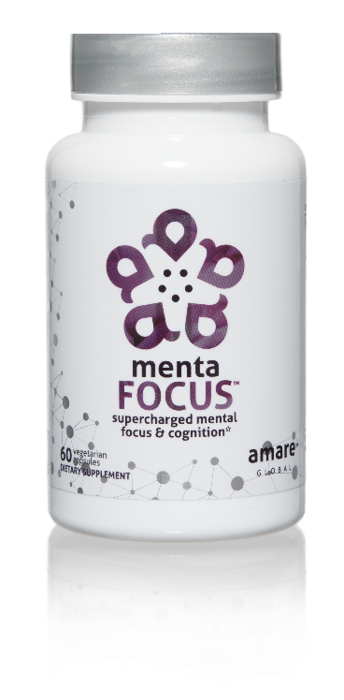
AMPLIFIES ATTENTION & ALERTNESS
ENHANCES BRAIN ACTIVATION
PROMOTES CLARITY COGNITION CREATIVITY
Supercharge your brain with key phytonutrients clinically shown to support focus, mental sharpness, clarity, creativity, and cognitive functioning.*
Item Code: Retail Price: Wholesale Price: Subscribe & Save:
S002 $60.00 $44.95 / 39 PV $39.95 / 35 PV
*These statements have not been evaluated by the Food and Drug Administration. This product is not intended to diagnose, treat, cure, or prevent any disease.
Notes:
Shawn: Slide: Menta Focus Pg.27 -- When we switch to our MentaFocus product, this is the product that we had to very rapidly re-formulate in order to get these sorts of benefits on mental sharpness, clarity, and cognitive functioning, but with no neuro-toxins instead of just a little bit of neuro-toxins. What we ended up getting is something that gives you all of those benefits, but also gives you this very nice overall activation of the brain.

Slide 16
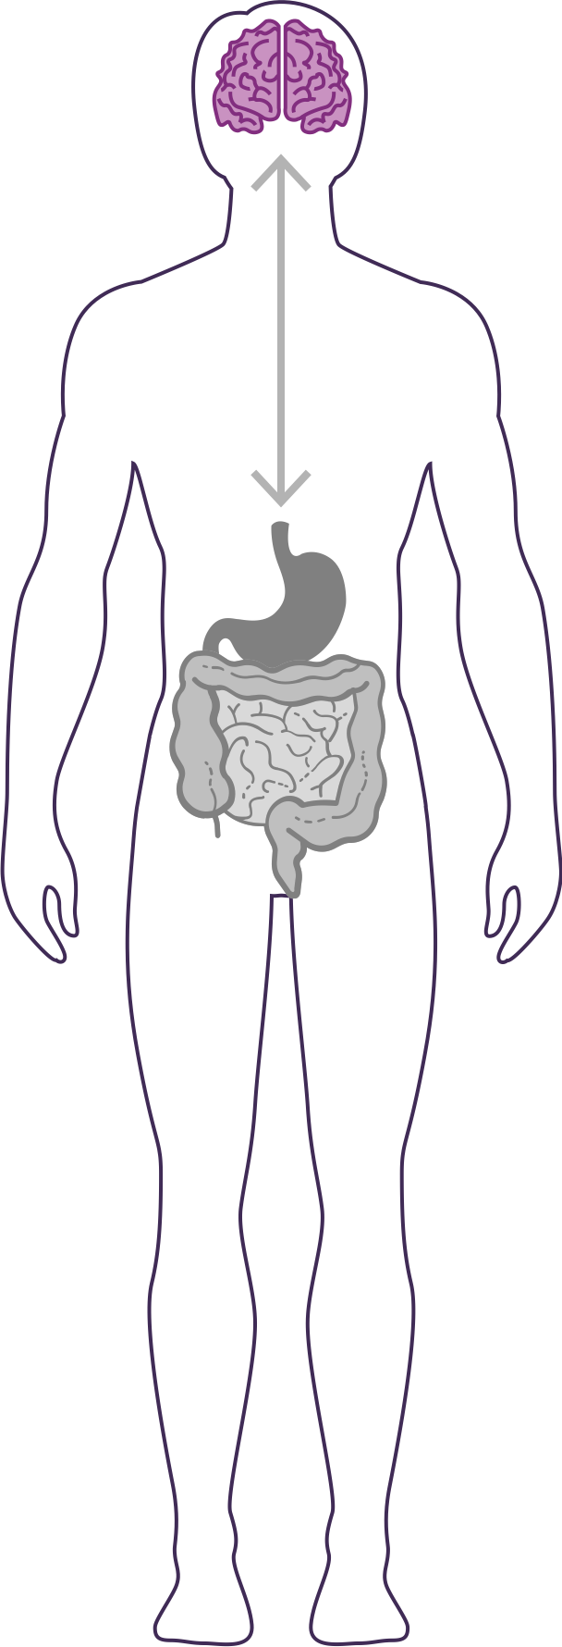



GUT – BRAIN - AXIS
The brain is an extremely complex & powerful system. Fuel it with the right nutrients for enhanced mental focus & cognitive function.
Restores “youthful” brain function*
Increases short-term and long-term memory by increasing visual and verbal recall by 28%*
Improves both working memory and recognition memory and reduces functional brain age by 12 years*
*These statements have not been evaluated by the Food and Drug Administration. This product is not intended to diagnose, treat, cure, or prevent any disease.
Notes:
Shawn: Slide: MentaFocus pg.29 -- As you are improving the function of this super-computer in your head, youre approving its ability to read the signals that are coming from the other parts of the body. Remember, that gut-brain axis is a bi-directional communication. So you can see things like, the second bullet down, increases short and long term memory by increasing visual and verbal recall. You can see the first one, where improving a youthful brain function, we are able to show actions through calculations where your brain de-aging in certain ways in the way that it is performing and by the way that it is recalling memory by a factor of about twelve years.
Broad-spectrum Memory & Brain Function Benefits
Increases short-term and long-term memory (+28% on visual and verbal recall)
Enhances overall brain activation (by fMRI – functional magnetic resonance imaging)
significantly higher brain blood flow
bilateral activation of the hippocampus (area of the brain involved in memory)
Improves both working memory and recognition memory
cognitive abilities that normally decline with aging
equivalent to ~12 years of recovered age-related loss in brain function
Sources:
Bookheimer et al. Pomegranate Juice Augments Memory and fMRI Activity in Middle-Aged and Older Adults with Mild Memory Complaints. Evidence-Based Complementary and Alternative Medicine Volume 2013, Article ID 946298
Ropacki et al. Pomegranate Supplementation Protects against Memory Dysfunction after Heart Surgery: A Pilot Study. Evidence-Based Complementary and Alternative Medicine Volume 2013, Article ID 932401
Theadom, A., Mahon, S., et al. (2012). Enzogenol®, for memory improvement in traumatic brain injury: a pilot placebo-controlled RCT. European Journal of Neurology (2012).
Pipingas et al. 2007, Journal of Clinical EEG & Neuroscience 16th Annual Conference of the Australasian Society for Psychophysiology (Dec 9-11, 2006)
Pipingas et al. 2008, Phytotherapy Research 22: 1168.
Letenneur et al. 2007, American Journal of Epidemiology 165: 1364.

Slide 17
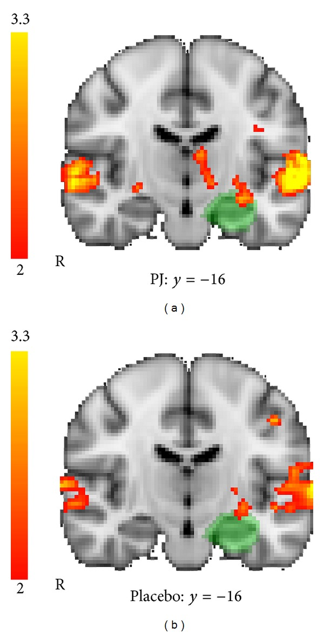
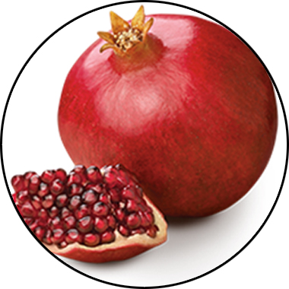
MENTAFOCUS KEY INGREDIENTS
™
POMx
Enhances Brain Activation
*These statements have not been evaluated by the Food and Drug Administration. This product is not intended to diagnose, treat, cure, or prevent any disease.
Notes:
Shawn: Slide: Key Ingredients: MentaFocus pg.30 -- When we look at brain scans conducted on one of the prime ingredients in here, pomegranate extract, you can see things like this bottom one, this is a placebo situation where you can see the brain is always a little bit active right, so the color areas are showing where the brain activity is, what's firing, where the neuroactivity is, where the blood flow is. The one on the top, is after supplementing with the pomegranate extract, and what you can see is, the brain is lighting up showing greater activity, greater blood flow, in the areas that we have that are both associated with memory and with stress resilience. So you're getting an effect here that its MentaFocus but its so much more than that, its really the overall activation of the entire brain.
Sources:
Bookheimer et al. Pomegranate Juice Augments Memory and fMRI Activity in Middle-Aged and Older Adults with Mild Memory Complaints. Evidence-Based Complementary and Alternative Medicine Volume 2013, Article ID 946298

Slide 18
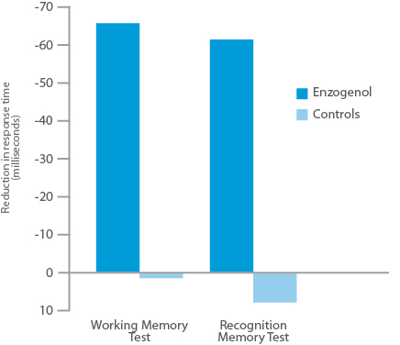
MENTAFOCUS KEY INGREDIENTS
™
Enzogenol
Improves Memory
*These statements have not been evaluated by the Food and Drug Administration. This product is not intended to diagnose, treat, cure, or prevent any disease.
Notes:
Shawn: Slide: Key Ingredients: MentaFocus pg.31 -- Another one of the key ingredients is a very unique pine bark extract, called Enzogenol. This is where we have these significant changes in memory. The speed of your brain being able to access and recall those memories.
Sources:
Pipingas et al. 2007, Journal of Clinical EEG & Neuroscience 16th Annual Conference of the Australasian Society for Psychophysiology (Dec 9-11, 2006)

Slide 19
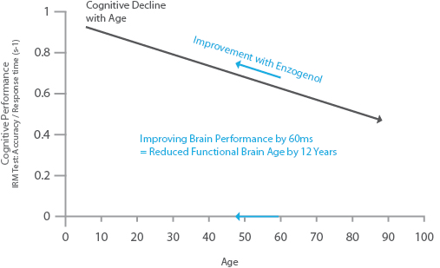
MENTAFOCUS KEY INGREDIENTS
™
Enzogenol
Restores “Youthful” Brain Function
*These statements have not been evaluated by the Food and Drug Administration. This product is not intended to diagnose, treat, cure, or prevent any disease.
Notes:
Shawn: Slide: Key Ingredients: MentaFocus pg.32 -- That’s the main parameter for us being able to show as our brains age, there is a cognitive decline every single year as we age. We are able to sort of push that back by improving the performance of the brain by a factor of about the equivalent of twelve years.
Sources:
Letenneur et al. 2007, American Journal of Epidemiology 165: 1364.

Slide 20
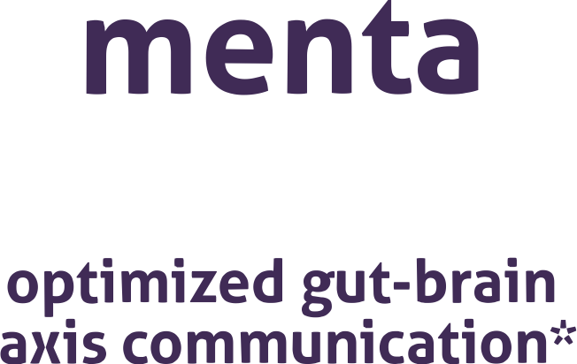

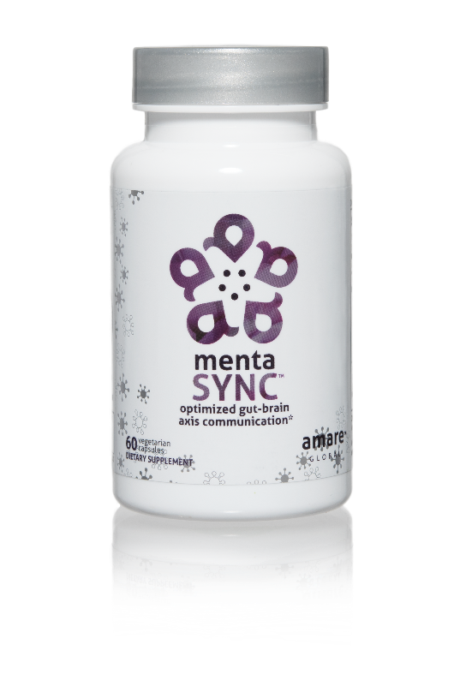
IMPROVES GUT-BRAIN COMMUNICATION
BALANCES SIGNALING BETWEEN CELLS
ENHANCES BIO-CHEMICAL COMMUNICATION
Optimize the communication sync of chemical messengers between your brain and your gut with the clinically studied key ingredients in MentaSync.*
Item Code: Retail Price: Wholesale Price: Subscribe & Save:
S003 $74.00 $54.95 / 47 PV $48.95 / 42 PV
*These statements have not been evaluated by the Food and Drug Administration. This product is not intended to diagnose, treat, cure, or prevent any disease.
Notes:
Shawn: Slide: MentaSync pg.33 -- [Video Time – 29:01]

Slide 21
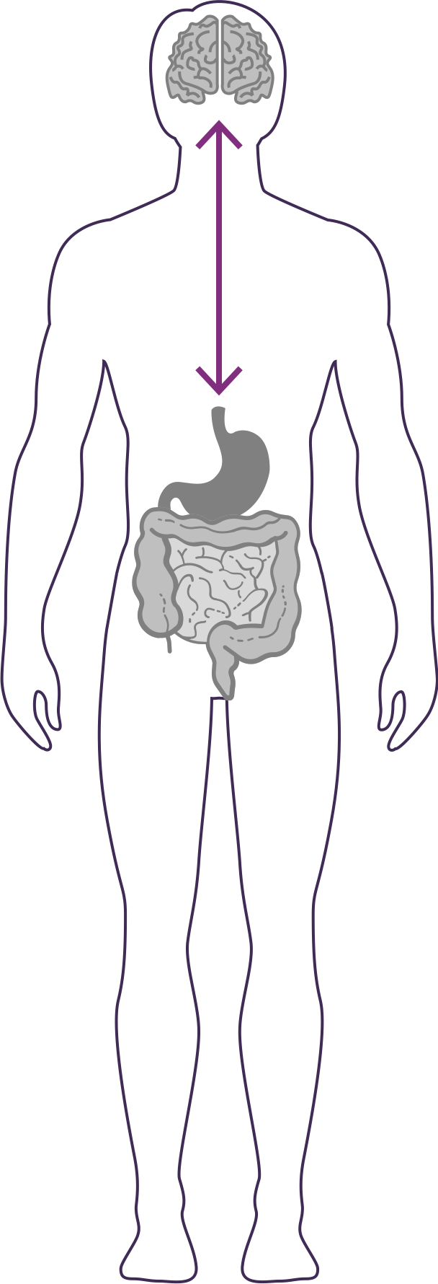


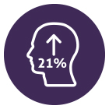
GUT – BRAIN - AXIS
The gut & brain are connected by a link known as the “axis”, which is an important component of the gut-brain axis system. It is the primary connection between our two brains and is greatly responsible for our overall well-being.
Balances normal signaling between cells of the gut, brain, and immune system.*
Enhances GBX (gut-brain axis) signaling and gut barrier function via alpha-glucans, beta-glucans, SCFAs (butyrate) and zinc-carnosine*
Increases psychological vigor by 21%*
*These statements have not been evaluated by the Food and Drug Administration. This product is not intended to diagnose, treat, cure, or prevent any disease.
Notes:
Optimizes the communication of the gut-brain axis
Balances normal signaling between cells of the gut, brain, and immune system
Improves psychological vigor (physical energy, mental acuity, and emotional wellbeing)
Improves overall well-being (+9% Global Mood State; 99 v 108)
Improves physical energy, mental acuity, and emotional well-being = psychological Vigor (+21%; 19.9 v 15.8)
Enhances GBX signaling & gut barrier function via alpha-glucans, beta-glucans, SCFAs (butyrate), and zinc-carnosine
Sources:
Carpenter et al. Baker’s Yeast ß-glucan Supplementation Increases Monocytes and Cytokines Post-Exercise: Implications for Infection Risk? British Journal of Nutrition. May 2012 10:1-9.
Fuller et al. Influence of yeast-derived 1,3/1,6 glucopolysaccharide on circulating cytokines and chemokines with respect to upper respiratory tract infections. Nutrition 28: 2012 665–669.
Talbott et al. ß-Glucan supplementation, allergy symptoms, and quality of life in self-described ragweed allergy suffer- ers. Food Science & Nutrition, 2012 10:1-12.
Talbott et al. Baker’s Yeast Beta-Glucan Supplement Reduces Upper Respiratory Symptoms and Improves Mood State in Stressed Women. Journal of the American College of Nutrition, August 2012, vol 31, no. 4, 295- 300.
Talbott et al. Beta 1,3/1,6 Glucan Decreases Upper Respiratory Tract Infection Symptoms and Improves Psychological Well-being in Moderate to Highly-Stressed Subjects. Agro Food Industry Hi-Tech. 2010 21:21-24.
Harger-Domitrovich et al. Effects of an immunomodulating supplement on upper respiratory tract infection symptoms in wildland firefighters. Medicine & Science in Sports & Exercise. 2008 40(5):S353.
Feldman et al. Randomized Phase II Clinical Trials of Wellmune WGP® for Immune Support During Cold and Flu Season. The Journal of Applied Research. 2009 9:20-42.
Talbott et al. Effect of Beta 1, 3/1, 6 Glucan on Upper Respira- tory Tract Infection Symptoms and Mood State in Marathon Athletes. Journal of Sports Science and Medicine. 2009 8:509-515.
Chan GC–F, Chan WK, Sze D M-Y. J Hemat Oncol. 2009;2:25.
Lull C. et al. Mediators of Inflammation. 2005(2):63-80.
Guggenheim A, Wright K and Zwickey H. Integrative Medicine. 2014;13(1):32-44
Vetvicka et al. Glucan supplementation enhances the immune response against an influenza challenge in mice. Ann Transl Med 2015;3(2):22
Vetvicka et al. Immune-enhancing effects of Maitake (Grifola frondosa) and Shiitake (Lentinula edodes) extracts. Ann Transl Med 2014;2(2):14

Slide 22
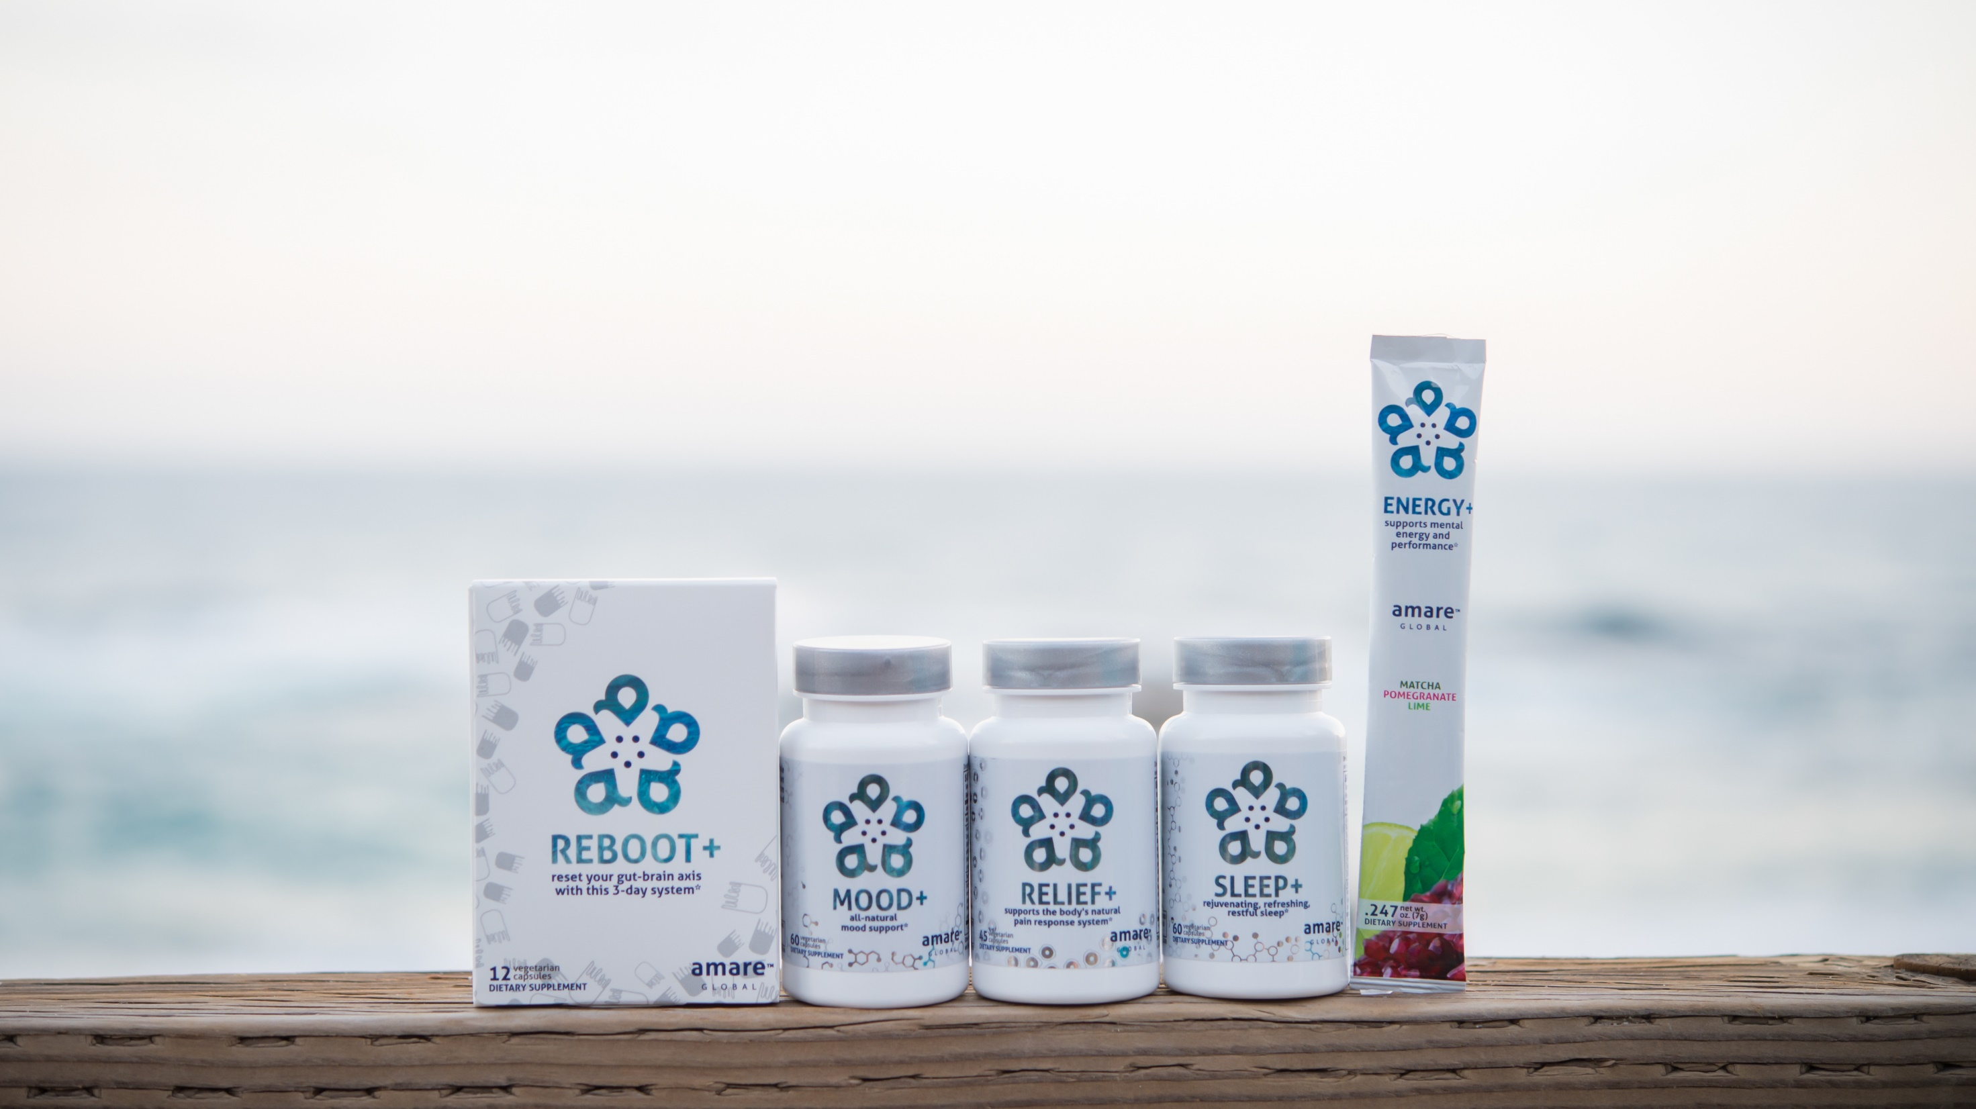

All-Natural Support Solutions for Energy, Mood, Pain, and Sleep*
MENTATHERAPEUTICS
™
*These statements have not been evaluated by the Food and Drug Administration. This product is not intended to diagnose, treat, cure, or prevent any disease.

Slide 23


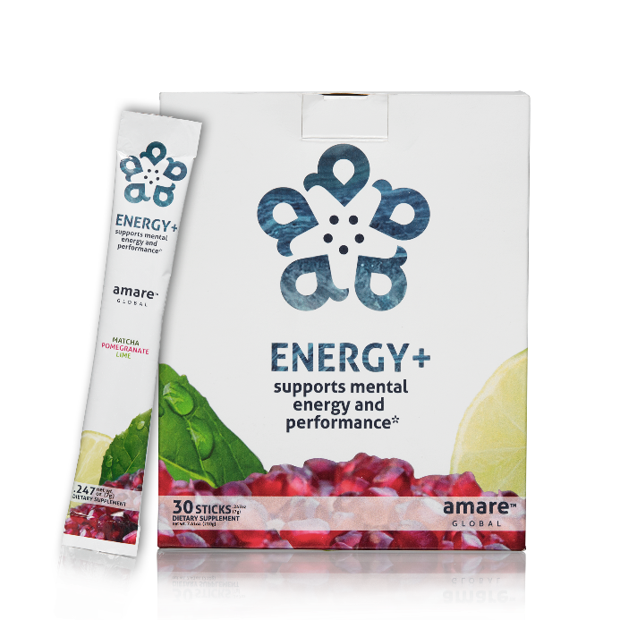
LONG-LASTING STAMINA
ALL-NATURAL NO SYNTHETICS
MENTAL
ENERGY
supports mental energy and performance*
A next-generation mental energy product that delivers rapid improvements in brain and physical performance, without the jitters or crash you might get from many high-stimulant or high-sugar energy drinks.*
Item Code: Retail Price: Wholesale Price: Subscribe & Save:
S005 $60.00 $44.95 / 36 PV $39.95 / 32 PV
*These statements have not been evaluated by the Food and Drug Administration. This product is not intended to diagnose, treat, cure, or prevent any disease.

Slide 24



supports mental energy and performance*
Rapid improvements in mental energy, acuity, and alertness*
Increases energy levels and endurance*
Provides energy without the jitters or crash from other high-stimulant or high-sugar energy drinks*
*These statements have not been evaluated by the Food and Drug Administration. This product is not intended to diagnose, treat, cure, or prevent any disease.

Slide 25
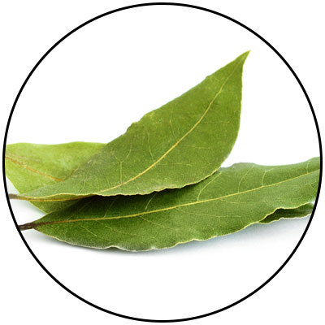
ENERGY+ KEY INGREDIENTS
Guayusa
Amazonian Awareness Enhancer
*These statements have not been evaluated by the Food and Drug Administration. This product is not intended to diagnose, treat, cure, or prevent any disease.
Notes:
Amazonian Hunters call guayusa the “Night Watchman” because it sharpens their awareness and gives them energy when heading into the jungle at night to hunt. Guayusa's effect is usually experienced as a bright and focused energy thanks to healthy synergistic compounds that help balance the naturally occurring caffeine.

Slide 26
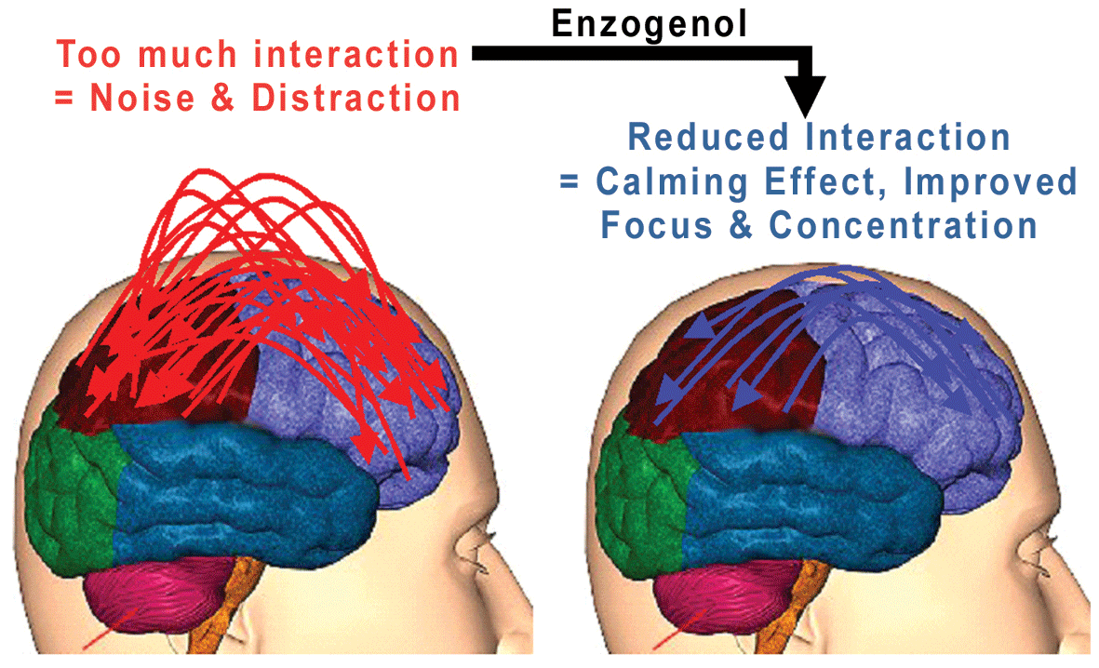
ENERGY+ KEY INGREDIENTS
Enzogenol
Calms “monkey mind”
*These statements have not been evaluated by the Food and Drug Administration. This product is not intended to diagnose, treat, cure, or prevent any disease.
Notes:
Image from the Enzogenol website

Slide 27
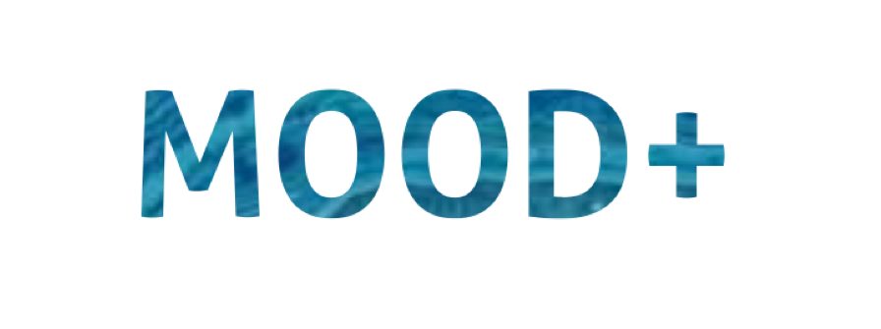
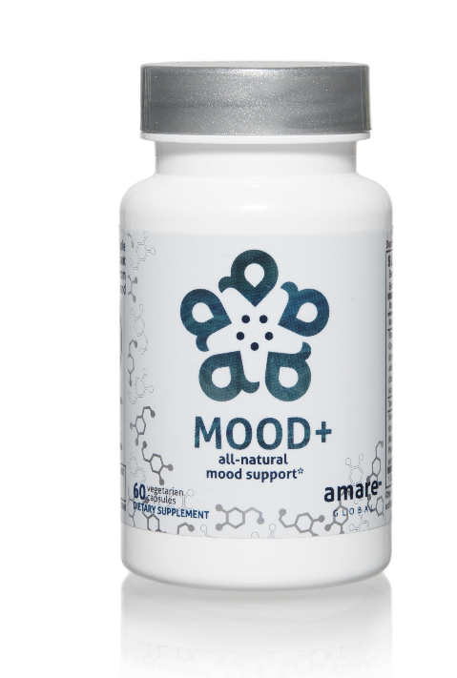
MOOD ELEVATING
PROMOTES RELAXATION
TENSION REDUCING
all-natural mood support*
The key ingredients in Mood+ have multiple scientific studies that show significant benefits for mood support such as relief from anxious feelings, sadness, restlessness, and overall stress relief.*
Item Code: Retail Price: Wholesale Price: Subscribe & Save:
S006 $80.00 $59.95 / 52 PV $53.95 / 46 PV
*These statements have not been evaluated by the Food and Drug Administration. This product is not intended to diagnose, treat, cure, or prevent any disease.

Slide 28
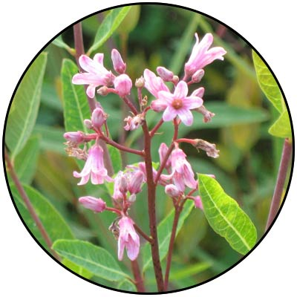
MOOD+ KEY INGREDIENTS
Venetron, Rafuma
Depression
*These statements have not been evaluated by the Food and Drug Administration. This product is not intended to diagnose, treat, cure, or prevent any disease.
Notes:
47% reduction in Overall Depression Scores
Venetron® brochure, Tokiwa Phytochemical Co., Ltd.,
KGK Synergize Inc. Effect of VENETRON on Symptoms of Depression in Individuals with Mild Depression
Yang, J. et al. 2009. Safety study of Apocynum venetum extract in healthy adults. Journal of Nutritional Food, no. 12:1–9.

Slide 29
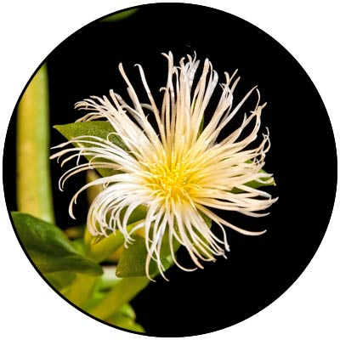
MOOD+ KEY INGREDIENTS
Zembrin, Kanna
Depression
*These statements have not been evaluated by the Food and Drug Administration. This product is not intended to diagnose, treat, cure, or prevent any disease.
Notes:
From the Zembrin product brochure – PLT Health

Slide 30
fMRI Study Results Show Reduced Stress Response
MOOD+ KEY INGREDIENTS
ZEMBRIN MAY HELP IN THE MANAGEMENT OF STRESS IN EVERYDAY LIFE
A single dose of Zembrin attenuates reactivity within the part of the brain (amygdala) that responds to threat/stress
®
®
*These statements have not been evaluated by the Food and Drug Administration. This product is not intended to diagnose, treat, cure, or prevent any disease.
Notes:
Terburg et al. Acute Effects of Sceletium tortuosum (Zembrin), a Dual 5-HT Reuptake and PDE4 Inhibitor, in the Human Amygdala and its Connection to the Hypothalamus. Neuropsychopharmacology (2013), 1–9.

Slide 31
Cognitive Set Flexibility
MOOD+ KEY INGREDIENTS
COGNITIVE FLEXIBILITY
Ability to shift attention between two or more tasks and the ability to adapt to rapidly changing directions and intelligently utilize the information.
Necessary for decision-making, impulse control and strategy formation.
CNS VitalSign has been used for testing neurocognitive function by over 5000 clinicians in 52 countries
®
*These statements have not been evaluated by the Food and Drug Administration. This product is not intended to diagnose, treat, cure, or prevent any disease.
Notes:
Chiu et al. Proof-of-Concept Randomized Controlled Study of Cognition Effects of the Proprietary Extract Sceletium tortuosum (Zembrin) Targeting Phosphodiesterase-4 in Cognitively Healthy Subjects: Implications for Alzheimer’s Dementia. Evidence-Based Complementary and Alternative Medicine Volume 2014, Article ID 682014

Slide 32
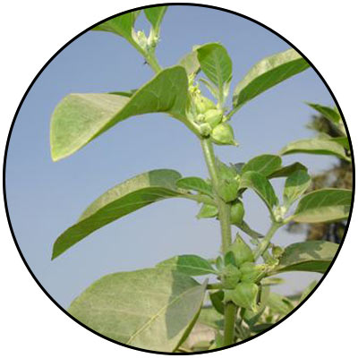
MOOD+ KEY INGREDIENTS
Sensoril, Ashwagandha
Anxiety
*These statements have not been evaluated by the Food and Drug Administration. This product is not intended to diagnose, treat, cure, or prevent any disease.
Notes:
Auddy et al. A Standardized Withania Somnifera Extract Significantly Reduces Stress-Related Parameters in Chronically Stressed Humans: A Double-Blind, Randomized, Placebo-Controlled Study. Journal of the American Nutraceutical Association Vol.11,No.1, 2008 pp50-56.

Slide 33
MOOD+ KEY INGREDIENTS
Sensoril, Ashwagandha
Anxiety
*These statements have not been evaluated by the Food and Drug Administration. This product is not intended to diagnose, treat, cure, or prevent any disease.
Notes:
Auddy et al. A Standardized Withania Somnifera Extract Significantly Reduces Stress-Related Parameters in Chronically Stressed Humans: A Double-Blind, Randomized, Placebo-Controlled Study. Journal of the American Nutraceutical Association Vol.11,No.1, 2008 pp50-56.

Slide 34
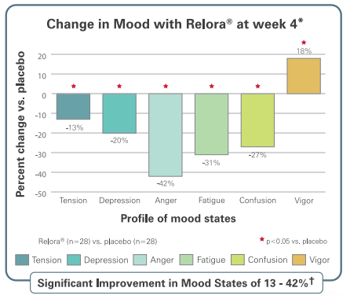
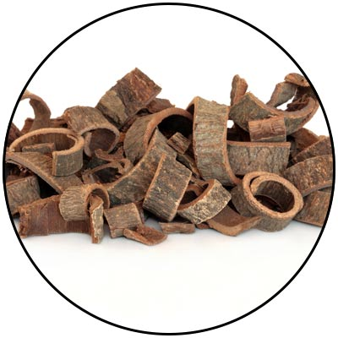
MOOD+ KEY INGREDIENTS
Relora, Magnolia & Phellondendron
Anxiety
*These statements have not been evaluated by the Food and Drug Administration. This product is not intended to diagnose, treat, cure, or prevent any disease.
Notes:
Talbott et al. Effect of Magnolia officinalis and Phellodendron amurense (Relora®) on cortisol and psychological mood state in moderately stressed subjects. Journal of the International Society of Sports Nutrition 2013, 10:37
Garrison et al. Effect of a proprietary Magnolia and Phellodendron extract on weight management: a pilot, double-blind, placebo-controlled clinical trial. Altern Ther Health Med. 2006;12(1):50-54.
Kalman et al. Effect of a proprietary Magnolia and Phellodendron extract on stress levels in healthy women: a pilot, double-blind, placebo-controlled clinical trial. Nutrition Journal 2008, 7:11

Slide 35

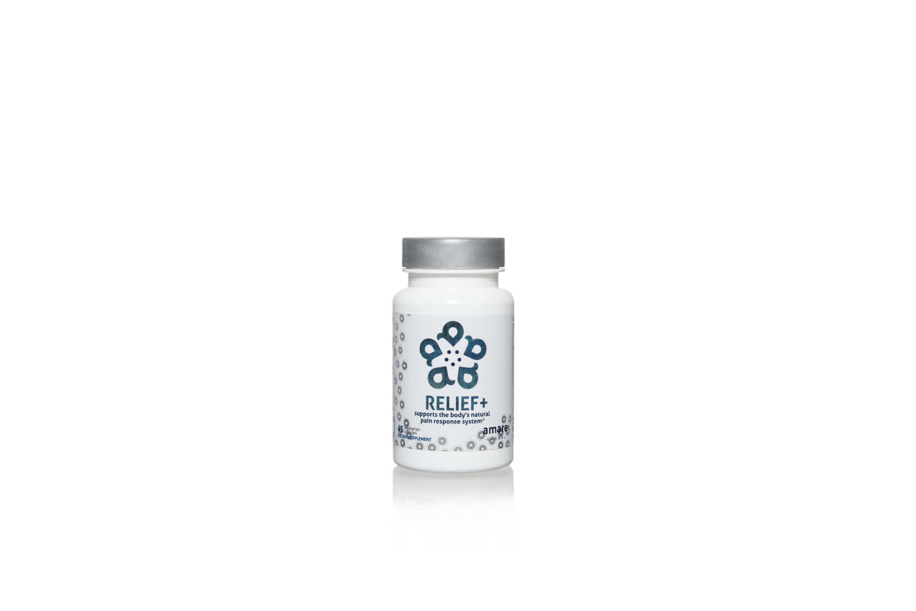
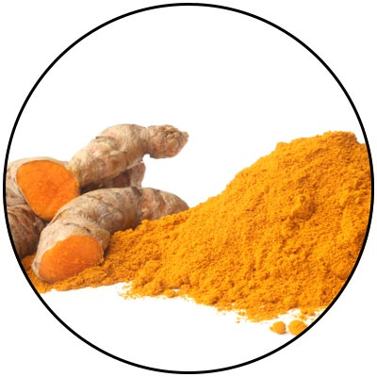
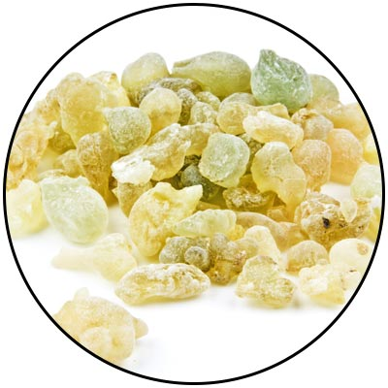
SOOTHE MINOR ACHES & DISCOMFORT
FAST-ACTING
LONG-LASTING
supports the body’s natural pain response system*
The key ingredients in Relief+ have been scientifically shown to balance normal inflammatory function and support antioxidant levels to provide fast-acting & long-lasting relief from occasional aches and pains.*
Item Code: Retail Price: Wholesale Price: Subscribe & Save:
S007 $74.00 $54.95 / 47 PV $48.95 / 42 PV
*These statements have not been evaluated by the Food and Drug Administration. This product is not intended to diagnose, treat, cure, or prevent any disease.

Slide 36



supports the body’s natural pain response system*
74% Decrease in osteomuscular pain*
53% Reduction in inflammation*
31% Decrease in cartilage damage*
Fast-acting relief*
Long-lasting relief*
Phytostome Technology: Superior absorption
Phytostome Technology: Enhanced metabolism
*These statements have not been evaluated by the Food and Drug Administration. This product is not intended to diagnose, treat, cure, or prevent any disease.
Notes:
Marczylo, T.H., et al., Comparison of systemic availability of curcumin with that of curcumin formulated with phosphatidylcholine. Cancer Chemother Pharmacol, 2007. 60(2): p. 171-7.
Cuomo, J., et al., Comparative absorption of a standardized curcuminoid mixture and its lecithin formulation. J Nat Prod, 2011. 74(4): p. 664-9.
Di Pierro, F. et al. Comparative evaluation of the pain-relieving properties of a lecithinized formulation of curcumin (Meriva®), nimesulide, and acetaminophen. J. Pain Res. 2013, 6, 201-205.
Drobnic, F., et al., Reduction of delayed onset muscle soreness by a novel curcumin delivery system (Meriva®): a randomised, placebo-controlled trial. J Int Soc Sports Nutr, 2014. 11: p. 31.
Sciberras, J.N., et al., The effect of turmeric (Curcumin) supplementation on cytokine and inflammatory marker responses following 2 hours of endurance cycling. J Int Soc Sports Nutr, 2015. 12(1): p. 5.
Franceschi et al. A novel lecithin based delivery form of Boswellic acids (Casperome®) for the management of osteo-muscular pain: a registry study in young rugby players. European Review for Medical and Pharmacological Sciences 2016; 20: 4156-4161.

Slide 37
RELIEF+ KEY INGREDIENTS
Meriva
As effective as Tylenol
*These statements have not been evaluated by the Food and Drug Administration. This product is not intended to diagnose, treat, cure, or prevent any disease.
Notes:
Di Pierro, F. et al. Comparative evaluation of the pain-relieving properties of a lecithinized formulation of curcumin (Meriva®), nimesulide, and acetaminophen. J. Pain Res. 2013, 6, 201-205.

Slide 38
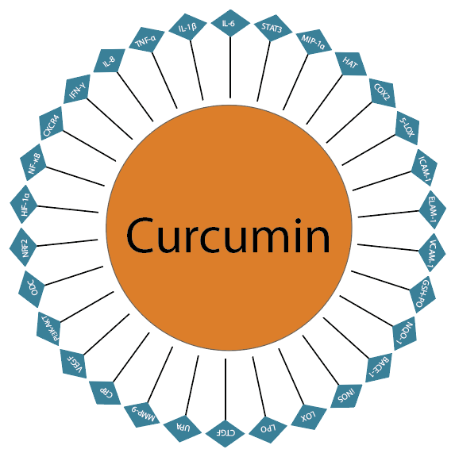
RELIEF+ KEY INGREDIENTS
Turmeric
Fast-acting inflammatory balance
*These statements have not been evaluated by the Food and Drug Administration. This product is not intended to diagnose, treat, cure, or prevent any disease.
Notes:
-shows effects of curcumin (Meriva/turmeric) on wide range of inflammatory enzymes

Slide 39
RELIEF+ KEY INGREDIENTS
TRANSCRIPTION FACTORS
NF-kb STAT-3 PPAR-γ C/EBP-α
↓
↓
↓
↓
ENZYMES COX-2 MMP-9 5-LO Caspase topoisomerase I topoisomerase II HLE
KINASES Akt ERK1/2 p38 MAPK IKKa/b CDK-2 CDK-4
↓
↓
↑↓
↓
↓
↓
↓
↓
↓
↓
↓
Boswellia
Long-lasting inflammatory balance
Molecular Targets of Boswellic Acids
RECEPTORS AR DR-4 DR-5 CXCR4 PDGFR
OTHERS
Cyclin D Cyclin E p21 P53 Rb Bcl-2 Bcl-xL Mcl-1 IAP-1 survivin
↓
↓
↓
↓
↓
↓
↓
↓
↓
↑↑
↓
↓
GROWTH FACTORS VEGF PDGF TF
↓
↓
↓
↓: Downregulation or Inhibition
↑: Upregulation or Activation
*These statements have not been evaluated by the Food and Drug Administration. This product is not intended to diagnose, treat, cure, or prevent any disease.
Notes:
-shows effects of boswellic acids (Casperome/boswellia) on wide range of different inflammatory enzymes)

Slide 40
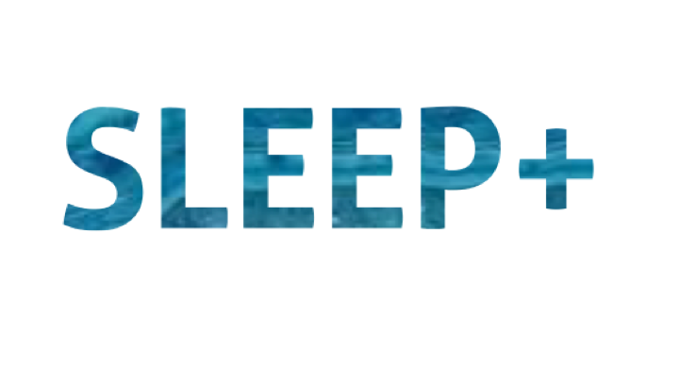
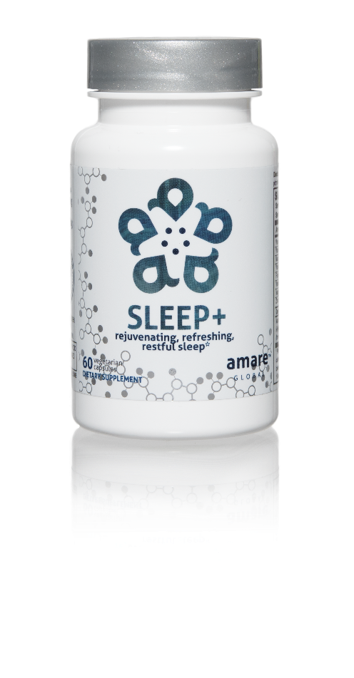

FALL ASLEEP FASTER
STAY ASLEEP LONGER
IMPROVES SLEEP QUALITY
rejuvenating, refreshing, restful sleep*
The key ingredients in Sleep+ have multiple scientific studies that show significant benefits including helping you to fall asleep faster, stay asleep longer, and experience higher quality plus more rejuvenating sleep.*
Item Code: Retail Price: Wholesale Price: Subscribe & Save:
S008 $80.00 $59.95 / 52 PV $53.95 / 46 PV
*These statements have not been evaluated by the Food and Drug Administration. This product is not intended to diagnose, treat, cure, or prevent any disease.

Slide 41
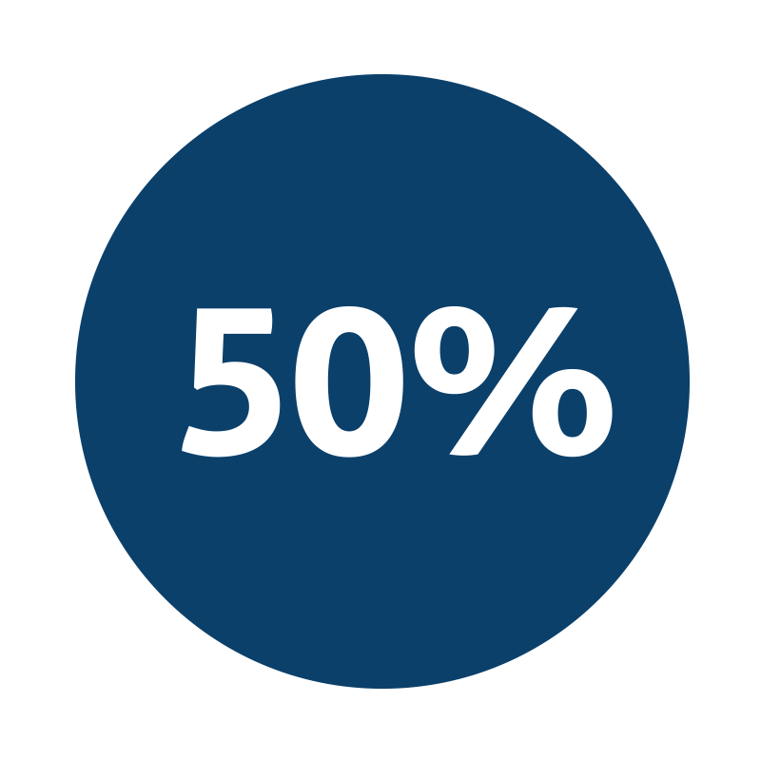
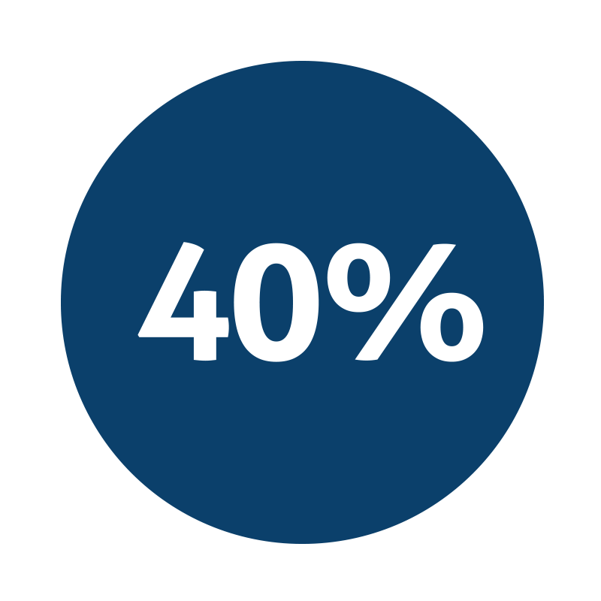

rejuvenating, refreshing, restful sleep*
Improvement in sleep efficiency*
Improvement in sleep quality*
Fall asleep faster by 33% and wake up fewer times each night by 30%*
*These statements have not been evaluated by the Food and Drug Administration. This product is not intended to diagnose, treat, cure, or prevent any disease.
Notes:
Talbott and Talbott: Effect of Monocot Grass Extract (MGE) on mood state and sleep patterns in moderately stress subjects. Journal of the International Society of Sports Nutrition 2013 10(Suppl 1):P26.

Slide 42


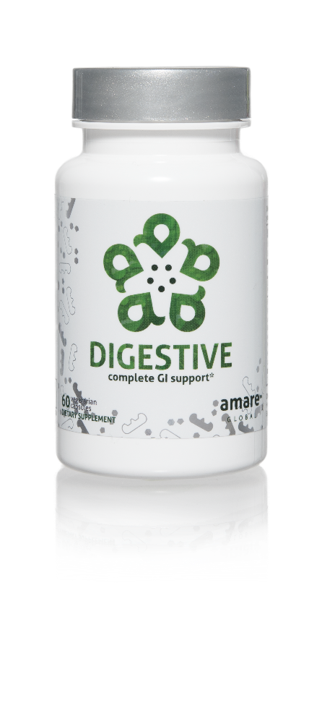
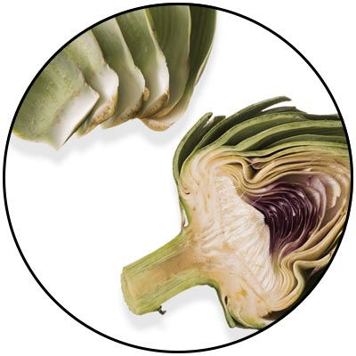
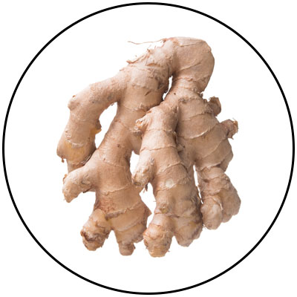
ACTIVATES HEALTHY DIGESTION
REDUCES BLOATING & GAS
SUPPORTS ALL PARTS OF THE GI SYSTEM
complete GI support*
A comprehensive blend of digestive enzymes to support the process of digestion in the upper, middle, and lower gastrointestinal system.*
Item Code: Retail Price: Wholesale Price: Subscribe & Save:
S009 $40.00 $29.95 / 24 PV $26.95 / 22 PV
*These statements have not been evaluated by the Food and Drug Administration. This product is not intended to diagnose, treat, cure, or prevent any disease.

Slide 43

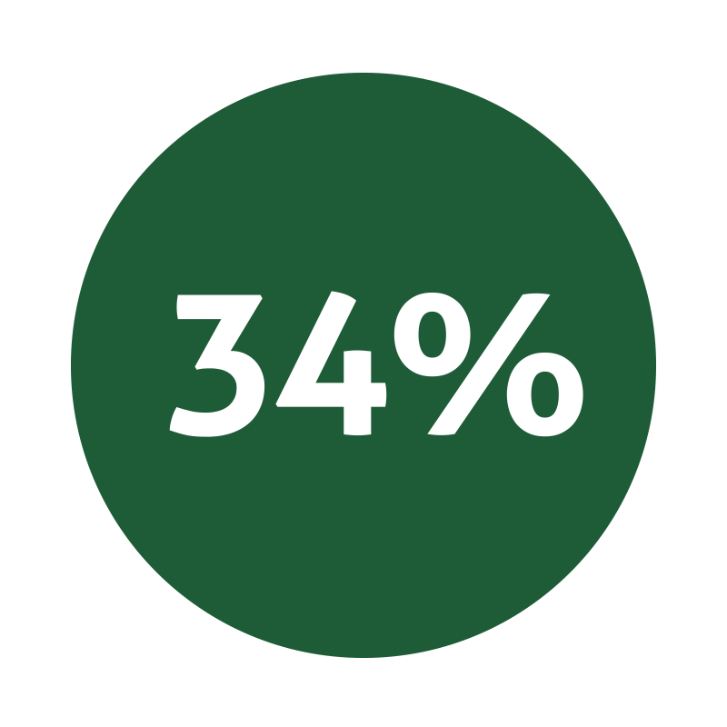
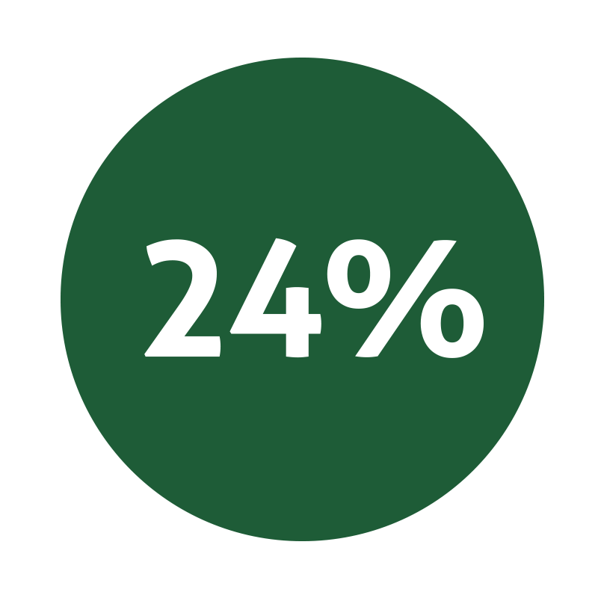
complete GI support*
Speeds conversion of food nutrients to cellular energy*
Reduction in overall digestive complaints*
Improvement in GI function*
*These statements have not been evaluated by the Food and Drug Administration. This product is not intended to diagnose, treat, cure, or prevent any disease.
Notes:
Giacosa et al. The Effect of Ginger (Zingiber officinalis) and Artichoke (Cynara cardunculus) Extract Supplementation on Functional Dyspepsia: A Randomised, Double-Blind, and Placebo-Controlled Clinical Trial. Evidence-Based Complementary and Alternative Medicine Volume 2015, Article ID 915087
Lazzini et al. The effect of ginger (Zingiber officinalis) and artichoke (Cynara cardunculus) extract supplementation on gastric motility: a pilot randomized study in healthy volunteers. European Review for Medical and Pharmacological Sciences 2016; 20: 146-149

Slide 44
THE THREE THINGS YOU SHOULD KNOW ABOUT MENTAL WELLNESS
How you feel is not just in your head – it’s also in your gut.
Our “second brain” includes the Microbiome and plays a major role in mental wellness.
You can now DO something NATURALLY to improve your mental wellness.
WHERE ARE YOU ON THE MENTAL WELLNESS CONTINUUM? (Circle your current number)
1
2
3
4
5
6
7
8
9
10
DISEASE STATUS
“NORMAL”
OPTIMIZED
Depression
Anxiety
Diabetes
Obesity
Heart Disease
Autoimmune
Arthritis
Fibromyalgia
CFS
Dementia
ADD / ADHD
Alzheimer’s
Fatigue
Tension
Sad
Brain Fog
Headaches
Acne
Eczema
Congestion
URTI’s
Joint Pain
Muscle Pain
Bloated
Chubby
Energetic
Calmness
Happy
Sharp
Creative
Clear Skin
Rarely Sick
Flexible
Lean
Strong
Resilient
RED
ORANGE
YELLOW
GREEN
BLUE
INDIGO
VIOLET

