Slide 1
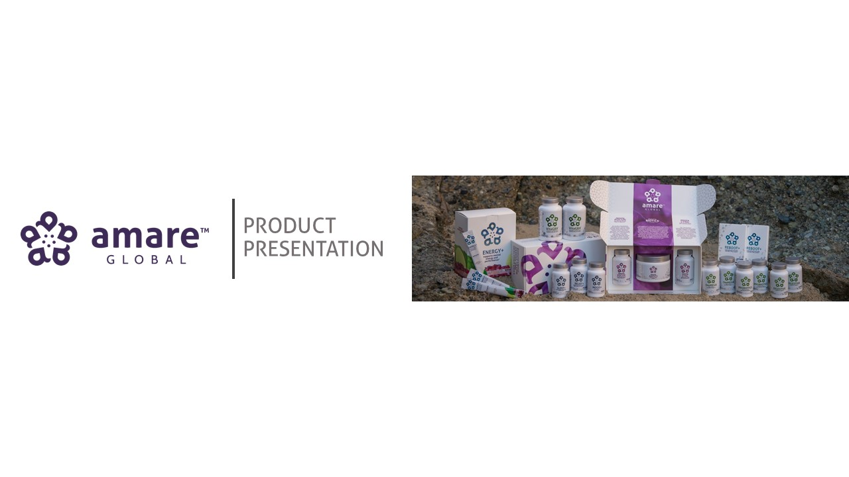

Slide 2


Slide 3


Slide 4


Slide 5


Slide 6
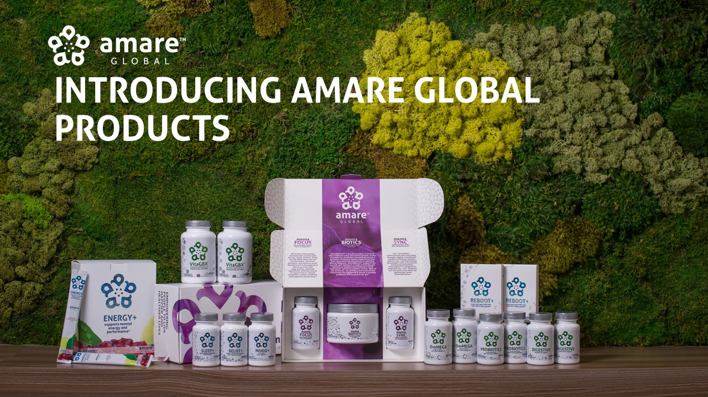

Slide 9
Maintain Brain Mass (Shrinkage)
Stimulates BDNF Production
Improved Signal Transduction
Improved Memory/Focus/Attention
Improved Mood

Slide 10
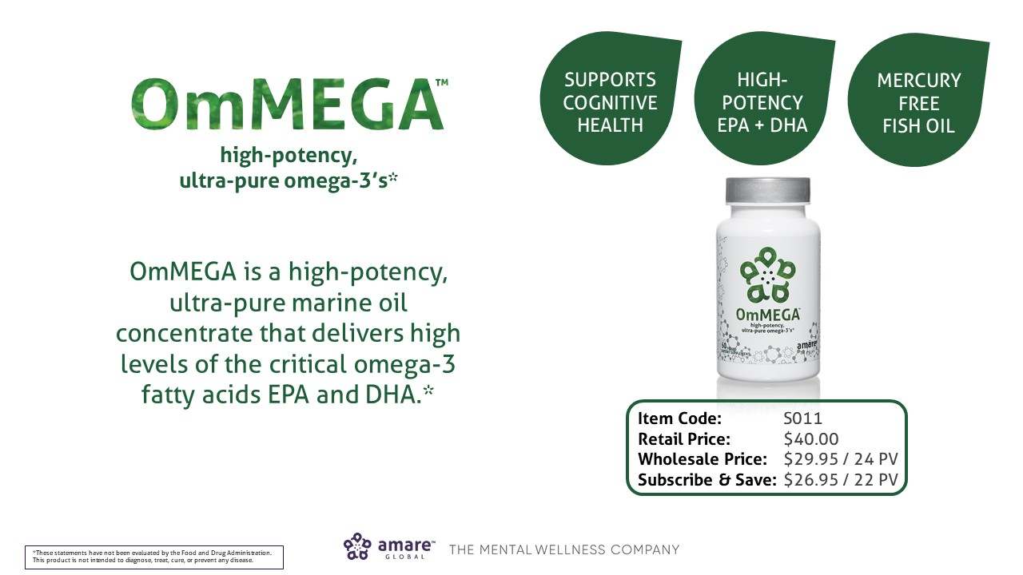

Slide 11
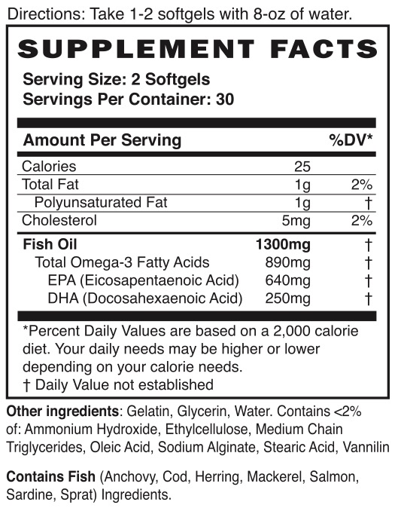
Alaska, Chile, Iceland, Norway
Peroxides
<5 meq/kg / <10 meq/kg
Totox <26
Anisidine <20
*Global Organization for EPA and DHA Omega-3s (GOED)
Heavy metals
<0.1ppm arsenic, cadmium, iron, lead, mercury
<10ppm maximum

Slide 12
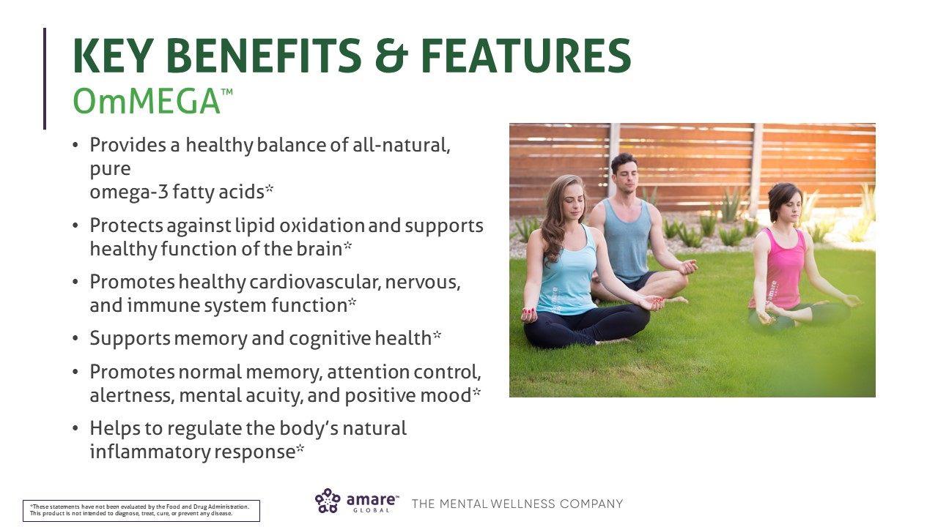

Slide 13
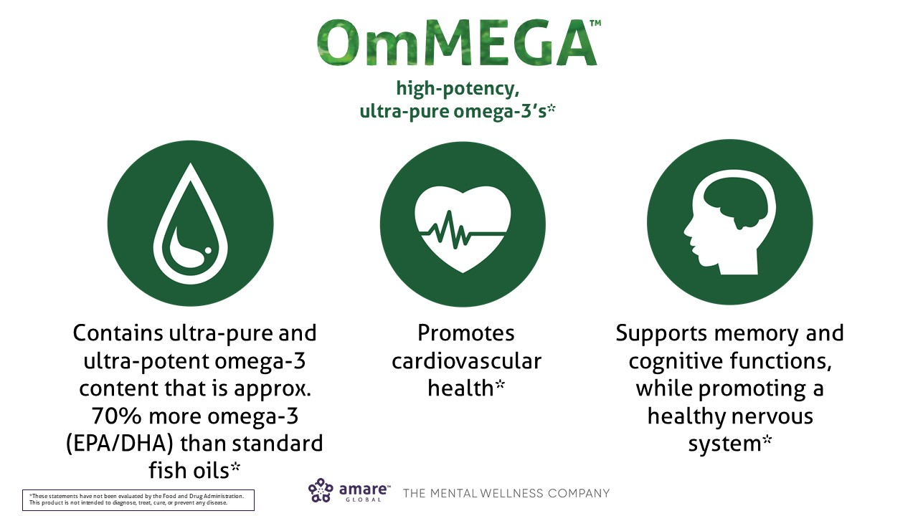

Slide 14


Slide 15
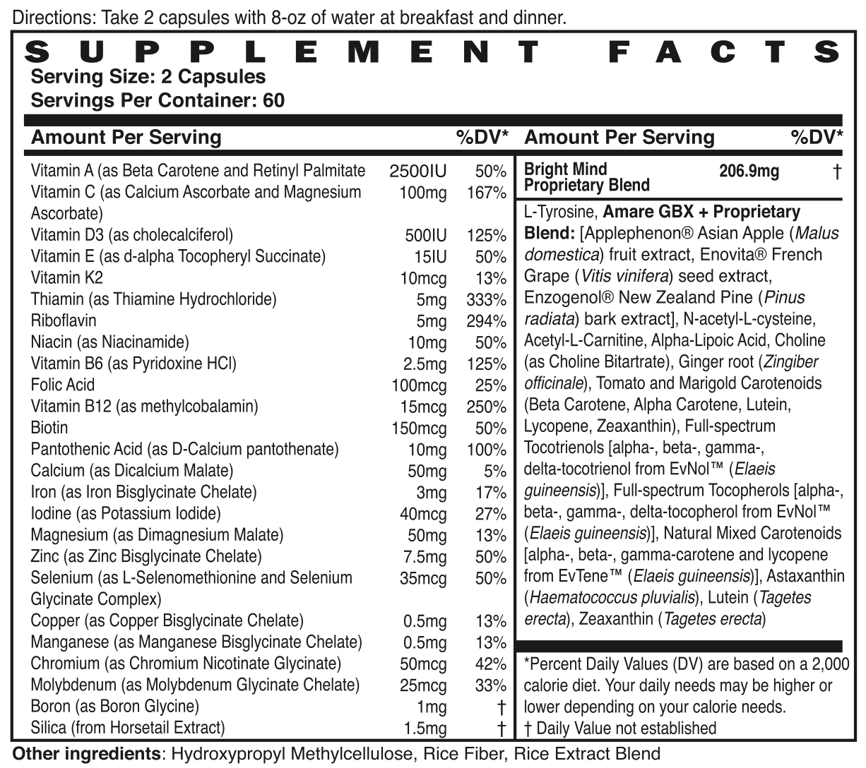

Slide 17
Natural Induction of CDRs = Cellular Defense Responses
Hundreds of natural bioactive plant compounds are known to trigger CDR pathways.
In many cases, the main reason that a particular fruit, vegetable, spice, or herb is “good for us” is because of its ability to trigger CDR and set in motion the production of the cell’s own protective proteins.
Anti-oxidant benefits of Flavonoids (GBX blend of Apple phenols, Grape Seed resveratrol/cetechins, NZ Pine Bark OPCs – oligomeric-proantho-cyanidins)
Anti-inflammatory benefits of effect of healthy spices such as turmeric (curcumin) and ginger (gingerols)
Mental-focus benefits of herbs such as ashwagandha (withaferin) and bacopa (bacopasides)

Slide 23
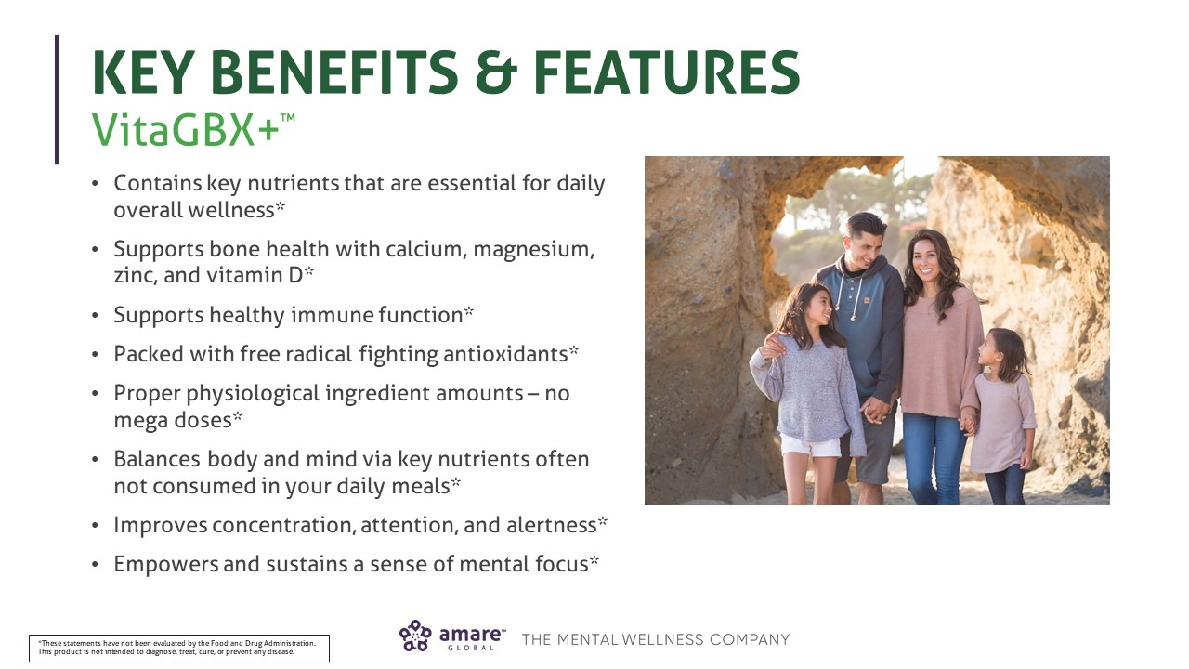

Slide 24
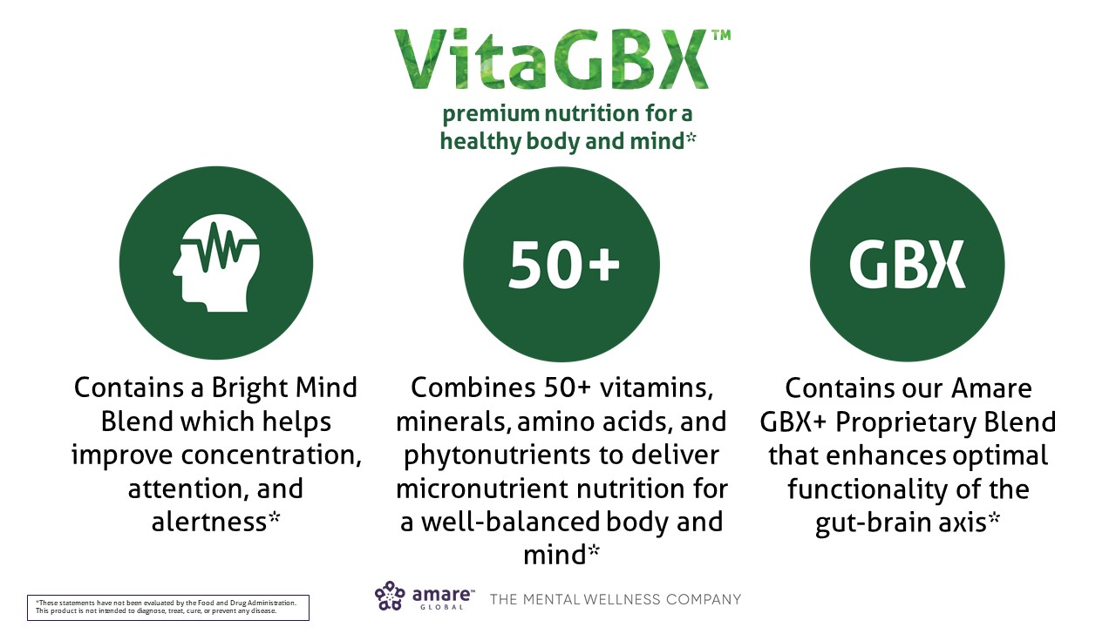

Slide 25
