Slide 1


Slide 2
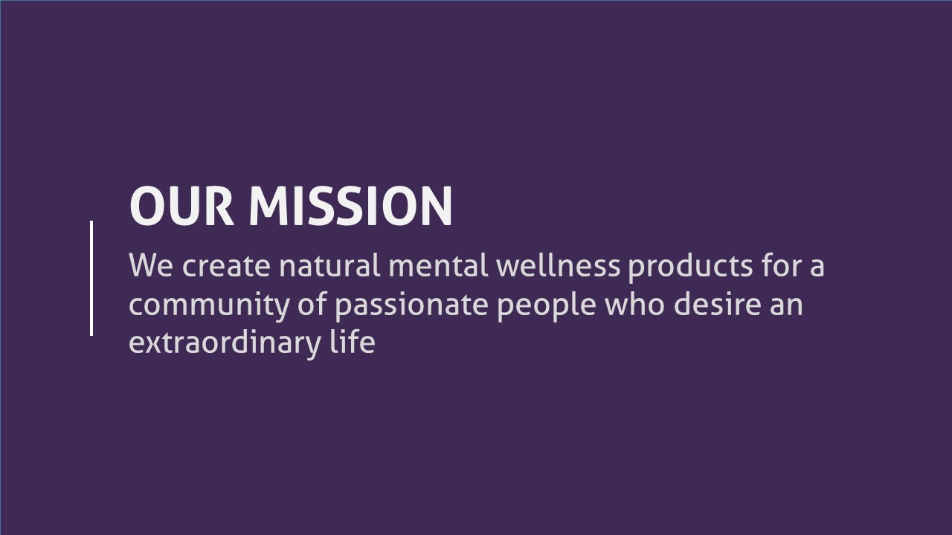

Slide 3
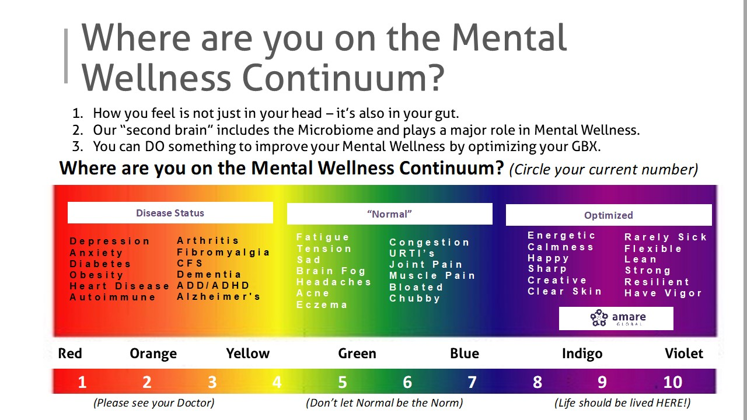

Slide 4
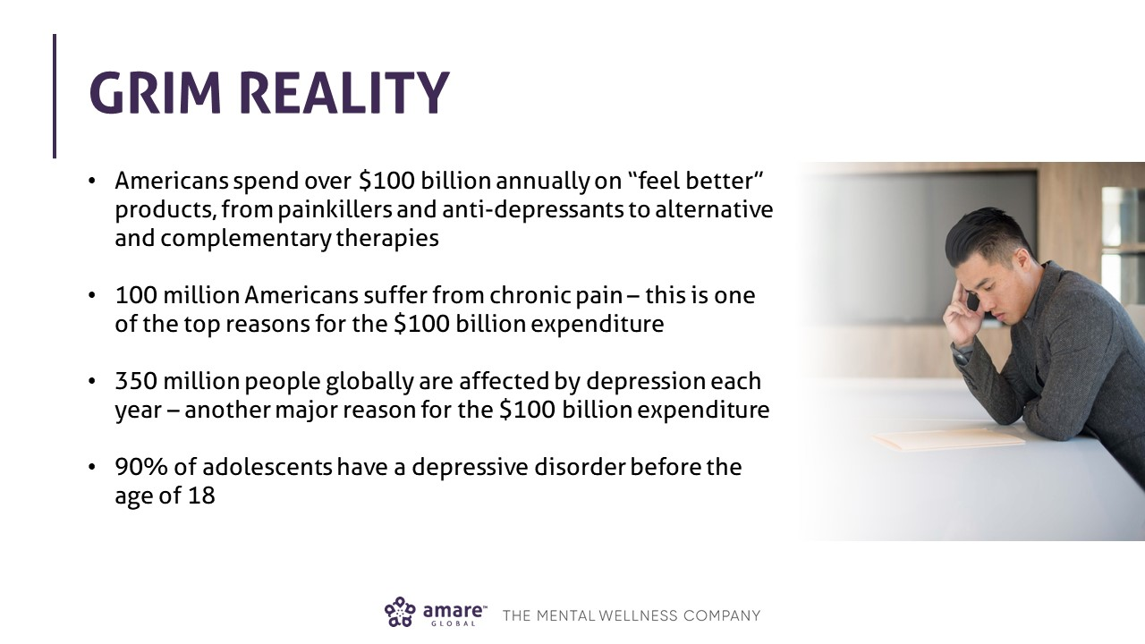

Slide 5
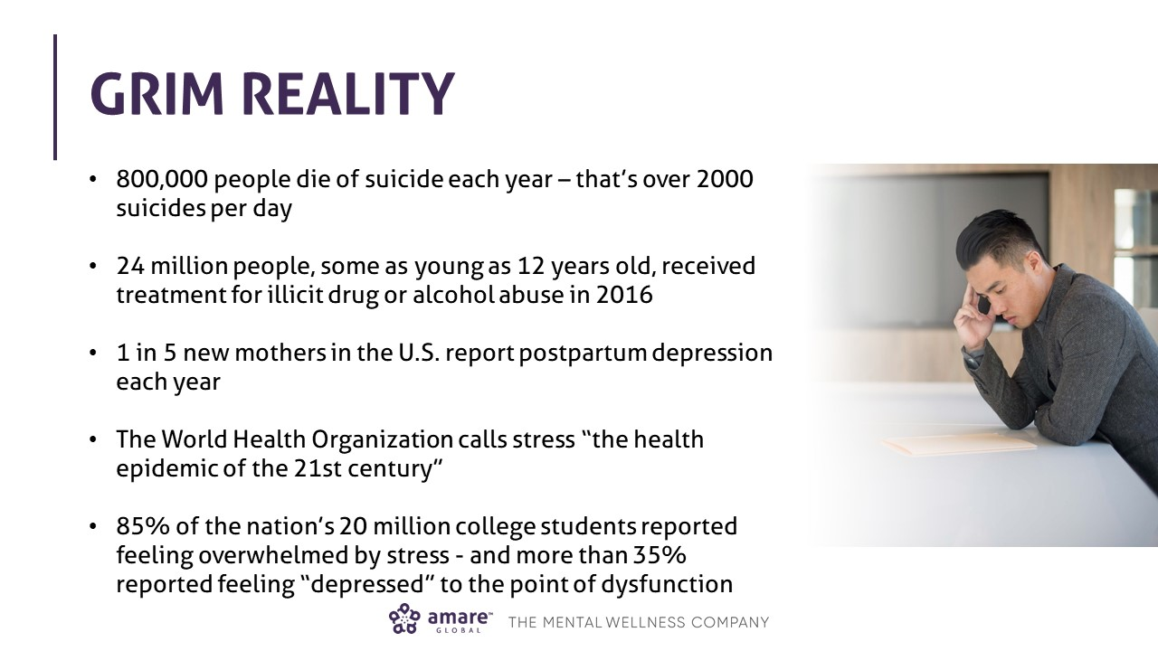

Slide 6
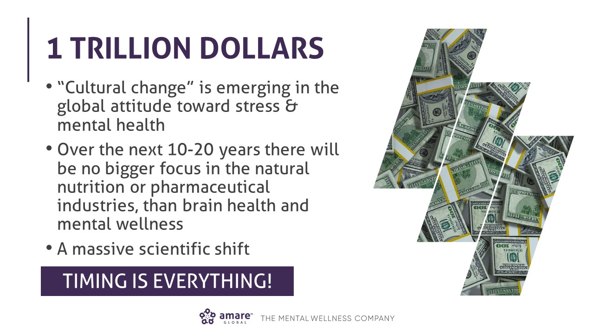

Slide 7
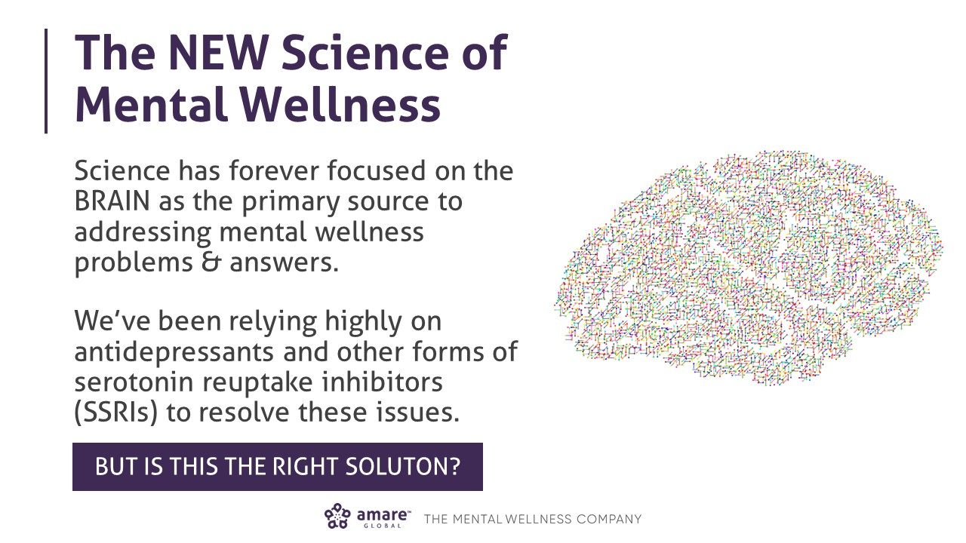

Slide 8
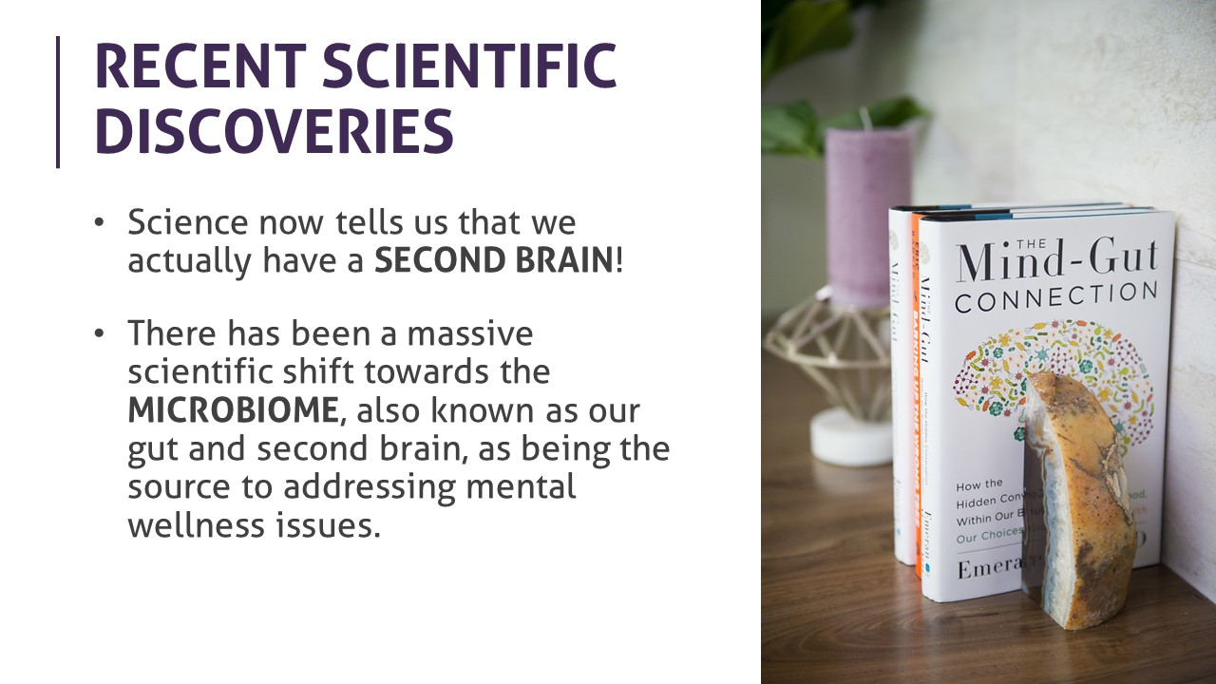

Slide 9
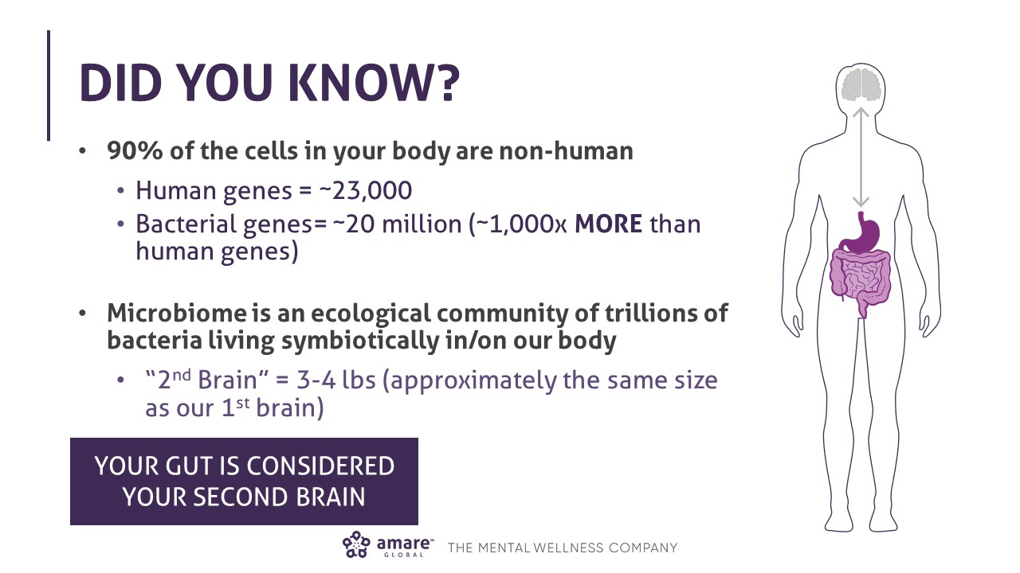

Slide 10
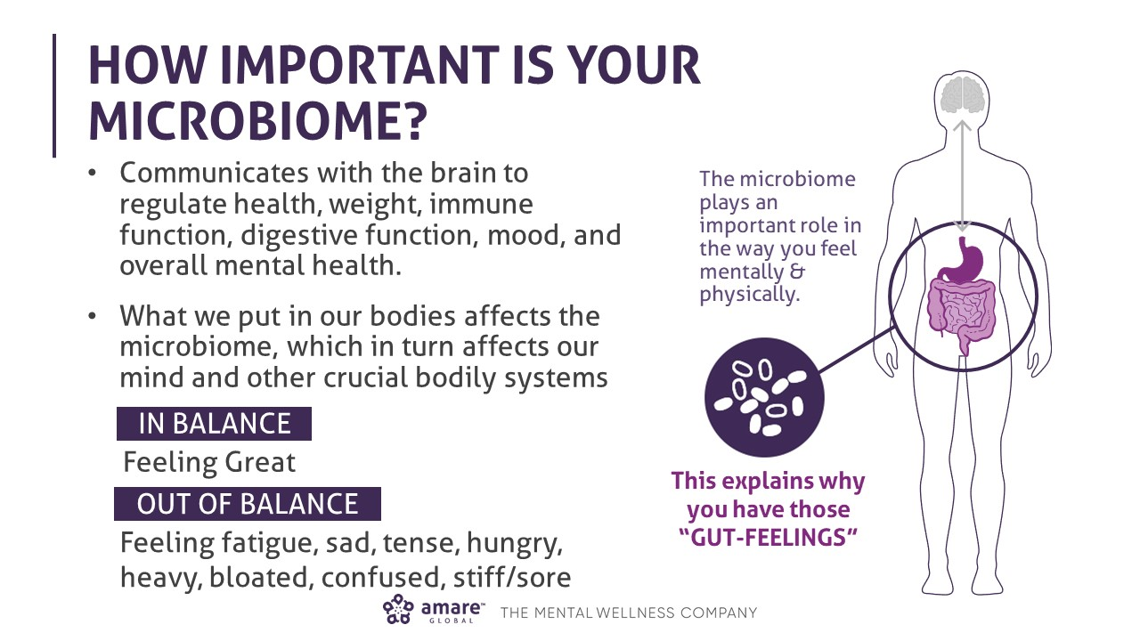

Slide 11
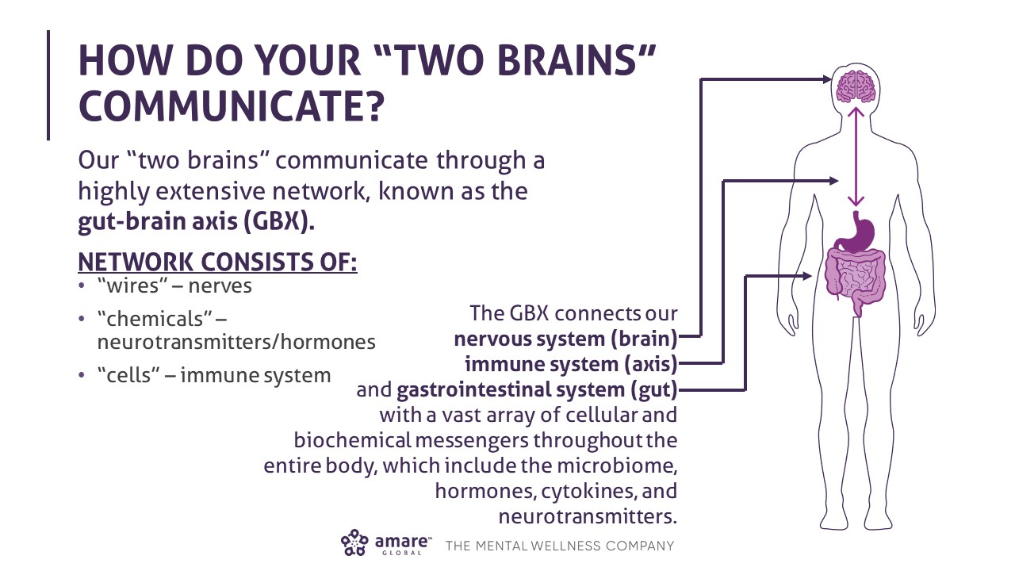

Slide 12


Slide 13
Attention-deficit/hyperactivity disorder (ADHD) is a brain disorder marked by an ongoing pattern of inattention and/or hyperactivity-impulsivity that interferes with functioning or development. (1 in 10 kids)
Autism, or autism spectrum disorder, refers to a range of conditions characterized by challenges with social skills, repetitive behaviors, speech and nonverbal communication, as well as by unique strengths and differences. We now know that there is not one autism but many types, caused by different combinations of genetic and environmental influences. (1:68 kids)
PANDAS (Pediatric Autoimmune Neuropsychiatric Disorders Associated with Streptococcal Infections) occurs when strep triggers a misdirected immune response results in inflammation on a child’s brain. In turn, the child quickly begins to exhibit life changing symptoms such as OCD, anxiety, tics, personality changes, decline in math and handwriting abilities, sensory sensitivities, restrictive eating, and more. (1:200 kids)

Slide 15
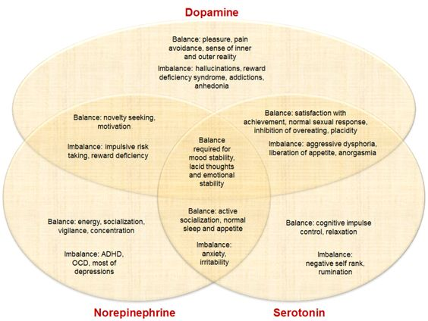

Slide 16
Dependence
Suicide

Slide 17
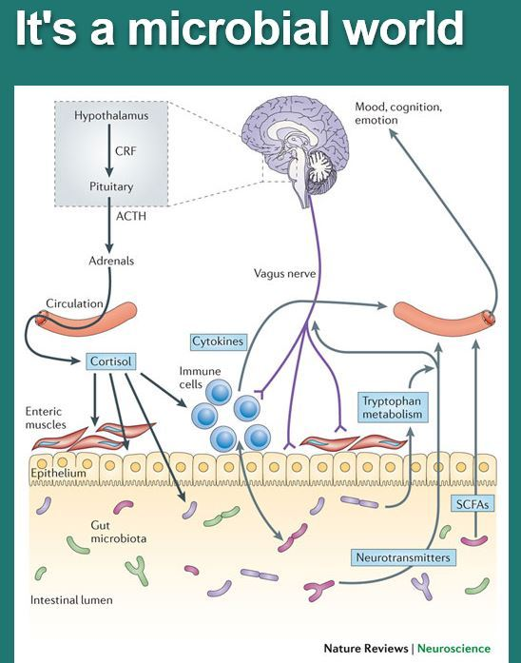
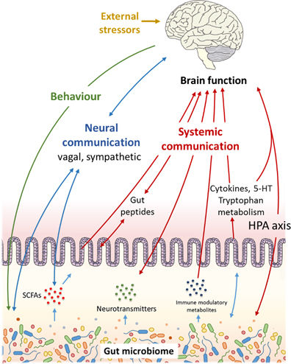
Food?
Gluten?
Milk?
Casein?
Texture?
Sugar?
Sunburn?

Slide 19
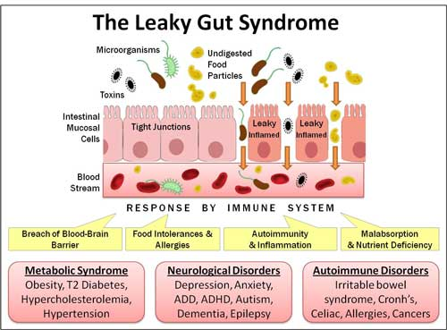

Slide 20
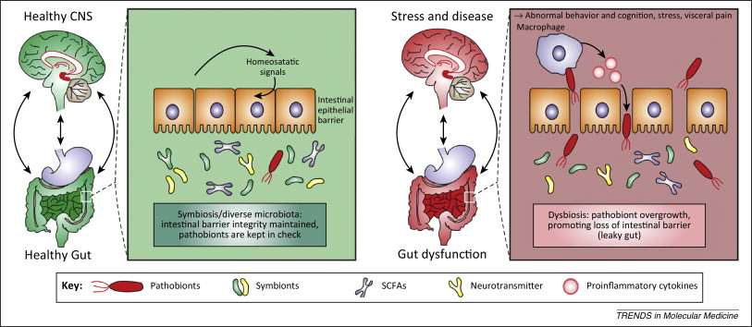

Slide 21
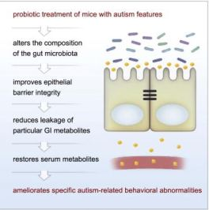

Slide 24
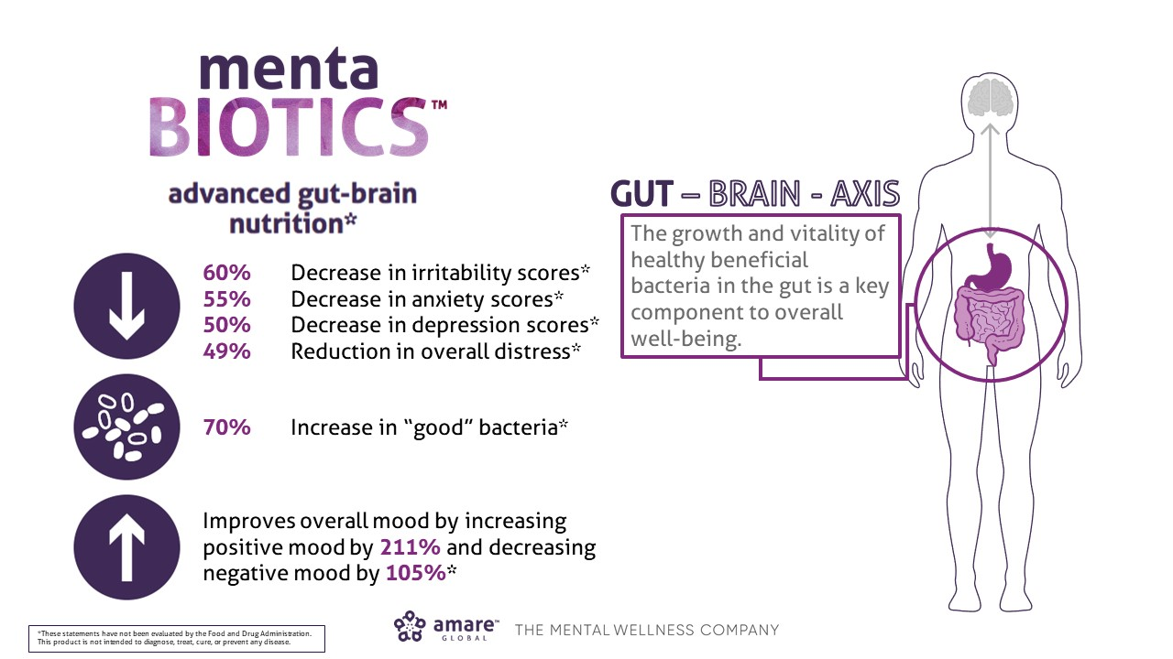

Slide 25
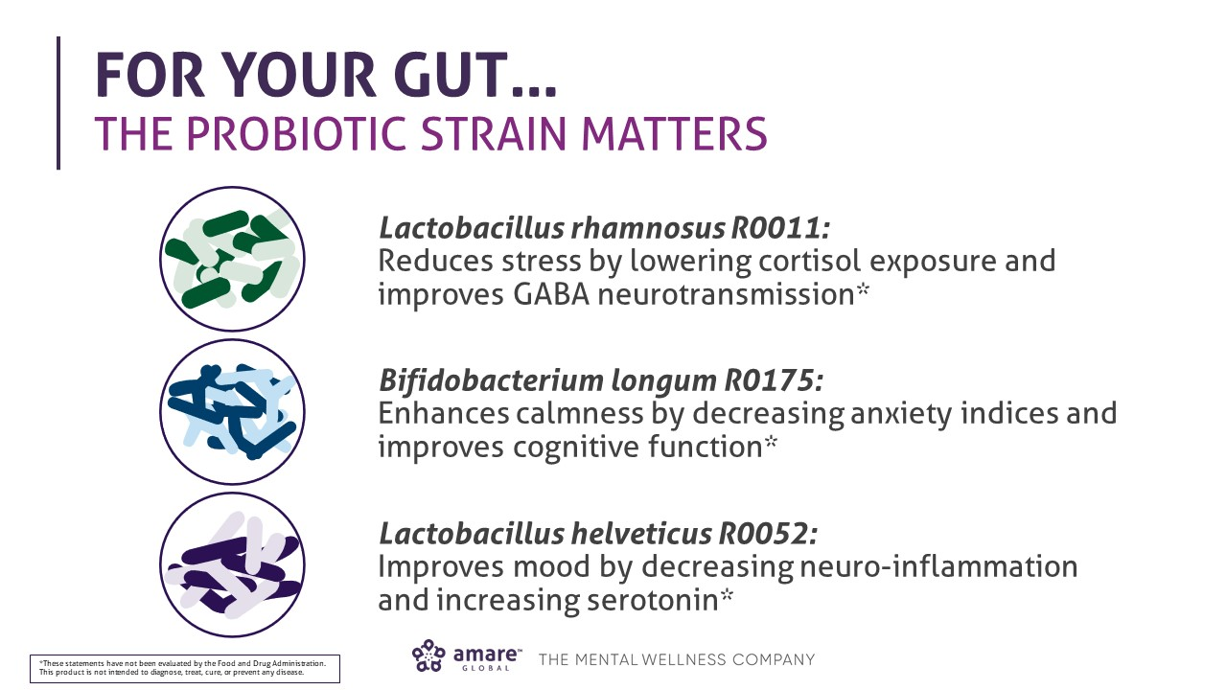

Slide 26
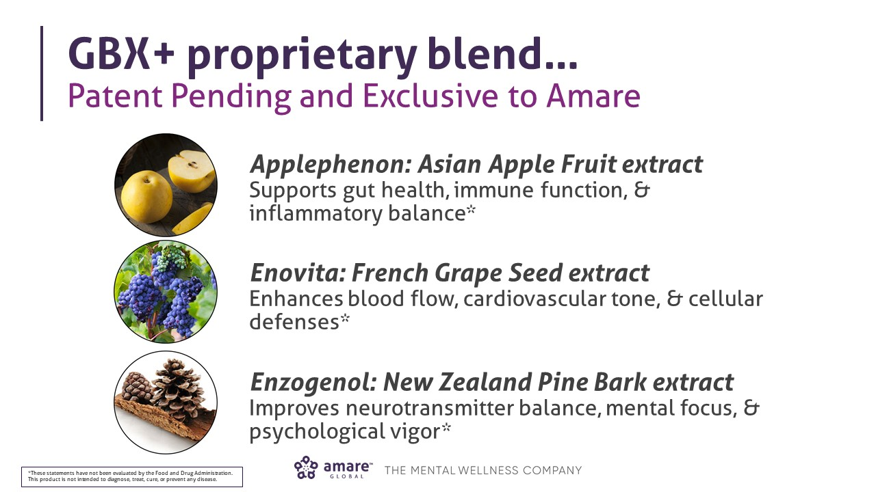

Slide 27
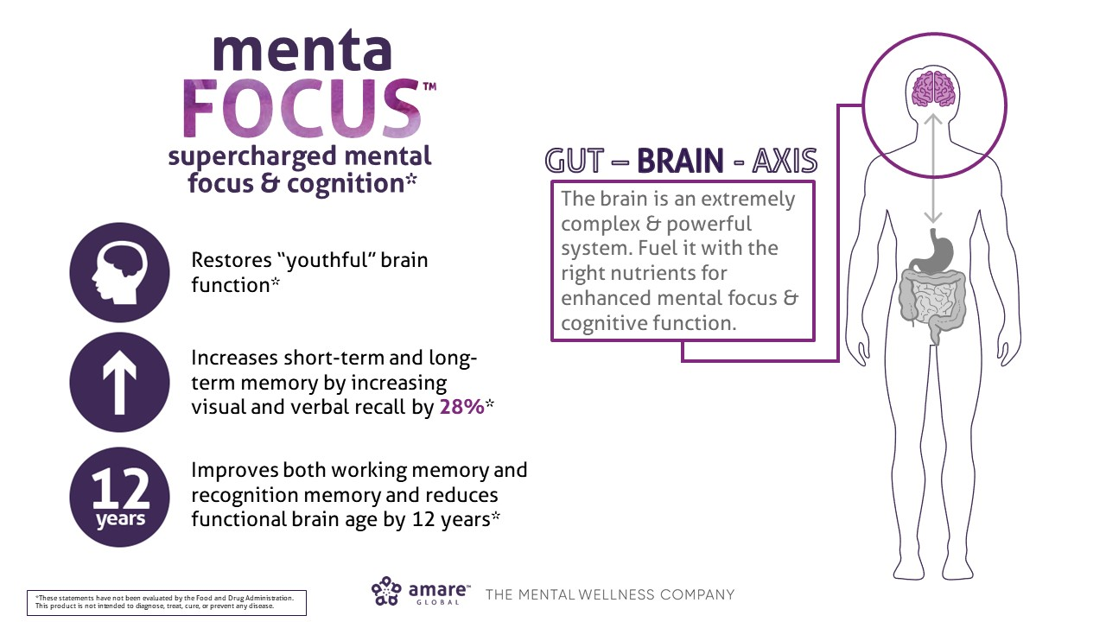

Slide 28
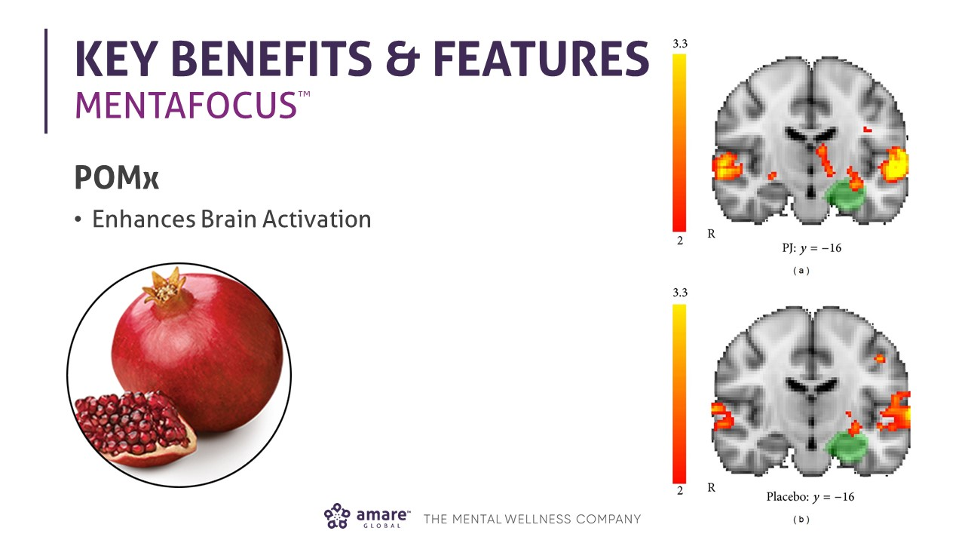

Slide 29
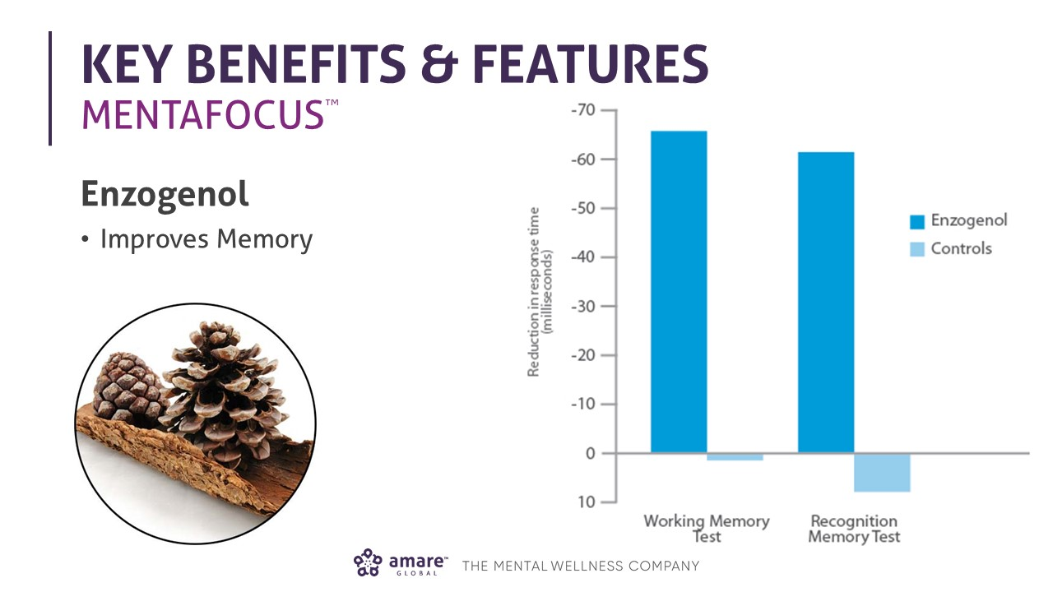

Slide 30
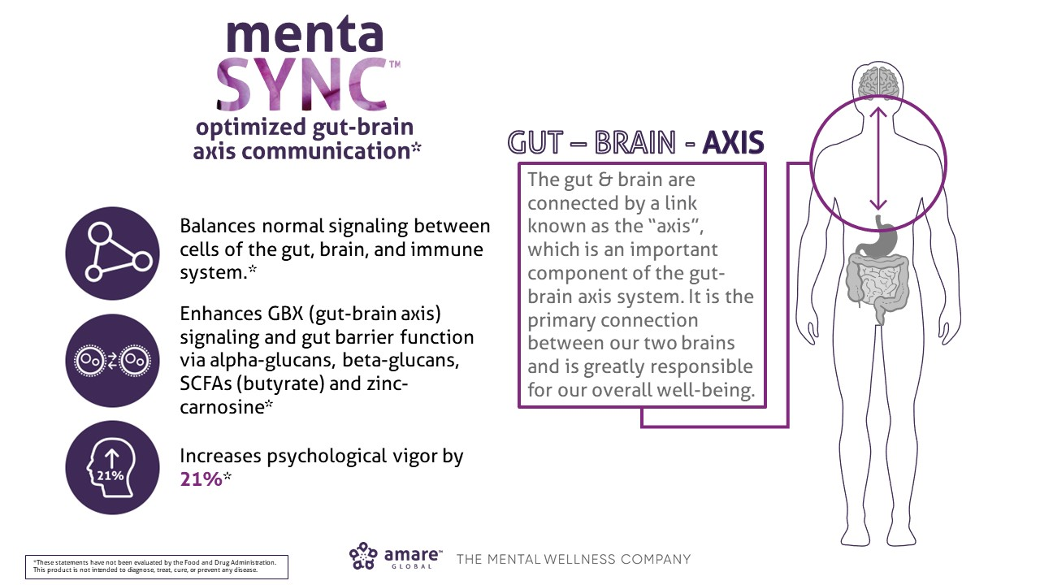

Slide 31


Slide 32
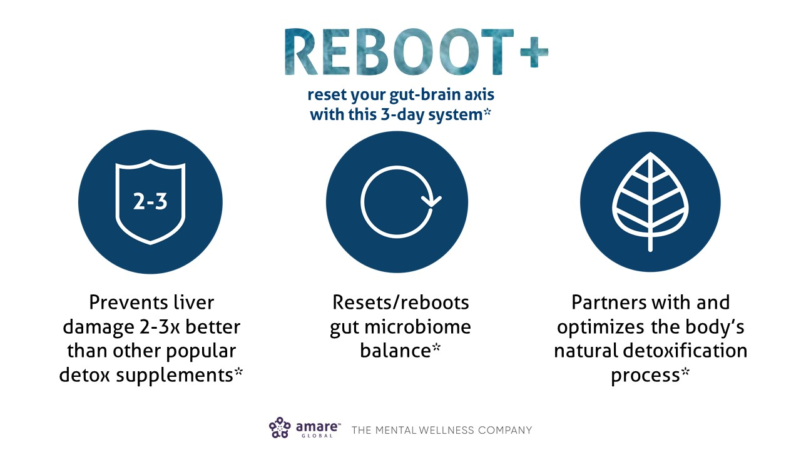

Slide 33
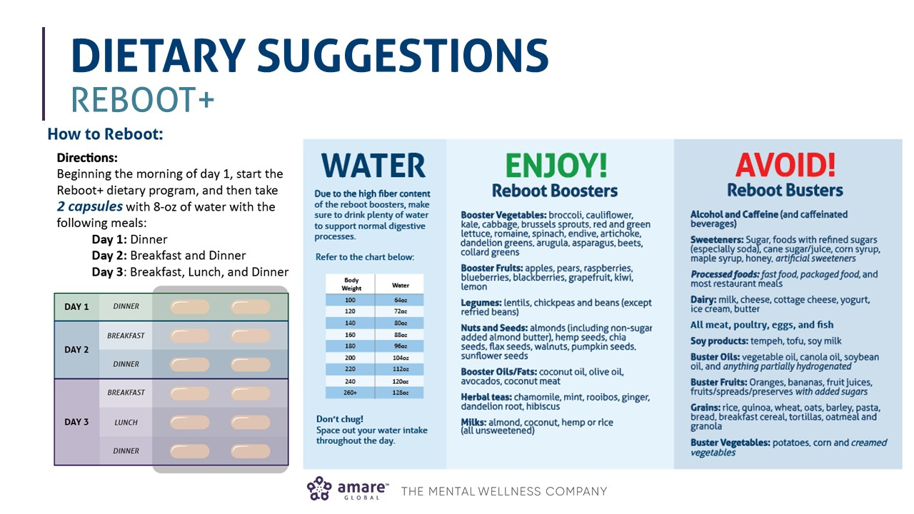

Slide 34
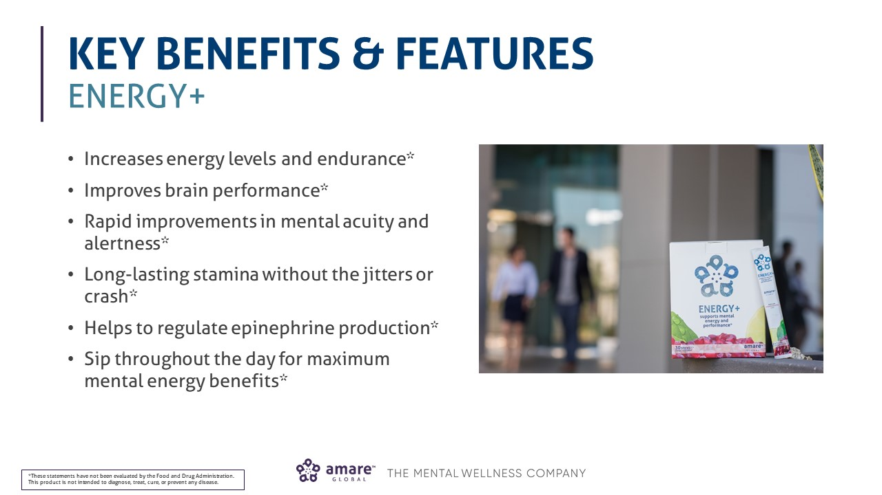

Slide 35
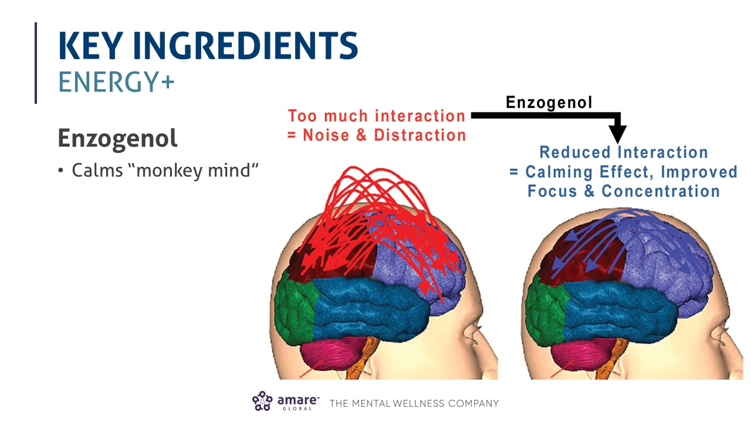

Slide 36
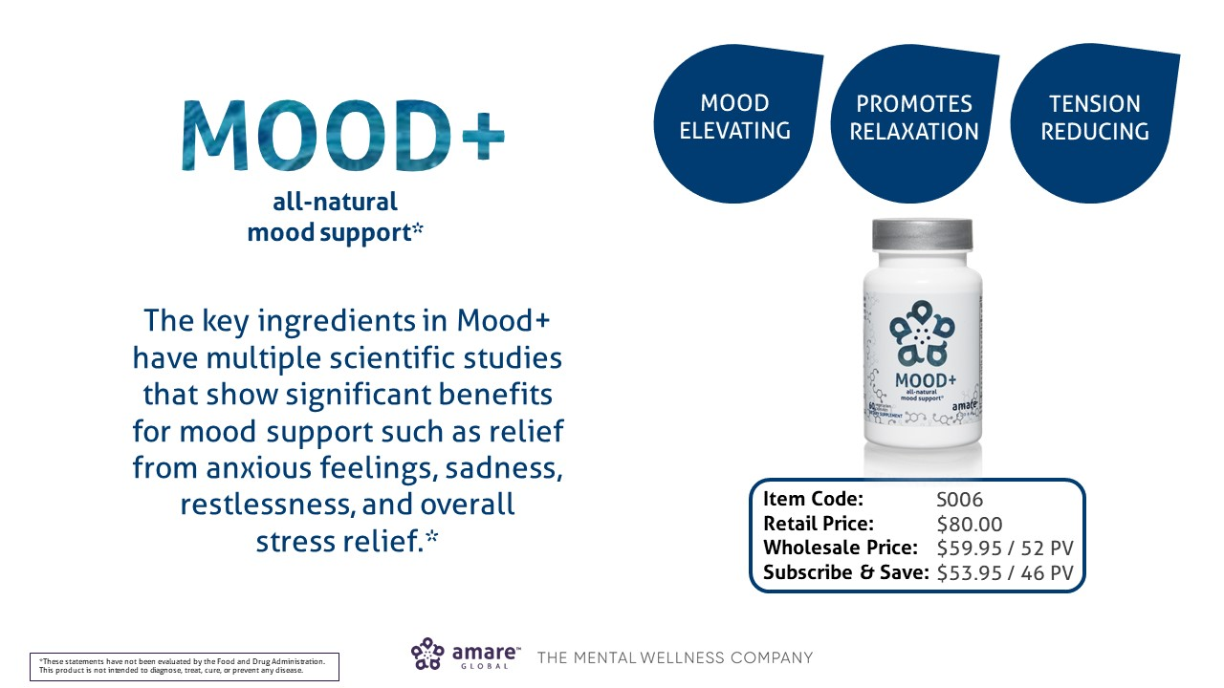

Slide 37
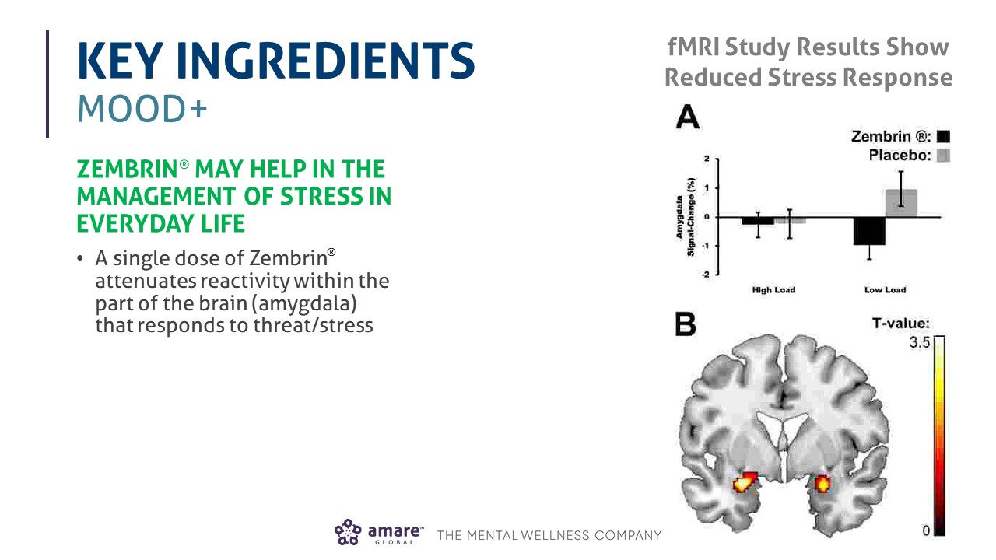

Slide 38
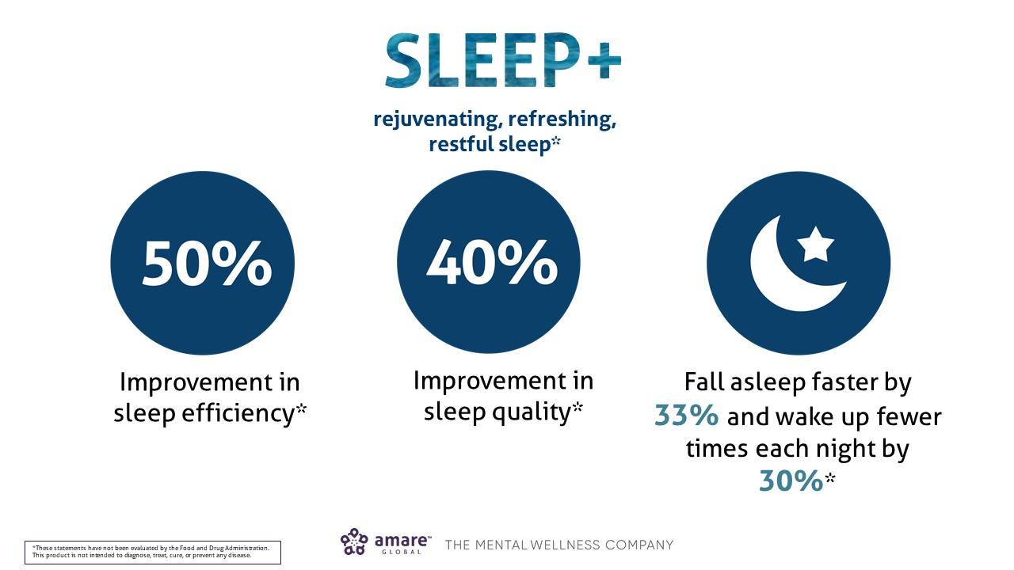

Slide 39
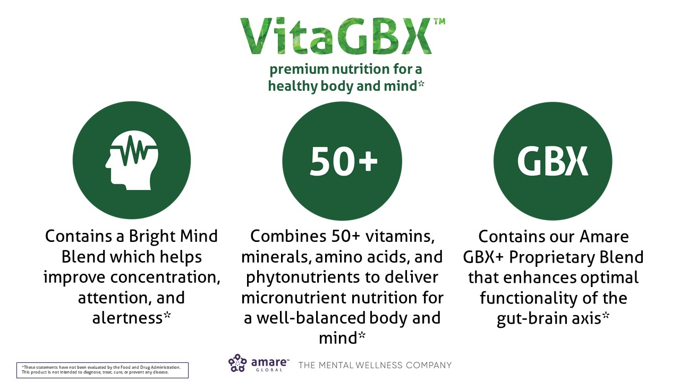

Slide 40
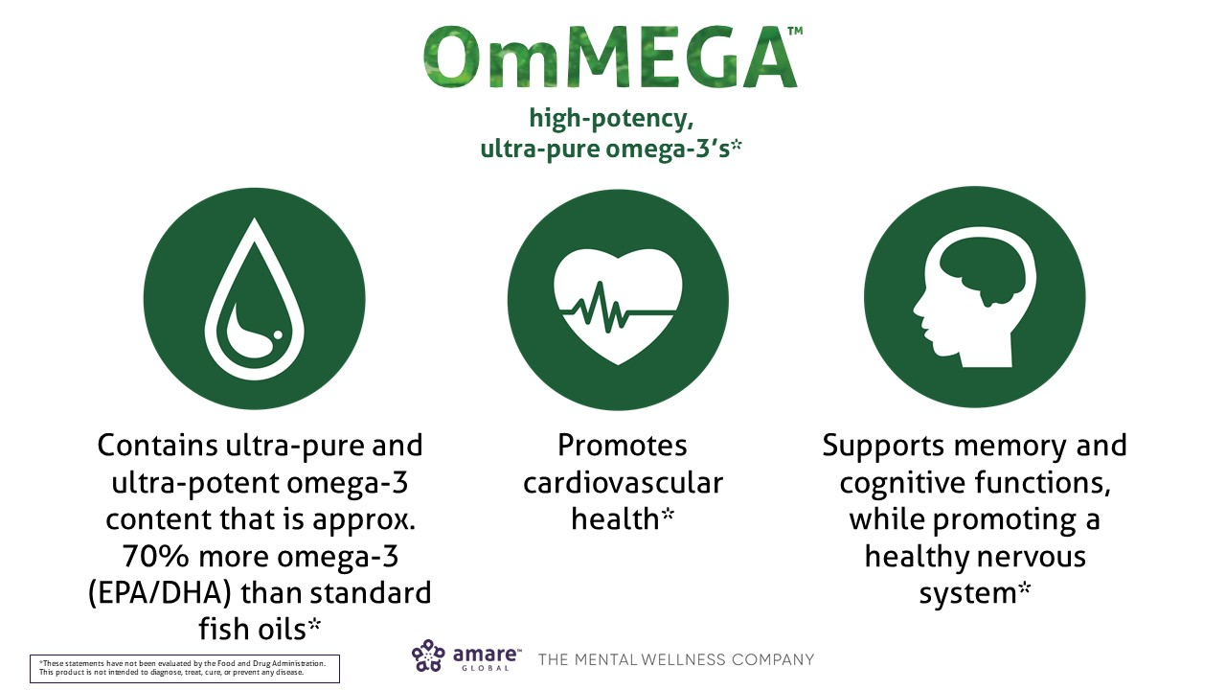

Slide 41
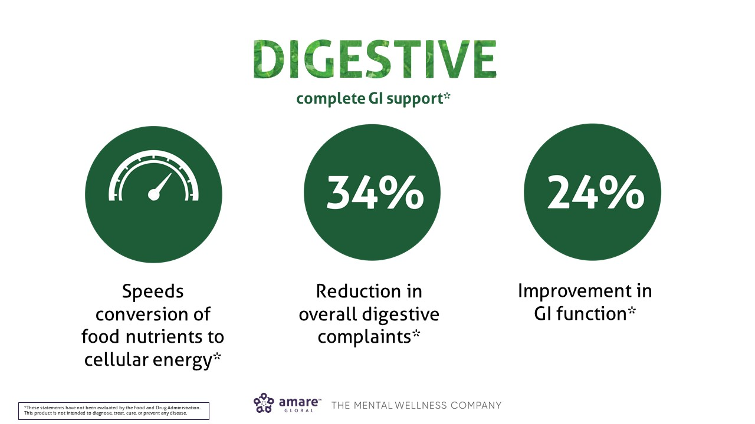

Slide 42
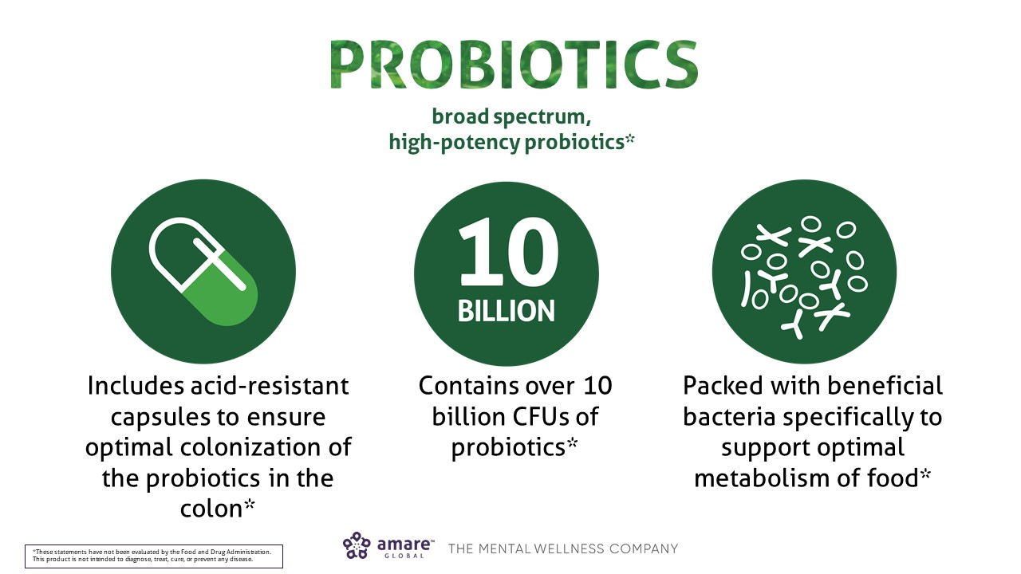

Slide 43
