Slide 1
Shawn M. Talbott, PhD
CNS, LDN, FACSM, FAIS, FACN
Chief Science Officer

Slide 2



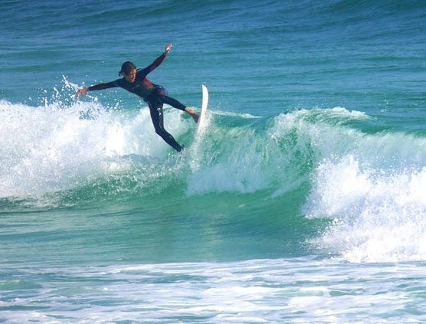

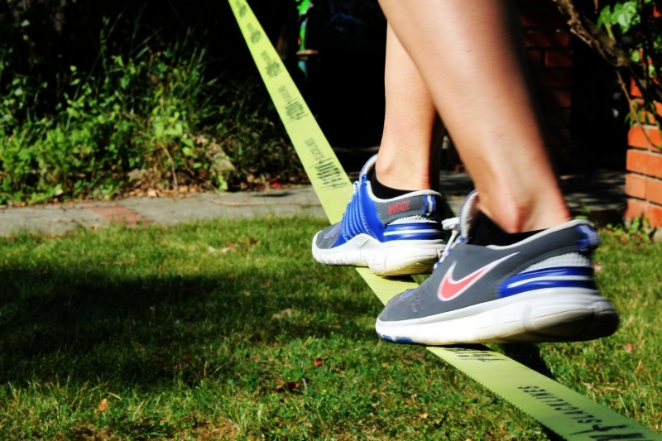

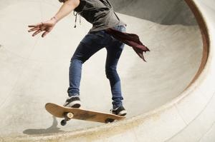
Notes:
Today, we have nearly 90% of the American population, including kids and teens, experiencing elevated levels of stress and burnout - enough stress to result in a stress-related disease such as depression, fatigue, diabetes, obesity, and even cancer.
The secret to reducing stress and maintaining health and vitality is to balance biochemistry by keeping cortisol, glucose, free radicals, and cytokines in check.

Slide 3

Causes of “Imbalance” (Stress)
Emotional stress (deadlines, bills, traffic…)
Physical stress (aging, sleep deprivation, exercise…)
Environmental stress (air/water pollution, heat, cold…)
Non-Optimal Diet (processed foods, inadequate nutrients/phytonutrients…)
Athletes / Dieters / Short-Sleepers / Stressed
  Share the SAME biochemical disruptions
  Share the SAME psychological outcomes
  Exhibit the SAME benefits to restored biochemical balance
Notes:
Sources of Imbalance (stress) are:
Internal
External
Everywhere!
Unavoidable!!

Slide 4

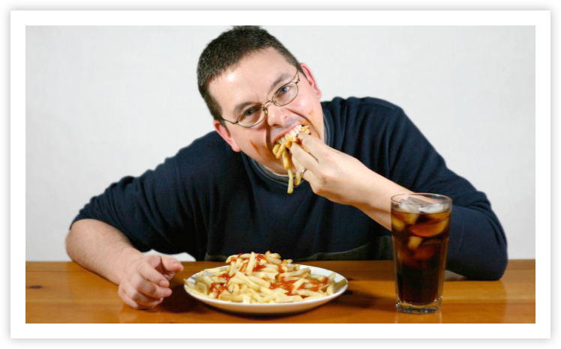
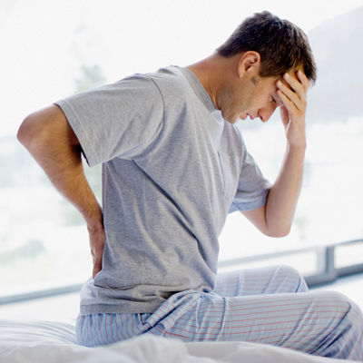
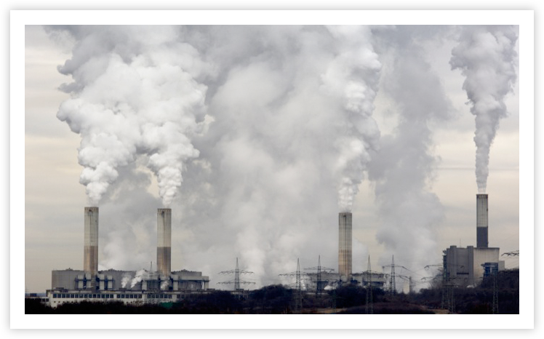

Slide 5

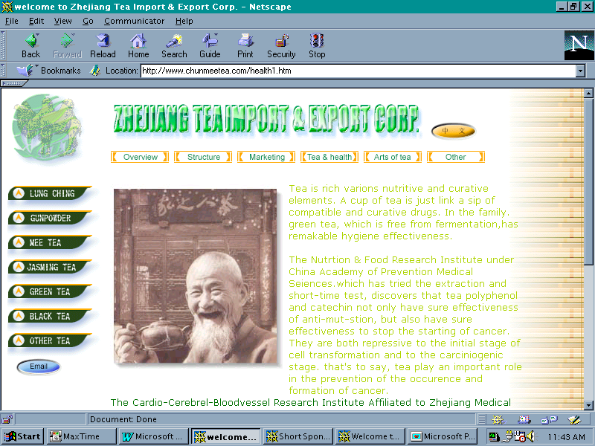

Notes:
Qi = Life Force in TCM
Prana in Ayurveda
Icarus

Slide 6
Prana
Zone
Mood
Qi
Mana
Swing
Energy
Focus
Vigor
Ki
Edge
Flow
Motivation
Runner’s High
Notes:
we know when we’re out of balance - and we know when we’re IN balance - we can FEEL it - and we can name it…

Slide 7


Vigor
3-tiered mood state…
characterized by:
Physical Energy
Mental Acuity
Emotional Well-Being
Notes:
-some people might refer to Vigor as “happiness” - or “well-being” - or “quality of life” - or “motivation” - or being “on” or “in the zone”
-in Ancient Medicine, it’s Qi - or Prana - or similar concept of being in Alignment or being in Balance

Slide 8

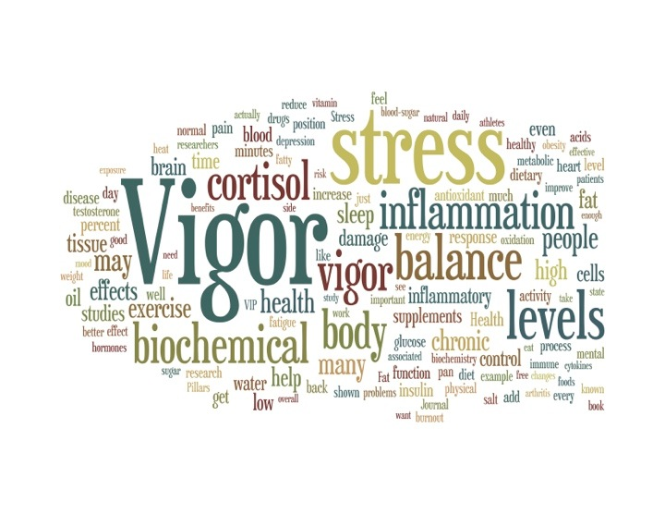

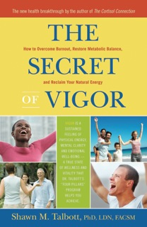

Slide 9
What does
Energy
mean to
YOU?
Notes:
Today - “energy” is all about stimulation with more sugar - more caffeine - and more stimulants such as illicit drugs
I want to tell you about a different kind of energy - an ancient energy that naturally emerges when we keep our bodies in proper biochemical balance.

Slide 10

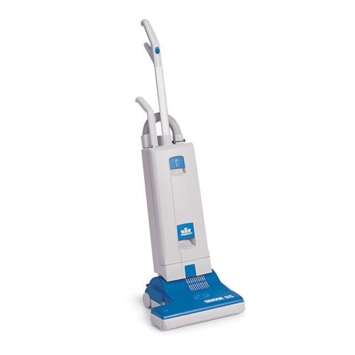
Notes:
what does energy mean to you? (motivation)
-physical energy (absence of fatigue = logical)
-brain fog - problems concentrating (ADHD) = perceived as fatigue
-suppressed mood - unhappiness (Depression) = perceived as fatigue
-burnout (the opposite of vigor) - stressed out = perceived as fatigue
more than just “one dimensional energy” - multi-dimensional that includes:
-physical energy (red bull)
-mental acuity (focus - ADHD)
-good mood (prozac)
-emotional well-being (zone - connection - flow) - peak experience
-stress resilience (ambien) - 'control' is most important driver of stress
-connection and engagement (with others when you’re sharing it)
so, to my 15-year old self, I’ll say again…
don’t lose your balance (and don’t forget to clean up your room)

Slide 11

Oxidation (free radicals)
Inflammation (cytokines)
Glycation (glucose)
“Vigor”
Allostation (cortisol)
Notes:
we can measure the biochemistry of being “off”

Slide 12
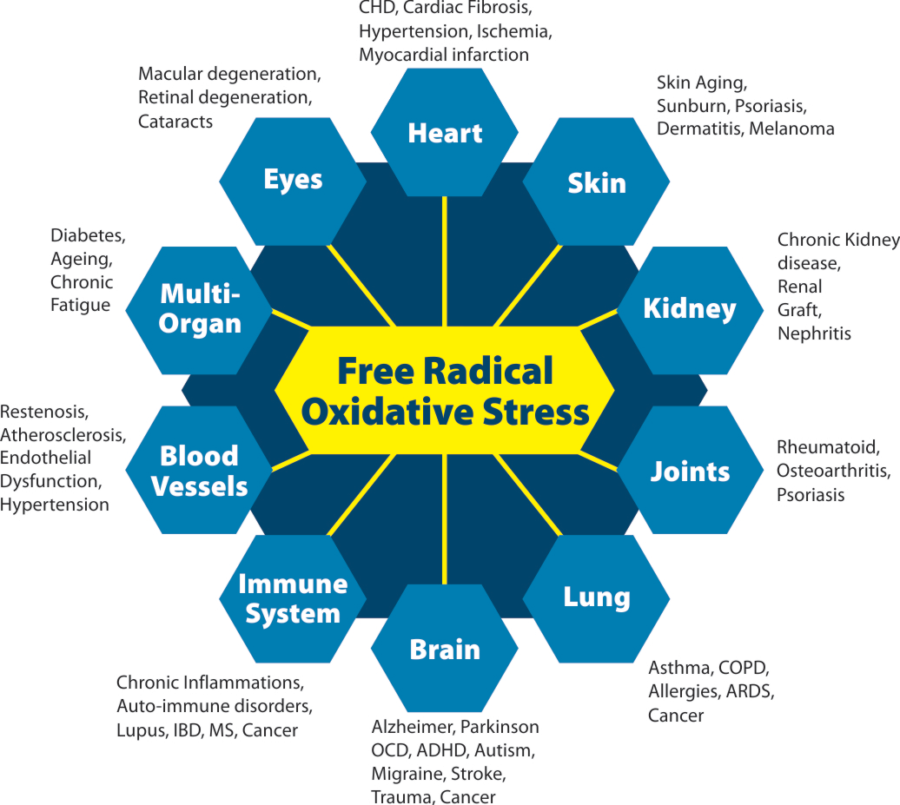

Just an Antioxidant?

Slide 13
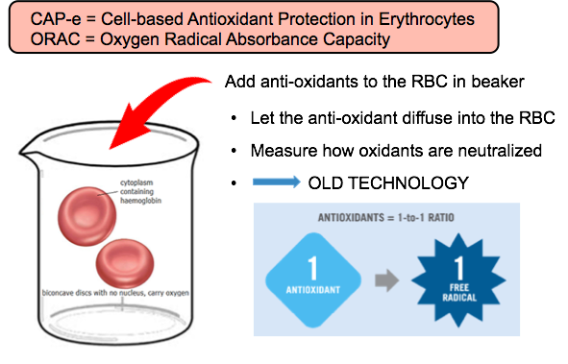

Slide 14
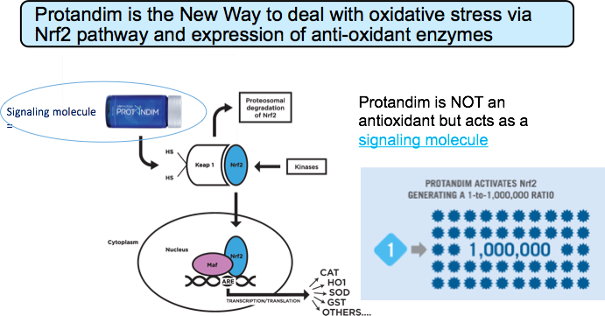

Slide 15
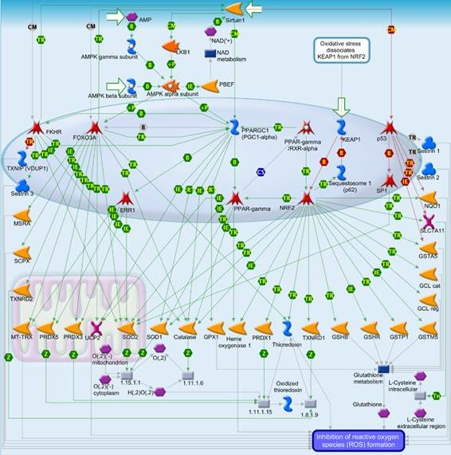

Slide 16
The Internal System of Protective Antioxidant Enzymes
Activated/Triggered by Nr2 Pathway
Peroxiredoxin 1
Detoxified
Products
Lipid hydroperoxides
Peroxiredoxin 2
Peroxiredoxin 6
Metallothionein 3
Cu⁺⁺,
e.g.
_
.
SOD 1
Catalase
O₂
H₂O₂
H₂O + O₂
SOD 2
+
Glutamate-cysteine ligase
GSH
Glu + Cys
Glutathione
Reductase
Glutathione Peroxidases 2,3,5 & 6
GSSG +
H₂O
Sulfiredoxin
glutathionylated proteins
reactivated proteins (PON1, e.g.)
Thioredoxin
Thioredoxin
Reductase
NADPH

Slide 17

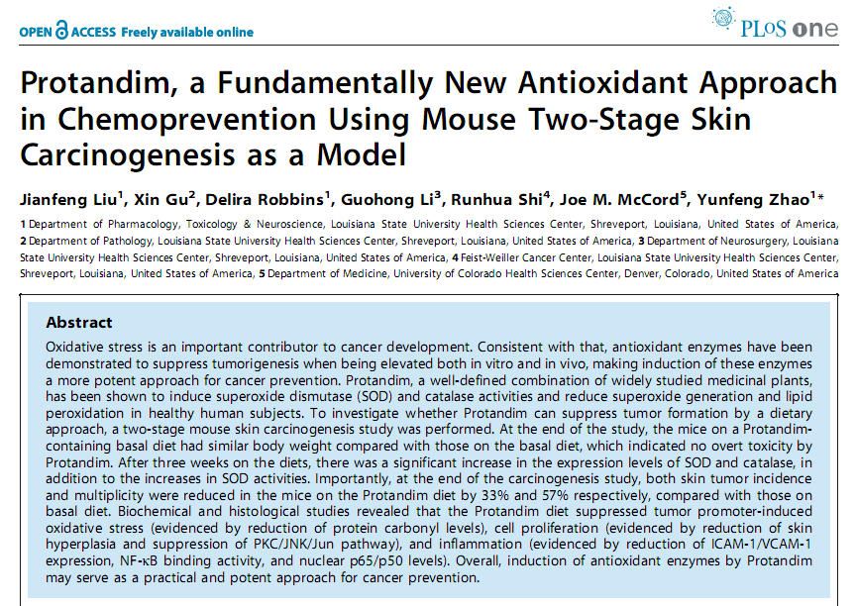
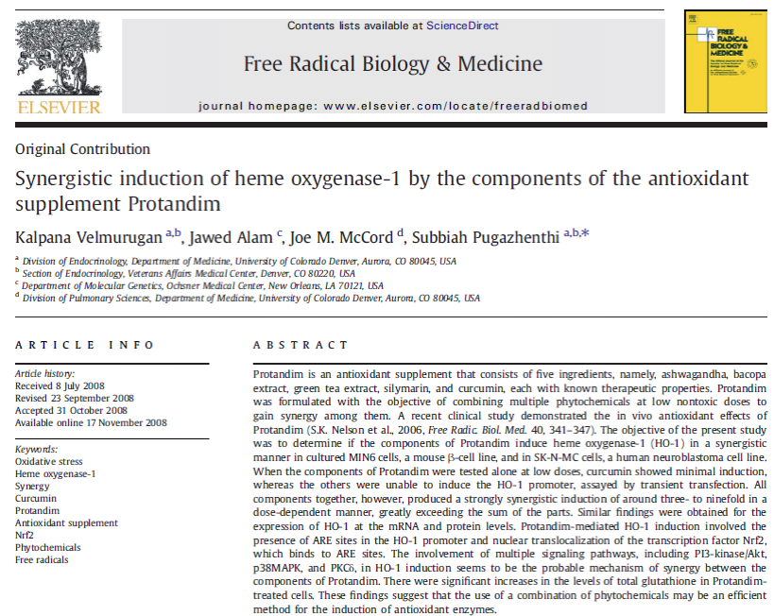
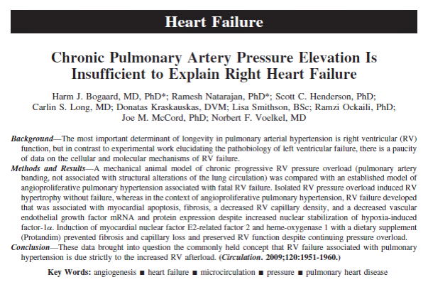
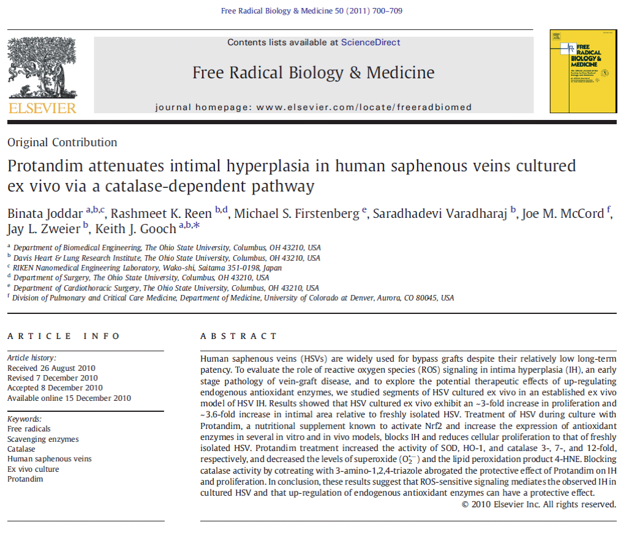
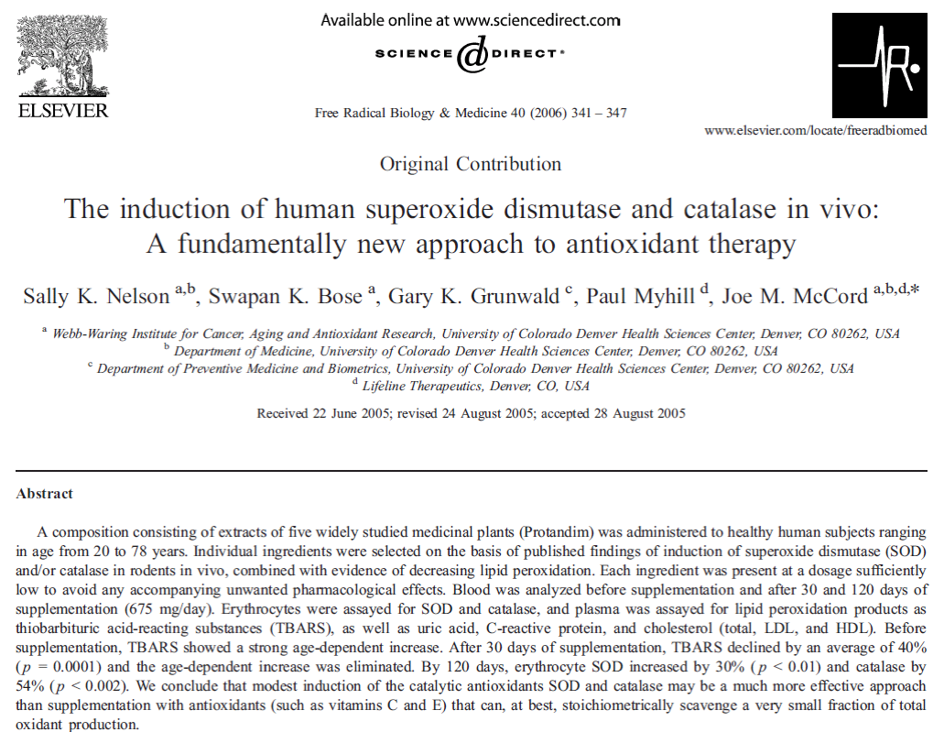
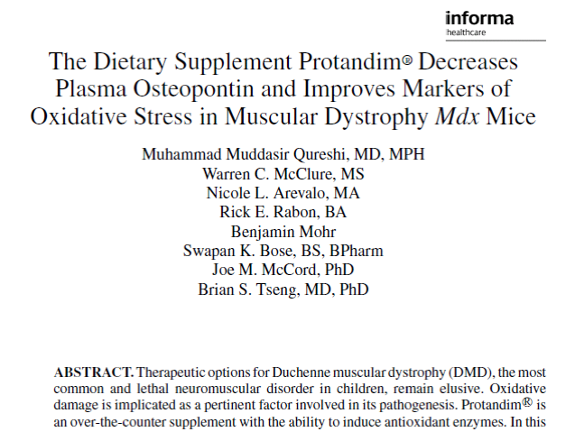
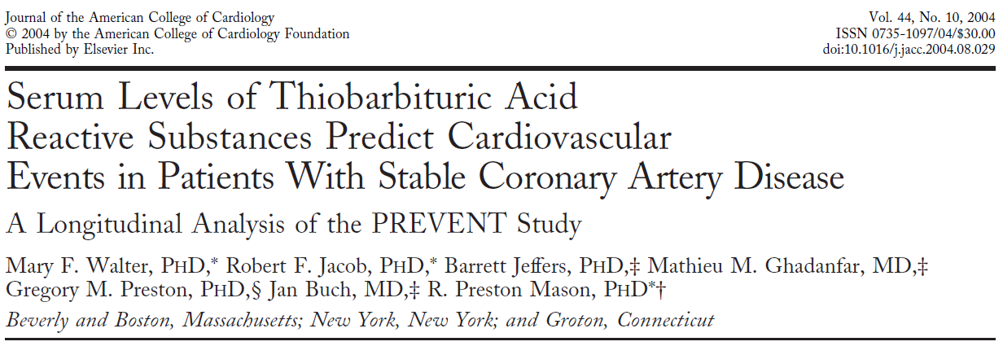
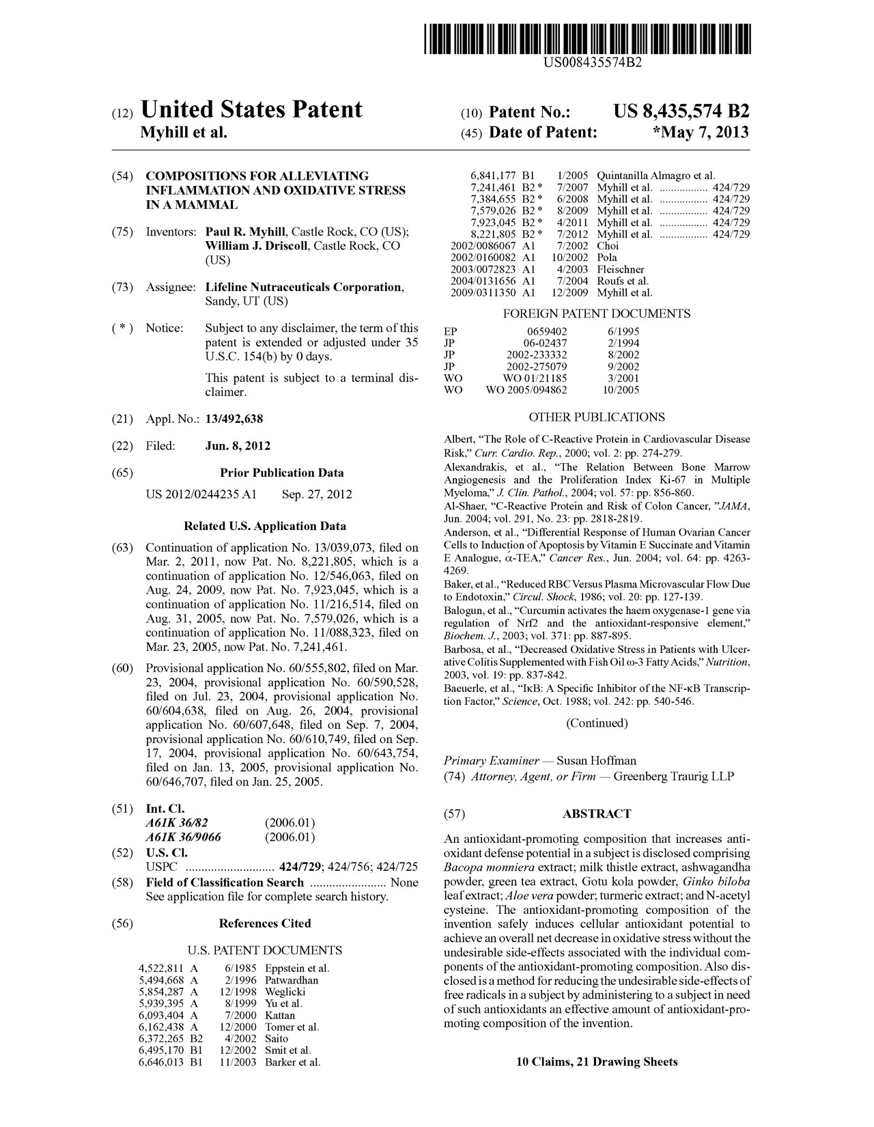
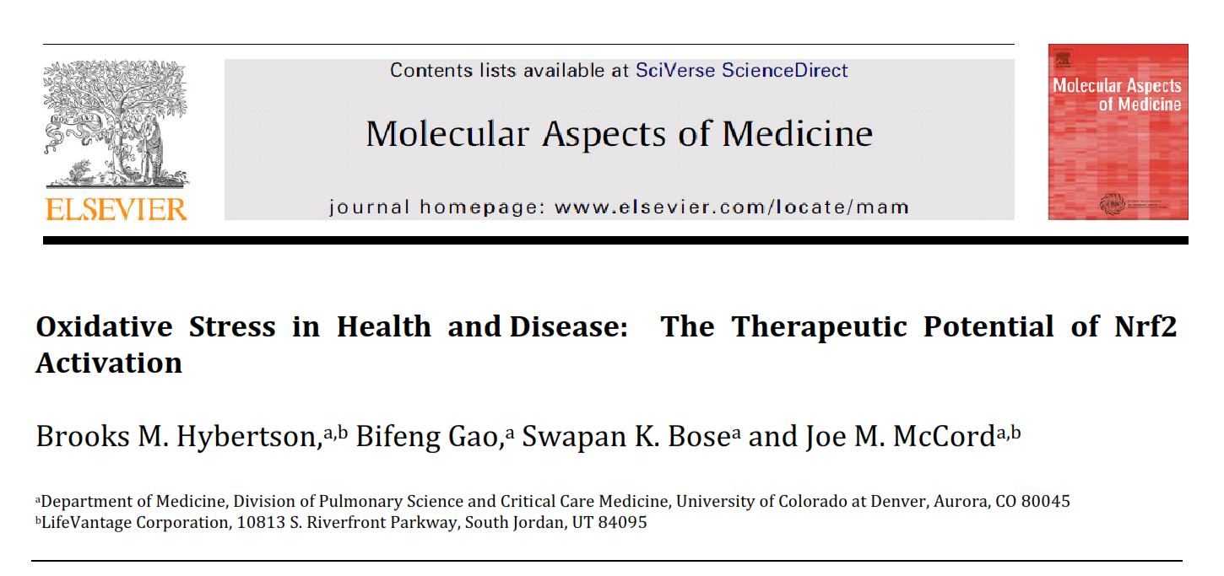
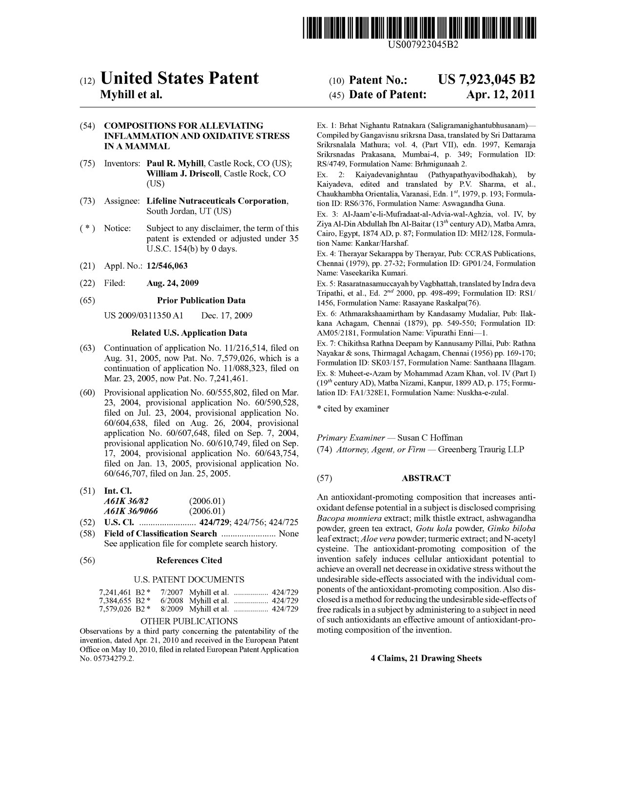
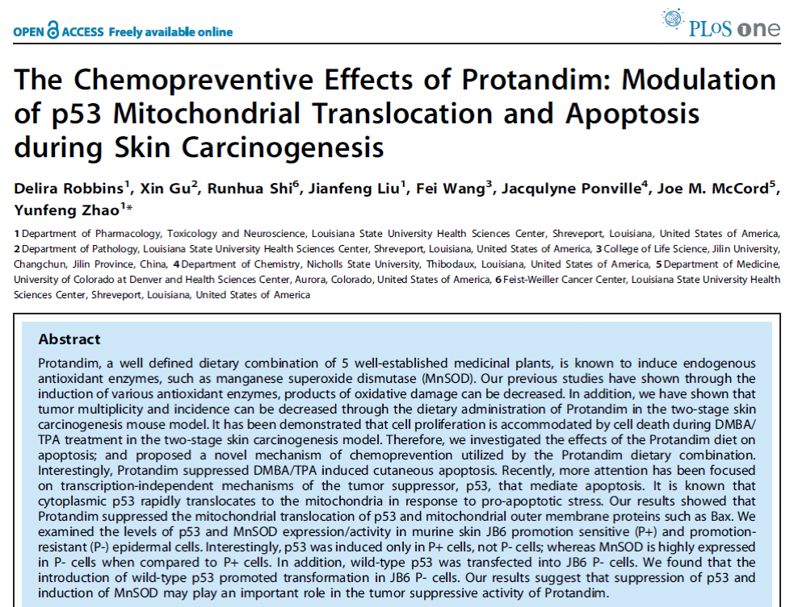
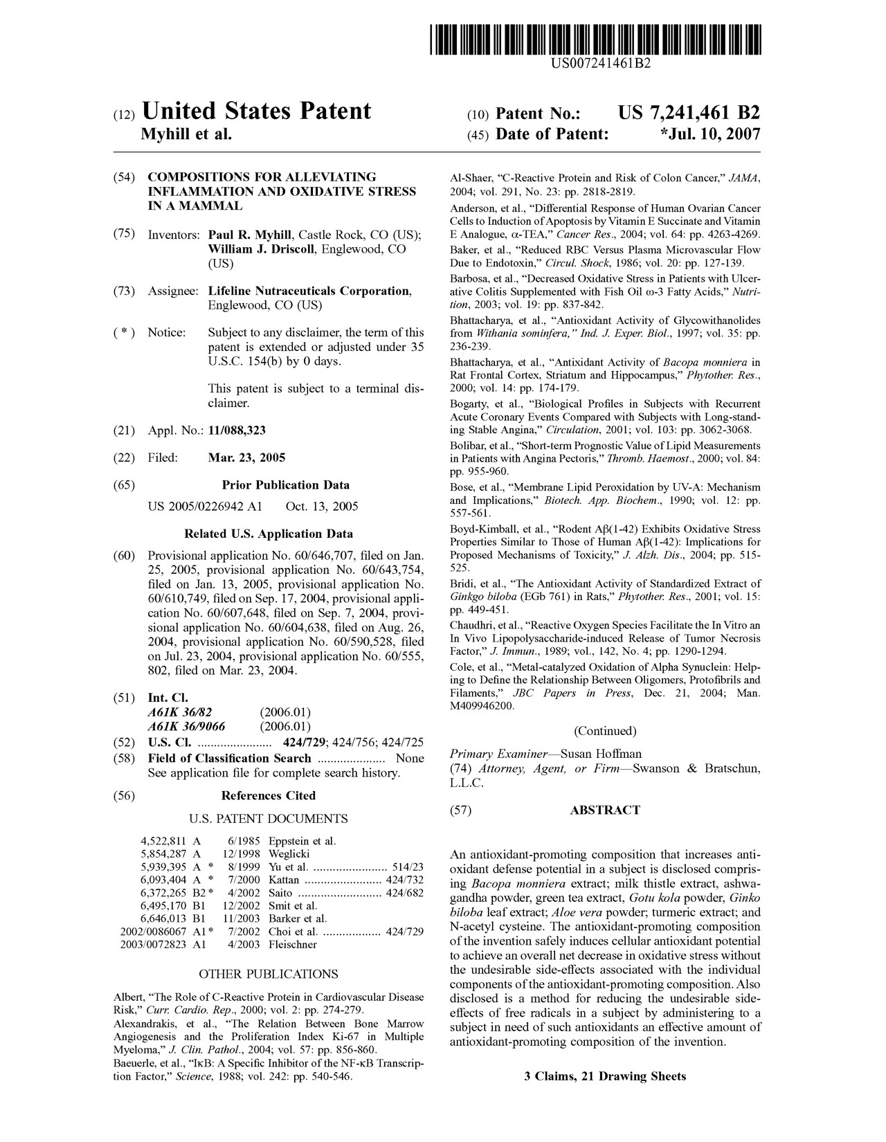

Slide 18
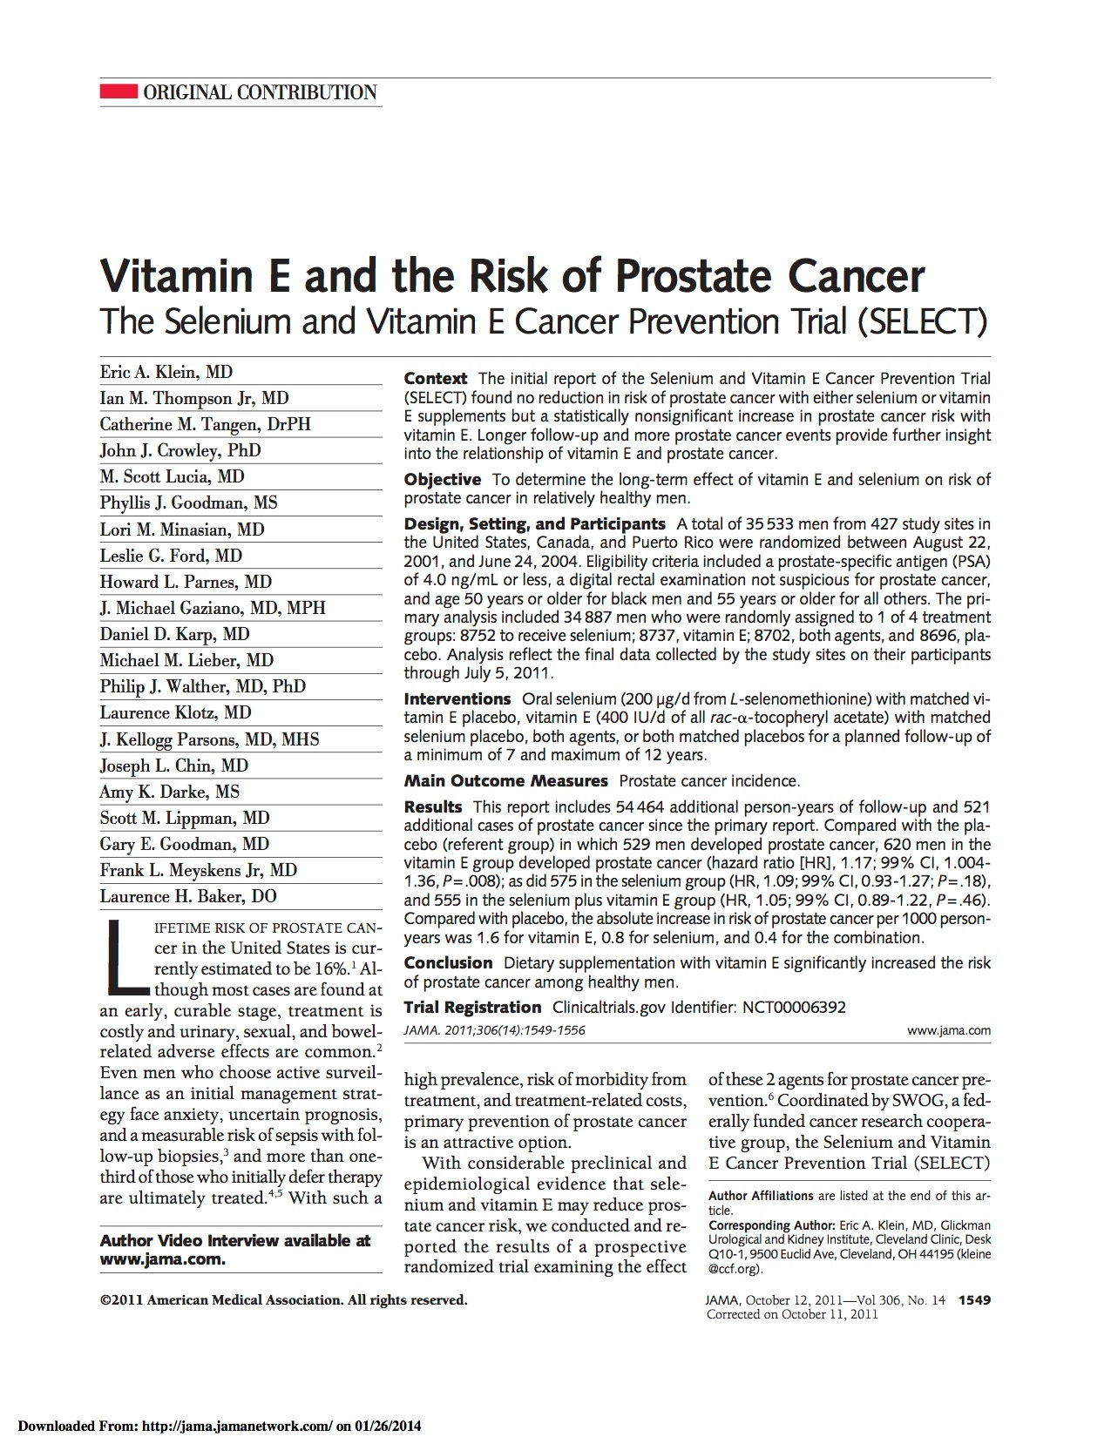
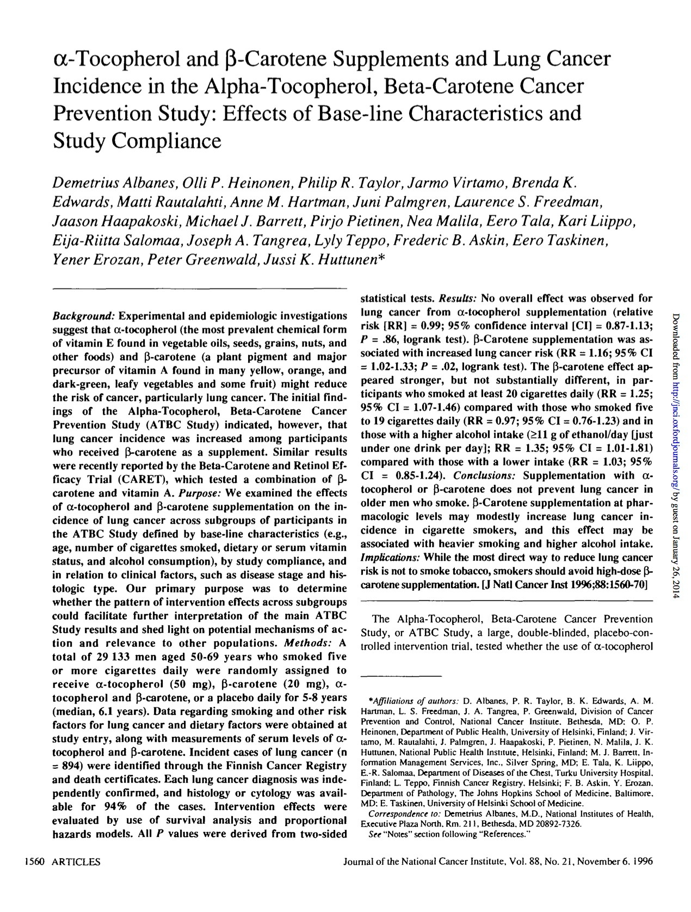
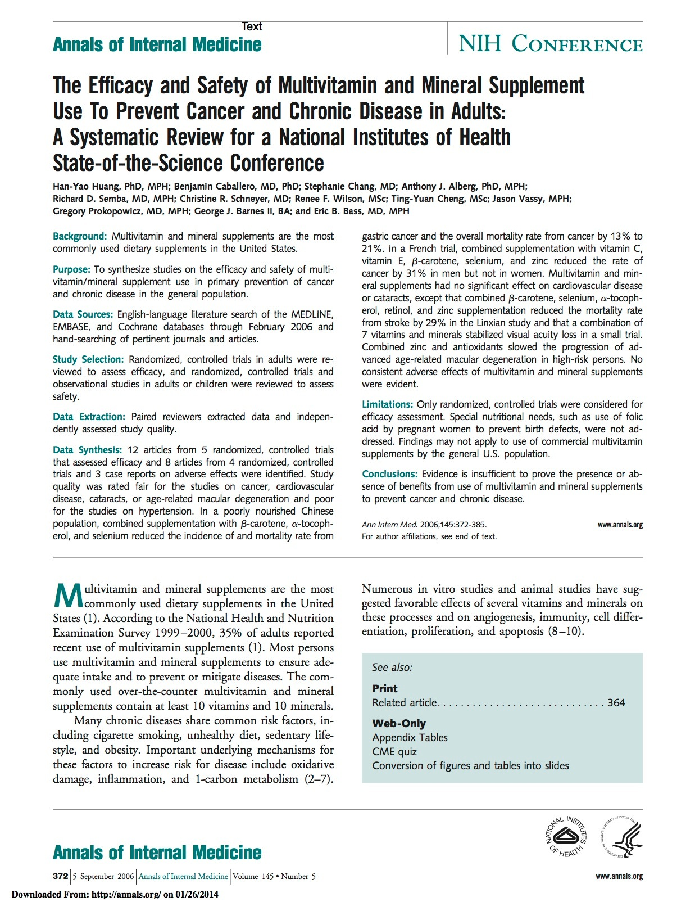
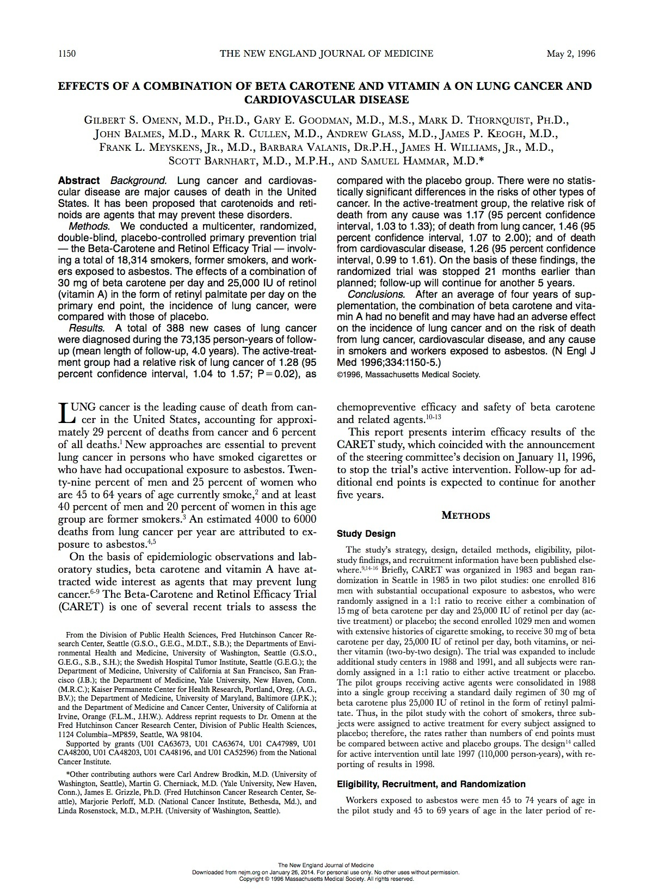
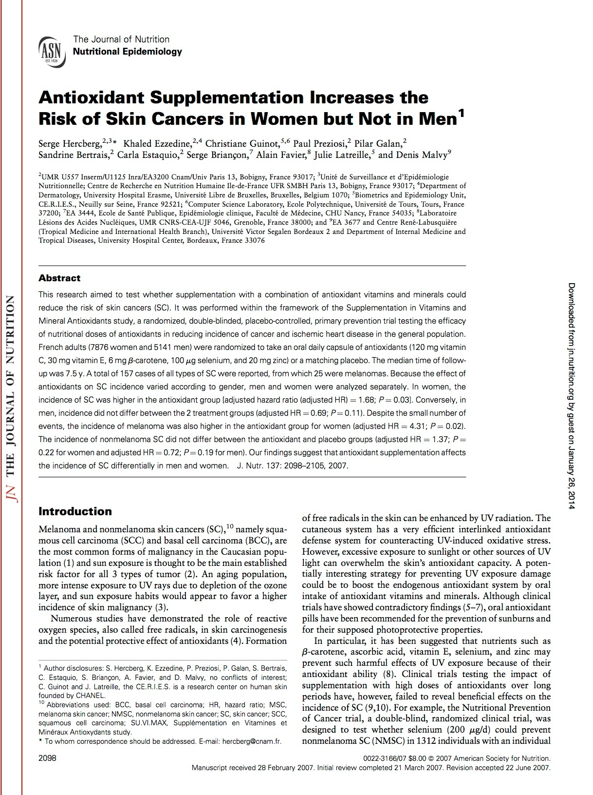
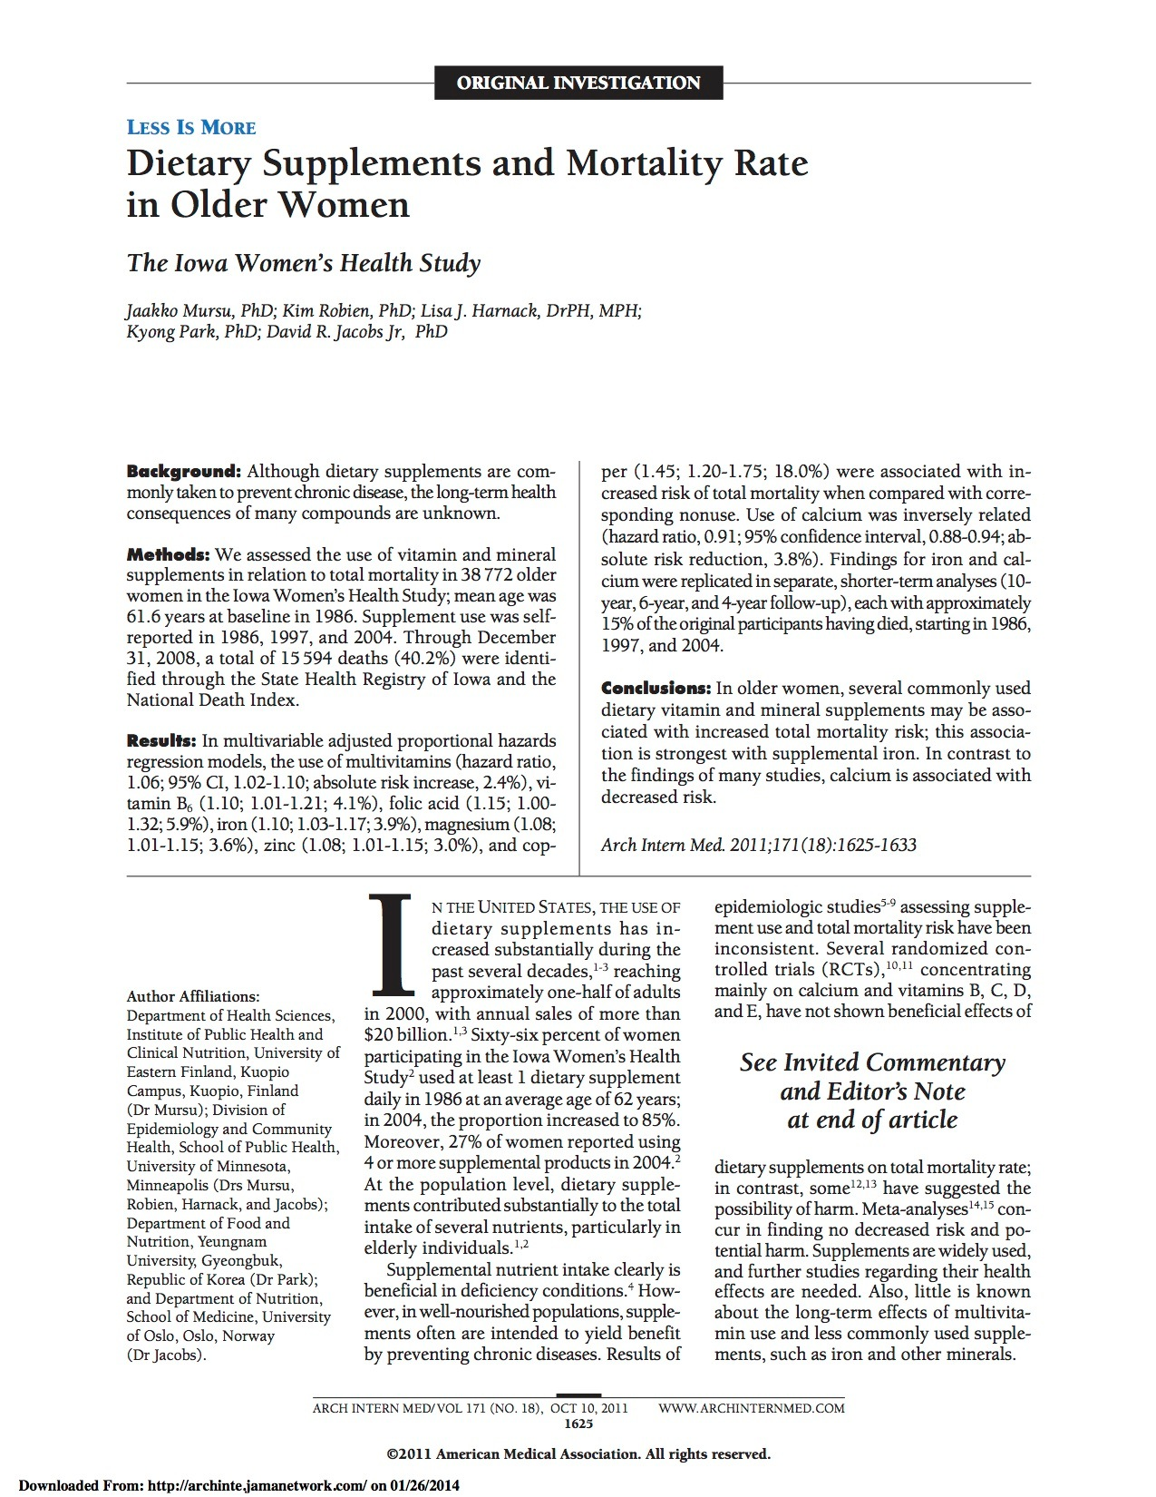

Slide 19


Slide 20

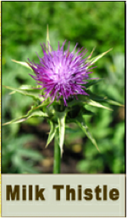
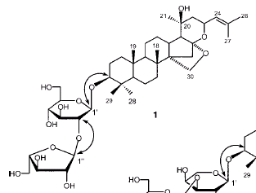
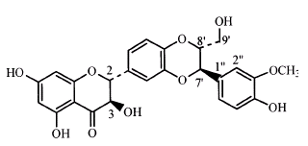
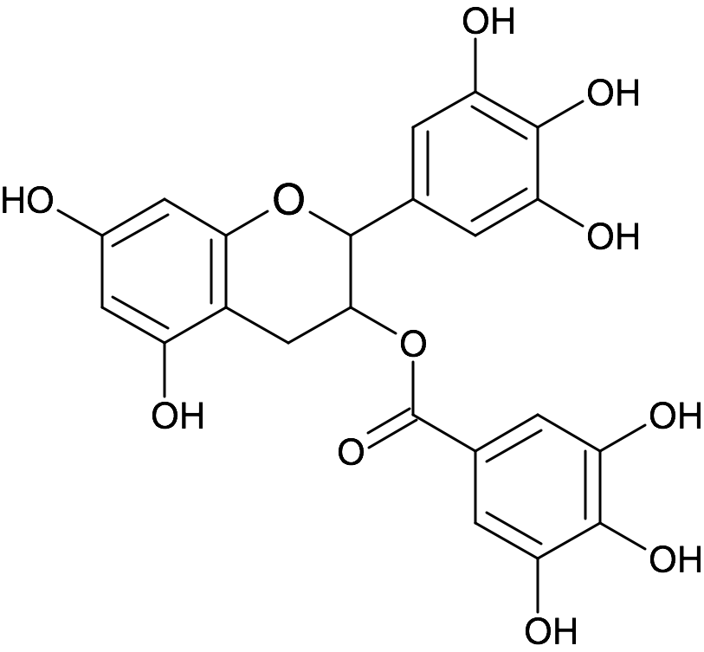
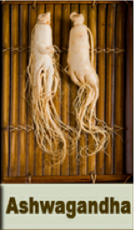

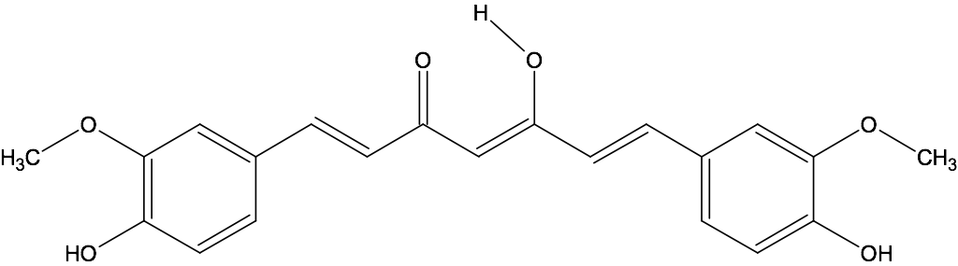
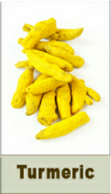
Nrf2 = a powerful “master regulator” of antioxidant enzymes and survival genes
Silymarin
Bacopa
HOCH₂
C
H
3
O
O
C
H
C
H
3
3
O
C
H
3
Withaferin A
Epigallocatechin gallate
EGCG
O
H
O
Curcumin

Slide 21
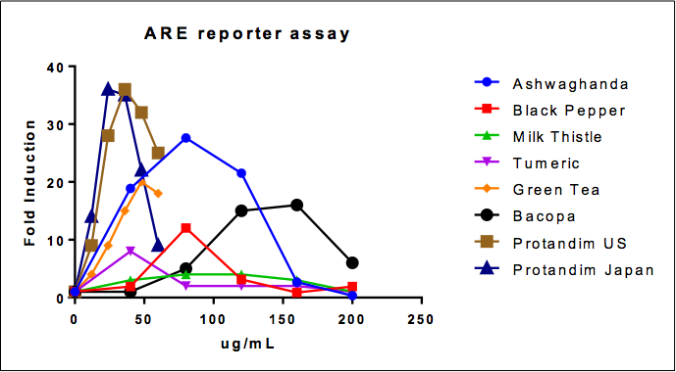

Slide 22
SYNERGY = Action greater than the sum of the parts
20
18
Alcohol extract from
30 ug protandim or individual
components per ml medium
16
All five ingredients together produced an 18-fold increase in the expression of this antioxidant gene.
Protandim BLEND works 18 times more effectively than the sum of its parts.
14
12
Fold Induction
Heme Oxygenase mRNA
10
8
6
4
2
0
Bacopa
Silymarin
Control
Green Tea
Curcumin
Protandim
Ashwagantha

Slide 23
Protandim
Antiinflammatory and
Antifibrotic Proteins
Kinase
Kinase
Kinase
Kinase
Stress-related
Enzymes
P
Keap1
Nrf2
Nucleus
ARE
DNA
Human cell

Slide 25
50
80
*
*
45
70
40
35
60
30
50
% increase SOD
% Increase in Catalase
25
40
20
30
15
20
10
5
10
0
0
0
30
120
0
30
120
Days on Protandim
Days on Protandim
After 120 days…
SOD increased by 34%
Catalase increased by 54%

Slide 26
4
3.5
R
2
= 0.238
Before Supplementation
3
Vit E and Vit C
2.5
No supplements
Oxidative Stress
TBARS (micromolar)
2
1.5
1
0.5
After Supplementation 30 d
R
2
= 0.003
0
0
20
40
60
80
100
AGE
After 30 days…
“Remarkably, this age-dependent increase in TBARS was almost completely abolished by Protandim treatment (Fig. 1D), with an overall average reduction of the oxidative stress marker by 40%.”

Slide 27
Exotic Ingredients + Proven Science + Exclusive IP =
World’s finest products that help you Feel / Look / Perform Your Best
Protandim/Nrf2 – Fundamentally different approach to cellular protection
Perform Your Best
Feel Your Best
Look Your Best
Coordinated Product Platform

Slide 28


Slide 29
Versus Select Competitive Ads*
LOOK Your Best…
TrueScience Regimen is equal/better compared to top “prestige” brands
Competitor |  | 28 Days | 56 Days
89% Perricone MD Cold Plasma at 4 weeks 75% Jeunesse Global Luminesce Cellular Rejuvenation at 8 weeks | Smoother looking skin | 89% | 94%
80% Nu Skin TruFace at 3 months | Firmer looking skin | 81% | 85%
78% L’Oreal Youth Code at 8 weeks | Younger looking skin |  | 87%
70% Lancôme Dream Tone at 8 weeks 79% SkinMedica Lytera at 12 weeks | More even skin tone |  | 83%
79% Clarins Double Serum at 4 weeks [Hydric + Lipidic System] 80% Nu skin 180°System at 8 weeks | Less noticeable fine lines and wrinkles | 78% | 82%
Cold Plasma is a trademark of Perricone MD
Youth Code is a trademark of L’Oreal
Dream Tone is a trademark of Lancôme
Lytera is a trademark of SkinMedica
Double Serum [Hydric + Lipidic System] is a trademark of Clarins
*Competitive advertising details available upon request

Slide 30
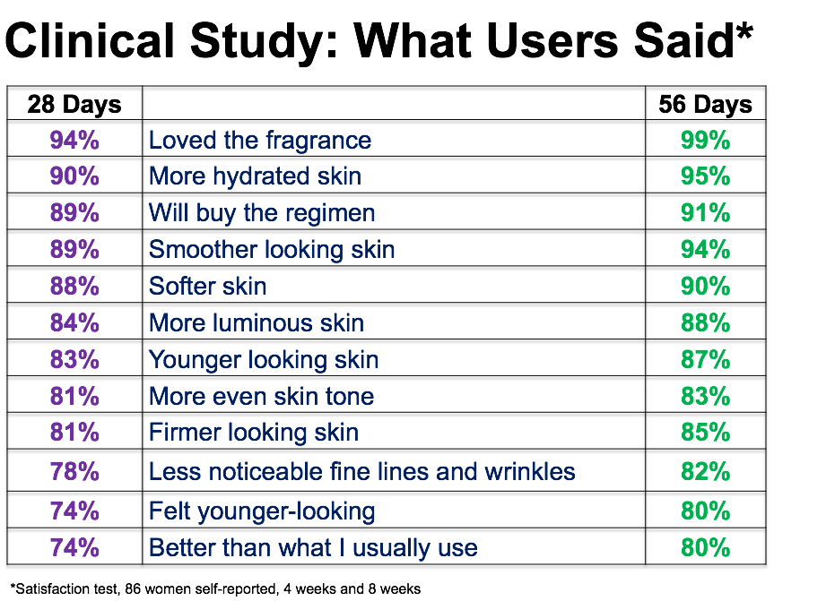

Slide 31

  TrueScience™ facial cream with Advanced Nrf2 Technology applied 2 times per day for 5 days
    (Nrf2 Technology: Bacopa, Milk Thistle, Turmeric, Green tea & Black Pepper extracts + Brassicas extract + Plantain extract)
Non Nrf2 cream applied 2x per day for 5 days
Then expose the samples to UV light
Quantify DNA damage and amount of Nrf2 Protein
Then collect DNA, run gene expression & identify biological pathways
Notes:
Testing was done in a specialized laboratory outside of Paris, France. Live skin was obtained from a 47 year lady who had undergone cosmetic surgery. The French lab has developed a unique media to keep the skin alive for 12 days. This type of skin model is the closest way to mimic what would happened when an individual uses the cream on their own skin. The live skin was divided in several smaller samples and a technician applied TrueScience Facial Cream with Nrf2 technology twice a day for 5 days on a set of skin samples and the non-Nrf2 facial cream in the same fashion to another set of skin. Two other set of skins were left untreated. At 5 days, the samples were exposed to UV light. At day 6, DNA damage and the amount of Nrf2 protein in the skin were determined by Immunostaining. DNA was collected for all samples to look for gene expression and compared the difference in activated biological pathways between our TrueScience facial cream and the non Nrf2 cream.

Slide 32
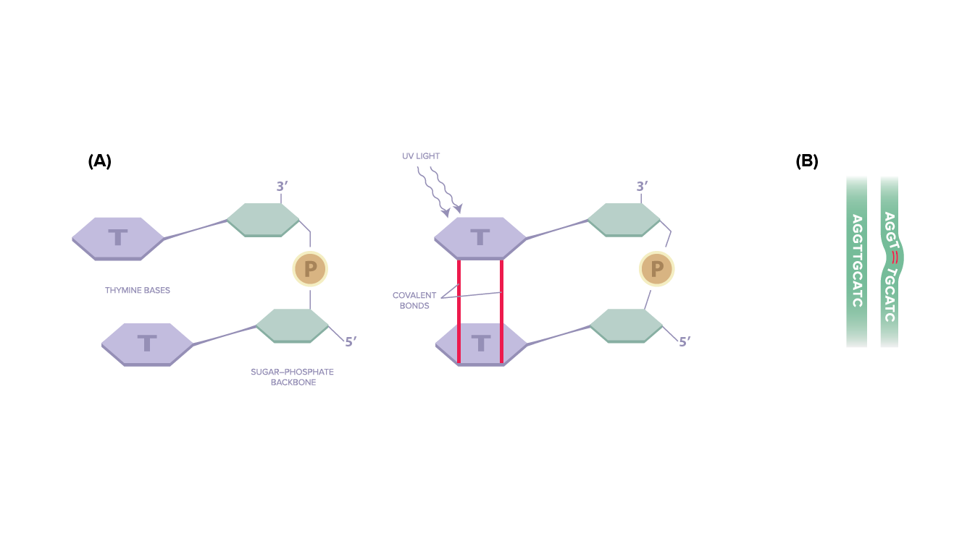
Affects DNA duplication
Causes genome instability
Following UV exposure, the cellular DNA is damaged (Thymine Dimers)
Notes:
We know that exposure to UV damages cell DNA. One of the significant damages is the formation of thymine dimers. This drawing represents how it happens. Each DNA strand is made of a succession of what are called bases (thymine, cytosine etc.) With UV exposure, bonds are formed between the thymine bases causing a deformation of the strand. It is like a pant zipper that has teeth that no longer line up. You cannot close the zipper properly. On picture (B) DNA is damaged and cannot replicate properly to make new proteins or cells because the strands are not properly lined up.
By immuno-staining the skin sample and looking at the amount of stain by microscopy
Keep in mind that more stain (color) means more thymine dimers, thus more damage

Slide 33
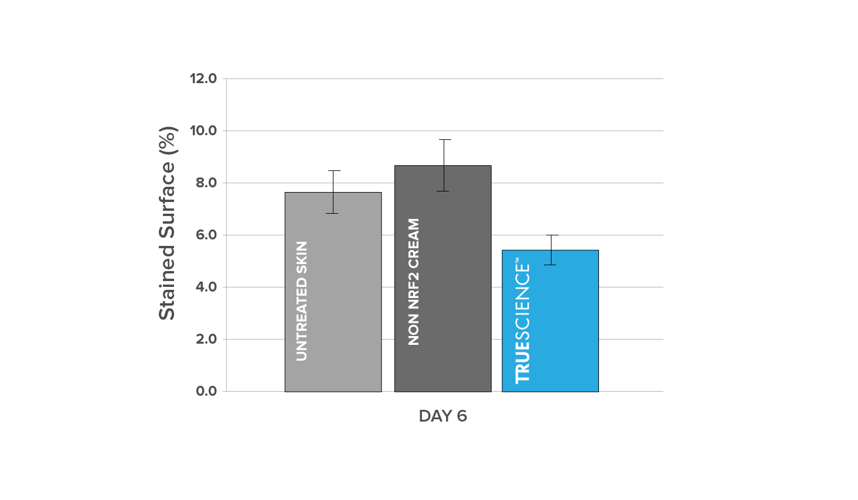
Less Thymine Dimers with TrueScience
TrueScience™ Facial Cream with Nrf2 protects the cell DNA!
Notes:
The day following the exposure to UV rays, we look at the surface that was occupied by thymine dimers that had been immunostained. For the skin samples that were left untreated, the surface with thymine dimers was 7.7%. The skin that had been treated with the non-Nrf2 cream showed an increase of 13% of the surface occupied by the dimers. More importantly the skin samples to which TrueScience facial cream had been applied had a 29% reduction in thymine dimers from the untreated or the non-nfr2 cream. This is significant because cellular DNA damage affects the cell ability to replicate properly and thus accelerates cellular aging.

Slide 34
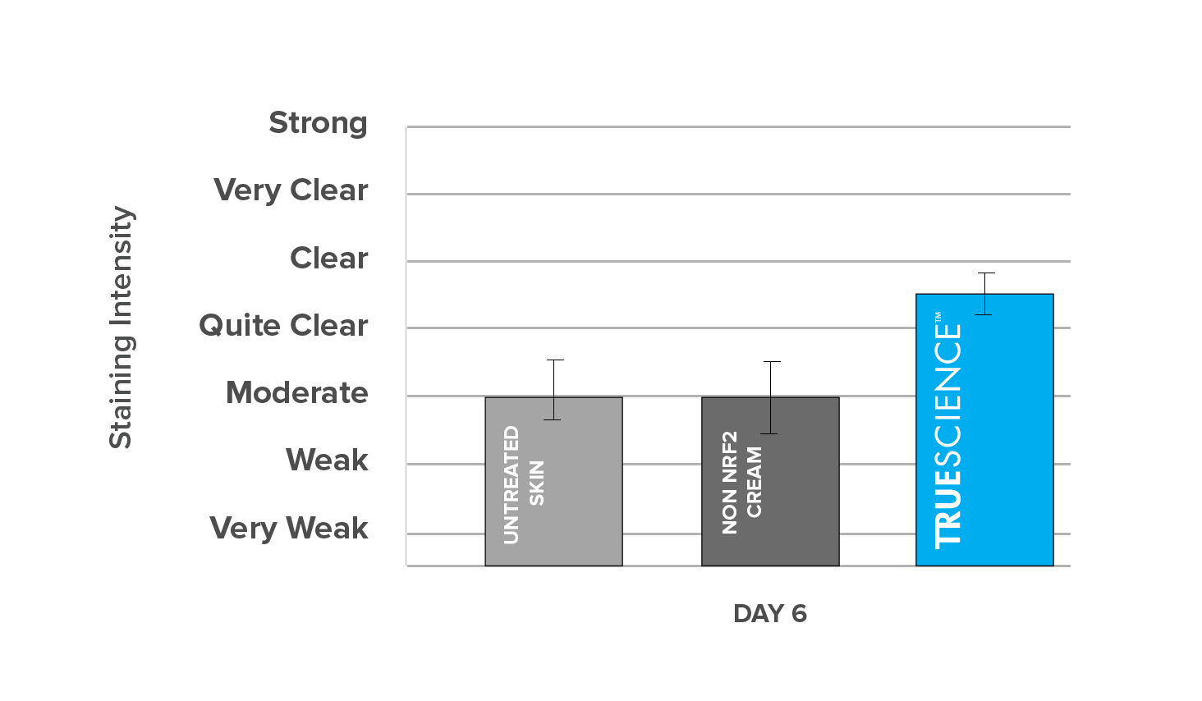
Nrf2 Staining Intensity 24 hours after UV Exposure
TrueScience™ Facial Cream results in more Nrf2 in skin, thus more protection!
Notes:
The next testing was to look at the amount of Nrf2 protein present in the skin also by Immunostaining. The untreated skin samples that were exposed to UVs at Day 5 showed less Nrf2 staining 24 hours later, at day 6. Applying the non-Nrf2 cream to the skin 2 twice a day for 5 days and exposing it to UV leads to a reduction also in the Nrf2 stain.
With the application of the new TS cream, after UV exposure the skin has a greater amount of Nrf2. Greater amount of Nrf2 implies greater protection
By immuno-staining the skin sample and looking at the amount of stain taken by Nrf2 protein by microscopy
Keep in mind that more stain (color) means more Nrf2 protein,
More Nrf2 is good because it implies more Protection

Slide 35
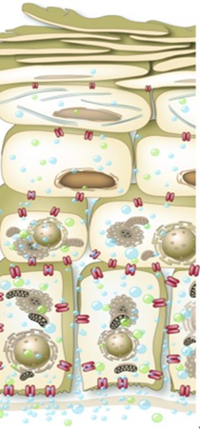
Cascade Effect = All Skin Layers
TS Facial cream initiates signals that cascade all the way though the deep layers of the skin
Resulting in better moisturization, protection, & younger looking skin
tissue homeostasis
healthier skin
Cornified layers
SPINK6 ⁶
KLK12 ⁶
balance and maintain serine protease activities in the skin
Granular
layers
DHCR7²⁴
NUS1²⁴
cholesterol synthesis
intracellular cholesterol trafficking
BMP6 ⁶
SOX21²⁴
DOK2²⁴
Spinous
layers
Cell differentiation
CEACAM1⁶
CEACAM5⁶
Cell proliferation
CCAR1⁶
mRNA surveillance
DNA repair
ARID3A²⁴
UPF3B⁶
EVL²⁴
Basal
layer
KRT19 ⁶
structural integrity
of epithelial cells
potential marker of epidermal stem cells
Dermis
TIMP4²⁴
MMP7 ⁶
tissue remodeling
Notes:
This drawing is a representation of which genes TrueScience facial cream turned on at least 1.5 times more than with the non Nrf2 cream. Simply said, what this slides shows is that applying topically TrueScience to the skin has effects throughout the layers of the skin above and beyond what the non nfr2 cream does. The various biological pathways that are involved with the named genes are shown on the right and all contribute to tissue homeostasis and a healthier looking skin

Slide 36
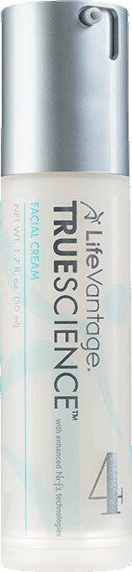
Conclusions
TrueScience^{tm} Facial Cream with Advanced Nrf2 Technology has been shown to:
Boost skin protection from UV exposure by reducing DNA damage
Increase Nrf2 Protein amount, thus improve resistance to oxidative stress
Fight the signs of aging though all layers of the skin

Slide 37

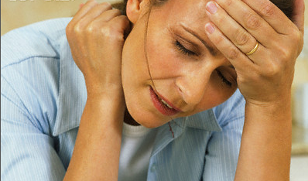
FEEL Your Best…
Tired, Stressed, Depressed… “Off”

Slide 38
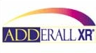




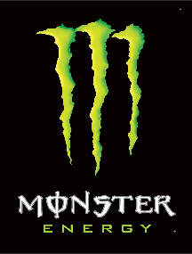
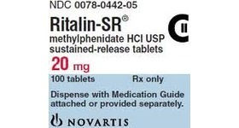















$100B+
Notes:
we’re spending $100 billion every year because we don’t feel the way we want to feel…

Slide 39





Proanthocyanidin
DMAE
Quercetin
Catechin
L-Theanine

Slide 40
Axio Usage Survey

Slide 41
Axio Usage Survey

Slide 42
Axio Usage Survey
"It felt like a morning cup of coffee with the energy it gave me, but more than that it improved my focus.”
"I liked the energy that it gave me, I would say it lasted pretty good maybe 4 or 5 hours."
"I was pleasantly surprised at this product’s ability to keep me energized, awake and focused without harmful stimulants and without feeling nervous, jittery or having rapid heart rate. I would take this over caffeine any day."
"It was a very subtle transition to having energy, just like I naturally had the energy. It was a good amount of energy too. Not too wired, not too draggy. The perfect amount. I didn't feel like it wore off halfway through the day or that I needed more energy. I also did not have a difficult time falling asleep at night because of it. I would definitely buy this instead of many other energy drinks or supplements."

Slide 43

PERFORM Your Best…

Slide 44


Neuronal
Atrophy
Normal Stress
Healthy, Large, Many Projections, Optimal Function
High Stress
Small, Thin, Disrupted, Structural Damage, Poor Function

Slide 45


ABDOMINAL FAT ACCUMULATION
Normal Stress
High Stress

Slide 46
Research Study Update
Completed¹, Ongoing², Planned³
19 studies¹ (U Colorado, Ohio State U, Louisiana State U, Virginia Commonwealth U, Colorado State U, Texas Tech U…)
“20th study” (Mayo Clinic, 2014)¹ - anecdotal patient report prompts series of translational cell culture and rodent studies
    Translational research = aims to make findings from basic science useful for practical applications that enhance human health and well-being
Montreal, Canada (skin)¹
National Institutes of Health (longevity)²
Nashville, TN (heart health)²
Melbourne, Australia (brain function)³
Okinawa, Japan (lung function)³
Research Institutions³ (Salt Lake, Miami, Louisville, Fort Collins, Boston, NYC…)
    energy/mood/focus, performance, antioxidant metabolism, eye health…
    canine health, periodontal health, blood sugar balance…

Slide 47





















Slide 48


Slide 49


ProductQuestions@LifeVantage.com
www.ShawnTalbott.com
www.ShareCare.com
FaceBook / Twitter / Amazon

Slide 50
Feel Your Best
Look Your Best
“Best Future
You”
Perform Your Best

